Slide 1

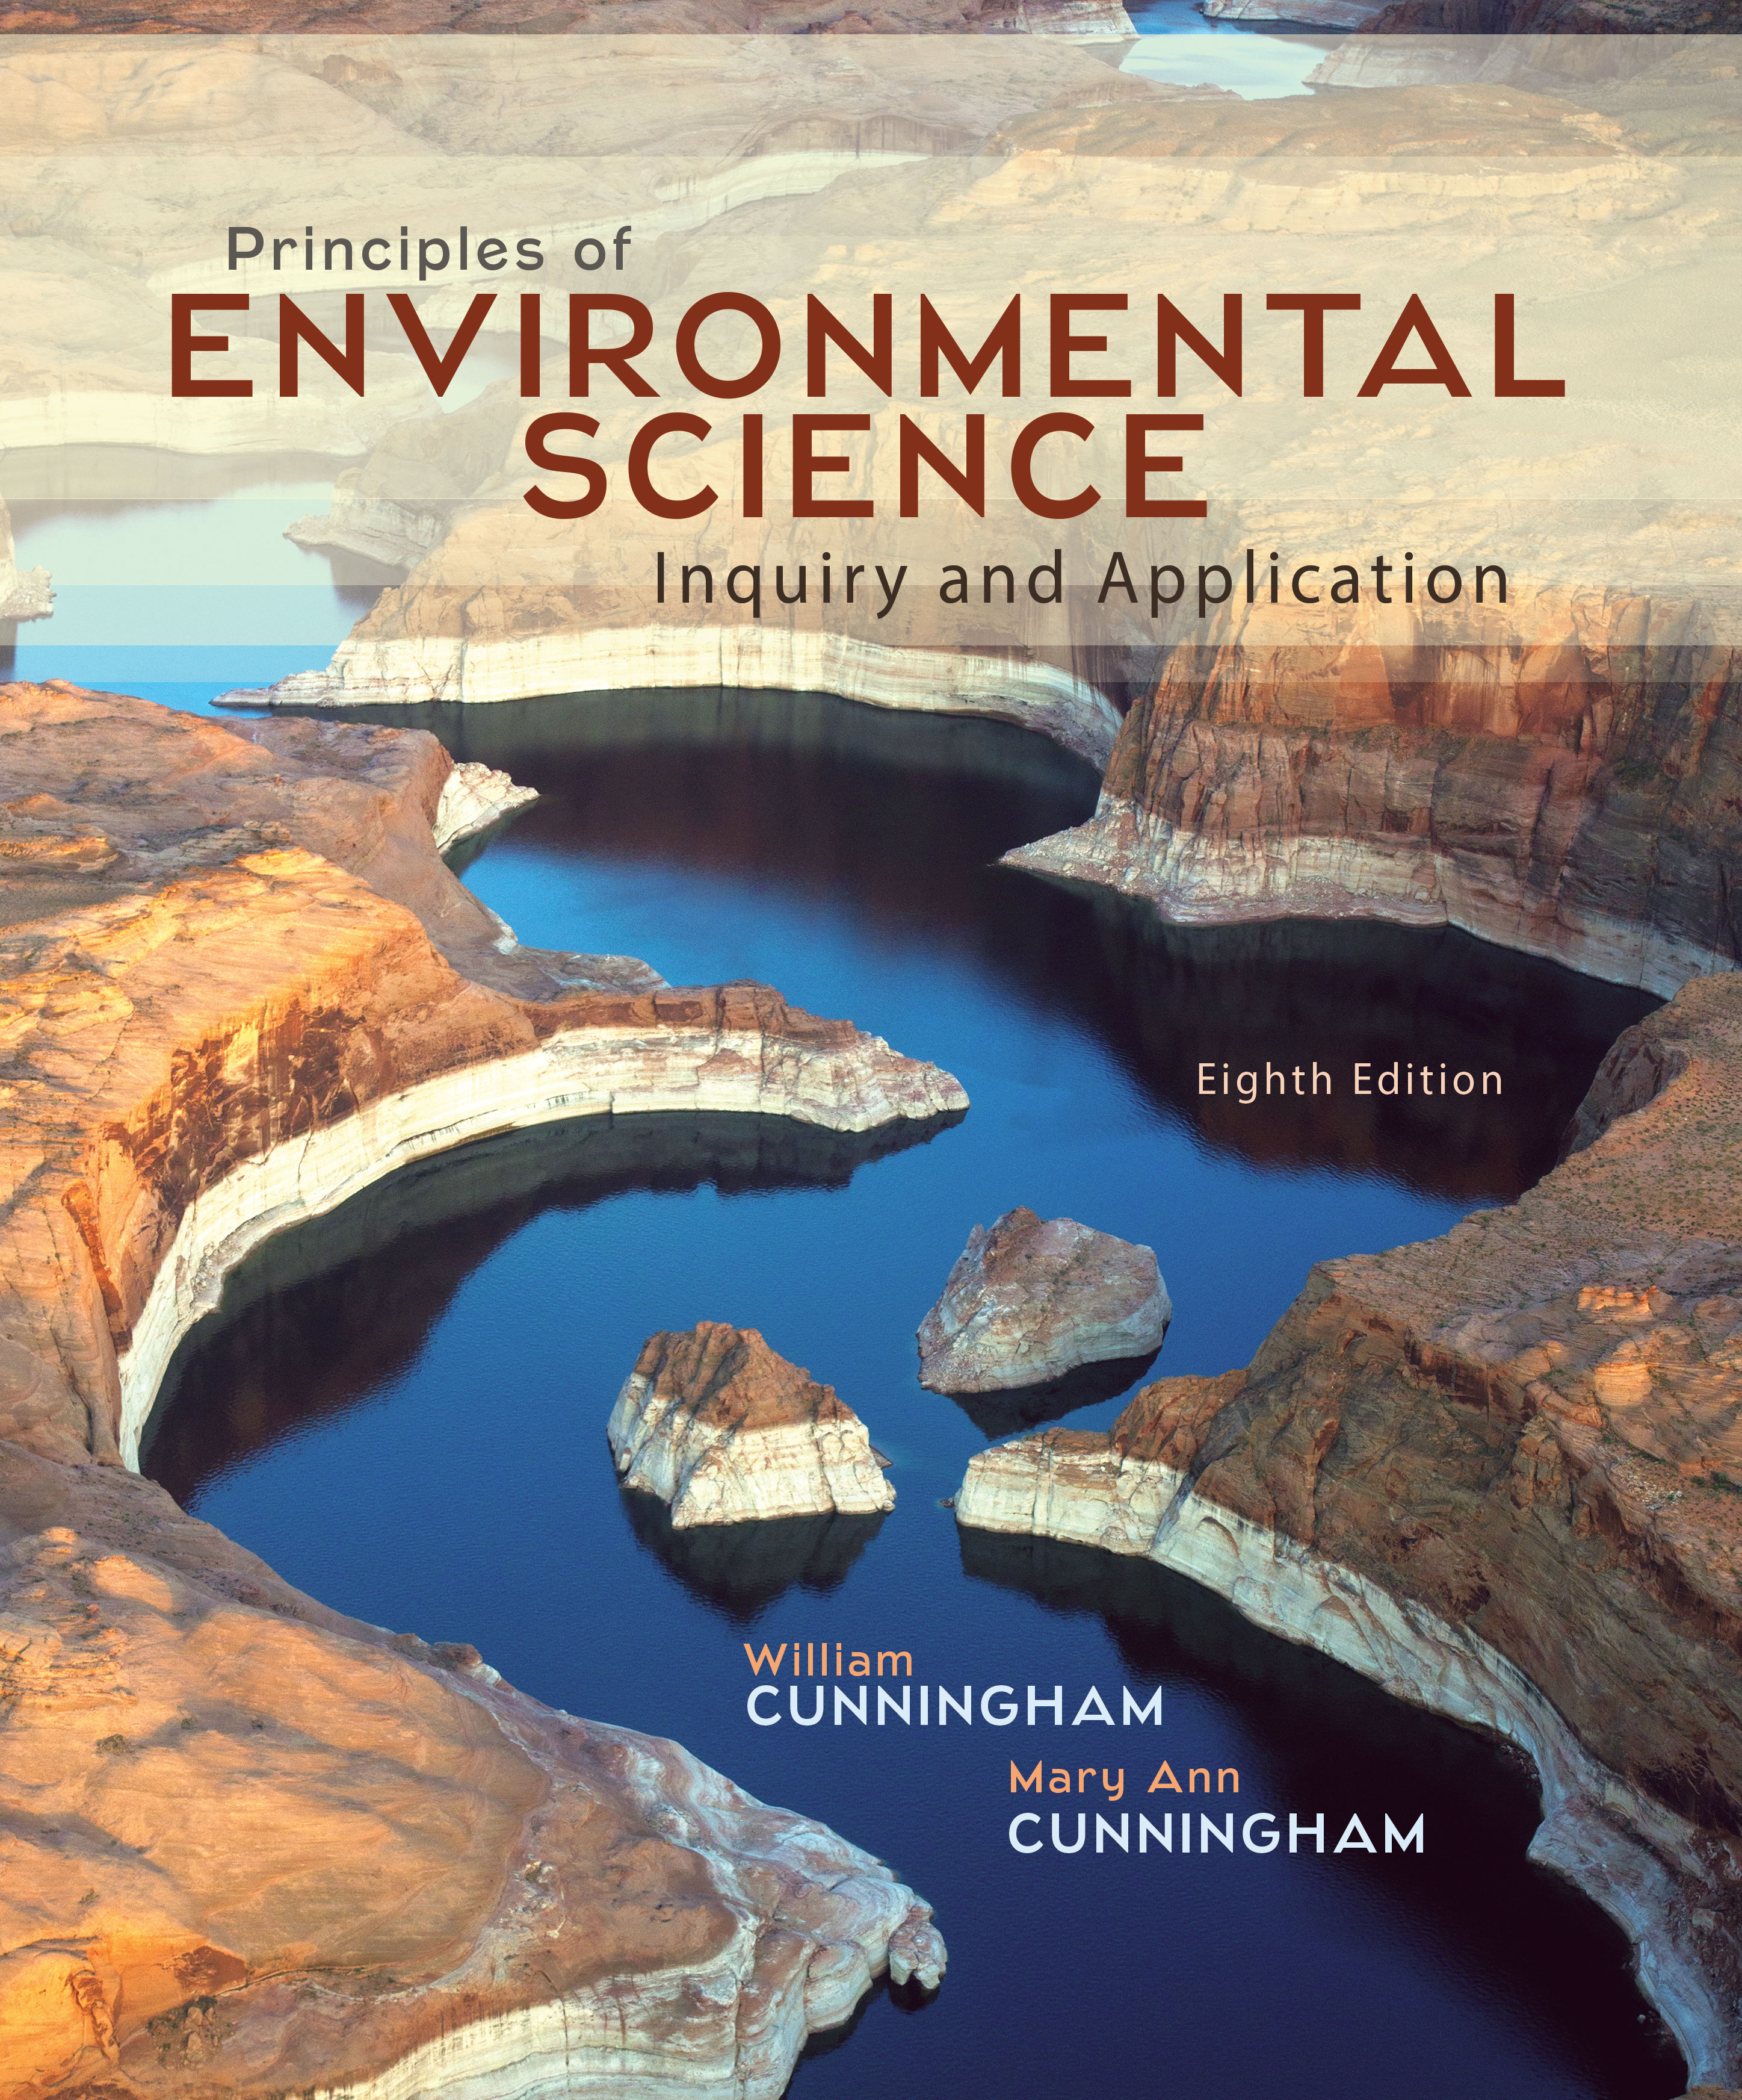
Chapter 9
Lecture
Outline

Slide 2
Learning Outcomes
After studying this chapter, you should be able to answer the following questions:
How do the troposphere and stratosphere differ?
What are some factors in natural climate variability?
Explain the greenhouse effect and how it is changing our climate.
How do we know the nature and cause of recent climate change?
List some effects of climate change.
What are some strategies for minimizing global climate change?

Slide 3
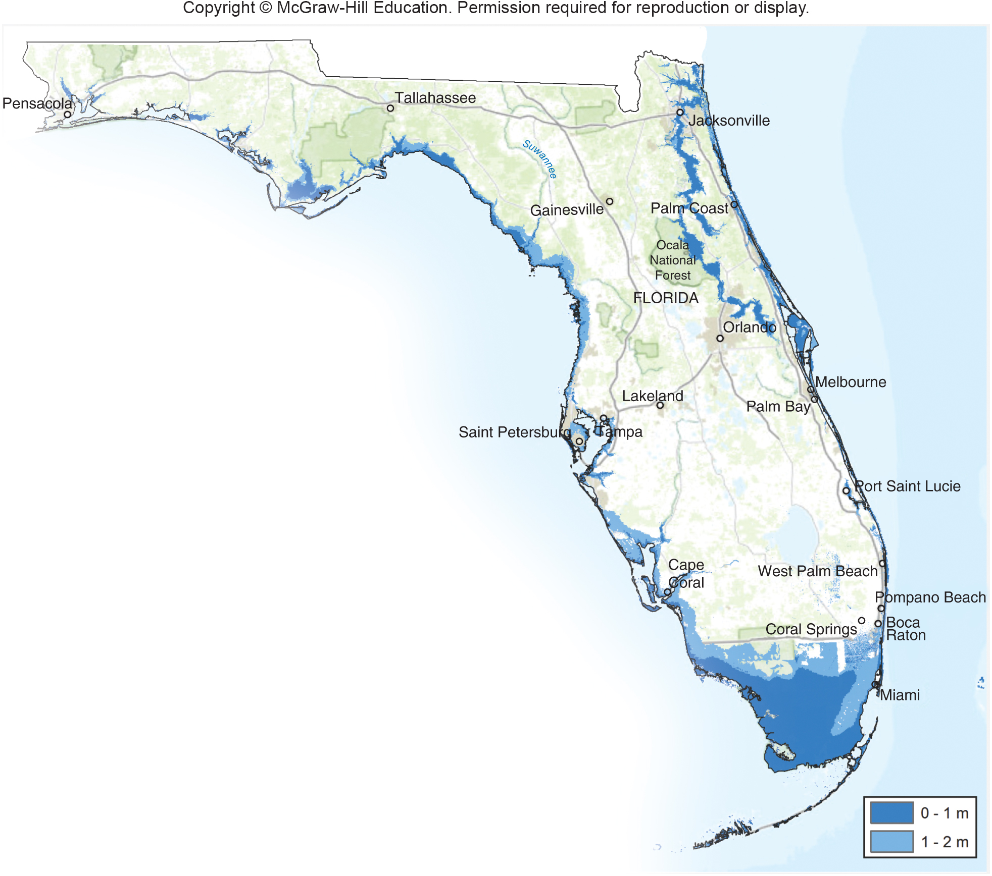
Case Study:
Shrinking Florida
Notes:
Shrinking Florida
What will Florida be like when its beaches are under water? It’s hard to say precisely, but the tourism industry is sure to struggle as beach resorts and coastal cities flood. The interior of the state will become more crowded as residents of coastal cities are forced to move inland, away from rising tides and storm surges. Because drought and hot summers will likely make much of the state’s agriculture uneconomical, it should not be hard to find space for cities to move inland, although fresh water resources will be scarce. Everglades National Park and much of the Florida Keys will exist only in photographs. Inland Florida is likely to have much less forest, as dry summers produce more frequent, larger wildfires.
This might seem an apocalyptic scenario, but it conforms to what the climate data indicate. Climate warming has already caused global mean sea level to rise about 20 cm (8 in.) in the past century. That sounds slight, but it brings higher storm waves and tides. By 2050, another 25 cm (10 in.) of sea level rise is likely, and by 2100 sea level is expected to be 1 m higher; some estimates put the change closer to 2 m. A meter of sea level rise is enough to inundate most of Florida’s coast, including much of Miami, Boca Raton, Fort Meyers, and Cape Canaveral (fig. 9.1).
Why is sea level rising? Thermal expansion explains about half of the change so far, because water expands slightly as it warms. Melting land-based glaciers contribute about one-quarter of the increase, and melting ice sheets contribute the remainder. This balance may change in the coming decades. Antarctica’s land-based ice sheets have begun to flow to the sea at an accelerating rate, and Greenland is melting at a rate few climatologists expected. Greenland’s massive ice cap holds enough water to raise sea level by about 6 m (about 20 ft) if it all melts. That degree of melting is likely to take centuries, but intermediate changes will cause tremendous damage.
South Florida faces special challenges because its porous limestone bedrock allows seawater to infiltrate aquifers. Saltwater intrusion has already affected wells, as farms and cities pump groundwater and sea water presses in to replace it. This process accelerate as sea levels rise.
All the extra energy in the atmosphere produces an added risk of increased hurricane frequency and intensity in the Gulf Coast region. Hurricanes occur when intense sunlight heats the ocean surface warming the air, evaporating water, and causing energetic circulation that evolves into swirling winds of 120 km/hr (74 mi/hr) or more. Warmer ocean surfaces increase the heat energy available to these weather systems. Climatologists anticipate that the simultaneous development of a hotter atmosphere and warmer oceans will lead to more and bigger hurricanes over time. Forty percent of all U.S. hurricanes hit Florida, according to the National Oceanic and Atmospheric Administration (NOAA ), so this is an important risk.
Although many policymakers don’t like to talk about climate change, it will affect all of us. The pattern of warming has become more and more clear, with more and more heat, drought, and storm records piling up in recent years (fig. 9.2). Certainly climate change will present a different world to our grandchildren. Because many state governors have refused to discuss climate science in emergency planning—for example in planning for hurricanes and heat waves, the Federal Emergency Management Agency has threatened to withhold funding from states that ignore impending climate threats. The economic and social threats are just as real as the environmental costs.
In this chapter we examine how our climate works, what causes temperature changes, and what factors are leading to recent anthropogenic (human-caused) climate shifts. We will also examine some of the many steps we can all take to reduce these changes and their impacts.
http://www.aoml.noaa.gov/hrd/tcfaq/E19.html.
3

Slide 4
9.1 What is the Atmosphere?
Earth’s atmosphere consists of gas molecules, mostly nitrogen and oxygen and a variety of other trace gases, relatively densely packed near the surface and thinning gradually to about 500 km (300 mi) above the earth's surface.
Minute particles and liquid droplets—collectively called aerosols—also are suspended in the air.
The atmosphere has four distinct zones of contrasting temperature due to differences in absorption of solar energy.
The layer closest to the earth’s surface, the troposphere, experiences daily temperatures changes, wind, and precipitation that we collectively call weather.
Notes:
Clean, dry air is 78 percent nitrogen and almost 21 percent oxygen, with the remaining 1 percent composed of argon, carbon dioxide (CO₂), and a variety of other gases. Water vapor (H₂O in gas form) varies from near 0 to 4 percent, depending on air temperature and available moisture. Minute particles and liquid droplets—collectively called aerosols— also are suspended in the air. Atmospheric aerosols and water vapor play important roles in the earth’s energy budget and in rain production.
4

Slide 5
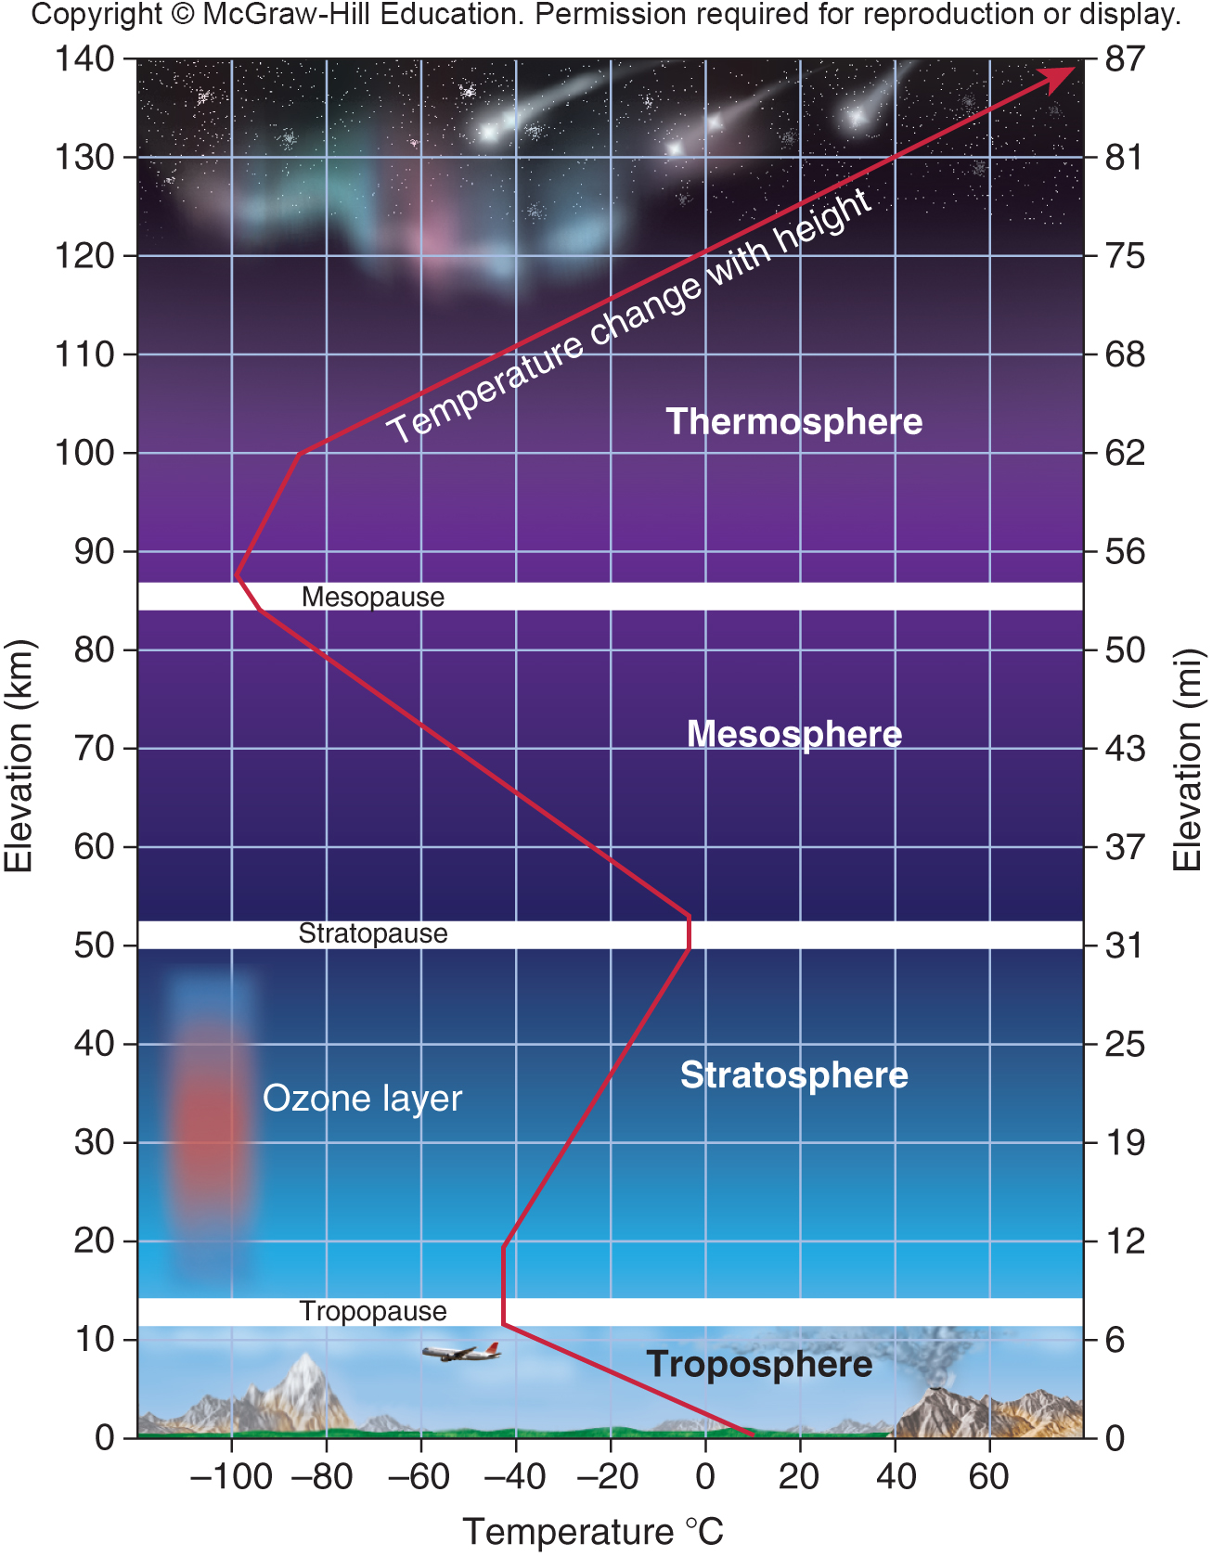
4 Distinct Zones of the Atmosphere
Within the troposphere, air circulates in great vertical and horizontal convection currents.
The stratosphere has almost no water vapor and nearly 1,000 times more ozone (O₃).
Notes:
The atmosphere has four distinct zones of contrasting temperature due to differences in absorption of solar energy (fig. 9.3). The layer immediately adjacent to the earth’s surface is called the troposphere (tropein means “to turn or change,” in Greek). Within the troposphere, air circulates in great vertical and horizontal
convection currents, constantly redistributing heat and moisture around the globe (fig. 9.4). The troposphere ranges in depth from about 18 km (11 mi) over the equator to about km (5 mi) over the poles, where air is cold and dense. Because gravity holds most air molecules close to the earth’s surface, the troposphere is much denser than the other layers: it contains about 75 percent of the total mass of the atmosphere. Air temperature drops rapidly with increasing altitude in this layer, reaching about –60°C (–76°F) at the top of the troposphere.
A sudden reversal of this temperature gradient creates a boundary called the tropopause. This temperature boundary occurs because ozone (O₃) molecules in the stratosphere absorb solar energy. In particular, ozone absorbs ultraviolet (UV) radiation (wavelengths of 290–330 nm; see fig. 2.13). This absorbed energy makes the
stratosphere warmer than the upper troposphere. The stratosphere extends about 50 km (31 mi) out from the tropopause. It is far more dilute than the troposphere, but it has a similar composition except that it has almost no water vapor and nearly 1,000 times more ozone. Unlike the troposphere, the stratosphere is relatively calm. There is so little mixing in the stratosphere that volcanic ash and human caused contaminants can remain in suspension there for many years.
Above the stratosphere, the temperature diminishes again, creating the mesosphere, or middle layer. The thermosphere (heated layer) begins at about 50 km. This is a region of highly ionized (electrically charged) gases heated by a steady flow of high-energy solar and cosmic radiation. In the lower part of the thermosphere, intense pulses of high-energy radiation cause electrically charged particles (ions) to glow. This phenomenon is what we know as the aurora borealis and aurora australis, or northern and southern lights.
5

Slide 6
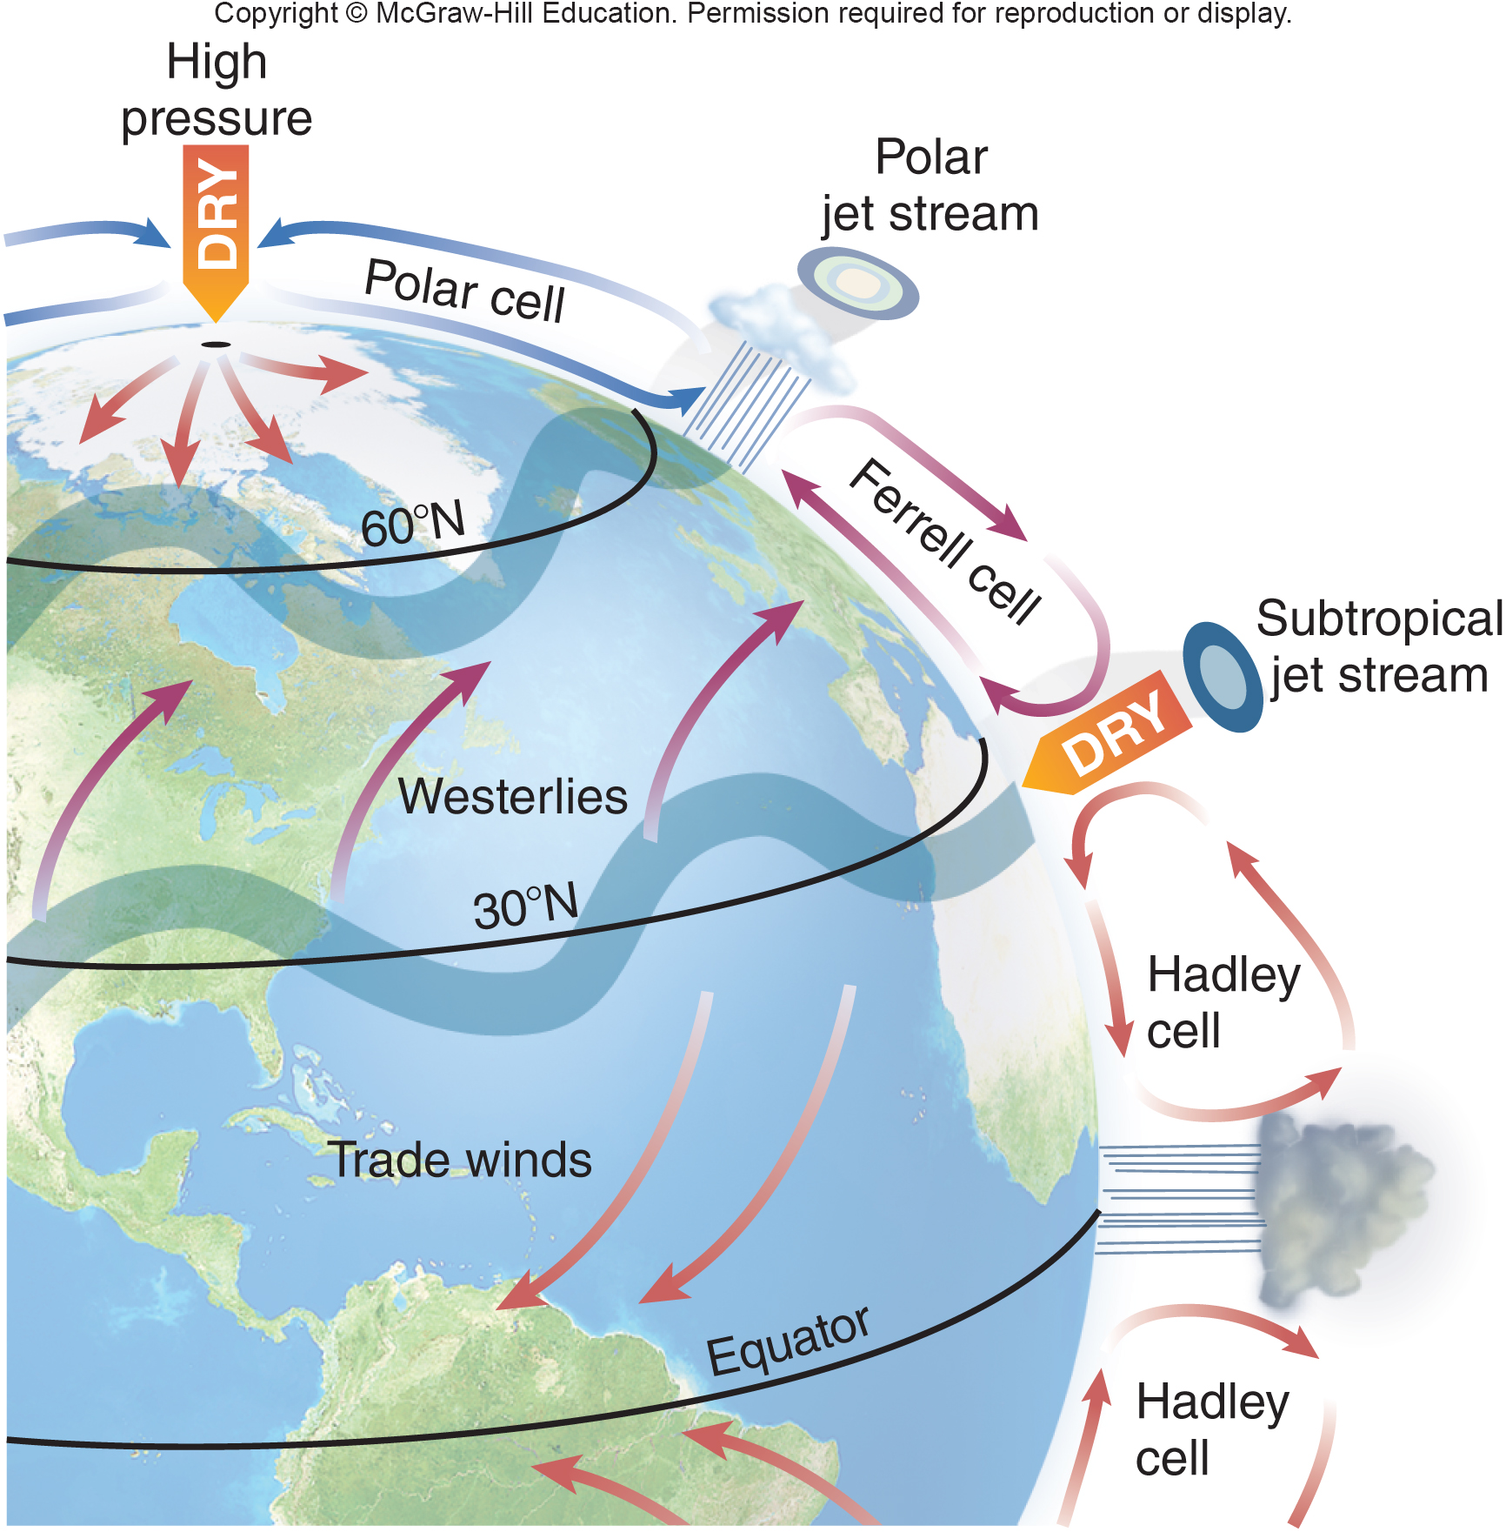
Convection Cells Circulate
Air, Water Vapor and Heat
Notes:
Convection cells circulate air, moisture, and heat around the globe. Jet streams develop where cells meet, and surface winds result from convection. Convection cells expand and shift seasonally.
6

Slide 7
The Atmosphere Captures
Energy–Selectively
The sun supplies the Earth with abundant energy, especially near the equator.
Of the solar energy that reaches the outer atmosphere:
¼ is reflected by clouds and atmospheric gases.
¼ is absorbed by carbon dioxide, water vapor, ozone, methane, and a few other gases.
½ of incoming solar radiation (insolation) reaches the Earth’s surface.
Notes:
The absorbed energy by gases warms the atmosphere slightly. Most of this energy is in the form of light or infrared (heat) energy.
Some incoming solar energy is reflected by bright surfaces, such as snow, ice, and sand. The rest is absorbed by the earth’s surface and by water. Surfaces that reflect energy have a high albedo (reflectivity). Fresh snow and dense clouds, for instance, can reflect as much as 85 to 90 percent of the light falling on them Surfaces that absorb energy have a low albedo and generally appear dark. Black soil, asphalt pavement, and water, for example, have low albedo, with reflectivity as low as 3 to 5 percent.
7

Slide 8
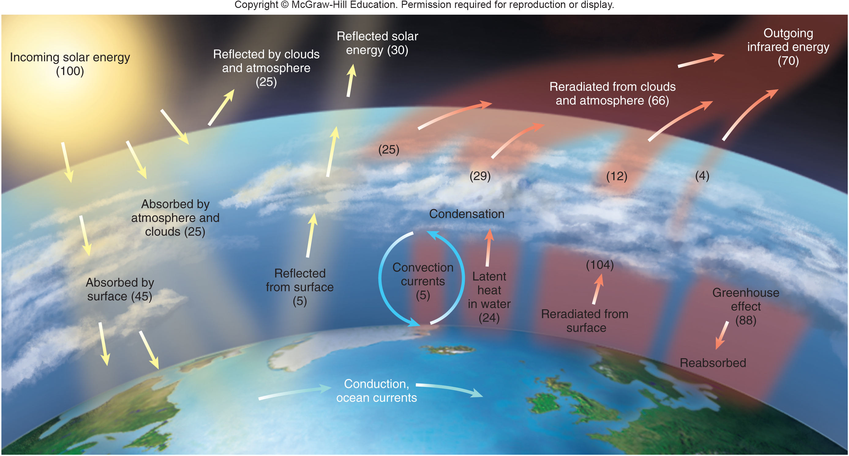
The Sun Warms Our World
Notes:
The atmosphere absorbs or reflects about half of the solar energy reaching the earth. Most of the energy reemitted from the earth’s surface is long-wave, infrared energy. Gases and aerosols in the atmosphere absorb and re-radiate most of this energy, keeping the surface much warmer than it would otherwise be. This absorption is known as the greenhouse effect.
8

Slide 9
The Greenhouse Effect
If our atmosphere didn’t capture this reemitted energy, the earth’s average surface temperature would be about –6°C (21°F), rather than the current 14°C (57°F) average.
Thus, energy capture is necessary for liquid water on earth and for life as we know it.
The greenhouse effect is a common term to describe the capture of energy by gases in the atmosphere.
Notes:
Something like the glass of a greenhouse, the atmosphere transmits sunlight but traps some heat inside. Also like a greenhouse, the atmosphere lets that energy dissipate gradually to space (see Key Concepts, p. 218).
The balance of the rate of incoming energy and outgoing energy determines the temperature inside the greenhouse. The policy issue that faces us is that we are slowing the rate of heat loss, thus increasing heat storage in our “greenhouse.” We are doing this by adding CO₂, CH₄, and N₂O to the atmosphere at levels the earth has not seen since before the appearance of humans as a species. The question is whether we will be able to agree on changing this trend.
9

Slide 10
Evaporated Water Stores and Redistributes Heat
Much of the incoming solar energy is used to evaporate water.
Every gram of evaporating water absorbs 580 calories of energy as it transforms from liquid to gas.
Globally, water vapor contains a huge amount of stored energy, known as latent heat.
When water vapor condenses, returning from a gas to a liquid form, the 580 calories of heat energy are released.
Notes:
Imagine the sun shining on the Gulf of Mexico in the winter. Warm sunshine and plenty of water allow continuous evaporation that converts an immense amount of solar (light) energy into latent heat stored in evaporated water. Now imagine a wind blowing the humid air north from the Gulf toward Canada. The air cools as it moves north (especially if it encounters cold air moving south). Cooling causes the water vapor to condense. Rain (or snow) falls as a consequence. Note that it is not only water that has moved from the Gulf to the Midwest: 580 calories of heat have also moved with every gram of moisture. The heat and water have moved from a place with strong incoming solar energy to a place with much less solar energy and much less water. This redistribution of heat and water around the globe is essential to life on earth.
10

Slide 11
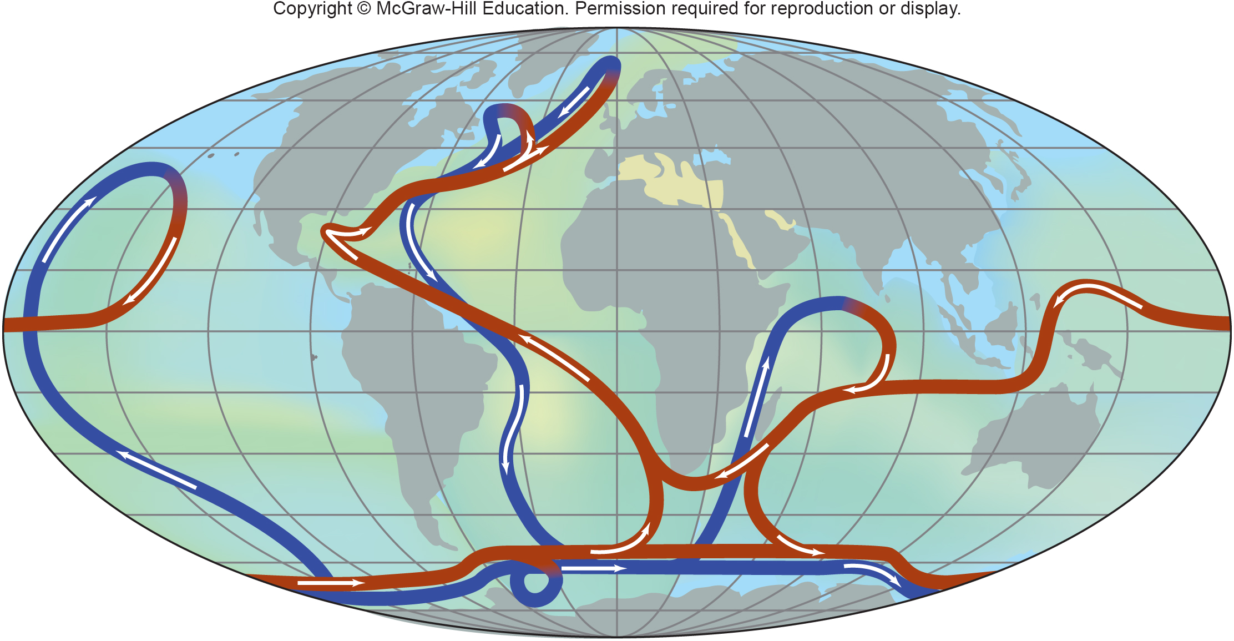
Ocean Currents Also Modify
Our Climate
Notes:
Ocean currents act as a global conveyor system, redistributing warm and cold water around the globe. These currents moderate our climate: for example, the Gulf Stream keeps northern Europe much warmer than northern Canada. Variations in ocean salinity and density, low (blue) to high (yellow), help drive ocean circulation.
11

Slide 12
9.2 Climate Changes Over Time
How stable is climate? That depends upon the time frame you consider. Over centuries and millennia, we know that climate shifts somewhat, but usually we expect little change on the scale of a human lifetime.
The question now is whether that is a reasonable expectation.
If climate does shift, how fast might it change, and what will those changes mean for the environmental systems we depend on?
Notes:
When climatologist Wallace Broeker said that “climate is an angry beast, and we are poking it with sticks,” he meant that we assume our climate is stable, but our thoughtless actions may be stirring it to sudden and dramatic changes. How stable is climate? That depends upon the time frame you consider. Over centuries and millennia, we know that climate shifts somewhat, but usually we expect little change on the scale of a human lifetime. The question now is whether that is a reasonable expectation. If climate does shift, how fast might it change, and what will those changes mean for the environmental systems on which we depend?
12

Slide 13
Ice Cores Tell Us About
Climate History
In Greenland and Antarctica and other places where cold is persistent, yearly snows slowly accumulate over the centuries. New layers compress lower layers into ice, but still tiny air bubbles remain.
Each bubble is a tiny sample of the atmosphere at the time that snow fell.
Climatologists have discovered that by drilling deep into an ice sheet, they can extract ice cores samples that show how the atmosphere has changed over time.
Notes:
Every time it snows, small amounts of air are trapped in the snow layers
Climatologists have discovered that by drilling deep into an ice sheet, they can extract ice cores from which they can collect air-bubble samples. Samples taken every few centimeters show how the atmosphere has changed over time. Ice core records have revolutionized our understanding of climate history (fig. 9.7). We can now see how concentrations of atmospheric CO₂ have varied and detect ash layers and spikes in sulfate concentrations that record volcanic eruptions.

Slide 14
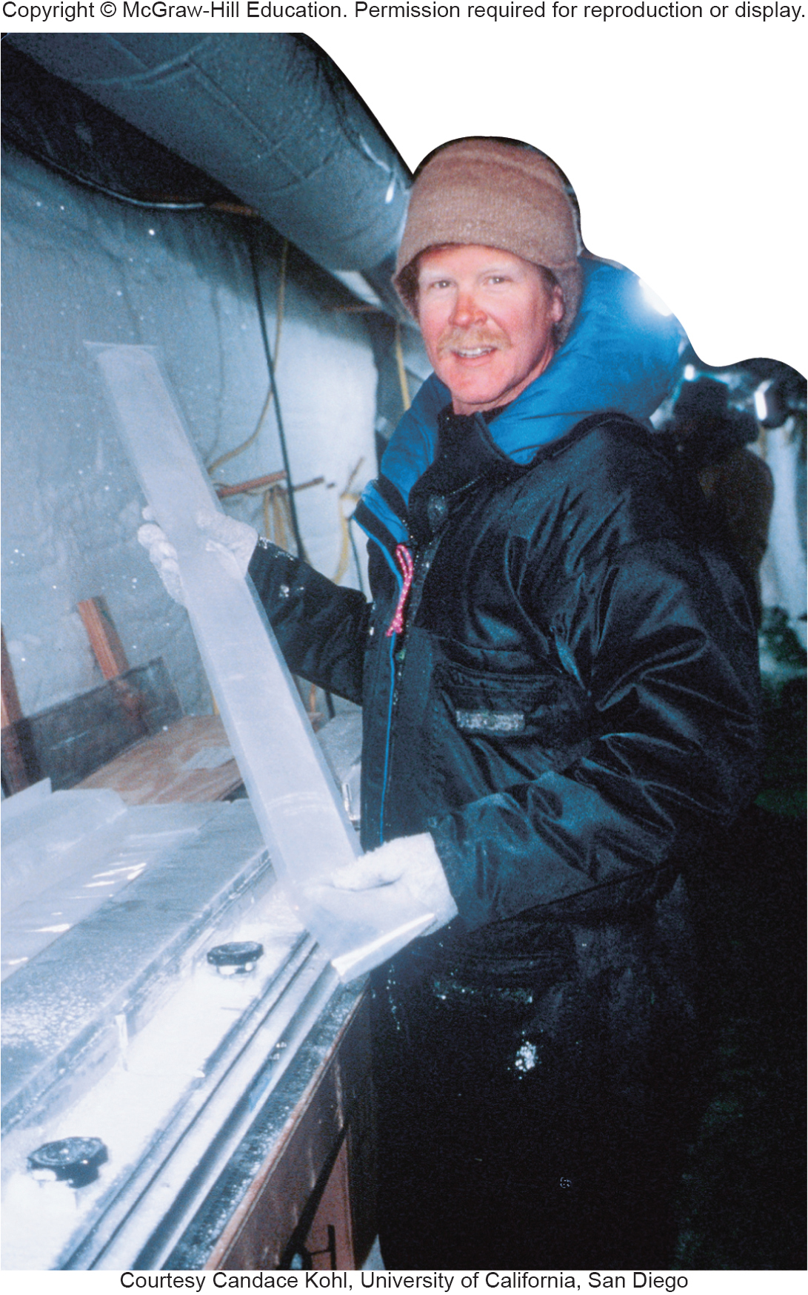
Scientists Study Ice Cores to
Understand Past Climate Changes
Notes:
Dr. Mark Twickler, of the University of New Hampshire, holds a section of the 3,000 m Greenland ice sheet core, which records 250,000 years of climate history.

Slide 15
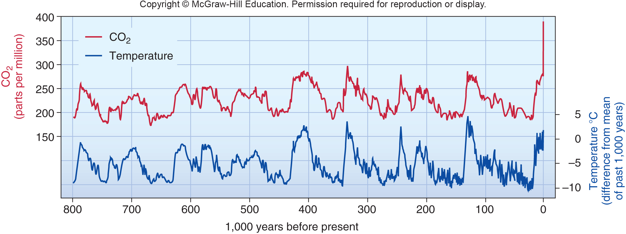
The Correlation Between Historic CO₂ Levels and Historic Temperatures
Notes:
Recently the European Project for Ice Coring in Antarctica (EPICA) has produced a record reaching back over 800,000 years (fig. 9.8). These cores not only show that climate has varied dramatically over time but that there is a close correlation between atmospheric temperatures and CO₂ concentrations.
From these ice cores, we know that CO₂ concentrations have varied between 180 to 300 ppm (parts per million) in the past 800,000 years. Therefore, we know that today’s concentrations of approximately nearly 400 ppm (and rising about 2 ppm per year) are about one-third higher than the earth has seen in nearly a million years. Concentrations of methane and nitrous oxide, two other important greenhouse gases, are also higher than in any records in the EPICA sample. We also know from oxygen isotopes that present temperatures are nearly as warm as any in the ice core records. Further warming in the coming decades is likely to exceed anything ever seen by our species, Homo sapiens, which appeared just 200,000 years ago.
15

Slide 16
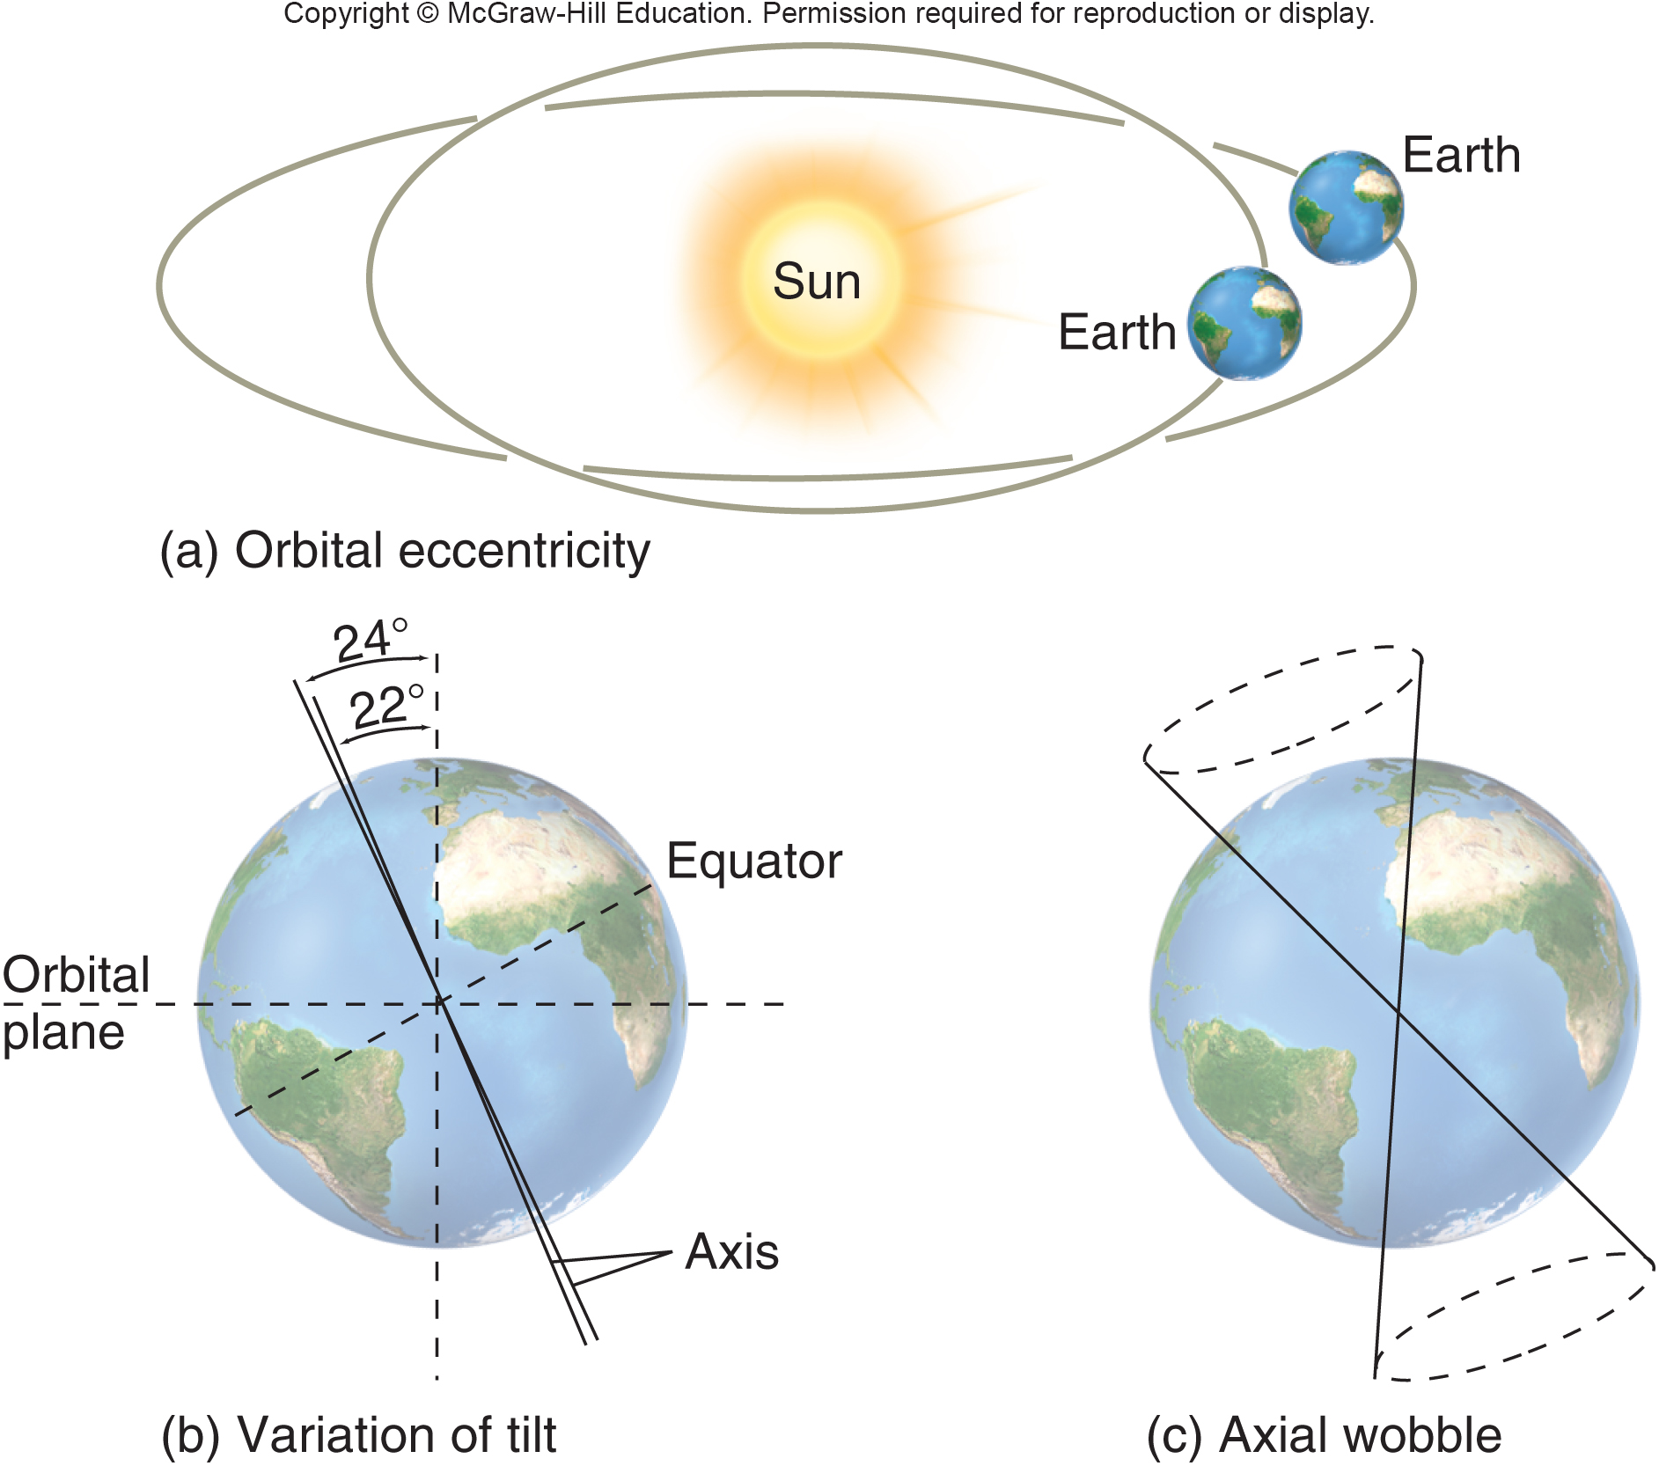
What Causes Natural Climatic Swings?
Modest climate changes correspond to an 11-year cycle in the Sun’s intensity.
More dramatic shifts called Milankovitch cycles are due to changes in the Earth’s orbit and tilt and wobble on its axis.
Notes:
These are known as the Milankovitch cycles, after the Serbian scientist Milutin Milankovitch, who first described them in the 1920s. There are three of these cycles: (1) the earth’s elliptical orbit stretches and shortens in a 100,000-year cycle; (2) the earth’s axis changes its angle of tilt in a 40,000-year cycle; (3) over a 26,000-year period, the axis wobbles like an out-of-balance spinning top. These cycles cause variation in the intensity of incoming solar energy at different latitudes and in the intensity of summer heating or winter cooling.
16

Slide 17
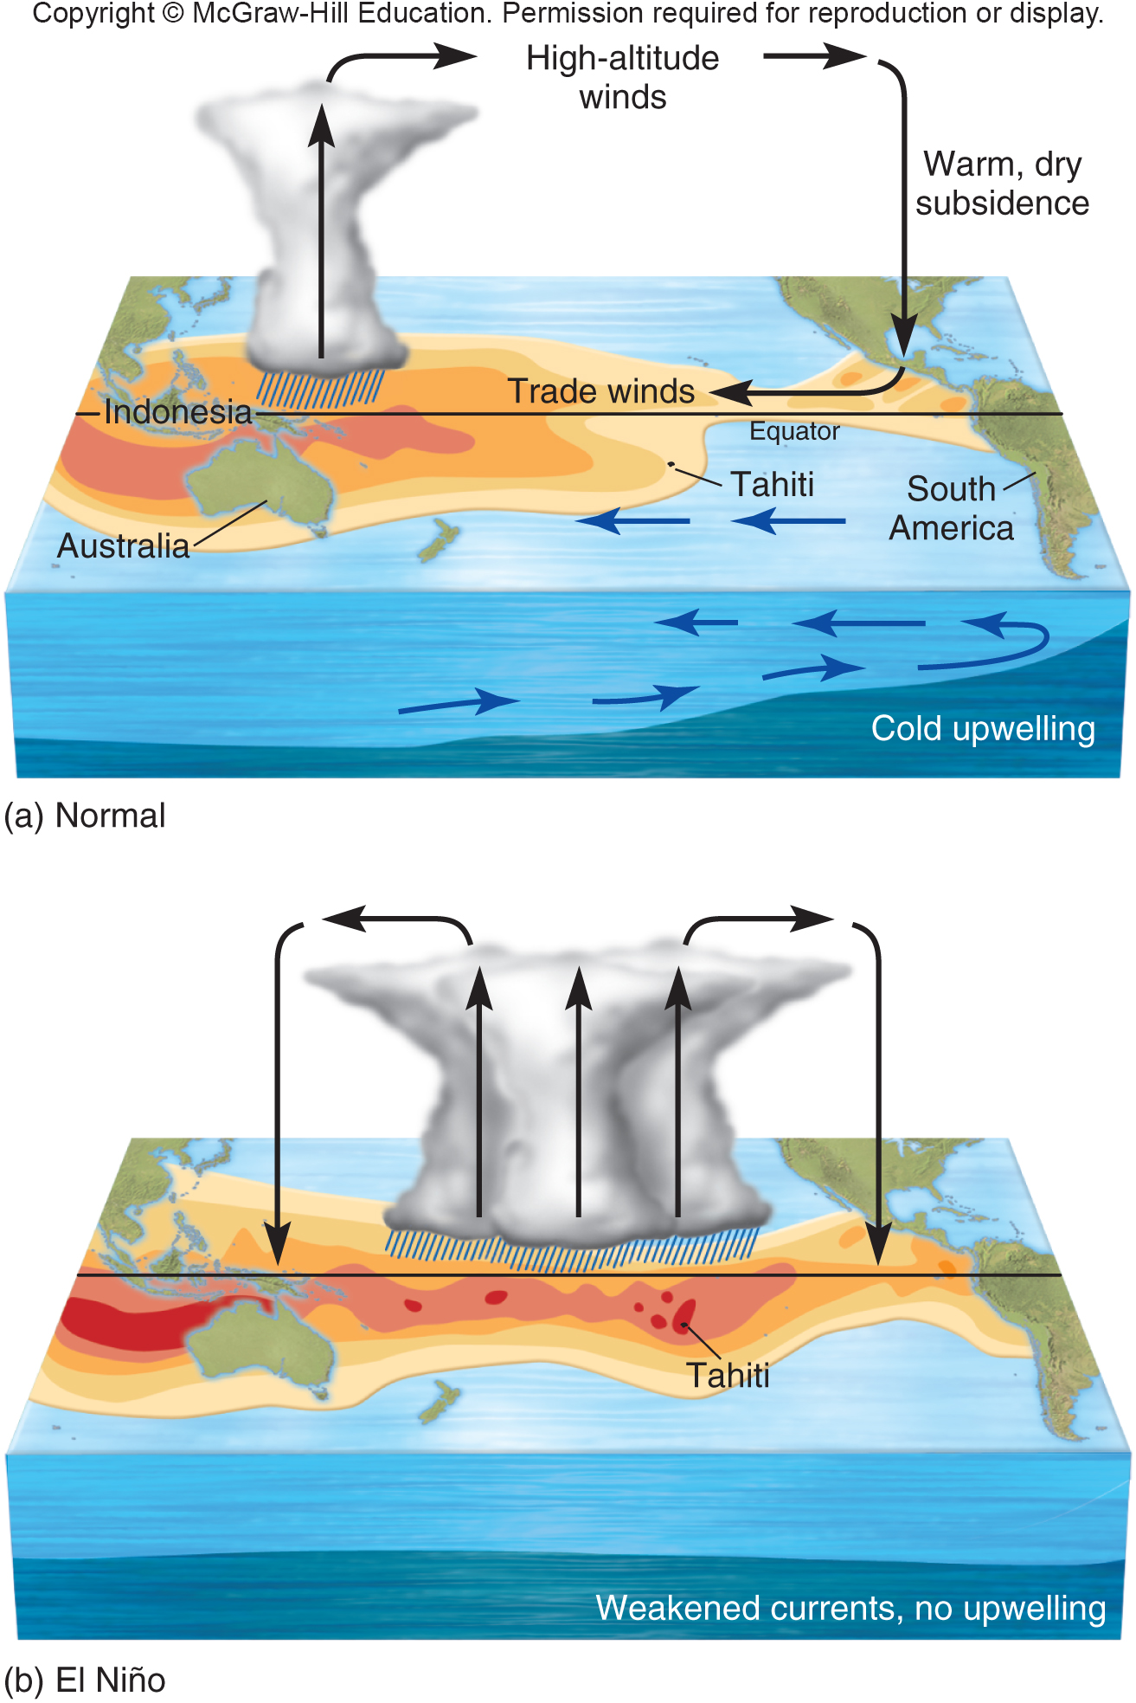
The El Niño/Southern Oscillation
Can Have Far-reaching Effects
The climate also changes according to oscillations in the ocean and atmosphere.
El Niño/ Southern Oscillation (ENSO) is the best know.
ENSO affects weather throughout the Pacific, causing heavy monsoons or serious droughts.
Notes:
On the scale of years or decades, the climate also changes according to oscillations in the ocean and atmosphere. These coupled ocean–atmosphere oscillations occur in all the world’s oceans, but the El Niño/Southern Oscillation (ENSO) is probably the best known. ENSO affects weather across the Pacific and adjacent continents causing heavy monsoons or serious droughts.
The core of this system is a huge pool of warm surface water in the Pacific Ocean that sloshes slowly back and forth between Indonesia and South America like water in a giant bathtub. Most years, steady equatorial trade winds hold this pool in place in the western Pacific (fig. 9.10). From Southeast Asia to Australia, this concentration of warm equatorial water provides latent heat (water vapor) that drives strong upward convection (low pressure) in the atmosphere resulting heavy rains in Indonesia support dense tropical forests.
On the American side of the Pacific, cold upwelling water along the South American coast replaces westward-flowing surface waters. This upwelling deep water is rich in nutrients. It supports dense schools of anchovies and other fish. In the atmosphere, dry, sinking air in Mexico and California replaces the air moving steadily westward in the trade winds resulting in dry conditions in the southwestern United States.
17

Slide 18
9.3 How Do We Know the Climate is
Changing Faster than Usual?
Many scientists consider anthropogenic (human-caused) global climate change to be the most important environmental issue of our times.
Pivotal evidence that human activities are increasing atmospheric CO₂ came from an observatory on Mauna Loa volcano in Hawaii.
Measurements show CO₂ levels increasing about
0.5% per year since 1958. This “Keeling curve” shows that CO2 concentrations have risen from 315 ppm in 1958 to 393 ppm in 2012.
Notes:
The observatory was established in 1957 as part of an International Geophysical Year, to provide atmospheric data in a remote, pristine environment. Measurements taken by atmospheric chemist Charles David Keeling showed CO₂ levels increasing about 0.5 percent per year. The “Keeling curve” (fig. 9.11), which has been continuously updated, shows that CO₂ concentrations have risen from 315 ppm in 1958 to 393 ppm in 2012. The line is jagged because of annual fluctuations: concentrations decline each May as plants in the Northern Hemisphere (which has far greater continental area than the Southern Hemisphere) begin photosynthesizing and capturing CO₂. During the northern winter, plant decay releases CO₂, causing levels to levels rise.

Slide 19
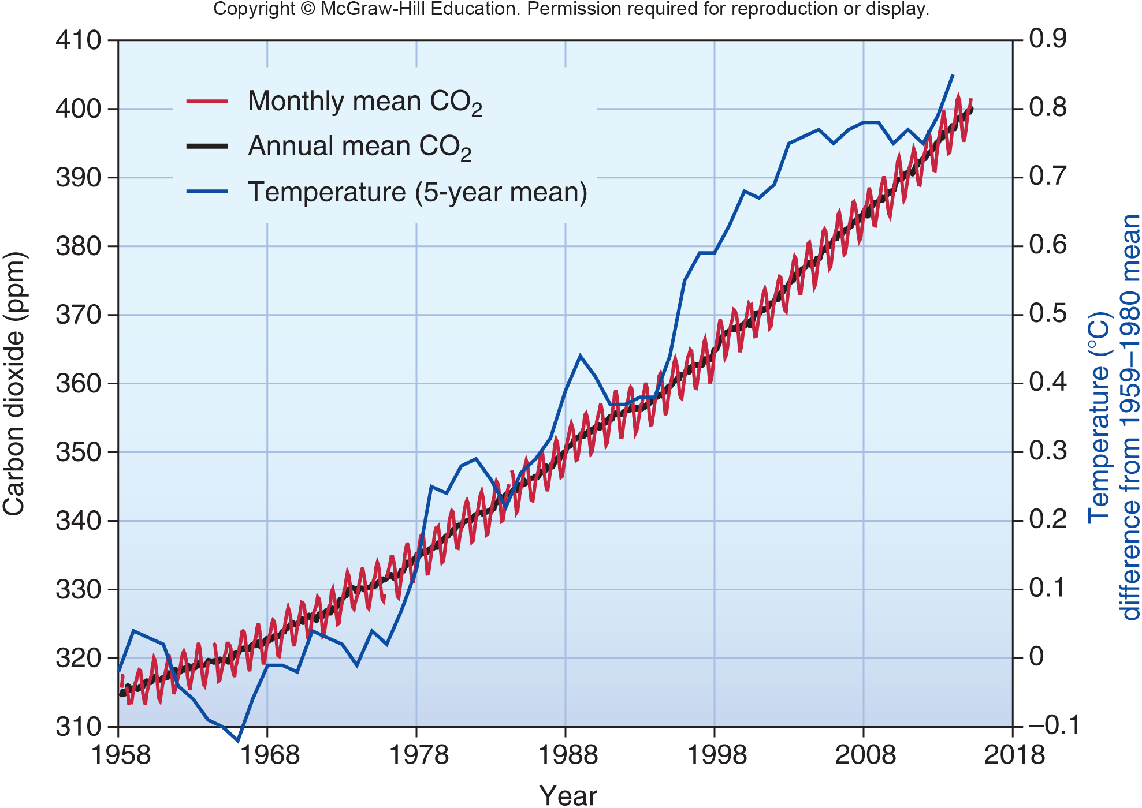
CO₂ and Temperature Readings from Mauna Loa Volcano in Hawaii
Notes:
Measurements of atmospheric CO₂ taken at the top of Mauna Loa, Hawaii, show an increase of about 2.2 percent per year in recent years. Monthly mean CO₂ (red) and annual average CO₂ (black) track closely with the general trend in global temperatures (blue).
19

Slide 20
Scientific Consensus is Clear
Because the climate is so complex, climate scientists worldwide have collaborated in collecting and sharing data and in programming models to describe how the climate system works.
Evidence shows minor differences among models but no disagreement about the direction of change.
The evidence shows unequivocally, that climate is changing, and the global average is a warming because of increased retention of energy in the lower atmosphere.
Notes:
But among climate scientists who work with the data and models, there is no disagreement about the direction of change. The evidence shows unequivocally, as in the Mauna Loa graph, that climate is changing, and the global average is warming because of increased retention of energy in the lower atmosphere.
20

Slide 21
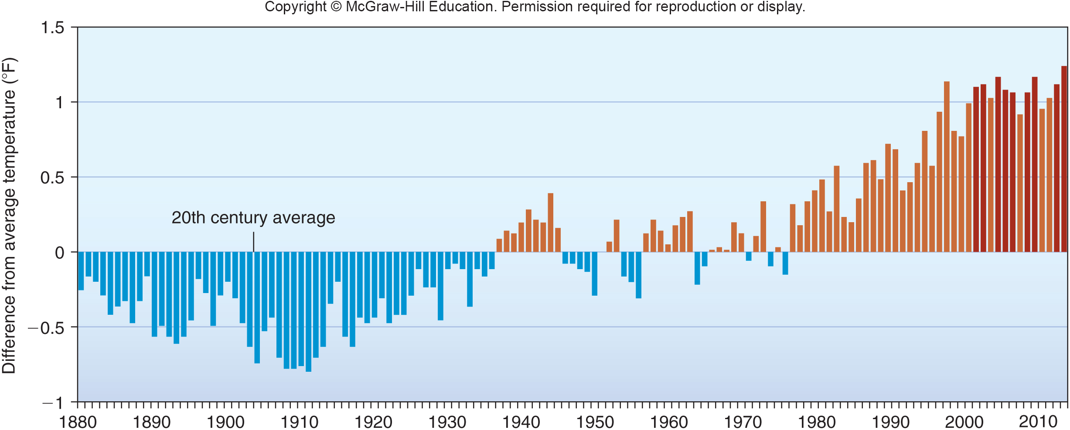
Differences from average annual temperature since 1880.
Notes:
Differences from average annual temperature, since 1880. The ten warmest years on record (darkest red) have occurred in the most recent decades. New monthly and annual records are increasing in frequency. SOURCE: Graph by NOAA Climate.gov, based on data from the National Climatic Data Center.
21

Slide 22
What is the IPCC?
The most comprehensive effort to describe the state of climate knowledge is that of the Intergovernmental Panel on Climate Change (IPCC).
The IPCC brings together scientists and government representatives from 130 countries with the aim to review scientific evidence on the causes and likely effects of human-caused climate change.
In 2007, the IPCC issued its 4th Assessment Report. The conclusion is a 90% certainty that observed climate change is caused by human activity.
Subsequent reports raised that certainty to 99%.
Notes:
You can view the report, with figures and related documents, at the IPCC’s website: http://www.ipcc.ch. The IPCC’s Fifth Assessment Report is due out in 2013.

Slide 23
Changes in Heat Waves, Sea Level, and Storms are Expected
The 4th IPCC Report presents a variety of climate scenarios for predicted emissions of greenhouse gases. For each scenario, the IPCC modeled future emissions, starting in 2000.
Observations since 2007 show that all the IPCC scenarios were too conservative – Greenhouse gas emissions, temperature rises, sea level, and energy use have accelerated faster than IPCC projections.
Droughts, floods, crop failure, and waves of refugees may result.
Notes:
The IPCC’s Fourth Assessment Report presents a variety of climate scenarios for predicted emissions of greenhouse gases. For each scenario, the IPCC modeled future emissions, starting in 2000. Scenarios differed in expected population growth, economic growth, energy conservation and efficiency, and adoption of greenhouse gas controls (or lack thereof). The different scenarios project a temperature increase by 2100 of 1–6°C (2–11°F) compared to temperatures at the end of the twentieth century (fig. 9.12, colored trend lines).
According to the IPCC, the “best estimate” for temperature rise is now about 2–4°C (about 3–8°F). A change of 4°C is just slightly less than the difference in global temperature between now and the middle of the last glacial period, which was about 5°C cooler.
Observations since 2007 show that all the IPCC scenarios were too conservative. Greenhouse gas emissions, temperatures, sea level, and energy use have accelerated faster than even the worst IPCC projections (fig. 9.12, bold line). There is serious concern that increased heat stress and drought could cause increased deaths as well as crop failure and new waves of refugees from drought-stricken regions.

Slide 24
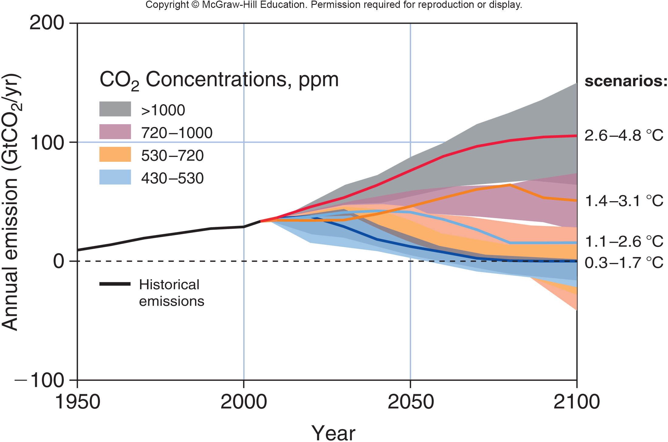
Annual anthropogenic CO₂ emissions for four climate change scenarios
Notes:
Annual anthropogenic CO2 emissions for four climate change scenarios, with differing temperature ranges by 2100. The 0.3–1.7°C scenario involves aggressive and rapid reduction of GHGs; the 2.6–4.8°C scenario represents business as usual. The likely range of CO2 concentrations associated with each scenario is shown. SOURCE: Modified from IPCC 2013, AR5 Working Group 1 SPM fig. SPM.5
24

Slide 25
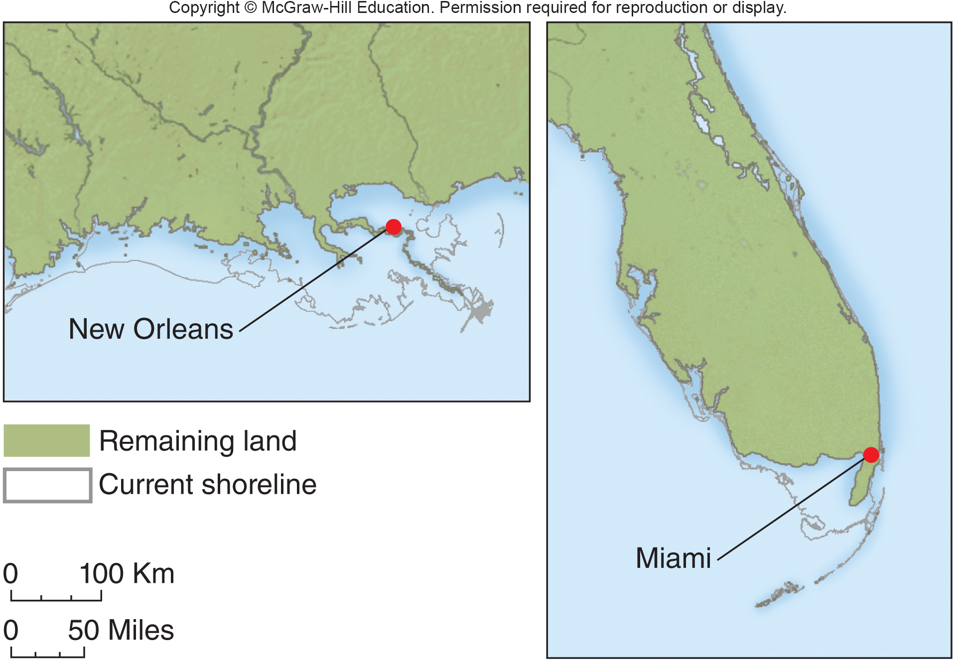
Impact of a 1 m Rise in Sea Level
Notes:
Approximate change in land surface with 1 m (3 ft) of sea level rise, a change that is likely by 2100. If no action is taken, sea level change may be 2 m (6 ft) or more.

Slide 26
Policy Makers Have Made Little
Progress in Finding Solutions
Climate control is a classic free-rider problem, in which nobody wants to take action for fear that someone else might benefit from their sacrifices.
The question is whether the sacrifices need necessarily be as big as some policy makers suggest.
Climate scientists point out that shifting our energy strategy from coal to wind, solar, and greater efficiency, could produce millions of new jobs and save billions in health care costs associated with coal burning.

Slide 27
The Main Greenhouse Gases are
CO₂, CH₄, and N₂O
Since pre-industrial times, atmospheric concentrations of CO₂, methane (CH₄,), and nitrous oxide (N₂O) have climbed by over 31%, 151 %, and 17 % respectively.
Carbon dioxide is by far the most important of these because of its abundance and because it lasts for decades or centuries in the atmosphere.
If current trends continue, CO₂ concentrations could reach about 500 ppm (approaching 2X the pre-industrial level of 280 ppm) by the end of the 21st century.
Notes:
Fossil fuel use is responsible for 80 percent of CO₂ emissions. Cement production furnaces and burning of forests and grasslands are also major sources. Together these release more than 33 billion tons of CO₂ every year, on average (fig. 9.15a). About 3 billion tons of this excess carbon is taken up by terrestrial ecosystems, and around 2 billion tons are absorbed by the oceans, leaving an annual atmospheric increase of some 4 billion tons per year. If current trends continue, CO₂ concentrations could reach about 500 ppm (approaching twice the preindustrial level of 280 ppm) by the end of the twenty-first century.
Methane (CH4) is much less abundant than CO2, but it absorbs 23 times as much infrared energy per molecule and is accumulating in the atmosphere about twice as fast as CO2. Methane can be produced anywhere organic matter decays without oxygen, especially under water. Natural gas, which is mainly CH4, derives from ancient swamp material. Methane also is released by ruminant animals, wet-rice paddies, coal mines, landfills, wetlands, and pipeline leaks.
Nitrous oxide (N2O) is produced mainly by chemical reactions between atmospheric N and O, which combine in the presence of heat from internal combustion engines. Other sources are burning of organic material and soil microbial activity.
27

Slide 28
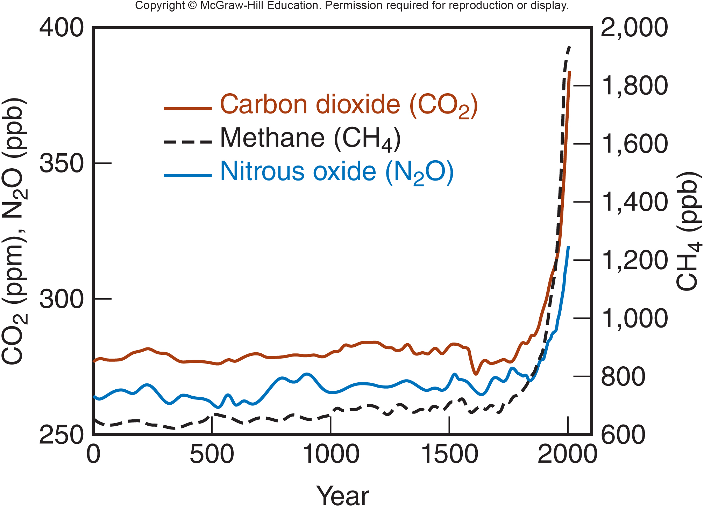
Increases in Greenhouse Gases
Since Industrialization
Notes:
Methane (CH₄, black) and nitrous oxide (N₂O, blue) have risen with CO₂ (red) since industrialization began in about 1750. Concentrations are shown in parts per million (ppm) and parts per billion (ppb).

Slide 29
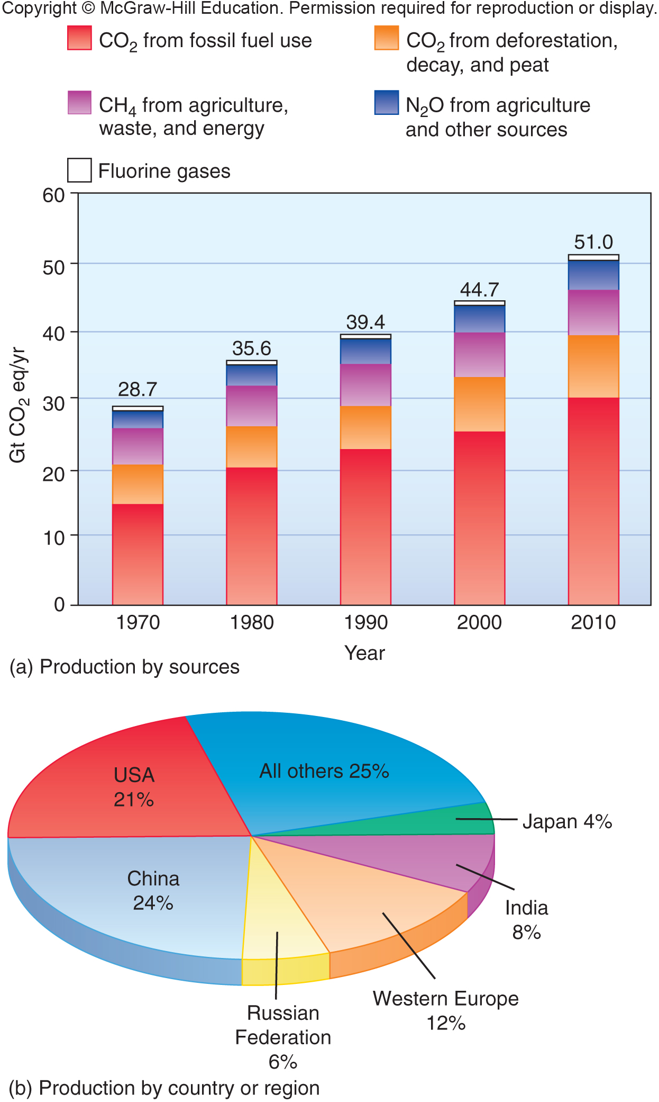
Contributions to Global Warming from Different Gases

Slide 30
What Consequences Do We See?
It is now warmer than it has been in the last two thousand years.
Over the last century, the average global temperature has climbed about 0.6 degree C (1 degree F).
Global sea level has risen approximately 20 cm (8 in.) in the past century.
Permafrost is melting; houses, roads, pipelines, sewage systems, and transmission lines are being damaged as the ground sinks beneath them.
Arctic sea ice is only half as thick now as it was 30 years ago and Antarctic ice shelves are breaking up.
Notes:
The American Geophysical Union, one of the nation’s largest and most respected scientific organizations, has stated that, as best as can be determined, the world is now warmer than it has been in the last two thousand years—since the beginning of civilization as we know it. If current trends continue, by the end of the century it will be hotter than at any point in the last two million years. The average global temperature has climbed about 0.6°C (1°F) in the past century, and 19 of the 20 warmest years in the past 150 have occurred since 1980. This warming has resulted in some important changes.

Slide 31
Evidence (continued)
Nearly all mountain glaciers are retreating rapidly and many have disappeared entirely.
Satellite images and surface measurements show that growing seasons are now as much as three weeks longer in a band across northern Eurasia and North America than they were 30 years ago.
Droughts are becoming more frequent and widespread.
Plants and animals are breeding earlier or extending their range into new territory.
Coral reefs worldwide are “bleaching,” losing key algae.
Notes:
Satellite images and surface measurements show that growing seasons are now as much as three weeks longer in northern Eurasia and North America, compared to 30 years ago. Southern plants and animals are moving into arctic regions, while arctic species such as musk ox, caribou, walrus, and seal are declining.
Africa, for example, droughts have increased about 30 percent since 1970. Marginal farmlands are becoming less productive as warmer temperatures evaporate available moisture.
• Plants and animals are breeding earlier or extending their range into new territory. In Europe and North America, 57 butterfly species have disappeared from the southern end of their range or extended the northern limits. Many plants may be unable to migrate as rapidly as conditions are changing: we now are forcing them to move much faster than they did at the end of the last ice age (fig. 9.16d).
• Coral reefs worldwide are “bleaching” (losing the colorful algae they rely on for survival) as water temperatures rise above 30°C (85°F). Marine ecologists worry that warming oceans could be the final blow for reefs, which are already threatened by pollution and overfishing, and for the fisheries and ecosystems they support.
31

Slide 32
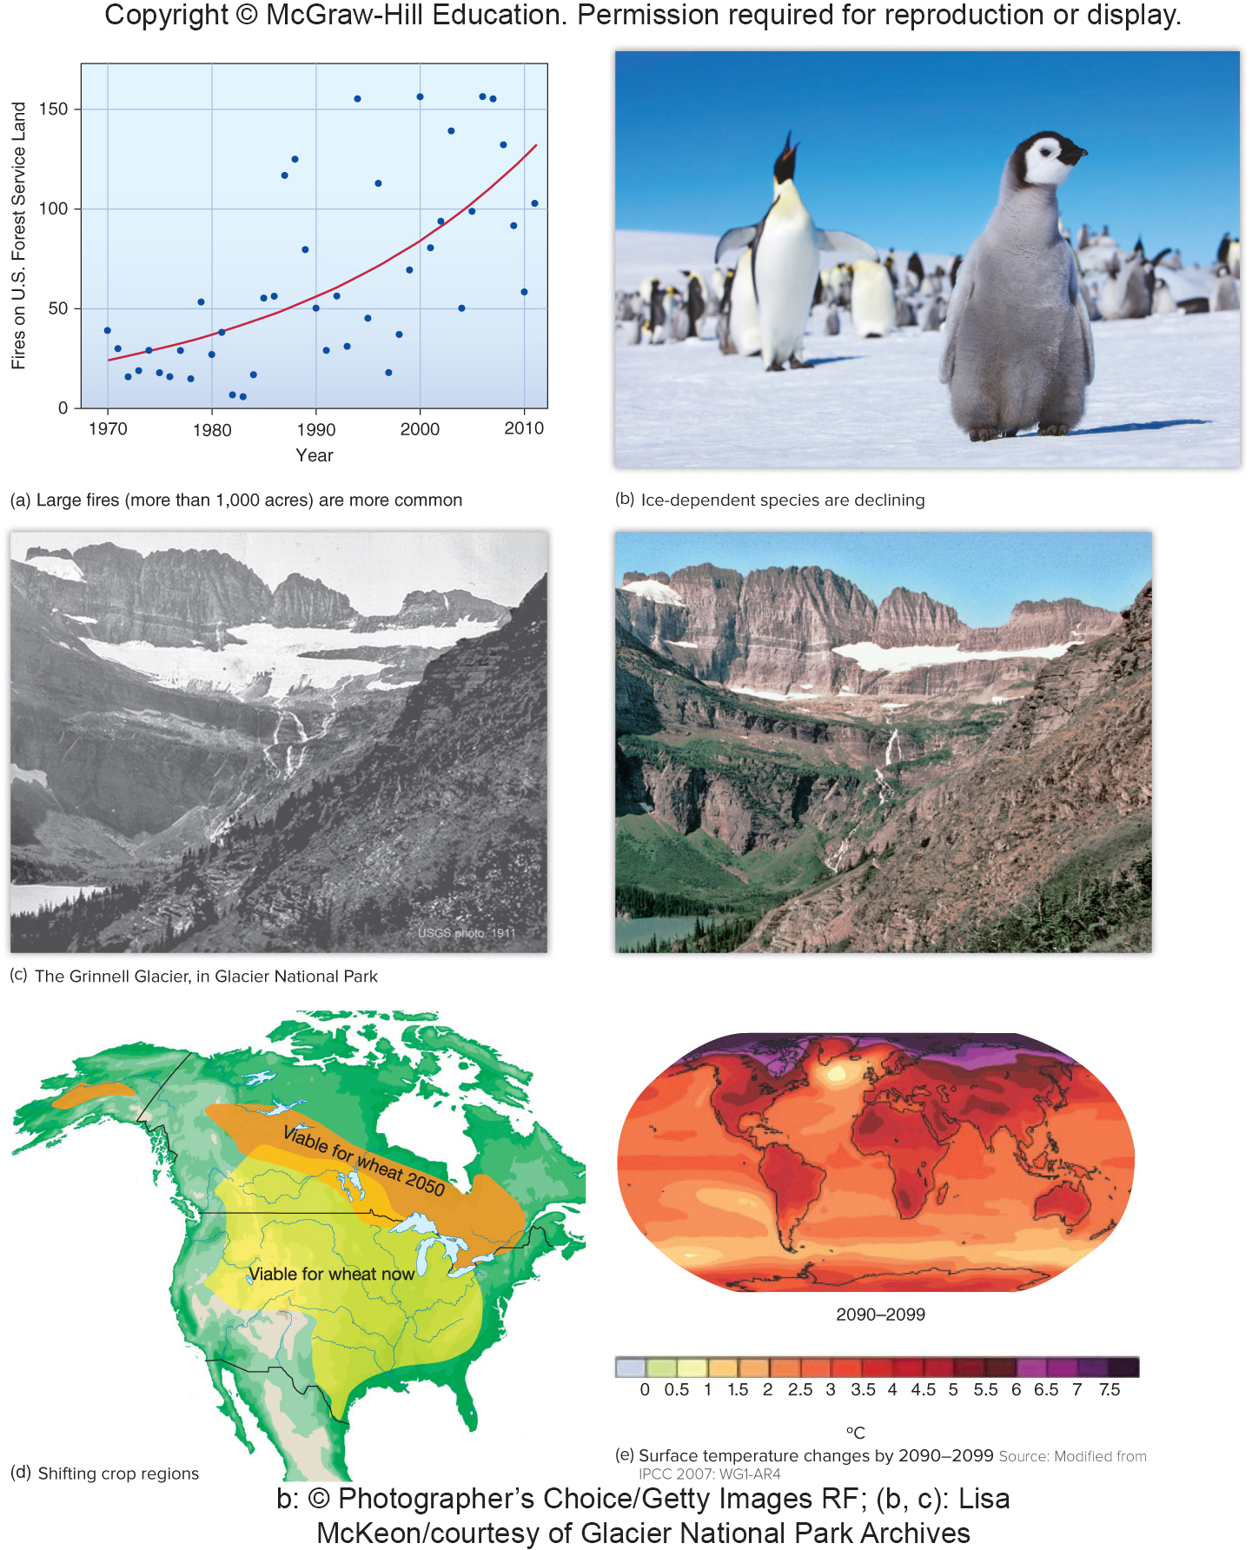
Evidence of Climate Change

Slide 33
Large Fires are Common

Slide 34
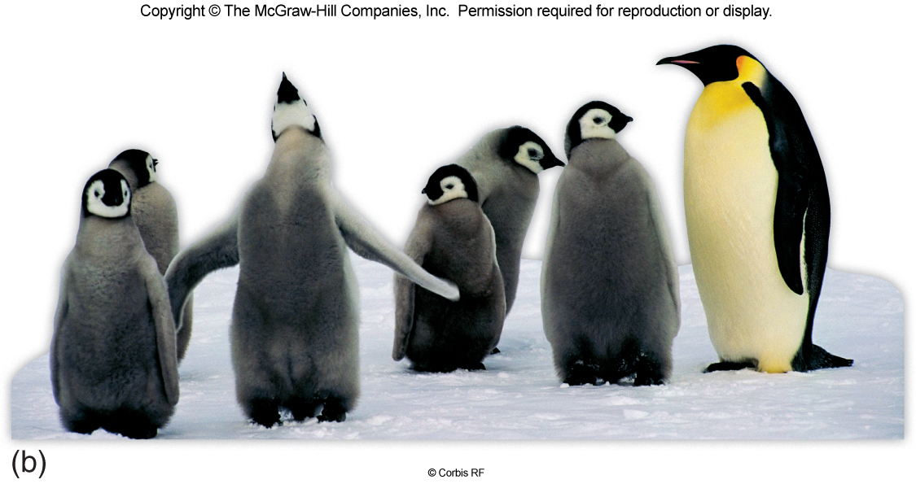
Evidence of Climate Change:
Ice Dependent Penguins Declining
Notes:
sharp declines in ice-dependent species, some of which have lost half or more of their population.

Slide 35
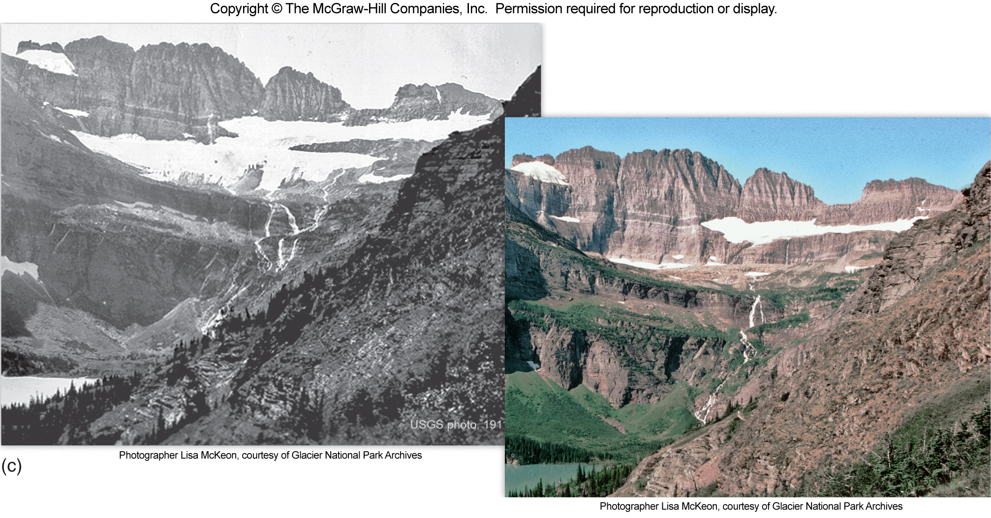
Evidence of Climate Change: Alpine Glaciers Retreating
Notes:
Mountain glaciers are retreating, except where snowfall has increased, including a Montana’s Glacier National Park.

Slide 36
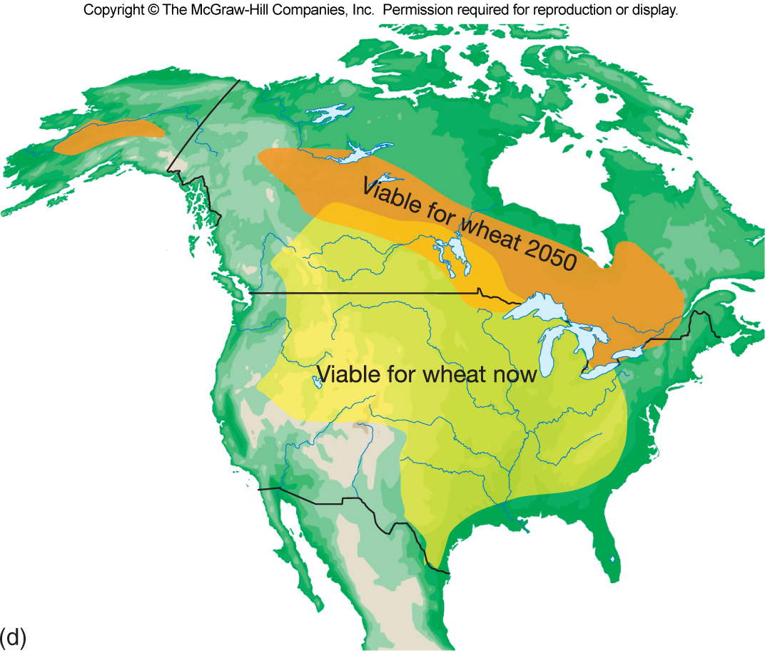
Evidence of Climate Change: Changing Climactic Range for Growing Wheat
Notes:
Climatic conditions for farming are shifting, and by 2050 wheat production may have shifted to central Canada.

Slide 37
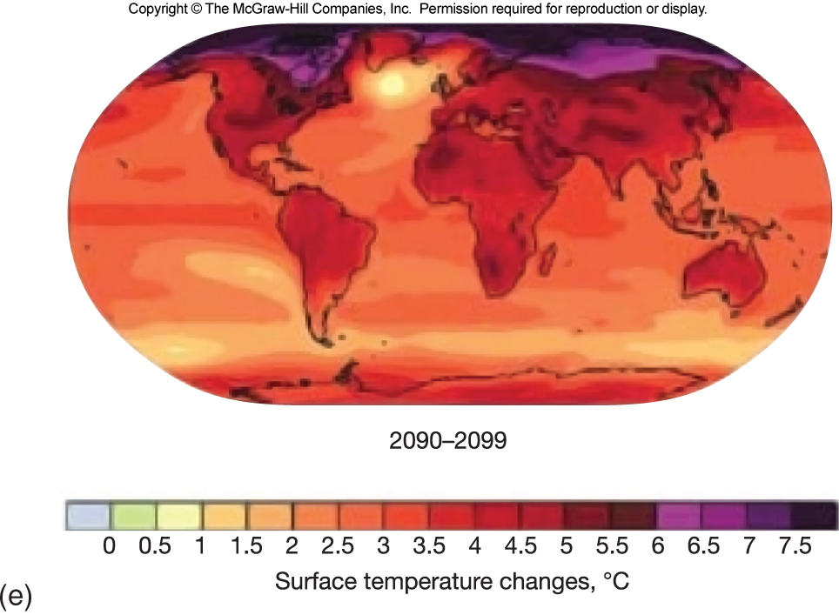
Evidence of Climate Change:
IPCC Surface Temperature Projections
Notes:
Surface temperature is projected to rise sharply, even under IPCC scenario B1, which assumes rapid adoption of new energy technology, reduction of fossil fuel use, and a declining population after 2050.

Slide 38
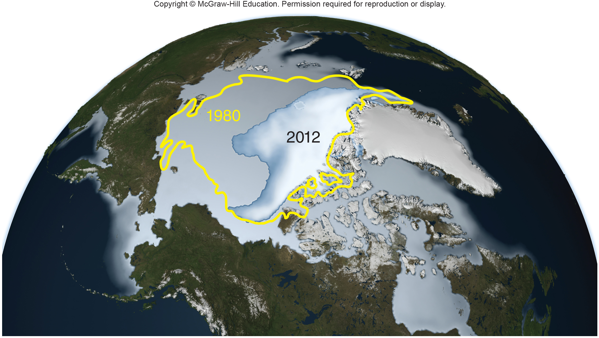
Sea Ice Change From Sept. 1980-2012
Notes:
Sea ice change from September 1980 to September 2012. Melting ice produces positive feedbacks with greater heat absorption and later freezing in the fall.

Slide 39
Controlling Emissions is Cheaper than the Cost of Climate Change
A 2010 study by the Pew Trust estimates the cost of lost ecological services by 2100. Costs included factors such as lost agricultural productivity from drought, damage to infrastructure from flooding and storms, lost biological productivity, health costs from heat stress, and lost water supplies.
The Pew report found that climate change is likely to cost between $5 trillion and $90 trillion by 2100.
The Stern report estimates a cost of only about 1% of global GDP to avoid the worst impacts of climate change.
Notes:
The Pew report found that climate change is likely to cost between $5 trillion and $90 trillion by 2100, depending on how economic discount rates and other factors are calculated. In a study issued on behalf of the British government, Sir Nicholas Stern, former chief economist of the World Bank, estimated the cumulative costs of climate change equal between 5 and 20 percent of the annual global gross domestic product (GDP). In contrast, the Stern report estimated it would cost only about 1 percent of global GDP to reduce greenhouse gas emissions now to avoid the worst impacts of climate change. The IPCC says it would cost even less, only 0.12 percent of annual global GDP to reduce carbon emissions the 2 percent per year necessary to stabilize world climate.
39

Slide 40
Why are there Disputes Over Climate Evidence?
Climate scientists offer the following responses to some of the claims in the popular media:
Reducing climate change requires abandoning our current way of life (no, but it does require that we use different energy sources).
There is no alternative to current energy systems (Europe and China are showing this to be false).
A comfortable lifestyle requires high CO₂ output (data show this is false).
Natural changes such as solar variation can explain observed warming (changes are slight and do not coincide with the climate changes).
Notes:
.
40

Slide 41
Responses to Disputes
Over Climate Change
The climate has changed before, so this is nothing new (Today’s CO₂ level exceeds anything the Earth has seen for nearly a million years).
Temperature changes are leveling off (True on short time frames sometimes, but over decades the trends in surface air temperatures and in sea level continue to rise).
We had cool temperatures and snowstorms last year, not heat and drought (Regional differences in temperature and precipitation trends are predicted by climate models).
Climate scientists don’t know everything, and they have made errors and misstatements (fraud in data collection is almost unheard of in science).

Slide 42
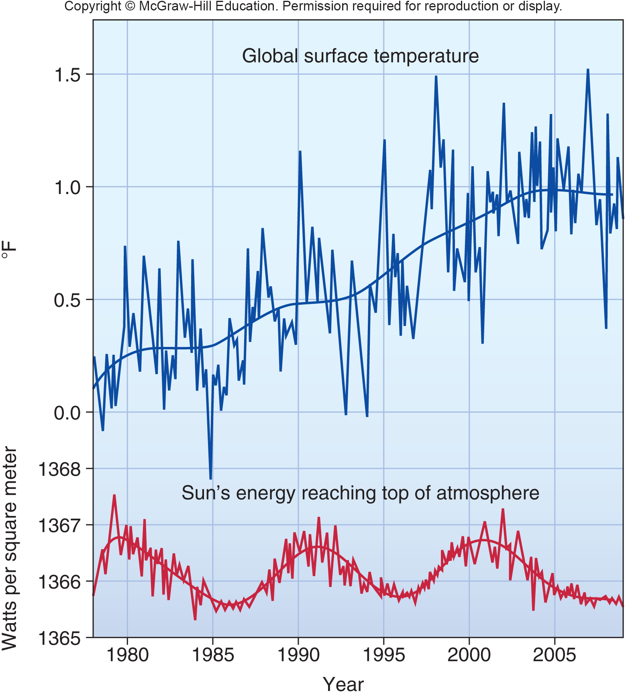
Solar Energy Usage
Notes:
Solar energy received at the top of the earth’s atmosphere has been measured by satellites since 1978. It has followed a natural 11-year cycle of small shifts but no overal increase (bottom). Over the same period, surface temperatures have increased markedly (top). Source : Climate Change Compendium, 2009.

Slide 43
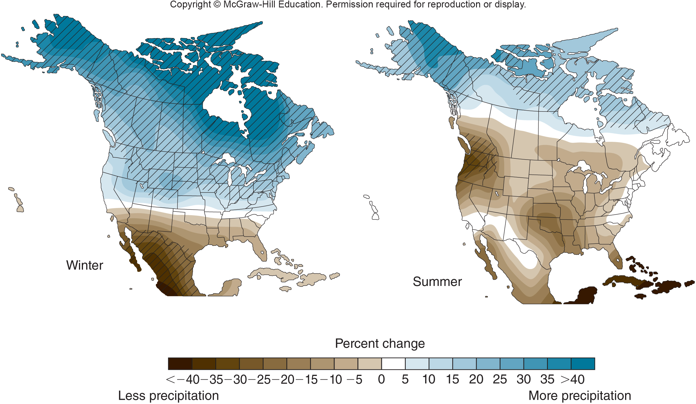
Climate Change Will Cause
Changes in Precipitation
Notes:
Precipitation in 2100 is expected to produce wetter northern winters and drier southern winters, compared to recent averages, while drier summers are expected for most of North America. Values are averages of 15 climate models.

Slide 44
9.4 Envisioning Solutions
Former president Bill Clinton has argued that combating climate change doesn’t have to mean economic hardship.
It could be the biggest development stimulus since World War II, creating millions of jobs and saving trillions of dollars in foreign fuel imports.
What are some of the strategies we have available?
Notes:
44

Slide 45
There are Many Ways We Can
Control Greenhouse Emissions
We can reduce dependence on coal, which produces more CO₂ per energy unit than any other fuel.
We could institute fees for selling fossil fuels–these would help fossil fuel prices represent their many hidden costs.
We can invest in new technologies and energy efficiency.
We can institute emissions trading by instituting a legal cap on emissions then allowing companies to buy and sell shares of that total cap.
Notes:
Coal produces more CO₂ per unit energy than any other fuel. We can reconsider the $120 billion per year in tax credits for oil and coal development, which transfer operating costs to taxpayers and hide the real price of these fuels. We can plan cities and transportation systems to provide better alternatives to private automobiles, which are the main way individuals contribute to our climate impacts. We can account for the hidden costs (such as health costs, biodiversity and recreation costs, military expenditures to protect oil fields); and, when these costs are no longer hidden, it will be clear that fossil fuels are not cheaper than alternatives. We can invest in new technologies—the price of solar power has plummeted in recent years, making the cost of new solar, wind, and coal power equivalent.
45

Slide 46
International Protocols Have Tried to Establish Common Rules
In 1992 The United Nations Earth Summit meeting in Rio de Janeiro set an objective of stabilizing greenhouse gas emissions.
In Kyoto, Japan, in 1997, 160 nations agreed to roll back CO₂, methane, and nitrous oxide emissions about 5 percent below 1990 levels by 2012, but China and India were exempted from the agreement and the U.S. never ratified this agreement.
Notes:
Many of the largest business conglomerates in America have joined environmental groups to call for strong national legislation to achieve significant reductions of greenhouse gas emissions. Those companies would prefer a single national standard rather than a jumble of conflicting local and state rules, which cost them time, money, and sometimes contracts with potential trading partners.
International climate accords continue to be stymied by the largest economies; however, the largest European economies overshot their Kyoto targets by 2012, at the same time as their economies have grown. International recognition of the costs of climate change seems to be growing. What progress we will make remains unclear.
46

Slide 47
A Wedge Approach
Could Fix the Problem
An alternative approach is wedge analysis,
breaking down a large problem into smaller, bite-size pieces.
Each one might start small now, but their impacts will grow over time, producing a larger wedge-like impact in 50 years.
Pacala and Socolow’s paper described 14 “wedges”, each represents 1 GT (1 billion tons) of carbon emissions avoided in 2058.
Notes:
Pacala and Socolow’s paper described 14 “wedges” (table 9.2). Each wedge represents 1 GT (1 billion tons) of carbon emissions avoided in 2058, compared to a “business as usual” scenario. Accomplishing just half of these wedges could level off our emissions. Accomplishing all of them could return to levels well below those envisioned in the Kyoto Protocol. A “stabilization triangle” shows the difference between our current path of rising CO₂ and alternative strategies to lower emissions. The “business as usual” scenario follows the current pattern of constantly increasing CO₂ output. This trajectory heads toward at tripling of CO₂ by 2100, with temperature increases of around 5°C (9°F) (see fig. 9.2). A “stabilization scenario” would prevent further increases in CO₂ emissions, but atmospheric CO₂ in the atmosphere would still double by 2100 because of processes already in place. Temperatures increase by about 2–3°C. A third trajectory would produce declining CO₂ emissions.
To achieve stabilization, we need to reduce our annual carbon emissions by about 7 billion tons (or 7 gigatons, GT) per year within 50 years. None of the 14 wedge options is going to please everybody, and some will be more popular than others, but the potential benefits of the entire portfolio are large enough that not every option must be used.
47

Slide 48
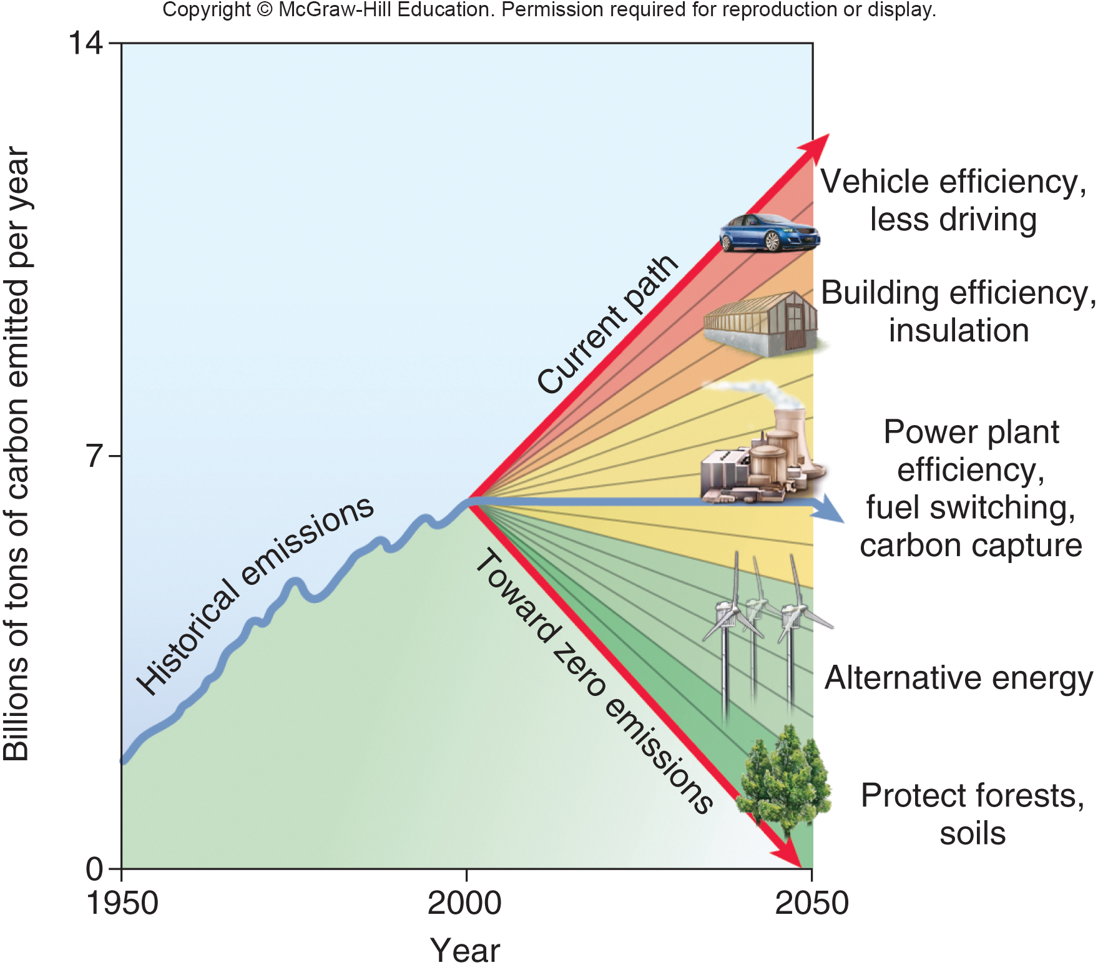
Wedge Analysis
Accomplishing just half of these wedges could level off our emissions.
Accomplishing all of them could return to levels well below those envisioned in the Kyoto protocol.
Notes:
A wedge approach could use multiple strategies to reduce or stabilize carbon emissions rapidly and relatively cheaply.
48

Slide 49
Local Initiatives are Everywhere
Britain has already started to substitute natural gas for coal, promote energy efficiency in homes and industry, and raise its already high gasoline tax.
New Zealand Prime Minister Helen Clark pledged that her country will be the first to be “carbon neutral”.
Germany has reduced its CO₂ emissions at least 10 percent by switching from coal to gas and by encouraging energy efficiency throughout society.
Denmark now gets 20% of its electricity from windmills.
Notes:
In the United States, nearly 1,000 cities and 39 states have announced their own plans to combat global warming. And over 450 college campuses have pledged to reduce greenhouse emissions. Part of the motivation for these steps is that alternative solutions often are advantageous in their own right. Making buildings more energy efficient and buying high-mileage vehicles saves money in the long run. Buying better light bulbs saves money in the near term. Planning cities for better transit, biking, and walking saves tax dollars we now spend on far-flung road and service networks. Walking, biking, and climbing stairs are good for your health, and they help reduce traffic congestion and energy consumption. As the Irish statesman and philosopher Edmund Burke said, “Nobody made a greater mistake than he who did nothing because he could do only a little.”
49

Slide 50
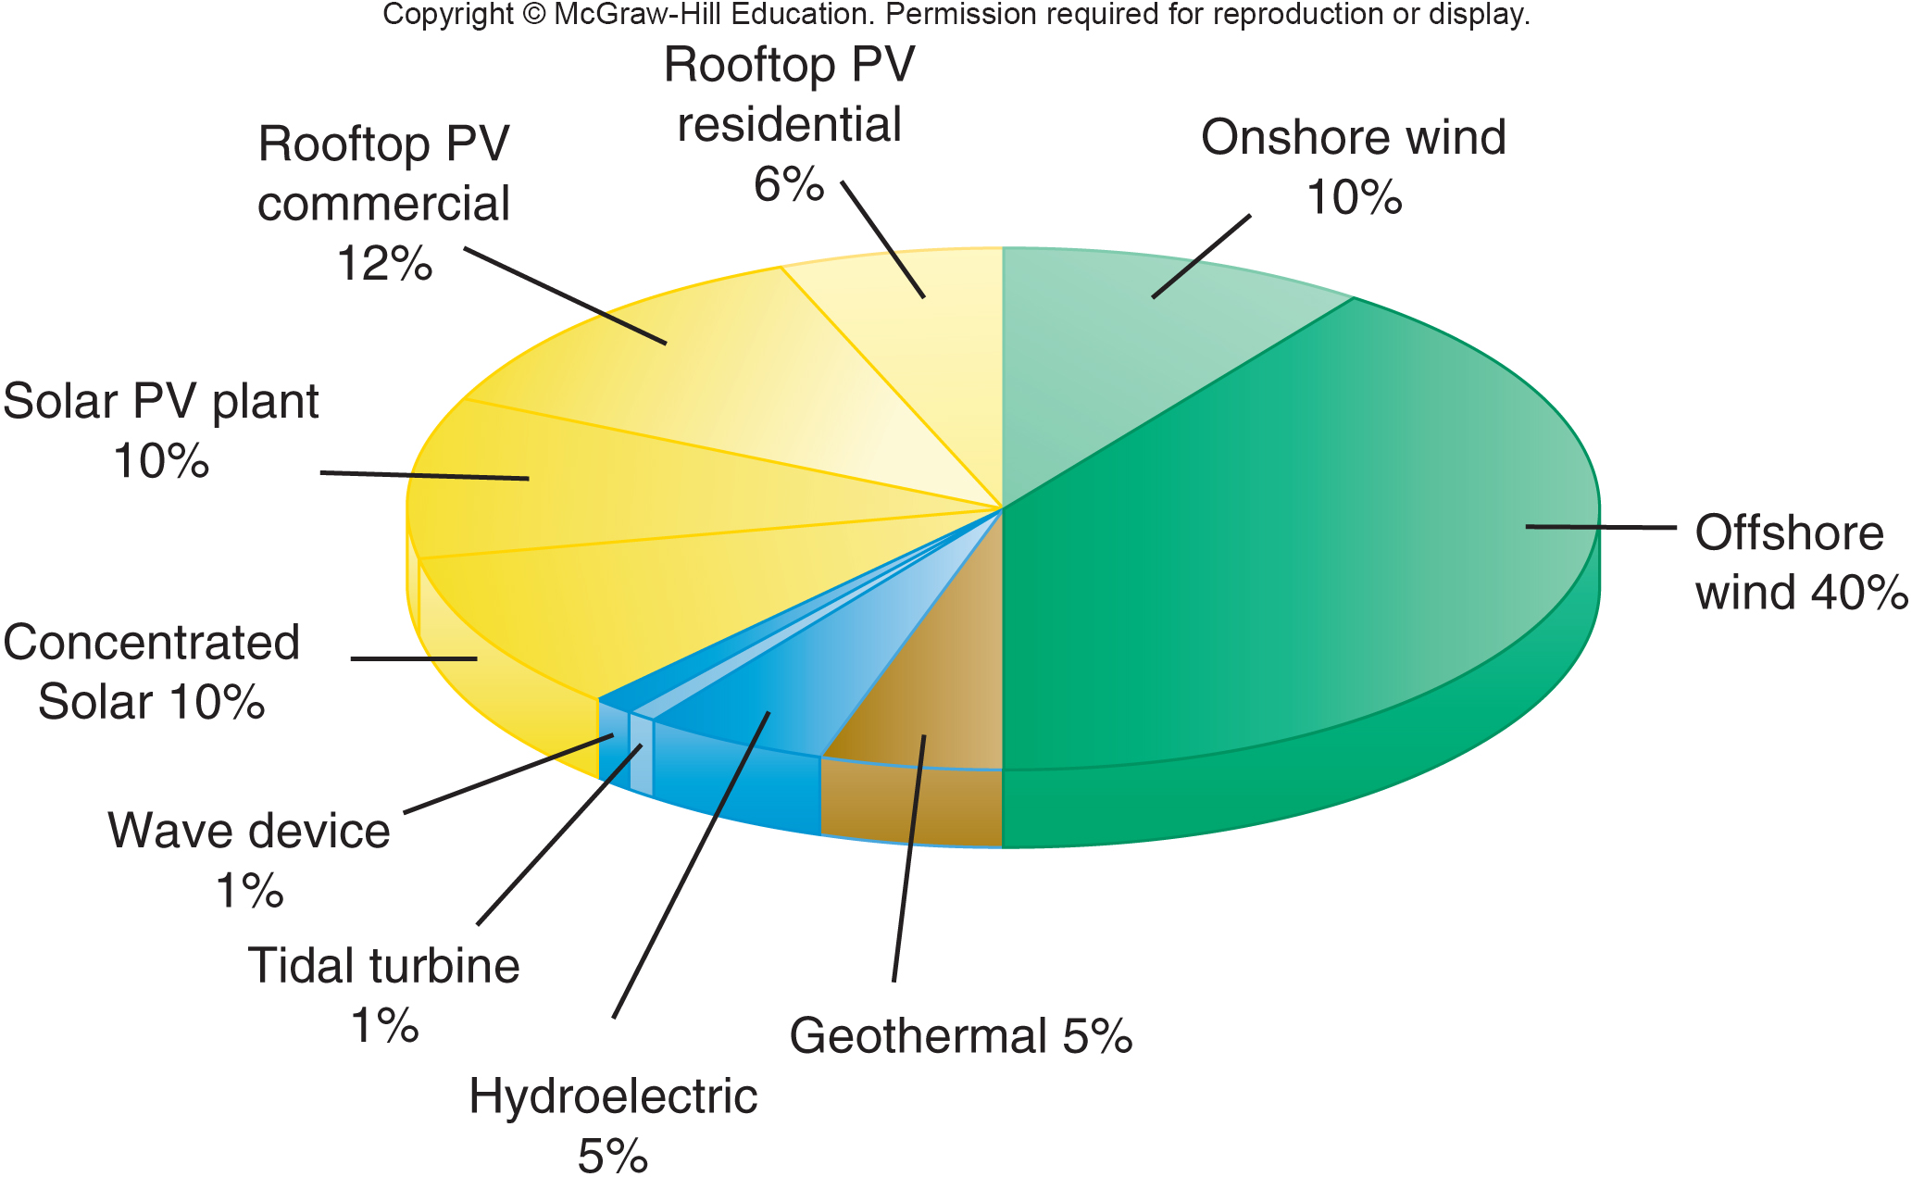
Wind, water & solar could save the climate
Notes:
Access to affordable and feasible technology is no longer the problem it once was. Renewable energy costs have plummeted as the market has grown, and many scenarios have been developed for converting to most or all energy production from renewable sources. Mark Jacobson and his colleagues, for example, outlined a strategy by which New York State could produce 100% of its energy with wind, water, and solar by 2030 (fig. 9.22). Like Pacala and Socolow’s approach, this plan relies on existing and feasible technologies. If environmental and health costs are included in accounting, as well as tax breaks and other subsidies for fossil fuels, these alternatives are substantially cheaper than conventional fuels.
Renewable energy has been a leading strategy for reducing climate change and for long-term energy stability, because global oil supplies are politically unstable and economically volatile. Sweden now produces 50 percent of its energy from renewable sources, including wind, geothermal, biomass, biogas (methane from garbage), fuel cells, and especially hydropower. Denmark, the world’s leader in wind power, has no hydropower and little sunshine, but now gets 30 percent of its electricity from windmills. Plans are to generate half of the nation’s electricity from offshore wind farms by 2030. Spain, El Salvador, and Germany have all had months where nearly all electricity was produced by renewables. China, the world’s fastest-growing economy, has promised to cut 10 percent of its CO 2 emissions per unit of economic output by shifting to renewable energy and conservation.

Slide 51
Carbon Capture Stores CO₂
but is Expensive
It is possible, though expensive, to store CO₂ by injecting it deep into geologic formations.
Since 1996, Norway’s Statoil has been pumping more than 1 million metric tons of CO₂ per year into an aquifer 1,000 m below the seafloor in the North Sea.
The pressurized CO₂ enhances oil recovery and saves on carbon taxes in Norway.
Around the world, deep, briny aquifers could store a century’s worth of CO₂ output at current fossil fuel consumption rates.
Notes:
Proponents of carbon management, as these various projects are called, argue that it may be cheaper to clean up fossil fuel effluents than to switch to renewable energy sources. By far, the easiest way to remove CO₂ from a coal-fired power plant is the integrated gasification combined cycle (IGCC) technology described in chapter 12. Geological formations around the world could hold hundreds of years’ worth of CO₂ at current production levels. These formations, however, aren’t necessarily near the sites where we now produce CO₂.
51

Slide 52
Conclusion
Temperatures are now higher than they have been in thousands of years, and climate scientists say that if we don’t reduce greenhouse gas emissions soon, drought, flooding of cities may be inevitable.
Exhaustive modeling and data analysis by climate scientists show that these changes can only be explained by human activity.
The “stabilization wedge” proposal is a list of immediate steps that could be taken to accomplish needed reductions in greenhouse gases.
Notes:
52

