Slide 1

Chapter 1
What Do We Mean by Leadership?
© McGraw-Hill Education. All rights reserved. Authorized only for instructor use in the classroom. No reproduction or further distribution permitted without the prior written consent of McGraw-Hill Education.

Slide 2
Chapter Outline
Introduction
Leadership
Leadership myths
The interactional framework for analyzing leadership
Illustrating the interactional framework: women in leadership roles
There is no simple recipe for effective leadership

Slide 3
What Is Leadership?
Lives of great men all remind us we can make our lives sublime and, departing, leave behind us footprints on the sands of time
Henry Wadsworth Longfellow

Slide 4
Profiles in Leadership
Sheikh Zayed bin Sultan Al Nahyan
Bill Gates
Alexander Hamilton
Lin-Manuel Miranda
Howard Schultz
Paul Revere

Slide 5
Leadership, 1
Complex phenomenon involving a leader, his or her followers, and the situation
Because of the complexity of leadership, leadership researchers have defined the concept in many different ways:
Process by which an agent induces a subordinate to behave in a desired manner
Directing and coordinating the work of group members
Interpersonal relation in which others comply because they want to, not because they have to

Slide 6
Leadership, 2
Process of influencing an organized group toward accomplishing its goals
Actions that focus resources to create desirable opportunities
Creating conditions for a team to be effective
The ability to engage employees, the ability to build teams, and the ability to achieve results
The first two represent the how and the latter the what of leadership
A complex form of social problem solving

Slide 7
Difference between Successful Managers and Effective Managers
Successful managers
Effective managers
Those promoted through the ranks
Spend more time in organizational socializing and politicking
Spend less time on traditional management responsibilities such as planning and decision making
Make real contributions to their organization’s performance

Slide 8
Leadership Is Both a Science and an Art
Bass and Stogdill’s Handbook of Leadership: Theory, Research, and Managerial Applications cites approximately 8,000 studies on leadership
Reflects the scope of the science of leadership
Leadership remains partly an art as well as a science
Some managers may be effective leaders without ever having taken a course or training program in leadership
Some scholars in the field of leadership may be relatively poor leaders themselves

Slide 9
Leadership Is Both Rational and Emotional, 1
Leadership includes actions and influences based on:
Reason and logic
Inspiration and passion
Since people are both rational and emotional, leaders use rational techniques and emotional appeals to influence followers
Leaders should weigh the rational and emotional consequences of their actions
Some leaders have been able to inspire others to deeds of great purpose and courage

Slide 10
Leadership Is Both Rational and Emotional, 2
Aroused feelings can be used either positively or negatively, constructively or destructively
Mere presence of a group causes people to act differently than when they are alone

Slide 11
Distinctions between Managers and Leaders
Managers:
Administer
Maintain
Control
Have a short-term view
Ask how and when
Imitate
Accept the status quo
Leaders:
Innovate
Develop
Inspire
Have a long-term view
Ask what and why
Originate
Challenge the status quo

Slide 12
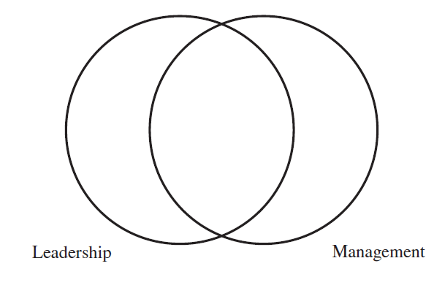
Figure 1.1: Leadership and Management Overlap

Slide 13
Leadership Myths, 1
Good leadership is all common sense
The term common sense is ambiguous
If leadership were simply common sense, then there would be fewer workplace problems

Slide 14
Leadership Myths, 2
Leaders are born, not made
Innate factors and formative experiences influence behavior and leadership
  Natural talents or characteristics may offer certain advantages or disadvantages to a leader
Research shows cognitive abilities and personality traits are partially innate
Different environments can nurture or suppress different leadership qualities

Slide 15
Leadership Myths, 3
The only school where leadership is learnt from is the school of hard knocks
Formal study and experiential learning complement each other
Formal study of leadership provides students with a variety of ways of examining a particular leadership situation
  Studying the different ways researchers have defined and examined leadership helps students use these definitions and theories to better understand what is going on in any leadership situation

Slide 16
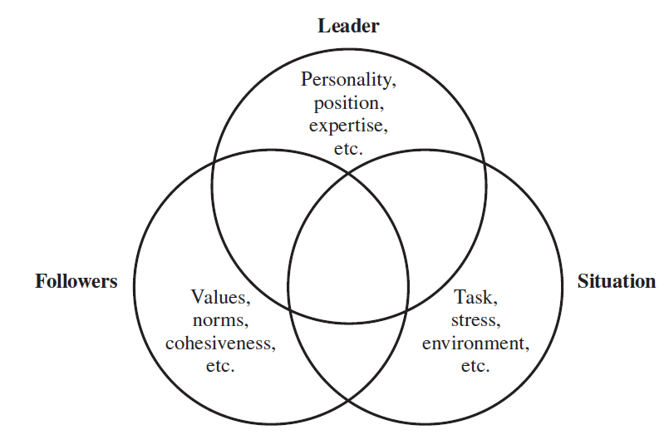
Figure 1.2: The Interactional Framework for Analyzing Leadership
Source: Adapted from E. P. Hollander, Leadership Dynamics: A Practical Guide to Effective Relationships (New York: Free Press, 1978).
Figure 1.2: The Interactional Framework for Analyzing Leadership, Appendix

Slide 17
The Interactional Framework for Analyzing Leadership
States that leadership is the result of a complex set of interactions among the leader, the followers, and the situation
Example: In-groups and out-groups
  In-groups: High degree of mutual influence and attraction between the leader and a few subordinates
    Subordinates feel a high degree of loyalty, commitment, and trust toward the leader
    Other subordinates belong to the out-group

Slide 18
Leader as an Individual, 1
Characteristics include:
Unique personal history
Interests
Character traits
Motivation
Effective leaders differ from their followers and from ineffective leaders on elements such as personality traits, cognitive abilities, skills, and values
Leaders are generally calm and are not prone to emotional outbursts

Slide 19
Leader as an Individual, 2
Leaders appointed by superiors may have less credibility and may get less loyalty
Leaders elected or emerging by consensus from ranks of followers are seen as more effective
Leader’s experience or history in a particular organization is usually important to her or his effectiveness
Leader’s legitimacy is affected by the extent of follower participation in a leader’s selection

Slide 20
Followers, 1
Both practitioners and scholars stress the relatedness of leadership and followership
Following aspects of followers affect the leadership process:
Expectations
Personality traits
Maturity levels
Levels of competence
Motivation

Slide 21
Followers, 2
Workers who share a leader’s goals and values, and who feel intrinsically rewarded for performing a job well may be more motivated
Following factors have significant implications:
Number of followers reporting to a leader
Followers’ trust and confidence in the leader

Slide 22
Followers, 3
Importance of the leader and follower relationship has undergone dynamic change for the following reasons:
Increased pressure to function with reduced resources
Trend toward greater power sharing and decentralized authority in organizations
Increase in complex problems and rapid changes in an organization

Slide 23
Followers, 4
Ways in which followers can take on new leadership roles and responsibilities in the future
Being proactive in their stance toward organizational problems
Contributing to the leadership process by becoming skilled at “influencing upward”
Staying flexible and open to opportunities
Alternative approach to understanding followership
Constructionist approach: Views leadership as combined acts of leading and following by different individuals, whatever their formal titles or positions in an organization may be

Slide 24
The Situation
Leadership makes sense in the context of how the leader and followers interact in a given situation
Most ambiguous aspect of the leadership framework

Slide 25
Illustrating the Interactional Framework: Women in Leadership Roles, 1
Women are taking on leadership roles in greater numbers than ever before
Problems that constrain the opportunity for capable women to rise to the highest leadership roles still exist

Slide 26
Illustrating the Interactional Framework: Women in Leadership Roles, 2
Findings from studies regarding problems that constrain women from gaining leadership roles
Mentors of women executives had less organizational influence and clout than did the mentors of their male counterparts
Compared to men, women’s trust in each other decreases when work situations become more professionally risky
Women’s commitment to the organizations they worked for was more guarded than that of their male counterparts
Strong masculine stereotype of leadership continues to exist in the workplace
Women are seen as less well suited to the requirements of leadership than men

Slide 27
Illustrating the Interactional Framework: Women in Leadership Roles, 3
Practice interactive leadership
Interactive leadership developed by women’s socialization experiences and career paths
Factors that explain the shift toward more women in leadership roles
Women themselves have changed
Leadership roles have changed
Organizational practices have changed
Culture has changed

Slide 28
Illustrating the Interactional Framework: Women in Leadership Roles, 4
Glass cliff: Female candidates for an executive position are more likely to be hired than equally qualified male candidates when an organization’s performance is declining
Challenge for women in addition to the glass ceiling
Reflects a greater willingness to put women in precarious positions

Slide 29
Things to Keep in Mind for Effective Leadership, 1
Leadership must always be assessed in the context of the leader, the followers, and the situation
Leaders may need to respond to:
Various followers differently in the same situation
Same followers differently in different situations

Slide 30
Things to Keep in Mind for Effective Leadership, 2
Followers may respond to:
Various leaders differently
Each other differently with different leaders
The right behavior in one situation is not necessarily the right behavior in another situation

Slide 31
Summary
Leadership is the process of influencing an organized group toward achieving its goals
Considerable overlap exists between leadership and management
Study of leadership must also include two other areas: the followers and the situation
Good leadership makes a difference, and it can be enhanced through greater awareness of the important factors influencing the leadership process

Slide 32
appendix

Slide 33
Figure 1.2: The Interactional Framework for Analyzing Leadership, Appendix
This Venn diagram consists of three circles that overlap each other. The circle on the top is labeled leader. The content in this circle reads personality, position, expertise, etcetera. The circle on the right is labeled situation. The content in this circle reads task, stress, environment, etcetera. The circle on the left is labeled followers. The content in this circle reads values, norms, cohesiveness, etcetera.
Jump back to Figure 1.2: The Interactional Framework for Analyzing Leadership

