Slide 1

Chapter 4
Power and Influence
© McGraw-Hill Education. All rights reserved. Authorized only for instructor use in the classroom. No reproduction or further distribution permitted without the prior written consent of McGraw-Hill Education.

Slide 2
Chapter Outline
Introduction
Important distinctions
Power and leadership
Influence tactics

Slide 3
Power and Influence
The true leader must submerge himself in the fountain of the people
V. I. Lenin, Leader of the 1917 Bolshevik Revolution

Slide 4
Important Distinctions, 1
Power: Capacity to produce effects on others or the potential to influence others
Function of the leader, the followers, and the situation
Does not need to be exercised in order to have its effect
Attributed to others on the basis and frequency of influence tactics they use and on their outcomes

Slide 5
Important Distinctions, 2
Influence: Change in a target agent’s attitudes, values, beliefs, or behaviors as the result of influence tactics
Influence tactics: One person’s actual behaviors designed to change another person’s attitudes, beliefs, values, or behaviors
Apart from leaders, followers can also wield power and influence over leaders as well as over each other

Slide 6
Important Distinctions, 3
Influence can be measured by the behaviors or attitudes manifested by followers as a result of a leader’s influence tactics
Leaders with high amounts of power can cause fairly substantial changes in subordinates’ attitudes and behaviors
Amount of power followers have in work situations can also vary dramatically
  Some followers may exert relatively more influence than the leader does in certain situations

Slide 7
Important Distinctions, 4
Individuals with a relatively large amount of power may successfully employ a wider variety of influence tactics
Followers often can use a wider variety of influence tactics than the leader
This is because the formal leader is not always the person who possesses the most power in a leadership situation

Slide 8
Sources of Leader Power
  Furniture arrangement
  Shape of the table used for meetings and seating arrangements
  Prominently displayed symbols
  Appearances of title and authority
  Choice of clothing
  Presence or absence of crisis

Slide 9
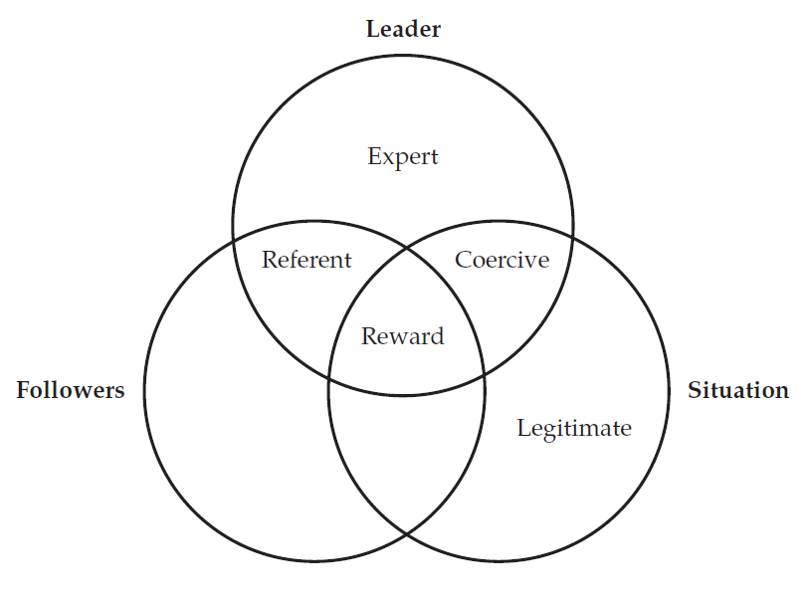
Figure 4.1: Sources of Leader Power in the Leader, Follower, and Situation Framework
Jump to Figure 4.1: Sources of Leader Power in the Leader, Follower, and Situation Framework, Appendix

Slide 10
French and Raven’s Bases of Social Power:
Expert Power
Power of knowledge
Some people are able to influence others with their relative expertise in particular areas
Followers may have more expert power than leaders at times
If different followers have considerably greater amounts of expert power, the leader may be unable to influence them using expert power alone

Slide 11
French and Raven’s Bases of Social Power:
Referent Power
Potential influence one has because of the strength of the relationship between the leader and the followers
Takes time to develop but can be lost quickly
Desire to maintain referent power may limit a leader’s actions in certain situations
The stronger the relationship, the more influence leaders and followers exert over each other
Followers with relatively more referent power than their peers are often spokespersons for their units and have more latitude to deviate from work-unit norms

Slide 12
French and Raven’s Bases of Social Power: Legitimate Power
Depends upon on a person’s organizational role or his or her formal or official authority
Allows exertion of influence through requests or demands deemed appropriate by virtue of one’s role and position
Holding a position and being a leader are not synonymous
Effective leaders often intuitively realize they need more than legitimate power to be successful
Followers can use their legitimate power, job descriptions, bureaucratic rules, or union policies to influence leaders

Slide 13
French and Raven’s Bases of Social Power:
Reward Power, 1
Involves the potential to influence others through control over desired resources
Potential to influence others through reward power is a joint function of the leader, the followers, and the situation
Problems associated with rewards
Overemphasizing performance rewards can lead to workers feeling resentful and manipulated
Extrinsic rewards such as praise or compensation may not have the same behavioral effects as intrinsic rewards such as personal growth and development
Rewards may produce compliance but not other desirable outcomes like commitment

Slide 14
French and Raven’s Bases of Social Power: Reward Power, 2
Leaders can enhance their ability to influence others based on reward power by:
Determining what rewards are available and most valued by subordinates
Establishing policies for the fair and consistent administration of rewards for good performance
Followers can exercise reward power over leaders by:
Controlling scarce resources
Modifying their level of effort based on the leader’s performance

Slide 15
French and Raven’s Bases of Social Power:
Coercive Power
Potential to influence others through the administration of negative sanctions or the removal of positive events
Reliance on this power has inherent limitations
Informal coercion can change the attitudes and behaviors of others
One of the most common forms of coercion is a superior’s temperamental outbursts
Followers that use coercive power to influence a leader’s behavior tend to have a relatively high amount of referent power among co-workers

Slide 16
Concluding Thoughts about French and Raven’s Power Taxonomy, 1
Leaders can usually exert more power during a crisis than during periods of relative calm
During a crisis, followers may be more eager to receive direction and control from leaders
Research indicates that leaders who rely on referent and expert powers have subordinates who:
Are more motivated and satisfied
Are absent less
Perform better

Slide 17
Concluding Thoughts about French and Raven’s Power Taxonomy, 2
Following generalizations can be made about power and influence:
  Effective leaders take advantage of all their sources of power
  Leaders in well-functioning organizations are open to being influenced by their subordinates
  Leaders vary in the extent to which they share power with subordinates
  Effective leaders generally work to increase their various power bases or become more willing to use their coercive power

Slide 18
Leader Motives, 1
People vary in their motivation to influence or control others
Need for power is expressed in the following ways:
  Personalized power is exercised for personal needs by selfish, impulsive, uninhibited individuals who lack self-control
  Socialized power is used for the benefit of others or the organization and involves self-sacrifice
Thematic Apperception Test, a projective personality test, can assess the need for power
Need for power is found to be positively related to various leadership effectiveness criteria

Slide 19
Leader Motives, 2
Leaders who are relatively uninhibited in their need for power will use power impulsively
Leaders with a high need for power but low activity inhibition may be successful in the short term, but the remainder of the organization may pay high costs for this success
Some followers have a high need for power, which can lead to tension between the leader and the follower

Slide 20
Leader Motives, 3
Individuals vary in their motivation to manage
Miner describes motivation to manage in terms of the following composites:
  Maintaining good relationships with authority figures
  Wanting to compete for recognition and advancement
  Being active and assertive
  Wanting to exercise influence over subordinates
  Being visibly different from followers
  Being willing to do routine administrative tasks

Slide 21
Leader Motives, 4
Miner’s Sentence Completion Scale or M S C S measures a person's motivation to manage
The overall composite M S C S score consistently predicts leadership success in hierarchical or bureaucratic organizations
Findings concerning need for power and motivation to manage have several implications for leadership practitioners
Not all individuals like being leaders
High need for power or motivation to manage does not guarantee leadership success

Slide 22
Leader Motives, 5
High need for socialized power and a high level of activity inhibition may be required for long-term leadership success
Followers and leaders differ in the need for power, activity inhibition, and motivation to manage

Slide 23
Types of Influence Tactics based on the Influence Behavior Questionnaire, 1
Rational persuasion: When logical arguments or factual evidence is used to influence others
Inspirational appeals: When a request or proposal is designed to arouse enthusiasm or emotions in targets
Consultation: When targets are asked to participate in planning an activity
Ingratiation: When an agent attempts to get a target in a good mood before making a request

Slide 24
Types of Influence Tactics based on the Influence Behavior Questionnaire, 2
Personal appeals: When a target is asked to do a favor out of friendship
Exchange: When a target is influenced through the exchange of favors
Coalition tactics: When agents seek the help of others to influence the target
Pressure tactics: When threats or persistent reminders are used to influence targets
Legitimizing tactics: When agents make requests based on their position or authority

Slide 25
Influence Tactics and Power, 1
A strong relationship exists between the relative power of agents and targets and the types of influence tactics used
Leaders with high referent power generally do not use legitimizing or pressure tactics
Leaders with only coercive or legitimate power tend to use coalition, legitimizing, or pressure tactics
Hard tactics are used when:
An influencer has the upper hand
Resistance is anticipated
The other person’s behavior violates important norms

Slide 26
Influence Tactics and Power, 2
Soft tactics are used when:
One is at a disadvantage
Resistance is expected
There is personal benefit if the attempt is successful
Rational tactics are used when:
Parties are relatively equal in power
Resistance is not anticipated
Benefits are organizational as well as personal

Slide 27
Influence Tactics and Power, 3
Using influence tactics is a social skill
Other ways to successfully influence superiors
Thoroughly preparing beforehand
Involving others for support or coalition tactics
Persisting through a combination of approaches
People select influence tactics as a function of their power relationship with another person
Relationship holds true universally across different social domains

Slide 28
A Concluding Thought about Influence Tactics
Leaders should pay attention to the actual influence tactics they use and why they believe particular methods are effective
Influence efforts intended to build others up more frequently lead to positive outcomes than influence efforts intended to put others down

Slide 29
Summary
By reflecting on their different bases of power, leaders may better understand how they can affect followers and even expand their power
Leaders can improve their effectiveness by finding ways to enhance the value of their personal contribution to their team
Leaders should discourage in-group and out-group rivalries from forming in the work unit
Exercise of power occurs primarily through the influence tactics leaders and followers use
Leadership practitioners should always consider why they are using a particular influence attempt before they actually use it

Slide 30
APPENDIX

Slide 31
Figure 4.1: Sources of Leader Power in the Leader, Follower, and Situation Framework, Appendix
Each of the three circles overlaps the other in a manner that it shares some of its area with another circle. The circle on the top is labeled leader. The circle on the bottom-left side is labeled followers, and the circle on the bottom-right side is labeled situation. The area where the bottom-left circle and the top circle overlap is labeled referent. The area where the bottom-right circle and the top circle overlap is labeled coercive. The area in the bottom-right circle that does not overlap with any other circle is labeled legitimate. The area in the top circle that does not overlap with any other circle is labeled expert. The area where the three circles overlap each other is labeled reward.
Jump back to Figure 4.1: Sources of Leader Power in the Leader, Follower, and Situation Framework

