Slide 1

Chapter 6
Leadership Attributes
© McGraw-Hill Education. All rights reserved. Authorized only for instructor use in the classroom. No reproduction or further distribution permitted without the prior written consent of McGraw-Hill Education.

Slide 2
Chapter Outline
Introduction
Personality traits and leadership
Personality types and leadership
Intelligence and leadership
Emotional intelligence and leadership

Slide 3
Leadership Attributes
Watch your thoughts, for they become words. Watch your words, for they become actions. Watch your actions, for they become habits. Watch your habits, for they become character. Watch your character, for it becomes your destiny.
Anonymous

Slide 4
Personality Traits and Leadership, 1
Personality has two meanings
Public reputation, or the impression a person makes on others
Identity, or how people see or define themselves
Most research about the relationship between personality and leadership success and effectiveness is based on the trait approach
Traits are recurring regularities or trends in a person’s behavior
Trait approach maintains that people behave the way they do because of the strengths of the traits they possess

Slide 5
Personality Traits and Leadership, 2
Personality traits are useful for explaining why people act fairly consistently in different situations
Knowing the differences in personality traits can help predict more accurately how people will tend to act in different situations
Leader behavior reflects an interaction between personality traits and various situational factors
  Traits play an important role in determining how people behave in unfamiliar, ambiguous, or weak situations
  Strong situations are governed by specific rules, demands, or organizational policies, which can minimize the effects that traits have on behavior
Strength of the relationship between personality traits and leadership effectiveness is inversely related to the relative strength of the situation

Slide 6
Table 6.1: The Five Factor or O C E A N Model of Personality
Factor | Behaviors or Items
Openness to experience | I like traveling to foreign countries I enjoy going to school
Conscientiousness | I enjoy putting together detailed plans I rarely get into trouble
Extraversion | I like having responsibility for others I have a large group of friends
Agreeableness | I am a sympathetic person I get along well with others
Neuroticism | I remain calm in pressure situations I take personal criticism well

Slide 7
Implications of the Five Factor or O C E A N Model, 1
Personality traits help explain leaders’ and followers’ tendencies to act in consistent ways over time
Behavioral manifestations of personality traits are often exhibited automatically and unconsciously
  Behaviors can be modified through experience, feedback, and reflection
The O C E A N model is useful in the following ways:
Helps leadership researchers categorize findings of the personality and leadership performance research
Helps in profiling leaders
Seems to be universally applicable across cultures

Slide 8
Implications of the Five Factor or O C E A N Model, 2
Personality traits:
Can be reliably categorized into the five major dimensions of the F F M
Are good measures of leadership potential
Can be used to make predictions about typical behavior at work
Tend to be difficult to change
Are exhibited automatically and without conscious thought
Predispose people to act in certain ways, but behaviors can be modified through experience, feedback, and reflection

Slide 9
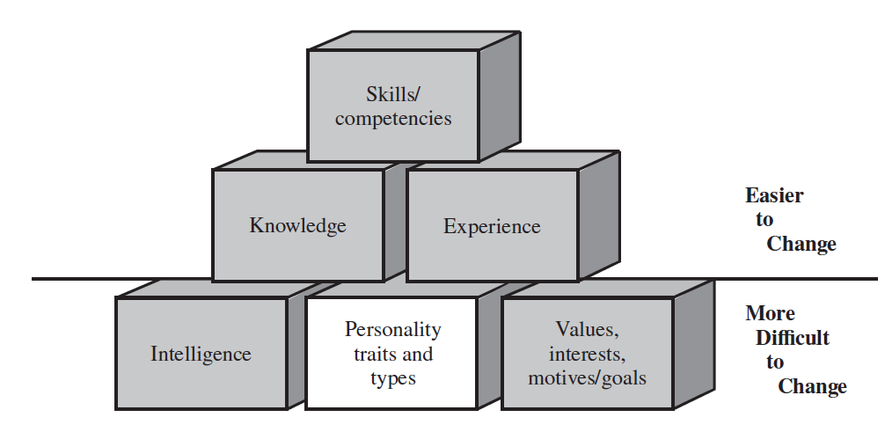
Figure 6.1: The Building Blocks of Skill
Jump to Figure 6.1: The Building Blocks of Skill,
Appendix

Slide 10
Differences between Traits and Types
An alternative framework to describe the differences in people’s day-to-day behavioral patterns is through types, or in terms of a personality typology
Types are thought of as relatively discrete categories
  Psychological typologies are often expressed in terms of polar opposites
    Typologies tend to put people into discrete psychological categories and emphasize the similarities among people in the same category and the differences between people of different types regardless of actual score

Slide 11
Myers-Briggs Type Indicator or M B T I, 1
Most popular measure of preferences
Used to better understand oneself, co-workers, partners in intimate relationships, children, and educational and occupational choices
People differ in the following preference dimensions:
  The extraversion and introversion dimension is concerned with where people get their energy
  The sensing and intuition dimension is concerned with how people look at data

Slide 12
Myers-Briggs Type Indicator or M B T I, 2
  The thinking and feeling is concerned with the considerations leaders prefer when making decisions
  The judging and perceiving dimension describes the amount of information needed before a leader is comfortable making a decision
Predominant preferences can be used to create 16 psychological types

Slide 13
Limitations of M B T I
It was based on the theory of Jungian psychological types, which has never been proven
The four preference dimensions omit critical aspects of personality, such as neuroticism
More people are likely to exhibit characteristics associated with ambiverts than they are to exhibit characteristics solely associated with Extraversion or Introversion
Types are not stable over time
The Forer effect: People tend to give high accuracy ratings to descriptive statements that are personally flattering but so vague that they could apply to virtually anyone

Slide 14
Intelligence
A person’s all-around effectiveness in activities directed by thought
Intelligence is relatively difficult to change because of heredity but can be modified with education and experience
Intelligent leaders:
  Are faster learners
  Make better assumptions, deductions, and inferences
  Are better at creating a compelling vision and strategizing to make their vision a reality
  Can develop better solutions to problems
  Can see more of the primary and secondary implications of their decisions

Slide 15
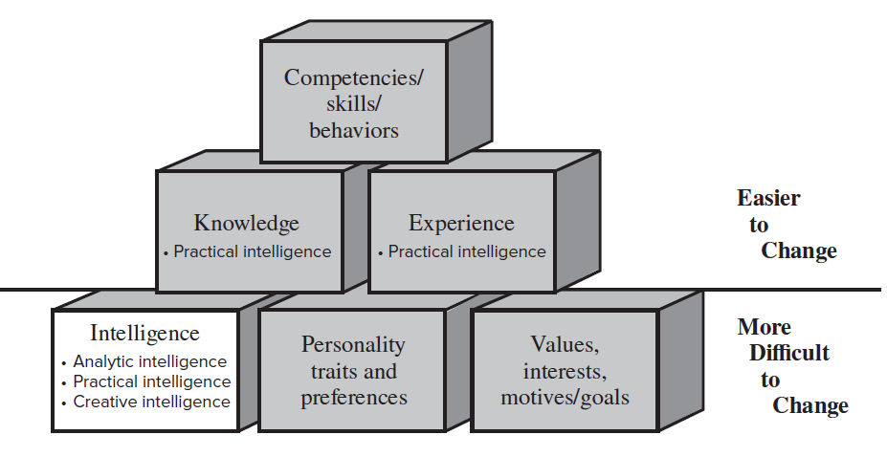
Figure 6.4: The Building Blocks Of Skills
Jump to Figure 6.4: The Building Blocks Of Skills, Appendix

Slide 16
Sternberg’s Triarchic Theory of Intelligence
Focuses on what a leader does when solving complex mental problems
Types of intelligence
Analytic intelligence: General problem-solving ability
Practical intelligence: Knowing how things get done and how to do them
Creative intelligence: Ability to produce novel and useful work
  Tests of creativity
    Tests that assess divergent thinking have many possible answers, and tests that assess convergent thinking have one single best answer

Slide 17
Implications of the Triarchic Theory of Intelligence, 1
Leadership effectiveness or emergence is positively correlated with analytic intelligence
Sometimes, personality is much more predictive of leadership emergence and effectiveness than analytic intelligence
In certain cases, analytic intelligence may have a curvilinear relationship with leadership effectiveness
Leaders’ primary role is to build an environment where others can be creative

Slide 18
Implications of the Triarchic Theory of Intelligence, 2
To improve the group and organizational factors affecting creativity, leaders should be mindful that:
  Various sorts of incentives or rewards can have various effects on creativity
  Creativity can be hindered if ideas will be evaluated
  In order to develop new products and services, the level of turnover should be low and goals should be clear

Slide 19
Table 6.3: Creativity Killers: How to Squelch the
Creativity of Direct Reports
Ways in Which Leaders Can Stifle the Creativity of Their Followers
Take away all discretion and autonomy
Create fragmented work schedules
Provide insufficient resources
Focus on short-term goals
Create tight timelines and rigid processes
Discourage collaboration and coordination
Keep people happy
Notes:
Rename table 6.3

Slide 20
Intelligence and Stress: Cognitive Resources Theory, or C R T, 1
Provides a conceptual scheme for explaining how leader behavior changes under stress levels to impact group performance
Key concepts of C R T: Intelligence, experience, stress, and group performance
Predictions
Greater experience but lower intelligence may account for higher-performing groups in high-stress conditions
Leaders with high levels of experience may misapply old solutions when situations require creative solutions

Slide 21
Intelligence and Stress: Cognitive Resources Theory, or
C R T, 2
Problematic issues concerning C R T
There is apparent dichotomy between intelligence and experience
Ability of leaders to tolerate stress differs
Leadership implications of C R T
Best leaders are often smart and experienced
Leaders may be unaware of the degree to which they are causing stress in their followers
Level of stress inherent in the position needs to be understood before selecting leaders

Slide 22
Emotional Intelligence, 1
Term is attributed to Peter Salovey and John Mayer
Models
Ability model: Focuses on how emotions affect the way leaders think, decide, plan, and act
  Defines emotional intelligence as the ability to:
    Accurately perceive one’s own and others’ emotions
    Generate emotions to facilitate thought and action
    Accurately understand the causes of emotions and the meanings they convey
    Regulate one’s emotions

Slide 23
Emotional Intelligence, 2
Mixed model: Provides a broader and more comprehensive definition of emotional intelligence than the ability model because it includes more leadership qualities
  More popular among human resource professionals than the ability model but is no more predictive of job performance than O C E A N assessments

Slide 24
Ability and Mixed Models of Emotional Intelligence, 1
Ability Model Mayer, Salovey, and Caruso | Mixed Models Goleman et al. | Mixed Models Bar-On
Perceiving emotions | Self-awareness: Emotional awareness, accurate self-assessment, and self-confidence | Intrapersonal: Self-regard, emotional self-awareness, assertiveness, independence, and self-actualization
Managing emotions | Self-regulation: Self-control, trustworthiness, conscientiousness, adaptability, and innovation | Adaptability: Reality testing, flexibility, and problem solving
Using emotions | Motivation: Achievement, commitment, initiative, and optimism | Stress management: Stress tolerance and impulse control
Sources: R. Bar-On, Emotional Quotient Inventory (North Tonawanda, NY: Multi-Health Systems, 2001); D. Goleman, Working with Emotional Intelligence (New York: Bantam Doubleday Dell, 1998); D. R. Caruso, J. D. Mayer, and P. Salovey, “Emotional Intelligence and Emotional Leadership,” in Multiple Intelligences and Leadership, ed. R. E. Riggio, S. E. Murphy, and F. J. Pirozzolo (Mahwah, NJ: Lawrence Erlbaum Associates, 2002), pp. 55–74, http:// www.eiconsortium.org

Slide 25
Ability and Mixed Models of Emotional Intelligence, 2
Ability Model Mayer, Salovey, and Caruso | Mixed Models Goleman et al. | Mixed Models Bar-On
Understanding emotions | Empathy: Understanding others , developing others, service, orientation, diversity, and political awareness Social skills: Influence, communication, conflict management, leadership, change catalyst, building bonds, collaboration or cooperation, and team capabilities | Interpersonal: Empathy, social responsibility, and interpersonal relationship General mood: Optimism and happiness
Sources: R. Bar-On, Emotional Quotient Inventory (North Tonawanda, NY: Multi-Health Systems, 2001); D. Goleman, Working with Emotional Intelligence (New York: Bantam Doubleday Dell, 1998); D. R. Caruso, J. D. Mayer, and P. Salovey, “Emotional Intelligence and Emotional Leadership,” in Multiple Intelligences and Leadership, ed. R. E. Riggio, S. E. Murphy, and F. J. Pirozzolo (Mahwah, NJ: Lawrence Erlbaum Associates, 2002), pp. 55–74, http:// www.eiconsortium.org

Slide 26
Comparison between the O C E A N Model and
Goleman’s Model of E Q, 1
Goleman et al. | Likely O C E A N Correlates
Self-awareness Emotional awareness Accurate self-assessment Self-confidence | Agreeableness Neuroticism Extraversion
Self-regulation Self-control Trustworthiness Conscientiousness Adaptability Innovation | Neuroticism, conscientiousness Conscientiousness Conscientiousness Neuroticism, conscientiousness Openness to experience, conscientiousness
Motivation Achievement Commitment Initiative Optimism | Extraversion Extraversion Extraversion Neuroticism

Slide 27
Comparison between the O C E A N Model and
Goleman’s Model of E Q, 2
Goleman et al. | Likely O C E A N Correlates
Empathy Understanding others Developing others Service orientation Diversity Political awareness | Agreeableness Openness to experience Agreeableness Agreeableness Agreeableness
Social skills Influence Communication Conflict management Leadership Change catalyst Building bonds Collaboration or cooperation Team capabilities | Extraversion, agreeableness Extraversion Agreeableness Extraversion Extraversion Agreeableness Agreeableness Extraversion, agreeableness

Slide 28
Measuring Emotional Intelligence
Mayer, Salovey, and Caruso’s Emotional Intelligence Test
Measure of the ability model of emotional intelligence
Bar-On’s self, self and other, youth, and organizational measures of emotional intelligence
Goleman’s Emotional Competence Inventory, or E C i
Consists of 10 questionnaires to be completed by the individual and nine others

Slide 29
Implications of Emotional Intelligence
Shows that people can be extremely ineffective when their thoughts, feelings, and actions are misaligned
Popularized the idea that noncognitive abilities can play important roles in leadership success
Helped bring emotion back to the workplace
Moderates employees’ reactions to job insecurity and their coping ability toward stress when threatened with job loss
E Q attributes are personality traits and would be difficult to change using training

Slide 30
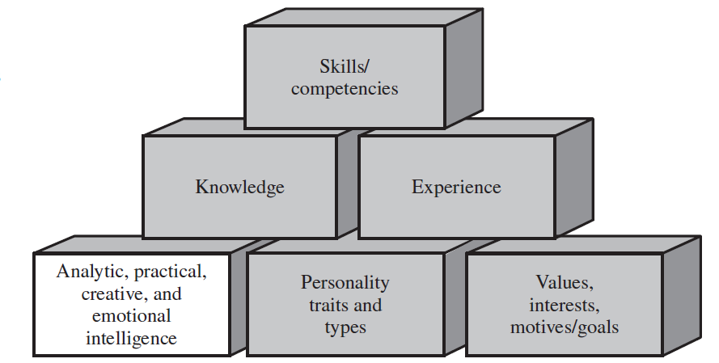
Figure 6.6: Emotional Intelligence and the Building Blocks Of Skills
Jump to Figure 6.6: Emotional Intelligence and the Building Blocks Of Skills, Appendix

Slide 31
Summary
Personality, intelligence, and emotional intelligence can help a leader influence a group toward the accomplishment of its goals
The term personality has many different meanings, but we use the term to describe one’s characteristic patterns of behavior
Research suggests a positive correlation between leadership success and the O C E A N personality dimensions
Analytic intelligence, practical intelligence, and creative intelligence theories help in understanding intelligence
Leaders who possess emotional intelligence may be more effective

Slide 32
Appendices

Slide 33
Figure 6.1: The Building Blocks of Skill, Appendix
A horizontal line separates the bottom row of boxes from the top two rows. The area above the horizontal line is labeled easier to change. The area below the horizontal line is labeled more difficult to change. The bottom row has three boxes. Starting from the left, the first box is labeled intelligence. The second box is labeled personality traits and types. The third box is labeled values, interests, motives slash goals. The second row from the bottom contains two boxes. The first box is labeled knowledge. The second box is labeled experience. The topmost row contains one box. It is labeled skills slash competencies.
Jump Back to Figure 6.1: The Building Blocks of Skill

Slide 34
Figure 6.4: The Building Blocks Of Skills, Appendix
A horizontal line separates the bottom row of boxes from the top two rows. The area above the horizontal line is labeled easier to change. The area below the horizontal line is labeled more difficult to change. The bottom row has three boxes. Starting from the left, the first box is labeled intelligence. The points listed below the label are analytical intelligence, practical intelligence, and creative intelligence. The second box is labeled personality traits and preferences. The third box is labeled values, interests, motives slash goals. The second row from the bottom contains two boxes. The first box is labeled knowledge. The point below this label reads practical intelligence. The second box is labeled experience. The point below this label reads practical intelligence. The topmost row contains one box. It is labeled competencies slash skills slash behaviors.
Jump Back to Figure 6.4: The Building Blocks Of Skills, Appendix

Slide 35
Figure 6.6: Emotional Intelligence and the
Building Blocks Of Skills, Appendix
Starting from the bottom, the first row has three boxes. Starting from the left, the first box is labeled analytical, practical, creative, and emotional intelligence. The second box is labeled personality traits and types. The third box is labeled values, interests, motives slash goals. The second row contains two boxes. The first box is labeled knowledge. The second box is labeled experience. The third and topmost row contains one box. It is labeled skills slash competencies.
Jump Back to Figure 6.6: Emotional Intelligence and the Building Blocks Of Skills, Appendix

