Slide 1
Globalization
Chapter 1

Slide 2
What Is Globalization?
Globalization refers to the shift toward a more integrated and interdependent world economy.
Globalization facets
  The globalization of markets (Downstream)
    The merging of historically distinct and separate national markets into one huge global marketplace.
The globalization of production (Upstream)
  The sourcing of goods and services from locations around the globe to take advantage of national differences in the cost and quality of factors of production (such as labor, energy, land, and capital).

Slide 3
The Globalization of Markets
Falling barriers to cross-border trade and investment have made it easier to sell internationally
The tastes and preferences of consumers in different nations are beginning to converge on some global norm, thereby helping create a global market.
  Consumer products such as, Coca-Cola soft drinks, video games, McDonald’s hamburgers, Starbucks coffee, and Apple iPhones are frequently held up as prototypical examples of this trend.
  Products that serve universal needs are global
    Aluminum, oil, and wheat, microprocessors, DRAMs (computer memory chips), and commercial jet aircraft

Slide 4
The Globalization of Markets
It is important not to push too far the view that national markets are giving way to the global market.
  significant differences still exist among national markets along many relevant dimensions, including consumer tastes and preferences, distribution channels, and cultures.
Benefits small and large companies
  In the United States, for example, according to the International Trade Administration, more than 300,000 small and medium-size firms exported in 2017, accounting for 33 percent of the value of U.S. exports of manufactured goods

Slide 5
The Globalization of Production
The sourcing of goods and services from locations around the globe to take advantage of national differences in the cost and quality of factors of production (such as labor, energy, land, and capital).

Slide 6
The Globalization of Production
Early outsourcing was confined to manufacturing
Increasingly, however, companies are taking advantage of modern communications technology, particularly the Internet, to outsource service activities to low-cost producers in other nations.
  The Internet has allowed hospitals to outsource some radiology work to India, where images from MRI scans and the like are read at night while U.S. physicians sleep.
  Many software companies use Indian engineers to perform test functions on software designed in the United States.

Slide 7
Boeing’s 777
Eight Japanese suppliers make parts for the fuselage, doors, and wings
A supplier in Singapore makes the doors for the nose landing gear
Three suppliers in Italy manufacture wing flaps
In total, some 30 percent of the 777, by value, is built by foreign companies.
For its most recent jet airliner, the 787, Boeing has pushed this trend even further
  Some 65 percent of the total value of the aircraft is outsourced to foreign companies, 35 percent of which goes to three major Japanese companies.

Slide 8
The Globalization of Production
But as with the globalization of markets, companies must be careful not to push the globalization of production too far
Substantial impediments still make it difficult for firms to achieve the optimal dispersion of their productive activities to locations around the globe
formal and informal barriers to trade
barriers to foreign direct investment
transportation costs
issues associated with economic and political risk
the sheer managerial challenge of coordinating a globally dispersed supply chain

Slide 9
The Emergence of Global Institutions
As globalization of markets and production grows, institutions are needed to help
  manage, regulate, and police the global marketplace
  promote the establishment of multinational treaties to govern the global business system.

Slide 10
The Emergence of Global Institutions
General Agreement on Tariffs and Trade (GATT)
World Trade Organization
International Monetary Fund
The World Bank
The United Nations

Slide 11
The World Trade Organization
The WTO (like the GATT before it) is primarily responsible for policing the world trading system and making sure nation-states adhere to the rules laid down in trade treaties signed by WTO member states.
As of 2017, 164 nations that collectively accounted for 98 percent of world trade were WTO members, thereby giving the organization enormous scope and influence.

Slide 12
The World Trade Organization
Without an institution such as the WTO, the globalization of markets and production is unlikely to have proceeded as far as it has.
However, critics charge that the organization is usurping the national sovereignty of individual nation-states.

Slide 13
The International Monetary Fund
World Bank is about growth and stability
The IMF exists primarily to stabilize exchange rates and maintain order in the international monetary system
IMF is a fund
  Meaning it has a pool of money given to it by 182 member countries in the past and just lends out of that fund.
  It doesn't usually borrow new money.

Slide 14
The International Monetary Fund
Often, a loan provided by the IMF as a form of "rescue" for countries in serious debt ultimately only stabilizes international trade and eventually results in the country repaying the loan at rather hefty interest rates.

Slide 15
The International Monetary Fund
IMF loans come with strings attached
In return for loans, the IMF requires nation-states to adopt specific economic policies (e.g., austerity programs, tax reforms, monetary reform) aimed at returning their troubled economies to stability and growth
These requirements have sparked controversy.
  By telling national governments what economic policies they must adopt, the IMF, like the WTO, is usurping the sovereignty of nation-states.
Notes:
Contingent conditions

Slide 16
The World Bank
To reduce poverty and promote long-term economic development
It accomplishes this by making technical and financial support available to countries
Focused on making low-interest loans to cash-strapped governments in poor nations that wish to undertake significant infrastructure investments.
For example, you go to the World Bank when you want to build a dam or power plant or a road.

Slide 17
The World Bank
World Bank is a bank
  Meaning it borrows money from investors around the world and then lends to the poor governments that are building projects.

Slide 18
Drivers of Globalization
Declining Trade and Investment Barriers
Technological Change

Slide 19
Declining Trade and Investment Barriers
Many of the barriers to international trade took the form of high tariffs on imports of manufactured goods.
The typical aim of such tariffs was to shield domestic companies and their workers from foreign competition.
One consequence, however, was “beggar thy neighbor” retaliatory trade policies, with countries progressively raising trade barriers against each other.
Adam Smith considered the protectionist economic policies a zero-sum understanding of the market, encouraging nations to beggar each other in order to increase economic gain

Slide 20
Declining Trade and Investment Barriers
Ultimately, high trade barriers depressed world demand and contributed to the Great Depression of the 1930s
Having learned from this experience, the advanced industrial nations committed themselves after WWII to progressively reducing barriers to the free flow of goods, services, and capital among nations

Slide 21
Declining Trade and Investment Barriers
Average Tariff Rates on Manufactured Products as Percentage of Value
 | 1913 | 1950 | 1990 | 2017
France | 21% | 18% | 5.9% | 1.6%
Germany | 20 | 26 | 5.9 | 1.6
Italy | 18 | 25 | 5.9 | 1.6
Japan | 30 | - | 5.3 | 1.4
United Kingdom | - | 23 | 5.9 | 1.6
United States | 44 | 14 | 4.8 | 1.6

Slide 22
Knowledge Society and Trade Agreements
The value of world trade in merchandised goods has grown consistently faster than the growth rate in the world economy since 1950.
The chart shows that this growth has been markedly higher since the turn of the century.
World Trade across country borders is 2.6 times higher than world production.

Slide 23
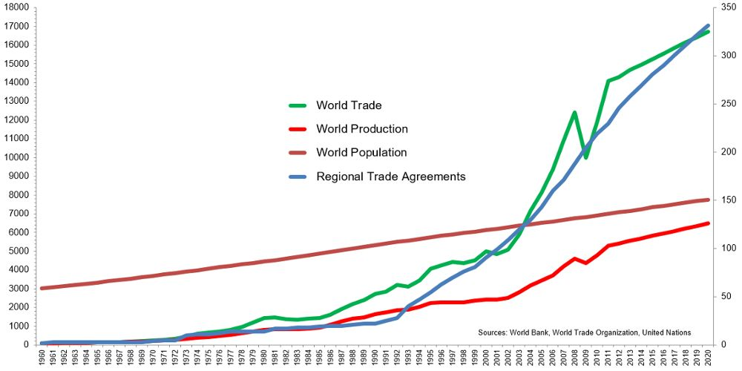
Value of world trade, world production, number of regional trade agreements in force, and world population from 1960 to 2020 (index 1960 = 100)

Slide 24
Knowledge Society and Trade Agreements
The difference in the growth rates of world production and world trade is why studying international business is so important.
While we produce more goods and services today compared with before, a far greater proportion of that production is being traded across national borders than at any time in modern history.
The knowledge society that we live in has resulted in consumers knowing more than ever about goods and services being produced worldwide.
This is driving demand for internationally traded goods.

Slide 25
Knowledge Society and Trade Agreements
The fact that the volume of world trade has been growing faster than world GDP implies several things.
  More firms are doing what Boeing does with the 777 and 787: dispersing parts of their production process to different locations around the globe to drive down production costs and increase product quality
  The economies of the world’s nation-states are becoming increasingly dependent on each other for important goods and services

Slide 26
    Removal of Restrictions to FDI
Foreign direct investment (FDI) occurs when a firm invests resources in business activities outside its home country.
Despite the recent wave of nationalism around the world (e.g., Brexit, 2016 U.S. presidential election), many countries have been progressively removing restrictions to foreign direct investment over the past 20 years.
The average yearly outflow of FDI increased from $14 billion in 1970 to $1.45 trillion in the most recent year, 2016

Slide 27
More Trade Agreements
Another important facilitator of trade across country borders is the increased number of trade agreements that have been implemented in the world.

Slide 28
Declining Trade and Investment Barriers
The globalization of markets and production and the resulting growth of world trade, foreign direct investment, and imports all imply that firms are finding their home markets under attack from foreign competitors.

Slide 29
Declining Trade and Investment Barriers
However, declining barriers to cross-border trade and investment cannot be taken for granted.
Nationalism and the global financial crisis of 2008–2009 and the associated drop in global output that occurred led to more calls for trade barriers to protect jobs at home.
Although a return to the restrictive trade policies of the 1920s and 1930s is unlikely, it is not clear whether the political majority in the industrialized world favors further reductions in trade barriers.

Slide 30
Role of Technological Change
The lowering of trade barriers made globalization of markets and production a theoretical possibility.
Technological change has made it a tangible reality

Slide 31
Communications
Perhaps the single most important innovation since World War II has been the development of the microprocessor, which enabled the explosive growth of high-power, low-cost computing, vastly increasing the amount of information that can be processed by individuals and firms.
The microprocessor also underlies many recent advances in telecommunications technology such as wireless technologies, and the Internet

Slide 32
Communications
The cost of microprocessors continues to fall, while their power increases (a phenomenon known as Moore’s law, which predicts that the power of microprocessor technology doubles while the costs are halved. every 18 months)
Notes:
the number of transistors on a chip doubles every 18 months while the costs are halved.

Slide 33
Internet of Things
In North America alone, e-commerce retail sales will surpass $520 billion in 2020 (up from almost nothing in 1998), while global e-commerce sales surpassed $2 trillion for the first time in 2017

Slide 34
Internet of Things
It allows businesses, both small and large, to expand their global presence at a lower cost than ever before.
The Internet makes it much easier for buyers and sellers to find each other, wherever they may be located and whatever their size (globalization of markets).
It enables enterprises to coordinate and control a globally dispersed production system in a way that was not possible 25 years ago (globalization of production).

Slide 35
  Transportation Technology
Several major innovations in transportation technology have occurred since the 1950s.
  The development of commercial jet aircraft and super freighters
  The introduction of containerization

Slide 36
Transportation Technology
  The advent of commercial jet reduced the time needed to get from one location to another.
  In terms of travel time, New York is now “closer” to Tokyo than it was to Philadelphia in the colonial days.

Slide 37
Transportation Technology
Containerization has revolutionized the transportation business, significantly lowering the costs of shipping goods over long distances.
Before the advent of containerization, moving goods from one mode of transport to another was very labor intensive, lengthy, and costly.

Slide 38
The Changing Demographics of the
Global Economy
The Changing World Output and World Trade Picture
The Changing Foreign Direct Investment Picture
The Changing Nature of the Multinational Enterprise
The Changing World Order

Slide 39
The Changing World Output and World Trade Picture
In the early 1960s, the United States was the world’s dominant industrial power in the world economy and world trade picture; accounted for 38.3 percent of world output.
By 2018, the United States accounted for 15.8 percent of world output, with China now at 17.1 percent of world output.
The change in the U.S. position was not an absolute decline because the U.S. economy grew significantly between 1960 and 2018).
Rather, it was a relative decline, reflecting the faster economic growth of several other economies, particularly China and BRIC countries.

Slide 40
The Changing Foreign Direct Investment Picture
U.S. firms accounted for 66.3 percent of worldwide foreign direct investment flows in the 1960s.
  The second-largest source country was Japan with 16.6 percent of the largest multinationals.
  The motivation for much of this foreign direct investment by non-U.S. firms was the desire to disperse production activities to optimal locations.
  Beginning in the 1970s, European and Japanese firms began to shift labor-intensive manufacturing operations from their home markets to developing nations where labor costs were lower.
  In addition, many Japanese firms invested in North America and Europe—often as a hedge against unfavorable currency movements and the possible imposition of trade barriers.

Slide 41
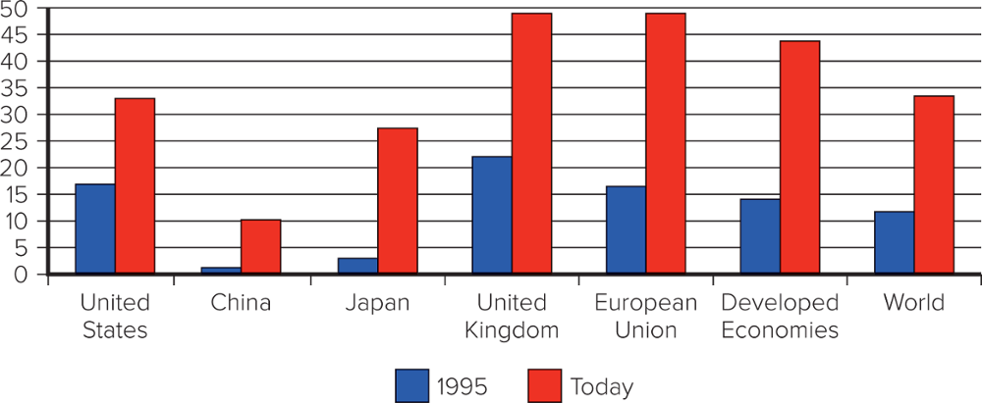
Share of FDI stock outward as a percentage of GDP.
In all cases in the Figure, we invest more today outside of our own country than we did in 1995.
Sources: OECD data 2017, FDI stocks.
Notes:
(The stock of foreign direct investment (FDI) refers to the total cumulative value of foreign investments as a percentage of the country’s GDP.)

Slide 42
The Changing Nature of the Multinational Enterprise
In the 1960s, global business activity was dominated by large U.S. multinational enterprise (MNE) which accounted for about two-thirds of foreign direct investment during the 1960s,.
A multinational enterprise (MNE) is any business that has productive activities in two or more countries.

Slide 43
The Changing Nature of the Multinational Enterprise
Two notable trends in the demographics of the multinational enterprise have been
  the rise of non-U.S. multinationals
    By 2017, things had shifted. Some 27 percent, or 540 firms, of the top 2000 global firms are now U.S. multinationals,
  the growth of small and medium-sized multinationals (mini-multinationals).
    The rise of the Internet is lowering the barriers that small firms face in building international sales.

Slide 44
The Changing World Order
For half a century, former communist countries were essentially closed to Western international businesses.
Now, they present a host of export and investment opportunities.
Two decades later, the economies of many of the former communist states are still relatively undeveloped, and their continued commitment to democracy and market-based economic systems cannot be taken for granted.

Slide 45
The Changing World Order
China represents a huge and largely untapped market.
  between 1983 and 2017, annual foreign direct investment in China increased from less than $2 billion to $249.8 billion annually.
For decades, most Latin American countries were ruled by dictators
  In the past two decades, much of this has changed throughout most of Latin America
    debt and inflation are down
    governments have sold state-owned enterprises to private investors
    foreign investment is welcomed

Slide 46
The Globalization Debate
Is the shift toward a more integrated and interdependent global economy a good thing?
Many influential economists, politicians, and business leaders seem to think so.
They argue that falling barriers to international trade and investment are the twin engines driving the global economy toward greater prosperity
  result in lower prices for goods and services
  stimulates economic growth
  raises the incomes of consumers
  helps create jobs in all countries that participate in the global trading system

Slide 47
The Globalization Debate
Despite the existence of a compelling body of theory and evidence, globalization has its critics
  Antiglobalization Protests
  Globalization, Jobs, and Income
  Globalization, Labor Policies, and the Environment
  Globalization and the World’s Poor

Slide 48
Antiglobalization Protests
Protesting against a wide range of ills that could be laid at the feet of globalization
  job losses in industries under attack from foreign competitors
  downward pressure on the wage rates of unskilled workers
  environmental degradation
  the cultural imperialism of global media and multinational enterprises, which was seen as being dominated by what some protesters called the “culturally impoverished” interests and values of the United States

Slide 49
Antiglobalization Protests
Indeed, the strong support for President Donald Trump in the 2016 U.S. election was primarily based on his repeated assertions that trade deals had
  exported U.S. jobs overseas
  created unemployment and low wages in America.
Both theory and evidence suggest that many of these fears are exaggerated.

Slide 50
Globalization, Jobs, and Income
Critics of globalization argue:
  Falling trade barriers allow firms to move manufacturing activities to countries where wage rates are much lower
    Destroy manufacturing jobs in wealthy advanced economies
  Services also being outsourced
    Contributing to higher unemployment and lower living standards in their home nations

Slide 51
Globalization, Jobs, and Income
Supporters argue:
  Benefits outweigh the costs
  Free trade will result in countries specializing in the production of goods and services that they can produce most efficiently, while importing goods and services that they cannot produce as efficiently
    As a result, the whole economy is better off

Slide 52
Globalization, Jobs, and Income
When a country embraces free trade, there is always some dislocation—lost textile jobs at Harwood Industries or lost call-center jobs at Dell.
According to this view, it makes little sense for the United States to produce textiles at home when they can be produced at a lower cost in China. Importing textiles from China leads to lower prices for clothes in the United States, which enables consumers to spend more of their money on other items.
At the same time, the increased income generated in China from textile exports increases income levels in that country, which helps the Chinese purchase more products produced in the United States, such as pharmaceuticals from Amgen, Boeing jets, microprocessors made by Intel, Microsoft software, and Cisco routers.

Slide 53
Globalization, Jobs, and Income
The data suggest that over the past two decades, the share of labor in national income has declined.
However, the share of national income enjoyed by skilled labor has actually increased, suggesting that the fall in labor’s share has been due to a fall in the share taken by unskilled labor.
Real wages for unskilled workers have decreased while real wages for skilled workers have increased.

Slide 54
Globalization, Jobs, and Income
    Technological change has a bigger impact than globalization on declining share of national income enjoyed by labor
    A shift within advanced economies away from jobs where the only qualification was a willingness to turn up for work every day and toward jobs that require significant education and skills.
This suggests that a solution to the problem of slow real income growth among the unskilled is to be found not in limiting free trade and globalization but in increasing society’s investment in education to reduce the supply of unskilled workers.

Slide 55
Globalization, Labor Policies, and the Environment
Globalization critics often argue that adhering to labor and environmental regulations
  significantly increases the costs of manufacturing enterprises and puts them at a competitive disadvantage in the global marketplace vis-à-vis firms based in developing nations that do not have to comply with such regulations.
  encourages firms from advanced nations to move manufacturing facilities to less developed countries that lack adequate regulations to protect labor and the environment.

Slide 56
Globalization, Labor Policies, and the Environment
Supporters of free trade argue that tougher environmental regulations and stricter labor standards go hand in hand with economic progress.
In general, as countries get richer, they enact tougher environmental and labor regulations (see the Figure next).
While the hump-shaped relationship depicted in the Figure seems to hold across a wide range of pollutants—from sulfur dioxide to lead concentrations and water quality—carbon dioxide emissions are an important exception, rising steadily with higher-income levels.

Slide 57
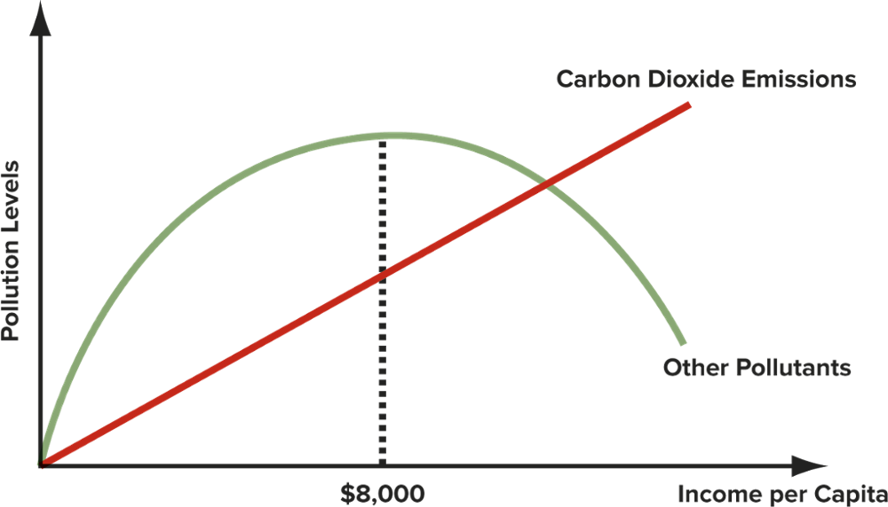
Income Levels and Environmental Pollution
Source: C. W. L. Hill and G. T. M. Hult, Global Business Today (New York: McGraw-Hill Education, 2018).
Notes:
While the hump-shaped relationship depicted in the Figure seems to hold across a wide range of pollutants—from sulfur dioxide to lead concentrations and water quality—carbon dioxide emissions are an important exception, rising steadily with higher-income levels.

Slide 58
Globalization and National Sovereignty
Globalization is criticized because it shifts economic power away from national governments and toward supranational organizations such as the World Trade Organization, the European Union, and the United Nations.
Many economists and politicians maintain that the power of supranational organizations such as the WTO is limited to what nation-states collectively agree to grant

Slide 59
Globalization and the World’s Poor
Critics of globalization argue that over the past 100 years or so the gap between the rich and poor nations of the world has gotten wider.
In 1870, the average income per capita in the world’s 17 richest nations was 2.4 times that of all other countries.
In 1990, the same group was 4.5 times as rich as the rest.

Slide 60
Globalization and the World’s Poor
In 2017, the 34 member states of the Organisation for Economic Co-operation and Development (OECD), which includes most of the world’s rich economies, had an average gross national income (GNI) per person of more than $40,000, whereas the world’s 40 least developed countries had a GNI of under $1,000 per capita—implying that income per capita in the world’s 34 richest nations was 40 times that in the world’s 40 poorest.

Slide 61
Globalization and the World’s Poor
Although the reasons for economic stagnation vary, several factors stand out, none of which has anything to do with free trade or globalization.
Many of the world’s poorest countries have suffered from
  totalitarian governments
  economic policies that destroyed wealth rather than facilitated its creation
  endemic corruption
  scant protection for property rights
  prolonged civil war

