Slide 1
Cross-Cultural Differences
Chapter 2

Slide 2
Introduction
The chapter explores cross-cultural literacy—understanding how differences in culture across and within countries can have an effect on the development and implementation of a company’s international business strategies.
Understanding and adapting to the local cultural is important in international companies.

Slide 3
Introduction
Another theme in the chapter is that a relationship may exist between culture and the costs of doing business in a country or region.
  For example, cultural factors lowered the costs of doing business in Japan and raised them in GB that has a class division.
Culture is not static
  Culture can and does evolve

Slide 4
What Is Culture?
Culture is a system of values and norms that are shared among a group of people.
  Values refer to ideas about what a group believes to be good, right, and desirable.
  Values are shared assumptions about how things ought to be.
Norms refer to the social rules and guidelines that prescribe appropriate behavior in particular situations.
Notes:
Social norms are standards, rules, guides and expectations for actual behaviour, whereas values are abstract conceptions of what is important and worthwhile. Honesty is a general value; the expectation that students will not cheat or use such material forbidden by the codes in the examinations is a norm.
Values are general guidelines, while norms are specific guidelines. Values are general standards, which decide what is good and what is bad. Norms are rules and expectations that specify how people should and should not behave in various social situations.

Slide 5
What Is Culture?
Norms and values are culturally defined.
  This means every culture has different ways of behaving.
In the United States, for example, drinking alcohol is widely accepted, whereas in Saudi Arabia the consumption of alcohol is viewed as violating important social mores and is punishable by imprisonment.
Standards of proper dress differs from country to country.

Slide 6
What Is Culture?
There are several subcultures within a certain culture.
  For example, For example, in the United States, one can talk about African American culture, Cajun culture, Chinese American culture, Hispanic culture, Indian culture, Irish American culture, Southern culture, and many more cultural groups

Slide 7
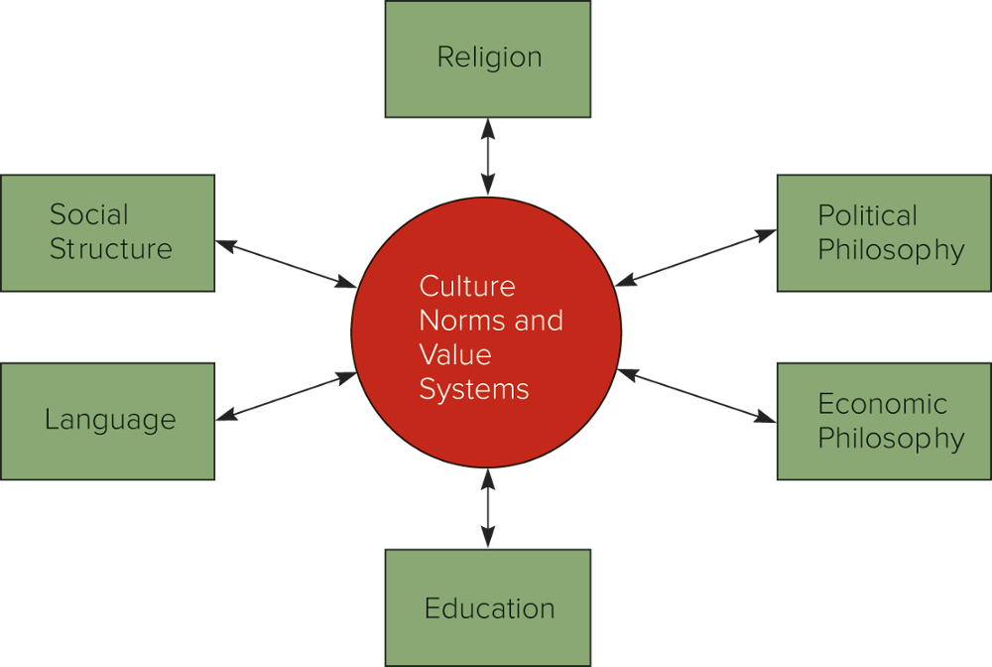
Determinants of culture

Slide 8
Social Structure
  Three dimensions explain differences among cultures
    The degree to which the basic unit of a social organization is the individual, as opposed to the group, or even company for which a person works.
    Societies differ in the way they define family
    The degree to which a society is stratified into classes or caste

Slide 9
Individual versus Group
    Because respect for individual authority and responsibility is so strong in the United States, children are trained to believe that their destinies lie in their own hands.
    Conversely, in group-focused societies such as Japan, children are taught that their role is to serve the group.
      Virtues such as unity, loyalty, and harmony are highly valued in such societies.
      the social status of an individual has traditionally been determined as much by the standing of the group to which he or she belongs as by his or her individual performance.
      If the worth of an individual is closely linked to the achievements of the group this creates a strong incentive for individual members of the group to work together for the common good.

Slide 10
Individual versus Group
The primacy of the value of group identification discourages managers and other workers to move from company to company.
Lifetime employment in a particular company was long the norm in certain sectors of the Japanese economy.

Slide 11
Individual versus Group
Since the U.S. culture promotes individualism, the U.S. society is characterized by a great deal of dynamism and entrepreneurship, reflecting the primacy of values associated with individualism
  the United States has led the world in innovation for some time, especially radically new products and services
Japanese society is characterized by a corresponding lack of dynamism and entrepreneurship.

Slide 12
The View of Family
The American view of family ties and responsibilities focuses on the nuclear family (father, mother, and offspring).
In other cultures, the extended family is far more important.
  Arabs, for example, consider uncles, brothers, cousins, and in-laws as parts of their family unit to whom they owe obligations of support and assistance.
  Other societies use an even broader definition of family.
    For instance, Somalia’s society is organized in clans, each of which comprises individuals of the same tribe who share a common ancestor.

Slide 13
The View of Family
These differing social attitudes are reflected in the importance of the family to business.
In the United States, firms discourage nepotism.
In Arab-owned firms, and similarly in China, family ties are crucial, and hiring relatives is a common, accepted practice.

Slide 14
Social Stratification
  All societies categorize people to some extent on the basis of their birth, occupation, educational achievements, or other attributes.
  Societies differ from each other with regard to
  the degree of mobility between social strata.
  the significance attached to social strata in business contexts

Slide 15
  Social Mobility
The extent to which individuals can move out of the strata into which they are born. Social mobility tends to be higher in less stratified societies.
The most rigid system of stratification is a caste system.
  A caste system is a closed system of stratification in which social position is determined by the family into which a person is born, and change in that position is usually not possible during an individual’s lifetime.
  Often, a caste position carries with it a specific occupation. Members of one caste might be shoemakers, members of another might be butchers, and so on.

Slide 16
Social Mobility
A class system is a less rigid form of social stratification in which social mobility is possible. It is a form of open stratification in which the position a person has by birth can be changed through his or her own achievements or luck.
Individuals born into a class at the bottom of the hierarchy can work their way up; conversely, individuals born into a class at the top of the hierarchy can slip down.
While many societies have class systems, social mobility within a class system varies from society to society.
Social Mobility is higher in the United States and other Western societies, for example, than in the United Kingdom or India.

Slide 17
Significance
In American society, the high degree of social mobility and the extreme emphasis on individualism limit the impact of class background on business operations.
MNCs operating in highly stratified societies often must adjust their hiring and promotion procedures to take into account class differences among supervisors and workers.
Hiring members of one group to do jobs traditionally performed by members of another group may lower workplace morale and productivity.

Slide 18
Significance
In highly stratified societies, advertisers must tailor their messages more carefully to ensure that they reach only the targeted audience and do not spill over to another audience that may be offended by receiving a message intended for the first group.

Slide 19
Religious and Ethical Systems
Most of the world’s ethical systems are the product of religions.
Religion affects the ways in which members of a society relate to each other and to outsiders.

Slide 20
Religious and Ethical Systems
Among the thousands of religions in the world today, four dominate in terms of numbers of adherents:
Christianity with roughly 2.20 billion adherents
Islam with around 1.60 billion adherents
Hinduism with 1.10 billion adherents (primarily in India),
Buddhism with about 535 million adherents

Slide 21
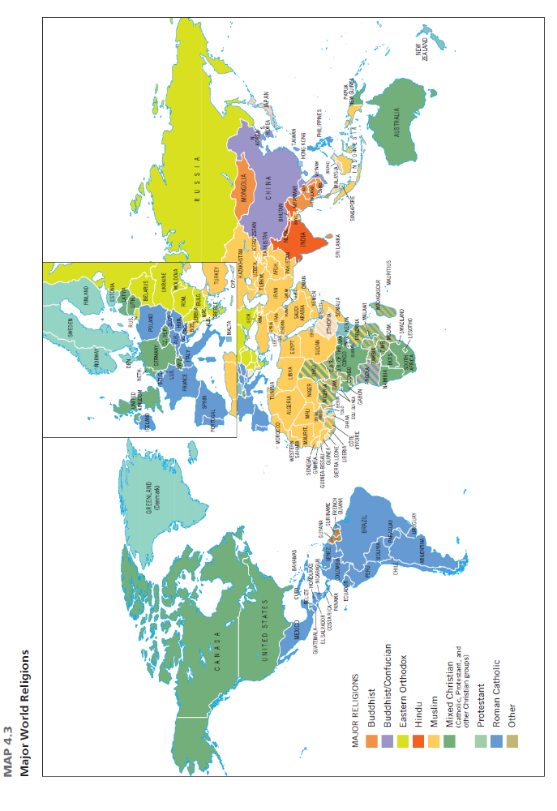
World Religions
Notes:
Religion is an important aspect of most societies. It affects the ways in which members of a society relate to each other and to outsiders. Approximately 84 percent of the world’s 6.9 billion people claim some religious affiliation. As reflected in Map 4.3, 77 percent of the world’s population adheres to one of four religions: Christianity (31.5 percent), including Roman Catholics, Protestants, and Eastern Orthodox; Islam (23.2 percent); Hinduism (15.0 percent); and Buddhism (7.1 percent)

Slide 22
Religion
Christianity is the world’s largest religion
Found throughout Europe, the Americas, and other countries settled by Europeans

Slide 23
Religion
Islam has roots in both Judaism and Christianity (Islam views Jesus Christ as one of God’s prophets).
Like Christianity and Judaism, Islam is a monotheistic religion.
The Koran speaks approvingly of free enterprise and of earning legitimate profit through trade and commerce
The protection of the right to private property is also embedded within Islam.
Given the Islamic proclivity to favor market-based systems, Muslim countries are likely to be receptive to international businesses as long as those businesses behave in a manner that is consistent with Islamic ethics, customs, and business practices.

Slide 24
Religion
Islamic finance differs from conventional banking systems in that usury and speculation are prohibited.
Transactions have to comply with Shariah, the legal code of Islam based on the Koran, and are based on principles of risk and profit-sharing.
Islam prohibits taking interests on loans and funding any business involving products like alcohol, pork or gambling.
Islamic banking is more risk adverse in its investment practices, typically avoiding business that could be associated with economic bubbles.

Slide 25
Religion
One economic principle of Islam prohibits the payment or receipt of interest, which is considered usury.
This is not just a matter of theology; in several Islamic states, it is also a matter of law.
Now there are hundreds of Islamic banks in more than 50 countries with assets of around $1.6 trillion
More than $1 trillion is managed by mutual funds that adhere to Islamic principles.
Even conventional banks are entering the market: both Citigroup and HSBC, two of the world’s largest financial institutions, now offer Islamic financial services.

Slide 26
Religion
When an Islamic bank lends money to a business, rather than charging that business interest on the loan, it takes a share in the profits that are derived from the investment.
Similarly, when a business (or individual) deposits money at an Islamic bank in a savings account, the deposit is treated as an equity investment in whatever activity the bank uses the capital for.

Slide 27
Religion
Unlike Christianity and Islam, Hinduism’s founding is not linked to a particular person.
Nor does it have an officially sanctioned sacred book such as the Bible or the Koran.
Hindus believe in reincarnation, or rebirth into a different body, after death.
Modern India is a very dynamic entrepreneurial society.

Slide 28
Religion
Today, most Buddhists are found in Central and Southeast Asia, China, Korea, and Japan.
According to Buddhism, suffering originates in people’s desires for pleasure.
Unlike Hinduism, Buddhism does not support the caste system.

Slide 29
Religion
Religion affects the business environment in important ways.
Often religions impose constraints on the roles of individuals in society.
For example, the caste system of Hinduism traditionally has restricted the jobs individuals may perform, thereby affecting the labor market and foreclosing business opportunities.
Countries dominated by strict adherents to Islam, such as Saudi Arabia, limit job opportunities for women, in the belief that their contact with adult males should be restricted to relatives.

Slide 30
Religion
Religion may also affect the way products are sold.
In Nigeria, advertisements in the predominantly Christian south might feature attractive women mouthing double entendres, following the old Madison Avenue precept that “sex sells”
In the predominantly Muslim north that approach would not be beneficial.

Slide 31
Religion
Religion also affects the types of products consumers may purchase as well as seasonal patterns of consumption.
In most Christian countries, for example, the Christmas season represents an important time for gift-giving, yet little business is done on Christmas Day itself.

Slide 32
Religion
Ironically, countries characterized by religious diversity may offer even greater challenges.
Firms that operate in the cosmopolitan cities of London and New York, such as Barclays Bank, and IBM, must accommodate the religious needs of their Jewish, Christian, Muslim, and Hindu employees and customers by taking into account differences in religious holidays, dietary restrictions or customs, and Sabbath days.
Firms that fail to adjust to these needs may suffer from absenteeism, low morale, and lost sales.

Slide 33
Language
One obvious way in which many countries differ is language.
English is increasingly becoming the language of international business throughout the world, or lingua franca.
When Japanese and German businesspeople get together to do business, it is almost certain that they will communicate in English.

Slide 34
Language
Although English is widely used, learning the local language yields considerable advantages.
Most people prefer to converse in their own language, and being able to speak the local language can build rapport and goodwill.
International businesses that do not understand the local language can make major blunders through improper translation.
Cultural differences can affect the interpretation of the meaning of common words.
  A U.S. executive might say that she’d “like” something done by next Thursday. A U.S. colleague would interpret this to mean that Thursday is the deadline, whereas a colleague in Thailand might view it as a preference rather than a demand.

Slide 35
Language
Of course, some linguistic differences may be overcome through translation.
Translation requires more than merely substituting words of one language for those of another.
Translators must be sensitive to subtleties in the connotations of words and focus on translating ideas, not the words themselves.
Far too often, translation problems create marketing disasters.
  A classic case is KFC’s initial translation of “Finger Lickin’ Good” into Chinese, which came out as the far less appetizing “Eat Your Fingers Off.”

Slide 36
Language
Firms can reduce the chances that they are sending the wrong message to their customers by using a technique known as backtranslation.
With backtranslation, one person translates a document, then a translator or team of professional translators translates or interprets the translated version back into the original language.
This technique provides a check that the intended message is actually being sent, thus avoiding communication mistakes.

Slide 37
Unspoken Language
Unspoken language refers to nonverbal communication which includes facial expressions, hand gestures, intonation, eye contact, body positioning, and body posture
The raising of eyebrows, for example, is a sign of recognition in most cultures, while a smile is a sign of joy.
Many nonverbal cues, however, are culturally bound.
A failure to understand the nonverbal cues of another culture can lead to a communication failure.
For example, making a circle with the thumb and the forefinger is a friendly gesture in the United States, but it is a male homosexuals to the Maltese, and vulgar sexual invitation in Greece and Turkey.
international businesspeople should avoid gesturing in a foreign culture unless they are sure of a gesture’s meaning in that culture.

Slide 38
Unspoken Language
Another aspect of nonverbal communication is personal space, which is the comfortable amount of distance between you and someone you are talking with.
In the United States, people discussing business at a party typically stand 20 inches from each other.
In Saudi Arabia, the normal conversational distance is 9 to 10 inches.
A U.S. businessperson conversing with a Saudi counterpart at a party will respond to the Saudi’s polite attempts to move in closer by politely moving back.
Each is acting politely within the context of his or her own culture—and insulting the other in the context of that person’s culture.

Slide 39
Education
A good education system a determinant of national competitive advantage
  Japan’s excellent education system is an important factor explaining the country’s postwar economic success.
A good education system is an important factor guiding the location choices of international businesses.
  The recent trend to outsource information technology jobs to India, for example, is partly due to the presence of significant numbers of trained engineers in India, which in turn is a result of the Indian education system.

Slide 40
Education
The general education level of a country is a good index of the kind of products that might sell in a country and of the type of promotional material that should be used.
  As a direct example, a country where more than 50 percent of the population is illiterate is unlikely to be a good market for popular books.
  In addition, promotional material containing written descriptions of mass-marketed products is unlikely to have an effect in a country where a half of the population cannot read. It is far better to use pictorial promotions in such circumstances.

Slide 41
Cultural Dimensions: The GLOBE Project and Hofstede Study
A massive and ongoing cross-cultural investigation of nine cultural dimensions involved in leadership and organizational processes

Slide 42
GLOBE Project Value Dimensions
Global Leadership and Organizational Behavior Effectiveness (GLOBE)
Assertiveness
Future Orientation
Uncertainty Avoidance
Gender Differentiation
Power Distance
Societal Collectivism
Individual Collectivism
Performance Orientation
Humane Orientation
Extension of Hofstede’s assessment

Slide 43
The GLOBE Project and Hofstede Study
Note that these dimensions reflect tendencies within cultures, not absolutes. Within any given culture, there are likely to be people at every point on each dimension.
Moreover, cultures can change over time, albeit usually slowly.

Slide 44
GLOBE Project
Individualism
  A worldview that values individual freedom and self-expression comes first.
  These people often put their own career interests before the good of their organizations, and they tend to assess decisions in terms of how those decisions affect them as individuals.
  Collectivism
    the belief that the group comes first
    People should take pride in being members of their family, circle of close friends, and their work organization.

Slide 45
GLOBE Project
Individualism
  For example, a commercial should show how YOU will have more fun or how YOU will be the cool guy. YOU YOU YOU
  U.S., Denmark, Sweden, Great Britain, and Australia
Collectivism
A commercial should emphasize how we can make a FAMILY happy.
  Widespread and prevalent in India and Egypt.

Slide 46
GLOBE Project
International firms must be aware of differences in the social orientations of countries.
Nepotism is often frowned on in individualistic cultures but may be a normal hiring practice in collectivistic cultures.

Slide 47
GLOBE Project
Power Distance
  The extent to which people in a country accept that power is distributed unequally in society and organizations.
    In high power distance societies, inequalities in rewards are easily accepted. Expect to find great respect for age, status, and titles.
    You cannot question people in authority because they are considered superior.

Slide 48
GLOBE Project
    In the low power distance societies, people expect equality in power.
      people are more willing to question a decision or mandate from someone at a higher level or perhaps even refuse to accept it.
      They are willing to follow a leader when that leader is perceived to be right or when it seems to be in their own self-interest to do so but not because of the leader’s intangible right to issue orders.

Slide 49
GLOBE Project
Power Distance
  Countries that value high power distance are Philippines, China, Russia, and Panama
  Countries that value low power distance are Germany, Sweden, and U.S.

Slide 50
GLOBE Project
Such cultural norms may lead to tragedy.
During the late 1990s, for example, Korean Airlines (KAL) suffered an abnormally high number of fatal accidents. Some aviation safety experts attributed the problem to the power-respecting norms of Korean culture. Behavioral scientists found that KAL first officers (the second-in-command pilots) were often unwilling to suggest to their captains that the captain might be making a mistake even if the mistake was putting the aircraft in danger.

Slide 51
GLOBE Project
Achievement Orientation
  The extent to which cultures are highly assertive (masculine) or nurturing (feminine).
  Masculine-oriented societies value assertiveness, performance, achievement, material-success, and money.
    People tend to be competitive and confrontational.
  Feminine-oriented cultures value quality of life, personal relationships, and service.
    People tend to be tender

Slide 52
GLOBE Project
For example, in masculine societies such as Japan and United States, the workplace is generally high in job stress and supervisor oversight.
Females managers are more common in organizations in nurturing cultures, such as Sweden and Norway, than in achievement societies.

Slide 53
GLOBE Project
Uncertainty Avoidance
  Societies and people differ in their tolerance for uncertainty and risk.
  Low uncertainty avoidance cultures (e.g., U.S. and Hong Kong) have high tolerance for the unstructured, the unclear, and the unpredictable.
  High uncertainty avoidance means that members of a society (e.g., France, Greece) feel threatened and uncomfortable with uncertainty and ambiguity.

Slide 54
GLOBE Project
Uncertainty orientation affects many aspects of managing international firms.
Those operating in uncertainty-avoiding countries, for example, tend to adopt more rigid hierarchies and more elaborate rules and procedures for doing business.
Conversely, uncertainty-accepting cultures are more tolerant of flexible hierarchies, rules, and procedures.

Slide 55
GLOBE Project
Risk taking (“nothing ventured, nothing gained”) is highly valued in uncertainty-accepting cultures such as that of the United States and Hong Kong,
Low-risk strategies is more important in uncertainty-avoiding countries such as Spain, Belgium, and Argentina.

Slide 56
GLOBE Project
Future Orientation
  Long-term orientation cultures have greater concern for the future, defer gratification, and highly values planning and saving.
  Short-term orientation is the tendencies toward impatience and desire for quick, even instantaneous gratifications, show short-term thinking.
  Countries with short-term orientations are consumer driven whereas countries with long-term orientations are savings driven.

Slide 57
GLOBE Project
The long term orientation might help explain why Japan’s auto executives were more willing than their American counterparts years ago invest in hybrid engine technologies and stick with them, even though market demand was very low at first and any return on the investments would take a long time to materialize.

Slide 58
Cultural Literacy and Competitive Advantage
Primary Attitudes among International Managers
  Ethnocentric
  Polycentric
  Geocentric

Slide 59
Attitudes among International Managers
Managers with an ethnocentric attitude believe that people in foreign countries don't have the needed skills, expertise, knowledge, or experience to make the best business decisions as people in the home country do.
  Involve staffing the most important positions in foreign subsidiaries with expatriates from the company’s home country.
Is ethnocentrism bad for business? It seems so.
  High turnover, Lawsuits, recruiting difficulties.

Slide 60
Attitudes among International Managers
A polycentric attitude is the view that the managers in the host country (the foreign country where the MNC is doing business) know the best work approaches and practices for running their business.
A geocentric attitude is a world-oriented view that focuses on using the best approaches and people from around the globe.

Slide 61
Wal-Mart Retreats from Germany
In late 1997, facing a saturated U. S. market, Walmart entered Germany.
In 2006, however, Walmart exited Germany, after losing billions of dollars.
This massive failure came as a shock to a company that was used to success.
What went wrong?

Slide 62
Wal-Mart Retreats from Germany
Wal-Mart attempted to implement its U. S. personnel policies and procedures:
  the Wal-Mart cheer
  a door greeter
  every associate within 10 feet of a customer smiling and offering help
  bagging groceries at the checkout
  video surveillance
  a prohibition against dating co-workers, and so on.
German employees, however, simply refused to accept these policies.

Slide 63
Wal-Mart Retreats from Germany
It also didn’t help that the first Wal-Mart boss in Germany was installed from Wal-Mart headquarters in Bentonville, Arkansas.
The executive didn’t speak any German, and simply decreed that English would be the official in-house language.
It does not seem that Wal-Mart management and executives have geocentric attitude.

