Slide 1
Introduction to Healthcare
Quality Management
Measuring Performance

Slide 2
Measurement
Purpose
  Understand current performance.
  Identify where improvement is needed.
  Evaluate how changes in work processes affect performance.

Slide 3
Measurement: The Starting Point
Measurement is a tool used to monitor the quality of some aspect of healthcare services.
  Absolute number
  Percentage
  Average
  Ratio

Slide 4
Effective Measurement
Accurate
Useful
Easy to interpret
Consistently reported

Slide 5

Measurement Categories
Structure
Process
Outcome
Patient Experience

Slide 6
Structure Measures
Assess adequacy of the environment
  For example: Does the clinic conduct regular fire drills?
Often used for licensing and accreditation
Notes:
Ask students to identify other structure measures for a healthcare facility.

Slide 7
Process Measures
Assess what is done and whether the system is working as it should
  Example: Do physical therapists consistently measure and document a patient’s level of pain?
The most common type of healthcare performance measure
Notes:
Ask students to identify other process measures for a healthcare facility.

Slide 8
Outcome Measures
Assess discrete, patient-focused endpoints
  Example: Percentage of hospital patients who develop a urinary tract infection
Results can be influenced by factors out of the provider’s control
Notes:
Ask students to identify other outcome measures for a healthcare facility.

Slide 9
Patient Experience Measures
Patient’s perception of processes and outcomes
  Percentage of patients reporting their doctor explained medication side-effects
  Percentage of patients reporting their pain was well-controlled
Notes:
Ask students to identify other patient experience measures for a healthcare facility.

Slide 10
Measurement Levels
System level and activity level
Setting | Organization-Wide Performance Goal |  | System-Level Measure |  | Activity-Level Measures
Hospital | Reduce incidence of hospital-acquired infections |  | Percentage of patients who develop an infection while in the hospital |  | Rate of staff compliance with hand hygiene procedures Percentage of central vein line catheter insertions done according to protocol Percentage of staff immunized for influenza

Slide 11
Selecting Measurement Topics
External influences
  Priorities of national groups (regulatory, accreditation, and purchasers)
Internal influences
  Strategic priorities of the organization

Slide 12
How to Construct a Measure
Identify topic of interest
Develop measure
Design data collection system

Slide 13
Identify Topic of Interest
What might the laboratory director want to know about the lab function of analyzing specimens and reporting test results?
Notes:
Ask students to consider the six Institute of Medicine key dimensions of quality to choose what the director might want to know about:
Safe
Effective
Patient Centered
Timely
Efficient
Equitable
Use a different example if students are more familiar with another function or process.

Slide 14
Develop Measure
Define the measure in fundamental measurement terms.
  Culture results can be inaccurate when specimens are contaminated during a blood draw. What data are needed to measure the percentage of blood specimens collected for culture that are found to be contaminated?
Numerator:
Denominator:
Notes:
Numerator: Number of contaminated blood specimens (result of interest)
Denominator: Total number of blood specimens drawn for a culture (the entire population)

Slide 15
Design Data Collection Strategy
Identify the best sources of accurate data.
  Administrative files
  Patient records
  Misc. business and clinical information

Slide 16
Design Data Collection Strategy
What
  Study population
  Sample or not?
Who
  Data collectors
  Provide oversight of data collectors
  Provide sufficient training and supervision

Slide 17
Design Data Collection Strategy
When
  Frequency of data collection
  Frequency of data reporting
How
  Data collection instruments
  Electronic data query

Slide 18
Externally Developed Measures
Created using a rigorous process.
Detailed data specifications are available and should be used by data collectors.
Be sure your internal definitions match the data specifications for the measures.

Slide 19
National Quality Forum
Quality stakeholder group was formed in 1999 for the purpose of creating national standards for measurement and public reporting of healthcare performance data.
NQF endorsement is a “seal of approval” for healthcare quality measures.

Slide 20
Clinical Measures
Clinical decision-making is the process by which physicians and other clinicians determine which patients need what and when.
Measures of clinical decision-making
  Often derived from clinical practice guidelines: “Systematically developed statements to assist practitioner and patient decisions about appropriate health care for specific clinical circumstances”
Source: Institute of Medicine. 1990. Clinical Practice Guidelines: Directions for a New Program, edited by M. J. Field and K. N. Lohr. Washington, DC: National Academies Press.

Slide 21
Clinical Measures
Measures of clinical decision making
  Primarily evidence-based process measures
Topic of Interest | Evidence-Based Process Measure
Management of children with pharyngitis | Percentage of children aged 2 through 18 with a diagnosis of pharyngitis who were prescribed an antibiotic and received a group A streptococcus test for the episode
Management of patients with diabetes mellitus | Percentage of patients aged 18 through 75 with diabetes mellitus whose most recent blood pressure measured less than 140/80 mm Hg

Slide 22
What Is a Balanced Scorecard?
A framework that helps organizations put strategy at the center of the organization by translating strategy into operational objectives that drive behavior and performance

Slide 23
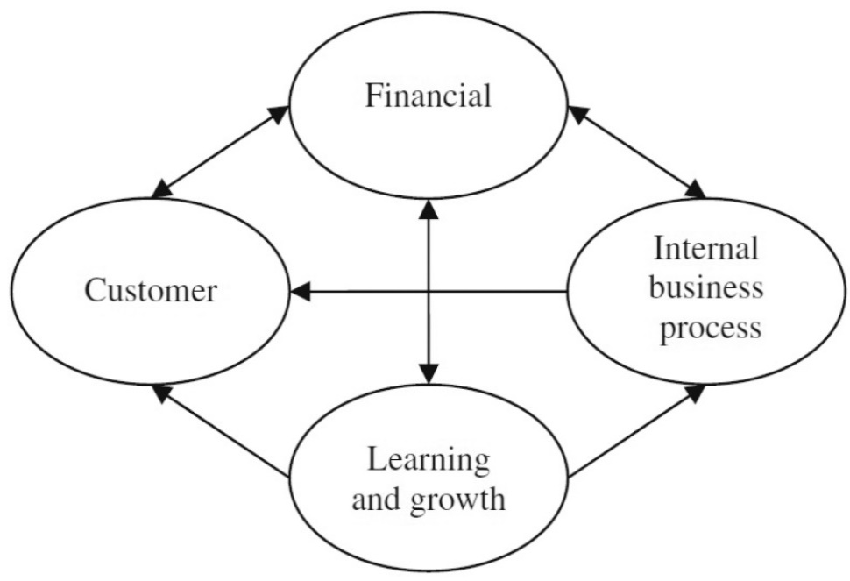
Balanced Scorecard Categories
Can vary among healthcare organizations
Common categories

Slide 24
Measurement: Just the Starting Point
Measurement alone does not improve performance.
Results must be analyzed.

