Slide 1
National Differences in Political, Economic, and Legal Systems
Chapter 3

Slide 2
Introduction
Countries have different political, economic, and legal systems.
They vary significantly in their
  level of economic development and future economic growth trajectory.
  the education and skill levels of the population.
  The legal system
All these differences can and do have major implications for the practice of international business.

Slide 3
Political Systems
Political system refers to the system of government in a nation
Political systems.
  totalitarian vs. Democratic
  However, a large gray area exists in the middle.

Slide 4
Totalitarianism
political repression is widespread
free and fair elections are lacking
media are heavily censored
basic civil liberties are denied
those who question the right of the rulers to rule find themselves imprisoned or worse.

Slide 5
Socialism
Modern socialists trace their intellectual roots to Karl Marx (1818–1883).
Marx argued that the few benefit at the expense of the many in a capitalist society where individual freedoms are not restricted.
Marx argued that capitalists expropriate for their own use the value created by workers, while paying workers only subsistence wages in return.
To correct this perceived wrong, Marx advocated state ownership of the basic means of production, distribution, and exchange (i.e., businesses) so that the state could ensure that workers were fully compensated for their labor.

Slide 6
Socialism
The needs of society as a whole are generally viewed as being more important than individual freedoms.
In such circumstances, an individual’s right to do something may be restricted on the grounds that it runs counter to “the good of society” or to “the common good.”

Slide 7
Socialism
In the early twentieth century, the socialist ideology split into two broad camps.
  The communists believed that socialism could be achieved only through violent revolution and totalitarian dictatorship
  Social democrats committed themselves to achieving socialism by democratic means, turning their backs on violent revolution and dictatorship.
  Social democrats are not totalitarian.
  Thus, communists are socialists, but socialists are not necessarily communist.

Slide 8
Communist Totalitarianism
Although China is still nominally a communist state with substantial limits to individual political freedom, in the economic sphere, the country has moved sharply away from strict adherence to communist ideology.
Old-style communism, with state control over all economic activity, hangs on in only a handful of small fringe states, most notably North Korea.

Slide 9
Social Democracy
A political, social and economic ideology that supports economic and social interventions to promote social justice within the framework of a liberal democratic polity and capitalist economy.
Social democracy also seems to have passed a high-water mark, although the ideology may prove to be more enduring than communism.
Social democracy has had its greatest influence in a number of democratic Western nations, including Australia, Denmark, Finland, France, Germany, Great Britain, Norway, Spain, and Sweden, where social democratic parties have often held political power.

Slide 10
Social Democracy
Evidences show State ownership of the means of production ran counter to the public interest.
Protected from competition by their monopoly position and guaranteed government financial support, many , state-owned companies performed poorly became increasingly inefficient.

Slide 11
Democracy
An emphasis on the importance of guaranteeing individual freedom and self-expression.
The welfare of society is best served by letting people pursue their own economic self-interest, as opposed to some collective body (such as government) dictating what is in society’s best interest.

Slide 12
Democracy
The United States is a constitutional republic that operates as a representative democracy.
In a representative democracy, citizens periodically elect individuals to represent them.
These elected representatives then form a government whose function is to make decisions on behalf of the electorate.
Elected representatives who fail to perform this job adequately will be voted out of office at the next election.

Slide 13
  Pseudo-Democracies
Many of the world’s nations are neither pure democracies nor iron-clad totalitarian states.
A governing system in which, although elections take place, citizens are cut off from knowledge about the activities of those who exercise real power because of the lack of civil liberties.
  In the Russia of Vladimir Putin, for example, elections are still held.
  However, Putin has used his position to systematically limit the political and civil liberties of opposition groups

Slide 14
Doing Business in Totalitarian Countries
On the plus side
  International companies can be relatively less concerned with local political opposition to their activities.
On the negative side
  They might need to pay bribes and kickbacks to government officials.
  Refusal to pay could result in loss of market access or even forfeiture of investments in the country.
  Laws regarding the resolution of contractual disputes can be either vague or nonexistent, and people in powerful government positions can interpret laws largely as they please.

Slide 15
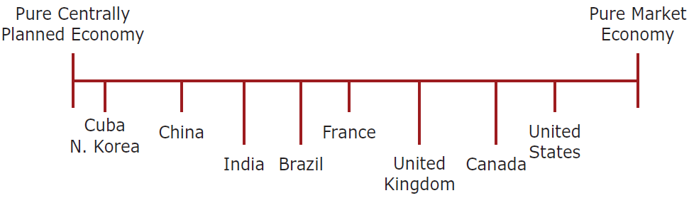
Economic Systems
Range of Economic Systems
Market Economy
Centrally Planned Economy
Mixed Economy

Slide 16
Market Economy
All productive activities are privately owned, as opposed to being owned by the state.
The goods and services that a country produces are not planned by anyone.
Production is determined by supply and demand

Slide 17
Market Economy
For market economy to work, supply must not be restricted.
A supply restriction occurs when a single firm monopolizes a market.
Rather than increase output in response to increased demand, a monopolist might restrict output and let prices rise.
This allows the monopolist to take a greater profit margin on each unit it sells.
The net result is that the monopolist is likely to become increasingly inefficient, producing high-priced, low-quality goods.

Slide 18
Market Economy
Given the dangers inherent in monopoly, one role of government in a market economy is to
  ban restrictive business practices designed to monopolize a market (antitrust laws serve this function in the United States and European Union).

Slide 19
Centrally Planned Economy (Command Economy)
All businesses are state owned
The government plans the goods and services that a country produces, the quantity in which they are produced, and the prices at which they are sold.
Consistent with the socialist ideology, the objective of a command economy is for government to allocate resources for “the good of society.”
Since the demise of communism in the late 1980s, the number of command economies has fallen dramatically.

Slide 20
Mixed Economy
In a mixed economy, certain sectors of the economy are left to private ownership and free market mechanisms, while other sectors have significant state ownership and government planning.
Mixed economies were once common throughout much of the developed world, although they are becoming less so.
Until the 1980s, Great Britain, France, and Sweden were mixed economies, but extensive privatization has reduced state ownership of businesses in all three nations.
Privatization refers to the selling of government-owned economic resources to private operators is

Slide 21
Mixed Economy
Privatization creates opportunities for international businesses.
They are often attractive to international businesses seeking to expand their operations into new markets located in key sectors of a national economy, such as telecommunications, transportation, and manufacturing.

Slide 22
Mixed Economy
The government tends to control the economic sectors that it considers important to national security and long-term stability. Such sectors usually include
  iron and steel manufacturing (for building military equipment)
  oil and gas production (to guarantee continued manufacturing and availability)
  automobile manufacturing (to guarantee employment for a large portion of the workforce).
Many mixed economies maintain generous welfare systems to support the unemployed and to provide health care for the general population.

Slide 23
Mixed Economy
Governments tend to take into state ownership troubled firms whose continued operation is thought to be vital to national interests.
For example, in 2008 the U.S. government took a significant percent stake in AIG, Citigroup, and General Motors to stop those companies from collapsing,
The theory being that if those companies did collapse, it would have very serious consequences for the entire financial and economic system.
The intention was to sell the institution back to private investors as soon as possible.
  As soon as it was able to, the U.S. government sold these stakes.

Slide 24
Legal Systems
Common Law
Civil Law
Theocratic Law

Slide 25
Common Law
It is the foundation of the legal systems in the United Kingdom and its former colonies, including the United States, Canada, Australia, India, New Zealand, Hong Kong, and Malaysia.
is based on the cumulative wisdom of judges’ decisions on individual cases through history.
Judicial precedents are set to be binding
  each new interpretation sets a precedent that may be followed in later cases. Like cases should be treated alike.

Slide 26
Common Law
As new precedents arise, laws are altered to clarify vague wording or to accommodate situations not previously considered.
Common-law systems are flexible.
Instead of applying uniformly to all situations, laws take into account particular situations and circumstances.
Business contracts tend to be lengthy in common-law nations (especially the United States) because they must consider many possible contingencies and many possible interpretations of the law in case of a dispute.

Slide 27
Common Law
Common law has evolved differently in each common law country.
Thus, laws affecting business practices vary somewhat among these countries.
For example, manufacturers of defective products are more vulnerable to lawsuits in the United States than in the United Kingdom as a result of evolutionary differences in the two countries’ case law.

Slide 28
Common Law
Statutory laws—those enacted by legislative action—also vary among the common law countries.
For example, many business transactions between firms and the British government are shielded from public scrutiny—and the prying eyes of competitors—by Britain’s Official Secrets Act.
In contrast, more information about transactions between firms and the U.S. federal government is publicly available because of the U.S. Freedom of Information Act.
Even the administration of law may vary.
  For instance, in the United States the plaintiff and the defendant in a lawsuit generally pay their own legal fees.
  In the United Kingdom, the losers in trials pay the legal expenses of both parties. Thus, the British have less incentive to file frivolous lawsuits.

Slide 29
Civil Law
A civil law system tends to be less adversarial than a common law system because the judges rely on detailed legal codes rather than interpreting tradition, precedent, and usage.
If a new situation comes up the judges in a civil law system cannot make a decision until new laws written by the government
More than 80 countries—including Germany, France, Japan, and Russia—operate with a civil law system.
Judges under a civil law system have less flexibility than those under a common law system.
  Judges in a common law system have the power to interpret the law, whereas judges in a civil law system have the power only to apply the law.

Slide 30
Theocratic Law
A theocratic law system is one in which the law is based on religious teachings.
Most theocratic legal systems also have elements of common or civil law)
Islamic law and Jewish law persisted into the twentieth century.
A country that applies religious law to civil and criminal conduct is called a theocracy.
Examples of theocracies include Iran and Saudi Arabia.

Slide 31
Theocratic Law
Islamic law is intended to govern all aspects of life.
An example is the payment or receipt of interest, which is considered usury and outlawed by the Koran.
In the 1990s, for example, Pakistan’s Federal Shariat Court, the highest Islamic lawmaking body in the country, pronounced interest to be un-Islamic and therefore illegal and demanded that the government amend all financial laws accordingly.
By the late 2000s, there were some 500 Islamic financial institutions in the world, and as of 2014, they collectively managed more than $1 trillion in assets.

Slide 32
DIFFERENCES IN CONTRACT LAW
Because common law tends to be relatively ill specified, contracts drafted under a common law framework tend to be very detailed with all contingencies spelled out.
In civil law systems, however, contracts tend to be much shorter and less specific because many of the issues are already covered in a civil code.
Thus, it is more expensive to draw up contracts in a common law jurisdiction, and resolving contract disputes can be very adversarial in common law systems.

Slide 33
Contract Disputes
To resolve contract disputes that arise in international trade, a number of countries, including the United States, have ratified the United Nations Convention on Contracts for the International Sale of Goods (CISG).
By adopting the CISG, a nation signals to other adopters that it will treat the convention’s rules as part of its law.
The CISG applies automatically to all contracts for the sale of goods between different firms based in countries that have ratified the convention.
One problem with the CISG, however, is that as of 2017, only 89 nations had ratified the convention.
Some of the world’s important trading nations, including India and the United Kingdom, have not ratified the CISG.

Slide 34
Contract Disputes
When firms do not wish to accept the CISG, they often opt for arbitration by a recognized arbitration court to settle contract disputes.
The most well known of these courts is the International Court of Arbitration of the International Chamber of Commerce in Paris, which handles more than 500 requests per year from more than 100 countries.

Slide 35
Laws Directly Affecting International Business Transactions
A country may attempt to induce a second country to change an undesirable policy by imposing sanctions—restraints against commerce with that country.
Sanctions may take many forms
  restricting access to high-technology goods
  withdrawing preferential tariff treatment
  boycotting the country’s goods, and denying new loans

Slide 36
Laws Directly Affecting International Business Transactions
A particularly important form of export control involves high-technology goods
Many technologically advanced countries limit the export of so-called dual-use products that may be used for both civilian and military purposes.
  McDonnell Douglas ran afoul of U.S. dual-use controls when it sold sophisticated machine tools to the China National Aero-Technology Import and Export Company, which claimed that the equipment would be used to build civilian aircraft.

Slide 37
Property Rights and Corruption
Property rights refer to the legal rights over the use to which a resource is put and over the use made of any income that may be derived from that resource.
Almost all countries now have laws on their books that protect property rights.
In many countries these laws are not enforced by the authorities, and property rights are violated.
Property rights can be violated in two ways:
  private action
  public action

Slide 38
Private Action
Theft, piracy, blackmail, and the like by private individuals or groups.
Although theft occurs in all countries, a weak legal system allows a much higher level of criminal action.

Slide 39
  Public Action
Occurs when public officials, such as politicians and government bureaucrats, extort income, resources, or the property itself from property holders through
  Legal mechanisms such as levying excessive taxation, requiring expensive licenses or permits from property holders, taking assets into state ownership without compensating the owners.
  illegal means, or corruption, by demanding bribes from businesses in return for the rights to operate in a country, industry, or location.

Slide 40
  Corruption
No society is immune to corruption.
There are systematic differences in the extent of corruption.
Corruption is so endemic in some countries that politicians and bureaucrats regard it as a perk of office and openly flout laws against corruption.

Slide 41
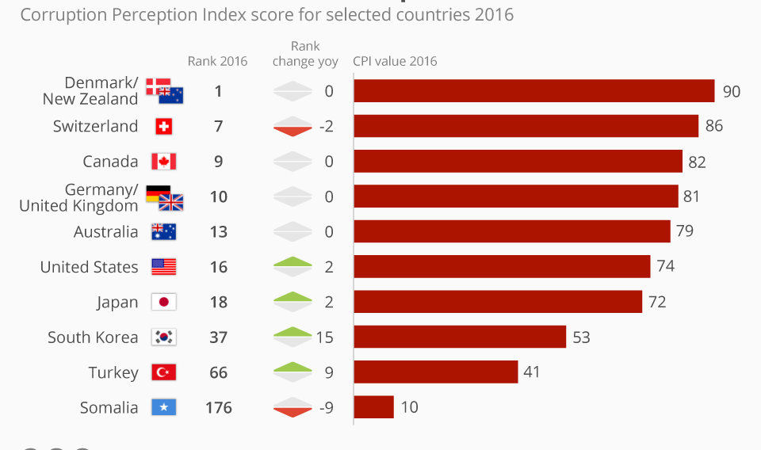
Rankings of corruption by country, 2016
Corruption Index (Clean =100 Totally corrupt = Zero)

Slide 42
Foreign Corrupt Practices Act (FCPA)
    Illegal to bribe a foreign government official to obtain or maintain business over which that foreign official has authority
In 2012, evidence emerged that in its eagerness to expand in Mexico, Walmart may have run afoul of the FCPA.

Slide 43
Convention on Combating Bribery of Foreign Public Officials in International Business Transactions
Is a convention of the OECD aimed at making the bribery of foreign public officials a criminal offense.
Both the U.S. law and OECD convention include language that allows exceptions known as facilitating or expediting payments (also called grease payments or speed money), the purpose of which is to expedite or to secure the performance of a routine governmental action
For example, they allow small payments made to speed up the issuance of permits or licenses, process paperwork, or just get vegetables off the dock and on their way to market.

Slide 44
The Protection of Intellectual Property
Intellectual property (IP) refers to creations of the mind, such as
  computer software
  a screenplay
  a music score
  the chemical formula for a new drug
  names and images used in commerce
IP is protected in law by, for example, patents, copyright and trademarks, which enable people to earn recognition or financial benefit from what they invent or create.

Slide 45
The Protection of Intellectual Property
The protection of intellectual property rights differs greatly from country to country.
Although many countries have stringent intellectual property regulations on their books, the enforcement of these regulations has often been lax.

Slide 46
The Protection of Intellectual Property
Weak enforcement encourages the piracy (theft) of intellectual property.
  China and Thailand have often been among the worst offenders
The computer software industry is an example of an industry that suffers from lax enforcement of intellectual property rights.
Estimates suggest that violations of intellectual property rights cost personal computer software firms revenues equal to $63 billion in 2011.

Slide 47
The Protection of Intellectual Property
The Agreement on Trade-Related Aspects of Intellectual Property Rights (TRIPS) is an international legal agreement between all the member nations of the World Trade Organization (WTO).
TRIPS oblige WTO members to grant and enforce patents lasting at least 20 years and copyrights lasting 50 years after the death of the author.
  Rich countries had to comply with the rules within a year.
  Poor countries, in which such protection generally was much weaker, had five years of grace,
  The very poorest have 10 years

Slide 48
The Protection of Intellectual Property
Firms can file lawsuits on their own behalf.
For example, Starbucks won a landmark trademark copyright case in China against a copycat that signaled a change in the approach in China.
Firms need to ensure that pirated copies of their products produced in countries with weak intellectual property laws don’t turn up in their home market or in third countries.
Microsoft, for example, discovered that pirated Microsoft software, produced illegally in Thailand, was being sold worldwide as the real thing.

