Slide 1
Economic Development of Nations
Chapter 4

Slide 2
Introduction
In previous Chapters, we described how countries differ with regard to their political systems, economic systems, and legal systems.
In this chapter, we explain how these differences influence the level of economic development of a nation and, thus, how attractive it is as a place for doing business.

Slide 3
Differences in Economic Development
One common measure of economic development is a country’s gross national income (GNI) per head of population.
Gross national income (GNI) measures the total annual income received by residents of a nation.
Countries such as Japan, Sweden, Switzerland, the United States, and Australia are among the richest on this measure,
Large developing countries such as China and India are significantly poorer.
Japan, for example, had a 2016 GNI per capita of $38,000, but China achieved only $8,260 and India just $1,680.

Slide 4
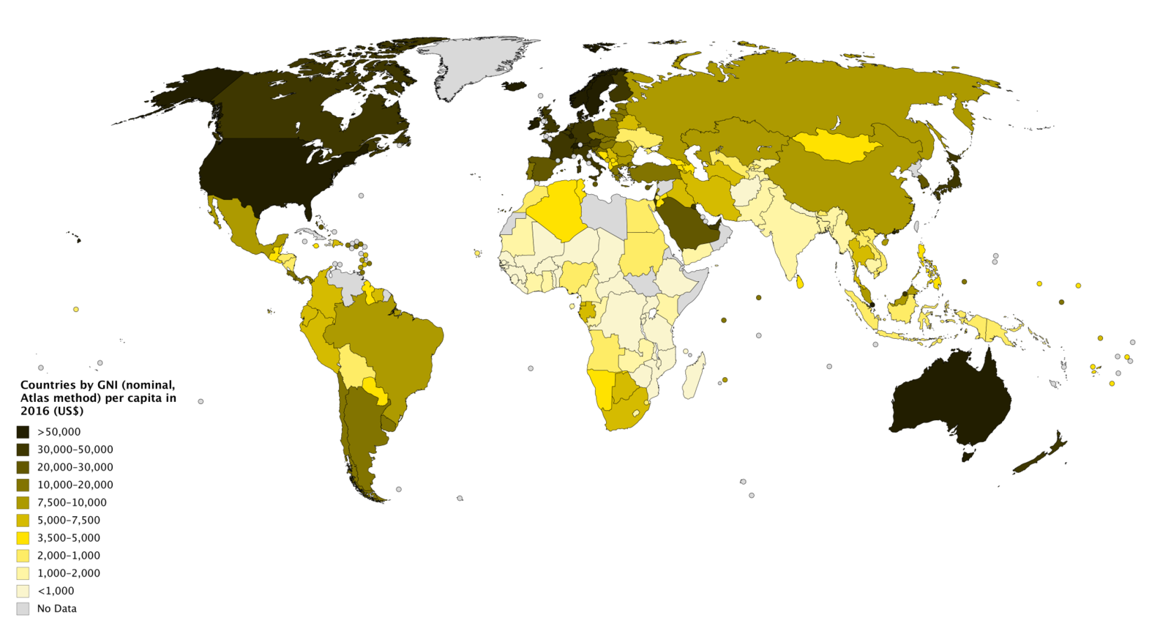
GNI per capita, 2016

Slide 5
Differences in Economic Development
GNI per person figures can be misleading because they don’t consider differences in the cost of living.
For example, although the 2016 GNI per capita of Switzerland at $81,240 exceeded that of the United States by a wide margin, the higher cost of living in Switzerland meant that U.S. citizens could actually afford almost as many goods and services as the average Swiss citizen.
To account for differences in the cost of living, one can adjust GNI per capita by purchasing power.
Purchasing power is the value of goods and services that can be purchased with one unit of a country’s currency.

Slide 6
Purchasing power parity (PPP)
Is the relative ability of two countries’ currencies to buy the same “basket” of goods in those two countries.
This basket of goods is representative of ordinary, daily-use items such as apples, rice, soap, toothpaste, and so forth.
Estimates of gross product per capita at PPP allow us to see what a currency can actually buy in real terms.
GNI per capita at PPP is lower in Switzerland because of that nation’s higher cost of living.
It simply costs more to buy the same basket of goods in Switzerland than it does in the United States.

Slide 7
Economic Data for Select Countries
Country | GNI per Capita, 2016 ($) | GNI PPP per Capita, 2016 ($) | Annual GDP Growth Rate, 2007-2016 (%) | Size of Economy GDP, 2016 ($ billions)
Brazil | $8,840 | $14,810 | 2.1 | $1,796
China | 8,260 | 15,500 | 9.0 | 11,199
Germany | 43,660 | 49,530 | 1.3 | 3,467
India | 1,680 | 6,490 | 7.4 | 2,263
Japan | 38,000 | 42,870 | 0.5 | 4,939
Nigeria | 2,450 | 5,740 | 5.0 | 405
Poland | 12,680 | 26,770 | 3.6 | 470
Russia | 9,720 | 22,540 | 1.7 | 1,283
Switzerland | 81,240 | 63,660 | 1.6 | 660
United Kingdom | 42,390 | 42,100 | 1.1 | 2,618
United States | 56,180 | 58,030 | 1.3 | 18,569
Source: World Development Indicators Online, 2017.

Slide 8
Differences in Economic Development
Given the very low GNI in some countries, i.e., India, we might conclude that despite having a population of 1.2 billion, India is unlikely to be a very lucrative market for the consumer products produced by many Western international businesses.
However, in many countries the “official” figures do not tell the entire story.
Signfincant amounts of economic activity may be in the form of unrecorded cash transactions or barter agreements.
People engage in such transactions to avoid paying taxes.
Known as the black economy or shadow economy, estimates suggest that in India it may be around 50 percent of GDP, which implies that the Indian economy is half as big again as the figures reported in Table.

Slide 9
Differences in Economic Development
Although countries such as China and India are currently relatively poor, their economies are already large in absolute terms and growing far more rapidly than those of many advanced nations (see Table which gives the rate of growth in gross domestic product (GDP)).
If both China and the United States maintain their current economic growth rates, China will become the world’s largest economy sometime during the next decade.
On current trends, India too will be among the largest economies in the world.
Given that potential, many international businesses are trying to establish a strong presence in these markets.

Slide 10
Human Development Index (HDI)
Development should be assessed less by material output measures such as GNI per capita and more by opportunities that people enjoy.
Human Development Index (HDI) which is based on
  Life expectancy at birth
  Educational attainment
  Whether average incomes are sufficient to meet the basic needs of life in a country (Measured by GNI)
Norway retains its top position, while Niger is at the bottom of the index.

Slide 11
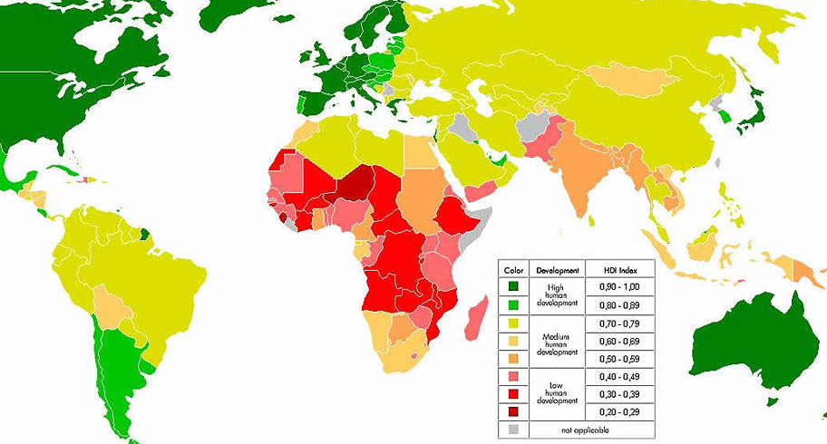
Human Development Index (HDI)

Slide 12
Economic Transition
The political economy of many of the world’s nation-states has changed radically since the late 1980s.
  First, during the late 1980s and early 1990s, a wave of democratic revolutions swept the world.
  Totalitarian governments fell and were replaced by democratically elected governments
  Second, there has been a move away from centrally planned and mixed economies and toward a more free market economic model.
Transition from central planning to free-market economies generates tremendous international business opportunities.

Slide 13
The Nature of Economic Transformation
The shift toward a market-based economic system often entails a number of steps:
  Deregulation
  Privatization
  Creation of a legal system to safeguard property rights

Slide 14
Deregulation
The reduction or elimination of government power in a particular industry, usually enacted to create more competition within the industry.
Before the collapse of communism, the governments in most command economies
  Exercised tight control over prices and output
  They prohibited private enterprises from operating in most sectors of the economy
  Severely restricted direct investment by foreign enterprises, and limited international trade.

Slide 15
Privatization
Privatization refers to the transfer of the ownership of state property into the hands of private individuals.
For privatization to work, it must also be accompanied by a general deregulation of the economy.

Slide 16
Privatization
Despite this three-decade trend, large amounts of economic activity are still in the hands of state-owned enterprises in many nations.
In China, for example, state-owned companies still dominate the banking, energy, telecommunications, health care, and technology sectors. Overall, they account for about 40 percent of the country’s GDP.

Slide 17
Legal Systems
A well-functioning market economy requires laws
  Protecting property rights
    required for a business environment to be conducive to innovation and entrepreneurial activity
  Providing mechanisms for contract enforcement
Although many nations have made big strides toward instituting the required system, it may be years before the legal system is functioning as smoothly as it does in the West.

Slide 18
Implications for Management Practice of National Difference in Political Economy
The political, economic, and legal environments of a country clearly influence the attractiveness of that country as a market or investment site.
Countries with democratic regimes, market-based economic policies, and strong protection of property rights are more likely to attain high and sustained economic growth rates and are thus a more attractive location for international business.

Slide 19
Implications for Management Practice of National Difference in Political Economy
The overall attractiveness of a country as a market depends on balancing the likely long-term benefits of doing business in that country against the likely costs and risks.

Slide 20
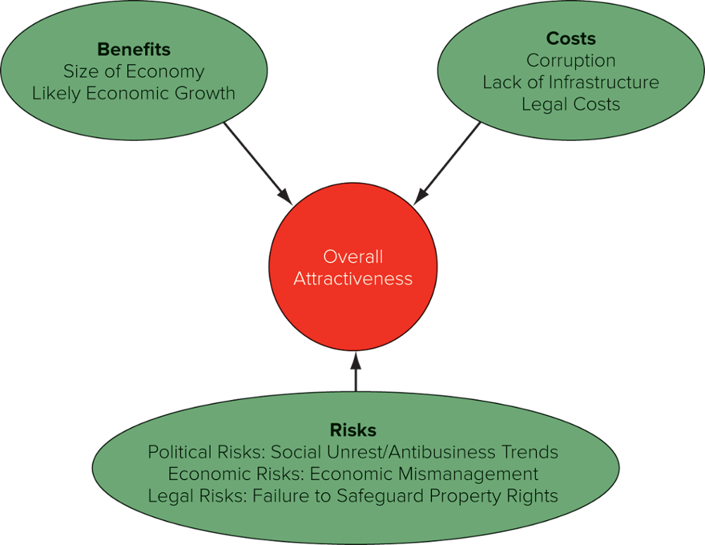
Country Attractiveness

Slide 21
Benefits
The long-run monetary benefits of doing business in a country are a function of
  The size of the market
  The present wealth (purchasing power) of consumers in that market
  The likely future wealth of consumers.

Slide 22
Benefits
In 1960, South Korea was viewed as just another impoverished third-world nation.
By 2017, it had the world’s 11th-largest economy.
By identifying and investing early in a potential future economic star, international firms may build brand loyalty and gain experience in that country’s business practices.
These will pay back substantial dividends if that country achieves sustained high economic growth rates.

Slide 23
Benefits
First-mover advantages are the advantages that accrue to early entrants into a market.
This kind of reasoning has been driving significant inward investment into China, which may become the world’s largest economy by 2030 if it continues growing at current rates
  (China is already the world’s second-largest national economy).
In contrast, late entrants may find that they lack the brand loyalty and experience necessary to achieve a significant presence in the market.

Slide 24
Costs
With regard to political factors, a company may be pushed to pay off politically powerful entities in a country before the government allows it to do business there.
The need to pay what are essentially bribes is greater in closed totalitarian states than in open democratic societies.

Slide 25
Costs
With regard to economic factors, one of the most important variables is the sophistication of a country’s economy.
It may be more costly to do business in relatively primitive or undeveloped economies because of the lack of infrastructure and supporting businesses.

Slide 26
Costs
At the extreme, an international firm may have to provide its own infrastructure and supporting business, which obviously raises costs.
When McDonald’s decided to open its first restaurant in Moscow, it found that to serve food and drink indistinguishable from that served in McDonald’s restaurants elsewhere, it had to vertically integrate backward to supply its own needs.
The quality of Russian-grown potatoes and meat was too poor.
Thus, to protect the quality of its product, McDonald’s set up its own dairy farms, cattle ranches, vegetable plots, and food-processing plants within Russia.
This raised the cost of doing business in Russia, relative to the cost in more sophisticated economies where high-quality inputs could be purchased on the open market.

Slide 27
Costs
As for legal factors, it can be more costly to do business in a country where
  local laws and regulations set strict standards with regard to product safety, safety in the workplace, environmental pollution.
  the absence of a cap on damage awards has meant spiraling liability insurance rates (e.g., the United States).
  a country that lacks well-established laws for regulating business practice (as is the case in many of the former communist nations).
  there is an absence of a well-developed body of business contract law, in this case international firms may routinely face large losses from contract violations.
  local laws fail to adequately protect intellectual property can lead to the theft of an international business’s intellectual property and lost income.

Slide 28
Risks
Political risk has been defined as the likelihood that political forces will cause drastic changes in a country’s business environment that adversely affect the profit and other goals of a business

Slide 29
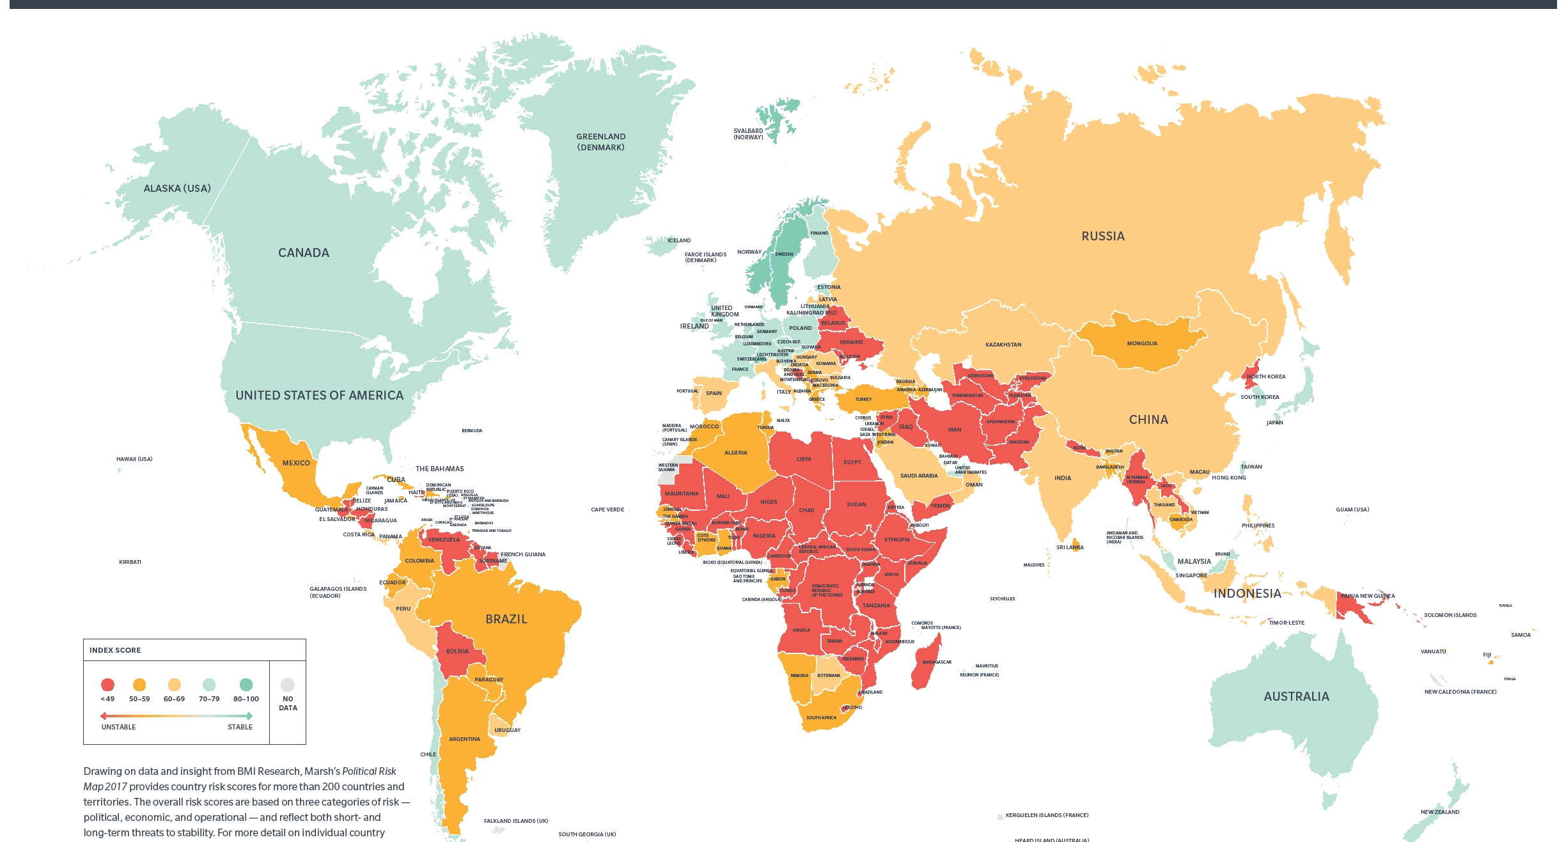
Political Risk Map

Slide 30
Risk
Political risks may result from
  governmental actions such as passage of laws that
    expropriate private property
    devalue the currency
    constrain the repatriation of profits.
  nongovernmental actions, such as
    kidnappings
    extortion
    acts of terrorism

Slide 31
Risk: Terrorism and Kidnapping
Kidnapping and the taking of hostages for ransom may be used to fund a terrorist group’s activities.
Executives of large international companies are often prime targets for kidnappers because their employers have “deep pockets” to pay large ransoms.
Latin American countries have some of the world’s highest kidnapping rates
Mexico City is at or near the top of the list of cities with the highest kidnapping rates.
Annual security costs for a company with a sales office in Bogotá, Colombia, can be $125,000 and up to $1 million for a company with operations in rebel-controlled

Slide 32
Risk: Terrorism and Kidnapping
When high-ranking executives are required to enter countries with high kidnapping rates, they should
  enter unannounced
  meet with only a few key people in secure locations
  leave just as quickly and quietly
Some companies purchase kidnap, ransom, and extortion insurance, but security experts say that training people to avoid trouble in the first place is a far better investment.

Slide 33
Risk: Property Seizure
Governments sometimes seize the assets of companies doing business within their borders.
Asset seizures fall into one of three categories:
  confiscation
  expropriation
  nationalization

Slide 34
Risk: Property Seizure
Confiscation
  The forced transfer of assets from a company to the government without compensation.
Expropriation
  The forced transfer of assets from a company to the government with compensation normally determined by the expropriating government.
Today, governments rarely resort to confiscation or expropriation because these acts can jeopardize investment in the country.

Slide 35
Risk: Property Seizure
Whereas expropriation involves one or several companies in an industry, nationalization means government takeover of an entire industry.
Likely candidates for nationalization include industries important to a nation’s security and those that generate large revenues.
Venezuela’s late President Hugo Chavez nationalized that country’s telephone, electricity, and oil industries and threatened to nationalize many more.
Businesses from other countries reacted to these moves by not investing in Venezuela.

Slide 36
Overall Attractiveness
The overall attractiveness of a country as a potential market or investment site for an international business depends on balancing the benefits, costs, and risks associated with doing business in that country.
If a firm is considering an investment in a politically risky environment, it should be sure that it can obtain rates of return that are high enough to offset the risks of entering that market.

Slide 37
Managing Political Risk
A firm can reduce its financial exposure by
Reducing its net investment in the local subsidiary, perhaps by repatriating the subsidiary’s profits to the parent company through dividend payments
Partnering with locals through selling shares in the subsidiary to host country citizens
Using short-term leases to acquire new capital equipment rather than purchasing it outright.
Build domestic political support in the host country by being a good corporate citizen
  for example, the firm might purchase inputs from local suppliers

Slide 38
Managing Political Risk
Most MNCs continually monitor the countries in which they do business for changes in political risk.
Often the best sources of information are employees.
Whether they are citizens of the home country or of the host country,
Employees possess firsthand knowledge of the local political environment and are a valuable source of political risk information.
Embassy officials and international chambers of commerce are often rich sources of information.
Numerous consulting firms specialize in political risk assessment to help firms evaluate the risks of doing business in a particular country.

Slide 39
Managing Political Risk
To reduce the risk of foreign operations, most developed countries have created government-owned or government-sponsored organizations to insure firms against political risks.
For instance, the Overseas Private Investment Corporation (OPIC) insures U.S. overseas investments against nationalization, insurrections or revolutions, and foreign-exchange inconvertibility.

Slide 40
Managing Political Risk
In a typical transaction, OPIC sold Plant-Tech Concrete Solutions, a Maryland building supply company, $2.8 million of political risk insurance, allowing it to construct a facility producing low-cost concrete products in Angola.
However, OPIC insurance is limited to firms operating in countries with which the United States has signed bilateral investment treaties.

