Slide 1
Chapter 5
International Trade Theory

Slide 2
Benefits of International Trade
International trade allows a country to specialize in the manufacture and export of products that can be produced most efficiently in that country, while importing products that can be produced more efficiently in other countries.
Thus, it may make sense for the United States to specialize in the production and export of commercial jet aircraft because the efficient production of commercial jet aircraft requires resources that are abundant in the United States, such as a highly skilled labor force and cutting-edge technological know-how.
On the other hand, it may make sense for the United States to import textiles from Bangladesh because the efficient production of textiles requires a relatively cheap labor force—and cheap labor is not abundant in the United States.

Slide 3
Benefits of International Trade
Greater choice of goods and services.
Important engine for job creation in many countries.
  The U.S. Department of Commerce estimates that for every $1 billion increase in exports, 22,800 jobs are created in the United States.
  It is estimated that 12 million U.S. jobs depend on exports
    these jobs pay on average from 13 to 18 percent more than those not related to international trade.

Slide 4
World’s Top Exporters
World’s Top Merchandise Exporters
World’s Top Service Exporters
Rank | Exporter | Value (U.S. $ billions) | Share of World Total (%)
1 | China | 2,275 | 13.8
2 | United States | 1,505 | 9.1
3 | Germany | 1,329 | 8.1
4 | Japan | 625 | 3.8
5 | Netherlands | 567 | 3.4
6 | South Korea | 527 | 3.2
7 | Hong Kong | 511 | 3.1
8 | France | 506 | 3.1
9 | United Kingdom | 460 | 2.8
10 | Italy | 459 | 2.8
Rank | Exporter | Value (U.S. $ billions) | Share of World Total (%)
1 | United States | 690 | 14.5
2 | United Kingdom | 345 | 7.3
3 | China | 285 | 6.0
4 | Germany | 247 | 5.2
5 | France | 240 | 5.0
6 | Netherlands | 178 | 3.7
7 | Japan | 158 | 3.3
8 | India | 155 | 3.3
9 | Singapore | 139 | 2.9
10 | Ireland | 128 | 2.7
Source: Based on International Trade Statistics 2013 (Geneva: World Trade Organization, November 2013), Tables I.7 and I.9, available at www.wto.org.
Notes:
The value and volume of international trade continues to increase. Today, world merchandise exports are valued at more than $16.5 trillion, and service exports are worth more than $4.8 trillion. Table 5.1 shows the world’s largest exporters of merchandise and services. Perhaps not surprisingly, the United States ranks first in commercial services exports and ranks second in merchandise exports (behind China).

Slide 5
International Trade
The United States ranks first in commercial services exports and ranks second in merchandise exports (behind China).
Most of world merchandise trade is composed of trade in manufactured goods.
  its growth is much faster than trade in the two other classifications of merchandise—mining and agricultural products.
Trade in services accounts for around 22 percent of total world trade.

Slide 6
International Trade Theories
It is often said that a better understanding of economic history would have helped us to avoid the worst of the recent crisis.

Slide 7
Early Country-Based Theories
The first theories of international trade developed with the rise of the great European nation-states during the sixteenth century.
These early theories focused on the individual country.
These country-based theories are particularly useful for describing trade in commodities—standardized, undifferentiated goods such as oil, sugar, or lumber that are typically bought on the basis of price rather than brand name.

Slide 8
Modern Firm-Based Theories
As multinational corporations (MNCs) rose to power in the middle of the twentieth century, scholars shifted their attention to the firm’s role in promoting international trade.
The firm-based theories developed after World War II are useful in describing patterns of trade in differentiated goods—those such as automobiles, consumer electronics, and personal care products, for which brand name is an important component of the customer’s purchase decision.

Slide 9
Classical Country-Based Trade Theories: Mercantilism
A country’s wealth is measured by its holdings of gold and silver.
The main tent of mercantilism was that it was in a country’s best interests to maintain a trade surplus, to export more than it imported (i.e.. promoting exports and discouraging imports).
By doing so, a country would accumulate gold and silver and, consequently, increase its national wealth, prestige, and power.

Slide 10
Mercantilism
To achieve the tenet of mercantilism, government should actively intervene and support
  Export-oriented manufacturers through trade policies, such as those establishing subsidies or tax rebates, which stimulated sales to foreigners.
  Domestic manufacturers threatened by foreign imports through trade policies, such as those imposing tariffs or quotas, which protected those threatened manufacturers from foreign competition.

Slide 11
Mercantilism
Most members of society, however, are hurt by such policies.
Governmental subsidies of the exports of certain industries are paid by taxpayers in the form of higher taxes.
Governmental import restrictions are paid for by consumers in the form of higher prices because domestic firms face less competition from foreign producers.

Slide 12
Mercantilism: Flaws
It viewed trade as a zero-sum game.
  (A zero-sum game is one in which a gain by one country comes at the expense of other nations’ loss)
If all nations were to barricade their markets from imports and push their exports onto others, international trade would be severely restricted.
  In fact, trade in all nonessential goods would likely cease altogether.

Slide 13
Mercantilism
Because mercantilism does benefit certain members of society, mercantilist policies are still politically attractive to some firms and their workers.
Modern supporters of such policies are called neomercantilists, economic nationalism, or protectionists.

Slide 14
Mercantilism
The mercantilist doctrine is by no means dead.
Donald Trump appears to advocate neo-mercantilist policies.
Neo-mercantilists equate political power with economic power and economic power with a balance-of-trade surplus.
China long pursued a neo-mercantilist policy, deliberately keeping its currency value low against the U.S. dollar in order to sell more goods to the United States and other developed nations, and thus amass a trade surplus.

Slide 15
Classical Country-Based Trade Theories: Absolute Advantage
Adam Smith attacked the mercantilist assumption that trade is a zero-sum game.
Smith argued that countries differ in their ability to produce goods efficiently.
According to Smith, countries should specialize in and export the production of goods and services for which they have an absolute advantage and and import those goods and services for which other countries have absolute advantage.
A country has an absolute advantage in the production of a product when it is more efficient than any other country at producing it.

Slide 16
Absolute Advantage
Adam Smith’s Absolute Advantage Theory
Country’s Level of Productivity | Import Goods and Services | Export Goods and Services
More Productive Than Other Countries (Absolute Advantage) |  | ✓
Less Productive Than Other Countries | ✓

Slide 17
Absolute Advantage
France has an absolute advantage in the production of perfume
Japan has an absolute advantage in the production of clocks
Trade: Both will be better off
 | Output per hour of labor
 | France | Japan
Perfume | 2 | 1
Clock | 3 | 5

Slide 18
Absolute Advantage
Assume, for the sake of simplicity, that
  there are only two countries in the world, France and Japan
  only two goods, perfume and clocks
  only one factor of production, labor.
In France one hour of labor can produce either two bottles of perfumes or three clocks.
In Japan one hour of labor can produce either one bottle of perfume or five clocks.
France has an absolute advantage in the production of perfume:
  One hour of labor produces two bottles in France but only one in Japan.
Japan has an absolute advantage in the production of clocks:
  One hour of labor produces five clocks in Japan but only three in France.

Slide 19
Absolute Advantage
If France and Japan are able to trade with each other, both will be better off.
Suppose France agrees to exchange two bottles of perfume for four clocks.
Only 1 hour of French labor is needed to produce the two bottles of perfume bound for Japan.
In return, France will get four clocks from Japan.
These four clocks would have required 1.33 hours of French labor had France produced them rather than buy them from Japan.

Slide 20
Absolute Advantage
By trading with Japan rather than producing the clocks itself, France saves 0.33 hour of labor.
France can use this freed-up labor to produce more perfume, which in turn can be consumed by French citizens or traded to Japan for more clocks.
By allocating its scarce labor to produce goods for which it is more productive than Japan and then trading them to Japan, France can consume more goods than it could have done in the absence of trade.

Slide 21
Absolute Advantage
As this example shows, the theory of absolute advantage destroys the mercantilist idea that international trade is a zero-sum game
Because there are gains to be had by both countries party to an exchange, international trade is a positive-sum game.
Nations should trade so that their people can obtain a greater quantity of goods more cheaply.
The theory does not measure a nation’s wealth by how much gold and silver it has on reserve but by the living standards of its people.

Slide 22
Absolute Advantage
Unfortunately, the theory is flawed.
What happens to trade if one country has an absolute advantage in both products?
The theory of absolute advantage incorrectly suggests that no trade would occur.

Slide 23
Absolute Advantage
David Ricardo, an early-nineteenth-century British economist, solved this problem by developing the theory of comparative advantage
When a country is not able to produce a good more efficiently than other nations, but produces the good more efficiently than it does any other good, it is said to have a comparative advantage

Slide 24
Classical Country-Based Trade Theories: Comparative Advantage
A country should produce and export those goods and services for which it is relatively more productive than other countries are and import those goods and services for which other countries are relatively more productive than it is.
The distinction occurs because comparative advantage considers the concept of opportunity cost—the value of what is given up to get a good.
Ricardo incorporates this concept into the determination of what goods a country should produce.

Slide 25
Comparative Advantage
David Ricardo’s Comparative Advantage Theory
Country’s Level of Productivity | Import Goods and Services | Export Goods and Services
Relatively More Productive Than Other Countries |  | ✓
Relatively Less Productive Than Other Countries | ✓
Notes:
What happens to trade if one country has an absolute advantage in both products? The theory of absolute advantage incorrectly suggests that no trade would occur.
David Ricardo, an early-nineteenth-century British economist, solved this problem by developing the theory of comparative advantage. This theory states that a country should produce and export those goods and services for which it is relatively more productive than other countries are. That same country should import those goods and services for which other countries are relatively more productive than it is.
The difference between the two theories is subtle: Smith’s theory looks at absolute productivity differences; Ricardo’s theory looks at relative productivity differences. The distinction occurs because comparative advantage considers the concept of opportunity cost—the value of what is given up to get a good. Ricardo incorporates this concept into the determination of what goods a country should produce.

Slide 26
Comparative Advantage
Consider a brain surgeon who is better at both brain surgery and lawn mowing than her neighbor’s teenaged son is.
If the surgeon has an absolute advantage over his neighbor 'son in both areas, so he should try to outproduce him across the board, right?
Wrong.
If the surgeon is comparatively better at surgery than at lawn mowing, she will spend most of her time at the operating table and pay the teenager to mow her lawn.
The brain surgeon behaves this way because the opportunity cost of mowing the lawn is too high

Slide 27
Comparative Advantage
Why don't NBA players mow their own lawns?
Ostensibly, NBA players are stronger and faster than their landscapers and could do it more effectively.
However, NBA players can maximize their value and productivity by focusing on basketball rather than wasting energy with a lawnmower; the opportunity cost is too high (The value of what is given up to mow the yard).
Instead, the basketball player and landscaper each specialize and trade, using money as an intermediary representation of their respective productivity.
Comparative advantage says that countries should behave similarly.

Slide 28
Absolute Advantage
Comparative Advantage
Output per hour of labor
 | France | Japan
Perfume | 4 | 1
Clock | 6 | 5
Absolute Advantage
 | Output per hour of labor
 | France | Japan
Perfume | 2 | 1
Clock | 3 | 5

Slide 29
Comparative Advantage
Suppose productivity stays the same in Japan but doubles in France as the result of new job training programs.
Table on the right side shows this new situation.
France now can produce four bottles of perfume or six clocks per hour of labor.
France now has an absolute advantage in both wine and clocks: For each hour of labor, France can produce three more bottles of wine (four minus one) or one more clocks (six minus five) than Japan can.
According to the theory of absolute advantage, no trade should occur because France is more productive than Japan in producing both goods.

Slide 30
Comparative Advantage
The theory of comparative advantage indicates that trade should still occur.
France is 4 times better than Japan is in perfume production but only 1.2 times better in clock production.
Japan is only 0.25 times as good as France in perfume production but 0.83 times as good in clock production.
France is comparatively better than Japan in perfume production, whereas Japan is comparatively better than France in clock production.
By the theory of comparative advantage, France should export perfume to Japan and Japan should export clocks to France.
If they do so, both will be better off.

Slide 31
Comparative Advantage
If Japan offers to trade 2 clock radios for one bottle of wine, France will be better off.
Without trade, sacrificing one bottle of wine domestically would yield France only 1.5 clocks in increased production.
With trade, France could get 2 clocks by giving up one bottle of perfume to Japan.
France gets more clock radios per bottle of perfume given up by trading with Japan than by producing the clock radios domestically.

Slide 32
Comparative Advantage
Japan also gains.
Without trade, Japan has to give up five clocks to get one more bottle of perfume.
With trade, Japan has to give up only two clocks to obtain one more bottle.
Japan gets more perfume per clock given up by trading with France than by producing the wine domestically.

Slide 33
Comparative Advantage: Assumptions and Limitations
The world economy produces more than two goods and services and is made up of more than two countries.
Barriers to trade may exist
Someone must pay to transport goods between markets
Inputs other than labor are necessary to produce goods.
The world economy uses money as a medium of exchange.

Slide 34
Theory of Relative Factor Endowments
The theory of comparative advantage begs a broader question: What determines the products for which a country will have a comparative advantage?
To answer this question, two Swedish economists, Eli Heckscher and Bertil Ohlin, developed the theory of relative factor endowments, now often referred to as the Heckscher-Ohlin theory or Factor Proportions.

Slide 35
Theory of Relative Factor Endowments
Factor endowments (or types of resources) vary among countries.
  For example, Argentina has much fertile land, Saudi Arabia has large crude oil reserves.
different factor endowments explain differences in factor costs
  specifically, the more abundant a factor, the lower its cost.

Slide 36
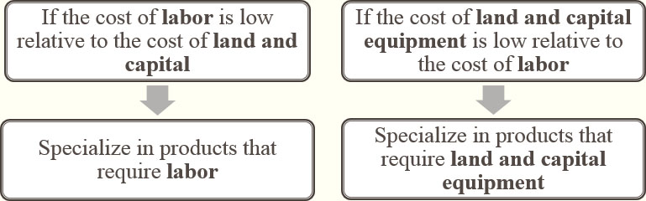
Theory of Relative Factor Endowments
Factor Proportions Theory: Trade theory stating that countries have comparative advantage and produce and export goods that require resources (factors) that are abundant and import goods that require resources in short supply
Notes:
Factor proportions theory resulted from the research of two economists, Eli Heckscher and Bertil Ohlin, and is therefore sometimes called the Heckscher–Ohlin theory.
Factor proportions theory differs considerably from the theory of comparative advantage. Whereas the theory of comparative advantage focus on the productivity of the production process for a particular good, factor proportions theory says that a country specializes in producing and exporting goods using the factors of production that are most abundant and thus cheapest—not the goods in which it is most productive.
Labor versus Land and Capital Equipment
Factor proportions theory breaks a nation’s resources into two categories: labor on the one hand, land and capital equipment on the other. It predicts that a country will specialize in products that require labor if the cost of labor is low relative to the cost of land and capital. Alternatively, a country will specialize in products that require land and capital equipment if their cost is low relative to the cost of labor.

Slide 37
Theory of Relative Factor Endowments
Like Ricardo’s theory, the Heckscher–Ohlin theory argues that free trade is beneficial.
Unlike Ricardo’s theory, however, the Heckscher–Ohlin theory argues that the pattern of international trade is determined by differences in factor endowments, rather than differences in productivity.

Slide 38
Relative Factor Endowments-Leontief paradox
 | U.S. Export | U.S. Import
Heckscher-Ohlin Theory | Capital-Intensive Goods (Abundant Capital) | Labor-Intensive Goods (Labor Scarcity)
Leontief paradox | U.S. imports were more capital-intensive than were U.S. exports
Notes:
Heckscher-Ohlin theory was tested empirically after World War II by economist Wassily Leontief using input-output analysis, a mathematical technique for measuring the interrelationships among the sectors of an economy. Leontief believed the United States was a capital-abundant and labor-scarce economy Therefore, according to the Heckscher-Ohlin theory, he reasoned that the United States should export capital-intensive goods, such as bulk chemicals and steel, and import labor-intensive goods, such as clothing and footwear.
The results were not consistent with the predictions of the Heckscher-Ohlin theory: U.S. imports were nearly 30 percent more capital-intensive than were U.S. exports. The economics profession was distraught. The Heckscher-Ohlin theory made such intuitive sense, yet Leontief’s findings were the reverse of what was expected. Thus was born the Leontief paradox.

Slide 39
Leontief paradox
This leaves economists with a difficult dilemma.
They prefer the Heckscher–Ohlin theory on theoretical grounds, but it is a relatively poor predictor of real-world international trade patterns.
On the other hand, the theory they regard as being too limited, Ricardo’s theory of comparative advantage, actually predicts trade patterns with greater accuracy.
The best solution to this dilemma may be to return to the Ricardian idea that trade patterns are largely driven by international differences in productivity.

Slide 40
Leontief paradox
Thus, one might argue that the United States exports commercial aircraft and imports textiles not because its factor endowments are especially suited to aircraft manufacture and not suited to textile manufacture, but because the United States is relatively more efficient at producing aircraft than textiles.

Slide 41
Leontief paradox
A key assumption in the Heckscher–Ohlin theory is that technologies are the same across countries.
This may not be the case. Differences in technology (the sophisticated management techniques that control the world’s largest assembly lines at Boeing )may lead to differences in productivity, which in turn, drives international trade patterns.

Slide 42
Modern Firm-Based Trade Theories
Unlike country-based theories, firm-based theories incorporate factors such as quality, technology, brand names, and customer loyalty into explanations of trade flows.
Because firms, not countries, are the agents for international trade, the newer theories explore the firm’s role in promoting exports and imports.

Slide 43
Modern Firm-Based Trade Theories:
Vernon’s Product Life Cycle Theory
1. New Product Stage
2. Maturing Product Stage
3. Standardized Product Stage
Product Life Cycle
Notes:
Product life cycle theory from the field of marketing was modified by Raymond Vernon of the Harvard Business School. According to Vernon’s theory, the international product life cycle consists of three stages:
In Stage 1, the new product stage, a firm develops and introduces an innovative product in response to a perceived need in the domestic market. The existence of a profitable market for the product is uncertain, so marketing executives must monitor customer reactions closely. Furthermore, the firm often minimizes its investment in manufacturing capacity for the product, and sells mostly to the domestic market.
In Stage 2, the maturing product stage, demand for the product expands dramatically as consumers recognize its value. The innovating firm builds new factories to expand its capacity and satisfy domestic and foreign demand for the product. Domestic and foreign competitors begin to emerge, lured by the prospect of lucrative earnings.
In Stage 3, the standardized product stage, the market for the product stabilizes. The product becomes more of a commodity, and firms are pressured to lower their manufacturing costs as much as possible by shifting production to facilities in countries with low labor costs. As a result, the product begins to be imported into the innovating firm’s home market (by either the firm or its competitors). In some cases, imports may result in the complete elimination of domestic production.

Slide 44
International Product Life Cycle
In Stage 1, the new product stage, a firm develops and introduces an innovative product in response to a perceived need in the domestic market.
  Because the exact level of demand in the domestic market is highly uncertain at this point, the company keeps its production volume low and based in the home country.

Slide 45
International Product Life Cycle
In Stage 2, the maturing product stage, demand for the product expands dramatically as consumers recognize its value.
  The innovating firm builds new factories to expand its capacity and satisfy domestic and foreign demand for the product.
  Domestic and foreign competitors begin to emerge, lured by the prospect of lucrative earnings.

Slide 46
International Product Life Cycle
In Stage 3, the standardized product stage, As the market in the United States and other advanced nations matures, the product becomes more standardized, and price becomes the main competitive weapon.
  As the market becomes more price sensitive, and firms are pressured to lower their manufacturing costs as much as possible by shifting production to facilities in countries with low labor costs.

Slide 47
International Product Life Cycle
In Stage 3, the standardized product stage,
  Producers based in advanced countries where labor costs are lower than in the United States (e.g., Italy) might now be able to export to the United States.
  If cost pressures become intense, the process might not stop there.
  advanced countries might lose their advantage, as developing countries (e.g., Thailand) begin to acquire a production advantage over advanced countries.
  The consequence of these trends for the pattern of world trade is that over time, the United States switches from being an exporter of the product to an importer of the product as production becomes concentrated in lower-cost foreign locations.

Slide 48
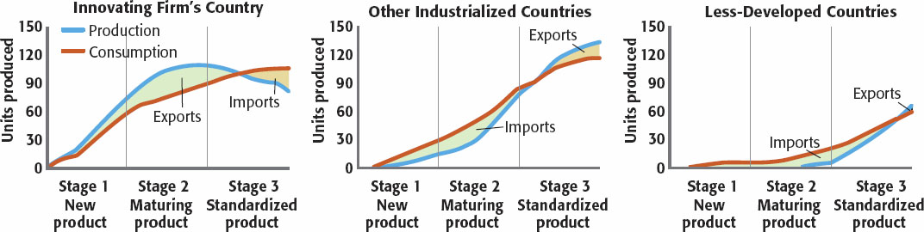
International Product Life Cycle
International Product Life Cycle: Theory stating that a company will begin by exporting its product and later undertake foreign direct investment as the product moves through its life cycle

Slide 49
New Trade Theory
The theory incorporate the impact of economies of scale on trade in differentiated goods.
Exist in an industry when a firm’s costs (i.e., cost per unit of output) fall as a function of its volume of production.
A firm enjoys this cost advantages because it can spreads fixed costs over increasing output and demand better terms from their suppliers.
The more units are produced, the larger the number of units over which costs can be spread—that is, the greater the economies of scale.

Slide 50
New Trade Theory
For example, Microsoft realizes economies of scale by spreading the fixed costs of developing new versions of its Windows operating system, which runs to about $10 billion, over the 2 billion or so personal computers on which each new system is ultimately installed.
Similarly, economies of scale explains why Italian automaker must sell globally to be efficient.

Slide 51
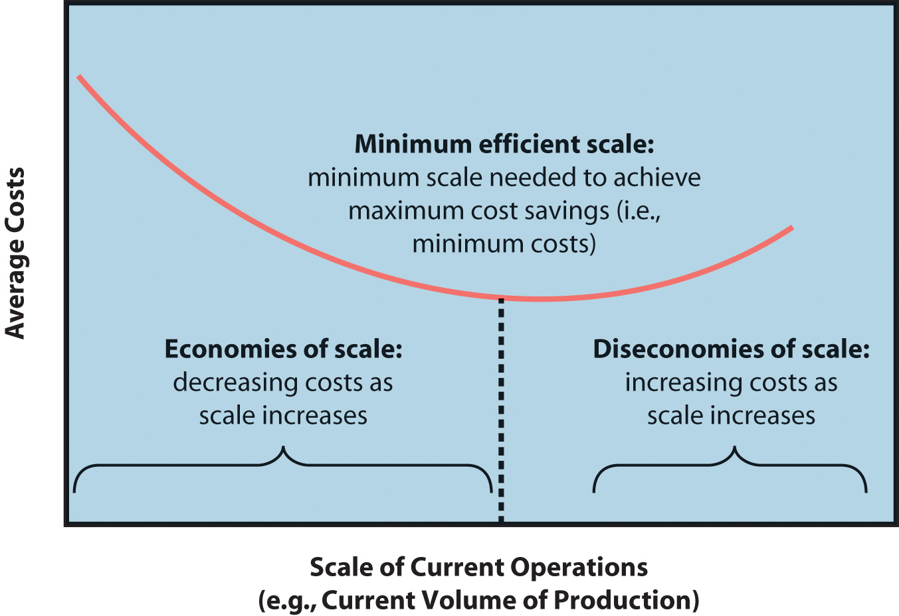
Minimum Efficient Scale (MES)

Slide 52
New Trade Theory
New trade theory argues that for those products where economies of scale are significant and represent a substantial proportion of world demand, the first movers in an industry can gain a scale-based cost advantage that later entrants find almost impossible to match.
Thus, world trade in certain products may be dominated by countries whose firms were first movers in their production.

Slide 53
New Trade Theory
Consider the commercial aerospace industry.
There are substantial scale economies that come from the ability to spread the fixed costs of developing a new jet aircraft over a large number of sales.
It has cost Airbus some $15 billion to develop its superjumbo jet, the 550-seat A380.
To recoup those costs and break even, Airbus will have to sell at least 250 A380 planes.

Slide 54
New Trade Theory
If Airbus can sell more than 350 A380 planes, it will apparently be a profitable venture.
Total demand over the next 20 years for this class of aircraft is estimated to be between 400 units.
Thus, the global market can probably profitably support only one producer of jet aircraft in the superjumbo category.
It follows that the European Union might come to dominate in the export of very large jet aircraft, primarily because a European-based firm, Airbus, was the first to produce a superjumbo jet aircraft and realize scale economies.

Slide 55
New Trade Theory
Other potential producers, such as Boeing, might be shut out of the market because they will lack the scale economies that Airbus will enjoy.
By pioneering this market category, Airbus may have captured a first-mover advantage based on scale economies that will be difficult for rivals to match.

Slide 56
First-Mover Advantages
First- mover advantages are advantages that come to firms that make important strategic and technological decisions early in the development of an industry.
These advantages are often critical to a firm’s success in industries experiencing rapid technological developments and relatively short product life cycles.

Slide 57
First-Mover Advantages
Technological leadership
Preemption of strategically valuable assets
The creation of customer-switching costs
Brand loyalty

Slide 58
Technological Leadership
Early investments in particular technologies can generate two advantages in emerging industries.
  Obtain economies of learning based on their greater cumulative volume of production with a particular technology.
  Obtain patent protections that enhance their performance.

Slide 59
Preemption of Strategically Valuable Assets
Better Expectations of Future Values
  First movers that move to tie up strategically valuable resources in an industry before their full value is widely understood can gain sustained competitive advantages.

Slide 60
Better Expectations of Future Values
A firm may gain a competitive advantage if it buys a parcel of land for a low cost in an undeveloped rural area 40 miles north of San Antonio, Texas.
Several years later, an interstate highway is built right near the firm’s land.
With the highway, suburban growth explodes as many new neighborhoods and shopping malls are built.

Slide 61
Better Expectations of Future Values
When an oil company such as Royal Dutch Shell (because of its superior exploration skills) acquires leases with greater development potential than was expected by its competition, the company is gaining access to raw materials in a way that is likely to generate sustained competitive advantages.

Slide 62
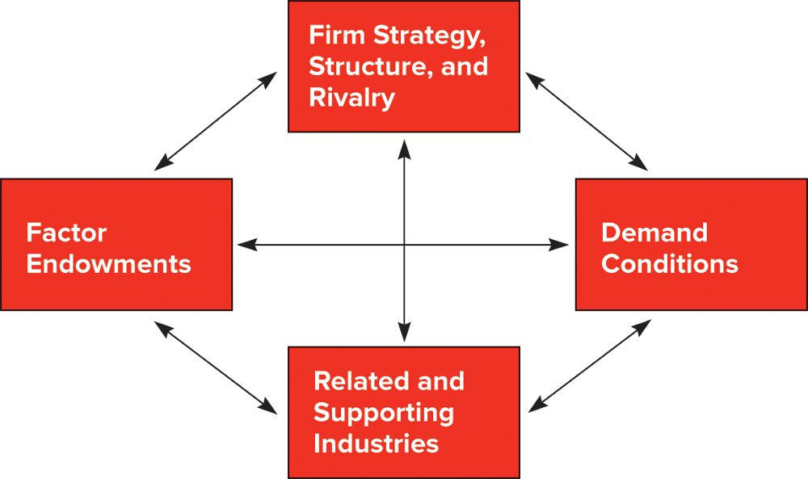
Modern Firm-Based Trade Theories:
Porter’s Theory of National Competitive Advantage: Porter’s diamond
Notes:
Porter is not preoccupied with explaining the export and import patterns of nations but rather with explaining why some nations are more competitive in certain industries.

Slide 63
Porter’s Theory of National Competitive Advantage
Porter is not preoccupied with explaining the export and import patterns of nations but rather with explaining why some nations are more competitive in certain industries.
Porter’s theory is a hybrid:
  Argues that success in international trade comes from the interaction of four country- and firm-specific elements.

Slide 64
Porter’s Theory of National Competitive Advantage
A country’s factors of production affect its ability to compete.
Porter goes beyond the basic factors (land, labor, and capital) to include the advanced factors such as the educational level of the workforce and the quality of the country’s infrastructure.
Notes:
Porter believes that success in international trade comes from the interaction of four country- and firm-specific elements:

Slide 65
Porter’s Theory of National Competitive Advantage
Demand Conditions
  The existence of a large, sophisticated consumer base who hold companies to a high standard of value creation and cost containment contributes to national competitive advantage
  often stimulates the development and distribution of innovative products as firms struggle for dominance in their domestic markets.
  In meeting their domestic customers’ needs, firms develop and fine-tune products that also can be marketed internationally.
Notes:
Porter believes that success in international trade comes from the interaction of four country- and firm-specific elements:

Slide 66
Porter’s Theory of National Competitive Advantage
  The rapid adoption of the Internet, tablets, and smartphones by US consumers and companies was driven by a sophisticated US market for these technologies and created a fertile climate for companies such as Twitter, Facebook, eBay, and Amazon to develop and tailor new products to meet the needs of this market domestically and internationally.

Slide 67
Porter’s Theory of National Competitive Advantage
Related and supporting industries
The emergence of an industry often stimulates the development of local suppliers eager to meet that industry’s business needs.
Competition among input suppliers leads to lower prices, higher-quality products, and technological innovations in the input market, all of which reinforce the industry’s competitive advantage in world markets.
Notes:
Porter believes that success in international trade comes from the interaction of four country- and firm-specific elements:

Slide 68
Porter’s Theory of National Competitive Advantage
For example, Hollywood’s dominance of the world film industry is based in part on the local availability of specialist input suppliers, such as casting directors, stunt coordinators, costume and set designers, demolition experts, animators, special-effects firms, and animal wranglers.
Toyota’s global success in the 1990s and early 2000s was based to a large extent on a network of world-class suppliers in Japan.
Notes:
Porter believes that success in international trade comes from the interaction of four country- and firm-specific elements:

Slide 69
Porter’s Theory of National Competitive Advantage
Firm strategy, structure, and rivalry
  The domestic environment in which firms compete shapes their ability to compete in international markets.
  Firms overcome vigorous domestic competition by reducing costs, boosting product quality, raising productivity, and developing innovative products
  Firms that have been tested in this way often develop the skills needed to succeed internationally.
  Further, many of the investments they have made in the domestic market are transferable to international markets.
Notes:
Porter believes that success in international trade comes from the interaction of four country- and firm-specific elements:

Slide 70
Porter’s Theory of National Competitive Advantage
Porter also contends that government can influence each of the four components of the diamond—either positively or negatively.
Factor endowments can be affected by subsidies, and policies toward education.
Government can shape domestic demand through local product standards or with regulations that mandate or influence buyer needs.
Government policy can influence supporting and related industries through regulation
Influences firm rivalry through such devices as antitrust laws.

Slide 71
Porter’s Theory of National Competitive Advantage
If Porter is correct, we would expect that countries should be exporting products from those industries where all four components of the diamond are favorable, while importing in those areas where the components are not favorable.

