Slide 1
How Chemotherapy Affects the Body

Slide 2
Introduction
Chemotherapy is a drug treatment that kills the fast-growing cells in the body by the use of powerful chemicals.
It is mostly used in the treatment of cancer because the cancer cells tend to multiply more quickly than most of the body cells.
Chemotherapy treatment affects almost every part of the body and the systems of the body.
The powerful chemo drugs affect the reproductive system, digestive system, nervous system, and the excretory system.
This presentation explores the various effects of chemotherapy on the body.

Slide 3
Blood disorders
Chemotherapy interferes with the making of new blood cells leading to the formation of a few blood cells. These results into;
Anemia
The drop in blood cells reduces the amount of oxygen in the body. Anemic symptoms include feeling- cold, weak, tired, dizzy and cranky.
Infections
The drop in white blood cells lowers immunity
Any minor disease (e.g., A sore) becomes a serious matter

Slide 4
Bleeding problems
Reduced levels platelets (thrombocytopenia) cause bleeding complications.
A minor cut results in more extended of bleeding than normal.
occurrence of bleeding gums and nosebleeds.
Your bone marrow makes cells called platelets.
These cells keep you from bleeding too much by helping your blood clot.
Chemotherapy, radiation, and bone marrow transplants can destroy some of your platelets. This can lead to bleeding during cancer treatment

Slide 5
Effects on the nervous system and muscles
Chemotherapy drugs can damage the central nervous system and the peripheral nervous system.
Nervous system damage is often related to the dose of the drug.
Damage to the central nervous system is more likely to occur after radiation therapy to the brain or when chemotherapy drugs are injected into the cerebrospinal fluid (CSF).
Some of the chemotherapy drugs cause nerve damage.
Some of the muscle and nerve symptoms include, burning and tingling Tired, achy and weak muscles
Hands and or feet may be weak or numb.

Slide 6
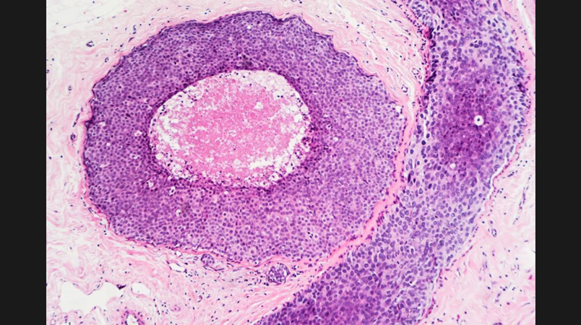

Slide 7
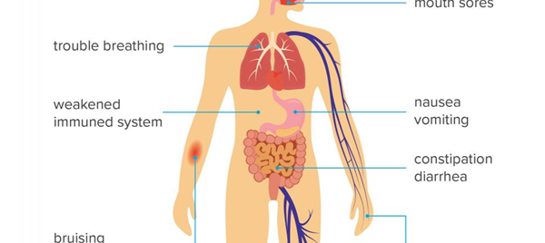
Effects of chemotherapy on different parts of the body.

Slide 8
Causes nausea/vomiting and changes in appetite
Chemotherapy drugs may change how food tastes
A patient may start preferring other food types
A patient may not feel hungry at all
One may feel nausea accompanied by vomiting immediately after treatment

Slide 9
Chemotherapy may lead to hair loss (alopecia)
Hair loss is perhaps the most infamous side effect of chemo treatments.
Hair loss may occur in areas like underarms, chest, legs, pubic region and the head.
Eyelashes and eyebrows may fall off.
Hair loss is perhaps the most infamous side effect of chemo treatments.
Many chemotherapy drugs affect hair follicles and can cause hair loss (alopecia) within a few weeks of the first treatment. Hair loss can occur anywhere on the body, from eyebrows and eyelashes to your legs. Hair loss is temporary. New hair growth usually begins several weeks after the final treatment.

Slide 10
Changes in skin and nails
Some of the drugs cause the peeling of the skin
The skin may darken, become itchy and dry
The skin becomes much sensitive to the sun
Nails may become darker, with white ridges across them
Nails may become dry and brittle

Slide 11
Changes in hearing and vision problems
A patient may lose the ability to hearing sounds with a high pitch
Chemotherapy may cause tinnitus( the ears experience a continuous ringing noise)
Permanent or temporary hearing loss and balance problems
Minor dry eyes
Risk of eye cataracts and gradual vision loss

Slide 12
Sexuality life may change
Fatigue may lower interest in sexual activities
Changes in general appearance affect self-esteem that in turn, affects someone`s sexual life.
Loss of confidence about one`s ability may also affect sexuality.
Chemotherapy drugs are also known to alter hormones in both men and women.
In women, hormonal changes can bring on hot flashes, irregular periods, or sudden onset of menopause. You may experience dryness of vaginal tissues that can make intercourse uncomfortable or painful. The chance of developing vaginal infections also increases.

Slide 13
Changes in fertility
Reduces production levels of hormones by ovaries
Irregular periods ( periods may stop entirely in other women-Menopause)
Menopause in women under 40 years may cause osteoporosis( Bones become weak and prone to breakage)
Vaginal dryness due to vaginal thinning (vaginal atrophy)-Causes pain during intercourse.
Chemotherapy drugs may lower sperm production in men
May reduce the mobility of the sperms
May affect the ability to have and maintain a meaningful erection( It is mostly temporal)
May result in temporal or permanent infertility

Slide 14
Mucositis
Is where the mucous membrane becomes inflamed. It can affect any section of the digestive system beginning from the mouth to the anus.
Causes mouth sores -ulcers
Causes pain during eating or talking
May cause a burning sensation on the lips and in the mouth
Constipation and vomiting
Diarrhea

Slide 15
Heart problems
Congestive and cardiomyopathy heart failure (affects pumping of blood)
Damaged valves ( becomes narrow and may leak).
Diseases-coronary artery disease, pericarditis, pericardial fibrosis, pericardial effusion).
some chemo drugs can damage the heart by weakening your heart muscle (cardiomyopathy) or disturb your heart rhythm (arrhythmia).
These conditions can affect your heart’s ability to pump blood effectively. Some chemo drugs may even increase your risk for heart attack.
These problems are less likely to occur if your heart is strong and healthy when you start chemotherapy.

Slide 16
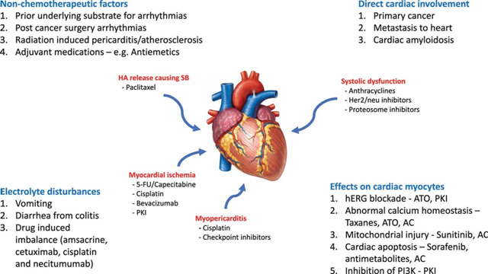
Effects of chemotherapy on the heart

Slide 17
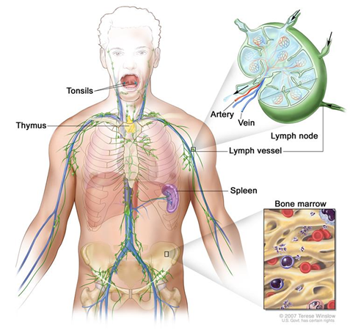
Chemotherapy can cause mouth sores and heart complications

Slide 18
Excretory (kidney) effects of chemotherapy
The kidneys work to excrete the powerful chemotherapy drugs as they move through your body.
In the process, some kidney and bladder cells can become irritated or damaged.
Chemo drugs may cause bladder irritation which causes a feeling of burning when urinating and increased urinary frequency.
symptoms of kidney include headache, decreased urination and swollen feet and ankles.
Chemotherapy causes renal dysfunction by damaging kidney structures/blood vessels
This leads to a decrease in the urine amount. The urine is dark and with bloodstains.

Slide 19
Psychological effects of chemotherapy
Living with cancer and dealing with chemotherapy can take an emotional toll.
You may feel fearful, stressed, or anxious about your appearance and health.
Depression is a common feeling as well, as people juggle work, family, and financial responsibilities on top of cancer treatment.
Cancer patients who have to take chemo drugs are mentally and emotionally affected.

Slide 20
Effects of chemotherapy on the digestive system
Chemo drugs affect the digestive system.
Dry mouth and mouth sores that form on the tongue, lips, gums, or in the throat can make it difficult to chew and swallow.
Mouth sores also make you more susceptible to bleeding and infection.
The powerful drugs can harm the cells along the gastrointestinal tract.
The drugs also cause nausea.

