Slide 1

CHESTER

Slide 2
Executive Summary
Contribution Margin: Reached a high of 33.3% for year 4 which increased each year except year 5.
Sales: Reached a high of $130,975,709 in year 3, being our highest number.
Market Share: Reached a high of $ 26.57 in year 3.
**Notes:
Chester's best year was year 3.
Year 1 was our first year so just learning the operations we did decent as a “start up.”
Year 4 and 5 were struggle years for the company.
We aren’t very happy with our ending results but we did our best at understanding the industry and the products and think if we had another few years Chester would be where the Board would like it to be.

Slide 3
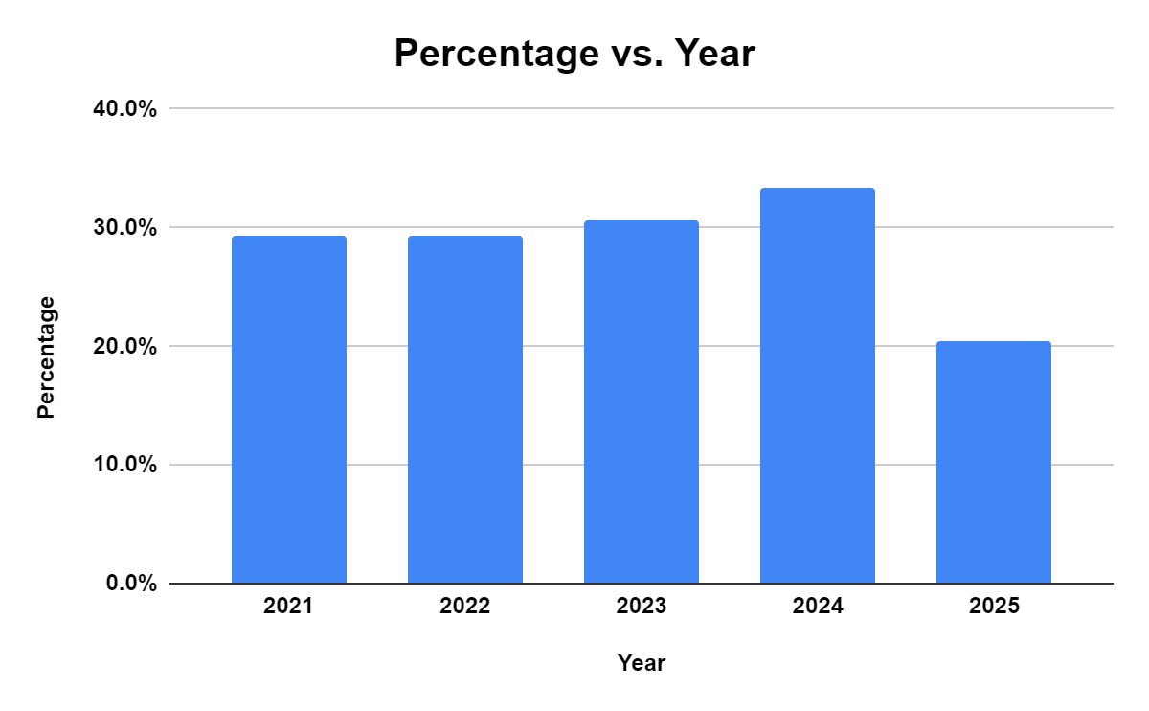
Contribution Margin %
Year Percentage
2021 29.3%
2022 29.3%
2023 30.6%
2024 33.3%
2025 20.4%

Slide 4
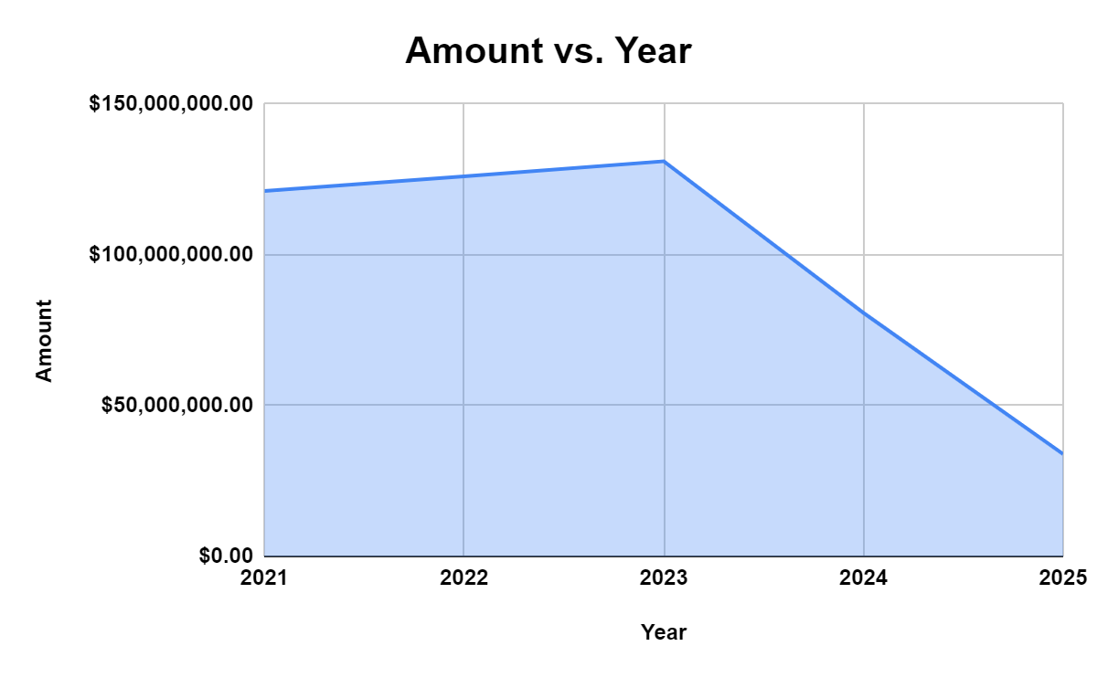
Sales
Year Amount
2021 $121,165,205.00
2022 $126,011,163.00
2023 $130,975,709.00
2024 $80,737,785.00
2025 $33,927,581.00

Slide 5
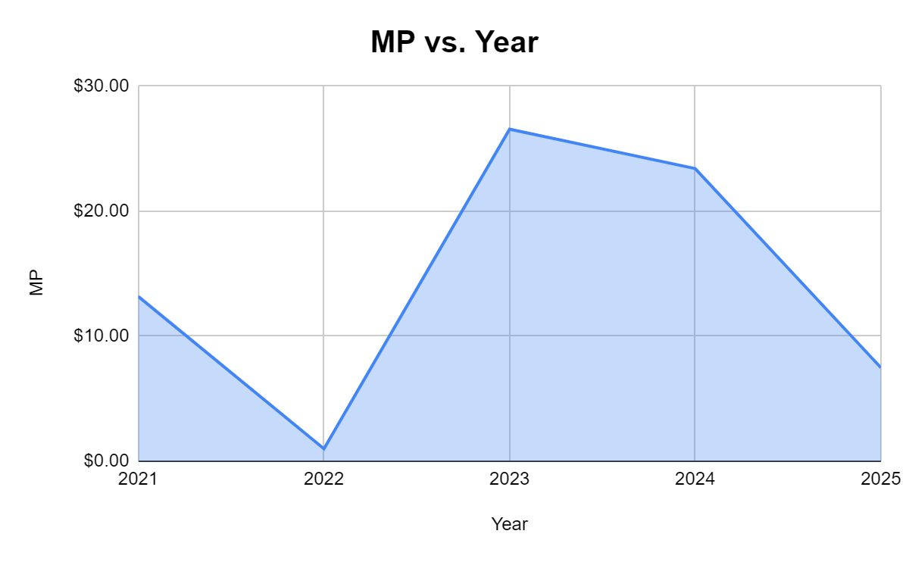
Market Price
Change
Year 1 - $ 13.18
Year 2 - $ 1.00 $ (12.18)
Year 3 - $ 26.57 $ 25.57
Year 4 - $ 23.41 $ (3.16)
Year 5 - $ 7.48 $ (15.93)

Slide 6
II. Corporate Governance

Slide 7
III. Mission, Objectives, and strategy
Our mission is to manufacture products that meet the specifications of our customers as those needs are a valuable part of our company.
1.Team Chester will obtain 28% of the high end segment market share by year 4
2. To increase units produced by 15% in the low end segment by each year
3. To increase the units sold in the size segment each year
1.Keep a steady production cycle to stay ahead of competitors to raise the market share.
2.Decrease the sales price to increase the units produced.
3. Increase the promo budget to increase the sales.

Slide 8
IV. FINANCIAL – STRATEGY
Businesses run for profit and our strategy for making Chester a profitable venture were:
  Issue stocks for fund requirement.
  Make Chester a debt free company to save on interest cost.
  Strive to increase the cash balance with each passing year through operating activities.
  Effective planning for funds required ensuring a low level of current debt and avoidance of emergency loan
  Aspire for increase in stock prices as we grow and expand.

Slide 9
V. FINANCIAL – HIGHLIGHTS
  Chester operated for 5 years in the industry and following our financial strategy, the highlights of our financial position is as under;
  Chester succeeded in not raising debt for the firm and we are a debt free company. However, in the initial years of operation we struggled to make arrangement for funds and ended up with emergency loans.
  Our operations have not been successful and we registered huge losses at the end of 5th year.
  Our stock price declined by over 43% in 5 years from $13.18 in year 2021 to $7.48 in year 5.
  We faced a cash crunch in 2025 with net cash of -$29.21 million.
  A graphical representation of our financial parameters next shows how we have not been successful in our strategies.

Slide 10
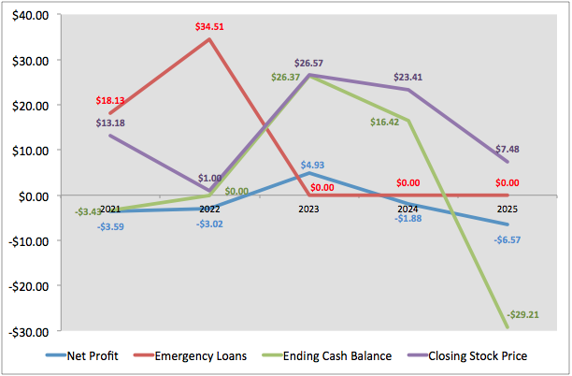
V. FINANCIAL – HIGHLIGHTS

Slide 11
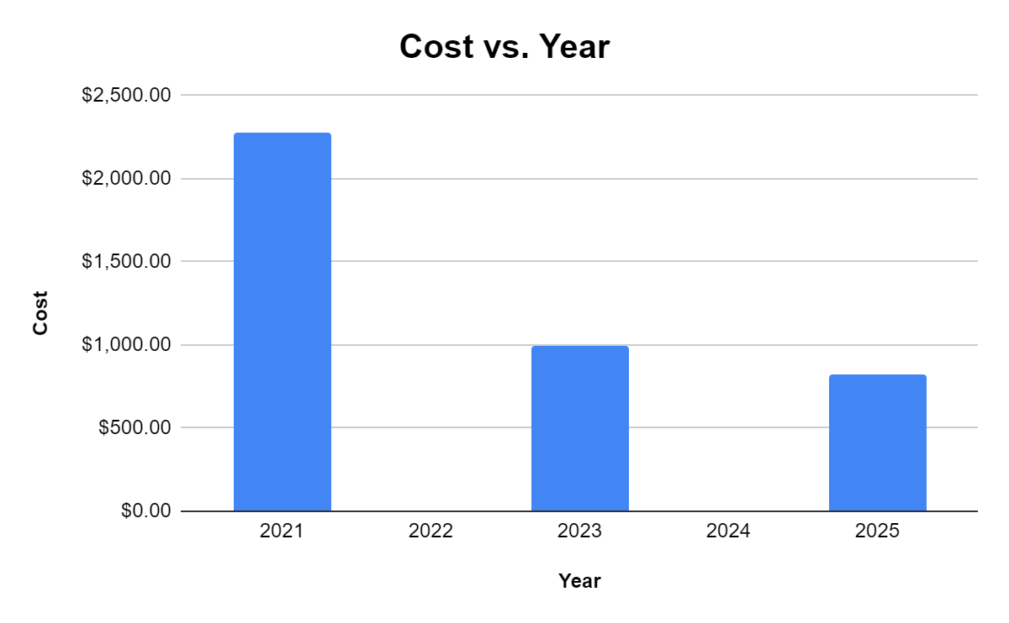
VI. R&D Strategy
VII. R&D High/Lowlights
-Meet the customer criteria for Size, Performance, MTBF, and Age as close as possible.
-To maintain the same revision date for each segment each year. (Ex Apr2023 for each segment)
-To keep a lower performance, higher size, and a lower MTBF to maintain a lower material cost.
Year 1 - $ 2,227.00
Year 2 - $ 0
Year 3 - $ 994.00
Year 4 - $ 0
Year 5 - $ 826.00
**For some reason Year 2 had zero cost for R&D

Slide 12
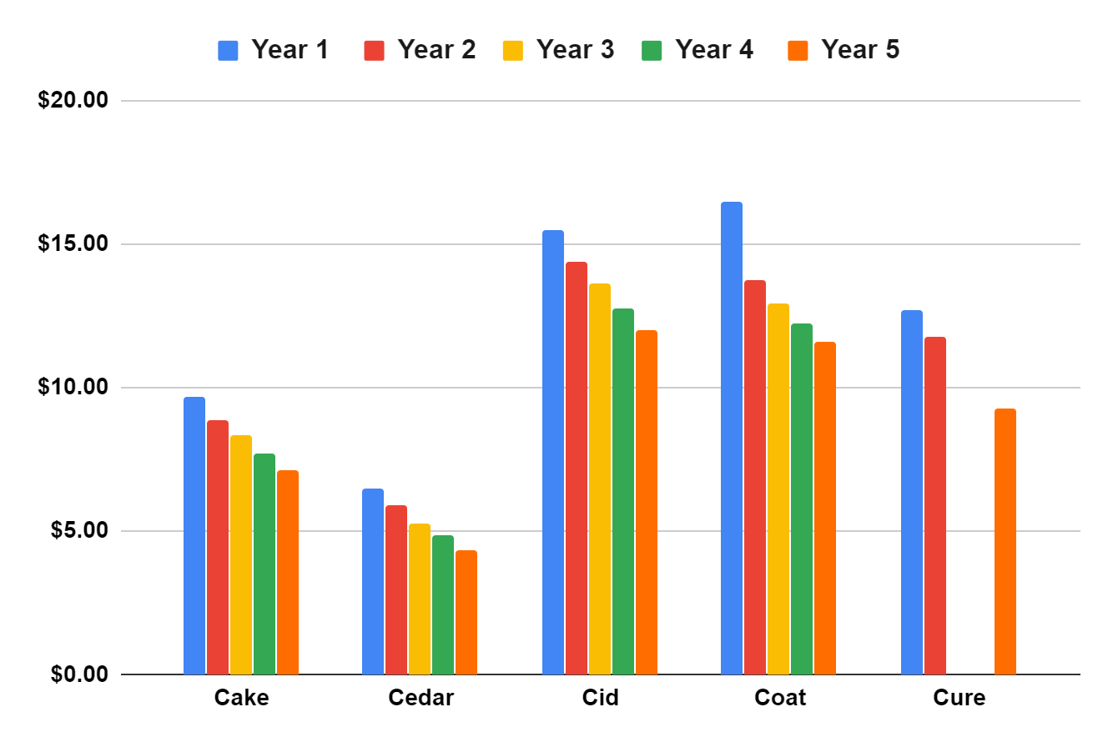
Material Cost Per Unit
Year 1 Year 2 Year 3 Year 4 Year 5
Cake $9.69 $8.88 $8.34 $7.69 $7.15
Cedar $6.51 $5.88 $5.29 $4.83 $4.36
Cid $15.46 $14.38 $13.63 $12.75 $11.99
Coat $16.47 $13.74 $12.96 $12.23 $11.59
Cure $12.72 $11.79 $0.00 $0.00 $9.30

Slide 13
VIII. MARKETING – STRATEGY
Marketing is important for sales and sales for profit. Our marketing efforts were targeted to make the product available and accessible. Our strategy included:
  Invent and reinvent an offering for each segment of the product.
  Increase customer awareness and accessibility through optimal sales and promo budget.
  Price the products at the lower side of the preferred price range in each segment.
  Adjust the forecast sales based on benchmark prediction ensuring we optimize our production based on sales forecast.

Slide 14
IX. MARKETING – HIGHLIGHTS
  We offered products in top 4 segments of the industry including size, performance, low and high segments.
  Our prices were set at the lower side of the preferred range.
  We were able to achieve a 85% in customer awareness and 50% in accessibility of our products.
  Our R&D efforts needs to be revamped as our offerings were not in line with the customer’s preference as we were ending with huge inventory levels.

Slide 15
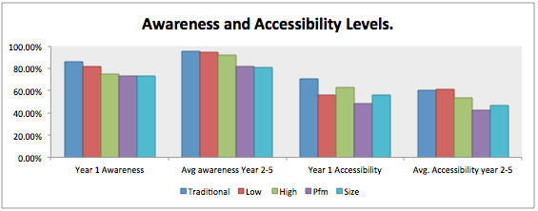
IX. MARKETING – HIGHLIGHTS

Slide 16
X, XI. PRODUCTION

Slide 17
X, XI. PRODUCTION

Slide 18
X, XI. PRODUCTION

Slide 19
X, XI. PRODUCTION

Slide 20
X, XI. PRODUCTION

Slide 21
XII. HRM Highlights
Strategy;
Investment in recruitment increased yearly
Invest in training hours from 0 in Y1, Y2, and Y3 to 56 in Y3 and Y4 and 60 in Y5
Progressive reduction in turnover rates ( Y0:10%. Y1;10%, Y2:10%, Y3:7.9%, Y4: 7.9%, Y5: 7.7%)
Overtime sustained at 0% for all years from the initial 0.2% during Y0
Employee production index was sustained at a minimum of 100% with the highest rate being 107.9% in Y5
The employee wages have increased year by year started from 22.05 in first year to 26.81 in the fifth year
raise the employees’ wages

Slide 22
XIII. HRM Highlights
Results
-We focus on our employee training hours to increase because we note Training leads to higher productivity and lower turnover,
Decrees in turnover rate from 10% to 7.7%
Overtime sustained at 0% for all years from the initial 0.2% during Y0
Separated employee in year3 490 and separating cost was/ 2450
Our employee felt comfortable with the company and the turnover rates started decreasing year by year.

Slide 23
XIII. HRM Highlights
Results
Training cost increased from year 3 until year 5 .
No employee works in the second shift
The Goal of HRM decisions was to establish a highly productive team of employees and to meet the yearly compliment
they don’t quit the job and to decrease the number of new employees year by year and stuck with the same team

Slide 24
XIV. TQM Strategy
Decided not to make investment in Total Quality Management
Because Net profit was low near the end
Decided to spend money elsewhere instead
For example money was invested in HR training and used for debt settlement

Slide 25
XVI. Market Segment Performance
Segment Rounds and Description | Traditional | Low-End | High-End | Performance | Size
0 Industry Unit Demand Actual Sales % of total Industry | 7.387 7.387 32.4% | 8.960 8.960 39.3% | 2.554 2.554 11.2% | 1.915 1.912 8.4% | 1.984 1.984 8.7%
1 Industry Unit Demand Actual Sales % of total Industry | 8.067 8.067 9.2% | 10.009 10.009 11.7% | 2.967 2.967 11.6% | 2.294 2.294 8.9% | 2.347 2.347 9.1%
2 Industry Unit Demand Actual Sales % of total Industry | 8.809 8.809 9.2% | 11.180 11.180 38.6% | 3.448 3.448 11.9% | 2.749 2.749 9.5% | 2.776 2.776 9.6%

Slide 26
Continuation
 | Traditional | Low-End | Low-End | Performance | Size
3 Industry Unit Demand Actual Sales % of total Industry | 9.619 9.619 29.4% | 12.448 12.448 38.2% | 4.007 4.007 12.3% | 3.293 3.293 10.1% | 3.284 3.284 10.1%
4 Industry Unit Demand Actual Sales % of total Industry | 10.504 10.504 28.4% | 13.949 13.949 37.8% | 4.656 4.656 12.6% | 3.945 3.945 10.7% | 3.885 3.885 10.5%
5 Industry Unit Demand Actual Sales % of total Industry | 11.471 11.471 27.5% | 15.581 15.581 37.3% | 5.410 5.410 13.0% | 4.726 4.641 11.3% | 4.596 4.596 11.0%

Slide 27
XVII. Outlook Within EACH SEGMENT
R&D
  Lower the MTBF to the average or minimum of the range in order to save cost and increase contribution margins.
MARKTING
  Keeping the numbers high a little bit in first 2 rounds and then keep decreasing the sale price last rounds.
PRODUCTION
  Focusing more on the sales and try to expect how many units can be sold for next round and then see how many can be in our capacity and according to that we decide the numbers of the units.
HUMAN RESOURCES
  More training hours.

Slide 28
XVII. Outlook Within EACH SEGMENT
FINANCE
  Keeping in eye in how much our sales and profits and make sure our profit doesn’t go on minus.
TQM
  Giving us a big advantage because it offers benefits such as lower cost of materials, lower cost of labor, faster R&D upgrades, and increased demand for your products.

Slide 29
XVIII. SHORT TERM STRATEGY
CURRENT
  Keeping our product research and development upgrades within the same year
  Producing to capacity each year
FUTURE
  Keeping our product research and development upgrades within the same year from June to July
  Purchased capacity for existing products.

Slide 30
XIX. LONG TERM STRATEGY
CURRENT
  Increasing profits and decreasing costs
  Spending more money on HR training
FUTURE
  If funds are available invest in automation for invented products.
  Changing a product size and or performance repositions a product on the perceptual map. Improving performance and decreasing size moves the product towards the lower right on the perceptual map.

Slide 31
XX. Connection between long term strategies and company goals and objectives
A goal is very broad with a primary outcome. A strategy is the approach you take to achieve a goal. An objective is a measurable step you take to achieve a strategy.
Each long term goal is supported by a short term goal(s) which connects back to the companies goals & objectives.
The long term strategies connect to our goals & objectives by:
Serving as a framework for making decisions and provides a basis for planning.
Helping us to see if we are heading in the right direction toward accomplishing the goals and objectives, and if not why.
Gives us an idea if we need to change/enhance/improve any of the process in production, marketing, or R&D.
Showing us if the goals and objectives are doable with the strategies we are using.
Long term strategies tell how the company wants to end up which reflects back to the companies objectives.
Setting up daily, weekly, and monthly short-long term goals will help in accomplishing the goals & objectives.

Slide 32
XXI. Hierarchy of Strategies
Corporate: Defines the business areas in which the company will operate.
Increase customer awareness of products.
To develop and coordinate the company’s portfolio of products.
To ensure the long-term success of business units.
Business: Competitive: Decided upon by the heads of strategic business units and the departments.
Keep a lower product price to attract returning customers and new ones.
Creating and sustaining a competitive advantage for each product.
Cost leadership, differentiation, and focus are the main areas for competition between companies.
Functional: Consists of R&D, Marketing, Production, HR, Finance, TQM
Maximize resource productivity by research and development to lower costs.
Integrate each department’s strategy and the coordination of resources at the business unit level.
Creating short term goals for each department. For example: Widen the range of market consumers by 5 in one quarter.

Slide 33
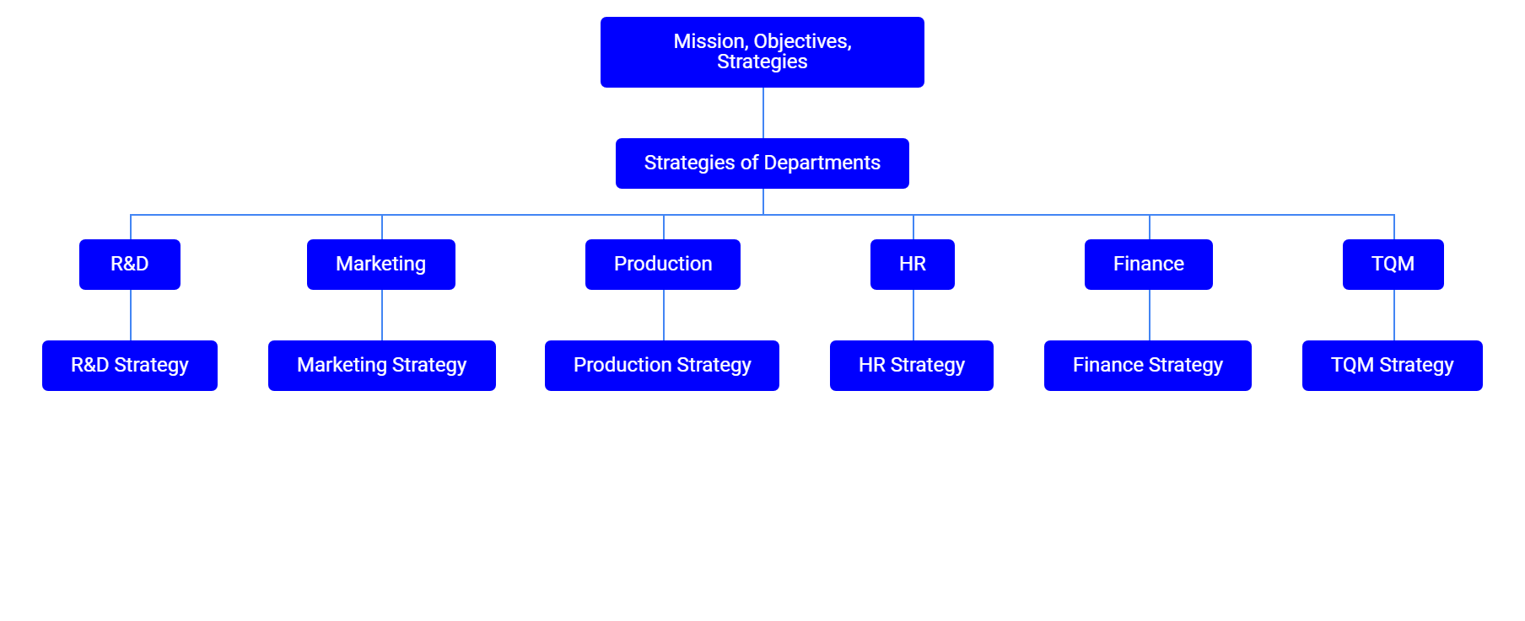

Slide 34

XXII. Focus on the Future
Chester’s focus should be geared toward introducing a new product as well as ending the lowest popular product. Putting the investment toward a new product instead of a failing one could open new doors and customers. Given a chance, we would invest more in the sales budget to make our products accessible.
Another focus should be in investing in automation to lower the cost of employees.

