Slide 1
The Chi-Square ( X²) Statistic
Categorical data may be displayed in contingency tables
The chi-square statistic compares the observed count in each table cell to the count which would be expected under the assumption of no association between the row and column classifications
The chi-square statistic may be used to test the hypothesis of no association between two or more groups, populations, or criteria
Observed counts are compared to expected counts

Slide 2
Displaying Data in a Contingency Table
Criterion 2 | Criterion 1
 | 1 | 2 | 3 | . . . | C | Total
1 | n11 | n12 | n13 | . . . | n1c | r1
2 | n21 | n22 | n23 | . . . | n2c | r2
3 | n31 |  |  |  | . . .
. . . | . . . |  |  |  | . . .
r | nr1 | . . . | . . . | . . . | nrc | rr
Total | c1 | c2 |  |  | cc | n

Slide 3
Chi-Square Test Statistic
The test statistic is:
2
k _{( O}
- )
2
c = ∑
i
E
i
i= 1 E i
The degrees of freedom are:
− (r–1)(c–1)
r = # of rows and c = # of columns
O_{i} = the observed frequency in the i^{th} cell of the table
E_{i} = the expected frequency in the i^{th} cell of the table
Where:

Slide 4
Example: Is Disease Associated With Exposure?
The relationship between disease and exposure may be displayed in a contingency table
We can see that:
37/54 = 68 % of diseased individuals were exposed 13/66 = 20 % of non-diseased were exposed
Do these data suggest an association between disease and exposure?
Disease
Exposure | Yes | No | Total
Yes | 37 | 13 | 50
No | 17 | 53 | 70
Total | 54 | 66 | 120

Slide 5
Observed Counts
The observed numbers or counts in the table are:
Disease
Exposure | Yes | No | Total
Yes | 37 | 13 | 50
No | 17 | 53 | 70
Total | 54 | 66 | 120

Slide 6
Test of No Association
Question of interest: is disease associated with exposure?
Calculate what numbers of “exposed” and “non-exposed” individuals would be expected in each disease group if the probability of disease were the same in both groups
If there was no association between exposure and disease, then the expected counts should nearly equal the observed counts, and the value of the chi-square statistic would be small
In this example, we can calculate:
Overall proportion with exposure = 50/120 = 0.42
Overall proportion without exposure = 70/120 = 0.58 = 1– 0.42

Slide 7
Expected Counts
Under the assumption of no association between exposure and disease, the expected numbers or counts in the table are:
Disease
Exposure | Yes | No | Total
Yes | 50/120 x 54 = 22.5 | 50/120 x 66 = 27.5 | 50
No | 70/120 x 54 = 31.5 | 70/120 x 66 = 38.5 | 70
Total | 54 | 66 | 120

Slide 8
_{χ2 = ∑} (O_{i} −E_{i} )²
Chi-Squared (X²) Statistic
E_{i}
i
₌ (37 − 22.5) ² ₊ (13 − 27.5) ²
22.5 27.5
₊(17 − 31.5) ² ₊ (53 − 38.5) ²
31.5 38.5

Slide 9
Test of Association
The test statistic is:
  χ² = 29.1 with 1 degree of freedom
Assumption: no association between disease and exposure
A small value of the χ² statistic supports this assumption (observed counts and expected counts would be similar)
A large value of the χ² statistic would not support this assumption (observed counts and expected counts would differ)
What is the probability of obtaining a statistic of this magnitude or larger when there is no association?

Slide 10
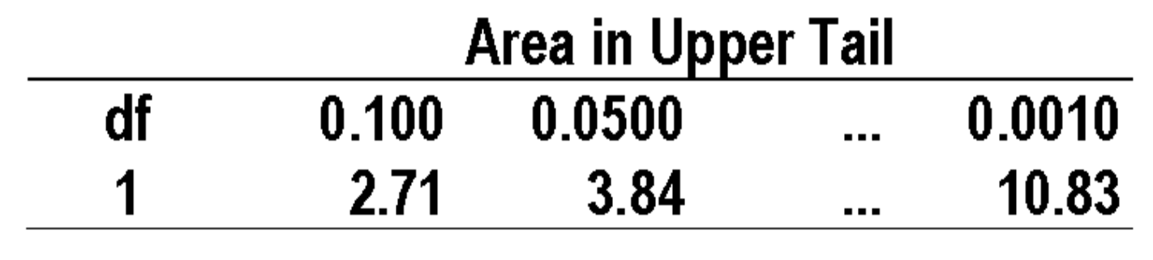
Probability Associated with a X² Statistic
If the assumption of no association is true, then what is the probability of observing this value of the χ² statistic?
Table A.8 of the Pagano text provides the probability (area in upper tail of the distribution) associated with values of the chi-square statistic for varying degrees of freedom
Degrees of freedom = 1 for a 2x2 table:

Slide 11
Conclusion: Test of (No) Association
For the data in this example, χ² = 29.1 with 1 degree of freedom
From the chi-squared table, the probability obtaining a statistic of this magnitude or larger when there is no association is < 0.001
In other words, the probability of obtaining discrepancies between observed and expected counts of this magnitude is
< 0.001 (unlikely to occur by chance alone)
Conclude that our finding is unlikely to occur if there is no association between disease and exposure
  Thus, we conclude that there appears to be an
association

Slide 12
Guidelines for Interpreting the X² Statistic
The χ² statistic is calculated under the assumption of no association
Large value of χ² statistic ⇒ small probability of occurring by chance alone (p < 0.05) ⇒ conclude that association exists between disease and exposure
Small value of χ² statistic ⇒ large probability of occurring by chance alone (p > 0.05) ⇒ conclude that no association exists between disease and exposure

Slide 13
Short-Cut X² Formula for 2x2 Table
Suppose:
Disease
Exposure | Yes | No | Total
Yes | a | b | a+b
No | c | d | c+d
Total | a+c | b+d | n
Then we can write:
n(ad– bc)²
2
χ =
1
(a+c)(b+d)(a+b)(c+d)

Slide 14
Short-Cut X² Formula for the Example
Using this formula for the previous example gives
120[(37)(53) – (13)(17)] ²
2
χ₁ =
54(66)(50)(70)
= 29.1
Disease
Exposure | Yes | No | Total
Yes | 37 | 13 | 50
No | 17 | 53 | 70
Total | 54 | 66 | 120

Slide 15
Helpful Hints Regarding the Chi-Square Statistic
The calculations use expected and observed counts or frequencies, not proportions
The χ² short-cut formula applies only to 2x2 tables
Probabilities are available from tables and computing packages

Slide 16
Review
The χ² statistic provides a statistical test for ascertaining whether an association exists between disease and exposure
A large value of the χ² statistic indicates that the observed data are unlikely under an assumption of no association between disease and exposure ⇒ small probability (p- value) ⇒ association
A small value of the χ² statistic indicates that the observed data are likely under an assumption of no association between disease and exposure ⇒ large probability (p- value) ⇒ no association

