Slide 1
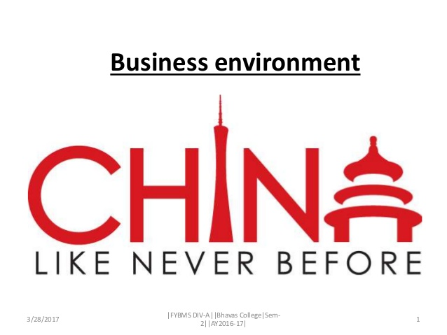
Business Environment in China
Institution
Course
Name
Date

Slide 2
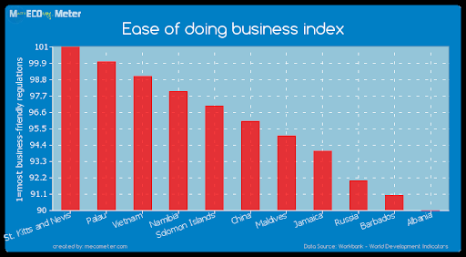
Introduction
Traditionally factors influencing companies included:
Land.
Labor
Capital.
Current factors thought to be influencing companies include:
Knowledge resources (tech and science)
Physical resources.
Human resources
Capital and infrastructure resources.
Notes:
In the past, business operation was thought to be influenced by factors such as land, labor and capital. However, following on Porter Diamond’s findings, businesses are currently influenced by knowledge resources, physical resources, human resources, capital and infrastructure resources. The government of China has been pushing for acquisition of knowledge resources which includes technology and science. It is this factors that tends to enable businesses to come up with new and innovative ways of doing business (Smook, 2005). The same government has also been keen on creation of infrastructure resources such as roads and railways that are used to support the businesses operating within and out of the country.

Slide 3

Utilization of Macro-Control Method
The Chinese government used the macro-control method to control economic development.
Chinese government imposed capital control.
The government comes up with ways to stimulate business growth
Some of these ways includes:
Policies.
Laws and regulations.
Financial incentives.
Taxation.
Subsidies.
Notes:
The Chinese government has been a key player in ensuring that businesses grow within its boundary. The government has been responsible for coming up with ways through which it could control capital (Smook, 2005). In addition, the government has been establishing policies and laws that are meant to improve on doing business within the country. it has also been offering financial incentives and subsidies which have resulted to helping the businesses to finance their operation.

Slide 4
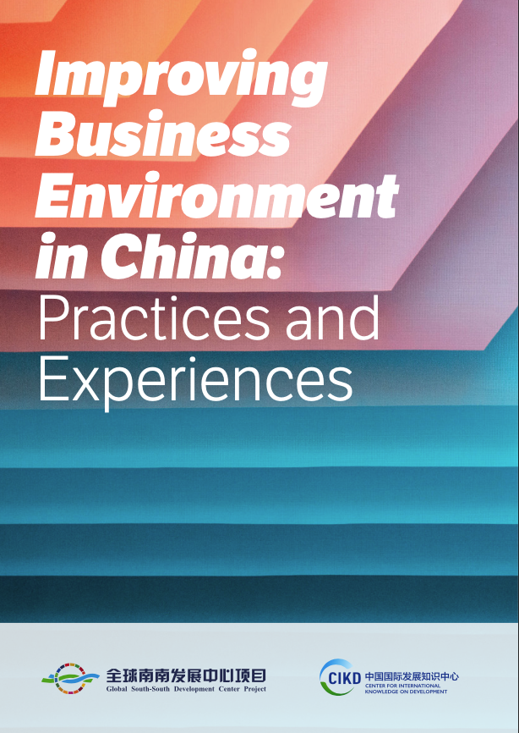
Factor Conditions
Relates to production factors such as infrastructure and knowledge.
They are relevant factors for competitiveness in certain industries.
These factors are classified into:
Material resources.
Human resources – labor cost and qualifications
Knowledge resources.
Infrastructure resources
Notes:
Factor conditions relates to factors of production such as knowledge and infrastructure. The Chinese government has been supporting its students to come up with new ways through which they can be able to carry out their work in an effective manner. This has resulted to availing the manpower that is required; a workforce comprising of motivated people. The cost of labor in the country is also low compared to the developed countries where there are high standards of living (MacKay, Arevuo, Mackay, & Meadows, 2020). Availability of infrastructure is another factor that has been provided by the Chinese government and which is attractive to the businesses that might want to establish themselves in the country. the Chinese government has been supporting to its textile industry.

Slide 5

Related & Supporting Industries
The success of any market relies on :
Presence of suppliers.
Related industries.
Competitive suppliers enhance internationalization & innovation.
Related organizations are significant.
Exchange technological know-how and encourage each other through the production of complementary products.
Notes:
Within the Chinese market, there are related and supporting industries. There are suppliers and the related industries which provide a market for the suppliers. The suppliers as well as the companies set up within the Chinese market compete each other resulting to enhancing innovation and internationalization. This ensures that they have produced products which makes their country to export more to the rest of the world (Smook, 2005). The companies also result to sharing their technological innovations which enhances the way they carry out production.

Slide 6
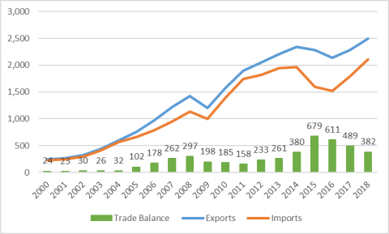
Home Demand Conditions
A market involves factors such as:
Economies of scale.
Transportation costs
Size of the home market.
The home market offers significant market.
Companies can thus realize sufficient economies of scale
Notes:
For a market to appear attractive to investors, it has to assure them of sufficient market. China has a large population meaning that if an investor happens to produce products that are in high demand them it can employ economies of scale (MacKay, et al., 2020). Since the market will provide the investor with a chance to use economies of scale from a single location, then it will incur less transport cost and thus will increase its profit margin.

Slide 7
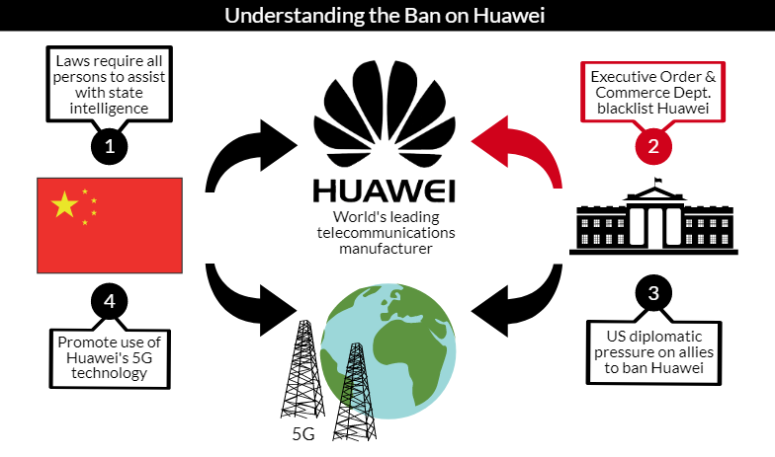
Strategy, Structure & Rivalry
Cultural aspects plays a significant role in deciding the location of a company.
Regions or countries might differ greatly from each other in factors such as:
Working morale.
Interactions between businesses due to different cultures.
The above can be both advantageous and disadvantageous.
Notes:
The way a company is organized or managed could be highly influenced by its corporate objectives as well as the measure of its rivalry within its organizational culture (MacKay, et al., 2020). As a company tends to look into domestic rivalry and continues to seek for competitive advantages available, it can assist the company to attain advantages on an international scale.

Slide 8
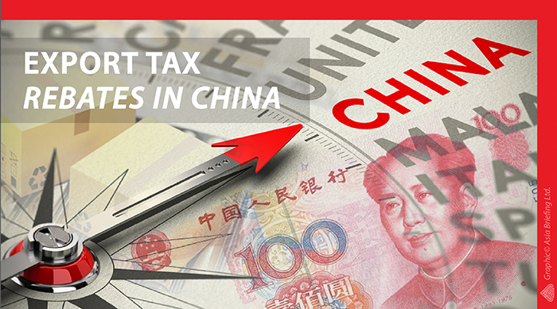
Government
Governments plays a significant part in encouraging the establishment of companies at home and abroad.
They finance and construct infrastructure.
Invest in education
Encourage organizations to utilize alternative energy that affect production
Government can give out incentives such as subsidies to encourage companies.
Notes:
The government takes up important roles that serves to encourage businesses to be set up within the domestic environment or internationally. The government is involved in establishment of infrastructure such as railway or roads which assist the businesses in moving their products to the market. the Chinese government has been ranked as the leading in infrastructure development (MacKay, et al., 2020). The government has also been encouraging companies through offering subsidies in order to enable them produce at lower cost.

Slide 9
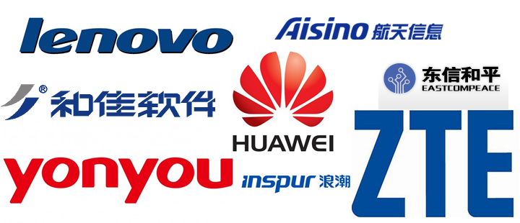
Chance Events
Chance play important roles in most markets.
It provides opportunities for innovative organizations
Notes:
Chance events plays important part in many of the market, China being not an exceptional. Chance events provides businesses with opportunities through which when utilized well can end up leading to creation of new business. For instance, chance events are taken up with tech companies and China has become lately a tech-nations which has resulted to taking up the tech-market with a boom.

Slide 10
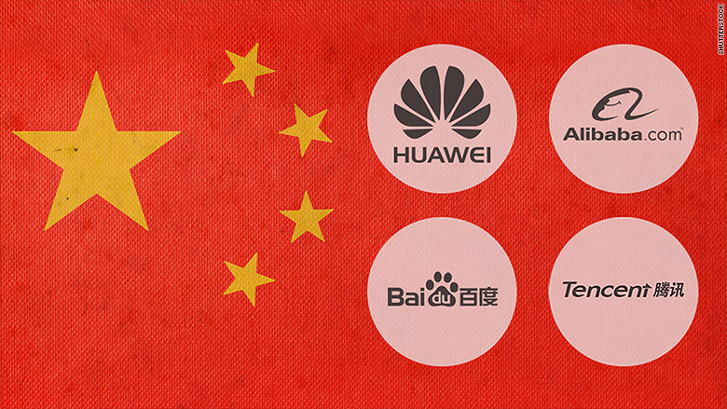
Conclusion
The Chinese government has provided the necessary infrastructure to do business.
Such infrastructure includes:
Roads.
Airport.
Railway
The country enables economies of scale for companies.
Availability of labor.

Slide 11
References
MacKay, B., Arevuo, M., Mackay, D., & Meadows, M. (2020). Strategy: Theory, practice, implementation.
Smook, L. (2005). An assessment of the Chinese textile apparel manufacturing industry and its ability to attain and sustain global competitiveness. Spring, TX: Wynot Books.

