Slide 1
The psychological effects cocaine has on the body through the dopamine receptors
Notes:
Welcome!

Slide 2
Student
Course
Date

Slide 3
Outline
This presentation is based on psychological effects of the cocaine in the body through Dopamine receptor.
In the introduction, we are going to see how the cocaine was introduced into United States.
The second part is going to be the material and method which is going to experiment the subject of the presentation.
The analysis is the next part, which will comprise of the charts and tables.
Later on, we are going to have the discussion and the conclusion part.
Notes:
This slide shows the outline of the presentation.

Slide 4
Introduction
Cocaine was first brought to United States in the 1880’s from Columbia, S America.
It was grown in different parts of the world before Colombia bringing it to United States, (Bolla, 389).
The coca plant has been known to be located and used by the Europeans and the Incan empire.
Cocaine is the product that is received from the coca plant and was traditionally used as a medicine by physicians and other doctors.
Doctors used the coca plant as a way to treat exhaustion, mental illness and morphine addiction.
Back in 1970’s cocaine was declared illegal after noticing its several side effects, (Redman, 95 ).
Notes:
This slide is an introduction to the presentation. According to the slide, Back in 1970’s cocaine was declared illegal after noticing its several side effects. Some of these side effects included chronic diseases.

Slide 5
Material and Methods
This experiment used male rats as a specimen to test whether the dopamine receptors are affected by chronic cocaine use or the intermittent use.
By use of the autoradiography, we will compare the modification of the D1 and D2 receptor densities in the dopaminergic system 1 (WD1) and 14(WD14) days after last cocaine injection.
This research will help doctors and future research help to determine how long it will take a chronic user of cocaine to heal their dopamine receptors versus people who use cocaine intermittently.
There will be a control variable in this experiment so that a comparison can be made to see how bad the dopamine receptors are effected in the chronic user of cocaine and intermittent user of cocaine.
Notes:
This slide shows the method part of the experiment. According to the experiment, this study will help doctors and future research help to determine how long it will take a chronic user of cocaine to heal their dopamine receptors versus people who use cocaine intermittently.

Slide 6
Materials- Animals
Four male Sprague –Dawley rats weighing 250g-300g are being used for this experiment.
The four rats were housed in the same environments.
They were housed on a 12h light and dark cycle set at a temperature of 22 degrees Celsius.
The humidity was set at 50 % environment, (Puig, 3132).
Notes:
This slide shows the materials parts, specifically the animals that are going to be used for the experiment. As per the experiment, 4 rats are going to be used.

Slide 7
Materials- Cocaine
The animals were treated by an intermittent cocaine, binge cocaine administration pattern of intraperitoneal injections of 20mg/kg cocaine hydrochloride dissolved in saline for (0.9%) for 14 days.
The schedule set was once daily at 9:00am for the intermittent cocaine treatment.
The binge pattern of administration was set at 9:00am, 12:00pm, and 3:00pm .
The control group was treated with saline solution at the same times as the intermittent injection and the binge injection.
Notes:
This part shows the material section- on chronic pattern and the binge injection.

Slide 8
Receptor
The rats died after decapitalization after carbon dioxide inhalation.
The brains were immediately removed and was frozen in isopentane at -40 C and was quickly stored at -20 C until they were processed.
The D1 and the D2 sections were preincubated at 50mM solution at 7.4 pH containing solutions to keep the brain usable.
After incubation with the Radioligands , the sections were washed in pre-incubation buffers at room temperature.
The levels of bound radioactivity brain area were directly determined by counting the numbers of B-particles emerging from the delineated areas using the B-vision program supplied with the counting apparatus.
Notes:
This slide shows the receptor, autoradiography, binding and count.

Slide 9
Results-Table
TITLE | VTA | SN | CPu | Nac
Intermittent Cocaine Use-Di Receptors | Stayed the same | Downregulation | Downregulation | Stayed the same
Binge Cocaine Use –D1 Receptors | Stayed the same | Upregulation | Downregulation | Downregulation
Figure 1: Caption: Beaulieu JM, Gainetdinov RR. The physiology, signaling, and pharmacology of dopamine receptors.
https://www.ncbi.nlm.nih.gov/pmc/articles/PMC3787501/#B5
Notes:
This slide shows the table of the intermittent Cocaine and Binge Cocaine Use-D1 Receptors. Caption: Beaulieu JM, Gainetdinov RR. The physiology, signaling, and pharmacology of dopamine receptors. https://www.ncbi.nlm.nih.gov/pmc/articles/PMC3787501/#B5

Slide 10
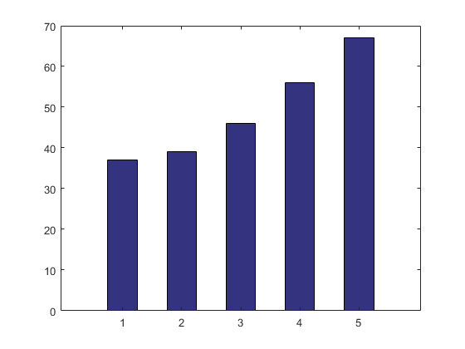
Results-Charts
D1 receptor
regulation
Rats
Rats
Y-Axis
X-Axis
Figure 2: Caption: Beaulieu JM, Gainetdinov RR. The physiology, signaling, and pharmacology of dopamine receptors.
https://www.ncbi.nlm.nih.gov/pmc/articles/PMC3787501/#B5
Notes:
This slide shows the graph of intermitted cocaine use and D1 against D5 receptor. In this graph list the receptor D1 to D5. The D1 receptors in the graph are shown to be lower intermittent cocaine use versus the other 4 receptors. Caption: Beaulieu JM, Gainetdinov RR. The physiology, signaling, and pharmacology of dopamine receptors. https://www.ncbi.nlm.nih.gov/pmc/articles/PMC3787501/#B5

Slide 11
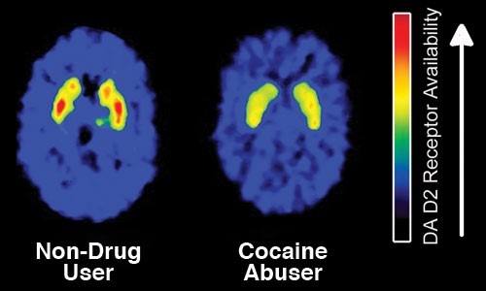
Cocaine User Brain Vs the Non-user’s Brain
Fig 3: Image of Cocaine User Brain Vs the Non-user’s Brain
Notes:
This slide shows the image of the damage that Cocaine causes to one’s body.

Slide 12
Discussion
According to above analysis, the cocaine has high impact on the body.
The experiment shown that D1 receptors were affected the most.
Moreover, binge cocaine group had more behavioral desensitization receptors affected than the intermittent cocaine group.
D2 receptor numbers were not clear enough to say whether they were affected by binge or cocaine administration.
Notes:
This slide shows the discussion of the performed discussion.

Slide 13
Conclusion
The main reason as to why this experiment was performed was to show that brain is more affected by chronic cocaine use than the intermittent cocaine use.
The study can be used in future in treatment of dopaminergic pathways that are affected by chronic or intermittent use
Notes:
This slide shows the conclusion part of the presentation. The research is going to be used by scientists. so see when the D2 receptors are effected by the chronic use of cocaine.

Slide 14
Work cited
Bolla, Karen I., et al. "The Neuropsychiatry of Chronic Cocaine Abuse." The Journal of Neuropsychiatry and Clinical Neurosciences, vol. 10, no. 3, Sum 1998, pp. 280-289. EBSCOhost, doi:10.1176/jnp.10.3.280.
Puig, Stéphanie, et al. "Influence of Cocaine Administration Patterns on Dopamine Receptor Regulation." Psychopharmacology, vol. 231, no. 16, 15 Aug. 2014, pp. 3131-3137. EBSCOhost, doi:10.1007/s00213-014-3488-3.
Redman, Melody. “Cocaine: What Is the Crack? A Brief History of the Use of Cocaine as an Anesthetic.” Anesthesiology and Pain Medicine 1.2 (2011): 95–97. PMC. Web. 18 June 2018.

