Slide 1
A COMPARISION OF
FRANKLIN DELANO ROOSEVELT AND ADOLF HITLER
Trysha Krasnosky

Slide 2
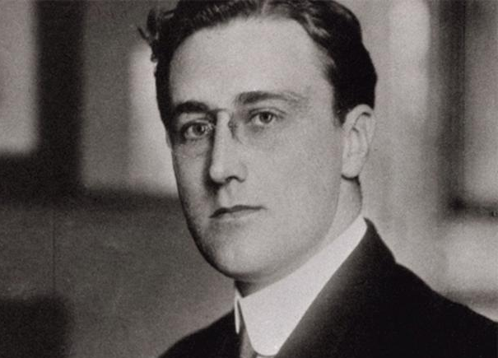
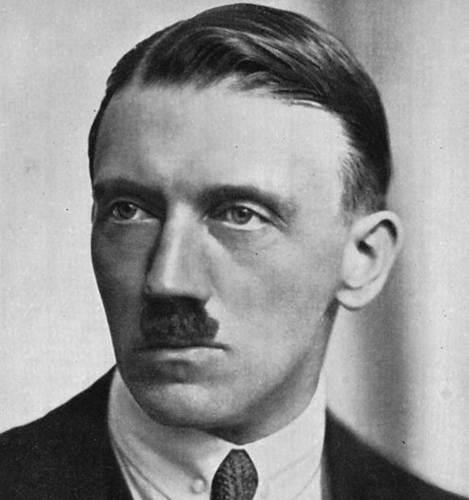
Franklin Delano Roosevelt
1882-1945
Adolf Hitler
1889-1945

Slide 3
EARLY YEARS
FDR
HITLER
Wealthy family from old money
Attended elite schools
Never graduated from Columbia Law School though did pass bar examination
Elected to New York State Senate in 1910
Assistant Secretary to the Navy in 1913
Vice President candidate to James Cox in 1920
Contracts polio while on vacation in 1921
In 1928 elected governor of New York
Upper level class- father was customs official
Dropped out of college preparatory school
Applied to Venice Academy of Arts, denied admittance twice
Lived as an artist in Venice 1908-1913
Joined Bavarian Army in 1914
Joined National Socialist German Workers’ Party (NAZI) in 1919
1921 elected party chairman
Imprisoned after failed coup d'état in 1923

Slide 4
IDEOLOGIES
Any idea or set of ideas that provide a prescriptive view of life.”
(Gonen, 2000)
FDR
HITLER
Identified as Liberal
  Democratic Socialist in today’s terms
Respect the rights of individuals
Nationalism at start of tenure
Isolationism to Internationalism
“FDR’s foundation rested upon the principles of neighborliness, moral humanitarianism, religious faith, the conservation of natural and human resources, the need for social balance and for security.” (Tugwell,1958)
Mixture of Authoritarian, Totalitarian, and Fascism
  Nazism
Rights taken away if it benefited Germany
Extreme Nationalism
Increase living space
“Hitler saw himself as the restorer and savior of Germany’s economic well-being.” (Kater, 1981)
Reject Versailles Treaty

Slide 5
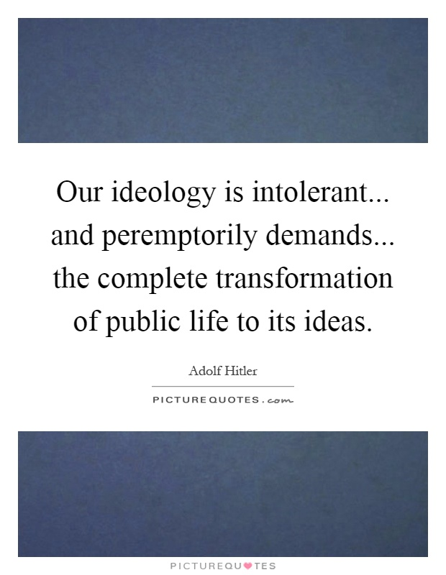
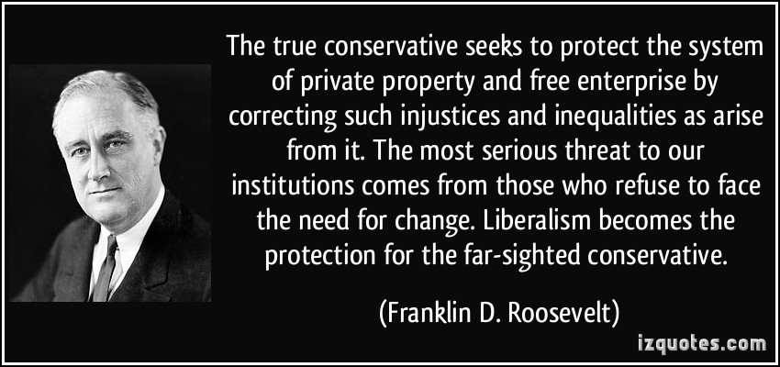

Slide 6
ECONOMIC POLICIES
FDR
HITLER
Reorganized banks, closed those that were insolvent
Subsidies for farmers
Keynesian Economic Theory?
  Increase government spending to stimulate economy
Initiated many public works projects
Created Works Progress Administration (WPA)
  Provide jobs for unemployed
Fair Labor Standards Act (1938)
  Created minimum wage
Federal Deposit Insurance Corporation (FDIC)
  Insures checking, savings, and other deposits
Military spending for WWII
Minister of Economy “New Plan”
  “the plan intended to reduce imports, reduce unemployment, channel government spending into a wide range of industries and make Germany self-sufficient.” (Trueman, 2016)
Keynesian Economic Theory
  Increase government spending to stimulate economy
Government spending 12 billion (1928) to 30 billion (1939)
Financial benefits to farmers and small businesses
Expand public works sector for National Labour Sector
German Labour Front created could not fire employees without approval of gov’t
Military rearmament created a war economy

Slide 7
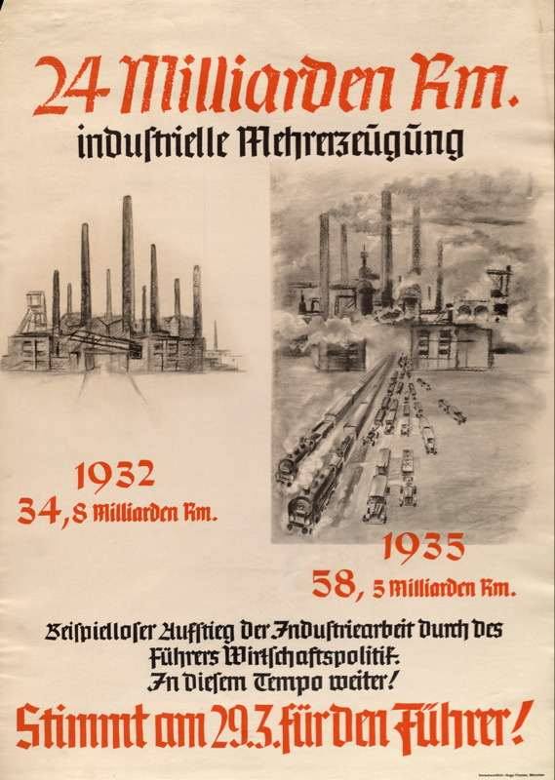
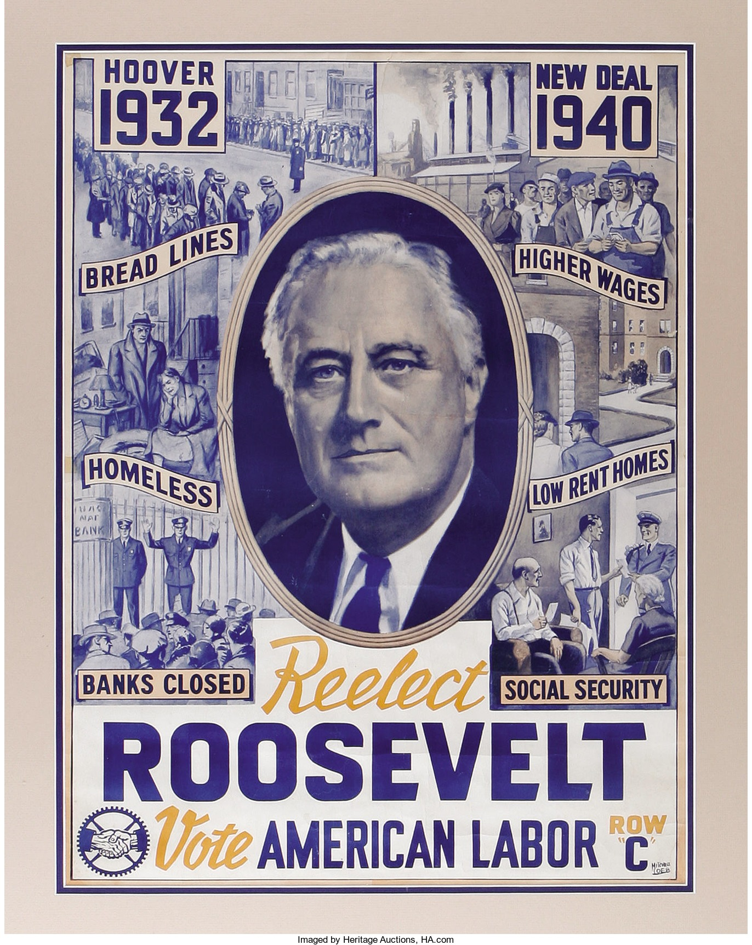
Nazi propaganda poster. The text says that German industrial production has risen from 34.8 billion marks in 1932 to 58.3 billion in 1935. “An unprecedented increase in industrial production is the result of the Führer’s economic policy. Keep it going! Vote for the Führer on 29.3!”

Slide 8
SOCIAL POLICIES
FDR
HITLER
Social Security Act of 1935
  Pensions
  Unemployment Insurance
  Care for elderly, disabled, and children
Failed attempt at court-packing
Instrument of social justice
Federal Housing Commission
  Made home ownership affordable
Japanese Internment Camps
Restrict free speech and other civil liberties
Persecution
  Anti-Semitism
  Gypsies
  Disabled
Traditional view of women & family
  Every women’s society abolished
Controlling education
  Separate schools
Hitler Youth Movement

Slide 9
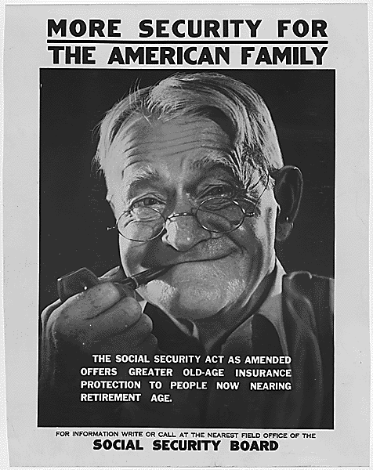
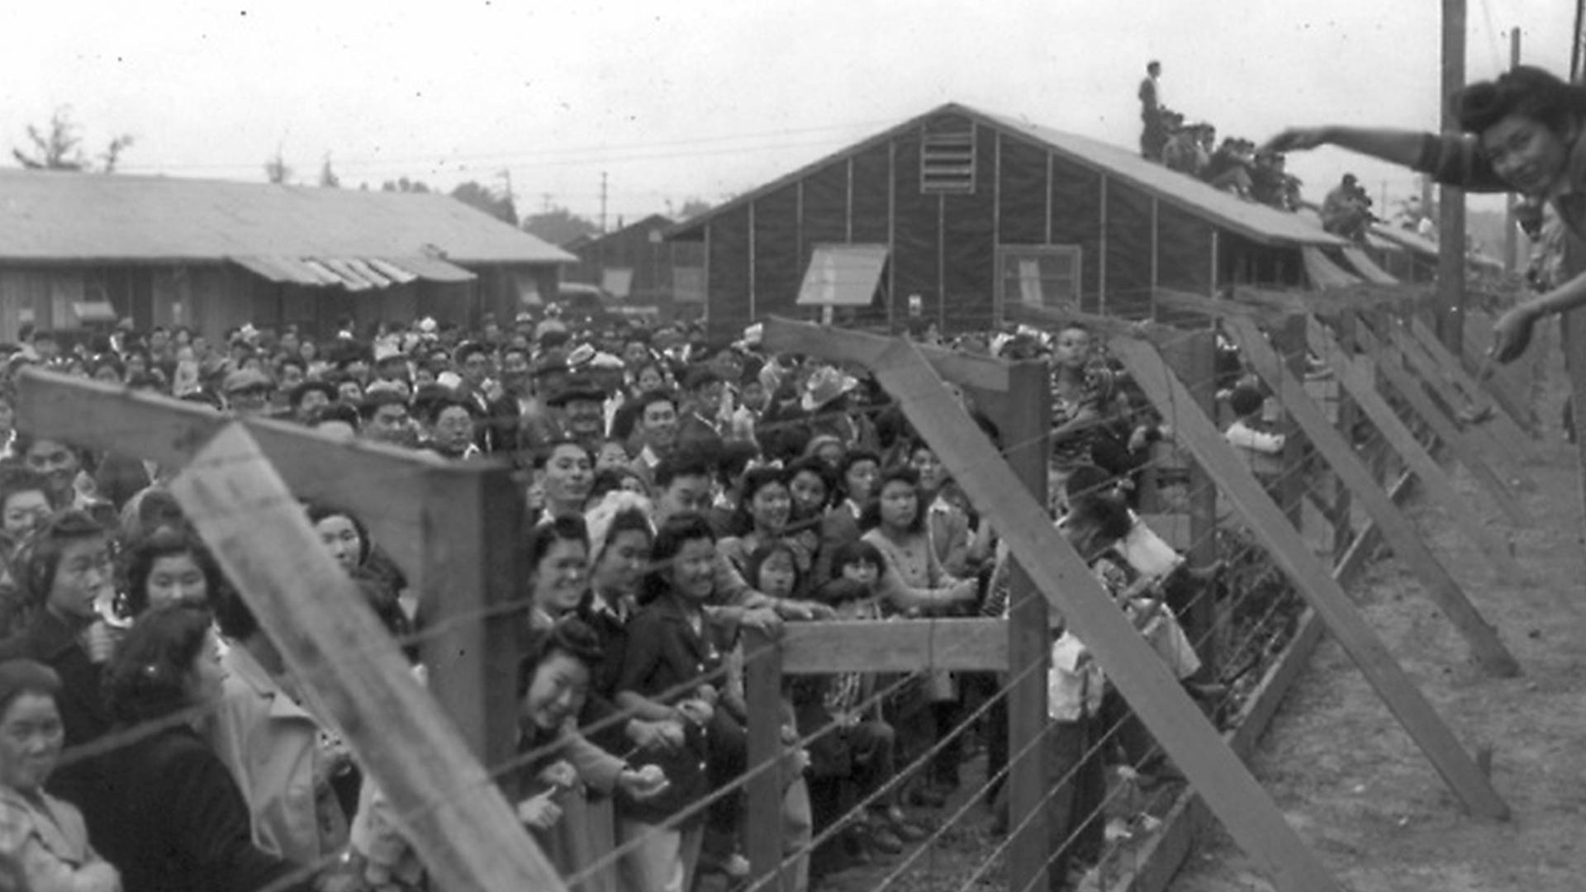
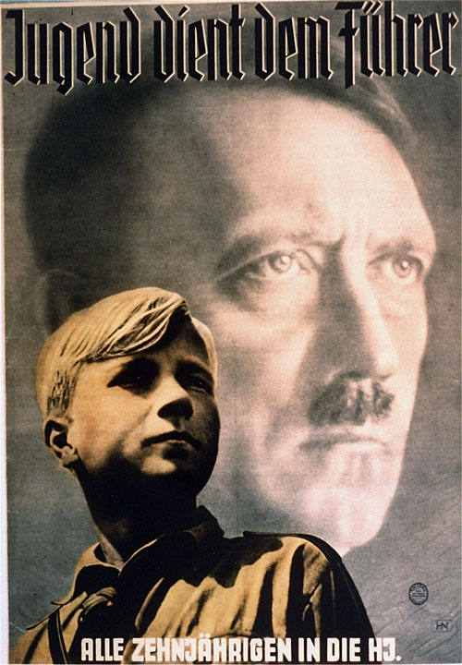
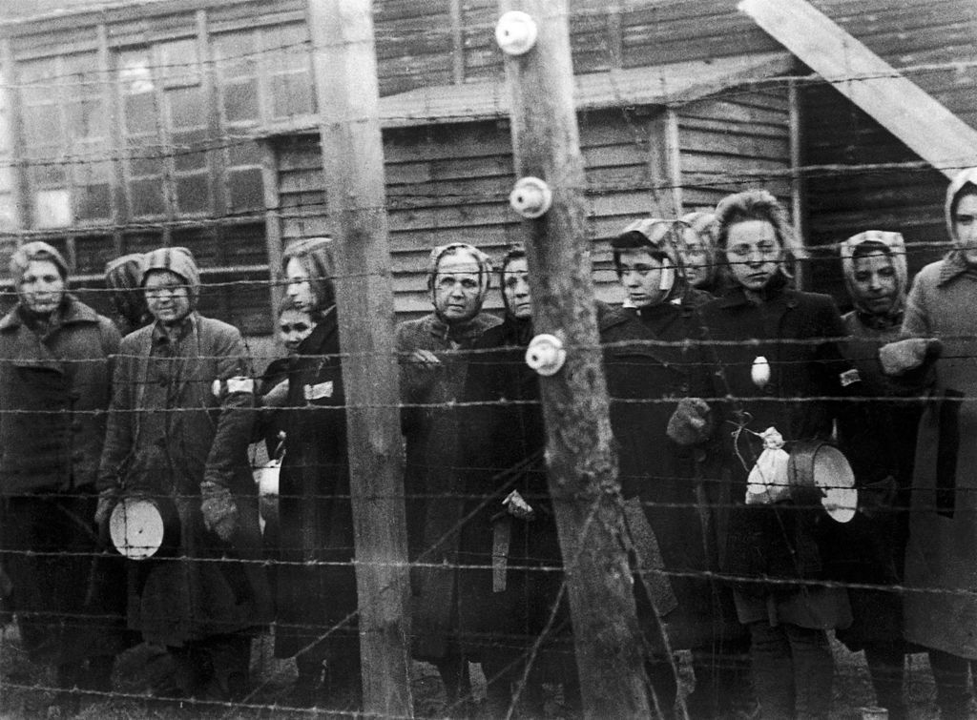
Youth Serves the Leader: All 10-Year-Olds into the [Hitler Youth]

Slide 10
GREAT COMMUNICATORS
FDR
HITLER
Fireside Chats (30)
  Allowed him to be more relatable to Americans
  Regained trust of the people
Precision of language
Set rules as to what could be printed and what could not
Nazi Rallies
  Charisma
  Motivating
Complete control of all forms of media
  Newspapers
  Radio Broadcast
Political Socialization- the process through which individuals acquire their beliefs and values about the political world (Danzinger, 2013)

Slide 11
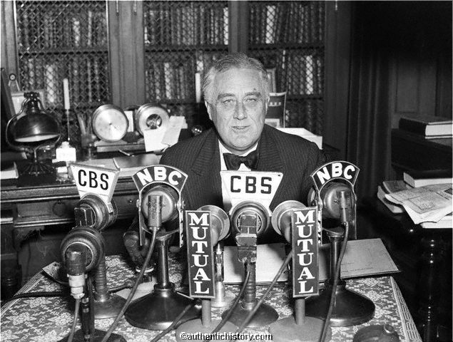
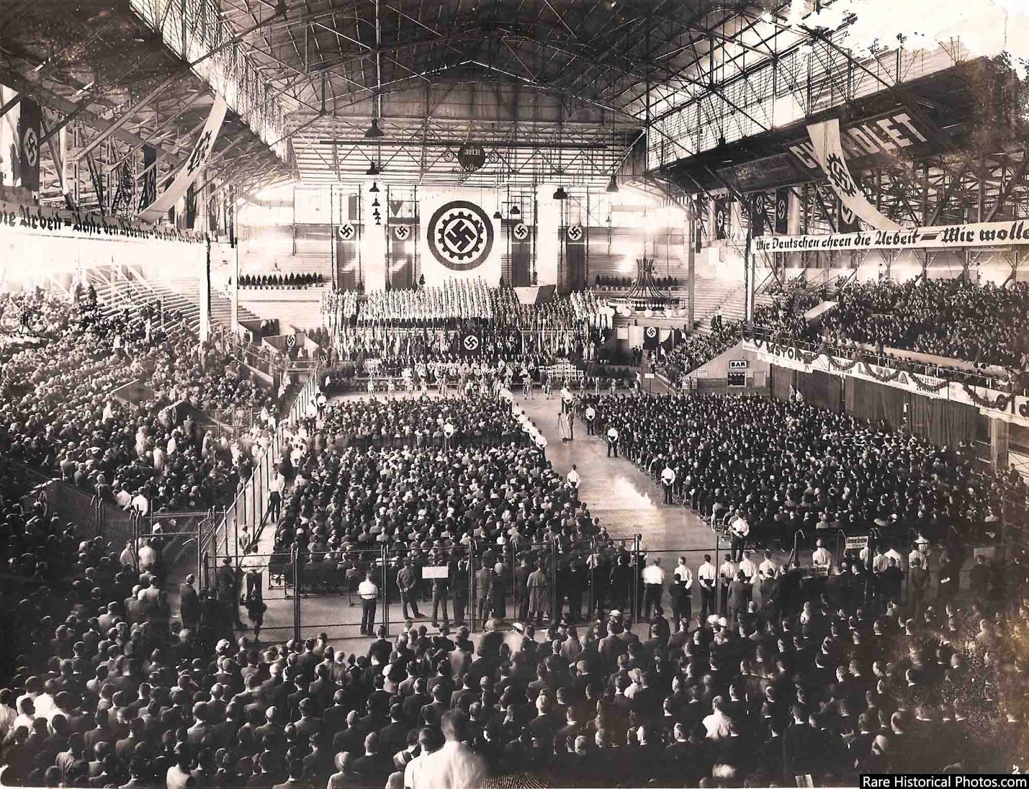

Slide 12
LASTING IMPACT
FDR
HITLER
Helped create the United Nations
New Deal programs still in effect
  Social Security
  Welfare Programs
  FDIC
Pushed America to internationalism
Expanded the role of the President
  Use of presidential war powers
Germany forever changed
  Lack of nationalism
  Pacifism
  Domestic Life
  International efforts
Role with the European Union
American influence in Europe
Caused Europe to question democracy
Pro-Hitler governments

