Slide 1
Creative Process and Creative Products
Student’s Name
Institution

Slide 2
1.
Creative products:
1. Foldable bicycle: Easy to store or carry
2. Wine glas holder clip: Keeps the glass safe
3. Traffic signal with a hour glass timer: Provides real-time and exact time
4. Car solar charging station: Reduces the cost of energy
5. Rear view mirror: Provides clear image and eliminate blind spots
6. Cup holder clip: Helps to organize desk if there are no sufficient space
Notes:
The above list of products that I believe are creative and adopted creative designs. The reasons for choosing each product has been written against the point.

Slide 3
1.
7. Self-locking bike: Enhances security
8. Liquid plastic melding tool: People can fix broken household items by themselves
9. Aerogarden: Ensure people can eat healthy by growing their vegetables
10. Temperature controlled insulated mug: One can keep their brages at the temperature they desire
11. Portable solar-powered light and charger: Making adventure easy
Notes:
This is a continuation of the previous slide, listing creative products ever made.

Slide 4
2.
Annoyance: Getting the same message over and over again
How to reoslve it:
1. Use snapchat that deletes messages after sometime
2. Use Nomorobo app and Robokiller that blocks and filters spam messages
3. Use the setting on the phone to block such messages from reappearing
Notes:
Here, I have listed one of the annoyances and different innovations that can help resolve the issue.

Slide 5

3.
B.) Product Prototype
Prompt 1:
A.) Pitch: Me-N-U plays a huge role by providing people with a unique, authentic, and easy social interaction with peers. We provide customers with better guidance than traditional social platforms. At Me-N-U, we aim to be a trusted source that helps you socialize and interact with your peers in real-time anywhere in the world’

Slide 6
4.
Pluses: This product provides a real-time virtual communication Faster and easy to use Can be used offline (without video) Authenticates the person you are communicating with | Concerns: How might we differentiate our key provisions with the other platforms-Most of the features here are available on the other major social platforms How might we convince people to use the technology-Difficult to convince people to adopt the technology How might it be used in large-scale communication-Still cannot support communication in big organizations
Potentials: It might help reduce online or cyberbullying It might help people embrace face-to-face communication again It might expand the concept of social interaction in communication | Overcoming the key concerns: How might we convince people to adopt it: The solution to this is promotion and advertising in the market How might it be used in largescale: Continue introducing new features

Slide 7
5.
The company: Aurora Solar Inc. A software company located in San Francisco, California. The company was founded by two collegemates who met at Stanford University. The company builds and designs digitalk platforms that powers solar industry The platforms that the company desings helps solar companies to streamline complex and manual processes | What are they doing to help others? Solar energy is becoming the new way of getting cheaper and clearner energy However, there are still challenges with the installation and efficiency. Aurora Solar Inc. provides software technology that seek to ease the problems Recently, the company ventured in construction of solar power plant. I seeks to create a 150MW solar thermal power plant in South Australia This construction is set to produce about 500GWh of clean energy
WHat is creative about it? The idea is creative because, unlike the other solar energy sources, this one seeks to use moltne salt as the heat tranfer medium. Molten salt is known to have unique qualities, in terms of durability. There is no need to replace it for the entire lifespan of the project. Also, it ca be reused with minimal or no expected loss (Power Technology, 2021) | How does it create additional value for stakeholders? Makes cheaper energy Long-lasting and efficient source of energy Cost-effective because of the materials used that do no need replacing (such as molten salt) Greaner and cleaner energy

Slide 8
5.
Creative Products
1. Electric metro bike: Very light (under 50 lbs) and powerful
2. Fitness tracker: Giving the user a 24/7 access to their health status snd progress. No need to constantly visit the doctor
3. Tempo studio home gym: Provides users with touc-screen TV housed in a cabinet that carries gym equipment
4. Sams galaxy earbuds: Convenient and noise cancelling
5. Moxie Robot: A child-friendly robot that tells stories and play games. Keeps the child busy and interactive

Slide 9
6.
List of Annoyances: | Annoyance to work on: Trying to sneeze and it does not come out
1. When a roommate leaves the house untidy 2. When I get message every minute the whole day 3. When trying to sneeze and it does not come out 4. When I can’t remember my password 5. When people repeatedly make mistakes 6. When getting to home and realize I forgot the keys at work 7. Waking up late and there are alot to do 8. When working and collegues keeps disrupting 9. Sending someone to get something then they claim they did not find it 10. When my phone hangs when I need to use it | Reason: There is nothing annoying like feeling that one wants to sneeze and it just dissappears. While the feeling may not be as bad as sneezing out loudly, it creates certain kind of discomfort. It can be embarrasing when it happens in a public place. How I intend to work on this annoyance: I intend to work on this annoyance by ensuring that I carry a handkerchief or acquire CTech’s innovative sneeze guard.

Slide 10
6.
List of Useful Products | Improvement
1. Flouride-free chacoal toothpaste- Helps people whiten their teeth 2. Kindle Paperweight-Enable readers to read every anytime 3. Elecric shaver-Better and faster than razer 4. Hot air brush- convenient and faster 5. Smartwatch 6. Fire TV stick 7. Popsockets 8. Vacuum wter bottle 9. Ambiance smart bulb 10. Backflip | -Improvement is make the price affordable. Currently, chacoal-based toothpaste are more expensive than contemporary toothpastes -Improvement is to make it accessible -Improvement involves making the product cheap -Make the product smaller -Make them avodable for people to access -Make it to be usable offline -Make them more durable- Use stronger and long-lasting gum -Make them affordable and readily accessible -Try to make them affordable -Make it cheaper for people to access them
Innovations formed in St. Pete/Tampa Bay Grow Smarter: This is a business innovation that brings together 90 organizations engaged in cross-sector collaboration Artificial intelligence: Tampa-based Scion Analytics is one of the first companies in Tampa Bay to deal with artifificial intelligence

Slide 11
7.
What I see Myself Doing (WIDMID)
I see myself havign a well-paying job in the next seven years.
Goals: 1. Learn how to manage time 2. Focus on being proactive rather than reactive 3. Be more creative 4. Complete college 5. Be a good listener 6. Wake up early | How am I going to do this? 1. Set schedules and have a diary to list my events 2. Have all the facts before making decisions on judgments 3. Research and learn more about events before make any decision 4. Attend classes and complete assignments in time 5. Learn and practice to give other people time to talk 6. Set an alarm to ensure that I wake up early everyday

Slide 12
8.
What I see Myself Doing (WIDMID)
I see myself havign a well-paying job in the next seven years.
Goals: A. Short-Term Goals 1. Wake up early 2. Be good listener B. Mid-Term Goals 1. Learn to manage time 2. Be creative 3. Complete college C. Long-Term Goals 1.Focus on being proactive rathern than reactive | How am I going to do this? 1. Set an alarm to ensure that I wake up early everyday 2. Learn and practice to give other people time to talk 1. Set schedules and have a diary to list my events 2. Research and learn more about events before make any decision 3. Attend classes and complete assignments in time 1. Have all the facts before making decisions on judgments

Slide 13
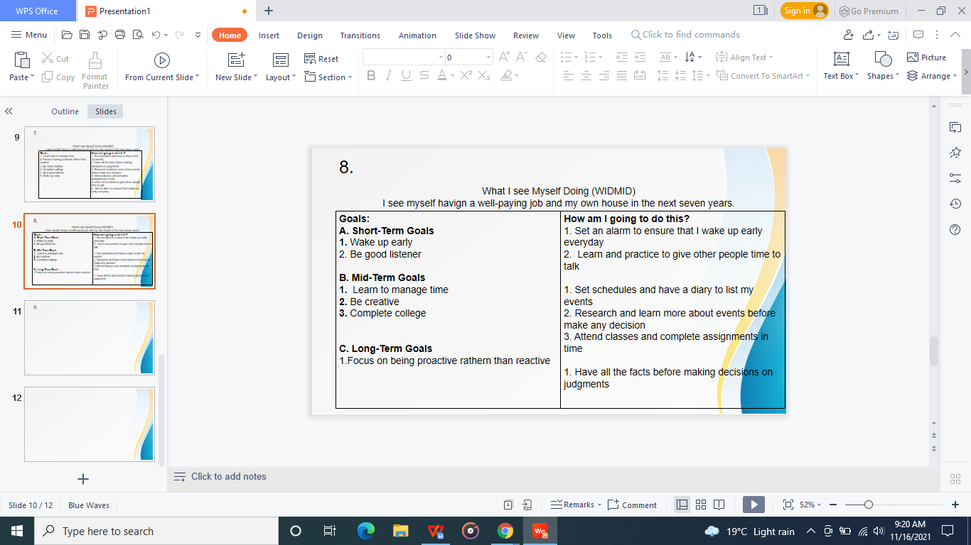
9.
After getting a well-paying job, I see myself
1. Buying a house
2. Getting a family
3. Buying a car
4. Creating an investment (establishing my own business)
5. Travelling with my family to see the world- go to places I always wanted to to go to like Paris (France) and Cairo (Egypt

Slide 14
10.
Explain a time where you faced a difficult situation: There was a time I faced an unusual situation. I was part of the team assigned to do software upgrade for a company. The schedule was so tight that we had to push some activities to weekend. That weekend, my cousin was getting married and I had to be at the wedding. This was difficult and placed me in a dilemma. I did not want to miss my cousin’s wedding, while also did not want to miss my job . Even though the entire team was there, the manpower was not enough to complete the job on time so that I could make it to the wedding. | Using creative thinking, how did you resolve the situation? I talked with my supervisor if I could get someone to help me complete my duties. He agreed and I brought in one of my colleagues who was not part of the team. When I went home Friday evening, I kept thinking about how I could make it to both wedding and also complete my job. Then, I thought of outsourcing strategy. I knew thaI had the solution and all I had to do is to convince my supervisor to allow me bring in someone.
How was this situation different than the way you would typically approach a problem? This situation was different because it placed me in a place that I had to choose one thing over the other and, one had a consequence to the other. Choosing to miss my cousin’s wedding to retain my job would have mean that I dissapoint my cousin. Going to the wedding and leaving my job undone would have mean I lose the job. I have never faced such kind of dilemma in my life and this was one of a kind.

Slide 15
Reference
Power Technology. (2021). “Aurora Solar Energy Project.” https://www.power-technology.com/projects/aurora-solar-energy-project/

