Slide 1
Dysfunctional Families and Crime
Student’s Name
Institutional Affiliation

Slide 2
Introduction
A family is said to be dysfunctional if there are regular conflicts and misconduct, especially between the parents.
In most cases, children are continuously abused and often neglected.
In recent times, the number of dysfunctional families has risen at a high rate.
After long term conflicts, some members of the family change their way of life and accommodate unpleasing actions.
Analyzing issues surrounding dysfunctional families is vital in determining the solutions to the resulting crimes.

Slide 3
The major topics of discussion in dysfunctional families and crime include:-
Parenting
Characteristics of parents from dysfunctional families
Signs of a dysfunctional family
Effects of drugs and substance abuse
Crime in broken families
How to overcome the effects of a dysfunctional family

Slide 4
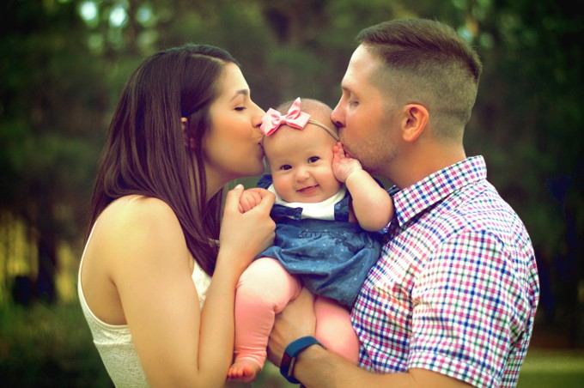
Parenting
The relationship between parents has a substantial impact on a child’s behavior.
If parents keep quarreling, children are likely to be disobedient.
Parents should have quality time with their children for bonding and attachment purpose.
Children are unable to make friends at school if their parents are brutal at home (Gable & Sharp, 2016).
Parents should show some concern to their children to help them improve social relations and academic performance.

Slide 5
Characteristics of parents from dysfunctional families
Controlling parents- These are the parents who fail to give their children the freedom to make their own decisions.
Alcoholic parents- Such parents are frequently involved in violence and expose their children to the risk of becoming alcoholics.
Abusive parents- This can be verbal or physical. Children with abusive parents have low self-esteem and are likely to cause chaos in the neighborhood (Kheswa, 2017).
Deficient parents- Parents who are unable to play their roles appropriately can make the children run away from home due to multiple responsibilities.

Slide 6

Signs of dysfunctional families
Disrespectful parents and children in public.
One or both parents start missing from home.
Gender bias. When parents treat some children better than others depending on their gender.
Frequent disagreements over petty issues. Most misunderstandings lead to fights.
Parents being stressed and depressed. Some medical causes of mental instability result from domestic violence (Berns, 2017).

Slide 7
Effects of drugs and substance abuse
Drugs and substance abuse is one of the major causes of conflicts in families.
In most cases, men are the victims of drug addiction.
Alcohol is the most used drug, especially by low-income earners.
Some drugs result in mental illness, which is often the leading cause of neglecting children.
Some parents abuse their children sexually under the influence of drugs (Jarvinen, 2015, p805).
Parents should portray good behavior for their children to emulate them.

Slide 8
Crime in broken families
According to statistics in America, most young people caught in criminal wrongs are from broken families.
Lack of guidance from parents from an early age of life has social effects on the children.
Some young individuals from dysfunctional homes experience financial problems, thus engaging in crime to satisfy their needs.
Children who watch their parents fighting at home have high chances of committing violent crimes.

Slide 9
How to overcome the effects of a dysfunctional family
Parents and children with emotional torture can seek help from cancellers and religious elders for guidance and support.
Affected individuals should learn to express their feelings and share their views with people for them to get help.
Ask for forgiveness from people you have wronged, to restore peace and harmony at home.
Practice good health habits like stopping drug abuse.
Work on your relationship with family members and learn to trust others.

Slide 10
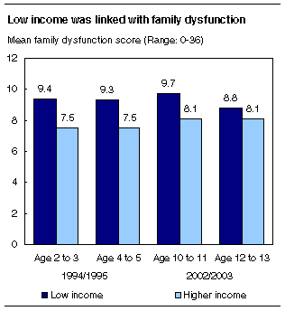
Analysis
Families with parents with low income are more likely to be dysfunctional

Slide 11
Conclusion
Parents are the key determinants of functional homes.
The development and success of children are determined by social relationship from their families.
Parents should control themselves in the use of drugs to avoid influencing children and young adults.
Crime rates can be reduced if parents take time to offer guidance to their children from an early age.
The government should enforce the laws that deal with child abuse and neglect.
Faith-based organizations should offer guidance and canceling to parents to improve their social relationships.

Slide 12
References
Kheswa, J. G. (2017). The impact of Dysfunctional Families and Sexual Abuse on the Psychological Well-being of Adolecent Females in Eastern Cape, South Africa: Research Note. J. Soc. & Soc. Welfare, 44, p161.
Berns, N. S. (2017). Framing the victim: Domestic violence, media and social problems. Routledge.
Gable, S., & Sharp, E. (2016). Parenting: Success requires a team effort.
Jarvinen, M. (2015). Understanding addiction: Adult children of alcoholics describing their parents’ drinking problems. Jounal of Family Issues, 36(6), p 805-825.

