Slide 1
Cyberbullying Among Children Aged 10-17
Lesson Plan Presentation

Slide 2
Lesson Objectives
Learner will know the various forms of cyber bullying for children aged 10-17years
Learner will learn the negative effects of cyberbullying to children
Learner will learn the how to handle cyberbullying cases
Learner will learn the signs of cyberbullying
Learner will know their role in preventing cyberbullying
Notes:
Internet or other technology, such as mobile telephones, can be used to intimidate, torment or threaten others. Cyberbullying is the use of inappropriate behavior, strength or influence, whether directly or indirectly, and whether, written, verbal, physical, or through displays of or use of imagery, symbols, or otherwise, to intimidate, torment, threaten, harass, or embarrass another person.

Slide 3
Various Forms Of Cyberbullying
Blogging bullying
Social media bullying
LGBT bullying
Spreading rumors through cell phones
Notes:
The various forms of cyberbullying include social media, blog bullying and LGBT . Internet or other technology, such as mobile telephones, can be used to intimidate, torment or threaten others(Jimenez, 2019). Cyberbullying is the use of inappropriate behavior, strength or influence, whether directly or indirectly, and whether verbal, written, physical, or through displays of or use of imagery, symbols, or otherwise, to intimidate, torment, threaten, harass, or embarrass another person.

Slide 4

Negative Effects Of Cyberbullying On Children
Low self esteem both at school and at home
Academic issues
Suicidal thoughts and self harm
Anger and Isolation
Humiliation
Notes:
Bullying of any kind can have negative physical and psychological consequences for a child(Baier et al., 2019). Depression, behavioral issues, low self-esteem, academic struggles, fear and suicidal thoughts are among the negative effects of children aged 10-27 experience as a result of cyberbullying.

Slide 5
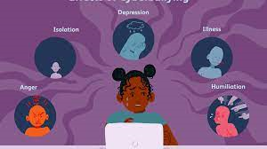
Notes:
Any type of bullying can have physical and psychological effects on a child. Anxiety, fear, depression, low self-esteem, behavioral issues, and academic struggles are just of the few challenges kids may experience if they are targets. Cyberbullying, however, may be particularly damaging.

Slide 6
How to Handle Cyberbullying Cases
Block the bully
Limit social media usage for the child
Know the sites the child regularly visits
Limit access to technology
Be part of the child's world
Notes:
Learner have a role in handling the case. limiting access to internet and knowing site that children visits often are great ways to handle and prevent cyberbullying(Baldry, Sorrentino and Farrington, 2019) . Make sure to keep the computer in a visible area of the house and to set limits on the usage of cell phones and video games. A parent can turn off messaging at certain hours or at night to prevent the children from being targeted.

Slide 7
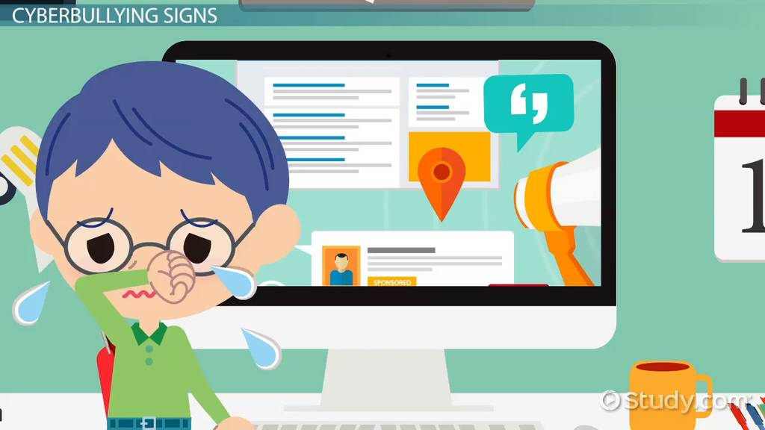
Signs Of Cyberbullying
Being emotionally upset after using a phone
Being secretive
Avoiding group gatherings(Group Work)
Change of mood, appetite, behavior or sleep.
Spending a lot of time in a room than usual.
Notes:
In many cases, children and who are cyberbullied may not want to tell a teacher, parent, or other trusted adults. This is typically due to feelings of embarrassment or concern that their devices will be confiscated at home. The various signs of being bullying include spending time alone and also too much time in the bedroom. A child can also be secretive and emotionally upset after using the mobile phone.

Slide 8

Role of Parents in Preventing Cyberbullying
Notify the school about the issue.
Offer effective support and comfort.
Let children know that it is not their fault.
Get necessary help from authority.
Keep records of bullying.
Notes:
If a child is cyberbullied a parent ought to make immediate notification to the school, offer support to the child and report the issue to the authority. However, before reporting the problem, inform your child of your intention to do so, so that Learner can come up with a solution that will satisfy both of you. Finally the parent can also screen shot the messages, photographs, and texts that appear on the child's cell phone(Helfrich et al., 2020) .
Moreover, According to Dorol and Mishara, (2021) cyberbullying prevention tactics include teaching stronger personal skills, encouraging school social ties, and proposing family interventions to lessen the consequences of cyberbullying.

Slide 9
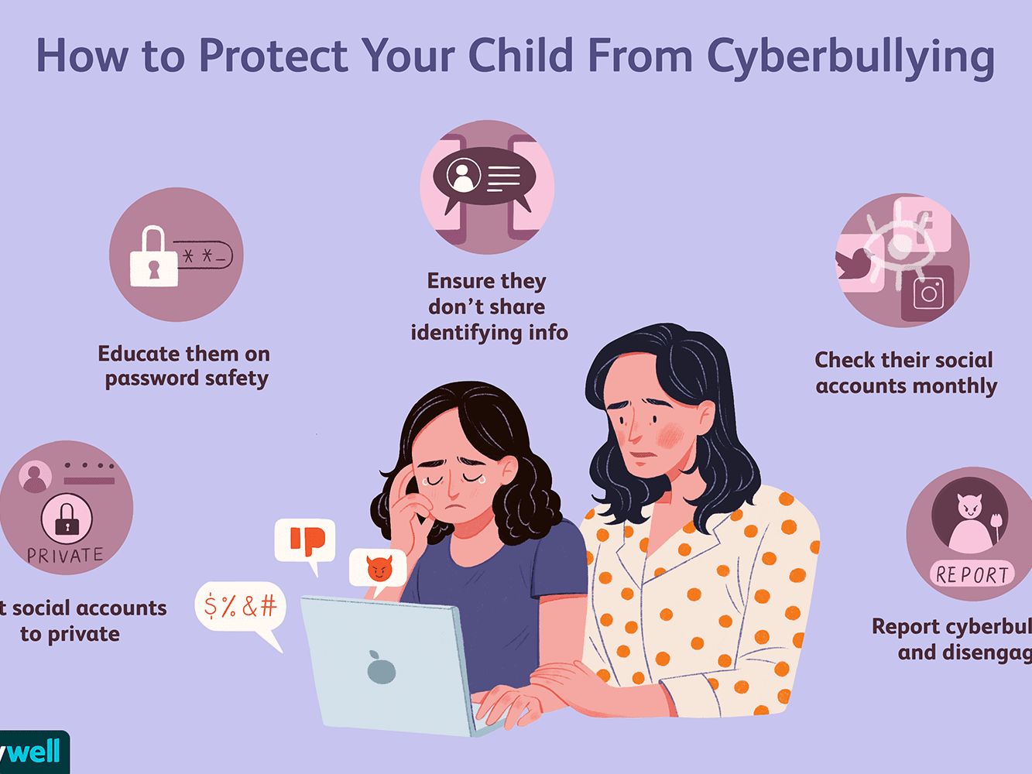
Notes:
While there is no foolproof way to prevent your child from ever being cyberbullied, there are things you can do together to reduce the likelihood they will be targeted.

Slide 10
References
Baier, D., Hong, J. S., Kliem, S., & Bergmann, M. C. (2019). Consequences of bullying on adolescents’ mental health in Germany: Comparing face-to-face bullying and cyberbullying. Journal of Child and Family Studies, 28(9), 2347-2357.
Baldry, A. C., Sorrentino, A., & Farrington, D. P. (2019). Cyberbullying and cybervictimization versus parental supervision, monitoring and control of adolescents' online activities. Children and Youth Services Review, 96, 302-307.
Dorol, O., & Mishara, B. L. (2021). Systematic review of risk and protective factors for suicidal and self-harm behaviors among children and adolescents involved with cyberbullying. Preventive Medicine, 152, 106684.
Helfrich, E. L., Doty, J. L., Su, Y. W., Yourell, J. L., & Gabrielli, J. (2020). Parental views on preventing and minimizing negative effects of cyberbullying. Children and Youth Services Review, 118, 105377.
Jiménez, R. (2019). Multiple victimization (bullying and cyberbullying) in primary education in Spain from a gender perspective. Multidisciplinary Journal of Educational Research, 9(2), 169-193.

