Slide 1
Material & Finishes
Materials and Finishes

Slide 2
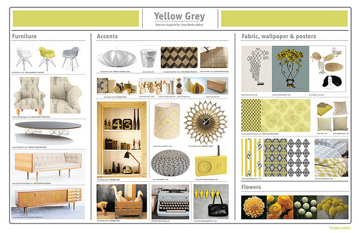
  in·te·ri·or de·sign
the art or practice of planning and supervising the design and execution of architectural interiors and their furnishings

Slide 3
Interior Designers
Meeting accessibility requirements of the Americans with Disabilities Act (ADA)
Installing doors, lighting and equipment for compliance with fire safety and other local, state and provincial building codes
Specifying ergonomic, sustainable designs and furnishings to protect human health
A qualified interior designer is a key asset to any building construction team, lending knowledge and taking responsibility for critical features that protect public health, safety and welfare. Interior designers provide expertise for:

Slide 4

Interior design includes a scope of services performed by a professional design practitioner, qualified by means of education, experience and examination, to protect and enhance the health, life safety and welfare of the public.

Slide 5

NCIDQ
The National Council for Interior Design Qualification protects public health, safety and welfare by identifying interior designers who have the knowledge and experience to create interior spaces that are not just aesthetically pleasing, but also functional and safe.
NCIDQ is the global leader in establishing standards of competence for interior design/interior architecture professionals.

Slide 6
Why?
Understanding how to select materials for a project.
To be aware of the existing materials, dimensions, textures, physical and
chemical features, existing forms and what we can achieve with them.
Material selection depending on functional character criteria, aesthetics,
comfort , and sustainability.
Work on the idea of a project and the choice of materials and finishes as parts of the same deed. The choice of materials and their application in a piece of work forms part of the overall project decision
Identify, formulate and solve problems regarding setting up the materials
and finishes from the point of view of the technical possibilities and the project intention.
Communicate efficiently, orally, graphically and in writing, using the
language specific to constructive elements.
Learn to do research on materials and finishes with the means we have
within our reach.

Slide 7
Guidelines
Why?
The spectrum of code stringency makes logical sense: This makes it easy to wrap your brain around the material restrictions that will apply to your project
Lightly Regulated
Heavily regulated
Private space (like a residence) in stand-alone building (vs. an apartment or condo building)
Used by able-bodied adults who are familiar with the premises (inhabitants stay for long duration)
Use presents no exceptional hazards.
Public spaces shared by a variety of people both publicly owned (like schools) and privately owned (like restaurants)
Spaces that serve vulnerable populations (like children or sick people)
Hazardous materials or processes are contained.

Slide 8
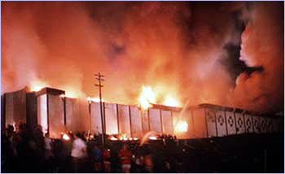
Why?
On May 28th, 1977, the place was packed with visitors that were expecting a night of glamour and star entertainer John Davidson. It is uncertain exactly how many patrons were in attendance that evening, but estimations put the number at approximately 3,000 at the entire facility with 1300 in the Cabaret Room. There were multiple events taking place in multiple rooms which were all filled to or over capacity, according to reports.

Slide 9
Why?
May 28, 1977 Loss of 165 lives.
EFFECTS OF SMOKE:
The effects of smoke on the Club's occupants has been deliberately omitted from the above analysis. Based on our experience with corridor fires, the smoke from the original fire in the Zebra Room and from the fire in the corridors would have spread in the same direction as the fire, but at an earlier period in this sequence. In other words, the smoke would have reached the Cabaret Room some time ahead of the fire. This smoke would have appeared to be dark, almost black in nature, to the occupants. In addition, it would have been extremely irritating, causing tearing of the eyes and a burning sensation to the nose. This was due to the nature of the materials undergoing combustion, i.e., the carpets and wall paneling. In addition, for a fire of this type, the smoke would have contained certain toxic gas species, the principal one being carbon monoxide. Carbon monoxide, although colorless and odorless in the quantities likely to have been present in the early stages of this fire, produces confusion and disorientation. Later, of course, as the levels increased, carbon monoxide produced unconsciousness and ultimately death among some of the occupants.

Slide 10
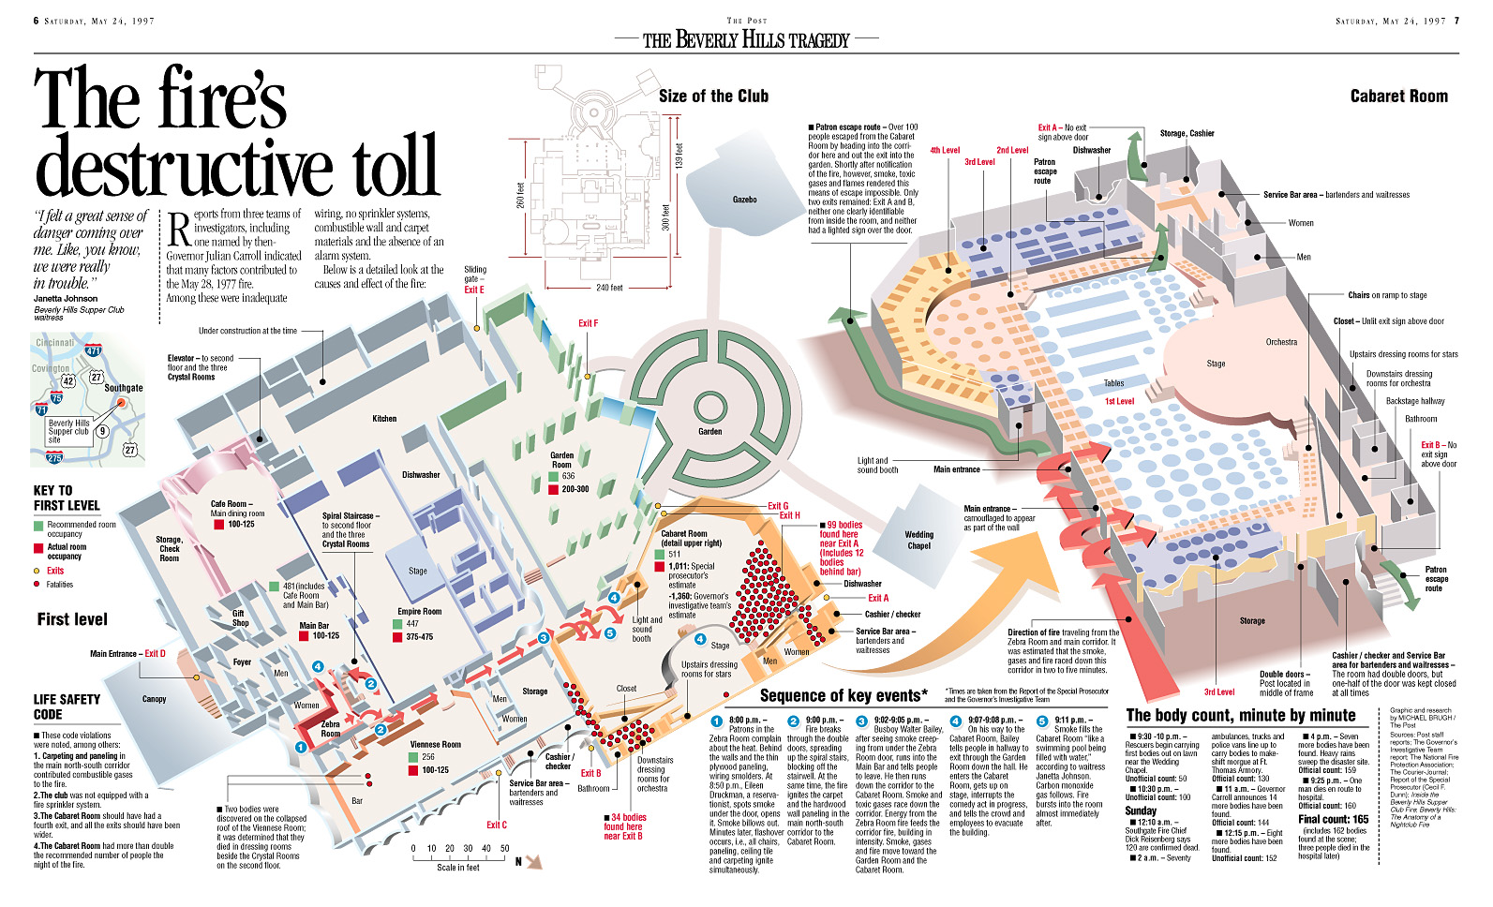
Beverly Hills Supper Club Fire
Building materials and contents must be fire-rated.
Rules regarding sprinklers, exit signs and room capacities have changed
Many Beverly Hills exits weren't clearly marked. Now, exit signs have to be illuminated with battery back-ups
Many Beverly Hills furnishings easily burned, releasing toxic gases. Most
Beverly Hills victims died in the overcrowded Cabaret Room. Today, room
capacities are clearly posted in public spaces..

Slide 11
Guidelines
Pertaining to materials:
Pertaining to items:
Fire-resistance
Slip-resistance
Ability to be cleaned or sanitized
Ease of use (particularly in panic situations)
Visibility
Air quality

Slide 12
Guidelines/ADA Requirements
Test methods for flammability include:
  Methenamine pill
  Steiner tunnel test
  Chamber test
  Radiant panel test
ADA requirements for flooring materials
  Must be level and flush with surrounding materials
  Coefficient of friction greater than 0.6
  Transitions with changes in height
  Maximum pile heights and fastening

Slide 13
Sustainability
When researching how green a product is, consider the course of its entire life:
  Manufacturing
  Packing and shipping
  Preparation and installation
  Use and maintenance
  Removal and disposal

Slide 14
Green Design
Green design focuses on the environment as in Nature and the world-at-large
  Recyclable & Recycled
  Sustainable / Renewable
  Durable
  Adaptable
  Non-toxic
  Low embodied energy & Local
  Sustainably maintained

Slide 15
Recycled, Recyclable
Pre-consumer: the materials of manufacturing do not reach a consumer and are recycled.
Post consumer:the materials being recycled have already passed through the consumer market and are recycled or re-constituted into a product for the consumer market once again.
Cradle 2 CradleProduct that is created that is not only efficient but also essentially waste free
Up-cycling and down-cycling
Upcycling is the process of converting waste materials or useless products into new materials or products of better quality or for better environmental value
Downcycling is the process of converting waste materials or useless products into new materials or products of lesser quality and reduced functionality.

Slide 16

Common Carcinogens
Antimony
Arsenic
Bisphenol A (BPA)
Cadmium
Chlorofluorocarbons (CFCs)
Dioxin
Formaldehydes
Furans
Halogenated compounds
Lead
Mercury
Per fluorinated chemicals (PFCs)
Polychlorinated biphenyls (PCBs)
Polyvinyl chloride (PVC)

Slide 17

LEED
Leadership in Energy and Environmental Design

Slide 18
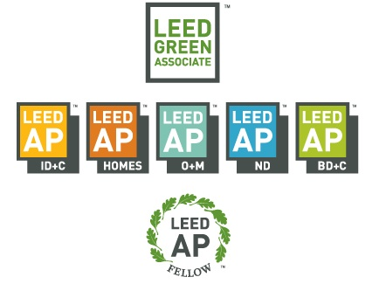
LEED Categories

Slide 19
LEED-certified buildings are designed to:
Lower operating costs and increase asset value
Reduce waste sent to landfills
Conserve energy and water
Be healthier and safer for occupants
Reduce harmful greenhouse gas emissions
Qualify for tax rebates, zoning allowances and other incentives in hundreds of cities

Slide 20
1. Since green products are one of the fastest growing markets in the country, some corporations may want to appear greener than they really are. As a result, they may change the name of product to make it sound more natural, or print “certified organic” on the label when it isn’t, or even claim association with a green group that doesn’t exist. Often this is all part of a carefully choreographed effort to attract new sales or new investors.
2. You have to read. Read the label and make sure that the ingredients are what you expected. Better yet, go to the website of the company for more information. And if you are still concerned, there are several websites that track greenwashing. One is run by the University of Oregon and the other by Green Peace.
Greenwashing

Slide 21
Greenwashing
Greenwashing
New eco-friendly ingredients!
Now great for the environment!
Recommended by the EPPV Environmental Agency!
The term greenwashing first appeared in 1989 and is a contraction of the words green (environmentalist) and brainwashing.
Look green, make green. Get it?
Caveat Emptor applies. Let the buyer beware.

Slide 22
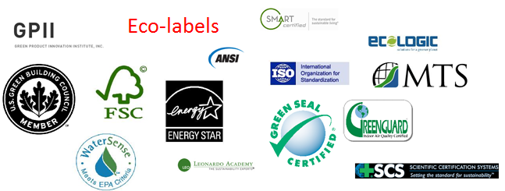
Sustainability
Professional interior designers make conscientious choices for their client’s jobs. What type of claim is being made single-attribute (like Energy Star – appliance energy efficiency) or does product meet broad standards such as those established by multiple attribute standards (like Eco-Logo and Green Seal)? Is it self-certification or is there an objective third party evaluating claims? Who is advocating – someone with a business association or political agenda?
They rely on
  Their own research
  Research performed by testing agencies
  Certification by first, second and third-party agents

Slide 23
Design Phases
Programming
Schematic
Design Development
Construction Document

Slide 24
Programming Phase
The Designer usually meets face-to-face with the Client to find out how the space will be used and to get an idea of the Client's preferences and budget.
The Designer also will visit the space to take inventory of existing furniture and equipment and identify positive attributes of the space and potential problems.
conducting research
identifying and analyzing the needs and goals of the client and/or occupant(s) of the space
evaluating existing documentation and conditions
assessing project resources and limitations
identifying life, safety and code requirements
developing project schedules and budgets

Slide 25
Conceptual Design Phase
The Designer creates a design that correctly implements the requirements of the Client. It is the first phase of the design process. It is programmatic, problem-solving and a creative visualization of the ‘BIG IDEA’. This is the phase where the creative side of the Designer is tested. During this stage the Designer and the Client/s will either agree or disagree upon the concept/s presented, finishes and materials recommended as well as the costs.
conceptual images
conceptual drawings – floor plans, elevations, sketches
3D model/s (project specific)
preliminary cost estimate
concept schedule of materials and finishes

Slide 26
Schematic Design
During this phase programming information is incorporated, basic special relationships are developed; sketches, preliminary plans, sections and elevations are presented to the Client. Upon completing the design plan, the designer will present it to the Client again and make revisions based on the Client's input.
During this phase programming information is incorporated, basic special relationships are developed; sketches, preliminary plans, sections and elevations are presented to the Client.
Upon completing the design plan, the designer will present it to the Client again and make revisions based on the Client's input.

Slide 27
Design Development
The Project becomes more technically polished and refined
During this phase the Designer refines the project, establishes the scope, relationships, forms, size and appearance of the project by means of plans, sections and elevations, typical construction details, equipment layouts, and three-dimensional visualizations.
Although some design issues will continue to be refined, resolved or modified during the construction documents, bidding, and construction phases of the project, the primary achievement is to enable the Client to understand how the project will function as well as give more detail about what it will look like.
The Design Development Documents shall also include specifications of the materials, finishes, furnishings such as furniture, lighting, flooring, wall covering, and artwork that will identify major materials and systems and establish in general their quality levels.
Depending on the complexity of the project, the Designer also might submit drawings for approval by a construction inspector to ensure that the design meets building codes. If a project requires structural work, the Designer works with an Architect or Engineer for that part of the project.

Slide 28
Construction Documents
non-load bearing interior construction
space planning
reflected ceiling plans
lighting
interior detailing
materials and finishes
furnishings, fixtures and equipment
The project is ready to be build
This phase is about the details and the requirements for construction of the Project. The Construction Documents shall include Drawings and Specifications that establish in detail the quality levels of materials and systems required for the Project.

Slide 29
Contract Administration
Finally the concept becomes a reality!
Contract Administration is a phase where the Designer administers the Client’s Contract for Construction with the General Contractor. A successful construction project depends on careful Contract Administration.
representing the Client’s interests during construction
reviewing shop drawings of building components
visiting the site
attending regular progress meetings
reviewing the contractor’s Applications for Payment

Slide 30
Design Intent
Specifications
Drawings

Slide 31
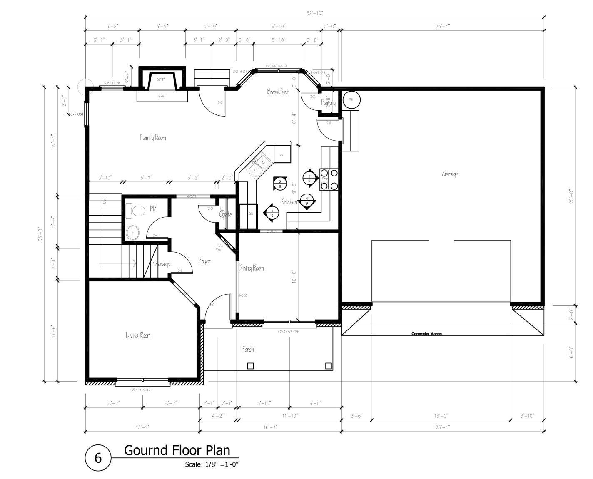
Drawings
DRAWINGS
The drawings show the shape and form of the space, as well as the quantities, sizes, and locations of materials and products. Drawings for construction contracts include demolition plans, existing construction to be modified, new construction, elevations, sections, and details. Drawings for FF&E contracts include furniture and furnishings plans.

Slide 32
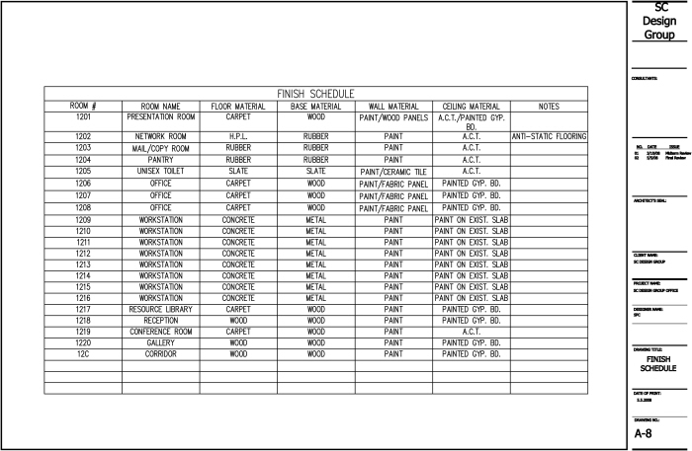
Specifications
Specifications
Specifications describe the quality of materials and their construction or installation . They include information that cannot be communicated graphically in the drawings

Slide 33
Specifications
Performance Specification
Proprietary Specification
Descriptive Specification
Reference Standard Specification

Slide 34
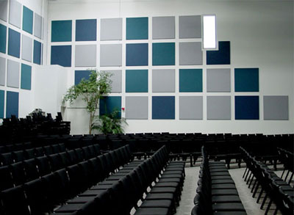
Performance Specification
Acoustical wall panel is specified by describing its fire-test-performance characteristics, acoustical properties expressed by noise reduction coefficient value, and the abrasion resistance of its fabric covering.
Describes the required results
The contractor or supplier has a choice of products, materials, and processes that will be used to achieve these results.
Will make references to industry standards

Slide 35
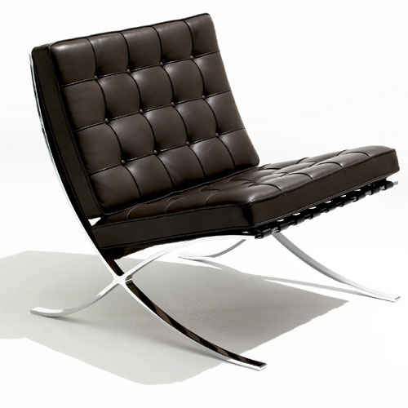
Proprietary Specifications
Knoll Group, studio line, Barcelona chair with black leather upholstery
Require a specific product from a specific manufacturer indicated by a brand name or model number.
The specifier has complete control over what will be incorporated in the project.

Slide 36
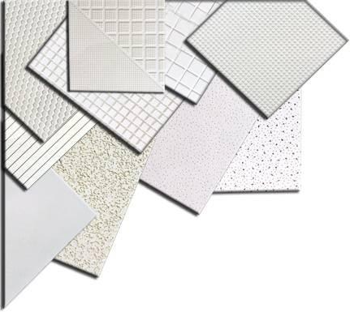
Descriptive Specifications
An acoustical ceiling tile would be specified by describing the tile material, pattern, finish, color, edge detail, thickness, and size.
Detail the requirements for the materials properties and workmanship.
They are the most difficult to write.

Slide 37
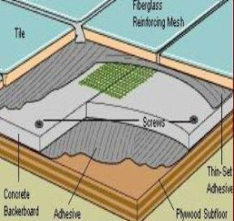
Reference Standard Specifications
Specifying compliance with ANSI A108 Specifications for Installation of Ceramic Tile.
American National Standards Institute
Based on requirements set by an accepted authority
Briefest type of specification
Specifier needs to understand the standard and verify that all provisions of the standard apply to the project.

Slide 38
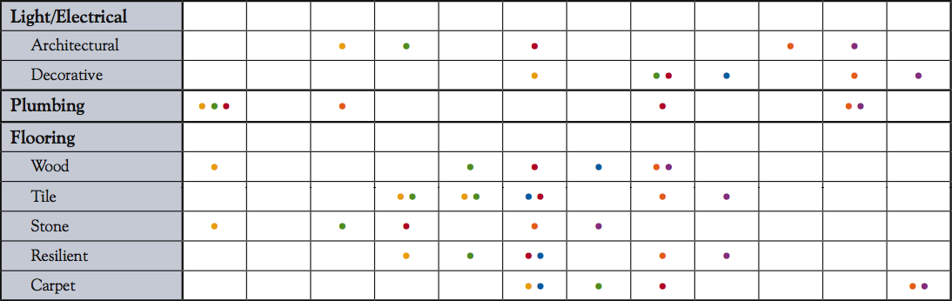
Project Organization
Interior designers must manage all phases of production from initial selection through inspection to close the punch list

Slide 39
The supply Chain
  The various suppliers include:
    Manufacturers
    Manufacturers Representatives (“Reps”)
    Dealers/Distributors/Vendors
    Resellers and Retailers

