Slide 1
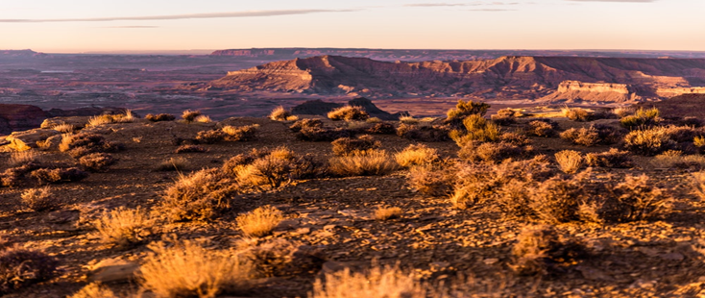
DESERT
ENVIRONMENTAL SCIENCE

Slide 2
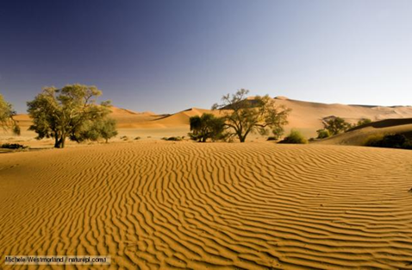
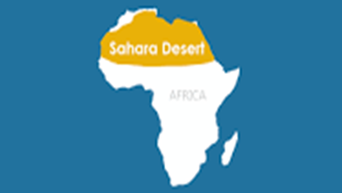
DESERT CHARACTERISTICS AND LOCATION
Deserts biomes are widespread and cover at least a third of the surface of the surface of the earth.
Deserts occur a long distance away from the coasts. In these locations, moisture coming from oceans and seas does not reach the land.
Deserts are divided into four categories hence there are numerous of them in many areas across the world.
The subtropical Sahara in Africa is the larges hot desert biome. However, the overall largest desert is the Antarctica- a polar desert (nabhan, 1999).
Deserts receive little rainfall of about 50cms a year.
Temperatures are extreme during the day and cold at night in deserts
Notes:
Desert biomes cover quite a large part of the earth surface. They are believed to cover a third of the earth surface. Desert biomes build on lands that are far away from the coast line since they are not exposed to moisture from these water bodies. Deserts are divided into four major categories hence they are widespread in many parts of the world. However, the Sahara desert in Africa and the Antarctica in the polar region are one of the largest deserts in the world. Temperatures in these regions are high during the day and low at night. They also receive little or no rainfall of about 50cms in a year.

Slide 3
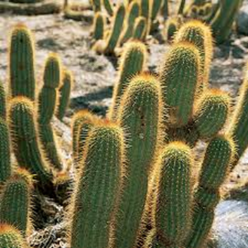
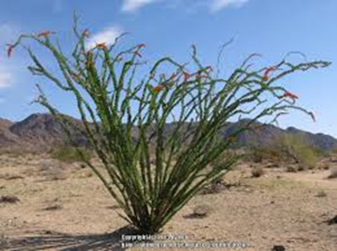
DESERT BIOME PLANTS
The cacti, small shrubs, succulents and grass are the most common plants in the desert. However, other plants such as Mugma tree, Desert Ironwood, Ocotillo, Brittle Bush just but a few thrive in desert conditions (nabhan, 1999).
To help them thrive in such difficult climatic conditions, these plants have developed certain unique adaptations
The most common are storage of water in stems and leaves, coverings of wax on eaves, shedding leaves, aimed at minimizing the loss of water.
Some have also developed long tap roots to help them reach the water table
The cactus has managed to survive these conditions for many years because it has shallow roots hence being able to soak up little rain and moisture available before evaporation
Notes:
The cactus, shrubs and grass are the most common plant that thrives in the desert. The cactus plant has unique features that makes it adapted to the harsh climatic conditions in the desert. Their leaves are reduced to thorns and wax to help in storage of water. They also have shallow roots that helps them tap water and moisture before evaporation. Other plants include Mugma tree, Desert Ironwood, Ocotillo, and Brittle Bush. Their general unique adaptation to desert life include shedding of leaves to help them retain as much water as possible.

Slide 4
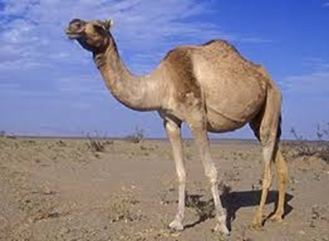
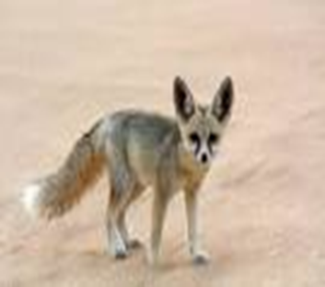
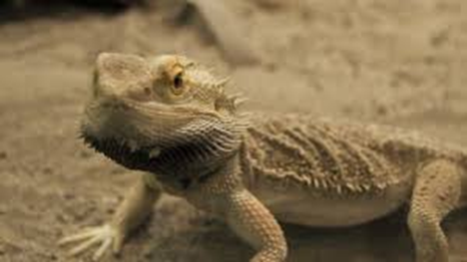
DESERT BIOME ANIMALS
In spite deserts experiencing harsh climatic conditions, many animals thrive here
Such animals have unique adaptations to help them remain cool and use less water
A camel, for example, can survive for many days without the availability of food and water due to the stored fat in its hump. A camel also has thick fur and underwool to help them survive harsh winter conditions
Foxes also survive here because of their burrowing and nocturnal living adaptations. The burrowing lifestyle ensures they avoid the high heat conditions during the day
Animals here have adaptations such as panting which helps them minimize heat, seasonal migration, and stretched periods of dormancy.
The other common animals in the desert include Coyotes, Thorny Devil, Desert Tortoise, Bobcats just but a few
Notes:
The most common animals in the desert include camels, foxes, coyotes, desert tortoise just but a few. Animals also have unique features that help them adapted to the harsh conditions in the desert. A camel, for example, has stored fat in the hump hence can go days without food and water. Foxes on the other hand have burrowing and nocturnal living adaptations hence can be able to avoid high heat conditions during the day. In addition, animals have unique adaptations such as panting, and seasonal migration.

Slide 5
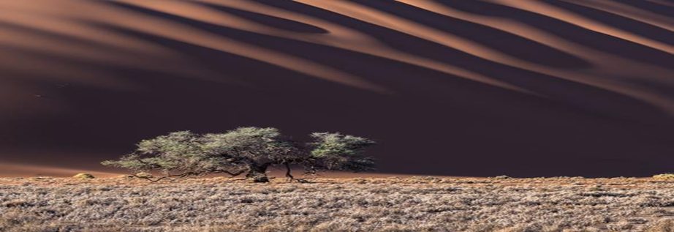
DESERT BIOME THREATS
Global warming is increasing drought incidences, which contributes to the drying of water holes. High temperatures may lead to high numbers of wildfires that alter the landscapes of deserts through the elimination of slow-growing trees and replacing them with fast-growing grasses (wallace, 1980).
Irrigation which is utilized in agriculture can lead to high levels of salt in the soil and hence cannot support plants.
Grazing animals also is threat to many desert plants and animals. This act deprives these plants and animals food and also leads to desertification
In addition, potassium cyanide mainly used in mining gold can may be poisonous to wildlife
When used carelessly, off-road vehicles can be hazardous to desert habitats.
Notes:
Desertification through grazing of animals deprives desert plants and animals food. Global warming is also a threat to deserts. Drought is a major threat which makes desert plant and animals susceptible to hunger. Irrigation used in agriculture also exposes plants to too much salt which can lead to stunted growth of plants. Off-road vehicles also can be hazardous too plants and animals if used carelessly.

Slide 6
SOLUTIONS TO DESERT THREATS
One way to ensure these threats do not exist is to use water resources efficiently. Using of the water resources efficiently and better control of salinization can help improve the conditions of arid lands
Engineering new methods of crop rotation can help protect the arid soils and the bushes
Planting plants with nitrogen fixing ability can paly a fundamental role in restoring the soil fertility
People can also dig artificial grooves on the surface to help in retaining water from the rain
Notes:
People need to embrace the efficient use of water resources to help improve the conditions of arid lands. Encouraging crop rotation is also an essential means of improving the conditions of the soil and plants. People also need to construct artificial grooves on the earth surface to help in the collection of rain water.

Slide 7
Bibliography
Grady, C. (2017). The desert biome.
Nabhan, G. P., & Holdsworth, A. R. (1999). State of the desert biome: uniqueness, biodiversity, threats and the adequacy of protection in the Sonoran bioregion. Arizona-Sonoran Desert Museum.
Wallace, A., Romney, E. M., & Hunter, R. B. (1980). The challenge of a desert: revegetation of disturbed desert lands. Great Basin Naturalist Memoirs, 216-225.
https://www.nationalgeographic.com/environment/habitats/desert-threats/

