Slide 1
Buying Car with Vending Machine
By Liza Lin
Notes:
Internet giant Alibaba plans to disrupt China’s auto retail scenery with an experiment that circumvents car salesmen.

Slide 2
Alibaba Group Holdings LTD.
Alibaba Group Holding Ltd. plans to open car-vending centers
This is its latest endeavor to translate its success in online transactions
The vending centers will operate in the shopping business world
Alibaba aims to succeed in China
China is where clients are heavily using the e-commerce economy.
Notes:
Chinese e-commerce giant Alibaba Group Holding Ltd. plans to open car-vending centers for automotives. This is part of the company’s latest endeavor to translate its success in online transaction to the physical shopping business world. Alibaba wants to succeed in China, where clients are in great deal using the e-commerce economy.

Slide 3
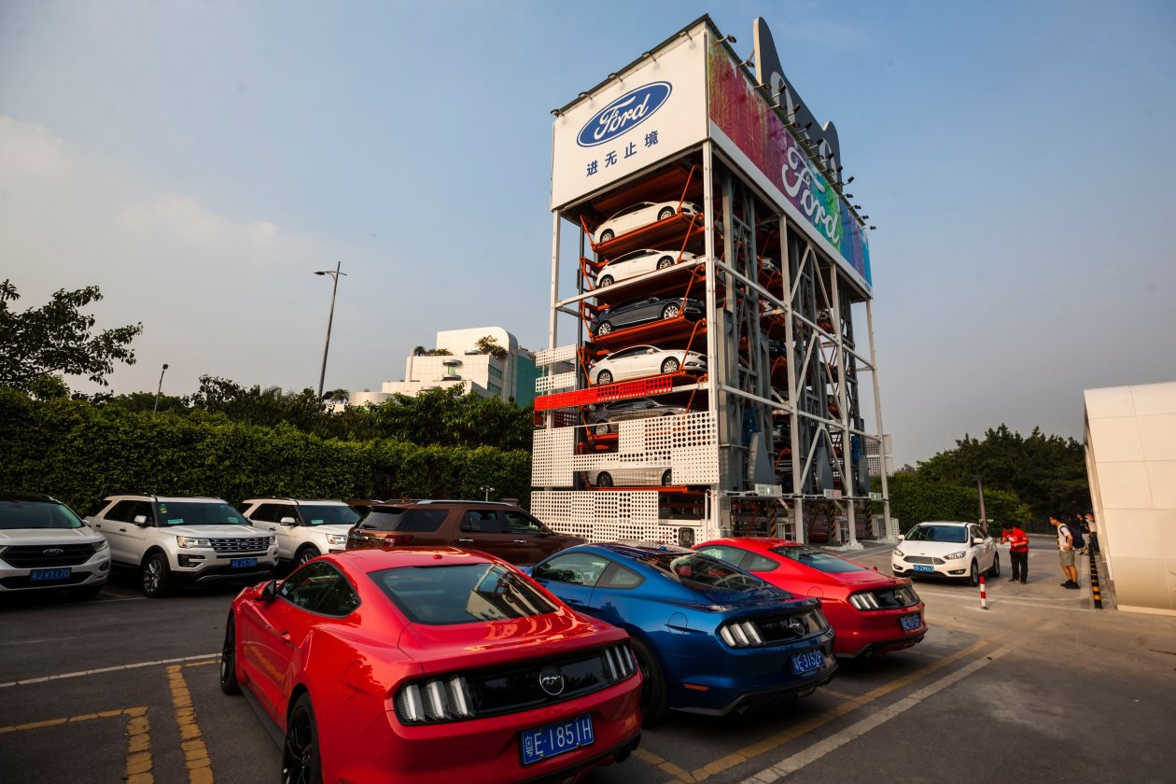
Car-Vending Center
Notes:
Alibaba established this car-vending center in Guangzhou. Fascinated car purchasers book a test drive online, surpassing traditional dealerships.

Slide 4
Car-Vending Technology
Technology has been tested in the U.S. but failed
Carvana, in Phoenix has been running the structures since 2013
Clients can look for, buy, fund and trade-in cars online
They have the choice of selecting it up from a vending machine full of cars
Clients in the US prefer one-on-one deals
Notes:
The car-vending technology has been tried in the U.S. with restricted success. Carvana, a used-car dealer located in Phoenix, has been running such structures since 2013. Clients can search for, buy, fund and trade-in cars online, then have the choice of picking it up from a huge vending machine filled with cars.

Slide 5
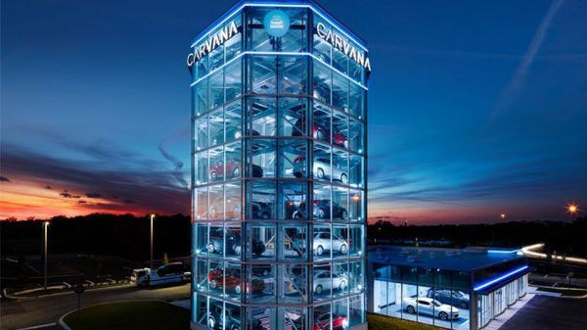
Carvana
Notes:
Carvana, the car-vending machine in Phoenix

Slide 6
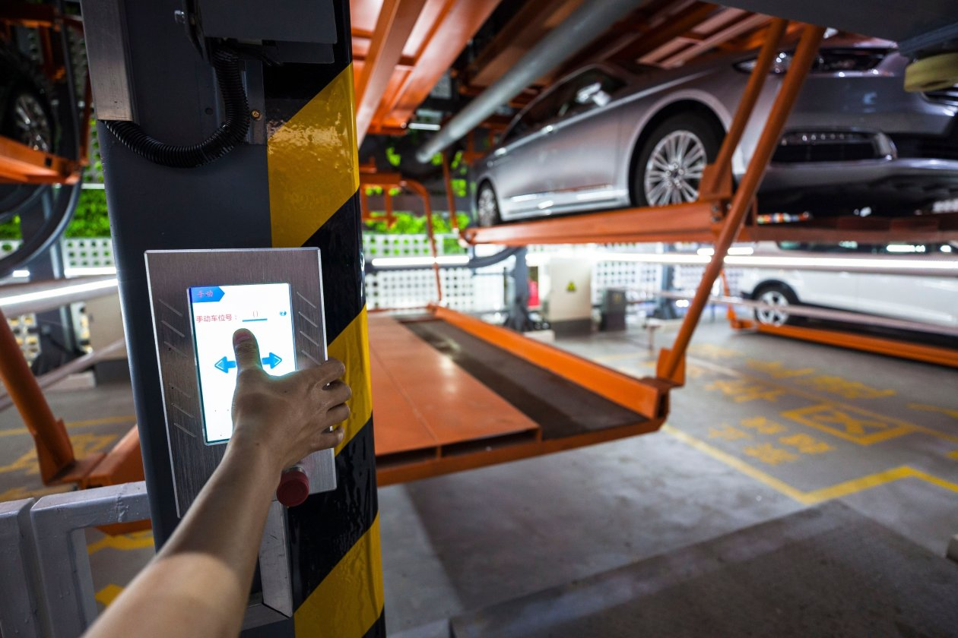
Auto-Vending Center
Notes:
Image of Alibaba’s auto vending center shows a man requesting delivery of a car. This center is some 5 stories tall and includes in an excess of 40 Ford vehicles.

Slide 7
China’s Retail Climate
China’s automotive retail climate is developed for commotion
China’s clients are willing to try out new concepts
Ford saw sales in China reduce recently
This is because domestic rivals gained popularity
Ford is today searching for fresh ways of engaging customers
The same is because many go online for their car-purchasing research.
Notes:
China’s automotive retail climate is ripe for commotion, analysts say. The clients, often first-time car purchasers, are willing to try out new concepts. Ford has witnessed sales in China reduce sharply recently as domestic rivals become more popular. Ford is today searching for fresh ways of engaging customers, as many go online to do their car-purchasing research.

Slide 8
Purchase Process
Attendants explain a car’s basic features and answer questions
Customers do not have to deal with salespeople
They do not haggle over price
Clients think for themselves and conduct the research
They then buy when ready on their mobile devices
This is the preferred transaction procedure for millennials
Notes:
A car vending machine is a frictionless commerce. Clients do not have to deal with salespeople trying to talk into things they do not want. Customers do not haggle over price. Clients can think for themselves, conduct the research, and make the buy when ready on their phone. This is the preferred transaction procedure for the millennial generation. There are attendants who provide details about vehicles

Slide 9
E-Commerce in Practice
Alibaba is experimenting with the principles of e-commerce
E-commerce companies are taking stakes in malls and supermarkets
They are digitizing the operations to find growth
Enterprises are aiming to use the huge troves of information
E-commerce shifts how consumers shop in the actual world
Notes:
Alibaba is experimenting with the principles of e-commerce into the physical retail world. Similar to Amazon.com Inc. experimentation with unmanned supermarkets, Chinese e-commerce companies are taking stakes in malls as well as supermarkets, digitizing the operations as they find growth beyond their online retail operations. In some cases, they are aiming to use the huge troves of information they have gleaned from e-commerce to vary how consumers shop in the actual world.

Slide 10
Chinese Companies
Alibaba uses augmented reality mirrors and vending machines in supermarkets
This allows clients try numerous lipstick colors and buy them via its online forums
JD.com Inc. developed its brand in online ordering and delivery
The firm is involved in brick and mortar with a series of clerkless convenience warehouses
This is where clients pay via facial-recognition technology.
Notes:
Alibaba is experimenting by applying augmented reality mirrors as well as vending machines in supermarkets to allow clients try on numerous lipstick colors and purchase them on the spot through Alibaba’s online forums. JD.com Inc., which developed its brand in online ordering in addition to delivery, is further involved into brick and mortar with a series of clerkless convenience warehouses where clients pay via facial-recognition technology.

Slide 11
Auto-Vending Machine Program
Using the auto vending-machine, clients access Alibaba’s Tmall website to book test drive
The drive is free for people with high scores on the Sesame Credit rating system
The services are given by Alibaba partner Ant Financial Services Group.
Customers (unregistered) pay 99 Yuan to test-drive Ford sedans
198 yuan is paid for Ford Mustang sports car.
Notes:
Under the auto vending-machine, clients access Alibaba’s Tmall website to order the test drive, which is free for people with high scores on the Sesame Credit rating by Alibaba associate Ant Financial Services Group. Without an elevated credit score, customers pay 99 Yuan to test-drive Ford sedans and 198 yuan for other brands, such as Ford Mustang sports car.

Slide 12
The Vending Machine in Guangzhou
The vending machine in Guangzhou recorded brisk business in inception
In 2 days, Ford recorded 450 orders to test-drive the vehicle
Ford provided no details about whether activity produced sales
The vending machine diminishes anxiety for car buyers
Notes:
The vending machine in Guangzhou recorded brisk business on its opening day of operation. In 48 hours, Ford received 450 bookings to test-drive the vehicle. Ford muted when asked if the new activity led to any sales. The vending machine assists diminish anxiety for car purchasers, who are tense when entering a dealership anticipating a hard sell.

Slide 13
Reasons for Longevity
Elongated test drives mean that buyers do not need help
No people are listening to feedback and trying to overcome objections
This is a reason that the auto retail process has maintained long life
Without a salesman is harder to change a test drive to a real sale
Attendants, therefore react to client feedback in the process
Notes:
With extended test drives, buyers do not require help, listening to feedback and endeavoring to overcome objections. This is among the reasons that the auto retail procedure has remained the same in the past three decades. Without a salesman, it might be harder to change a test drive to a real sale, or to react to client feedback in the process.

