Slide 1
Introduction to Probability
Business Statistics:
A Decision-Making Approach

Slide 2
Important Terms
Probability – the chance that an uncertain event will occur (always between 0 and 1)
Experiment – a process of obtaining outcomes for uncertain events
Experimental Outcome – the most basic outcome possible from a simple experiment
Sample Space – the collection of all possible experimental outcomes

Slide 3
Probability
Chance that a particular event will occur
0 ≤ p ≥ 1
P = uncertainty of event occurring
P = 0
P= 1

Slide 4


Slide 5
Probability Decisions in Marketing Strategy
Probability of a household is planning to buy a big screen TV or any other electronic product next year
Probability of actually buying
Probability of planning and actually buying
Probability that a purchaser is satisfied with purchase

Slide 6
Probability
Numeric value representing the chance, likelihood or possibility a particular event will occur
Examples:
Stock value
Sunny day
Warm day
Defective product
Product returned
Repeat customer

Slide 7
Probability
Impossible event – no chance of occurring: probability = 0
Certain event – sure to happen: probability = 1
A priori – the probability of success is based on prior knowledge of the process involved (not insider trading)
P = # of ways event occurs
total # of possible events

Slide 8
Joe’s Rules of Probability
Rule #1: the probability of any event is the sum of the probabilities of the outcomes that compose that event.
  Rule #2: If events A and B are mutually exclusive, the P(A or B) = P(A) + P(B)
Rule # 3: If two events are not mutually exclusive, the P(A or B) = P(A) + P(B) – P(AandB)

Slide 9
Rules of Probability
Probability of Event must be between 0 and 1 = sum of outcomes that compose that event
Example: P(7 or 11)
Complement rule: complement of event A = A’; P(A’) = 1-P(A)
Example: P(Ace), complement P(not an Ace)

Slide 10
Rules of Probability
3. If not mutually exclusive:
P(A or B) = P(A) + P(B) – P(A and B)
Example: P(A) = rolling a 1, 2, or 3
P(B) = rolling even number (2,4,6)
4. Mutually Exclusive and collectively exhaustive: probabilities have to add up to 1
Example: Roll of Die

Slide 11
Approaches to Probability
Classical: assign probability based on prior knowledge of process involved:
Empirical: assign probability based on frequencies obtained or observed – example:
Subjective: opinion, gut feeling, hunch
# times actually occurred
Max # times could occur

Slide 12
Sample Space
The Sample Space is the collection of all possible outcomes
e.g., All 6 faces of a die
e.g., All 52 cards of a deck

Slide 13
Events
Experimental outcome – An outcome from a sample space with one characteristic
  Example: A red card from a deck of cards
Event – May involve two or more outcomes simultaneously
  Example: An ace that is also red from a deck of
  cards

Slide 14
Visualizing Events
Contingency Tables
Tree Diagrams
Ace Not Ace Total
Black 2 24 26
Red 2 24 26
Total 4 48 52
Sample Space
Ace
2
24
2
24
Sample Space
Black Card
Full Deck
of 52 Cards
Not an Ace
Ace
Red Card
Not an Ace

Slide 15
Probability Concepts
Mutually Exclusive Events
  If E₁ occurs, then E₂ cannot occur
  E₁ and E₂ have no common elements
E₂
A card cannot be Black and Red at the same time.
E₁
Red
Cards
Black
Cards

Slide 16
Independent vs. Dependent Events
Independent Events
  E₁ = heads on one flip of fair coin
  E₂ = heads on second flip of same coin
  Result of second flip does not depend on the result of the first flip.
Dependent Events
  E₁ = rain forecasted on the news
  E₂ = take umbrella to work
  Probability of the second event is affected by the occurrence of the first event

Slide 17
Assigning Probability
Classical Probability Assessment
Number of ways E_{i} can occur
Total number of experimental outcomes
P(E_{i}) =
Relative Frequency of Occurrence
Relative Freq. of E_{i} =
Number of times E_{i} occurs
N
Subjective Probability Assessment
An opinion or judgment by a decision maker about the likelihood of an event

Slide 18
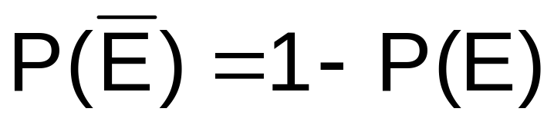
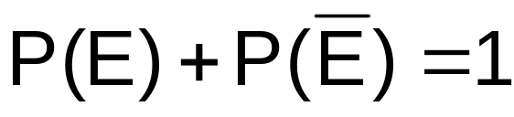
Complement Rule
The complement of an event E is the collection of all possible elementary events not contained in event E. The complement of event E is represented by E.
Complement Rule:
E
E
Or,

Slide 19
Probability
Joint event – two or more characteristics – craps table
Complement of event – A’
Joint probability – two or more events
Mutually exclusive
Collectively exhaustive

Slide 20
Probability
Conditional probability – probability of event A given information about occurrence of event B
Independent events – one event does not influence the probability of another event
Dependent events – the occurrence of one event influences the outcome of another event taking place – class

Slide 21
Experiments
Process that produces a single outcome whose result cannot be predicted with certainty
Could be as simple as a coin toss

Slide 22
Operations Research
Define the problem
Reformulate the problem in convenient form for analysis
Construct mathematical model that represents the problem
Models: portrait, globe, model cars, atom, genetic structure, organization charts
Determine decision variables
Determine the objective formula
Establish constraints – parameters
Gather relevant data

Slide 23
Probability
P(E_{n})= P(e₁) + P(e₂) + P(e₃) + P(e₄)
Survey of 5000 questionnaires on movie rentals
e₁ = ≥ 10
e₂ = 3-9
e₃ = 1-2
e₄ = 0

Slide 24
Probability – Relative Frequency
Relative
Frequency
Frequency
≥ 10 | 400 |  | 400/5000 | .08
3-9 | 1900 |  | 1900/5000 | .38
1-2 | 1500 |  | 1500/5000 | .30
0 | 1200 |  | 1200/5000 | .24

Slide 25
Multiplication rule and independent events
P_{a} * P_{b}
Example:
P(H first flip) = .5
P(H second flip) = .5
P(H₁ and H₂) = .5*.5 = .25

Slide 26
Multiplication rule and independent events
Example:
P(Hot) = .8
P(Dry) = .9
P(Hot and Dry) = .8*.9 = .72

Slide 27
Marginal Probabilities
TV Ad | Remembered (R) | Did not Remember (R’) | Total
Purchased Product (P) | 120 (.2) | 60 (.1) | 180
Did not Purchase (P’) | 80 (.13) | 340 (.57) | 420
 | 200 (.33) | 400 (.67) | 600

Slide 28
Conditional Probability
TV Ad | Remembered (R) | Did not Remember (R’) | Total
Purchased Product (P) | 120 (.2) | 60 (.1) | 180
Did not Purchase (P’) | 80 (.13) | 340 (.57) | 420
 | 200 (.33) | 400 (.67) | 600
P(P|R) = probability of purchase| remembered ad =
P(P|R’) = probability of purchase| did not remember ad =

Slide 29
Chapter Summary
Described approaches to assessing probabilities
Developed common rules of probability
  Addition Rules
  Multiplication Rules
Defined conditional probability
Use of Frequency/Relative Frequency/Contingency Tables

Slide 30
Discrete Random Variables

Slide 31
Introduction to Probability Distributions
Random Variable
  Represents a possible numerical value from a random event
  Takes on different values based on chance
Random
Variables
Discrete
Random Variable
Continuous
Random Variable

Slide 32
Discrete Random Variable
A discrete random variable is a variable that can assume only a countable number of values
  Many possible outcomes:
  number of complaints per day
  number of TV’s in a household
  number of rings before the phone is answered
  Only two possible outcomes:
  gender: male or female
  defective: yes or no
  spreads peanut butter first vs. spreads jelly first

Slide 33
Continuous Random Variable
A continuous random variable is a variable that can assume any value on a continuum (can assume an uncountable number of values)
  thickness of an item
  time required to complete a task
  temperature of a solution
  height, in inches
These can potentially take on any value, depending only on the ability to measure accurately.

Slide 34

Discrete Random Variables
Can only assume a countable number of values
  Examples:
  Roll a die twice
Let x be the number of times 4 comes up
(then x could be 0, 1, or 2 times)
  Toss a coin 5 times.
  Let x be the number of heads
  (then x = 0, 1, 2, 3, 4, or 5)

Slide 35
Discrete Probability Distribution
Experiment: Toss 2 Coins. Let x = # heads.
4 possible outcomes
Probability Distribution
T
T
x Value Probability
0 1/4 = .25
1 2/4 = .50
2 1/4 = .25
T
H
H
T
H
H

Slide 36
Discrete Probability Distribution
A list of all possible [ x_{i} , P(x_{i}) ] pairs
x_{i} = Value of Random Variable (Outcome)
P(x_{i}) = Probability Associated with Value
x_{i}’s are mutually exclusive
  (no overlap)
x_{i}’s are collectively exhaustive
  (nothing left out)
0 ≤ P(x_{i}) ≤ 1 for each x_{i}
Σ P(x_{i}) = 1

Slide 37
Introduction to Continuous
Probability Distributions
Business Statistics:
A Decision-Making Approach

Slide 38
Chapter Goals
Convert values from any normal distribution to a standardized z-score
Find probabilities using a normal distribution table
Apply the normal distribution to business problems

Slide 39
Continuous Probability Distributions
A continuous random variable is a variable that can assume any value on a continuum (can assume an uncountable number of values)
  thickness of an item
  time required to complete a task
  temperature of a solution
  height, in inches
These can potentially take on any value, depending only on the ability to measure accurately.

Slide 40
Example
Toyota managers concerned about cycle time – defined as the time between cars coming off the assembly line
Could also be time between ordering an item on the internet and when it arrives – order cycle time/customer order cycle time/customer wait time
Replenishment cycle time/order-ship cycle time

Slide 41
Example
What is probability that manufacturing cycle time will exceed the mean?
Harley – 1 bike every 54 minutes; 1 bike every 100 minutes; 4 per day in custom shop
What is the probability that shipment will take longer than average or longer than promised?

Slide 42
Variable of Interest
The value of the variable of interest is determined by measuring
Therefore, the # of variables is only limited by the capacity of the measuring device or measuring method

Slide 43
Continuous Probability Distribution
Can be used to estimate the distribution of possible outcomes for random variables or random samples
Works if the # of possible outcomes is large
Can be used to determine if a new product will be favorably accepted
The value can be anything along a continuum of values
Determine the probability for a range rather than a particular number

Slide 44
Normal Distribution
Bell Shaped
Symmetrical
Mean and median are equal
Amount of variation determines height and spread of the distribution

Slide 45
Probability of Normal Distribution
Calculate the probability of a normal distribution
→ convert to a standard normal distribution using standardized Z value
z = x – μ
σ
Z = # of standard deviations a point (x) is from the mean
Rescales from true units (time, weight, etc.) to standard measure - Z

Slide 46
The Normal Distribution
‘Bell Shaped’
Symmetrical
Mean, Median and Mode
are Equal
Location is determined by the mean, μ
Spread is determined by the standard deviation, σ
The random variable has an infinite theoretical range:
+ ∞ to − ∞
f(x)
σ
x
μ
Mean
= Median
= Mode

Slide 47
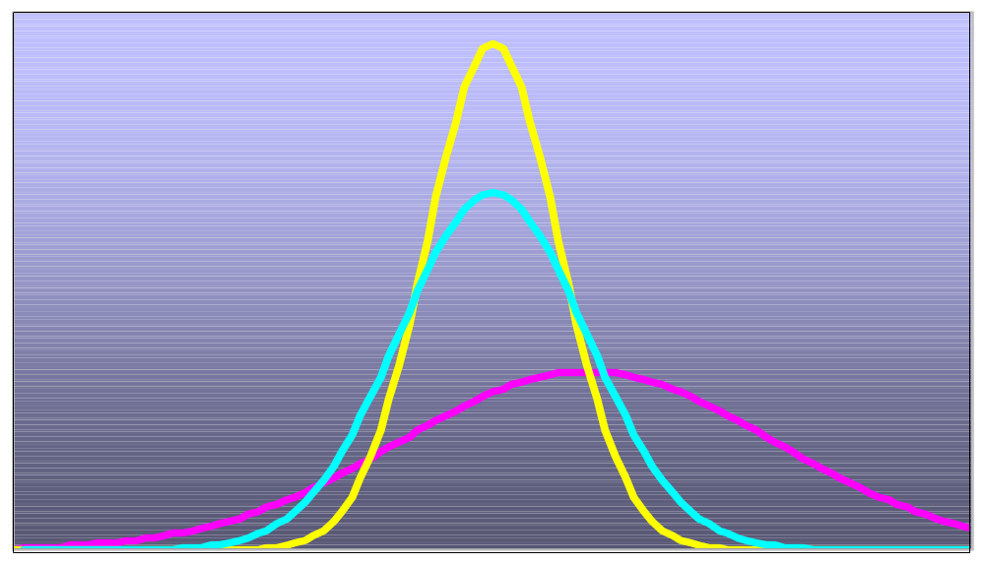
Many Normal Distributions
By varying the parameters μ and σ, we obtain different normal distributions

Slide 48
The Normal Distribution Shape
f(x)
Changing μ shifts the distribution left or right.
Changing σ increases or decreases the spread.
σ
μ
x

Slide 49
Finding Normal Probabilities
Probability is measured by the area under the curve
f(x)
P
(
a
≤
x
≤
b
)
a
b
x

Slide 50
Example
Ship Times: 6 days = μ ; σ = 1.5 days
Package 1 – 2 days
Package 2 – 8 days
Package 3 – 6 days
Z₁ = (2-6)/1.5 = -2.667 std dev from μ
Z₂ = (8-6)/1.5 = 1.33 std dev from μ
Z₃ = (6-6)/1.5 = 0

Slide 51
Steps
Determine mean (μ) and standard deviation (σ)
Define event of interest: P(x ≥ xx)
Calculate z value = x- μ
σ
find probability associated with z value –– probability between z value and mean
Determine the probability for event of interest

Slide 52
The Standard Normal Distribution
Also known as the “z” distribution
Mean is defined to be 0
Standard Deviation is 1
f(z)
1
z
0
Values above the mean have positive z-values, values below the mean have negative z-values

Slide 53
The Standard Normal
Any normal distribution (with any mean and standard deviation combination) can be transformed into the standard normal distribution (z)
Need to transform x units into z units

Slide 54
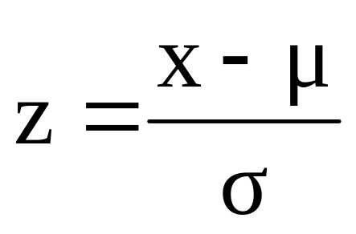
Translation to the Standard Normal Distribution
Translate from x to the standard normal (the “z” distribution) by subtracting the mean of x and dividing by its standard deviation:

Slide 55
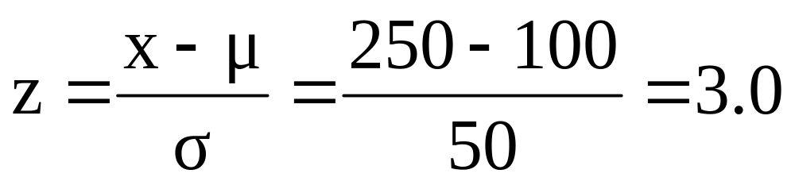
Example
If x is distributed normally with mean of 100 and standard deviation of 50, the z value for x = 250 is
This says that x = 250 is three standard deviations (3 increments of 50 units) above the mean of 100.

Slide 56
Comparing x and z units
μ = 100
σ = 50
100
250
x
0
3.0
z
Note that the distribution is the same, only the scale has changed. We can express the problem in original units (x) or in standardized units (z)

Slide 57
The Standard Normal Table
The Standard Normal table in the textbook Z chart gives the probability from the mean (zero) up to a desired value for z
.4772
Example:
P(0 < z < 2.00) = .4772
0
2.00
z

Slide 58
General Procedure for Finding Probabilities
To find P(a < x < b) when x is distributed normally:
Draw the normal curve for the problem in terms of x
Translate x-values to z-values
Use the Standard Normal Table

Slide 59
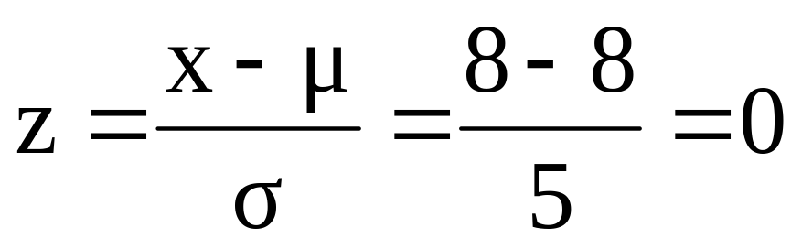
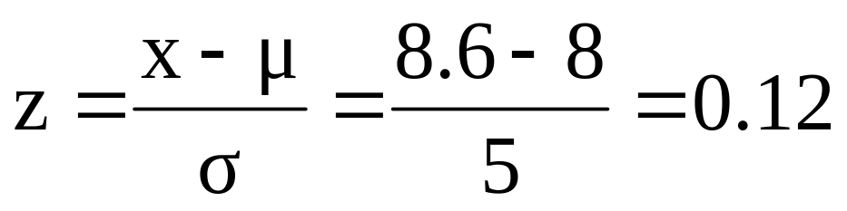
Z Table example
Suppose x is normal with mean 8.0 and standard deviation 5.0. Find P(8 < x < 8.6)
Calculate z-values:
8
8.6
x
0
0.12
Z
P(8 < x < 8.6)
= P(0 < z < 0.12)

Slide 60
Z Table example
(continued)
Suppose x is normal with mean 8.0 and standard deviation 5.0. Find P(8 < x < 8.6)
= 8
σ = 5
= 0
σ = 1
8
8.6
x
0
0.12
z
P(8 < x < 8.6)
P(0 < z < 0.12)

Slide 61
Solution: Finding P(0 < z < 0.12)
Standard Normal Probability
Table (Portion)
P(8 < x < 8.6)
= P(0 < z < 0.12)
z
.00
.01
.02
.0478
0.0
.0000
.0040
.0080
0.1
.0398
.0438
.0478
0.2
.0793
.0832
.0871
Z
0.3
.1179
.1217
.1255
0.00
0.12

Slide 62
Finding Normal Probabilities
Suppose x is normal with mean 8.0 and standard deviation 5.0.
Now Find P(x < 8.6)
Z
8.0
8.6

Slide 63
Finding Normal Probabilities
Suppose x is normal with mean 8.0 and standard deviation 5.0.
Now Find P(x < 8.6)
.5000
.0478
P(x < 8.6)
= P(z < 0.12)
= P(z < 0) + P(0 < z < 0.12)
= .5 + .0478 = .5478
Z
0.00
0.12

Slide 64
Commute Time Example
μ = 15; σ = 3.5
Employee commute probability ≥ 22 minutes – P(x ≥ 22)
Z = (22-15)/3.5 = 2.00
Probability that value will lie between μ and z = 2.00
P(x ≥ 22) = P (z ≥ 2.00) = .5000-.4772 = .0228
Probability that a commute is ≥ 22 minutes

Slide 65
Modified Example
μ = 15; σ = 3.5
Employee commute probability ≥ 20 minutes – P(x ≥ 20)
Z = (20-15)/3.5 = 1.43
= .4236
Probability that value will lie between μ and z = 1.43
P(x ≥ 20) = P (z ≥ 1.43) = .5000-.4236 = .0764
Probability that a commute is ≥ 20 minutes

Slide 66
Modified Example
μ = 15; σ = 3.5
Employee commute probability ≤ 10 minutes – P(x ≤ 10)
Z = (10-15)/3.5 = -1.43
-.4236
Probability that value will lie between –z and μ
= -1.43
P(x ≤ 10) = P (z ≤ -1.43) = .5000-.4236 = .0764
Probability that a commute is ≤ 10 minutes

Slide 67
Modified Example
μ = 15; σ = 3.5
Employee commute probability ≥ 10 minutes – P(x ≥ 10)
Z = (10-15)/3.5 = -1.43
= -.4236
Probability that value will lie above –z (-1.43)
P(x ≥ 20) = P (z ≥ -1.43) = .5000+.4236 = .9236
Probability that a commute is ≥ 10 minutes

Slide 68
Example
Premier Technologies
μ = 30
σ = 4.7
P(26≤ x ≤ 35)
Z₁ = (x- μ)/ σ = (26-30)/4.7 = -.85
Z₂ = (x- μ)/ σ = (35-30)/4.7 = 1.06
Z₁ = .3023; Z₂ = .3554
.3023 + .3554 = .6577 = P(26≤ x ≤ 35)
65.77% that step will stay on schedule

Slide 69
Excel Functions
POISSON.DIST (x, mean, cumulative)
STANDARDIZE (x, mean, standard_deviation) – get a z score

Slide 70
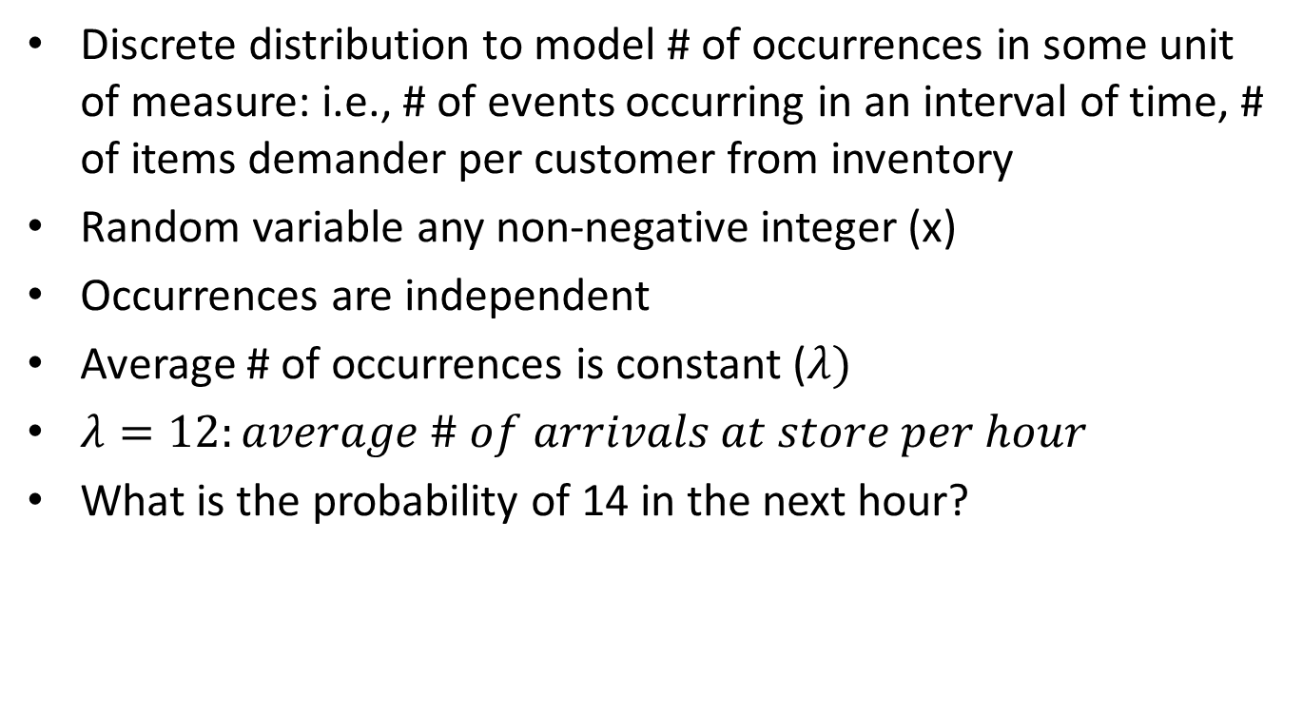
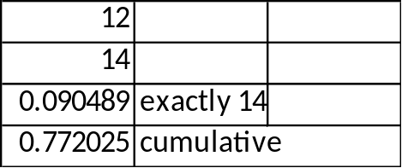
Poisson Probability

Slide 71
Chapter Summary
Reviewed key continuous distributions
  normal
  uniform
  exponential
Found probabilities using formulas and tables
Recognized when to apply different distributions
Applied distributions to decision problems

