Slide 1
Example
  We are going to convert the code in AddressBook7 (posted on Desire2Learn) to:
    Have a separate form for details
    Make the list view be inside a fragment
    Add an Add button to the menu
    Pass the id from the list view to the details form
    Make edit and insert (add) work

Slide 2
Warning !
  We are attempting major changes, have a backup copy of your code to refer to
  In lots of places you will save your self lots of work if you have the current code and a back up copy you use to get bits and pieces of the code

Slide 3
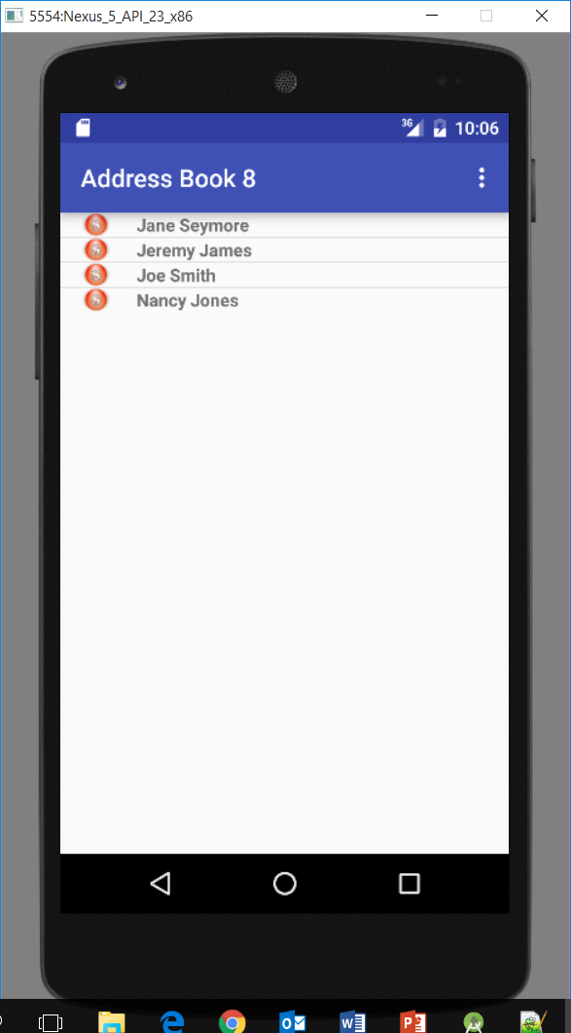
Example

Slide 4
Step 1
Step 1
  Create a new activity called DetailActivity

Slide 5
Step 1 – DetailActivity class
public class DetailActivity extends Activity {
@Override
public void onCreate(Bundle savedInstanceState){
super.onCreate(savedInstanceState);
//TODO - create this layout
//setContentView(R.layout.detail_activity);
}
}

Slide 6
Step 2
Step 2
  Add the new activity to manifest.xml
  Launch DetailActivity on list click in MainActivity class
  Test your changes
    When you click on a contact the detail form should load and be empty

Slide 7
Example – MainActivity class
private AdapterView.OnItemClickListener onListClick = new AdapterView.OnItemClickListener() {
public void onItemClick(AdapterView<?> parent, View view, int position, long id){
Intent i = new Intent(MainActivity.this, DetailActivity.class);
startActivity(i);
}
};

Slide 8
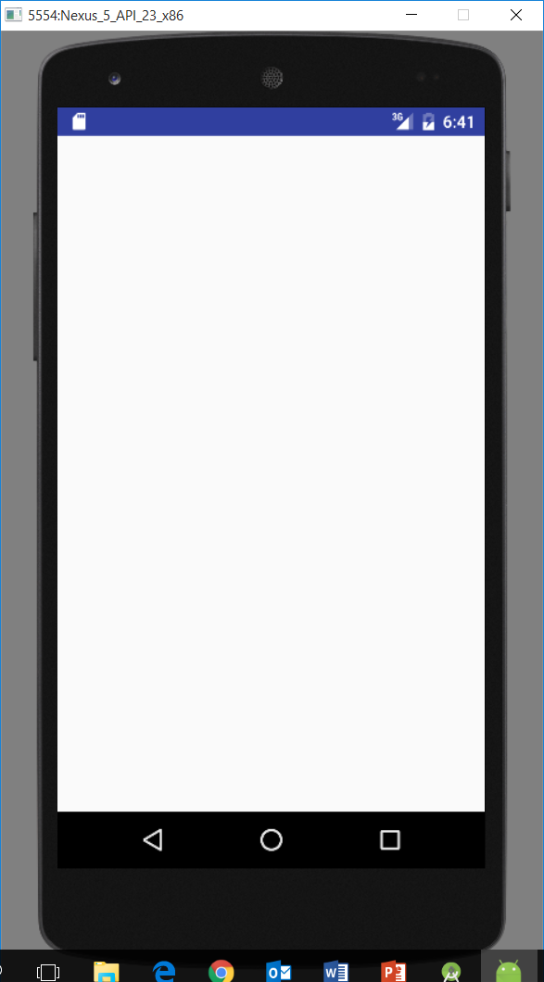
Step 2 – Test

Slide 9
Step 3
Step 3
  Start moving the detail UI from MainActivity to DetailActivity
  Create a detail_activity.xml with the controls for the detail form
  Enable setContentView in DetailForm class
  Copy over the member varaibles for the UI widgets from MainActivity to DetailForm
  Modify onCreate in DetailActivity to get references

Slide 10
Step 3
Step 3
  Implement OnClickListener in DetailForm and stub out the case for save

Slide 11
Step 3
– detail_form.xml
<?xml version="1.0" encoding="utf-8"?>
<TableLayout xmlns:android="http://schemas.android.com/apk/res/android"
android:id="@+id/details"
android:layout_width="fill_parent"
android:layout_height="wrap_content"
android:layout_alignParentBottom="true"
android:stretchColumns="1" >
<TableRow
android:id="@+id/tableRow1"
android:layout_width="wrap_content"
android:layout_height="wrap_content" >
<TextView
android:id="@+id/textView1"
android:layout_width="wrap_content"
android:layout_height="wrap_content"
android:text="@string/name_label" />
<EditText
android:id="@+id/Name"
android:layout_width="wrap_content"
android:layout_height="wrap_content"
android:ems="10"
android:inputType="textPersonName" >
<requestFocus />
</EditText>
</TableRow>

Slide 12
Step 3
– detail_form.xml
<TableRow
android:id="@+id/tableRow2"
android:layout_width="wrap_content"
android:layout_height="wrap_content" >
<TextView
android:id="@+id/textView2"
android:layout_width="wrap_content"
android:layout_height="wrap_content"
android:text="@string/phone_label" />
<EditText
android:id="@+id/Phone"
android:layout_width="wrap_content"
android:layout_height="wrap_content"
android:ems="10"
android:inputType="phone" />
</TableRow>

Slide 13
Step 3
– detail_form.xml
<RadioGroup android:id="@+id/types">
<RadioButton android:text="@string/cell_label" android:id="@+id/cell"> </RadioButton>
<RadioButton android:text="@string/home_label" android:id="@+id/home"> </RadioButton>
</RadioGroup>
<TableRow>
<TextView
android:text="@string/note_label"
/>
<EditText
android:id="@+id/note"
android:singleLine="false"
android:gravity="top"
android:lines="2"
android:maxLines="2"
android:scrollHorizontally="false"
android:maxWidth="200sp"
android:inputType="textMultiLine"
/>
</TableRow>
<Button
android:id="@+id/SaveButton"
android:layout_width="wrap_content"
android:layout_height="wrap_content"
android:text="@string/save_button" />
<Button
android:id="@+id/CancelButton"
android:layout_width="wrap_content"
android:layout_height="wrap_content"
android:text="@string/cancel_button" />
</TableLayout>`

Slide 14
Step 3 – DetailActivity class
public class DetailActivity extends Activity{
@Override
public void onCreate(Bundle savedInstanceState){
super.onCreate(savedInstanceState);
setContentView(R.layout.detail_activity);
}
}

Slide 15
Step 3 – DetailForm class
public class DetailActivity extends Activity{
EditText name = null;
EditText phone = null;
RadioGroup types = null;
@Override
public void onCreate(Bundle savedInstanceState){
super.onCreate(savedInstanceState);
setContentView(R.layout.detail_form);
}
}

Slide 16
Step 3 – DetailActivity class
Implement OnClickListener
public class DetailActivity extends Activity implements View.OnClickListener {
}

Slide 17
Step 3 – DetailActivity class
@Override
public void onClick(View v) {
switch (v.getId()) {
case R.id. SaveButton:
break;
}
}

Slide 18
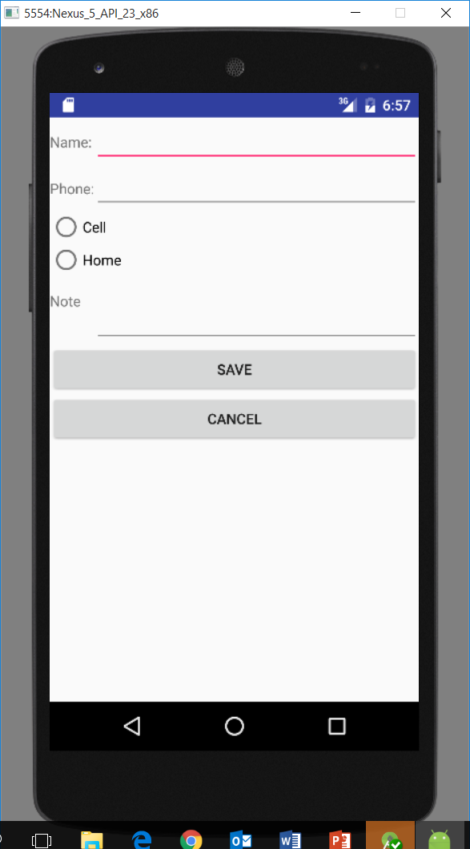
Step 3 – Detail Activity Test
Should have a UI, but no data yet

Slide 19
Step 4
Step 4
  Clean up the old UI
  All we really want in main activity now is the list view
  We need to do some refactoring
    Main Activity has a lot going on it
  Another way to get more separation of concerns is to use a ListFragment for our list view

Slide 20
Step 4
Step 4
  If we use ListFragment
    MainActivity will just be a container for the menu options
    All of the list code and database access will be moved to a new class we have to create

Slide 21
Step 4
Step 4
  Clean up the old ui
  Remove the layout for the details controls
  Going to change the layout to have a fragment with the list view in the fragment
  Simple Example of How This Works
  Do not implement OnClickListener (remove what is already there)

Slide 22
Step 4 - activity_main.xml
This will have an error because we have not written ContactListFragment yet
<?xml version="1.0" encoding="utf-8"?>
<LinearLayout
xmlns:android="http://schemas.android.com/apk/res/android"
android:layout_width="match_parent"
android:layout_height="match_parent"
android:orientation="vertical" >
<fragment
android:id="@+id/fragment1"
android:name="org.example.addressbook1.ContactListFragment"
android:layout_width="match_parent"
android:layout_height="match_parent" />
</LinearLayout>

Slide 23
Step 4
All that is going to be left in MainActivity class is the menu options

Slide 24
Step 4 – MainActivity class
@Override
protected void onCreate(Bundle savedInstanceState) {
//call parent class onCreate
super.onCreate(savedInstanceState);
//Ties the layout to this java class
setContentView(R.layout.activity_main);
}

Slide 25
Step 4 – MainActivity class
//get the menu we defined in menu.xml and inflate it
@Override
public boolean onCreateOptionsMenu(Menu menu) {
// Inflate the menu; this adds items to the action bar if it is present.
getMenuInflater().inflate(R.menu.menu, menu);
return true;
}

Slide 26
Step 4 – MainActivity class
//handle the menu items being selected
@Override
public boolean onOptionsItemSelected(MenuItem item) {
switch (item.getItemId()) {
// action with ID settings was selected
case R.id.settings:
Intent i = new Intent(this, PreferenceActivity.class);
startActivity(i);
break;
case R.id.exit:
finish();
break;
case R.id.about:
//call your activity here
startActivity(new Intent(this, AboutActivity.class));
break;
case R.id.video:
//call your activity here
startActivity(new Intent(this, HelpActivity.class));
break;
case R.id.add:
//Get an intent for DetailActivity
Intent intent = new Intent(this, DetailActivity.class);
//start up detail activity in add mode
startActivity(intent);
default:
break;
}
return true;
}

Slide 27
Step 5
Step 5
  Need to create a new class and layout that will only have a list view in it
  First create a layout called list_fragment.xml that only has a list view in it

Slide 28
Step 5 - list_fragment.xml
<?xml version="1.0" encoding="utf-8"?>
<LinearLayout xmlns:android="http://schemas.android.com/apk/res/android"
android:orientation="vertical" android:layout_width="match_parent"
android:layout_height="match_parent">
<ListView
android:id="@android:id/list"
android:layout_width="match_parent"
android:layout_height="wrap_content" >
</ListView>
</LinearLayout>

Slide 29
Step 5
Step 5
  Now create a class called ContactListFragment
  Extend ListFragment
  Implement AdapterView.OnItemClickListener

Slide 30
Step 5 -Example List Fragment
public class DemoListFragment extends ListFragment implements AdapterView.OnItemClickListener{
//inflate the list_fragment and return that as the view associated with this class
@Override
public View onCreateView(LayoutInflater inflater, ViewGroup container, Bundle savedInstanceState) {
View view = inflater.inflate(R.layout.list_fragment, container, false);
return view;
}

Slide 31
Step 5 List Fragment
//fires when the parent activity that contains this fragment is all initialized
@Override
public void onActivityCreated(Bundle savedInstanceState) {
super.onActivityCreated(savedInstanceState);
//let the list know what adapter we are using
setListAdapter(adapter);
//handle onItemClick
getListView().setOnItemClickListener(this);
}
@Override
public void onItemClick(AdapterView<?> parent, View view, int position, long id) {
//handle a list item being clicked
}

Slide 32
Step 5 - Contact List Fragment
Now we need to move all the DB code from MainActivity to ContactListFragment
Also need to move our two supporting classes
  ContactAdapter
  ContactHolder

Slide 33
Step 5 - Contact List Fragment
Move over class level variables
Cursor model = null;
ContactAdapter adapter = null;
DbHelper databaseHelper;
Plus one new one:
public final static String ID_EXTRA = "org.example.addressbook1._ID";

Slide 34
Step 5 - Contact List Fragment
This code is to make the list work, it mostly exists in MainActivity
@Override
public void onActivityCreated(Bundle savedInstanceState) {
super.onActivityCreated(savedInstanceState);
//get an instance of dBHelper, this is our database code wrapped into a class
//because we are in a fragment now, where ever we used to pass this, need to call getActivity
databaseHelper = new DbHelper(getActivity());
//run the query to get all rows from the table contacts
model = databaseHelper.getAll();
//start the cursor watching, must call getActivity first since we are a fragment now
getActivity().startManagingCursor(model);
//Create an adapter
adapter = new ContactAdapter(getActivity(), model);
//let the list know what adapter we are using
setListAdapter(adapter);
//handle onItemClick
getListView().setOnItemClickListener(this);
}

Slide 35
Step 5 - Contact List Fragment
This class moved over as is except replace this with getActivity()
class ContactAdapter extends CursorAdapter {
public ContactAdapter(Context context, Cursor c) {
super(context, c, FLAG_REGISTER_CONTENT_OBSERVER);
// TODO Auto-generated constructor stub
}
@Override
public void bindView(View row, Context context, Cursor cursor) {
ContactHolder holder = (ContactHolder)row.getTag();
holder.populateFrom(cursor, databaseHelper);
}
@Override
public View newView(Context context, Cursor cursor, ViewGroup parent) {
LayoutInflater inflater = getActivity().getLayoutInflater();
View row = inflater.inflate(R.layout.row, parent, false);
ContactHolder holder = new ContactHolder(row);
row.setTag(holder);
return row;
}
}

Slide 36
Step 5 - Contact List Fragment
This class moved over as is
static class ContactHolder{
private TextView title = null;
private ImageView icon = null;
//Constructor
ContactHolder(View row){
title = (TextView)row.findViewById(R.id.title);
icon = (ImageView)row.findViewById(R.id.icon);
}
void populateFrom(Cursor cursor, DbHelper databaseHelper){
title.setText(databaseHelper.getName(cursor));
icon.setImageResource(R.drawable.ball_red);
}
}

Slide 37
Step 5 - Contact List Fragment
This code copied over from MainActivity
//fragments have onDestroy just like activities
@Override
public void onDestroy(){
super.onDestroy();
//close our database
databaseHelper.close();
}

Slide 38
Step 5 - Contact List Fragment
Make onItemClick do something
@Override
public void onItemClick(AdapterView<?> parent, View view, int position, long id) {
//Get an intent for DetailActivity
Intent i = new Intent(getActivity(), DetailActivity.class);
//put extra lets you pass parameters to the new activity, we will be retrieving this
//in DetailActivity
i.putExtra(ID_EXTRA, String.valueOf(id));
//start up detail activity
startActivity(i);
}

Slide 39
Step 5
Step 5
  pass the contact id to the DetailForm
  Add a data member for ID_EXTRA to ContactListFragment

Slide 40
Step 5 – ContactListFragment class
public final static String ID_EXTRA = "com.example.addressbook._ID";

Slide 41
Step 5
Step 5
  Test now, there has been a ton of coding and moving things around
  With any luck, list will have data, can click and detail activity will load but will not have any data

Slide 42
Step 5 - testing

Slide 43
Step 5 - testing
Should have a UI, but no data yet

Slide 44

Step 5 – wow!

Slide 45
Step 5 – wow!
What we just did
  Spilit MainActivity into two classes
    MainActiviity does menus
    ContactListFragment does database and listView
  Created new activity for details
    Removed all detail UI from MainActivity

Slide 46
Step 6 – Back to Detail Activity
Add a class level variable
String contactId = null;

Slide 47
Step 6 – DetailActivity class
Bring over class level variables we need for Detail Activity
EditText name = null;
EditText phone = null;
RadioGroup types = null;
EditText note = null;
String contactId = null;
DbHelper databaseHelper;
Contact currentContact = null;

Slide 48
Step 6 – DetailActivity class
Get required references in onCreate, most of this code can be copied from MainActivity
//get references to form UI controls
name = (EditText)findViewById(R.id.Name);
phone = (EditText)findViewById(R.id.Phone);
types = (RadioGroup)findViewById(R.id.types);
note = (EditText)findViewById(R.id.note);
//find the save button
View saveButton = findViewById(R.id.SaveButton);
//tell the save button to listen for onClick
saveButton.setOnClickListener(this);
//find the cancel button
View cancelButton = findViewById(R.id.CancelButton);
//tell the cancel button to listen for onClick
cancelButton.setOnClickListener(this);
//get the parameter for what contact id to edit put in the intent by ContactListFragment
contactId = getIntent().getStringExtra(ContactListFragment.ID_EXTRA);
//get an instance of DbHelper
databaseHelper = new DbHelper(this);

Slide 49
Step 6 – more code for DetailActivity
Step 6
  load the contact into the DetailForm
  copy the onDestroy code from MainActivity to DetailForm (this closes our database)
  add a getById method to DBHelper
  add a load method to DetailActivity
  in DetailActivity onCreate, call load if the contact id is not null
  Test, detail form should have data now

Slide 50
Step 6 – DetailActivity class
@Override
public void onDestroy(){
super.onDestroy();
//close our database
helper.close();
}

Slide 51
Step 6 – DBHelper class
public Cursor getById(String id){
String[] args = {id};
String sql = "SELECT * FROM contacts WHERE _ID=?";
Cursor cursor = getReadableDatabase().rawQuery(sql, args);
return cursor;
}

Slide 52
Step 6 – DBHelper class
//get an instance of a Contact from the current row of the cursor
//assumes the cursor is already pointing to the correct row
public Contact getContact(Cursor c){
//create instance of Contact
Contact contact = new Contact();
//fill each property from the cursor column
contact.setName(getName(c));
contact.setPhone(getPhone(c));
contact.setType(getType(c));
contact.setNote(getNote(c));
contact.setId(getId(c));
//return the Contact
return contact;
}

Slide 53
Step 6 – DetailActivity class
private void load(){
//get the contact for this id from the DBHelper class
//the reason we are saving it in class level variable is we need the id to do updates
currentContact = databaseHelper.getContact(contactId);
//get the values for each form item from the database
name.setText(currentContact.getName());
phone.setText(currentContact.getPhone());
if (currentContact.getType().equals("cell")){
types.check(R.id.cell);
}
else if (currentContact.getType().equals("home")){
types.check(R.id.home);
}
note.setText(currentContact.getNote());
}

Slide 54
Step 6 – DetailActivity class
public void onCreate(Bundle savedInstanceState){
existing code +
if (contactId != null){
load();
}
}

Slide 55
Step 6 – test

Slide 56
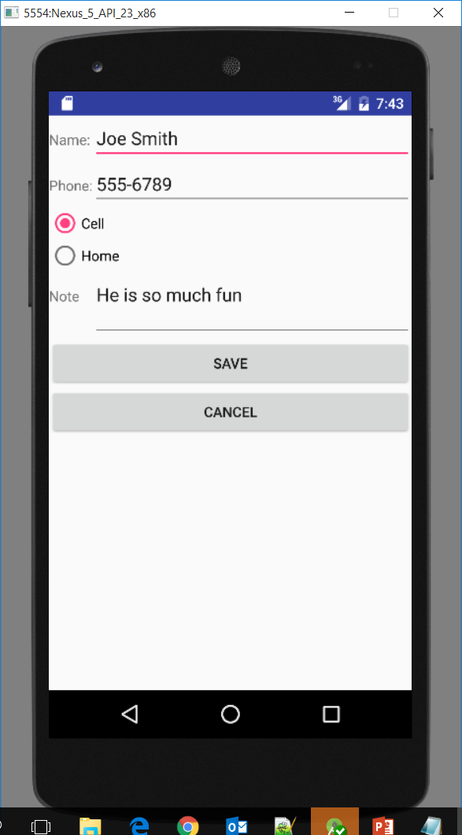
Step 6 – test

Slide 57
Step 6 – wow!

Slide 58
Step 6 – wow!
What we just did
  Moved all the code to make the details UI work over from MainActivity to DetailsActivity
  Added two new methods to DbHelper class
    These read a contact from the table and turn that into an instance of Contact
  Got the data loaded into the UI from the database
  The details form is passed the Id to load from ContactListFragment

Slide 59
Step 7
Step 7
  Add a menu option for add
  Create menu.xml (or edit if it’s already there) and add one item for add to it
  Test, menu should appear with add button

Slide 60
Step 7 – menu.xml
<menu xmlns:android="http://schemas.android.com/apk/res/android">
<item
android:id="@+id/add"
android:title="Add"
>
</item>
</menu>

Slide 61
Step 7 – MainActivity class
@Override
public boolean onOptionsItemSelected(MenuItem item){
switch(item.getItemId()){
case R.id.add:
startActivity(new Intent(this, DetailForm.class));
break;
}
return true;
}

Slide 62
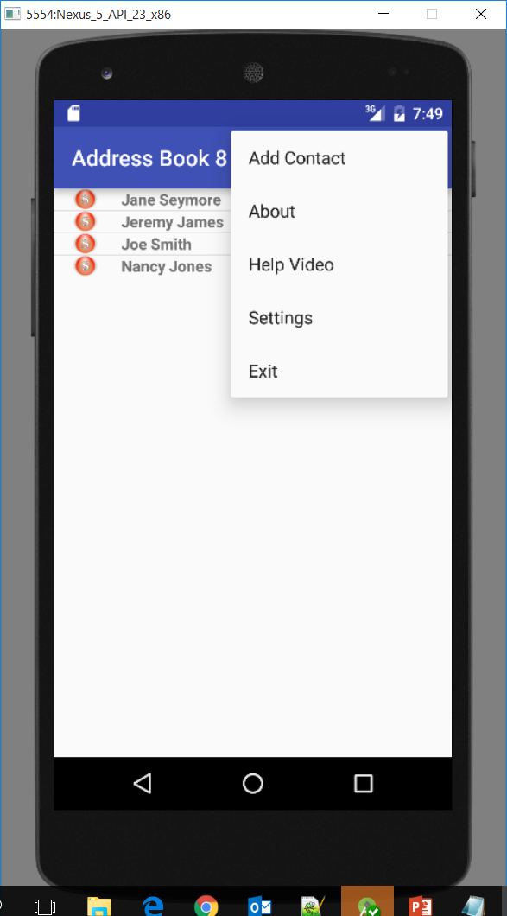
Step 7 – Test

Slide 63
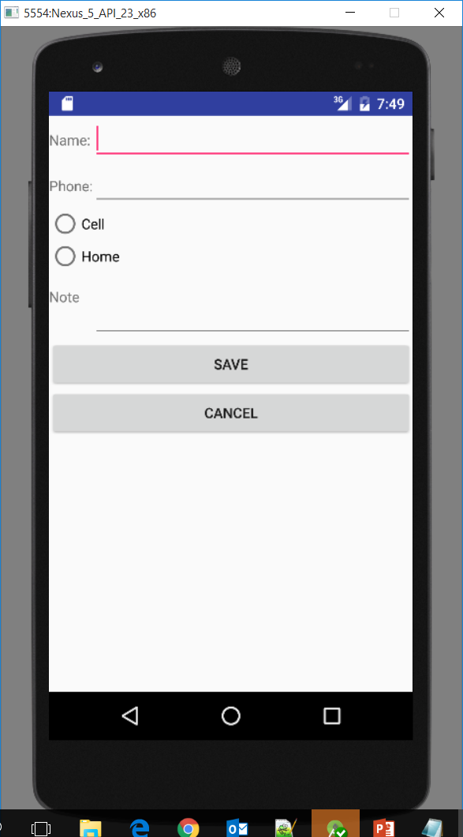
Step 7 – Test

Slide 64
Step 7 – wow!

Slide 65
Step 7 – wow!
What we just did
  Added new menu option for Add Contact
  Wired up the code so that Add Contact starts the DetailsActivity

Slide 66
Step 8
Step 8
  Get detail form to work with add and edit
  Put code in the save button to handle getting an instance of Address
  add an update method to DBHelper
  in DetailActivity, adjust save method to call correct method based upon if contactId is null or not
  call finish() to close the DetailActivity and return to list
  test, adds and updates should work

Slide 67
Step 8 – DBHelper class
public void update(Contact contact){
//this part is same as insert
//content values is a helper class that creates a sql update statement using the
//name value pairs we give it
ContentValues cv = new ContentValues();
//the first parameter of put is the column name, must be exact match to what you called
//the columns in the database create table statement above.
cv.put("name", contact.getName());
cv.put("phone", contact.getPhone());
cv.put("type", contact.getType());
cv.put("note", contact.getNote());
//need to get which to update, database wants an array of string
//with values for the where clause, get Id from contact
String[] args = {contact.getId()};
//write our values to the database, behind the scenes a
//SQL update is being performed for us
//"_ID? is the syntax to put ID in the where clause, the
//? is a place holder, the value for the where is pulled out
//of the args array
getWritableDatabase().update("contacts", cv, "_id=?", args);
}

Slide 68
Step 8 – DetailActivity class
case R.id.SaveButton:
//get the value that the user typed into the name
String nameValue = name.getText().toString();
//get the value that the user typed into the phone
String phoneValue = phone.getText().toString();
String phoneType = "";
//figure out which radio button is selected, only one can be selected
switch (types.getCheckedRadioButtonId()){
case R.id.cell:
phoneType = "cell";
break;
case R.id.home:
phoneType = "home";
break;
}

Slide 69
Step 8 – DetailActivity class
String noteValue = note.getText().toString();
//for updates we will already have an instance from calling load, that has id in it
//which we need for updates
if(currentContact == null){
//only create a new instance for inserts
currentContact = new Contact();
}
currentContact.setName(nameValue);
currentContact.setPhone(phoneValue);
currentContact.setType(phoneType);
currentContact.setNote(noteValue);

Slide 70
Step 8 – DetailActivity class
//add mode, do an insert
if(contactId == null){
databaseHelper.insert(currentContact);
}
else{
databaseHelper.update(currentContact);
}
//close this form when we are done
finish();
break;

Slide 71
Step 8 – Test

Slide 72
Step 8 – wow!

Slide 73
Step 8 – wow!
What we just did
  Got DetailsActivity to insert again
  Got DetailsActivity to edit, first time edit has worked the whole semester!

