Slide 1
Chapter 3
The Cultural Environment of International Business
Copyright © 2017, 2014, 2012 by Pearson Education, Inc. All rights reserved. This publication is protected by Copyright, and permission should be obtained from the publisher prior to any prohibited reproduction, storage in a retrieval system, or transmission in any form or by any means, electronic, mechanical, photocopying, recording, or likewise.

Slide 2

Outline
Baidu: Culture and Social Media in China
Culture and Cross-Cultural Risk
Dimensions of Culture
Role of Language and Religion in Culture
Culture’s Effect In International Business
Models and Explanations of Culture
Managerial Implications of Culture
Societal consequences of globalization
Closing Case: Hollywood and Global Culture

Slide 3
Objectives
3.1 Understand culture and cross-cultural risk.
3.2 Learn the dimensions of culture.
3.3 Appreciate the role of language and religion in culture.
3.4 Appreciate culture’s effect in international business.
3.5 Learn models and explanations of culture.
3.6 Understand managerial implications of culture.

Slide 4
Baidu: Culture and Social Media in China
3-1. Why are the Chinese such heavy users of the Internet?
3-2. What are the characteristics of a collectivistic society such as China?
3-3. In what ways does social media reflect cultural values in China?
Notes:
3-1. Why are the Chinese such heavy users of the Internet?
A:
3-2. What are the characteristics of a collectivistic society such as China?
A:
3-3. In what ways does social media reflect cultural values in China?
A:

Slide 5

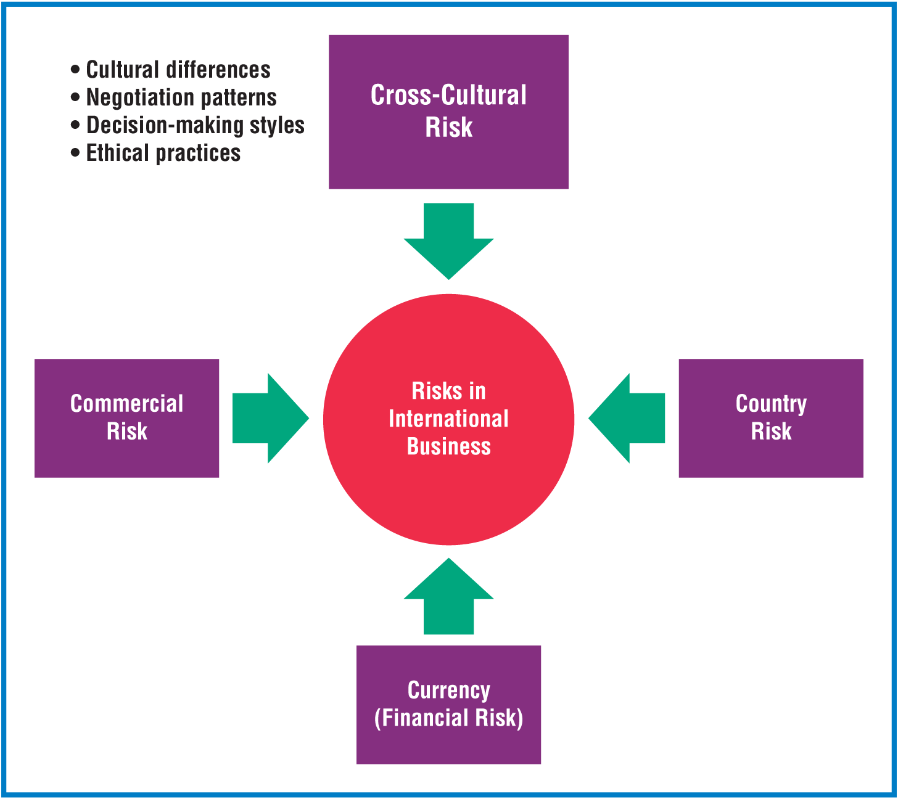
Culture and Cross-Cultural Risk
Culture
Risk
Exhibit 3.1 Framework on the Essential Elements of Culture (Cavusgil, 2016, p.57)
Exhibit 3.3 The Four Major Risks in International Business (Cavusgil, 2016, p.58)

Slide 6
Dimensions of Culture
Values and Attitudes
Manners and Customs
Perceptions of Time
Perceptions of Space
Symbolic Productions
Material Productions and Creative Expressions
Education
Social Structure

Slide 7
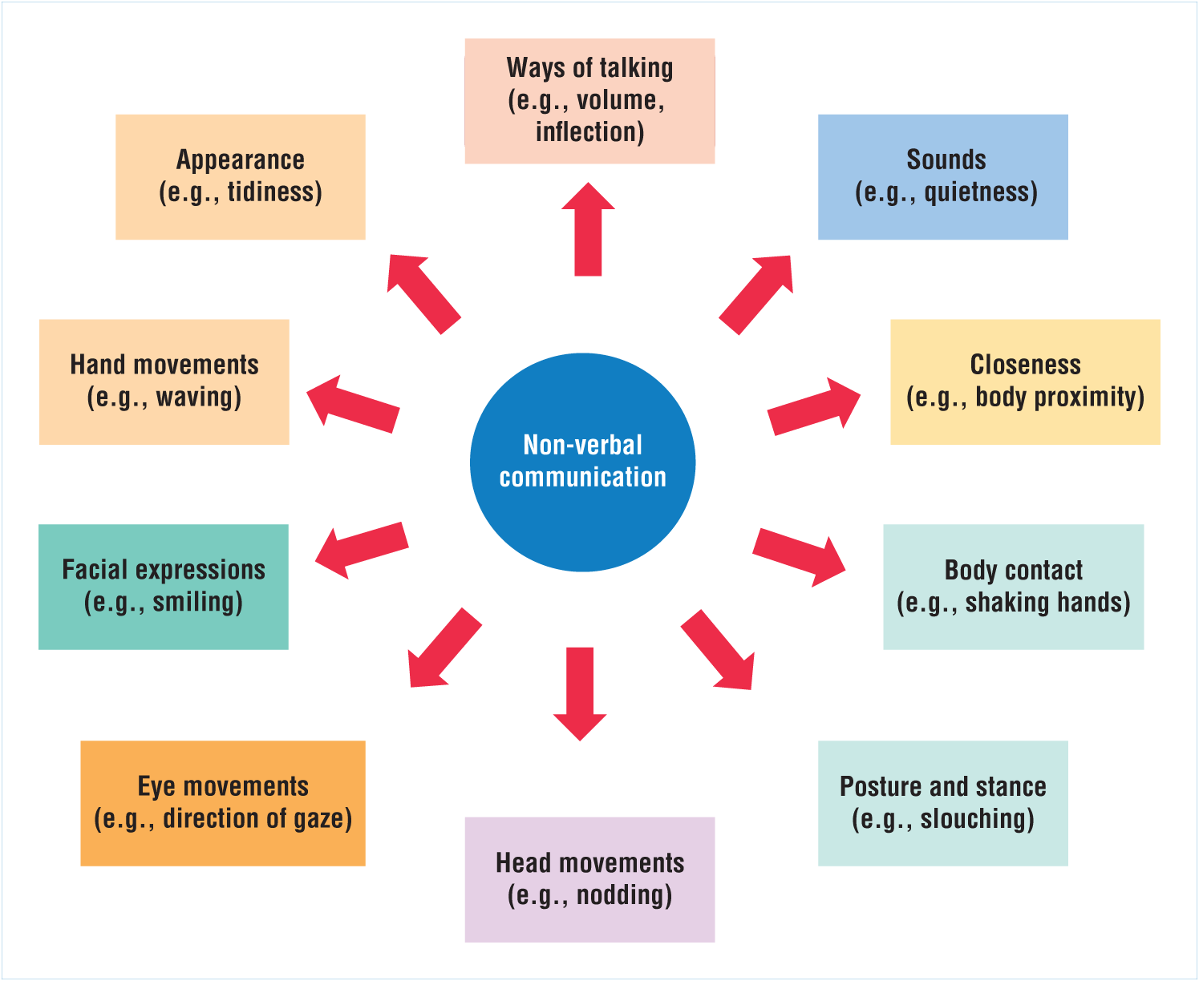
Role of Language and Religion in Culture
Verbal Language
Nonverbal Communication
Religion
Integration of world financial markets.
Advances in technology.
Exhibit 3.10 Nonverbal Communication (Cavusgil, 2016, p.66)

Slide 8
Culture’s Effect In International Business
Managing employees
Communicating and interacting with foreign business partners
Negotiating and structuring international business ventures
Developing products and services
Preparing advertising and promotional materials

Slide 9
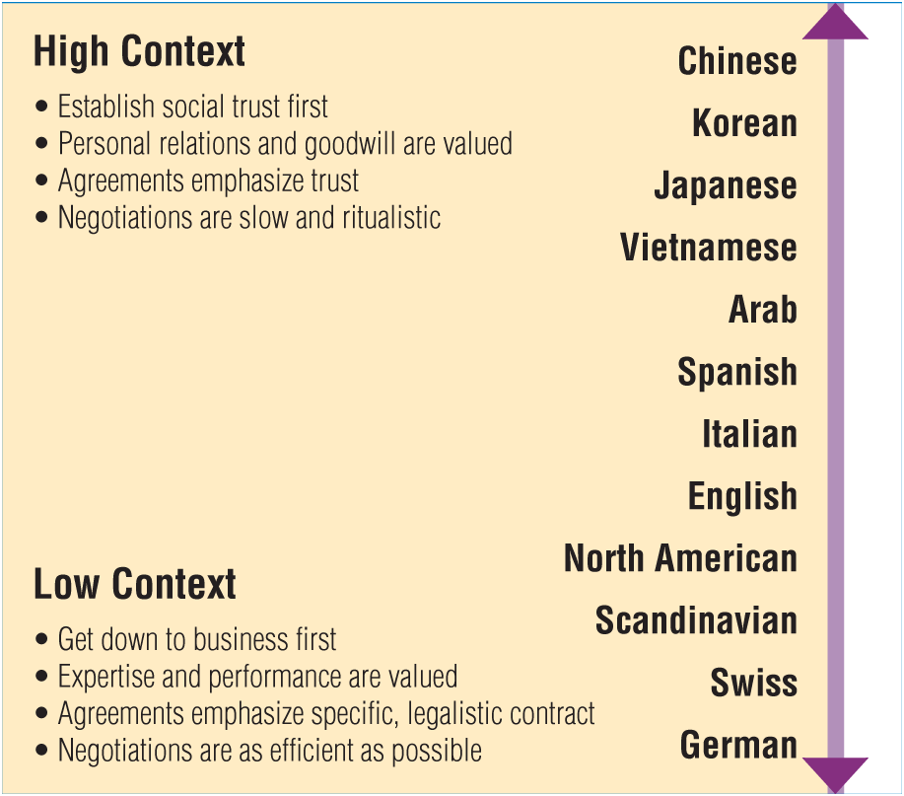
Models and Explanations of Culture
Cultural Metaphors
High- and Low-Context Cultures
Hofstede’s Research on National Culture
Deal versus Relationship Orientation
Exhibit 3.13 Hall’s High- and Low-Context Typology of Cultures (Cavusgil, 2016,, p.73)

Slide 10
Managerial Implications of Culture
Cultural Orientations
How to Acquire Cross-Cultural Competence
  Guideline 1: Acquire factual knowledge about the other culture and try to speak the language
  Guideline 2: Avoid cultural bias
  Guideline 3: Develop cross-cultural skills

Slide 11
Closing Case:
Hollywood and Global Culture
Notes:
3-4. Most aspects of foreign culture, such as language, religion, gender roles, and problem-solving strategies, are hard for the casual observer to understand. In what ways do Hollywood movies affect national culture outside the United States? What aspects of U.S. culture do Hollywood films promote around the world? Can you observe any positive effects of Hollywood movies on world cultures?
A:
3-5. Culture plays a key role in business. In what ways have movies influenced managerial tasks, company activities, and other ways of doing business around the world? Can watching foreign films be an effective way of learning how to do business abroad? Justify your answer.
A:
3-6. Hollywood movies are very popular abroad, but foreign films are not viewed much in the United States. What factors determine the high demand for Hollywood films? Why are they so popular in Europe, Japan, Latin America, and elsewhere? Why are foreign films demanded so little in the United States? What can foreign filmmakers do to increase demand for their movies in the United States?
A:

Slide 12
Summary
Culture
Dimensions of Culture
Role of Language and Religion in Culture
Culture’s Effect in International Business
Models and Explanations of Culture
Managerial Implications of Culture

