Slide 1
Tittle: Physical Exercise and Health
Pattern: Monroe’s Motivated Sequence
Purpose: To persuade
Specific objective: To persuade the audience to practice regular exercise
Main Objective: The importance of regular exercise

Slide 2
Introduction
Some highlights that relate to the exercise activity, I discuss them below:
I. The Harvard Medical School has proved over and over that physical exercise is the secret to better health, regardless of the age bracket. It is surprising since people today don’t find the essence of exercise – nearly everybody clings to their TV, browsing and surfing, playing video games and other sedentary pastimes for more than 12 hours in a day. America is reportedly found to contain the hugest number of obese cases and overweight cases too Hoeger et al., 2018).

Slide 3
Conti….
The little biology behind exercise is to help burn calories, at least 800 calories in a week. Heart diseases such as hypertension have taken root due to the lack of the exercise. The need for exercise has been a matter of concern talked over by government institutions since the government has established that the health sector is “eating up” the economy. A lot of funds are spent on health cases over and over. My speech covers the importance of exercise against the risks of not exercising as well as how exercise can become part of you.

Slide 4
Transition: Lack of exercise results to a number of problems. Let us start off with the latter problems:
II. Body and mental disorders: lack of exercise affects an individual mind and physique.
A. Obesity is attributed to lack of exercise. Some obese people tend to blame their biological processes arguing that their rate of metabolism is not normal which is not true. It is basically the intake of more calories than one is in a position to expend leading to excessive weight gain and muscle fall. Obese is a condition that kills a huge number of people world over. A study published by the New England Journal of Medicine June this year reported that about 30 percent of the 2015 deaths were cases of obesity. About 5 years ago, of every 100,000 deaths, only 50 were as a result of overweight but the number today is reported to have increased to 54 out of every 100,000 (Rushemeza, 2017).

Slide 5
B. Mental balance is very important. Exercise boosts mental balance. Chemicals that promote emotional balance in one’s mind are affected by lack of exercise. Serotonin, dopamine and endorphins need to be levelled by a bit of exercise (Rushemeza, 2017). These chemical help in:
Serotonin – is a nerve signaling chemical which balances mood, stimulates appetite and keeps the mind out of stress. A slight alteration would lead to lack of appetite, stress and feelings.
Dopamine is in direct control of the mind processes. It manages motion and stimuli response.
Endorphins manages external stimuli by euphoria feelings and this affects self-esteem and determination.

Slide 6
Transition: being conversant with the problems attributed to lack of exercise, how can we get over them?
III. Let us look at the steps that would help you fix the above mentioned problems. These steps are mental and physical at the same time.
A. Begin moderately with no haste and make the exercise part of your day to day routine. Some of the exercise that would be easy starting with include walking, cycling, climbing on steep stairs and even normal chores here and there. When we talk of exercise, there are people that think its hours and hours of activity in the gym, no. Actually experts say that 30 minute cardio exercise in a day is the best with good healthy results (Hoeger et al., 2018).

Slide 7
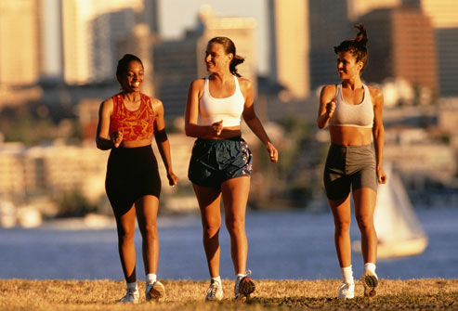
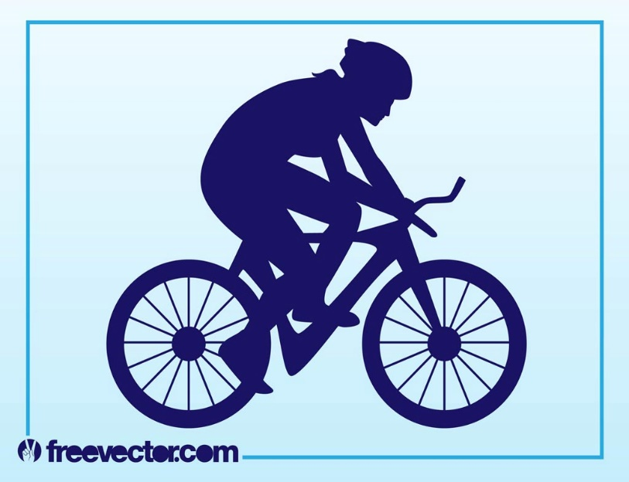
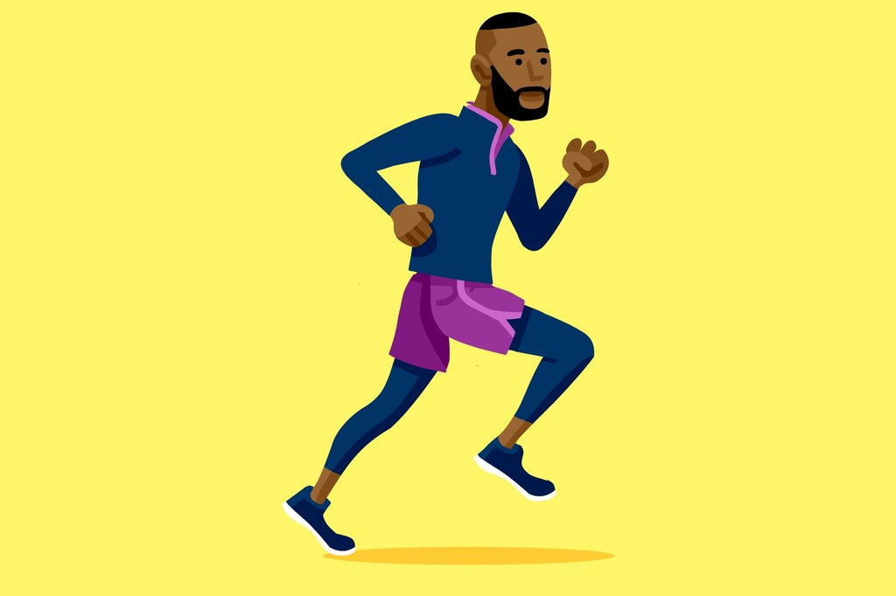
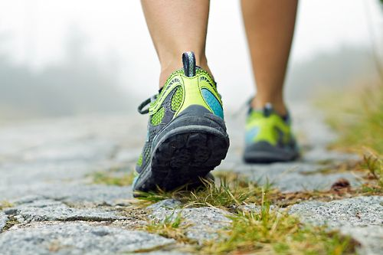

Slide 8
As a beginner, you need to start with 15 minutes and slowly graduate to 30 minutes. Trust me at the time you are doing 30 minutes, it will be something born from within you that you cannot stop.
B. Joining aerobics and gym class will out the best for you. At the gym, there are instructors, you will need to identify one and follow what they will guide on. At whatever level you begin at, you will find fellows who are versatile and other who need your help. It’s the association there that makes you turn out to be a routine exerciser.

Slide 9
Transition:
IV. Being ready for the routine exercise, what importance should keep you motivated for the activity?
A. Exercise will improve you mental functionality. Serotonin, aforementioned, is increased when energy production is increased leading to an improvement on how your brain works. This can be god for academia (Mandolesi et al., 2018). You perceive things in a mature and modest manner. Disappointments can rule over you and you will always be motivated in life. With exercise, you will ever be energized to doing whatever has to be done.

Slide 10
B. The feelings of an exercise activity are better. E.g. walking for distances can’t tire you. You will always stay up to campus activities. Minor and major ailments are kept off completely as the body develops a strong immune system that resists pathogens. Blood flow is streamlined hence like David says, the number of sick days is reduced by 50 percent (Nieman, 2011). Esteem is also boosted and as a result you get more confident in the things that you do. This results from increased endorphins production.
C. Exercise improves one’s eating habits. One tends to eat more of the foods that they like. This is to cater for muscle development and as well as lean muscles.

Slide 11
D. Heart diseases are controlled by exercise. Hypertension chances, for instance, are minimized by the cardiovascular strength. Alzheimer diseases is very acute but its instances are regulated by exercise.
CONCLUSION
In a nutshell, exercise helps;
Minimize the vulnerability of heart diseases
Keep off diabetic infections as well as hypertension
Motivate one’s mood and brain functioning
Stay strong having healthy joints
Keep a healthy weight

Slide 12
BIBLIOGRAPHY
Hoeger, W. W., Hoeger, S. A., Hoeger, C. I., & Fawson, A. L. (2018). Lifetime of Physical Fitness and Wellness. Cengage Learning.
Mandolesi, L., Polverino, A., Montuori, S., Foti, F., Ferraioli, G., Sorrentino, P., & Sorrentino, G. (2018). Effects of Physical Exercise on Cognitive Functioning and Wellbeing: Biological and Psychological Benefits. Frontiers in psychology, 9.
Nieman, D. C. (2011). Moderate exercise improves immunity and decreases illness rates. American Journal of Lifestyle Medicine, 5(4), 338-345.
Rushemeza, P. J. (2017). The Solution to a Better Healthy Life. WestBow Press.

