Slide 1
Effects Of Painkillers On The Human Body
Name
Professor
Course Title
Date

Slide 2
Overview of the Problem
A painkiller can be any of the medications used to relieve pain.
Over-the-counter (OTC) drugs such as aspirin, ibuprofen, and tylenol.
Prescribed drugs such as hydrocodone, vicodin, morphine, codeine, and oxycodone.
Potential to be addictive leading to misuse.
Cause serious and devastating changes to the brain and body of the user.
Extreme and dangerous changes typically occur from long-term abuse.
Users become dependent on the drugs to physically feel normal and avoid the withdrawal symptoms.
Second most abused substances in the United States after marijuana
Notes:
Painkillers are manufactured with the initial objective of relieving pain. However, in their action to reduce pain, they bring a feel-good effect to the consumer, which has made people to take advantage of these legal drugs and use them to get pleasure. Some of the drugs include the typical OTC ones such as aspirin, ibuprofen, and tylenol, and those acquired through prescription such as hydrocodone, vicodin, morphine, codeine, and oxycodone. Unfortunately, the painkillers are addictive with serious and devastating effects to the brain and the body of the user. Addiction typically occurs due to long-term use where individuals have to use the substances to feel normal and avoid withdrawal symptoms. Painkillers are the second most abused drugs in the United States after marijuana (The Refuge, 2019).

Slide 3
Signs & Symptoms of Painkiller Abuse
Painkillers are meant to reduce sensitivity to pain; in addition, they bring aa feeling of euphoria.
People crave for this feeling and get addicted to painkillers.
The warning signs include:
Thinking about the painkiller a lot.
Taking more than the doctor prescribed.
Doctor shipping i.e. going to more than one doctor for the same prescription.
Sourcing painkillers from unconventional sources; stealing, internet, streets.
Using the painkillers for longer periods than recommended.
Notes:
There are signs that an individual is indulging in painkillers more than the recommended dosage. When a person begins to miss the feeling of euphoria that comes with using painkillers, then it is apparent that the addiction is setting in. one is always thinking and anxiously waiting for his/her next dosage; there is always that feeling that the dosage is not enough and there is a need to get more. Taking more than the prescription is another red flag as well as doctor shipping whereby one goes to more than one doctor to get the same prescription. When all the sources are exhausted, one finds him/herself using unconventional means to get the drug, for instance, ordering through the internet, stealing other people’s prescriptions, robbing a pharmacy shop, among others (Robinson, n.d.) .

Slide 4
Signs & Symptoms of Painkiller Abuse Cont…
Some of the symptoms exhibited by the body due to painkillers use include:
Euphoria
Drowsiness
Poor coordination
Slowed breathing rate
Increased sensitivity to pain (hyperalgesia)
Constipation
Notes:
The symptoms exhibited by those who abuse painkillers include feelings of euphoria, drowsiness, poor coordination, slowed breathing rate, increased sensitivity to pain, and constipation, among others (The Refuge, 2019).

Slide 5

Notes:
https://drugabuse.com/wp-content/uploads/drugabuse_shutterstock-229365190-woman-feeling-effects-of-pain-killer-addiction.jpg
Picture depicts a woman feeling the effects of painkiller addiction. She is in deep pain and only painkillers can help her. The increased sensitivity to pain is due to the prolonged use of painkillers, especially opioids.

Slide 6
Causes of Painkiller abuse
To get high or feel good.
To relieve stress and relax
Experimenting the mental effects of the substance
For acceptance and approval by peer groups
To enhance concentration at work or in academics
To avoid withdrawal symptoms and sustain an addiction.
Notes:
People have distinctive reasons why they abuse painkillers; some just want to feel good or get high; others use them to relieve stress and relax; others just want to experiment the mental effect of the drugs while others use them because they are being used in their peer groups and find it a necessity for acceptance. For those are already addicted to the drugs, they can only concentrate in their work or school upon using the drugs otherwise they would have severe withdrawal symptoms that make them sick (Mayo Clinic, 2018).

Slide 7
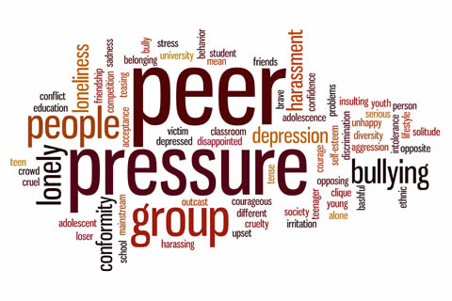
Notes:
https://www.drug-abuse-treatment.org/templates/drug-abuse-treatment-org/assets/img/articles/drug-abuse-peer-pressure.jpg
The picture displays the various reasons that people use to abuse painkillers among other drugs.

Slide 8
Effect on Brain and Body
Painkillers work by blocking the brain’s perception of pain.
They bind to opiate receptors; interferes with the signals conveyed by the CNS to the brain.
Narcotic painkillers are depressants; reduce the feeling of pain while enhancing the feeling of relaxation.
Contributes to depression.
Victims are unable to control feelings of pain or pleasure.
Their cognition become impaired over time.
Notes:
Painkillers work by blocking the brain’s perception of pain. They bind to opiate receptors; interferes with the signals conveyed by the CNS to the brain. Narcotic painkillers are depressants; reduce the feeling of pain while enhancing the feeling of relaxation; unfortunately, they lead to depression. Victims of painkillers abuse are unable to control feelings of pain or pleasure while their cognition become impaired over time (Maryland Addiction Recovery Center, 2014).

Slide 9
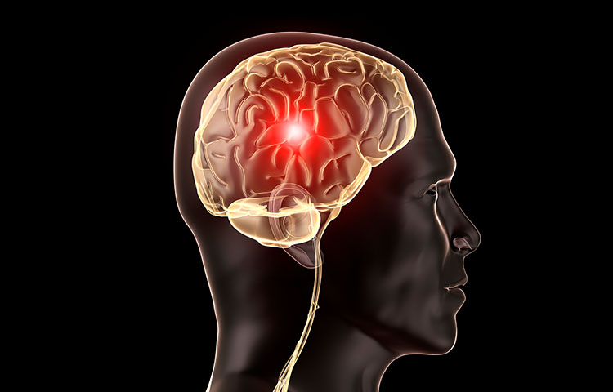
Notes:
https://www.injuryresources.com/media/brain-injury-52.jpg
Picture shows the devastation caused by painkillers in individuals with traumatic brain injury.
Studies have indicated that taking painkillers could aggravate the symptoms of traumatic brain injury. Long-term use of opioid drugs like Vicodin and Oxycontin can worsen recovery from brain injuries. Patients with brain injuries may also be more susceptible to substance abuse, which could increase their risk of developing an addiction to prescription painkillers (Trevino, deRoon-Cassini, and Brasel, 2013)

Slide 10
Neurotransmitter System Associated with Painkillers Effect
Painkillers bind to opiate receptors.
These receptors typically bind to neurotransmitters.
Through long term use of the drugs, the body slows down the production of the opiate receptors; body become less effective in pain management.
The painkillers fool the body that it has produced enough of the receptors thereby leaving the transmitters with nothing to bind.
consequently, neurotransmitter level significant decreases; body increases tolerance to painkillers.
Neurotransmitter affected include the natural endorphins; a feel good substance that also alleviate pain.
Notes:
Painkillers bind to opiate receptors, which typically bind to neurotransmitters. Through long term use of the drugs, the body slows down the production of the opiate receptors; body become less effective in pain management. The painkillers fool the body that it has produced enough of the receptors thereby leaving the transmitters with nothing to bind. Consequently, neurotransmitter level significant decreases; body increases tolerance to painkillers. Some of the neurotransmitters affected by painkillers long-term use include the natural endorphins; a feel good substance that also alleviate pain.
(Maryland Addiction Recovery Center, 2014)

Slide 11
Diagnosis of Painkiller Abuse
Physicians can perform drug tests to establish if a patient a patient has been talking the recommended amount of a painkiller.
Mental health screening also highlights the use of painkillers; euphoria, slow breathing rate, oversensitivity to pain.
Opioid testing; looks for the presence of opioids on saliva, blood, urine.
Looking for signs and symptoms of addiction; vomiting, constipation, reduced pupils of the eyes.
Painkiller addiction is often hidden in plain sight, making it difficult to identify.
Understand and recognize the signs, symptoms, and risks; the first step in the recovery journey.
Notes:
If you've been prescribed an opioid for chronic pain, your health care provider may order a drug test to make sure you are taking the right amount of your medicine. Opioid testing looks for the presence of opioids in urine, blood, or saliva. Opioids are powerful drugs that are used to relieve pain. Mental health screening also highlights the use of painkillers; euphoria, slow breathing rate, oversensitivity to pain. The physician also looks for signs and symptoms of addiction such as vomiting, constipation, reduced pupils of the eyes. Painkiller addiction is often hidden in plain sight, making it difficult to identify; it is imperative to understand and recognize the signs, symptoms, and risks, which is the first step in the recovery journey (Blendon and Benson, 2018).

Slide 12

Risk Factors for Painkiller Abuse
Genetic factors.
Brain chemistry.
Environmental factors.
Psychological factors.
Notes:
https://www.healthyplace.com/sites/default/files/images/stories/seroquel/1-addiction-to-prescription-drugs-healthyplace.jpg
Addiction to painkillers is thought to have a genetic component. Individuals with first degree relatives who struggle with addiction are more likely to develop addiction. They are therefore advised to seek physician intervention before using any painkiller.
Painkillers stimulate the reward system of the brain by releasing dopamine. There are individuals with inborn deficiencies in dopamine levels and rely on external nourishment for correct these deficiencies; painkillers provide one of the external source that is readily available.
People borne in chaotic homes would easily develop an addiction to anything that makes them feel goods; using morphine would bring a need of the feeling it brings thereby authenticating the urge to look for more of the drug.
Painkillers work by alleviating pain and boosting the mood. Individuals with low moods or co-occurring mental health problems are at greater risk of developing dependence on painkillers upon first time use (The Refuge, 2019).

Slide 13
Painkiller Addiction Treatment
Inpatient detox followed by inpatient rehab.
Cognitive behavior therapy; helps patients become less dependent on the painkillers to manage their cognitive function.
Group therapy; members motivate and encourage each other in the fight against addiction.
Outpatient drug counseling; for patients who cannot take full-time inpatient therapy program.
Medication; Suboxone; contains buprenorphine with naloxone; reduces the withdrawal symptoms.
Notes:
Inpatient detox programs help patients dig deep within themselves to uncover the root cause of their painkiller abuse. Knowing what caused them to use the substance in the first place will help prevent future triggers while in recovery. In group therapy, you’re more likely to be both challenged and supported by peers who are also going through drug rehab. Patients can also receive Suboxone, a pill that combines buprenorphine with naloxone. Buprenorphine relieves withdrawal symptoms (Weiss et al., 2011).

Slide 14
References
Maryland Addiction Recovery Center. (2014, July). The Effects of Painkillers on the Brain and Body. Retrieved from https://www.marylandaddictionrecovery.com/effects-of-painkiller-on-the-brain-and-body
Mayo Clinic. (2018, October). Prescription Drug Abuse. Retrieved from https://www.mayoclinic.org/diseases-conditions/prescription-drug-abuse/symptoms-causes/syc-20376813
Robinson, K.M. (n.d.). Painkillers: 7 Warning Signs of Addiction. WebMD. Retrieved from https://www.webmd.com/pain-management/features/painkiller-addiction-warning-signs#1
Blendon, R. J., & Benson, J. M. (2018). The public and the opioid-abuse epidemic. New England Journal of Medicine, 378(5), 407-411.

Slide 15
References Cont…
The Refuge. (2019). Prescription Painkiller Addiction Effects, Signs, & Symptoms. Retrieved from https://www.therefuge-ahealingplace.com/substance-abuse-treatment/prescription-drugs/painkillers/symptoms-signs-effects/
Trevino, C. M., deRoon-Cassini, T., & Brasel, K. (2013). Does opiate use in traumatically injured individuals worsen pain and psychological outcomes?. The Journal of Pain, 14(4), 424-430.
Weiss, R. D., Potter, J. S., Fiellin, D. A., Byrne, M., Connery, H. S., Dickinson, W., ... & Hasson, A. L. (2011). Adjunctive counseling during brief and extended buprenorphine-naloxone treatment for prescription opioid dependence: a 2-phase randomized controlled trial. Archives of general psychiatry, 68(12), 1238-1246.

