Slide 1
SurveyMonkey
NOTE: There is NO audio with this presentation.
Electronic Data Collection Instrument
Notes:
The next few slides will serve as an overview is to familiarize you with creating an electronic survey instrument. This week, you’ll create an electronic survey instrument through SurveyMonkey. Keep in mind that your view of SurveyMonkey may look different as the websites are constantly changing.

Slide 2
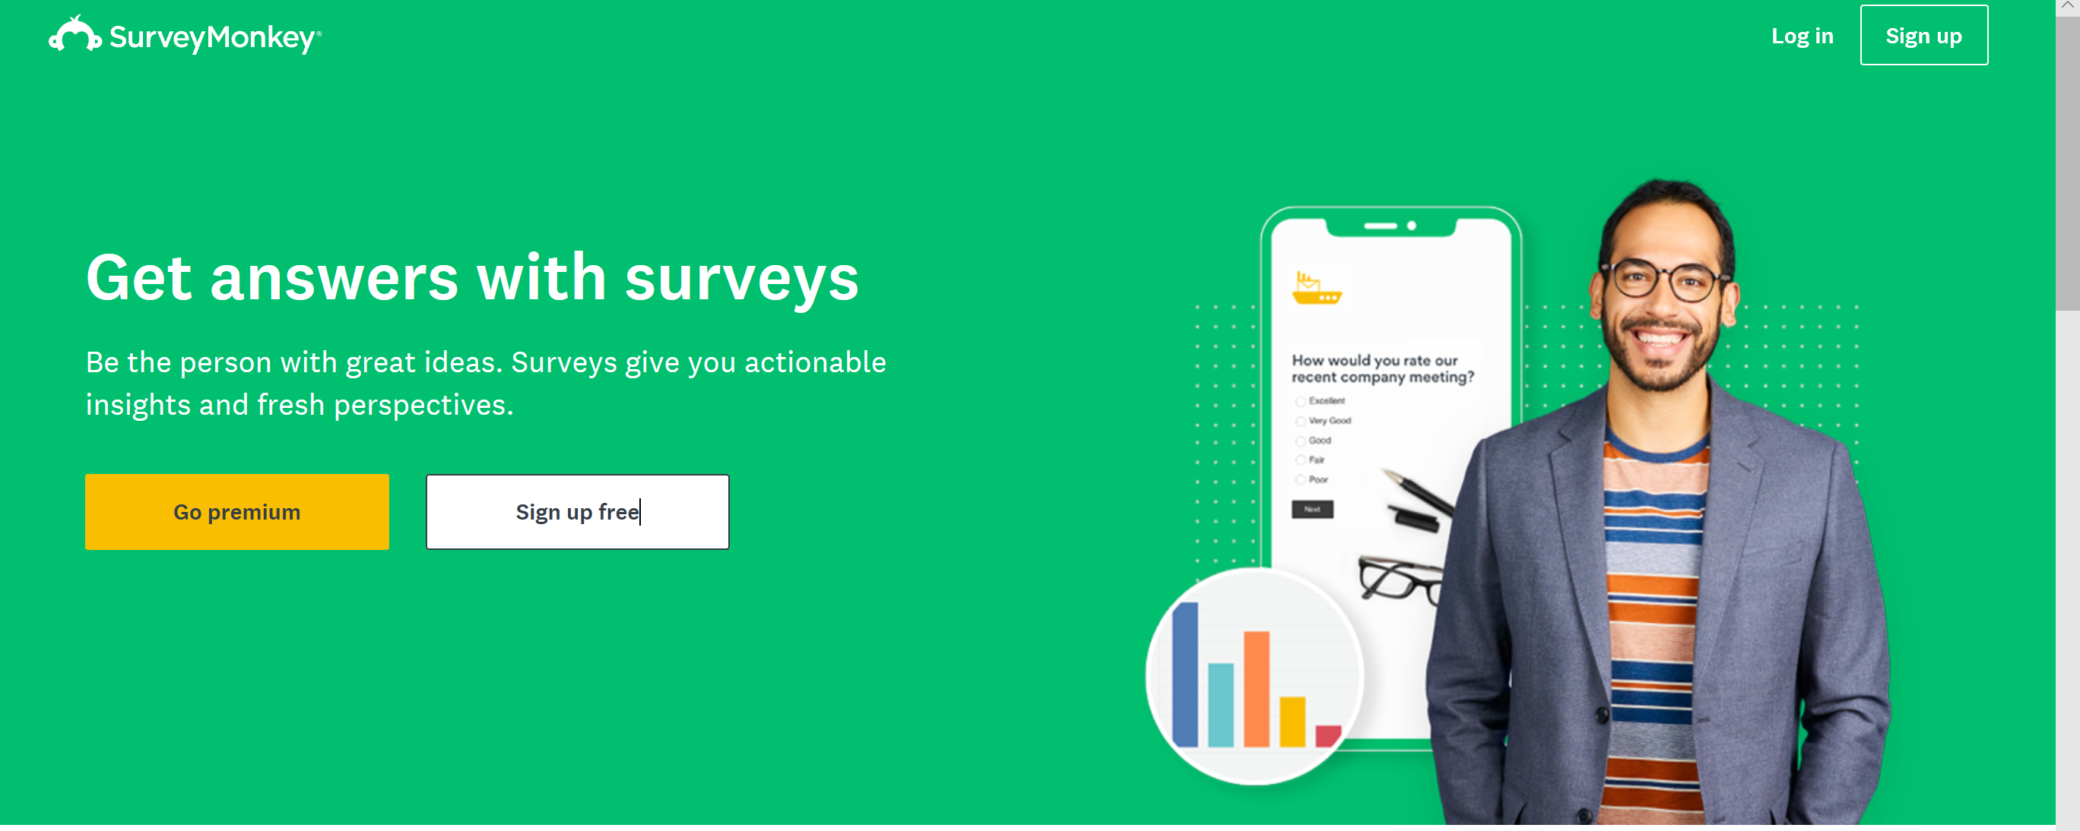
Logon to www.surveymonkey.com
Notes:
1. Logon to SurveyMonkey at: www.surveymonkey.com
2. Sign-up for a free basic account
3. If you already have an account, Sign-In

Slide 3
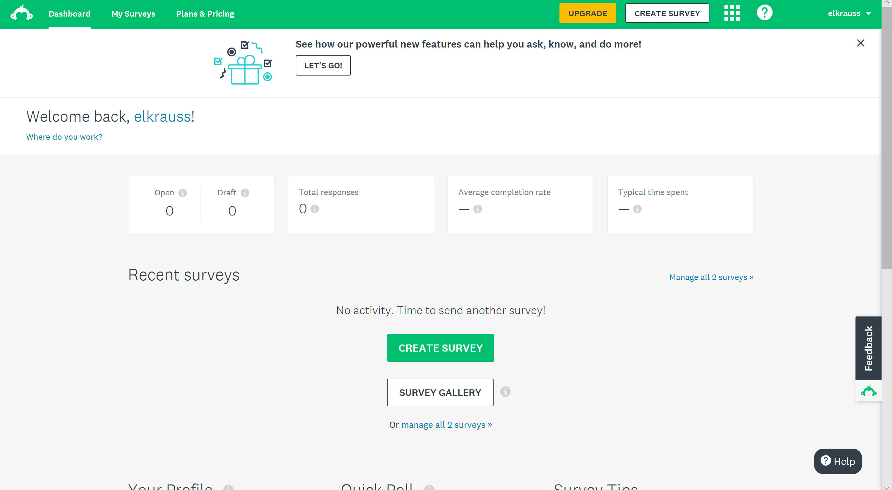
Notes:
Once you’ve created an account (or logged in), you’re ready to begin!
Now, select create a survey.

Slide 4
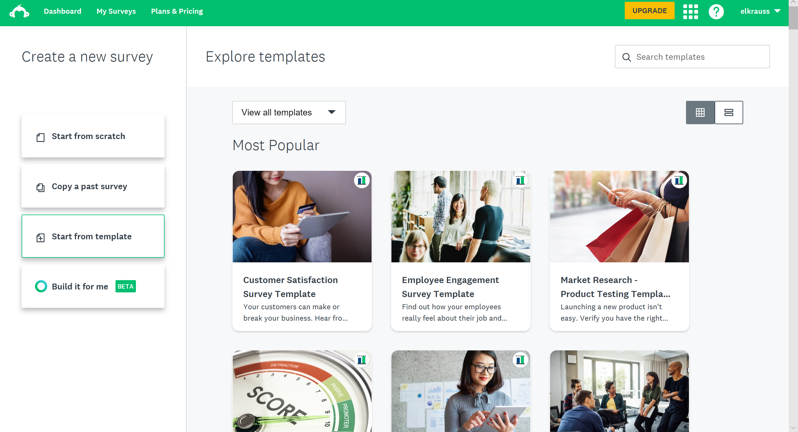
Notes:
Now, you can decide what type of survey to create. You can use a template, or start from scratch.
I’m going to select “Start from Scratch”, but you can decide what’s best for your survey.

Slide 5
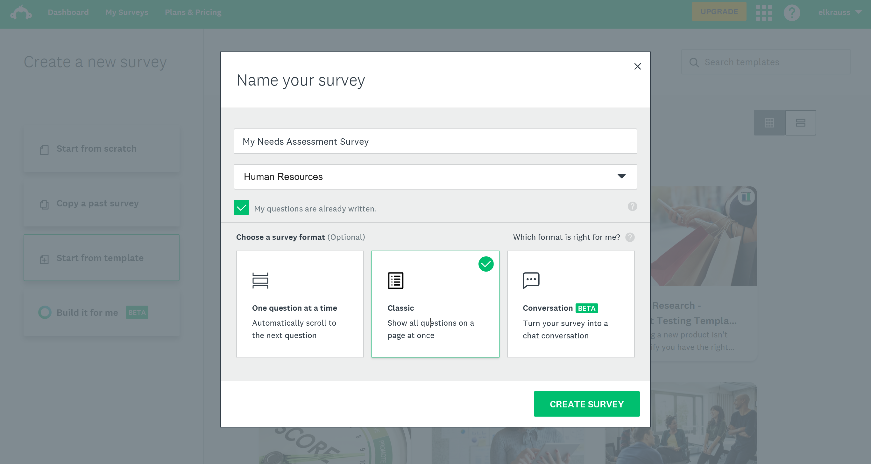
Notes:
On this webpage, you’ll need to name your survey. Be sure to select a title that accurately describes your survey but isn’t overly long or difficult to understand.
You’ll also need to select the category of your survey. Be sure to mark that your questions are already written. Then, select how your survey will be presented to your subjects .
Finally, click “Create Survey”.

Slide 6
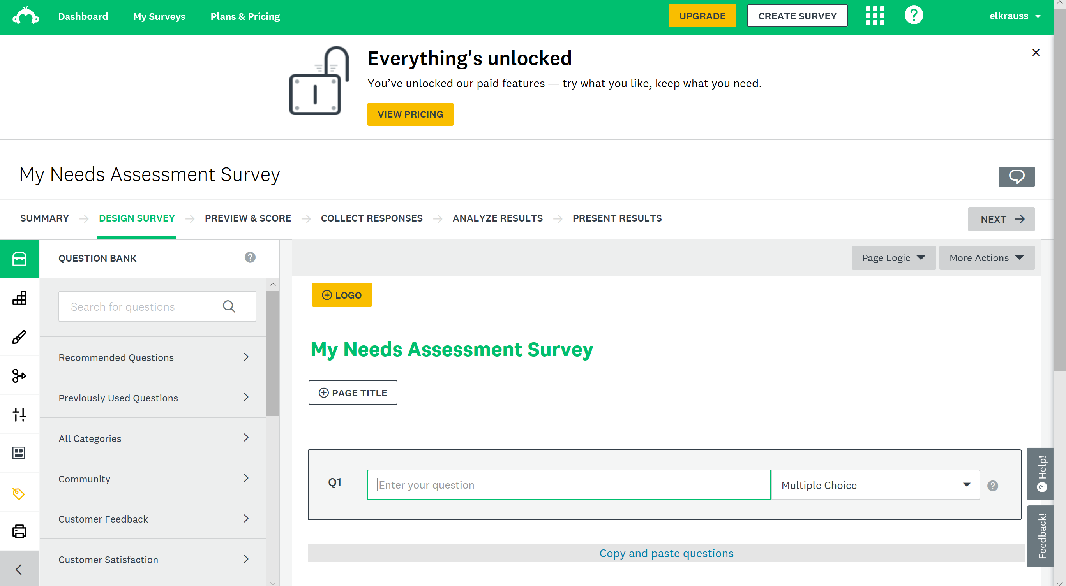
Notes:
You’re ready to begin entering your questions!

Slide 7
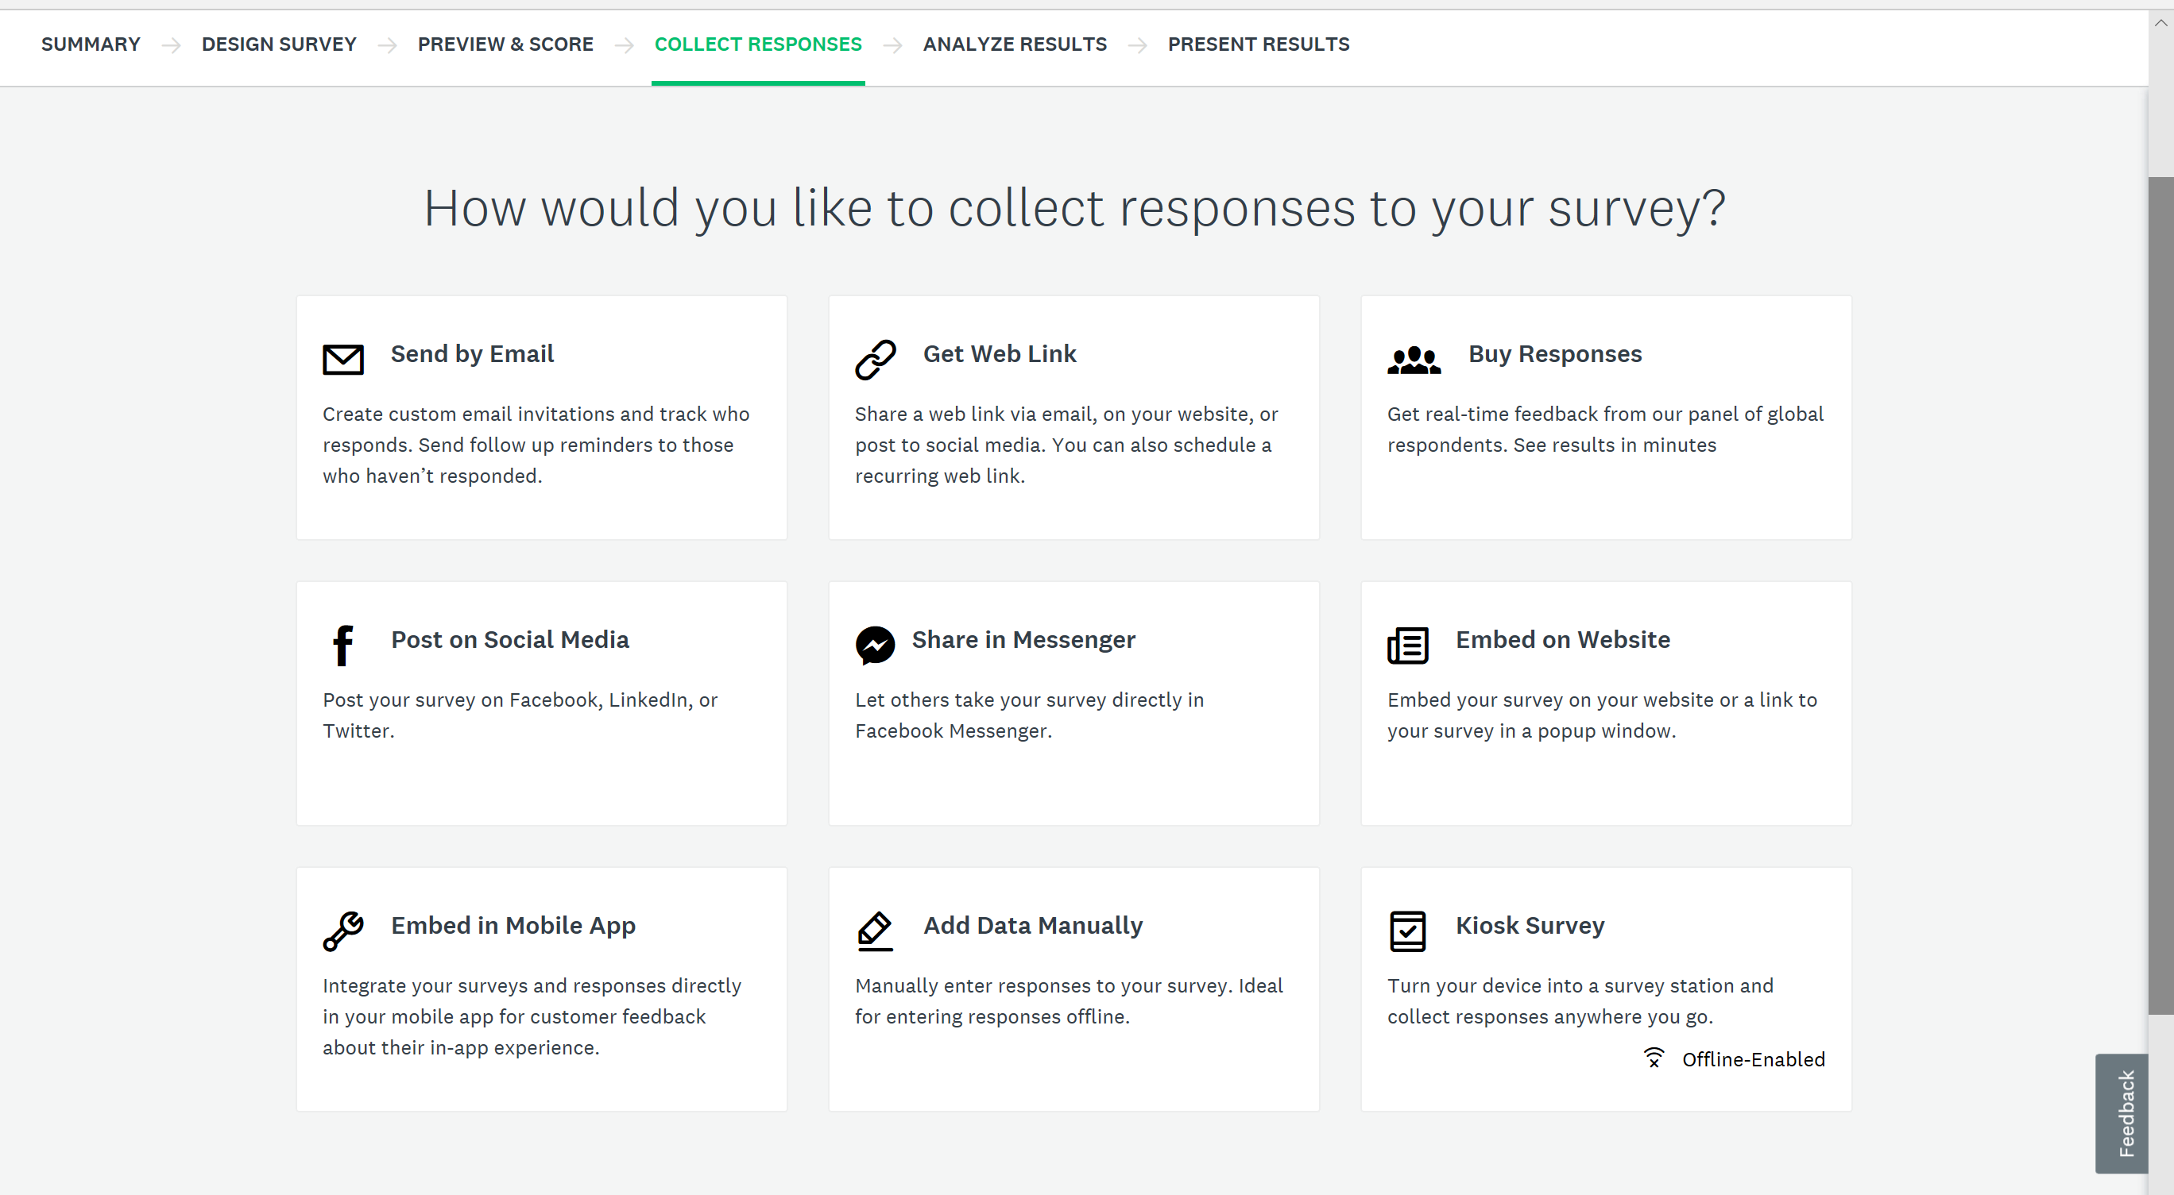
Notes:
After you’ve created and previewed your survey, you’re ready to decide how it will be distributed. Choose “Get Web Link”.
This will provide you with a URL for your survey.

Slide 8
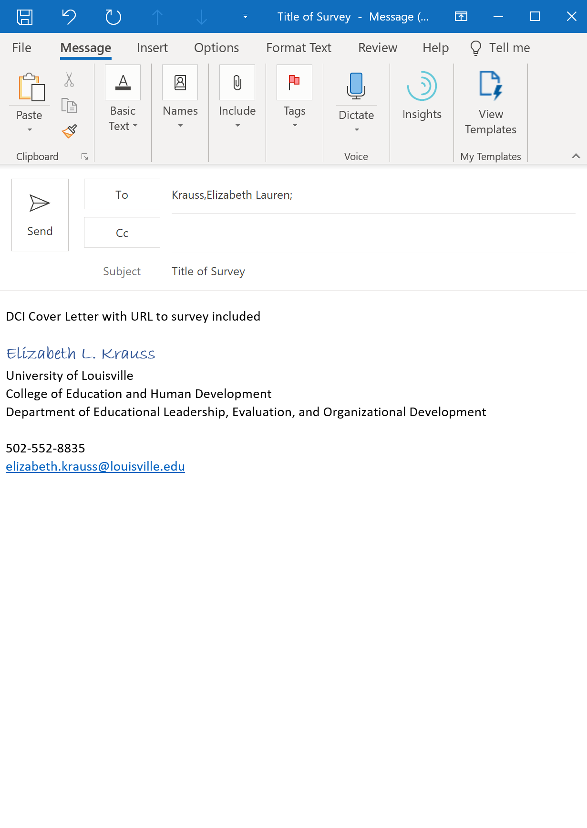
Email your DCI Cover Letter (with the link to your electronic survey included) to your instructor
elizabeth.krauss@louisville.edu
REMEMBER: The email you send to your instructor should look identical to the email you send to your subjects.
DO NOT email your survey to your subjects until you have gotten approval from your instructor.
Notes:
Do NOT deploy your survey to your participants until you have received feedback from your instrutor.

Slide 9
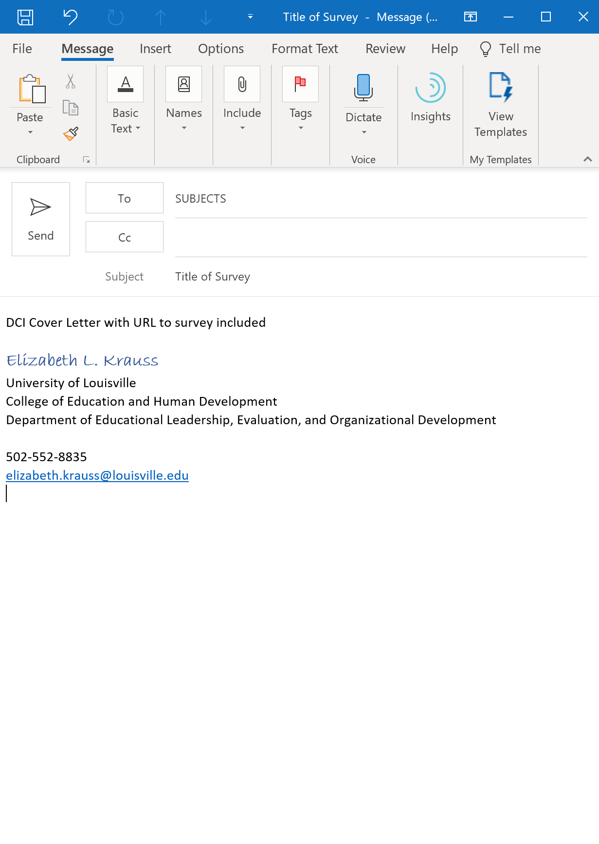
DO NOT email your survey to your subjects until you have gotten approval from your instructor.
AFTER receiving approval from your instructor, you’re ready to deploy your DCI to your subjects.
Be sure to include your DCI Cover Letter in the body of your email.

Slide 10
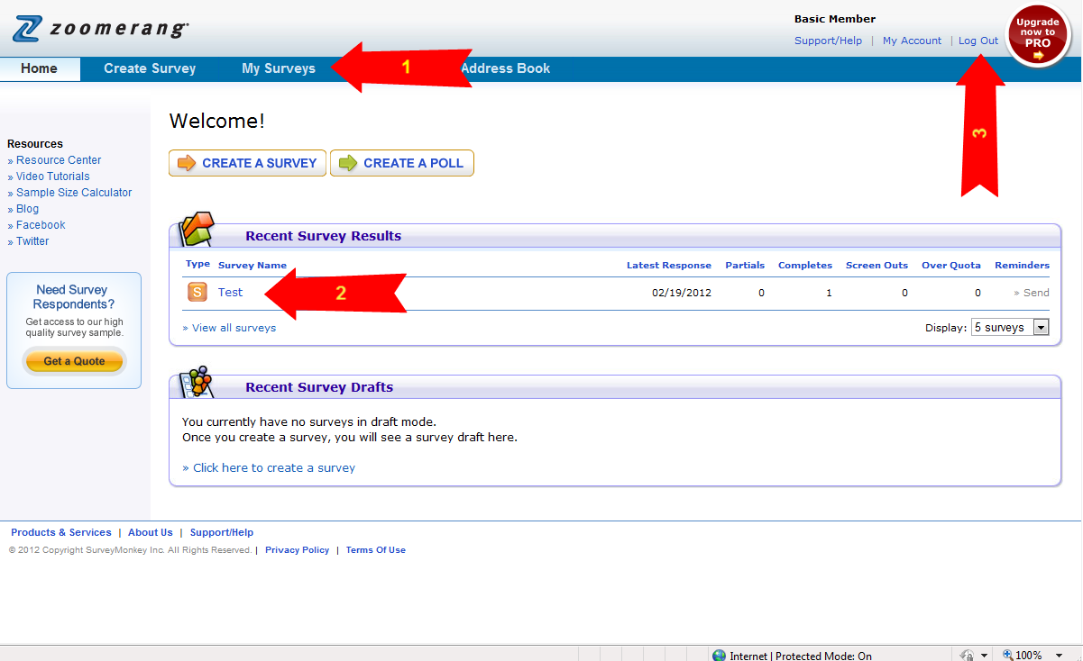
Notes:
Once the survey is deployed, you will be able to review it at the home page by selecting My Surveys
Or, review the results under Recent Survey Results
When finished or at the end of each session, Log Out
I encourage you to familiarize yourself with this process well in advance of needing to create the electronic version of your DCI.

