Slide 1
Ella Fitzgerald
First Name, Middle Initial(s), Last Name
Author's Affiliation
Course Number and Name(s)
Instructor's Name
Assignment Due Date

Slide 2
Biography
Ella Fitzgerald was born on April 25 1917 in Newport News, Virginia, USA and Died on June 15, 1996 at Beverly Hills California.
She was dubbed "The First Lady of Song and was the most celebrated female jazz singer in the united states of America for more than 50 years due to her rare and sweet voice.
From a young age, she wanted to become a dancer but later discovered her talent during a contest at New York city Apollo theatre in 1934 where she sang in a style influenced by Jazz vocalist Connee Boswell.

Slide 3
CONTINUED
The unexpected performance at the Apollo helped set Fitzgerald's career in motion. she soon met bandleader and drummer chick Webb and eventually joined his group as a singer.
She recorded the song Love and Kisses with Webb in the year 1935 and found herself regularly performing at Harlem's hottest club.
She also put out her first No. 1 hit, 1938's "A-Tisket, A-Tasket," which she co-wrote. Later that year, Fitzgerald recorded her second hit, "I Found My Yellow Basket.“

Slide 4
CONTINUED
Her parents separated after she was born, and her mother moved to New York. Her parent separation marked the beginning of her troubled childhood.
After moving to New York, they faced financial difficulties and young Fitzgerald helped her family by working as a messenger and acting as a lookout for a local brothel.
Her mother died in 1932 and she ended up moving in with one of her Aunts to escape from her hostile father who mistreated her.
While at her Aunt’s place She started skipping school. Fitzgerald was then sent to a special reform school but didn't stay there long.

Slide 5
Continued
Ella Fitzgerald soloed in cabarets and theatres and toured internationally with such pop and jazz stars as Benny Goodman, Louis Armstrong, Duke Ellington, the Mills Brothers, the Ink Spots, and Dizzy Gillespie. She also recorded prolifically.
She appeared in films (notably Pete Kelly’s Blues in 1955), on television, and in concert halls throughout the world. She also recorded a number of live concert albums and produced a notable duet version of Porgy and Bess (1957) with Armstrong

Slide 6
AWARDS AND HONORS
She became the first African American woman to win a Grammy award in 1958.
In her lifetime she won 13 Grammy Awards and sold more than 40 million albums.
She also won a Grammy Award for lifetime achievement.
Ella Fitzgerald also received a Kennedy Center Honor for lifetime achievement (1979) and the National Medal of Arts (1987).
She was also awarded the Presidential Medal of Freedom

Slide 7
ELLA FITZGERALD MUSIC STYLE
Ella Fitzgerald had a clear tone and a wide vocal range that were complemented by her mastery of diction, rhythm, intonation and harmony.
She was a perfect ballad singer who conveyed a winsome and ingenious music quality.
Her infectious scat style brought excitement during her concerts and recording for example the Ella in Berlin and Mack the knife

Slide 8
Health complications
In the 1970’s her health begun to deteriorate and experienced serious health complications but she would perform periodically.
She had a heart surgery in 1986, in 1993, her career went south following complications from diabetes which resulted in the amputation of both her legs all the way below her knees.
Ella Fitzgerald her last recording in 1989 and her last public performance in 1991 at New York's Carnegie Hall. Fitzgerald died on June 15, 1996, at her home in Beverly Hills

Slide 9
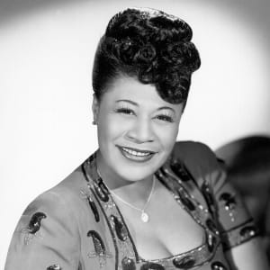
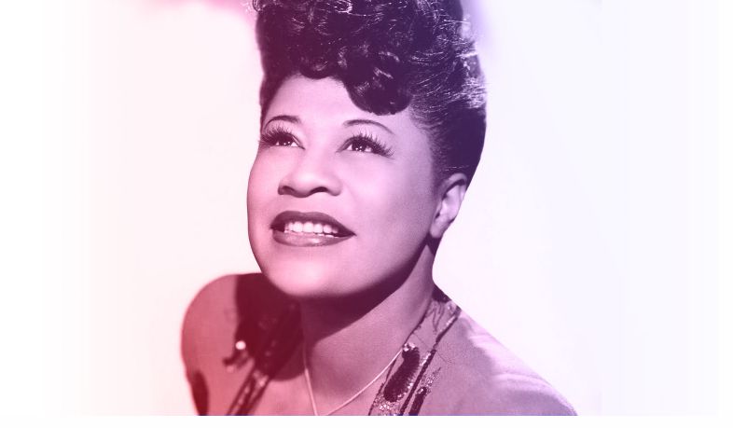
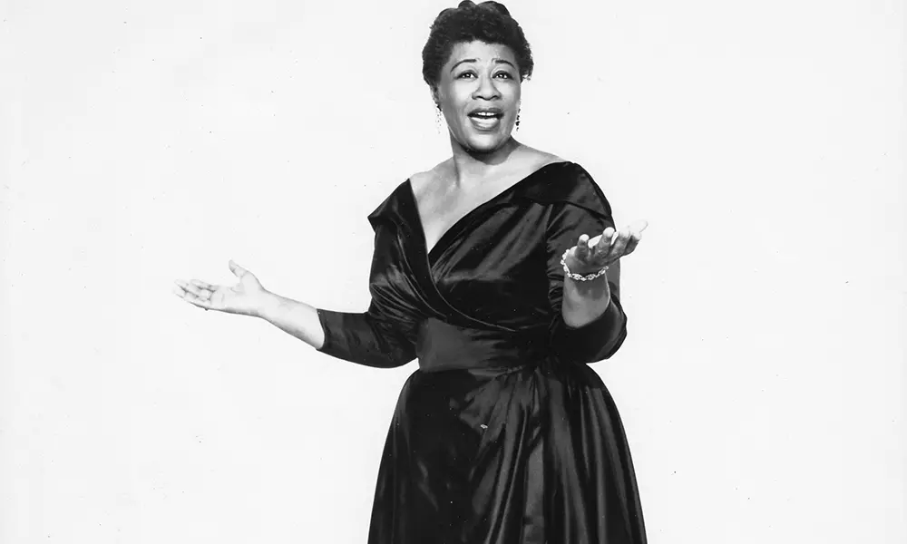
Ella Fitzgerald Images

Slide 10
References
Biography. (2017, April 7). Ella Fitzgerald. https://www.ellafitzgerald.com/about/biography
Biography.com Editors. (2018, January 19). Ella Fitzgerald. Biography. https://www.biography.com/musician/ella-fitzgerald
Dahl, L. (2001). undefined. American National Biography Online. https://doi.org/10.1093/anb/9780198606697.article.1803479
Ella Fitzgerald. (2020, October 6). uDiscover Music. https://www.udiscovermusic.com/artist/ella-fitzgerald/
Ella Fitzgerald. (n.d.). Encyclopedia Britannica. https://www.britannica.com/biography/Ella-Fitzgerald
Hill, M. R. (2019). undefined. African American Studies. https://doi.org/10.1093/obo/9780190280024-0073

