Slide 1
Ellis Island Immigration Scrap Book
Name
Course Unit
Institution of Affiliation

Slide 2
Narration of Audrey as an Immigrant Through Ellis Island
Year 1932
Audrey Elizabeth, a 15-year old girl is among thousands of immigrants entering the United States.
Through Ellis Island located in New Jersey side of upper New York Bay.
She is from Australia.
There had been violence against the Jews in their home country.
Only way to survive was flee
United states was the appropriate destination owing to its booming economy and acceptance of foreigners.
Notes:
Audrey Elizabeth is a 15-year old girl among the thousands of immigrants entering United States through Ellis Island around the Year 1932. She is from the Australian Empire where there have been regular outbreaks of violence against the Jews. Her father is already dead and with them being Jews, the only way to survive is to flee from their home country. At this time, the United States is the most appropriate destination or them owing to its favorable economy and compassion to immigrants. Her mother assemble them together with her two younger brothers and board a ship whose end journey is New York Bay at Ellis Island.

Slide 3
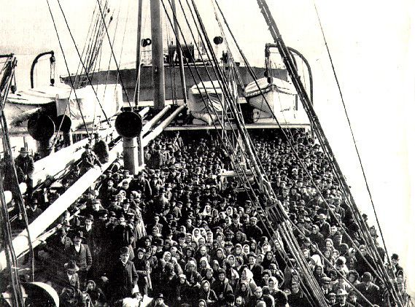
Arriving at New York Bay
Notes:
Photograph of Audrey and other immigrants arriving from Europe in a ship. Before being allowed to dock, the ship has to go through a quarantine checkpoint where all the immigrants are screened for contagious illnesses such as smallpox, leprosy, cholera, plague, and Yellow fever. The immigration officers then enter the ship via rope ladders with the ship docking thereafter.

Slide 4
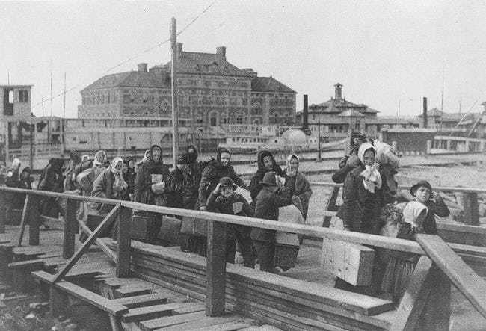
Notes:
Upon arrival, Audrey and other immigrants are funneled through a line in the Great Hall where they will be probed and subjected to medical examination (photo credit@ public domain).

Slide 5
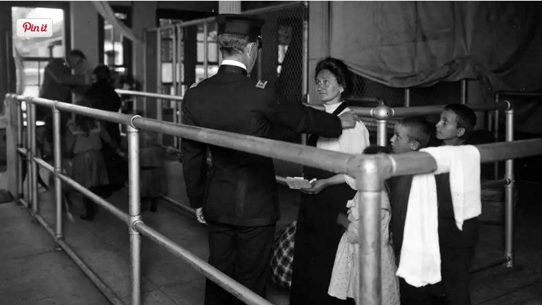
Clearing at the Immigration Department
Notes:
Photograph of Audrey with her mum and two brothers at the immigration department in Ellis Island. They are waiting to be attended. The process would take from a few hours, days, weeks or even months. In rare cases one would take a more than year to be cleared. The process has to be swift as the immigrants are in thousands and involved medical among other evaluations. Those fit to enter America are marked with an “X” using chalk on the right shoulder. A circled “X” means there is a problem. “B” means back problems, “Pg” means pregnant, “Sc” means Scalp infection (Talmon, n.d.)

Slide 6
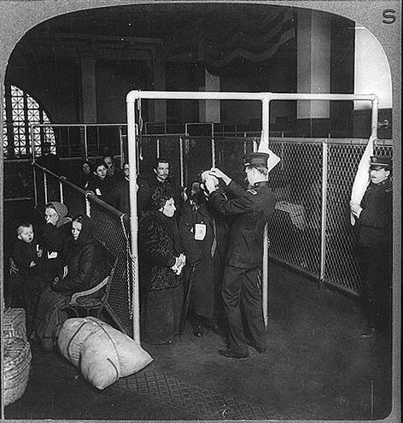
Notes:
Immigration officers inspecting eyes of immigrants in Ellis Island, New York Harbor (Photo credit @ Underwood)

Slide 7
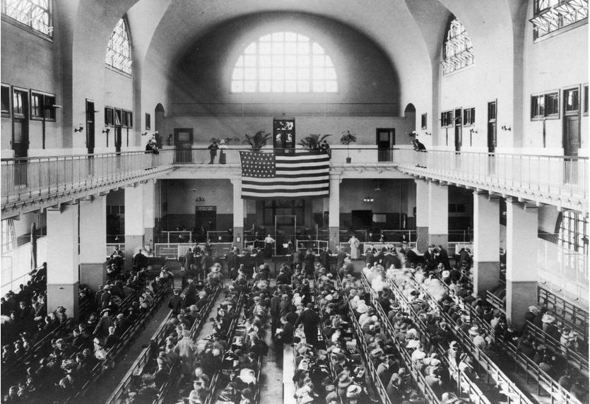
Notes:
Photograph of Audrey among other immigrants awaiting inspection in the registry room at Ellis Island (photocredit@ National Geographic, 2016)

Slide 8
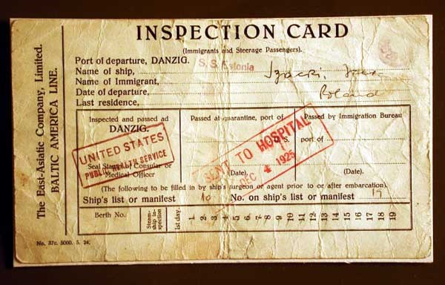
Sample Detention Card for the Immigrants
Notes:
The immigration officers question every person and if they find anything suspicious or not convincing, they detain the persons. They further inspect their luggage. The duration of detention is dependent upon the severity of the cases. The immigrants are not allowed to pass through the Ellis Island unless found without any conviction.

Slide 9
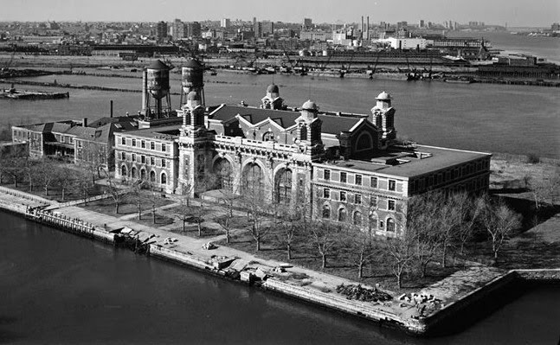
The Neighborhood of New York City Designating the Tenement Building Where Immigrants Stayed
Notes:
Photograph displays the map of the neighborhood in New York City where the immigrants stayed at Ellis Island before being integrated to the American community. In this buildings, Audrey and her family underwent massive evaluation encompassing medical, physical, and intellectual facets.

Slide 10
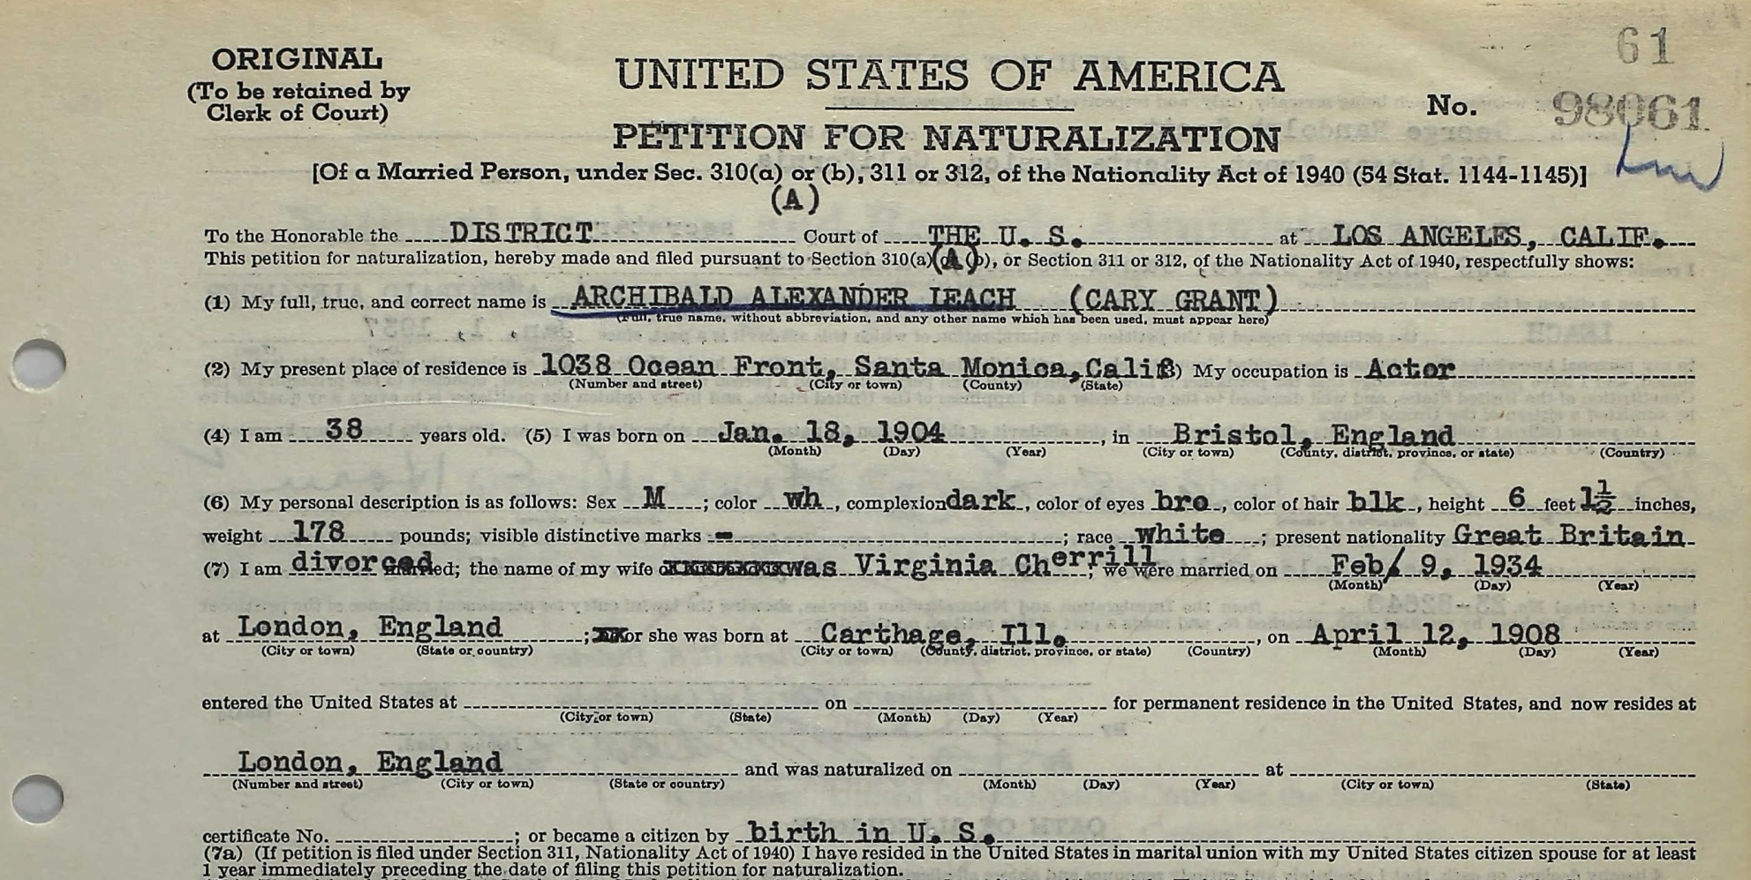
Work Visa Application
At this time, Immigrants are not required to have a visa to work
However, a profile of their skills and experiences is necessary.
The profile determines the duties they can be assigned.
Notes:
When Audrey and her family were migrating, they were not required to have a visa to work. However, a profile of their skills and experiences were taken to be used in recruiting them in labor firms. Photograph displays a sample prototype of a visa in those early years (Shapiro, 1986).

Slide 11
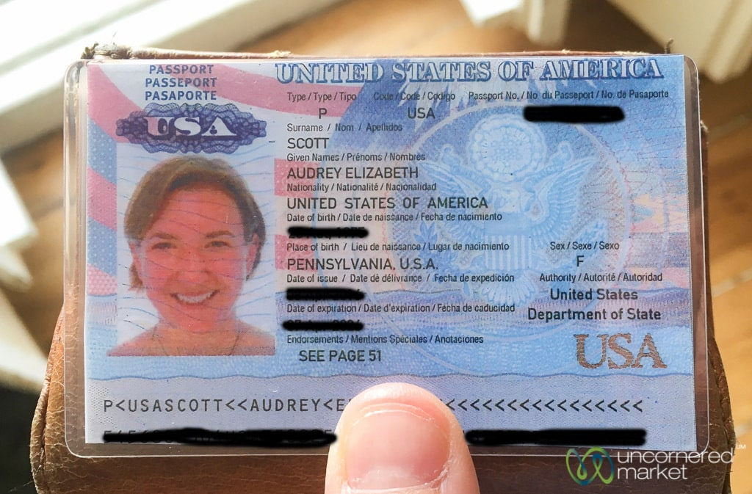
Identification Document for Audrey
Notes:
This is the identification document of Audrey, a settled United States citizen.

Slide 12
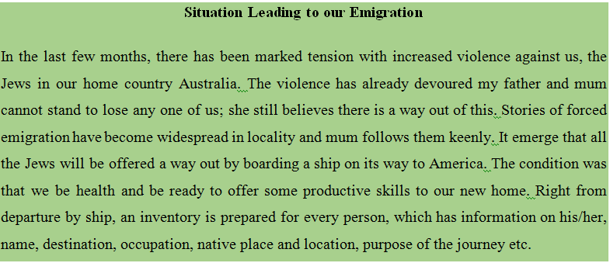
Audrey’s Reflection Letters
Notes:
This reflection letter indicates the situation at Australia that forced Audrey and her family to leave for United States.

Slide 13
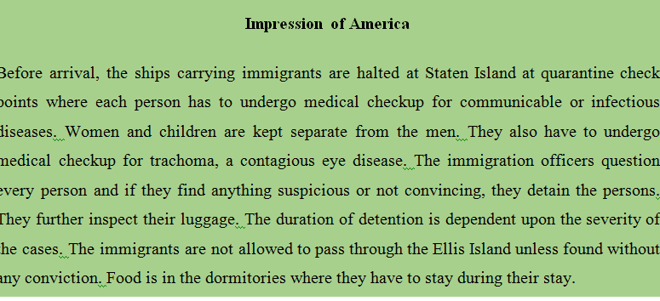
Audrey’s Reflection Letters Cont…
Notes:
The Letter highlight the experiences of Audrey upon arrival in Ellis Islands, the process that followed, and her perception of the experiences.

Slide 14
References
Selected Images of Ellis Island and Immigration, ca. 1880-1920. (2019). Retrieved 5 September 2019, from http://www.loc.gov/rr/print/list/070_immi.html
Shapiro, M. J. (1986). Gateway to liberty: the story of the Statue of Liberty and Ellis Island. New York: Vintage Books.
Talmon, N. (n.d.). The 12 Grueling Steps To Legal Immigration Through Ellis Island. Ranker. Retrieved from https://www.ranker.com/list/ellis-island-immigration-requirements/nicky-benson
Worrall, S. (2016, April). During Last Mass Migration, Europeans Were the Immigrants. National Geographic. Retrieved from https://www.nationalgeographic.com/news/2016/04/160424-refugee-migration-immigration-history-eastern-europe-jews-ngbooktalk/

