Slide 1
ELECTRICAL ENGINEERING
METAL STAMPING

Slide 2
introduction
The metal stamping process involves the use of stamping presses and dies to change the sheet metals into different shapes (Shanbhag, et al., 2018).
The scraps obtained in the stamping process are expected to generate profits.
In the production of the boxes, on the standardized sheets, the sections are nested on the surface of the sheet of metal.
The cost of production of the boxes from metal sheets is affected by the different parameters such as reliability of the machine, or the daily cost, based on the number of estimations and planned decisions the management has considered
The production process of the sheet metal product includes several phases from the raw material to the final product ready for sale in the market

Slide 3
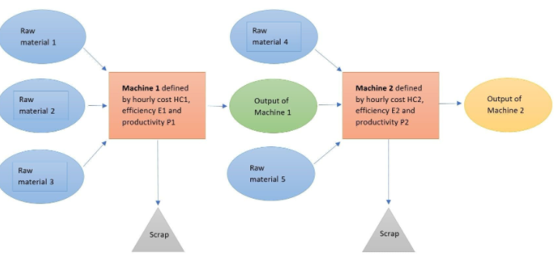
Cont…

Slide 4
Annual profit estimation
To determine the effectiveness of the company in production of the metal boxes, the annual profit should e estimated
This will help the management to identify areas of weakness and strengths
The weaknesses will be improved as the strengths are upheld
The sheet metal compony will also be able to compete effectively in the market.

Slide 5
Cost of raw materials
The manufacturing process of the boxes from the sheets requires raw materials
Cost of raw material= no. sheets x cost
Thus, the raw material is metal sheets. For a single production, one metal sheet is needed.
The material required is based on the gain of the company

Slide 6
Machining cost
The cost of machining requires the daily cost of the machine system and will not involve the cost of the overheads
Machining cost=daily cost x cycle time for one box
Reliability of the machine
Total production cost=coast of raw material+ cost of machining+ cost of labor
Since the machine is not 100% reliable, the company’s trying to come up with options helping in maximizing the profits for the success of the firm in the competitive market.
The management needs to decide on the value of the overhead linked to the operation of the machine, the gross margin profit to be earned and the daily rate generally used in the market (Ilic & Jaddivada, 2020).

Slide 7
Cont…
The invested cost of the machine is calculated based on the number of years the machine is to be repaid
Investment cost per day= investment value
Payback period x estimated days of operation
Machining cost=daily cost x cycle time for one box
Reliability of the machine

Slide 8
Conclusion
To maximize the profits, the sheet makers need to make informed decisions
The calculations done in the report shows some strategic evaluation and decisions that manufacturers have to make for effective payback to the company
The outlined options are necessary for the success of the company in the competitive market
The current metal forming industry is surrounded by optimization in all the activities done
The lean production helps the company to identify the wastes and reduce them as much as possible (Sathish, 2018)

Slide 9
Cont…
High reliability provided more return for the company and is expected to improve the profit margin for the sheet industry
The final return of the company depends on efficiency and cost of raw materials
Affordable raw materials improves the productivity
The pricing strategy is critical for the development of the company New machines increased the productivity

Slide 10
Recommendations
The current metal forming industry is surrounded by optimization in all the activities done
The company needs to utilize laser cutting machines for productivity
During the production process, the management needs to consider the highlighted factors such as reliability, the production rate and the machine daily costs
This will help in generating the high efficiency constant of the machine and system

Slide 11
Cont…
The company is recommended to apply the modern system of production of the metal boxes
The company should reduce the setup time for a higher return
The management needs to encourage savings and lower the cost of production
The overall cost in the industry shroud be reduced

Slide 12
References
Ilic, M., & Jaddivada, R. (2020). Unified value-based feedback, optimization and risk management in complex electric energy systems. Optimization and Engineering, 1-57.
Sathish, T. (2018). Prediction of spring-back effect by the hybridization of ANN with PSO in wipe bending process of sheet metal. Progress in Industrial Ecology, an International Journal, 12(1-2), 112-119.
Shanbhag, V. V., Rolfe, B. F., Arunachalam, N., & Pereira, M. P. (2018). Investigating galling wear behavior in sheet metal stamping using acoustic emissions. Wear, 414, 31-42.

