Slide 1
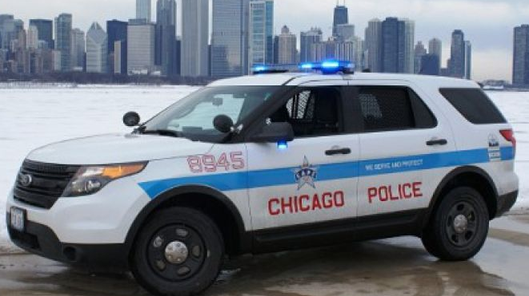
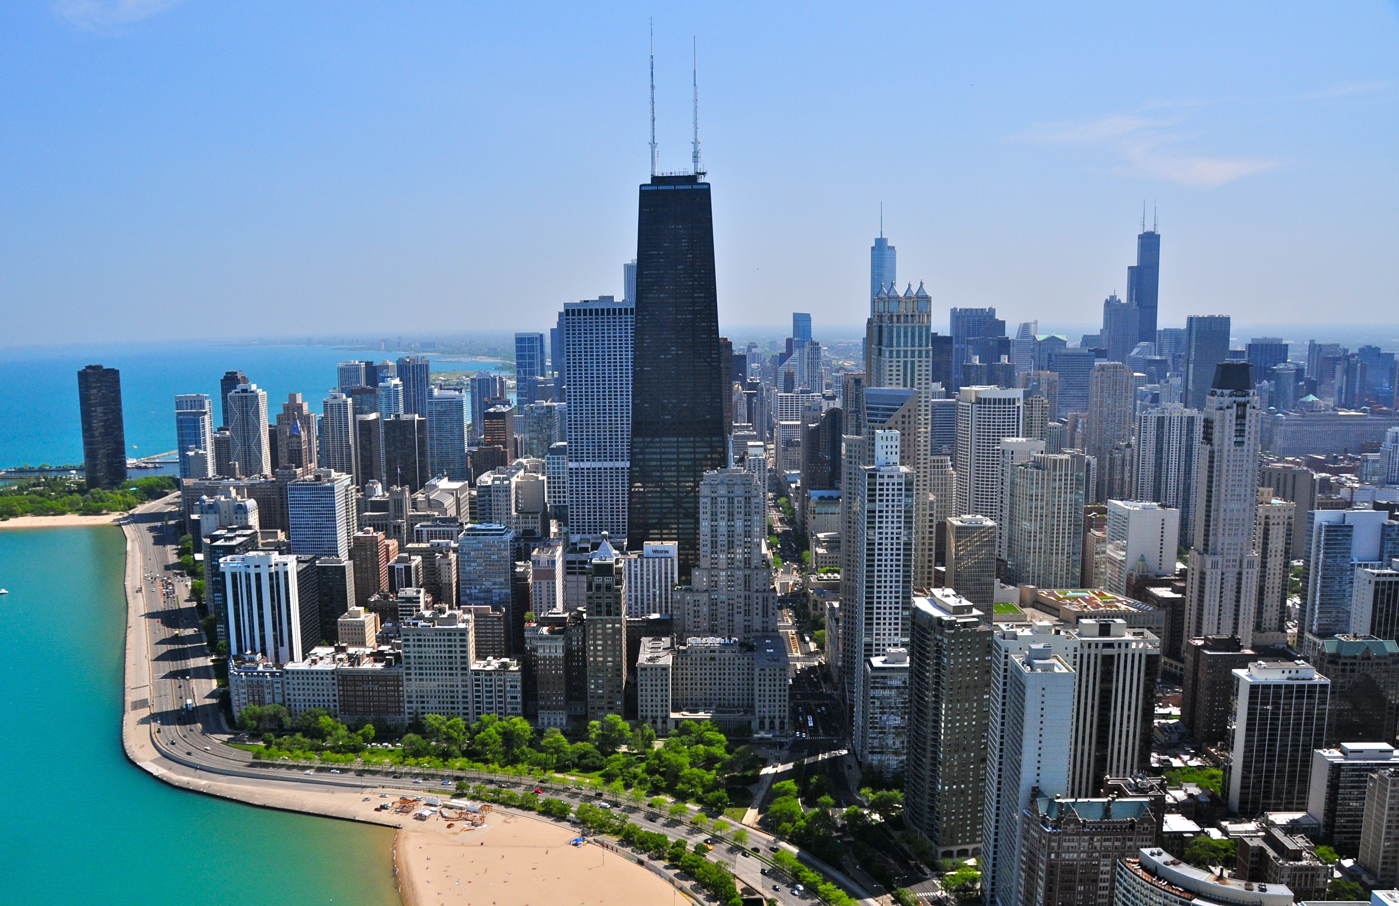
Chicago Crime 2016
Dataset Analysis

Slide 2
Crime Count
Most common crimes are theft and battery.
Least common crimes are gambling, stalking, prostitution and kidnapping.

Slide 3
Crime Date
97% of crimes were committed in March.
85% of crimes were committed between 3/28 and 3/31.

Slide 4
Crime Time
Most common time crimes were committed is 5PM.
Least common of top 10 is 3PM.

Slide 5
Crime by Street
Street with most crime is N State ST with 8 and 7 occurrences.

Slide 6
Crime Location
Most crime takes place in the street/sidewalk and residence/apartment.

Slide 7
Crime Arrests
Crime type with most arrests are narcotics and battery.

