Slide 1
Advanced Spreadsheet Modelling & Programming for Business
Excel VBA V
Excel Extended Functionality A

Slide 2
Solver Re-Visited
Solver Review
  Understanding the problem
  Preparing the worksheet
Solver commands in VBA
  Identifying Solver Input
  Setting Solver Options
  Running the Solver
  Generating Reports

Slide 3
Understanding the Problem
Mathematical models transform a word problem into a set of equations that clearly define the values you are seeking given the limitations of the problem.
There are three main parts of a mathematical model.
  Decision variables
  Objective function
  Constraints

Slide 4
The Mathematical Model
Decision Variables = variables assigned to a quantity or response that must be determined in the problem
Objective Function = equation which states the goal of the model
  Maximize
  Minimize
Constraints = equations which state limitations of the problem
To solve the model, each constraint must be considered simultaneously in conjunction with the objective function

Slide 5
Decision Variables
Decision variables are variables that are assigned to a quantity or response that you must determine in the problem.
They can be defined as negative, non-negative, or unrestricted variables.
  An unrestricted variable can be either negative or non-negative.
These variables are used to represent all other relationships in the model, including the objective function and constraints.

Slide 6
Objective Function
The objective function is an equation that states the goal, or objective, of the model.
Objective functions are either maximized or minimized.
  Most applications involve maximizing profit or minimizing cost.

Slide 7
Constraints
The constraints are the limitations of the problem.
In most realistic problems there are certain limitations, or constraints, which we must consider.
Constraints can be a limited amount of resources, labor, or requirements for a particular demand.
These constraints are also written as equations in terms of the decision variables.

Slide 8
Applying a model
In understanding the problem, we define the mathematical model.
  That is, we must define our decision variables, objective function, and constraints via mathematical representation.
For a problem involving production of different parts.
  The amount to produce of each part could be considered the decision variables.
  Maximizing profit (given certain costs and revenues for each part might be the objective function.
  There can also be constraints which limit the resources needed for each part and state a maximum demand limit that has to be met.

Slide 9
Excel Solver
The Excel Solver is used to solve a mathematical model which has been entered into an Excel spreadsheet.
This mathematical model can be either
  Linear Programming problem = there is a linear relationship among all constraints and the objective function
  Integer Programming problem = decision variables can only take integer values in a given range (these integer values can also be boolean = 0 or 1 only)
  Nonlinear Programming problem = do not have a linear objective function and/or constraints. NLP problems must use more challenging methods to solve these complex equations.
Notes:
Check now if all students have Solver. If not, go to
Add-Ins
Solver
Browse if necessary for Solver.xla file from Office\Library folder

Slide 10
The Solver Steps
Step 1: Read and Interpret the Problem
  Step 1.1: determine the decision variables
  Step 1.2: state the objective function
  Step 1.3: state any constraints
Step 2: Prepare the Spreadsheet
  Step 2.1: Enter the decision variables
  Step 2.2: Enter the constraints
  Step 2. 3: Enter the objective function
Step 3: Solve the model with the Solver
  Step 3.1: Set the Target Cell and choose Min or Max
  Step 3.2: Select Changing Cells
  Step 3.3: Add Constraints
  Step 3.4: Set Solver Options
  Step 3.5: Solve and review Results

Slide 11
Preparing the Worksheet
We must translate and clearly define each part of our model in the spreadsheet.
The Solver will then interpret our model according to how we have declared the decision variables, objective function, and constraints in the spreadsheet.
We use referencing and formulas to mathematically represent the model in the spreadsheet cells.

Slide 12
Entering Decision Variables
To enter the decision variables, we list them in individual cells with an empty cell next to each one (however, you should always make at least one cell numerical and non-zero).
The Solver will place values in these cells for each decision variable as it solves the model.
All other equations (for the objective function and constraints) will reference these cells.

Slide 13
Entering Objective Function
To enter the objective function, we place our objective function equation in a cell with an adjacent description.
This equation should be entered as a formula which references the decision variable cells.
As the Solver changes the decision variable values in the decision variable cells, the objective function value will automatically be updated.

Slide 14
Entering Constraints
To enter the constraints we list the equations separately with a description next to each constraint.
The most important part of setting up the constraint table is expressing the left side of our equations as formulas.
  As each constraint is in terms of the decision variables, all of these formulas must be in terms of the decision variable cells that Solver uses.
  These equations should reference the decision variable cells so that as the Solver places values in these cells the constraint values will automatically be calculated.
Another important consideration when laying out the constraints in preparation for Solver is that the RHS (right-hand side) values of each constraint should be in individual cells to the right of these equations.
We should also place all inequality signs in their own cells.

Slide 15
Naming the Ranges
Another advantageous way to keep our constraints organized as we use the Solver is to name our cells.
Using naming methods (see background folder), we can name the ranges decision variables and the cell which holds the objective function equation.
We can also name ranges of constraint equations which are in a similar category of constraints or which have similar inequality signs.
This makes inserting these model parts into the Solver easier when using both Excel and VBA code .

Slide 16
Solver Example
A company produces six different types of products. They want to schedule their production to determine how much of each product type should be produced in order to maximize their profits. This is known as the Product Mix problem.
Production of each product type requires labor and raw materials; but the company is limited by the amount of resources available.
There is also a limited demand for each product, and no more than this demand per product type can be produced. Input tables for the necessary resources and the demand are given.
Notes:
This is a Linear Programming problem as the constraints and objective function are linear with respect to the decision variables as well will see below. We will therefore use the Standard Solver. We now outline the model parts.

Slide 17
Solver Example, Step 1
Decision Variables:
The amount produced of each product type.
  x1, x2, x3, x4, x5, x6
Objective Function:
Maximize Profit.
  z = p1*x1 + p2*x2 + p3*x3 + p4*x4 + p5*x5 + p6*x6
Constraints:
There are two resource constraints: labor, l, and raw material, r.
  Labor Constraint:
    l1*x1 + l 2*x2 + l 3*x3 + l4*x4 + l 5*x5 + l 6*x6 <= available labor = 4500
  Raw Material Constraint
    r1*x1 + r 2*x2 + r 3*x3 + r 4*x4 + r 5*x5 + r 6*x6 <= available raw material = 1600
There is also a constraint that all demand, D, must be met, and no extra amount can be produced.
  Demand Constraint:
    xi <= Di for i = 1 to 6
Notes:
Note that all of these decision variables are non-negative; that is, we cannot produce a negative amount of any product type.
Profit is calculated as the sum of the array multiplication of the unit profit, p, and the amount produced of each product type.
Available amounts are given for each resource, and required amounts are given for the production of each product type. We therefore say that the sum of the array multiplication of the resource requirements and the amount produced of each product type must be less than or equal to the amounts available of each resource. These equations are written as follows:

Slide 18
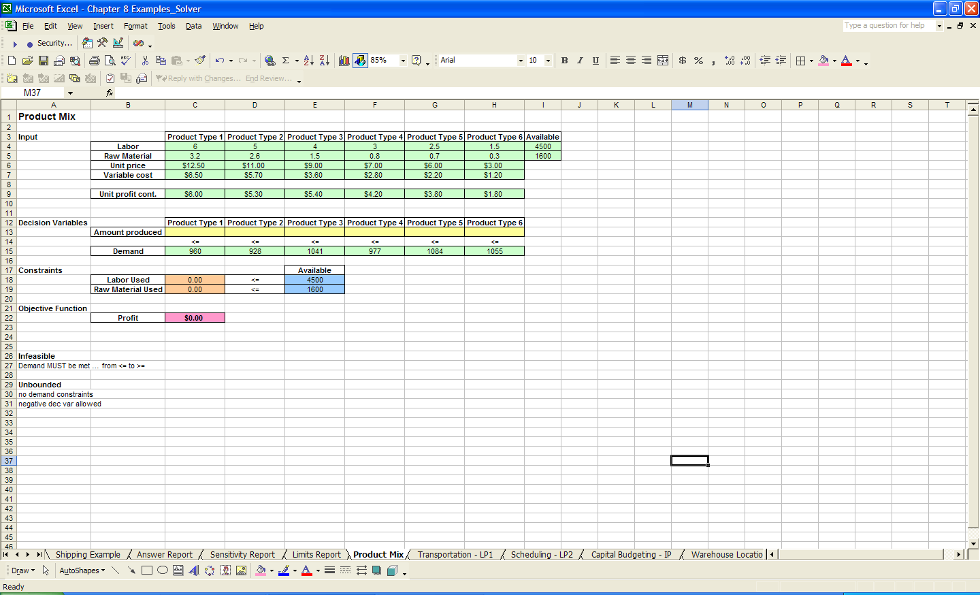
Solver Example, Step 2
The spreadsheet should have each part of the model clearly entered

Slide 19
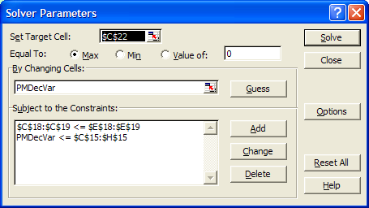
Solver Example, Step 3
The Solver parameters can now be set according to the cell references with the appropriate model parts

Slide 20
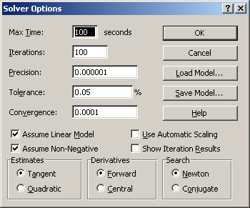
Solver Example, Step 3 (cont’d)
Solver Options should also now be set

Slide 21
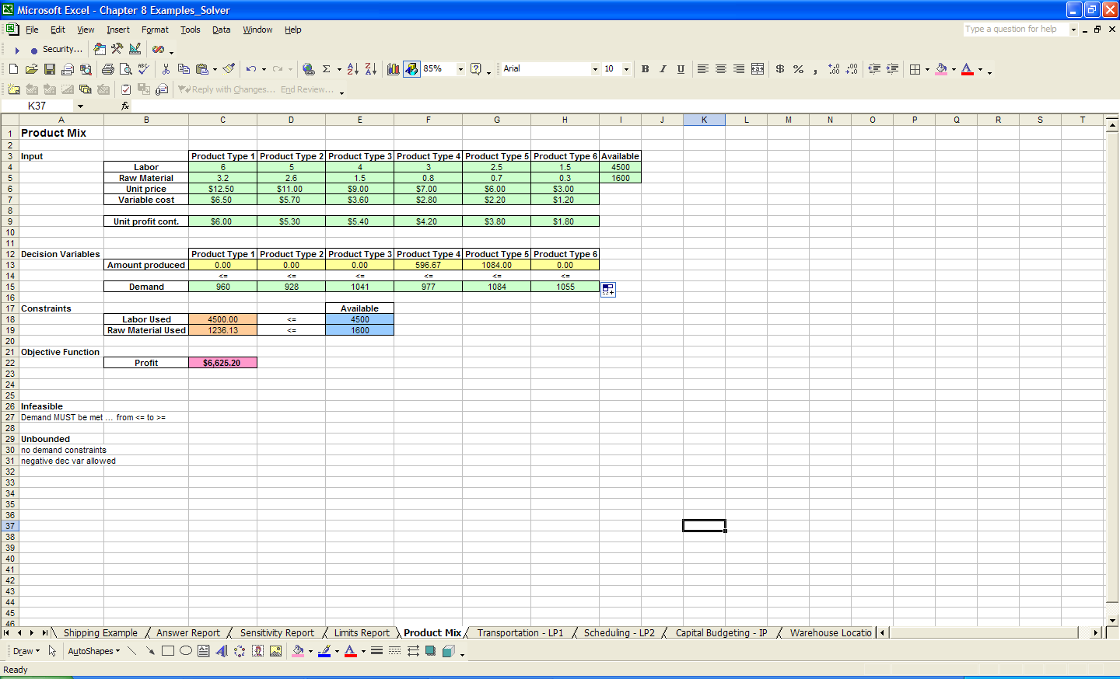
Solver Example, Results
The Results of the Solver are shown
All constraints are met

Slide 22
Solver Example, Reports
Answer Report = lists the target cell and the changing cells with their original and final values, constraints, and information about the constraints.
Sensitivity Report = shows how sensitive the solution is to small changes in the objective function formula or the constraints.
Limits Report = lists the target cell and the changing cells with their respective values, lower and upper limits, and target values.
Notes:
Sensitivity Report: This report is not generated for models that have integer constraints. For nonlinear models, the report provides values for reduced gradients and Lagrange multipliers.
Limits Report: This report is not generated for models that have integer constraints.

Slide 23
Premium Solver
To use the Premium Solver, simply press the Premium button on the Solver window.
The main Solver window will have a drop down list to select which Solver version, or which set of algorithms, you want to use to solve your problem.
  The Standard GRG Nonlinear and the Standard Simplex LP versions are basically the same as the Standard Solver for LP, IP, and NLP models.
  The Standard Evolutionary version can be used to solve more complex NLP models. This is what we will refer to as the Premium Solver.

Slide 24
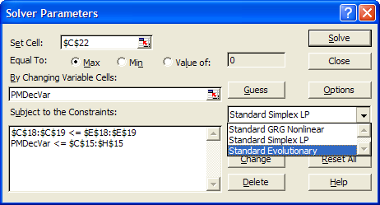
Premium Solver (cont)
Steps 1 and 2 are exactly the same when using the Premium Solver.
The options in Step 3 will be different when the Premium Solver is used.

Slide 25
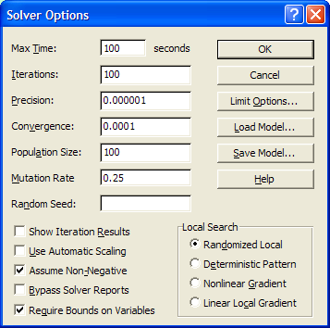
Premium Solver (cont)
The Evolutionary Solver uses the Genetic Algorithm to solve Nonlinear problems.
The Population Size and Mutation Rate are parameters associated with the Genetic Algorithm.
  The Population Size basically sets the initial number of feasible solutions; a good default value is 100 or 1000.
  The Mutation Rate determines how often the “Mutation” part of the Genetic Algorithm is performed; a good default value is 0.25.

Slide 26
Applications of the Solver
Transportation models
Scheduling problems
Capital Budgeting
Warehouse Location

Slide 27
Transportation Problem
A company ships their products from three different plants (one in LA, one in Atlanta, and one in New York City) to four regions of the United States (East, Midwest, South, West).
Each plant has a capacity on how many products can be sent out, and each region has a demand of products they must receive.
There is a different transportation cost between each plant, or each city, and each region.
The company wants to determine how many products each plant should ship to each region in order to minimize the total transportation cost.

Slide 28
Transportation Problem (cont)
Decision variables:
  The amount to ship from each plant to each region
Constraints :
  Demand: the total number of products received by a region (from each plant) is greater than or equal to its demand
  Capacity: the total number of products shipped from a plant (to each region) is less than or equal to its capacity
Objective function:
  Minimize the total transportation costs

Slide 29
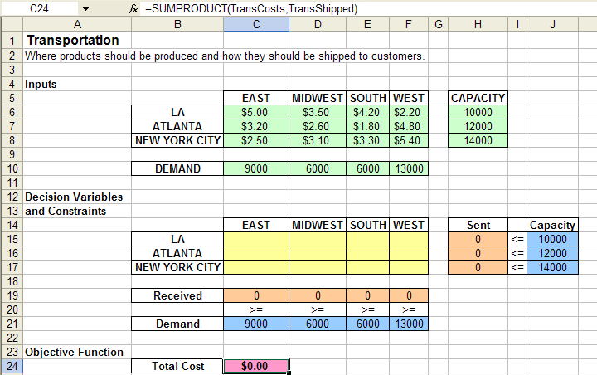
Transportation Problem (cont)
Prepare the spreadsheet

Slide 30

Transportation Problem (cont)
The Solver window

Slide 31
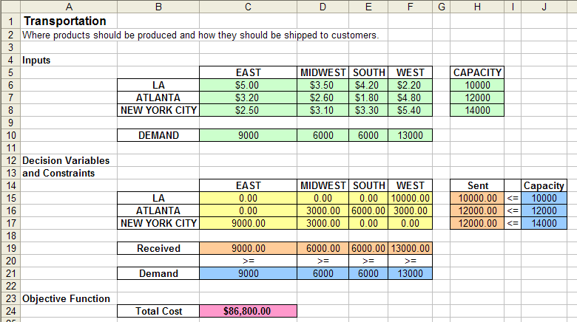
Transportation Problem (cont)
The solution

Slide 32
Workforce Scheduling
A company wants to schedule its employees for every day of the week.
Employees work 5 days consecutively, so the company wants to schedule on which day each employee starts working; that is how many employees start working each day.
There is a certain number of employees needed each day of the week.
The objective function is to find the schedule which minimizes the total number of employees working for the week.

Slide 33
Workforce Scheduling (cont)
Decision variables:
  The number of employees that will begin working (for 5 consecutive days) on each day of the week
Constraints:
  The total number of employees working on a given day (regardless of which day they started working) is greater than or equal to the number of employees needed on that particular day
objective function
  Minimize the total number of employees needed

Slide 34
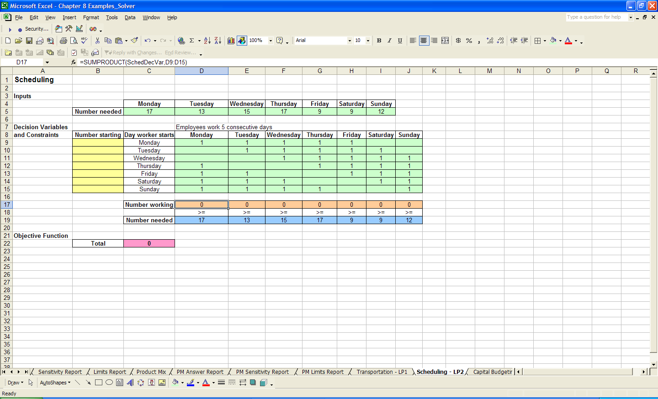
Workforce Scheduling (cont)
Prepare the spreadsheet

Slide 35
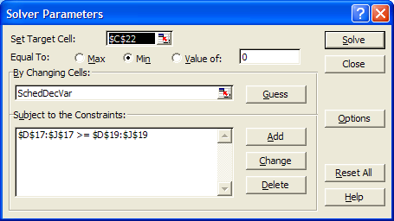
Workforce Scheduling (cont)
The Solver window

Slide 36
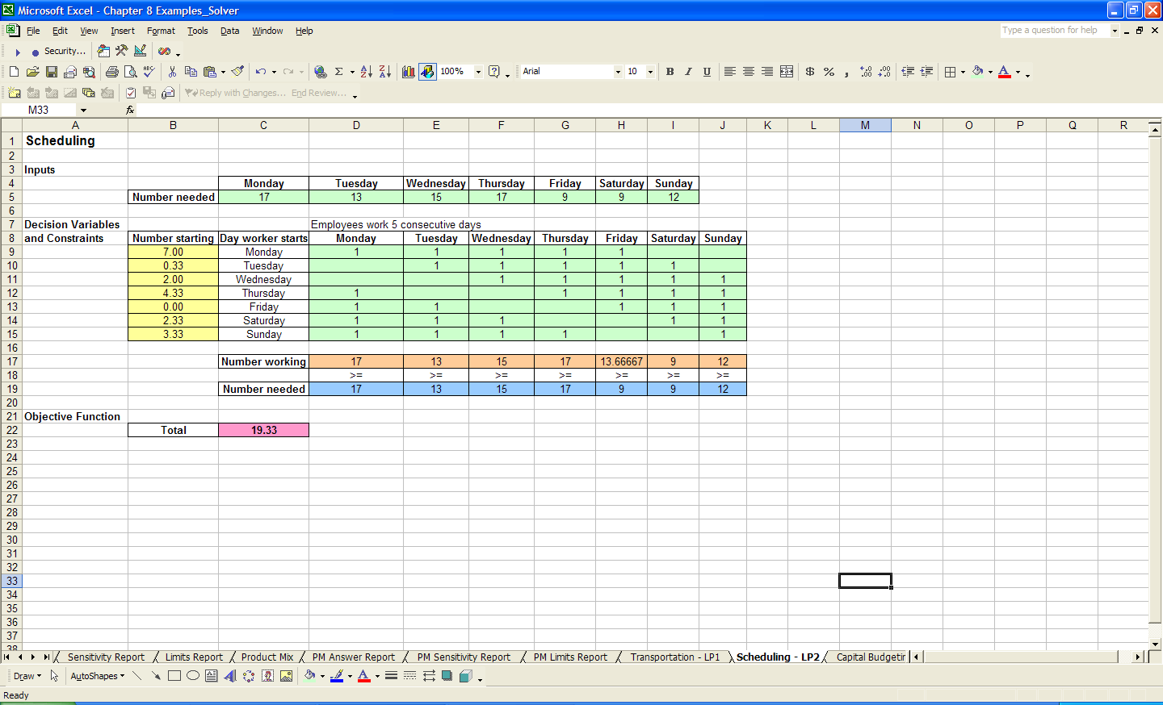
Workforce Scheduling (cont)
The solution

Slide 37
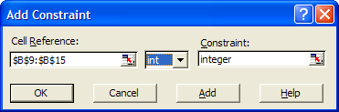

Workforce Scheduling (cont)
Integer constraint must be added

Slide 38
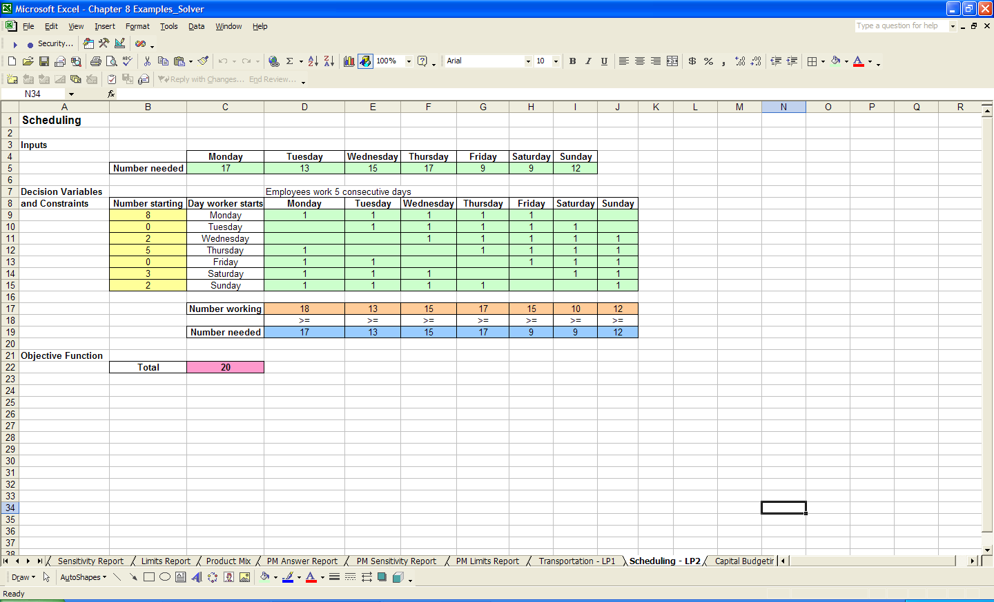
Workforce Scheduling (cont)
Updated solution

Slide 39
Capital Budgeting
There are 20 projects that a company, or individual, can invest in.
Each project has a net present value (NPV) and cost per year given.
The company, or investor, wants to determine how much to invest in each project, given a limited amount of yearly funds available, in order to maximize the total NPV of the investment.

Slide 40
Capital Budgeting (cont)
Decision variables:
  Which projects we do and do not invest in
Constraints:
  No more than the yearly available funds can be spent each year
Objective Function:
  Maximize the total NPV

Slide 41
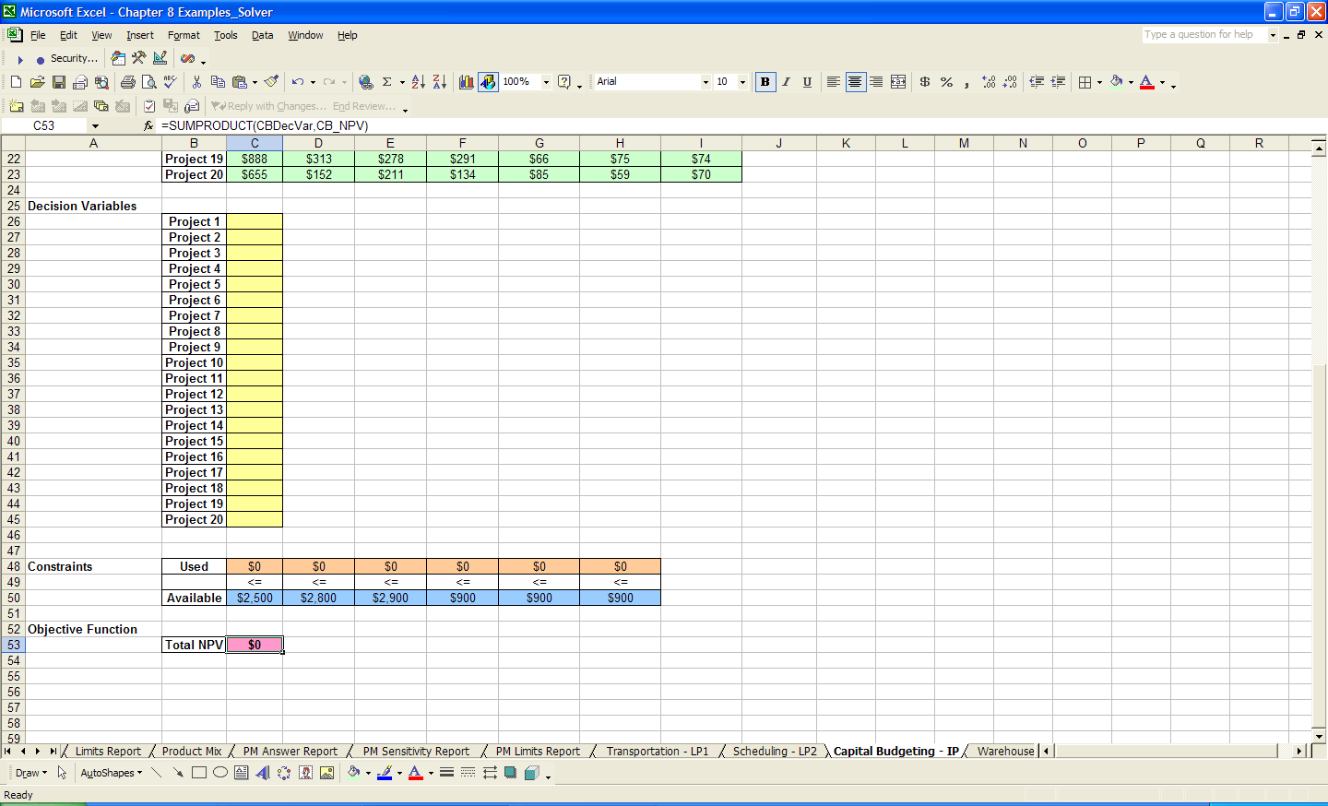
Capital Budgeting (cont)
Prepare the spreadsheet

Slide 42
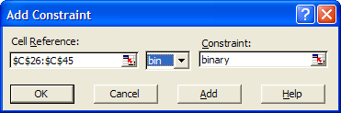
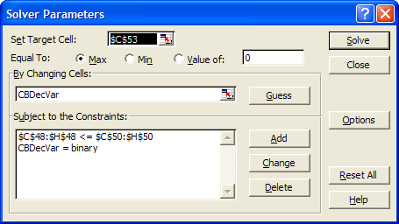
Capital Budgeting (cont)
A binary constraint
The Solver window

Slide 43
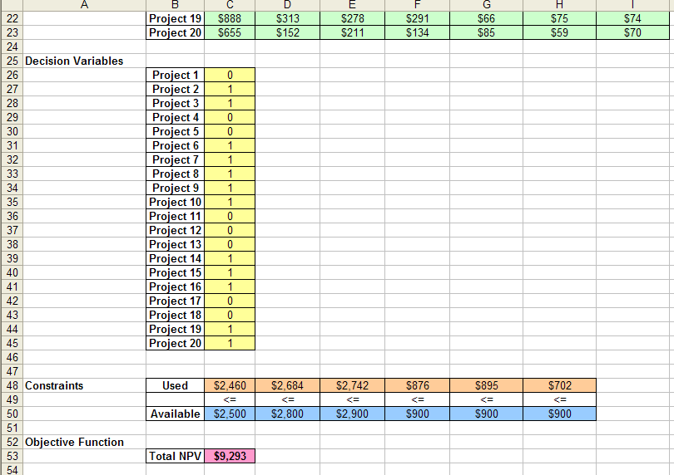
Capital Budgeting (cont)
The solution

Slide 44
Solver Commands in VBA
The SolverOK function is used to set the objective function and decision variables.
  SolverOK(SetCell, MaxMinVal, ValueOf, ByChange)
The SetCell argument is used to specify the range of the objective function.
The MaxMinVal argument specifies if this objective function will be maximized, minimized, or solved to a particular value.
  1( = maximize)
  2 (= minimize)
  3 (= value)
If this argument value is 3, then the ValueOf argument is used to set this value.
The ByChange argument specifies the range which contains the decision variables.
Notes:
Previously, when using the Solver from the Tools menu in Excel, we would have now identified these cells which contain the decision variables, objective function, and constraint equations to the Solver using the Changing Cells, Target Cell, and Add Constraint inputs, respectively

Slide 45
Previous Solver Example
A company produces six different types of products. They want to schedule their production to determine how much of each product type should be produced in order to maximize their profits. This is known as the Product Mix problem.
Production of each product type requires labor and raw materials; but the company is limited by the amount of resources available.
There is also a limited demand for each product, and no more than this demand per product type can be produced. Input tables for the necessary resources and the demand are given.
Notes:
This is a Linear Programming problem as the constraints and objective function are linear with respect to the decision variables as well will see below. We will therefore use the Standard Solver. We now outline the model parts.

Slide 46
Solver Example, Results
The Results of the Solver are shown
All constraints are met

Slide 47
Example Input
  SolverOK SetCell:=Range("F28"), MaxMinVal:=1,
  ByChange:=Range("E14:E15")
For this example, we had also named the input ranges; therefore, we can instead type the following
  SolverOK SetCell:=Range("ObjFunc"), MaxMinVal:=1,
  ByChange:=Range("DecVar")
Notes:
Note that the appropriate worksheet should be activated if we want to specify the ranges without a preceding worksheet name
As we know from working with named ranges in VBA, we can modify these ranges elsewhere in the code without having to update this function.
Note that we could also use range variables instead of range names; this is not useful when working with the Solver in Excel however

Slide 48
Identifying Solver Input (cont)
The SolverAdd function should be used to add each individual constraint or each group of similar constraints.
  SolverAdd(CellRef, Relation, FormulaText)
The CellRef argument specifies the (LHS) range which contains a constraint equation.
The Relation argument can take one of five values which specify the inequality of the constraint.
  1 is <=
  2 is =
  3 is >=
  4 is int
  5 is bin
The FormulaText argument specifies the range which contains the RHS value of the constraint.

Slide 49
Example Input (cont)
  SolverAdd CellRef:=Range(“C18:C20”), Relation:=3, FormulaText:=Range(“F18:F20”)
  SolverAdd CellRef:=Range(“C21:C23”), Relation:=1, FormulaText:=Range(“F21:F23”)
  SolverAdd CellRef:=Range(“C24”), Relation:=1, FormulaText:=Range(“F24”)
  SolverAdd CellRef:=Range(“C25”), Relation:=1, FormulaText:=Range(“F25”)
Again, since we named our constraint ranges, we could have instead typed
  SolverAdd CellRef:=Range(“QuotaCon”), Relation:=3, FormulaText:=Range(“F18:F20”)
  SolverAdd CellRef:=Range(“LimitCon”), Relation:=1, FormulaText:=Range(“F21:F23”)
  SolverAdd CellRef:=Range(“WeightCon”), Relation:=1, FormulaText:=Range(“F24”)
  SolverAdd CellRef:=Range(“SpaceCon”), Relation:=1, FormulaText:=Range(“F25”)
Notes:
We could have also named the corresponding RHS value ranges in the preparation step which could have been used in the FormulaText argument of this function.
We may have also grouped together those constraints which have the same Relation value.
Again, the idea is to increase the efficiency of your code by minimizing the amount of updates that would need to be made to the code if any changes were made to the input.

Slide 50
Identifying Solver Input (cont)
There are two more functions which can be used to modify constraints.
  SolverChange and SolverDelete
  These functions will allow you to modify or delete a constraints, respectively.
  They both have the same arguments as the SolverAdd function.
Another function, which can be used before any input is entered, is the SolverReset function.
  This function resets all Solver parameters.
  All input will be empty and all Solver options will be set to their default values.
  It is generally a good idea to use this function before any of the above input functions are used.

Slide 51
Setting Solver Options
To set the Solver options in VBA, we use the SolverOptions function.
  This function has many arguments for each of the options we have seen previously in the Solver Options dialog box.
There are two arguments which we will use more frequently, which are AssumeLinear and AssumeNonNeg.
  Both of these arguments take True/False values.
  True makes the corresponding assumption.
  For most of our models, we will set both of these arguments to true as follows.
  SolverOptions AssumeLinear:=True, AssumeNonNeg:=True
The other option arguments include: MaxTime, Iterations, Precision, StepThru, Estimates, Derivatives, Search, IntTol, Scaling, and Convergence. NOTE: It is always advisable to set Scaling:=True
Notes:
We normally ignore these option arguments; you can explore these options in more detail using the Help menu option.

Slide 52
Running the Solver
To run the Solver in VBA, we use the function SolverSolve.
  This function has two arguments and is written as follows.
  SolverSolve(UserFinish, ShowRef)
The UserFinish argument uses a True/False value to determine whether to return the Solver results with our without showing the Solver Results dialog box.
  We will usually set this argument value to True.
  If the value is False then the Solver Results dialog box will appear after the Solver has run the model.
The ShowRef argument is used when the StepThru option is set; hence we will usually ignore this argument.
  SolverSolve UserFinish:=True

Slide 53
Solver Solution
The SolverSolve function also returns an integer value classifying the result.
  The values 0, 1, or 2 signify a successful run in which a solution has been found.
  The value 4 implies that there was no convergence.
  The value 5 implies that no feasible solution could be found.
It can be useful to assign some variable to the SolverSolve function in order to display an appropriate Message Box to the user if needed.
  Dim result As Integer
  result = SolverSolve(UserFinish:=True)
  If result = 5 Then
  MsgBox “Your solution was infeasible, please modify your model.”
  End If

Slide 54
Generating Reports
When the Solver has finished running, we can decide whether or not we want to keep the results and if we want to generate any reports using the SolverFinish function.
  This function has two arguments and is written as follows
  SolverFinish(KeepFinal, ReportArray)
The KeepFinal argument takes the value 1 if you want to keep the Solver solution and the value 2 if you want the previous values to be kept.
  We will usually set this argument value to 1.
The ReportArray argument is used to specify which reports, if any, you want to generate.
  The value of this argument is entered using the Array function.
  The array values can be 1 (to generate an Answer Report), 2 (to generate a Sensitivity Analysis Report), and/or 3 (to generate a Limits Report).
  SolverFinish KeepFinal:=1, ReportArray:=Array(2, 3)
Notes:
Note that the KeepFinal default value is 1, so this argument does not need to be specified; that is, if we did not want to generate any reports but wanted to keep the Solver solutions, we could just type: SolverFinish

Slide 55
Final Solver Code
  Sub UsingSolver()
  Worksheets("Shipping").Activate
  Application.ScreenUpdating = False
  SolverReset
  SolverOK SetCell:=Range("ObjFunc"), MaxMinVal:=1, ByChange:=Range("DecVar")
  SolverAdd CellRef:=Range("QuotaCon"), Relation:=3, FormulaText:=Range("F18:F20")
  SolverAdd CellRef:=Range("LimitCon"), Relation:=1, FormulaText:=Range("F21:F23")
  SolverAdd CellRef:=Range("WeightCon"), Relation:=1, FormulaText:=Range("F24")
  SolverAdd CellRef:=Range("SpaceCon"), Relation:=1, FormulaText:=Range("F25")
  SolverOptions AssumeLinear:=True, AssumeNonNeg:=True
  SolverSolve UserFinish:=True
  SolverFinish KeepFinal:=1, ReportArray:=Array(2, 3)
  Application.ScreenUpdating = True
  End Sub
Notes:
Note:
Worksheets.Activate
Application.ScreenUpdating = True

Slide 56
Three other functions
We will now comment briefly on three other functions that correspond to saving a set of Solver parameters.
  These are SolverSave, SolverLoad, and SolverGet..
The SolverSave function will save a certain set of Solver parameters that have been summarized in a range on any worksheet.
  This range is the value of the one function argument SaveArea.
The SolverLoad function will load a set of Solver parameters that have been saved.
  The argument for this function, LoadArea, would take the same value entered as the SaveArea argument in the SolverSave function.
The third function, SolverGet, can be used to find information about a set of Solver parameters.
  More detailed information on its two arguments, TypeNum and SheetName, can be found using the Help menu option.
Notes:
Table summarizing five main Solver functions in book:
SolverOK, SolverAdd, SolverOptions, SolverSolve, SolverFinish

Slide 57
Application
We use an application to illustrate the use of the VBA Solver commands.
  Dynamic Production Problem

Slide 58
Description
We consider a production problem in which we are trying to determine how much to produce of different items in order to maximize profit.
Each item has a given weight, space requirement, profit value, quota to satisfy, and limit on production.
Each item must meet its quota but be less than its limit.
There is also a total weight requirement and space requirement for shipping which will limit the production.

Slide 59
Dynamic Solver
We want this production problem to be dynamic.
  That is, we want the user to decide how many items to consider in the problem and to provide the input for each item.
We limit these dynamic options to five possible items and prepare the spreadsheet for the maximum number possible.
To make this problem dynamic, we will develop a user interface.

Slide 60
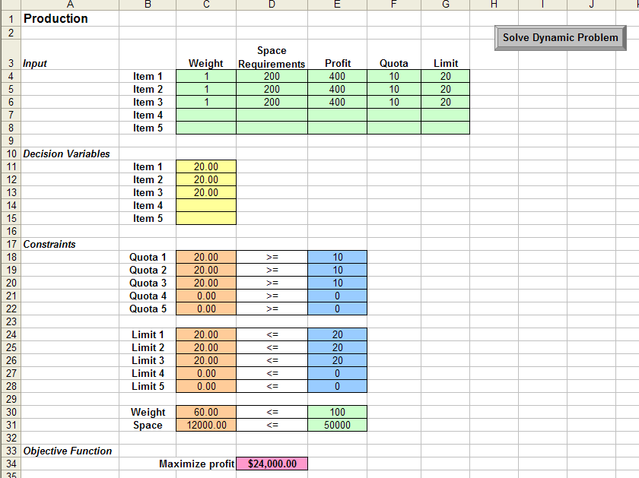
The Spreadsheet

Slide 61
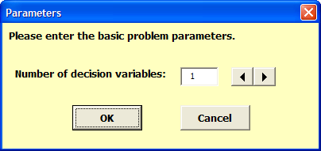
Parameters Form

Slide 62
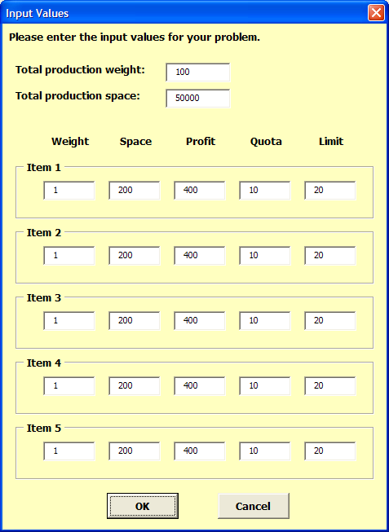
Input Form

Slide 63
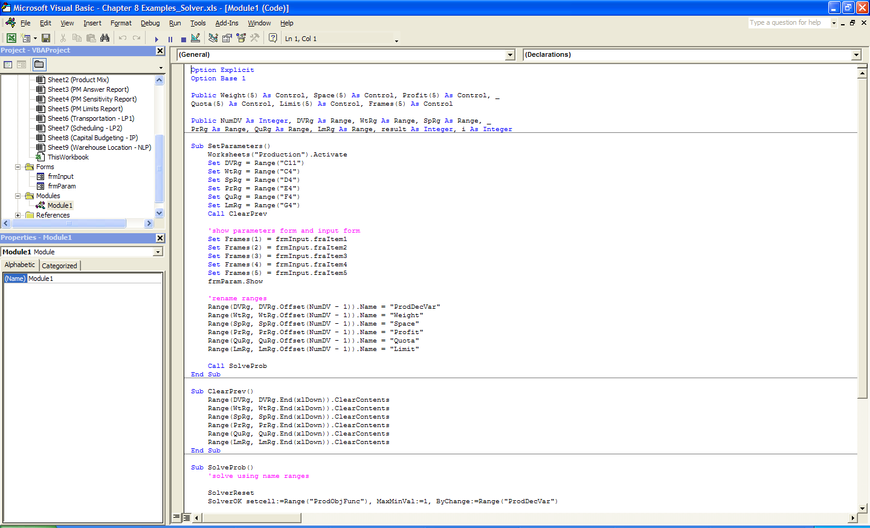
Initial Code
Variables
Clear Previous

Slide 64
Initial Code
Variables
  Public Weight(5) As Control, Space(5) As Control, Profit(5) As Control, _
  Quota(5) As Control, Limit(5) As Control, Frames(5) As Control

Slide 65
Initial Code (cont)
Set Parameters

Slide 66
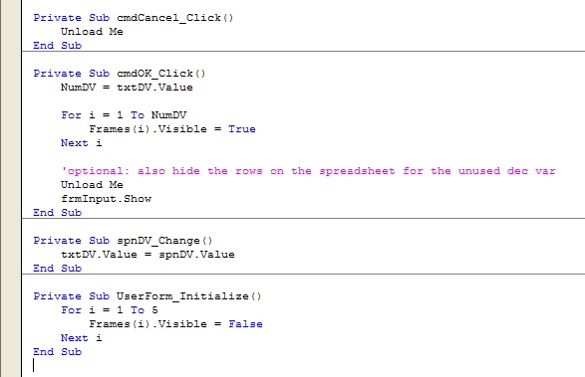
Parameters Form Code

Slide 67
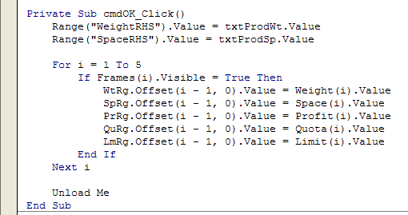
Input Form Code

Slide 68
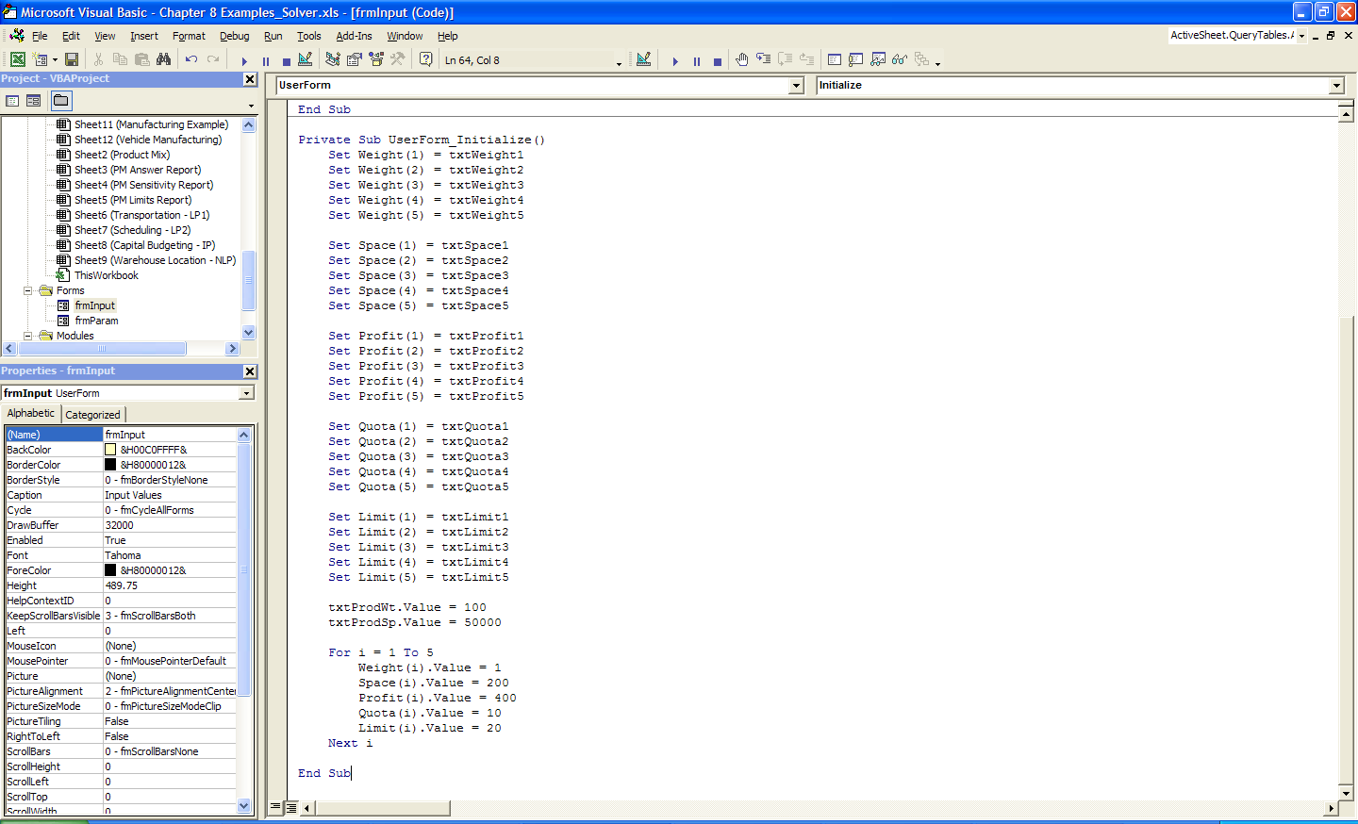
Input Form Code (cont)

Slide 69
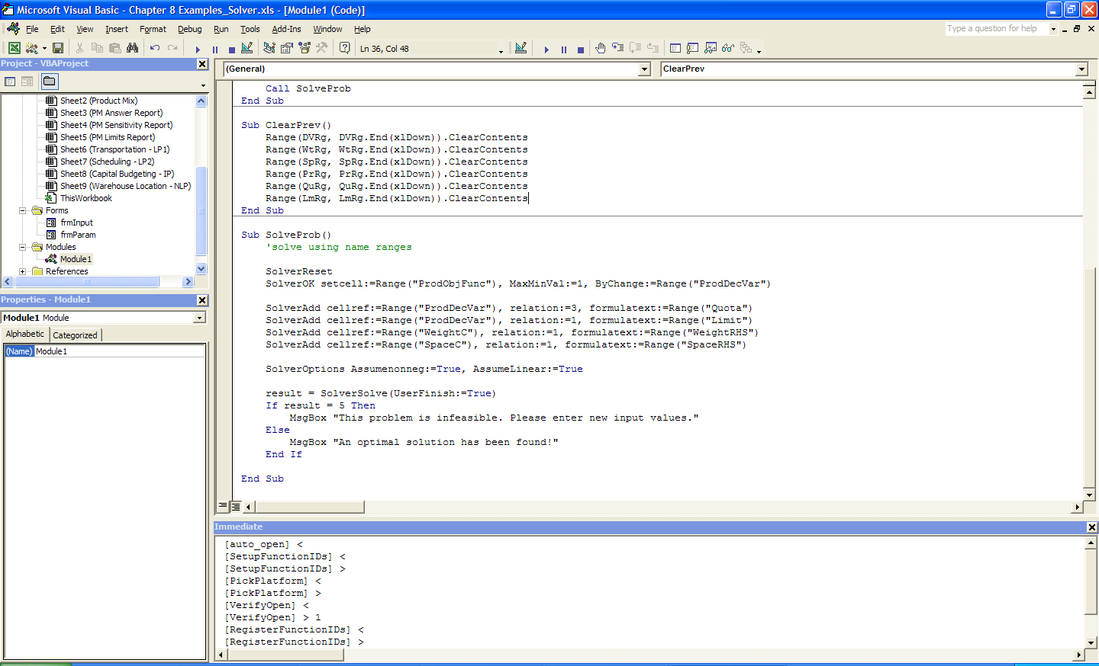
Solver Code

