Slide 1
Exxon Mobil
Student’s Name:
Professor’s Name:
Course:
Date:

Slide 2

What is Exxon Mobil?
Exxon Mobil is the largest and the oldest oil refinery company in the United States.
It trades in NYSE as XOM.
The company has been featured in a wide variety of corporate functions such as:
Environmental Conservation.
Philanthropic Efforts.
Innovation.
Notes:
Exxon Mobil is a descendant of the Standard Oil and it is a result of the 1999 merger between Exxon – the New Jersey’s Standard Oil Company – and Mobil – Standard Oil Company of New York.
The company has been at the forefront of corporate functions running parallel to today’s technological developments.
It’s headquarters are situated in Irvin, Texas.

Slide 3
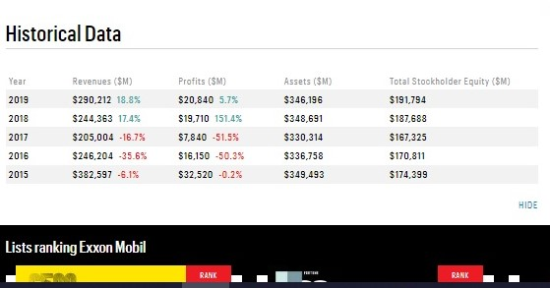
Exxon’s Stock Trends
With the outbreak of Corona Virus pandemic, Exxon, like any other corporation had lost market value.
However its stock has remained strong throughout the pandemic and election period.
The company still maintains a position 3 in the Fortune 500 list.
Notes:
Over the years, Exxon Mobil stocks have been the most sought after kind of investments as they have been regarded safe by many financial advisors.
And even with the 2020 economic downgrade, Exxon’s stocks prices did not fall below the expected minimum.

Slide 4

Exxon and environment
As an energy company, Exxon strives to be at the forefront of environmental conservation (Exxon Mobil, 2019)..
However, major environmental conservation campaigners believe that Exxon Mobil is among the companies that are to blame for global warming.
Though the company tries its best, it has a long way to get to a point where environment is ultimately safeguarded.
Notes:
Some of the major environmental conservation projects undertaken by Exxon Mobil include Protect Tomorrow that was introduced in 2010 (Exxon Mobil, 2019).
The company has also been investing billions of dollars in attempts to reduce gas emissions at their industries.
However, Exxon may not invest too much environmental conservation because its investors need to get returns on their investments.
Thus it might take a while before the company declares that it has established enough conservation measures.

Slide 5

Exxon’s Philanthropy
Through its Exxon Mobil Foundation, the company has funded multiple projects all over the world.
These projects are in multiple sectors including:
Fight against Malaria.
Women economic empowerment.
Education.
Notes:
In 2019, Exxon Mobil employees and retirees contributed a sum of 42 million dollars to the company’s Worldwide Giving project (Exxon Mobil, 2019).
The company ensures that philanthropic projects are well spread within the local countries where it does business.

Slide 6

Exxon Mobil’s Innovations
Some of the innovative measures taken by Exxon Mobil include:
Natural gas in power generation.
Manufacturing advanced fuels and lubricants.
Manufacturing chemical materials used in a variety of applications.
Carbon Capture and storage.
Advanced biofuels.
Notes:
Exxon Mobil leads in application of Liquid Natural Gas Technology which allows production, transportation and consumption in a safe and cost-effective manner (Exxon Mobil, 2019).
Exxon’s products such as Synergy and Mobil 1 are more advanced compared to other products in terms of gas mileage and fuel economy for the customers.
Various lightweight chemical products manufactured by Exxon Mobil are used by motor vehicle manufacturers to reduce vehicle weight and hence enhance fuel efficiency (Exxon Mobil, 2019)..
Exxon Mobil also uses carbon capture technology to ensure minimum carbon emissions from its factories.
Biofuels such as algae fuels can be used instead of petroleum and Exxon Mobil targets to produce approximately 10,000 barrels of algae biofuels by 2025 (Exxon Mobil, 2019).

Slide 7
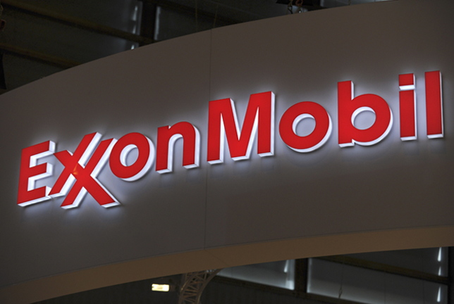
Exxon on the news
An article published by the renown gas and oil news company, Rigzone indicated Exxon’s announcement to cut jobs in the United States.
Another article featuring Exxon Mobil was published in September by the New York Times magazine illustrating the differences between US and European oil corporations in Climate Change matters (KRAUSS, 2020).
Most news on Exxon Mobil involve investments and stock prices.
Notes:
The Rigzone article which was published on 20th October, 2020 stated that Exxon Mobil’s move would affect approximately 1,900 employees (Exarheas, 2020). Additionally, the executive allegedly sent emails to employees warning that reduction may continue in future.

Slide 8
Conclusion
Exxon Mobil is undoubtedly among the largest corporations in the world especially in the field of oil refining.
It has portrayed pace-keeping in terms of technological advancements while striving to conserve the environment.
Although the Covid-19 pandemic brought challenges in the economy, Exxon Mobil tries to maintain its resilience.
However, with the latest news of job cuts, it is evident that even the large companies like Exxon were massively affected by the pandemic.

Slide 9
References
Exarheas, A., (October 30, 2020). ExxonMobil Announces US Job Cuts: RigZone Oil and Gas News.
KRAUSS, C., (September 21, 2020). U.S. and European Oil Giants Go Different Ways on Climate Change: The New York Times.
Exxon Mobil. (July 15, 2019). Innovating energy solutions: Research and development highlights.
Exxon Mobil. (August 23, 2019). Continually improving environmental performance while pursuing reliable and affordable energy

