Slide 1

Development Across the Life Span
Eighth Edition
Chapter 11
Physical and Cognitive Development in Adolescence
Copyright © 2017, 2014, 2011 Pearson Education, Inc. All Rights Reserved
Notes:
If this PowerPoint presentation contains mathematical equations, you may need to check that your computer has the following installed:
1) MathType Plugin
2) Math Player (free versions available)
3) NVDA Reader (free versions available)

Slide 2
Learning Objectives (1 of 3)
11.1 Describe the physical changes adolescents experience as the body reaches puberty.
11.2 Explain the nutritional needs and concerns of adolescents.
11.3 Summarize the ways in which the brain develops in adolescence.
11.4 Describe how cognitive development proceeds during adolescence according to Piaget.

Slide 3
Learning Objectives (2 of 3)
11.5 Summarize how information processing approaches explain adolescent cognitive development.
11.6 Describe how adolescent egocentrism affects thinking and behavior.
11.7 Analyze the factors that affect adolescent school performance.
11.8 Describe how adolescents use the Internet.

Slide 4
Learning Objectives (3 of 3)
11.9 Analyze what illegal drugs adolescents use and why.
11.10 Discuss how adolescents use and abuse alcohol.
11.11 Summarize how and why adolescents use tobacco.
11.12 Describe dangers adolescent sexual practices present and how these dangers can be avoided.

Slide 5
Physical Maturation
11.1 Describe the physical changes adolescents experience as the body reaches puberty.
11.2 Explain the nutritional needs and concerns of adolescents.
11.3 Summarize the ways in which the brain develops in adolescence.

Slide 6
Physical Manifestations of Puberty
Rapid growth
Development of primary and secondary sex characteristics
Changes in body composition
Changes in circulatory and respiratory systems
Notes:
Start of physical maturation:
Begins when the pituitary gland in the brain signals other glands in children's bodies to begin producing the sex hormones, androgens (male hormones) or estrogens (female hormones), at adult levels.
Males and females produce both types of sex hormones, but males have a higher concentration of androgens and females a higher concentration of estrogens.)
Pituitary gland also signals body to increase production of growth hormones that interact with the sex hormones to cause the growth spurt and puberty. In addition, the hormone leptin appears to play a role in the start of puberty.

Slide 7
Growth During Adolescence: The Rapid Pace of Physical and Sexual Maturation
Adolescent growth spurt
Weight increase
Skeletal changes
Asynchrony in growth
Notes:
Adolescence is the developmental stage that lies between childhood and adulthood. It is generally viewed as starting just before the teenage years and ending just after them. It is a transitional stage. Adolescents are considered no longer children, but not yet adults. It is a time of considerable physical and psychological growth and change.
One aspect of this transformation is the adolescent growth spurt, a period of very rapid growth in height and weight. On average, boys grow 4.1 inches a year and girls 3.5 inches a year. Some adolescents grow as much as 5 inches in a single year.
Boys’ and girls’ adolescent growth spurts begin at different times. As you can see in Figure 11-1, girls begin their spurts around age 10, while boys start at about age 12. During the 2-year period starting at age 11, girls tend to be taller than boys. But by the age of 13, boys, on average, are taller than girls—a state of affairs that persists for the remainder of the life span.
Wt and ht increase due to simultaneous release of growth hormone, thyroid hormones, and androgens; peak height velocity at adolescence and toddler years
In general two years earlier in girls; girls taller between 11 and 13
Changes in composition of skeletal structure; closing of long bones; ethnic differences
Height changes in torso rather than leg length
Accelerated growth spurt→extremities first (head, hands, feet) →arms and legs →torso and shoulder growth

Slide 8
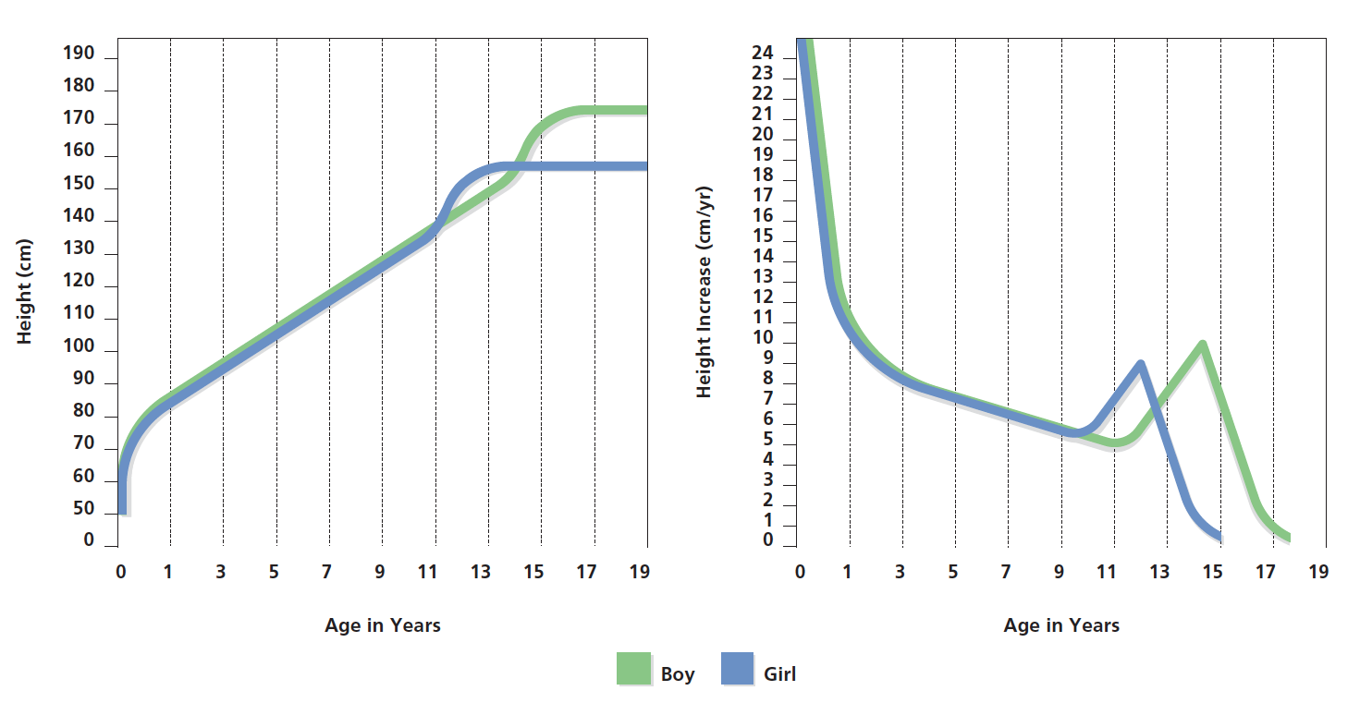
Figure 11-1 Growth Patterns
Patterns of growth are depicted in two ways. The first figure shows height at a given age, while the second shows the height increase that occurs from birth through the end of adolescence. Notice that girls begin their growth spurt around age 10, while boys begin the growth spurt at about age 12. However, by the age of 13, boys tend to be taller than girls. What are the social consequences for boys and girls of being taller or shorter than average? (Source: Adapted from Cratty, 1986.)
Notes:
Patterns of growth are depicted in two ways. The first figure shows height at a given age, while the second shows the height increase occurs from birth through the end of adolescence. Notice that girls begin their growth spurt around age 10, while boys begin the growth spurt at about age 12. However, by the age of 13, boys tend to be taller than girls. What are the social consequences for boys and girls of being taller or shorter than average? (Source: Adapted from Cratty, 1986.)

Slide 9
Secular Trends
Earlier start of puberty is an example of a significant secular trend
  Pattern of change occurring over several generations
  Trend occurs when a physical characteristic changes over the course of several generations
  Result of better nutrition over centuries

Slide 10
Puberty in Girls
Begins earlier for girls than for boys
Girls start puberty at around age 11 or 12, and boys begin at around age 13 or 14
Wide variations among individuals
Influences
Nutrition
Health
Environmental stress
Notes:
For example, some girls begin puberty as early as 7 or 8 or as late as 16 years of age.

Slide 11
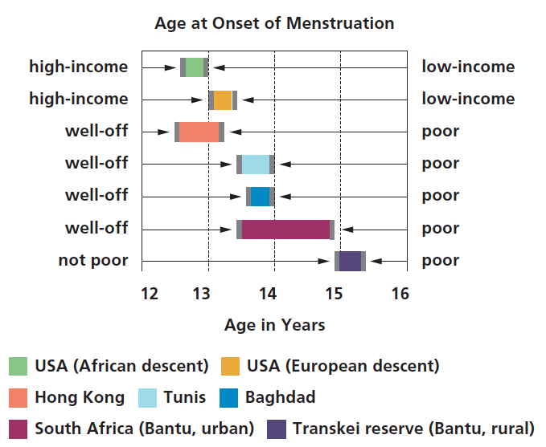
Figure 11-2 Onset of Menstruation
The onset of menstruation occurs earlier in more economically advantaged countries than in those that are poorer. But even in wealthier countries, girls living in more affluent circumstances begin to menstruate earlier than those living in less affluent situations. Why is this the case?
(Source: Adapted from Eveleth & Tanner, 1976.)
Notes:
Figure 11-2 Onset of Menstruation
The onset of menstruation occurs earlier in more economically
advantaged countries than in those that are poorer. But even in wealthier countries, girls living in more affluent circumstances begin to menstruate earlier than those living in less affluent situations. Why is this the case? (Source: Adapted from Eveleth & Tanner, 1976.)
Menarche, the onset of menstruation and probably the most obvious signal of puberty in girls.
Consequently, it appears that girls who are better nourished and healthier are more apt to start menstruation at an earlier age than those who suffer from malnutrition or chronic disease. In fact, some studies have suggested that weight or the proportion of fat to muscle in the body play a critical role in the timing of menarche.
Environmental stress due to such factors as parental divorce or high levels of family conflict can bring about an early onset.

Slide 12
Puberty in Boys
Penis and scrotum begin to grow at an accelerated rate around the age of 12 and reach adult size 3 or 4 years later
Enlargement of prostate gland and seminal vesicles
Spermarche around age 13
Notes:
A boy's first ejaculation, known as spermarche usually occurs around the age of 13, more than a year after the body has begun producing sperm. At first, the semen contains relatively few sperm, but the amount of sperm increases significantly with age.

Slide 13
Primary Sex Characteristics
Further development of sex glands
Testes in males
Ovaries in females

Slide 14
Secondary Sex Characteristics
Changes in genitals and breasts
Growth of hair:
  Pubic
  Facial
  Body
Further development of sex organs
Notes:
In girls, the development of primary sex characteristics involves changes in the vagina and uterus.
Secondary sex characteristics include the development of breasts and pubic hair.
Breasts begin to grow at around the age of 10, and pubic hair beings to appear at about age 11. Underarm hair appears about 2 years later.
For some girls, indications of puberty start unusually early. One out of 7 Caucasian girls develops breasts or pubic hair by age 8. Even more surprisingly, the figure is 1 out of 2 for African American girls.

Slide 15
Reactions to Physical Changes in Adolescence
Some of the changes of adolescence are not evident in physical changes, but carry psychological weight
Menstruation and ejaculations occur privately, but changes in body shape and size are public
Teenagers entering puberty are frequently embarrassed by the changes
Girls are frequently unhappy about their changing bodies

Slide 16
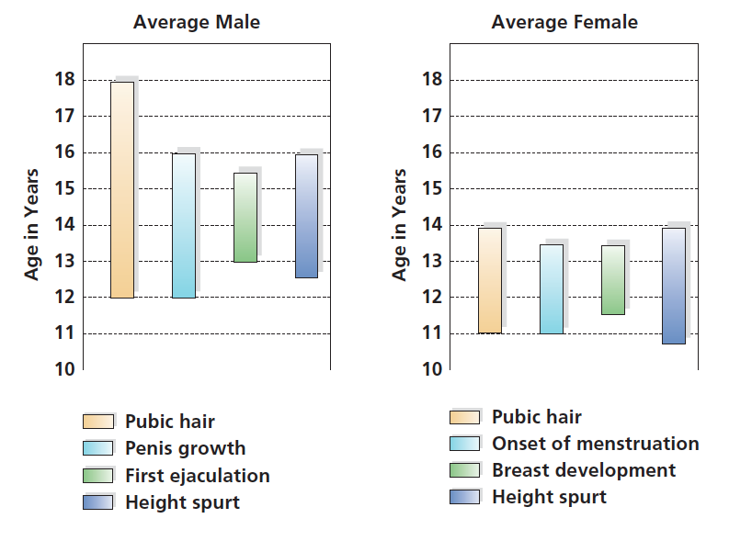
Figure 11-3 Sexual Maturation
The changes in sexual maturation that occur for males and females
during early adolescence.
(Source: Based on Tanner, 1978.)
Notes:
The changes in sexual maturation that occur for males and females during early adolescence.
(Source: Based on Tanner, 1978.)

Slide 17
The Consequences of Early Maturation (1 of 2)
Early maturation: Boys
  Early-maturing boys tend to be more successful at athletics, presumably because of their larger size
  They also tend to be more popular and have a more positive self-concept
  They have difficulties in school, and are more likely to become involved in delinquency and substance abuse
  Conspicuousness of their deviance from their later-maturing classmates may have a negative effect, producing anxiety, unhappiness, and depression

Slide 18
The Consequences of Early Maturation (2 of 2)
Early maturation: Girls
  Obvious changes in their bodies - such as the development of breasts - may lead them to feel uncomfortable and different from their peers
  May have to endure ridicule from their less mature classmates
  Tend to be sought after more as potential dates, and their popularity may enhance their self-concepts

Slide 19
The Consequences of Late Maturation (1 of 2)
Late Maturation: Boys
  Boys who are smaller and lighter than their more physically mature peers tend to be viewed as less attractive
  Disadvantaged when it comes to sports activities and social activities
  Decline in self-concept
  They have positive qualities, such as insightfulness and assertiveness
  They are more creatively playful than early maturers

Slide 20
The Consequences of Late Maturation (2 of 2)
Late Maturation: Girls
  May be overlooked in dating and other mixed-sex activities during middle school, and they may have relatively low social status
  Satisfaction with themselves and their bodies may be greater than that of early maturers
  Fewer emotional problems

Slide 21
Fueling the Growth of Adolescence
For most adolescents, the major nutritional issue is ensuring the consumption of a sufficient balance of appropriate foods
Rapid physical growth of adolescence is fueled by an increase in food consumption
Particularly during the growth spurt, adolescents eat substantial quantities of food, increasing their intake of calories dramatically
  During the teenage years, the average girl requires 2,200 calories a day
  The average boy requires 2,800
Several key nutrients are essential; in particular, calcium and iron

Slide 22
Nutritional Problems in Adolescence
Poor eating habits
High consumption of junk food/sugar/fats
Large portion sizes
Lack of variety
Related health concerns
Obesity
Osteoporosis
Diabetes
Heart disease
Notes:
Nutritional Problems in Adolescents
The incidence of obesity among six- to eleven-year-olds in the US has more than doubled in the past 20 years (USDHHS, 2004). As reported by the Office of the Surgeon General (USDHHS, 2001), most young people are not following recommendations set forth in the Dietary Guidelines for Americans. For example, 67% of youths aged 6-19 exceed dietary guidelines for fat intake and 72% exceed recommendations for saturated fat intake.
Most nutritional problems in adolescents are related to the consumption of too much “junk food,” or food with limited or no nutritional value. Most junk food is characterized by high levels of fats, particularly saturated fats, and refined sugar. The portion sizes of junk food also typically are very large. In addition, most adolescents eat very few fruits and vegetables per day or chose items, such as iceberg lettuce, with low nutritional values.
The eating habits of today's adolescents will lead to future health care problems. Obesity is related to a number of health problems, including Type 2 Diabetes, heart disease, stroke and cancer (NHLBI, 2004). Osteoporosis also is a growing problem, even among adolescents. Poor nutrition and insufficient exercise both contribute to low bone density among teenagers.
References:
[NHLBI] National Heart Lung and Blood Institute, National Institutes of Health. (2004). Aim for a Health Weight (website). Retrieved 6-16-2004 from http://www.nhlbi.nih.gov/health/public/heart/obesity/lose_wt/index.htm
[USDHHS] US Department of Health and Human Services, Centers for Disease Control, National Center for Chronic Disease Prevention and Health Promotion. (2004).
Resource Guide for Nutrition and Physical Activity Interventions to Prevent Obesity and Other Chronic Diseases. Retrieved 6-16-2004 from http://www.cdc.gov/nccdphp/dnpa/obesityprevention.htm
[USDHHS] US Department of Health and Human Services. (2001). The Surgeon General's call to action to prevent and decrease overweight and obesity. Rockville, MD: U.S. Department of Health and Human Services, Public Health Service, Office of the Surgeon General.

Slide 23
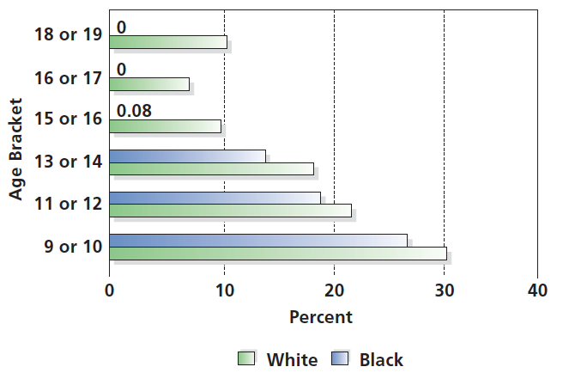
Figure 11-4 No Sweat
Physical activity among both white and black adolescent females declines substantially over the course of adolescence. What might be the reasons for this decline?
(Source: Based on Kimm et al., 2002.)
Notes:
Figure 11-4 No Sweat
Physical activity among both white and black adolescent females declines substantially over the course of adolescence. What might be the reasons for this decline? Source: Based on Kimm et al., 2002.)

Slide 24
Anorexia Nervosa and Bulimia
Anorexia: starvation to maintain low weight
Bulimia: binge and purge eating
  Higher incidence among females
Disorder in eating and body dissatisfaction reported across socioeconomic lines

Slide 25
Brain Development and Thought: Paving the Way for Cognitive Growth
Brain produces an oversupply of gray matter during adolescence which is later pruned at a rate of 1 to 2 percent per year
Myelination increases and continues to make transmission of neural messages more efficient
Notes:
Brain changes:
Size
Maturity
Growth spurts
Different part of brain
Different times
No clear 1:1 correspondence
With specific changes in brain size
With structures and intellectual changes in adolescence
As the number of neurons (the cells of the nervous system) continue to grow, and their interconnections become richer and more complex, adolescent thinking also becomes more sophisticated.

Slide 26
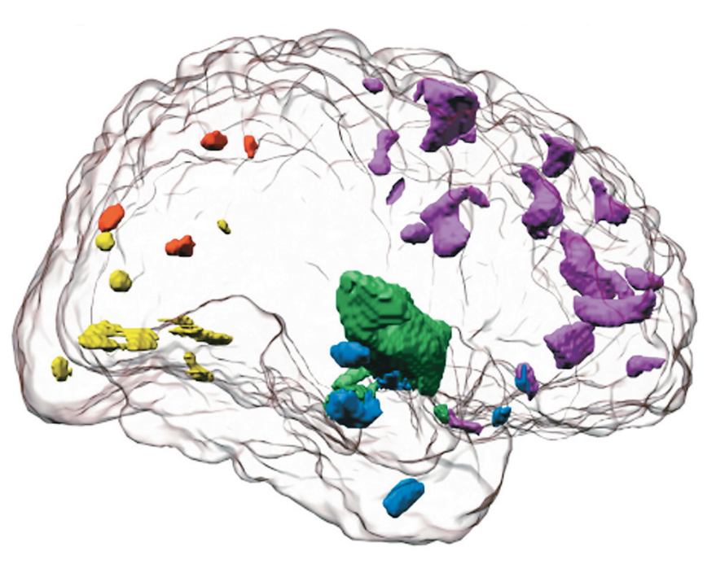
Figure 11-5 Pruning Gray Matter
This three-dimensional view of the brain shows areas of gray matter that are pruned from the brain between adolescence and adulthood. (Source: Sowell et al., 1999.)
Notes:
Rather than simply reacting to emotions such as anger or rage, an individual with a fully developed prefrontal cortex is able to inhibit the desire for action that stems from such emotions.

Slide 27
Sleep Deprivation
Adolescents go to bed later and get up earlier
Sleep deprivation results in:
  Lower grades
  Depression
  Greater difficulty controlling their moods
  Greater risk of auto accidents
Notes:
Older adolescents in particular experience the need to go to bed later and to sleep later in the morning, and they require nine hours of sleep each night to feel rested.
Because they typically have early morning classes but don’t feel sleepy until late at night, they end up getting far less sleep than their bodies crave.

Slide 28
Cognitive Development and Schooling
11.4 Describe how cognitive development proceeds during adolescence according to Piaget.
11.5 Summarize how information processing approaches explain adolescent cognitive development.
11.6 Describe how adolescent egocentrism affects thinking and behavior.
11.7 Analyze the factors that affect adolescent school performance.
11.8 Describe how adolescents use the Internet.

Slide 29
Piagetian Perspective on Cognitive Development
Fixed sequence of qualitatively different stages
Fundamentally different than cognitive strategies used as a child
Utilized in a variety of settings and situations
Notes:
Incorporates new, more advanced, and more adaptive form of reasoning
Occurs when biological readiness and increasingly complex environmental demands create cognitive disequilibrium

Slide 30
Stage of Formal Operations
11+ years
Development of abstract and hypothetical reasoning
Development of propositional logic
Cultural differences in enactment

Slide 31
Progression of Formal Operations
Emergent
Early adolescence
Variable usage depends on conditions surrounding assessment
Established
Late adolescence
Consolidated and integrated into general approach to reasoning

Slide 32
The Consequences of Adolescents’ Use of Formal Operations
Ability to reason abstractly, embodied in the use of formal operations, leads to a change in everyday behavior
Questioning parents and authority figures
Exhibiting greater idealism and impatience with imperfections
Experiencing indecision

Slide 33
Assessing Piaget’s Approach (1 of 2)
Pros
Catalyst for much research
Accounts for many changes observed during adolescence
Helps explain
  Developmental differences
  Metacognition

Slide 34
Assessing Piaget’s Approach (2 of 2)
Cons
Fails to provide adequate support for
  Stage-like fashion of cognition
  Formal operations as solely an adolescent cognitive stage
Fails to account for variability
  Between children
  Within a child
  Within specific situations

Slide 35
Information Processing Perspectives: Gradual Transformations in Abilities
Changes in adolescents’ cognitive abilities are evidence of gradual transformations in the capacity to take in, use, and store information
Number of progressive changes occur in the ways people organize their thinking about the world, develop strategies for dealing with new situations, sort facts, and achieve advances in memory capacity and perceptual abilities
Incorporates same techniques to understanding human reasoning that computer scientists employ in writing programs

Slide 36
Changes in Information Processing
Gains during adolescence help to explain developmental differences in abstract, multidimensional, and hypothetical thinking
Store of knowledge increases as the amount of material to which they are exposed grows and their memory capacity enlarges

Slide 37
Egocentrism in Adolescent Thinking
New abilities make adolescents particularly introspective and self-conscious
These hallmarks of the period may produce a high degree of egocentrism
Adolescent egocentrism is a state of self-absorption in which the world is viewed as focused on oneself
  Imaginary audience
  Personal fables
Notes:
Imaginary audience
Belief that one is center of everyone else's concern and attention
Personal fables
Egocentric belief that one's experiences are unique
Assessment methodology
May be right about existence of adolescent egocentrism but wrong about underlying processes

Slide 38
Thinking about Thinking
Metacognition improves during adolescence
Thinking about one's own thoughts, leading to self-consciousness
Monitoring one’s own learning processes more efficiently
Pacing one’s own studying

Slide 39
School Performance
Do higher grades mean smarter students?
Independent measures of achievement, such as S A T scores, have not risen
Consequently, a more likely explanation for higher grades is the phenomenon of grade inflation
According to this view, it is not that students have changed, but grades have been inflated
This is supported by comparison of U.S. students to those in other countries

Slide 40

Figure 11-6 U.S. Math Performance Compared with Other Countries
When compared to the math performance of students across the world, U.S. students perform at below-average levels.
(Source: Based on O E C D, 2014.)
Notes:
Ask: Why do you think US students performance is lower than that of students in other parts of the world?
Less time spent in classes and less intensive instruction
The broad diversity of the U.S. school population
Differences in socioeconomic status

Slide 41
Socioeconomic Status and School Performance
Individual Differences in Achievement
Children living in poverty lack many advantages
Later school success builds heavily on basic skills presumably learned or not learned early in school
Notes:
There are several reasons. For one thing, children living in poverty lack many of the advantages enjoyed by other children. Their nutrition and health may be less adequate. Often living in crowded conditions and attending inadequate schools, they may have few places to do homework. Their homes may lack the books and computers commonplace in more economically advantaged households.

Slide 42
Ethnic and Racial Differences in School Achievement
Significant differences in achievement between ethnic and racial groups
On average, African American and Hispanic students tend to perform at lower levels, receive lower grades, and score lower on standardized tests of achievement than white students
Asian American students tend to receive higher grades than white students

Slide 43
Achievement Testing in High School:
Will No Child Be Left Behind? (1 of 2)
No Child Left Behind Act
Passed by Congress in 2002, requires that every U.S. state design and administer achievement tests that students must pass in order to graduate from high school
Schools are graded so that the public is aware of which schools have the best (and worst) test results

Slide 44
Achievement Testing in High School:
Will No Child Be Left Behind? (2 of 2)
Unintended consequences
Teaching to the test
Approaches to teaching designed to foster creativity and critical thinking discouraged
Anxiety level raised in students

Slide 45
Dropping Out of School
Adolescents leave school for a variety of reasons
Males are more likely to drop out of school than females
Hispanics and African American students are more likely to leave high school before graduating than non-Hispanic white students.
Not all minority groups show higher dropout rates: Asians, for instance, drop out at a lower rate than whites
Poverty plays larger role in higher dropout rate

Slide 46
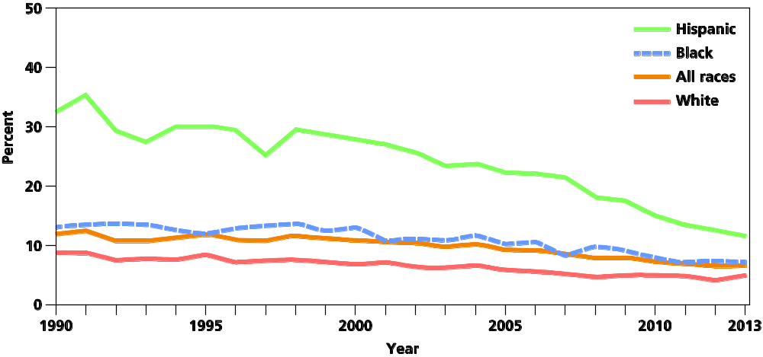
Figure 11-7 Dropout Rates of 16- through 24-Year-Olds by Race/Ethnicity: 1990-2013
Dropout rates have generally declined in the past 25 years, particularly for Hispanics.
(Source: U.S. Department of Education, 2015.)

Slide 47
Adolescent Media Usage
Kaiser Family Foundation survey
Young people spend an average of 6.5 hours a day with media
Around a quarter of the time they are using more than one form of medium simultaneously, they are actually being exposed to the equivalent of 8.5 hours per day
Some teenagers send nearly 30,000 texts a month

Slide 48
The Downside of Living Online
Objectionable material available
Growing problem of Internet gambling
Safety
Digital divide
Notes:
Poorer adolescents and members of minority groups have less access to computers than more affluent adolescents and members of socially-advantaged groups—a phenomenon known as the digital divide.

Slide 49
Threats to Adolescents’ Well-Being
11.9 Analyze what illegal drugs adolescents use and why.
11.10 Discuss how adolescents use and abuse alcohol.
11.11 Summarize how and why adolescents use tobacco.
11.12 Describe dangers adolescent sexual practices present and how these dangers can be avoided.

Slide 50
Adolescent Drug Use
One in 15 high school seniors smokes marijuana on a daily or near-daily basis
Marijuana usage has remained at fairly high levels over the last decade
Attitudes about marijuana use have become more favorable

Slide 51
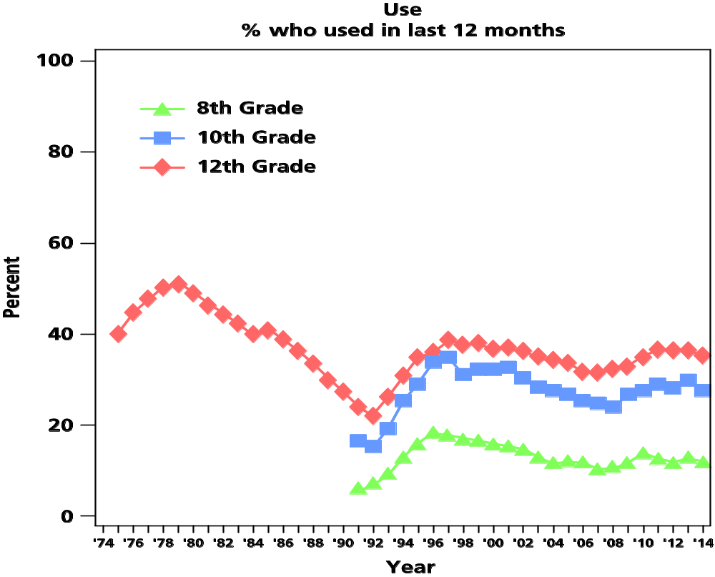
Figure 11-9 Marijuana Use Remains Steady
According to an annual survey, the proportion of students reporting marijuana use over the past 12 months has remained steady at fairly high levels.
(Source: http://www.monitoringthefuture.org/pubs/monographs/mtf-overview2014.pdf p.13.)

Slide 52
Why Do Adolescents Use Drugs?
Pleasurable experience
Escape
Peer pressure
Enhanced academic performance

Slide 53
Facets of Addiction
Psychological addiction
  Depend on drugs to cope with everyday stress of life; prevent adolescents from confronting - and potentially solving - problems that led them to drug use in the first place
  Biological addiction
  Presence in body becomes so common that body is unable to function in their absence; causes physical - and potentially lingering - changes in nervous system; drug intake no longer may provide a “high,” but may be necessary simply to maintain the perception of everyday normalcy

Slide 54
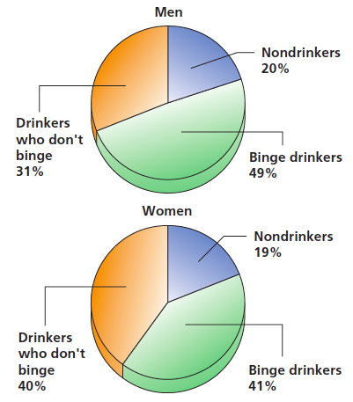
Figure 11-10 Binge Drinking among
College Students
For men, binge drinking is defined as consuming five or more drinks in one sitting; for women, the total is four or more. Why is binge drinking popular?
(Source: Wechsler et al., 2003.)

Slide 55
Why do Adolescents Start to Drink?
Genetics
Way of proving themselves to others
Release of inhibitions and tension and reduction
of stress
False consensus effect

Slide 56
From Activity to Addiction
Adolescent alcoholics
Alcohol use becomes uncontrollable habit
Increasing ability to tolerate alcohol
Increasing need to drink ever-larger amounts of liquor to bring about positive effects craved
Notes:
Alcoholics, those with alcohol problems, learn to depend on alcohol and are unable to control their drinking.
Reasons for addiction not understood.
Genetics
Stress
Environment

Slide 57
Why do Adolescents Begin to Smoke and Maintain the Habit?
Advertisements in the media
Addiction
Parent and peer models
Adolescent rite of passage

Slide 58
Sexually Transmitted Infections
AIDS
A leading cause of death among young people worldwide
Over 25 million people have died from AIDS worldwide, and people living with the disease number around 34 million worldwide
Notes:
African Americans and Hispanics account for 70 percent of new AIDS cases,
African American males have almost 8 times the prevalence of AIDS as white males

Slide 59
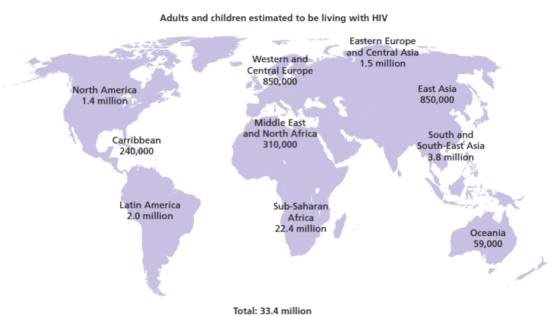
Figure 11-11 AIDS around the World
The number of people carrying the AIDS virus varies substantially by geographic region. By far the most cases are found in Africa and the Middle East, although the disease is a growing problem in Asia. (Source: U N A I D S & World Health Organization, 2009.)

Slide 60
Other Sexually Transmitted Infections
Human papilloma virus (H P V)
Trichomoniasis
Genital herpes
Gonorrhea and Syphilis
Notes:
The most common STI is human papilloma virus (HPV). HPV can be transmitted through genital contact without intercourse. Most infections do not have symptoms, but HPV can produce genital warts and in some cases lead to cervical cancer. A vaccine that protects against some kinds of HPV is now available. The U.S. Centers for Disease Control and Prevention recommends it be routinely administered to girls 11 to 12 years of age—a recommendation that has provoked considerable political reaction (Friedman et al., 2006; Kahn, 2007).
Another common STI is trichomoniasis, an infection in the vagina or penis, which is caused by a parasite. Initially without symptoms, it can eventually cause a painful discharge. Chlamydia, a bacterial infection, initially has few symptoms, but later it causes burning urination and a discharge from the penis or vagina. It can lead to pelvic inflammation and even to sterility. Chlamydial infections can be treated successfully with antibiotics (Nockels & Oakshott, 1999; Favers et al., 2003).
Genital herpes is a virus not unlike the cold sores that sometimes appear around the mouth. The first symptoms of herpes are often small blisters or sores around the genitals, which may break open and become quite painful. Although the sores may heal after a few weeks, the infection often recurs after an interval, and the cycle repeats itself. When the sores reappear, the infection, for which there is no cure, is contagious.
Gonorrhea and syphilis are the STIs that have been recognized for the longest time; cases were recorded by ancient historians. Until the advent of antibiotics, both infections were deadly. However, today both can be treated quite effectively.

Slide 61
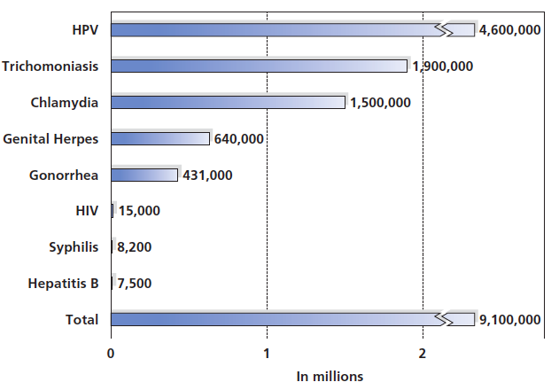
Figure 11-12 Sexually Transmitted Infections (S T I s) among Adolescents
Why are adolescents in particular in danger of contracting an S T I?
(Sources: Alan Guttmacher Institute, 2004; Weinstock, Berman, & Cates, 2006.)

Slide 62
Practicing Safer Sex (1 of 2)
The only foolproof method of avoiding a sexually transmitted infection (S T I) is abstinence.
However, by following the “safer sex” practices listed here, one can significantly reduce the risk of contracting an S T I:
Know your sexual partner- well. Before having sex with someone, learn about his or her sexual history.
Use condoms. For those in sexual relationships, condoms are the most reliable means of preventing transmission of S T I s.

Slide 63
Practicing Safer Sex (2 of 2)
Avoid the exchange of bodily fluids, particularly semen. In particular, avoid anal intercourse. The AIDS virus in particular can spread through small tears in the rectum, making anal intercourse without condoms particularly dangerous. Oral sex, once thought relatively safe, is now viewed as potentially dangerous for contracting the AIDS virus.
Stay sober. Using alcohol and drugs impairs judgment and can lead to poor decisions- and it makes using a condom correctly more difficult.
Consider the benefits of monogamy. People in long-term, monogamous relationships with partners who have been faithful are at a lower risk of contracting S T I s.

Slide 64

Copyright

