Slide 1
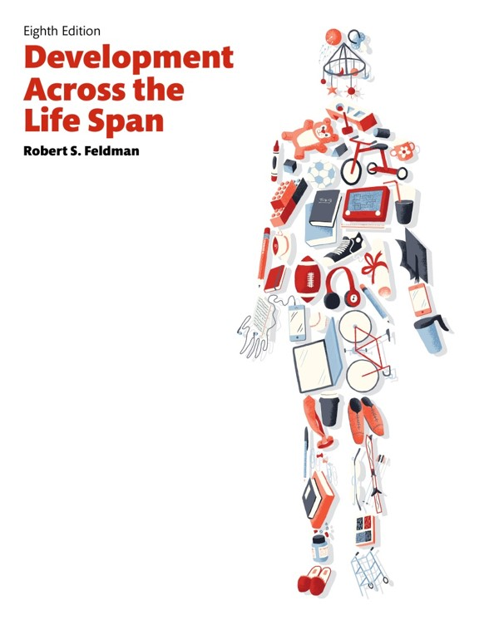
Development Across the Life Span
Eighth Edition
Chapter 12
Social and Personality Development in Adolescence
Copyright © 2017, 2014, 2011 Pearson Education, Inc. All Rights Reserved
Notes:
If this PowerPoint presentation contains mathematical equations, you may need to check that your computer has the following installed:
1) MathType Plugin
2) Math Player (free versions available)
3) NVDA Reader (free versions available)

Slide 2
Learning Objectives (1 of 3)
12.1 Describe how self-concept and self-esteem develop during adolescence.
12.2 Summarize how Erikson explains identity formation during adolescence.
12.3 Explain Marcia’s categories of adolescent identity.
12.4 Describe the role religion and spirituality play in identity formation in adolescence.

Slide 3
Learning Objectives (2 of 3)
12.5 Discuss the challenges ethnic and minority groups face in identity formation in adolescence.
12.6 Identify the dangers adolescents face as they deal with the stresses of their age.
12.7 Describe what family relationships are like during adolescence.
12.8 Explain how relationships with peers change during adolescence.

Slide 4
Learning Objectives (3 of 3)
12.9 Discuss what it means to be popular and unpopular in adolescence and how adolescents respond to peer pressure.
12.10 Describe the functions and characteristics of dating during adolescence and how sexuality develops.
12.11 Explain how sexual orientation develops in adolescence.
12.12 Summarize the challenges of teen pregnancy and the types of programs that are most effective in preventing it.

Slide 5
Identity: Asking “Who Am I?”
12.1 Describe how self-concept and self-esteem develop during adolescence.
12.2 Summarize how Erikson explains identity formation during adolescence.
12.3 Explain Marcia’s categories of adolescent identity.
12.4 Describe the role religion and spirituality play in identity formation in adolescence.
12.5 Discuss the challenges ethnic and minority groups face in identity formation in adolescence.
12.6 Identify the dangers adolescents face as they deal with the stresses of their age.

Slide 6
Identity: Who Am I?
Self-Concept
One’s own assessment of who they are
View self in terms of traits and multiple aspects
Notes:
Self concept broadens during adolescence to include both one's own assessment of who they are and also includes others' views.
The view of self becomes more organized and coherent.
Adolescents can look at themselves in terms of traits and can see multiple aspects of themselves (which can be confusing at first).

Slide 7
Self-Esteem
Knowing who you are and liking who you are two different things
Although adolescents are increasingly accurate in understanding who they are, this knowledge does not guarantee that they like themselves
Increasingly accurate in understanding self
Influenced by gender and socioeconomic status
Notes:
During adolescence, teens become increasingly accurate in understanding who they are (they develop their self concept).
Gender - especially in early adolescence, girls have lower self-esteem.
SES - higher SES leads to more self-esteem (especially in late adolescence when one can buy things of value).
The increase in self-concept does not mean that they like themselves any better (self esteem may still be low).
The same cognitive sophistication that allows adolescents to differentiate various aspects of the self also leads them to evaluate those aspects in different ways (Chan, 1997; Cohen, J., 1999). For instance, an adolescent may have high self-esteem in terms of academic performance, but lower self-esteem in terms of relationships with others. Or it may be just the opposite.

Slide 8
Identity Formation: Change or Crisis?
Identity-Versus-Identity-Confusion Stage
Identity: appropriate identity that sets foundation for future psychosocial development
Confusion: sense of self is “diffuse” with adoption of socially unacceptable roles
Notes:
Erik Erikson asserted that adolescents may encounter substantial psychological difficulties in their search for identity (“the adolescent identity crisis”).
Erikson's stage is IDENTITY-VERSUS-IDENTITY-CONFUSION STAGE, where adolescents seek to determine what is unique and distinctive about themselves.
Those who do not find a suitable identity, tend to follow a dysfunctional path because their sense of self is "diffuse".
There are a lot of social pressures to achieve a secure identity (or at least have clear career or major goals).
Which job track to follow?
Attend college? Which one?
Now, adolescents rely more on friends and peers than adults.

Slide 9
Erikson’s Stages (1 of 2)
Stage | Approximate Age | Positive Outcomes | Negative Outcomes
1. Trust-versus-mistrust | Birth to 1.5 years | Feelings of trust from others’ support | Fear and concern regarding others
2. Autonomy-versus-shame-and-doubt | 1.5 to 3 years | Self-sufficiency if exploration is encouraged | Doubts about self; lack of Independence
3. Initiative-versus-guilt | 3 to 6 years | Discovery of ways to initiate actions | Guilt from actions and thoughts
4. Industry-versus-inferiority | 6 to 12 years | Development of sense of competence | Feelings of inferiority; little sense of mastery
5. Identity-versus-identity-confusion | Adolescence | Awareness of uniqueness of self; knowledge of roles | Inability to identify appropriate roles in life

Slide 10
Erikson’s Stages (2 of 2)
Stage | Approximate Age | Positive Outcomes | Negative Outcomes
6.Intimacy-versus-isolation | Early adulthood | Development of loving, sexual relationships and close friendships | Fear of relationships with others
7.Generativity-versus-stagnation | Middle adulthood | Sense of contribution to continuity of life | Trivialization of one’s activities
8.Ego-integrity-versus-despair | Late adulthood | Sense of unity in life’s accomplishments | Regret over lost opportunities of life

Slide 11
Societal Pressures and Reliance on Friends and Peers
Societal pressure is high during identity-versus-identity-confusion stage
Difficult choices about future plans
Gender similarities as girls and boys progress through this stage

Slide 12
Psychological Moratorium
Experimentation period
  A time for exploring options
  A time for suspending upcoming responsibilities of adulthood
  Some adolescents may not have this luxury
Notes:
Erikson suggests that adolescents pursue a psychological moratorium to let go of responsibilities for awhile and explore new roles and possibilities.
For many, this experimentation period is an economic impossibility.
Probably no lasting, negative psychological affects.
Some benefits (satisfaction from working, independence, etc.).

Slide 13
Limitation of Erikson’s Theory
Male identity development used as a standard against which to compare female identity
Notes:
Erikson saw males as developing intimacy only after they have achieved a stable identity, which is viewed as the normative pattern. To critics, Erikson's view is based on male-oriented concepts of individuality and competitiveness.
Carol Gilligan has suggested that women develop identity through the establishment of relationships. In this view, a key component of a woman's identity is the building of caring networks between herself and others.

Slide 14
Marcia’s Approach to Identity Development
Commitment Present | Commitment Absent
Crisis/Exploration Identity achievement “I enjoyed working at an advertising company the last two summers, so I plan to go into advertising.” | Crisis/Exploration Moratorium “I’m taking a job at my mom’s bookstore until I figure out what I really want to do.”
Identity foreclosure “My dad says I’m good with kids and would be a good teacher, so I guess that’s what I’ll do.” | Identity diffusion “Frankly, I have no idea what I’m going to do.”
Notes:
James Marcia suggests four categories within which either:
A crisis (a period of identity development in which an adolescent consciously chooses between various alternatives and makes decisions) or
A commitment (a psychological investment in a course of action or an ideology), takes place.
1) IDENTITY ACHIEVEMENT - where adolescents consider and explore various alternatives without commitment.
2) IDENTITY FORECLOSURE - adolescents here did not do adequate personal exploration but made a commitment (usually following others' directives).
3) IDENTITY DIFFUSION - adolescents explore various options but never commit to one.
4) MORATORIUM - adolescents explore and do not commit to an option and that creates anxiety and conflict. An identity is usually defined later, after a struggle.

Slide 15
Religion and Spirituality (1 of 2)
Questions of religion and spirituality begin to be asked during adolescence
Increasing cognitive abilities facilitate more abstract thinking about religious matters
Adolescents begin to develop core set of beliefs and values

Slide 16
Religion and Spirituality (2 of 2)
Stages of understanding and practice of faith and spirituality
Childhood: Fairly literal view of God and biblical figures
Adolescence: Individuative-reflective stage of faith with possible multiple views of God
Adulthood: Conjunctive stage which includes broad, inclusive view of religion and humanity

Slide 17
Identity, Race, and Ethnicity
Cultural assimilation model
Pluralistic society model
Bicultural identity
Notes:
Forming an identity presents a particular challenge for members of ethnic and racial backgrounds because of contradictory societal values.
Society should be color blind, race and ethnic background should not affect opportunity or achievement.
Cultural assimilation model holds that individual cultural identities should be assimilated into a unified culture (“melting pot model”).
Racial and ethnic factors should be a central part of teenagers’ identities.
Pluralistic society model suggests that the U.S. society is made up of diverse, coequal cultural groups that should preserve their individual cultural features (“tossed salad model”).
Research suggests that the cultural assimilation model denigrates the cultural heritage of minorities and lowers self esteem.
Bicultural identity suggests that adolescents can draw from their own culture and integrate themselves into the dominant culture (“the middle ground model”).
Suggests that the teen live as a member of two cultures, and have two cultural identities without having to choose one.

Slide 18
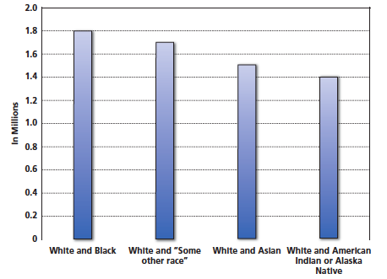
Figure 12-1 Bicultural Identity in the United States
The number of Americans who identified themselves as belonging to more than
one race grew substantially between 2000 and 2010. Almost 10 percent report
belonging to three or more races. (Source: U.S. Bureau of the Census, 2011.)

Slide 19
Psychological Difficulties in Adolescence (1 of 2)
Depression
Higher incidence among girls than boys
Stress more pronounced for girls due to many, sometimes conflicting demands of traditional female gender role
Notes:
More than one-quarter of adolescents report periods of feeling sad and hopeless for two or more weeks in a row.
But only a small number (3 percent) experience a major depression, a full-blown psychological disorder in which depression is severe and lingers for long periods.
Depression has several causes, including biological, environmental, and social factors.
Genetic predisposition
Death of loved one
Depressed parent
Unpopular
Few close friends
Experiencing rejection
Girls have higher incidences of depression than boys but the cause is not clear.
Are there more stresses on the female gender role?
Is this the results of girls' tendencies to react to stress by turning inward, thus experiencing helplessness and hopelessness?
Little evidence that hormones are a factor.
African Americans and Native Americans also have higher depression rates (same suspected reasons as for girls). Not all research supports this conclusion.

Slide 20
Psychological Difficulties in Adolescence (2 of 2)
Suicide
Rate has tripled in the last 30 years
One teen suicide every 90 minutes; 12.2 suicides per 100,000 adolescents
Cluster suicides can occur
Gender
Attempts higher in girls; success higher in boys

Slide 21
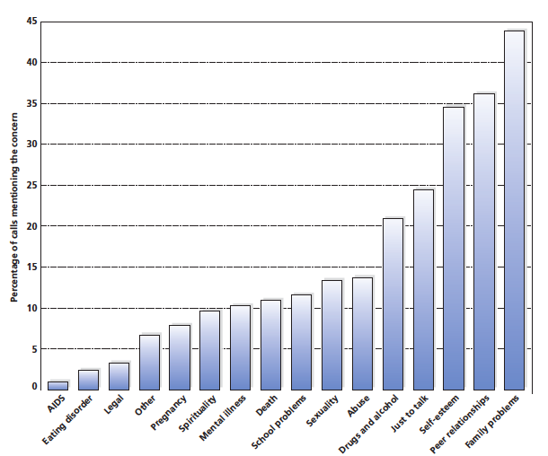
Figure 12-2 Adolescent Difficulties
Family, peer relationships, and self-esteem problems were most often mentioned by adolescents contemplating suicide, according to a review of phone calls to a telephone help line. (Source: Based on Boehm & Campbell, 1995.)

Slide 22
Warning Signs of Suicide (1 of 2)
Direct or indirect talk of harming self
School difficulties
Making arrangements as if preparing for a long trip
Writing a will
Changes in eating habits
Notes:
Direct or indirect talk
“I wish I were dead.”
“Don't worry, I’ll be out of your hair soon.”
School difficulties
Missed classes, drop in grades
Writing a will
Changes in eating habits

Slide 23
Warning Signs of Suicide (2 of 2)
General depression
Dramatic behavior changes
Preoccupation with death
For immediate help with a suicide-related problem, call: (800) 784-2433 or (800) 621-4000 National hotlines staffed with trained counselors
Notes:
General depression
Sleep habits, lack of energy, uncommunicative
Dramatic behavior changes
Preoccupation with death
Art, music, conversation

Slide 24
Relationships: Family and Friends
12.7 Describe what family relationships are like during adolescence.
12.8 Explain how relationships with peers change during adolescence.
12.9 Discuss what it means to be popular and unpopular in adolescence and how adolescents respond to peer pressure.

Slide 25
The Quest for Autonomy
Adolescents increasingly seek autonomy, independence, and a sense of control
Primary developmental task
Grows gradually over the course of adolescence
Consists of changes in relational symmetry
Notes:
At the start of adolescence, the relationship tends to be asymmetrical: Parents hold most of the power and influence over the relationship. By the end of adolescence, however, power and influence have become more balanced, and parents and children end up in a more symmetrical, or egalitarian, relationship. Power and influence are shared, although parents typically retain the upper hand.

Slide 26
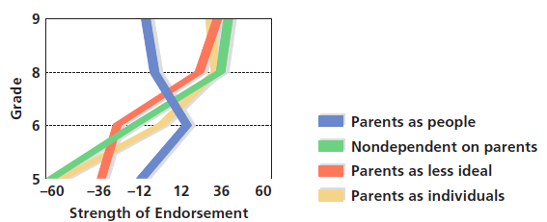
Figure 12-3 Changing Views of Parents
As adolescents become older, they come to perceive their parents in less idealized terms and more as individuals. What effect is this likely to have on family relations?
(Source: Based on Steinberg & Silverberg, 1986.)

Slide 27
Culture and Autonomy
Adolescents from different cultural backgrounds vary in their degree of felt family obligation
In general, male adolescents are permitted more autonomy at an earlier age than female adolescents
Notes:
Degree of autonomy that is eventually achieved varies from one family and one child to the next. Cultural factors play an important role.
In Western societies, which tend to value individualism, adolescents seek autonomy at a relatively early stage of adolescence.
Asian societies are collectivistic; they promote the idea that the well-being of the group is more important than that of the individual. In such societies, adolescents’ aspirations to achieve autonomy are less pronounced.

Slide 28
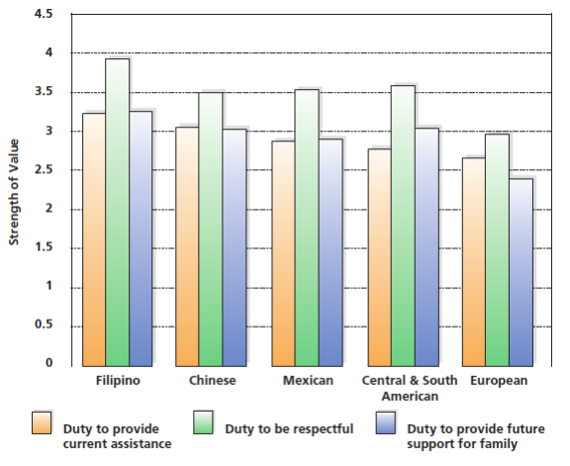
Figure 12-4 Family Obligations
Adolescents from Asian and Latin American groups feel a greater sense of respect and obligation toward their families than those adolescents with European backgrounds.
(Source: Fuligni, Tseng, & Lam, 1999.)

Slide 29
The Myth of the Generation Gap
Generation gap
Social, political, and religious issues
Dress, music, friends
Differences in values and attitudes between
teens are greater than the differences between parents and teens
Notes:
The GENERATION GAP, a divide between parents and adolescents in attitudes, values, aspirations, and worldviews, is mostly a myth: adolescents and their parents tend to share the same major values.
On social, political, and religious issues, parents and teens are mostly in synch.
The difference in values and attitudes between teens is greater than the difference between parent and teen.
Most parents and teens get along well.

Slide 30
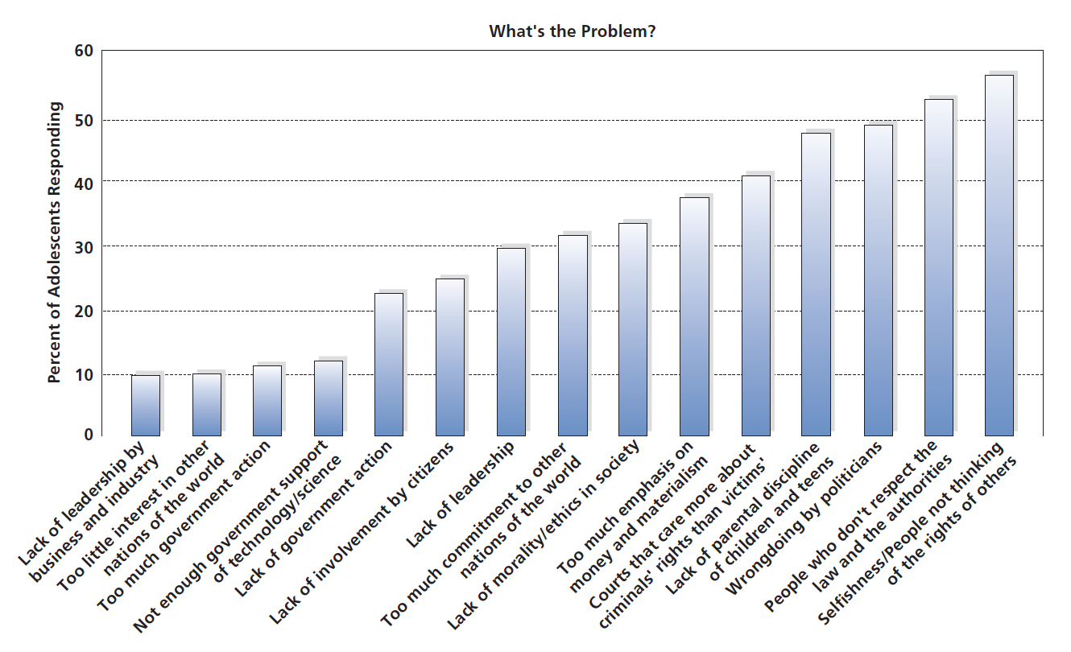
Figure 12-5 What’s the Problem?
Parents are most likely to agree with their adolescents’ views of society’s ills.
(Source: Based on P R I M E D I A/Roper National Youth Survey, 1999.)
Notes:
Parents are most likely to agree with their adolescents’ views of society's ills. Source: Based on PRIMEDIA/Roper National Youth Survey, 1999.)

Slide 31
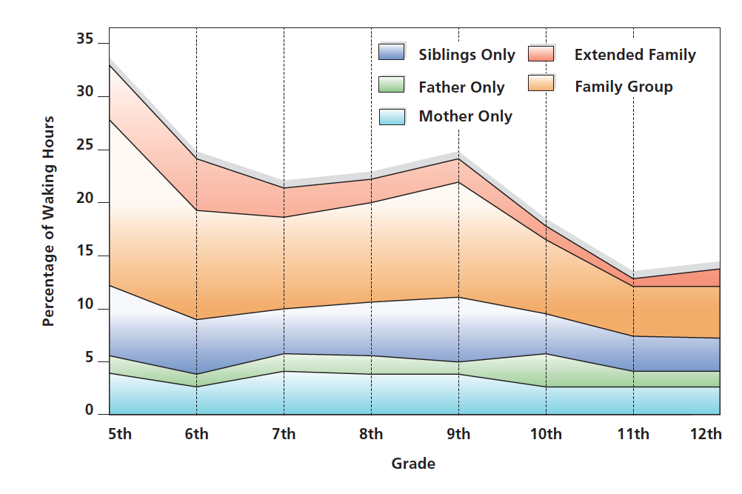
Figure 12-6 Time Spent by Adolescents with Parents
Despite their quest for autonomy and independence, most adolescents have deep love, affection, and respect for their parents, and the amount of time they spend alone with each parent (the lower two segments) remains remarkably stable across adolescence.
(Source: Larson et al., 1996.)
Notes:
Despite their quest for autonomy and independence, most adolescents have deep love, affection, and respect for their parents, and the amount of time they spend alone with each parent (the lower two segments) remains remarkably stable across adolescence. (Source: Larson et al., 1996.)

Slide 32
Relationships with Peers
Peer relationships
Critical during adolescence
Provide opportunity for social comparison and information gathering
Reference groups
Notes:
Peer relationships are more critical to adolescents than any other time of life.
Peers provide an opportunity for social comparison and information.
REFERENCE GROUP, a group of people with whom one compares oneself.
Reference groups present a set of norms or standards, against which adolescents judge their social success.

Slide 33
Cliques and Crowds: Belonging to a Group
Cliques
Groups of 2 to 12 people whose members have frequent interaction with one another
Crowds
Larger groups who share common characteristics but may not interact with one another
Sex cleavage
Boys interact with boys; girls interact with girls
Notes:
CLIQUES are 2 to 12 people who have frequent interaction.
CROWDS are larger groups where people share some characteristic but often don't interact with each other.
Membership in cliques and crowds determined by degree of similarity with members in a group.
Stereotypes: jocks, brains, druggies
There are strong expectations that people in a particular crowd behave in specific ways. (Is it a self-fulfilling prophesy?)
Gender relations change during the period of adolescence.
SEX CLEAVAGE is characteristic of early adolescence where girls play with girls, boys with boys.
With puberty, there is hormonal and social pressure to interact and eventually most adolescents are in mixed-sex cliques.
At the end of adolescence, cliques become less powerful and male-female relationships become the focus.

Slide 34
Popularity and Rejection
Adolescent social world is complex
High status categories
Low status categories
Notes:
High status categories
Popular adolescents, who are most liked.
Controversial adolescents, who are like by some and disliked by others.
Low status categories
Rejected teens, who are uniformly disliked.
Neglected teens adolescents, who are neither liked nor disliked.

Slide 35
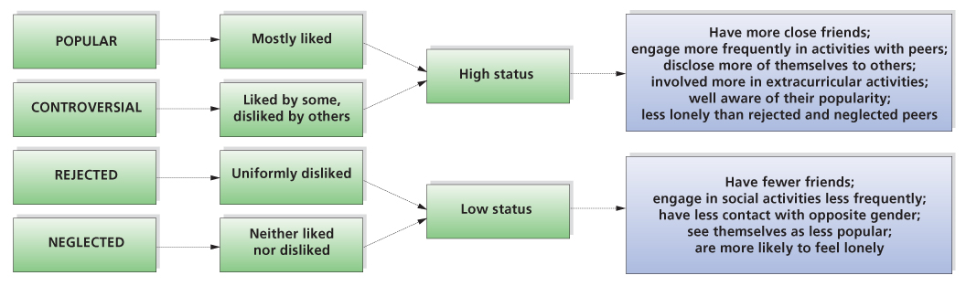
Figure 12-7 The Social World of Adolescence
An adolescent’s popularity can fall into one of four categories, depending on the opinions of his or her peers. Popularity is related to differences in status, behavior, and adjustment.
Notes:
Some adolescents are controversial; in contrast to popular adolescents, who are mostly liked, controversial adolescents are liked by some and disliked by others.
A controversial adolescent may be highly popular within a particular group such as the string orchestra, but not popular among other classmates.
There are rejected adolescents, who are uniformly disliked, and neglected adolescents, who are neither liked nor disliked. Neglected adolescents are the forgotten students—the ones whose status is so low that they are overlooked by almost everyone.

Slide 36
What determines status in high school?
According to college men | blank | According to college women | blank
High-status high-school girls: | High-status high-school boys: | High-status high-school girls: | High-status high-school boys:
1.Are good-looking | 1.Take part in sports | 1.Have high grades and are Intelligent | 1.Take part in sports
2.Have high grades and are Intelligent | 2.Have high grades and are Intelligent | 2.Participate in sports | 2.Have high grades and are intelligent
3.Take part in sports | 3.Are popular with girls | 3.Are sociable | 3.Are sociable
4.Are sociable | 4.Are sociable | 4.Are good-looking | 4.Are good-looking
5.Are popular with boys | 5.Have nice cars | 5.Have nice clothes | 5.Participate in school clubs government
Notes:
Say: Look at the Table. Did these results surprise you? Why? Why not?

Slide 37
Conformity: Peer Pressure in Adolescence
Susceptibility to conformity
Adolescents turn to the opinions of “experts”
  In some matters those experts are peers
  In some matters those experts are parents
  As adolescent autonomy develops, conformity to both peers and adults decreases
Notes:
Some teens are highly susceptible to peer pressure, the influence of one's peers to conform to their behavior and attitudes.
Susceptibility to peer pressure does not rise in adolescence; in fact conformity decreases as adolescents increase their own autonomy.
Ultimately, adolescents conform less to both peers as adults, as they grow in confidence in the ability to make their own decisions.
If teens do not resist the urge to conform to peers, they will likely get into trouble.
Although people assume that peer pressure is an influential component of adolescent development, few empirical studies have investigated the nature and extent of its influence. Using retrospective accounts from 297 college undergraduates, the present study assessed how much pressure peers exerted in numerous areas of high school life and how this pressure influenced teenagers' attitudes and behaviors. One-third of both genders identified peer pressure as one of the hardest things they had to face as a teenager. Generally, however, peer pressure appeared stronger for females than males, and the genders disagreed about the areas in which pressure was strongest. Perceptions of peer pressure were significantly associated with dating attitudes, sexual activity, and use of drugs and alcohol, but not with relationships with parents. The findings suggested that adolescents may be their own worst enemy in any attempt to break away from gender-stereotypic attitudes and behavior.
BB Brown

Slide 38
Juvenile Delinquents
Undersocialized delinquents
Adolescents raised with little discipline or harsh, uncaring parental supervision
Socialized delinquents
Adolescents who know and subscribe to the norms of society, and who are fairly psychologically normal
Notes:
Overall violent crimes by juveniles decreasing, but 16 percent of arrests for serious crimes involved juveniles.
Why do teens become involved in criminal activity?
UNDERSOCIALIZED DELINQUENTS are raised with little parental supervision or discipline: they have not been appropriately socialized.
They tend to be relatively aggressive and violent early in life; rejected by peers; likely to have ADHD; and are usually less intelligent than average.
They are relatively unlikely to be rehabilitated.
SOCIALIZED DELINQUENTS are adolescent delinquents who know and subscribe to the norms of society, and who are fairly normal psychologically.
They are usually influenced by a group & their criminal behavior is usually committed with a group.
Crimes by this group tend to be minor.

Slide 39
Dating, Sexual Behavior, and Teenage Pregnancy
12.10 Describe the functions and characteristics of dating during adolescence and how sexuality develops.
12.11 Explain how sexual orientation develops in adolescence.
12.12 Summarize the challenges of teen pregnancy and the types of programs that are most effective in preventing it.

Slide 40
Dating: Close Relationships in the 21st Century
Functions of Dating
Learning to establish intimacy
Learning to engage in entertainment
Shaping identity
Cultural influences affect dating patterns
Notes:
Adolescents today talk more of “hooking up”, which means anything from kissing to sexual intercourse.
Dating, though, is a common form of social interaction that serves developmental functions:
Learning how to establish intimacy.
Learning how to engage in entertainment.
Contributes to an identity in progress.
Cultural influences affect dating patterns, especially if the concept of dating is unfamiliar to the parents (often more control, attempts to maintain cultural patterns).

Slide 41
Dating and the Development of Psychological Intimacy
Dating in early and middle adolescence is not terribly successful at facilitating intimacy
True intimacy becomes more common during later adolescence
Gay and lesbian couples experience a variety of challenges related to dating
Notes:
Dating in early and middle adolescence is not terribly successful at facilitating intimacy.
On the contrary, dating is often a superficial activity in which the participants so rarely let down their guards that they never become truly close and never expose themselves emotionally to each other. Psychological intimacy may be lacking even when sexual activity is part of the relationship.
For homosexual adolescents, dating presents special challenges. In some cases, blatant homophobic prejudice expressed by classmates may lead gays and lesbians to date members of the other sex in efforts to fit in. If they do seek relationships with other gays and lesbians, they may find it difficult to find partners, who may not openly express their sexual orientation. Homosexual couples who do openly date face possible harassment, making the development of a relationship all the more difficult.
True intimacy becomes more common during later adolescence. At that point, the dating relationship may be taken more seriously by both participants, and it may be seen as a way to select a mate and as a potential prelude to marriage.

Slide 42
Sexual Relationships
Hormonal changes of puberty not only trigger the maturation of the sexual organs, but also produce a new range of feelings in the form of sexuality
Maturation of sexual organs
Initiation into sexuality
Masturbation
Sexual intercourse
Notes:
The maturation of sexual organs during the teen years creates a whole new world of relationship issues and possibilities for teens.
Research shows that teens think about sex a substantial amount of time each day.
For most adolescents, their initiation into sexuality begins with masturbation (self stimulation).
Since masturbation often produces feelings of shame and guilt in the American culture.
Experts view masturbation as normal and harmless.
Ages for sexual intercourse have been declining
The average age at which adolescents first have sexual intercourse has been steadily declining over the last 50 years, and about 13 percent of adolescents have had sex before the age of 15.
Numbers postponing sex is rising.
Today, premarital intercourse is viewed as acceptable for males and females, no more “double standard.”

Slide 43
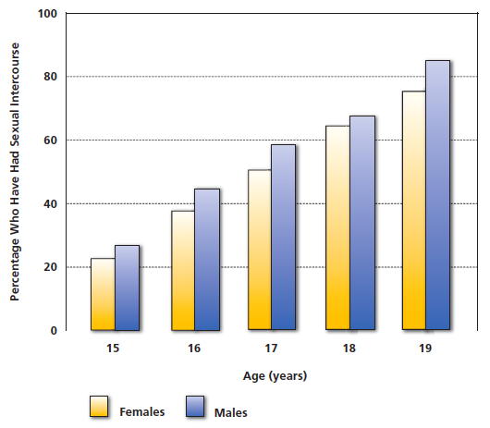
Figure 12-8 Adolescents and Sexual Activity
The age at which adolescents have sexual intercourse for the first time is
declining, and around three-quarters have had sex before the age of 20.
(Source: Morbidity and Mortality Weekly Report, 2008.)
Notes:
The average age at which adolescents first have sexual intercourse has been steadily declining over the last 50 years, and about one in five adolescents have had sex before the age of 15.
Overall, around half of adolescents begin having intercourse between the ages of 15 and 18, and at least 80 percent have had sex before the age of 20 (see Figure 12-8).
At the same time, though, many teenagers are postponing sex, and the number of adolescents who say they have never had sexual intercourse increased by nearly 10 percent from 1991 to 2001, largely as a response to the threat of infection by the virus that causes AIDS.

Slide 44
Permissiveness with Affection
In the past, there was a gender-related double standard for premarital sexual activity
Today, premarital intercourse is viewed as permissible for both men and women if it occurs in the context of a long-term, committed, or loving relationship
Significant cultural and subcultural variation about premarital sex
Notes:
Prevailing norm several decades ago was the double standard in which premarital sex was considered permissible for males but not for females. Women were told by society that “nice girls don't,” while men heard that premarital sex was permissible—although they should be sure to marry virgins.

Slide 45
Sexual Orientation
Sexual orientation questions occur during adolescence
Heterosexuality
Homosexuality
Bisexuality
Transsexualism
Notes:
Sexual orientation questions occur at adolescence.
The most frequent pattern of adolescent sexual development is heterosexuality (sexual attraction and behavior directed at someone of the opposite sex).
Yet some are homosexual (attracted to same sex) and bisexual (attracted to both).
About 25% of boys and 10% of girls have had at least one same-sex encounter.
Far fewer numbers become exclusively homosexual, maybe 4 to 10 percent.
Sexual orientation relates to sexual interests, while gender identity refers to ones psychological orientation, of feeling, behaving, like assigned sex.

Slide 46
What Determines Sexual Orientation?
Genetic and biological factors
Family and peers
Conditioning
Notes:
Genetic and biological factor
Identical twins are more likely to both be homosexual.
Hormones may play a factor.
Family and peers
Inappropriate identification with same sex parent?
Learning theory plays a role
Rewarding homosexual experience versus unsatisfying heterosexual encounters.

Slide 47
Teenage Pregnancies
Number of teenage pregnancies has decreased significantly in the last two decades
In 2012, the birth rate for U.S. teenagers was the lowest level ever reported in the seven decades that the government has been tracking pregnancies
Birth rate disparities remain, with the rate of teenage births higher for non-Hispanic blacks and Hispanics than for whites
Overall, the pregnancy rate of teenagers is 34.3 births
per 1,000

Slide 48
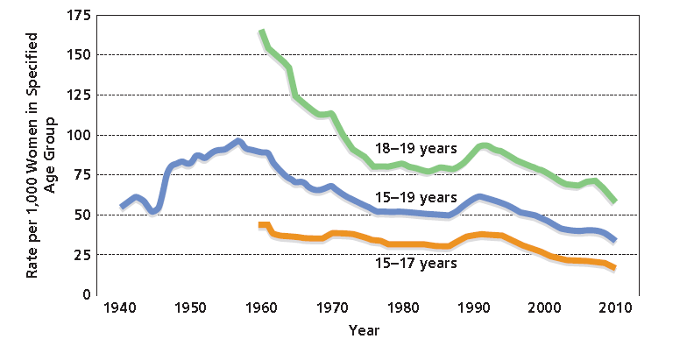
Figure 12-9 Teenage Pregnancy Rates
Although there has been a small increase in recent years, the rate of teenage
pregnancies has dropped dramatically among all ethnic groups since 1991.
(Source: Hamilton & Ventura, 2012.)

Slide 49
What Contributes to the Decline in Teenage Pregnancy?
New initiatives have raised awareness among teenagers of the risks of unprotected sex
The rates of sexual intercourse among teenagers declined
The use of condoms and other forms of contraception increased
Substitutes for sexual intercourse are more prevalent
Notes:
Ask: Why do you think the teen pregnancy rate has declined? List reasons before advancing items on the slide.
New initiatives have raised awareness among teenagers of the risks of unprotected sex. For example, about two-thirds of high schools in the United States have established comprehensive sex education programs (Villarosa, 2003; Corcoran & Pillai, 2007).
The rates of sexual intercourse among teenagers has declined. The percent of teenage girls who have ever had sexual intercourse dropped from 51 percent to 43 percent from 1991 to 2001.
The use of condoms and other forms of contraception has increased. For example, 57 percent of sexually-active high school students reported using condoms.
Substitutes for sexual intercourse may be more prevalent. For example, data from the 1995 National Survey of Adolescent Males found that about half of 15- to 19-year-old boys reported having received oral sex, an increase of 44 percent since the late 1980s. It is possible that oral sex, which many teenagers do not even consider “sex,” may increasingly be viewed as an alternative to sexual intercourse.

Slide 50

Copyright

