Slide 1

Development Across the Life Span
Eight Edition
Chapter 15
Physical and Cognitive Development in Middle Adulthood
Copyright © 2017, 2014, 2011 Pearson Education, Inc. All Rights Reserved
Notes:
If this PowerPoint presentation contains mathematical equations, you may need to check that your computer has the following installed:
1) MathType Plugin
2) Math Player (free versions available)
3) NVDA Reader (free versions available)

Slide 2
Learning Objectives (1 of 2)
15.1 Describe the physical changes that affect people in middle adulthood.
15.2 Explain how the senses change in middle adulthood.
15.3 Explain how reaction time changes during middle adulthood.
15.4 Compare how middle-aged men and middle-aged women experience changes in sexuality.
15.5 Describe changes in health that occur in middle adulthood.

Slide 3
Learning Objectives (2 of 2)
15.6 Describe the risk factors related to coronary heart disease.
15.7 Summarize what causes cancer and what tools are available to diagnose and treat it.
15.8 Describe what happens to a person’s intelligence in middle adulthood.
15.9 Explain the role of expertise in middle adulthood.
15.10 Describe how aging affects memory and how memory can be improved.

Slide 4
Physical Development
15.1 Describe the physical changes that affect people in middle adulthood.
15.2 Explain how the senses change in middle adulthood.
15.3 Explain how reaction time changes during middle adulthood.
15.4 Compare how middle-aged men and middle-aged women experience changes in sexuality.

Slide 5
Physical Transitions in Middle Adulthood
Gradual changes in body’s capabilities
Depends in part on self-concept and lifestyle
Notes:
Time when most people first become aware of gradual changes in body that mark aging process.
Reactions to physical changes of middle adulthood depend in part on self-concept.
Signs of aging they see in the mirror signal not just a reduction in their physical attractiveness, but also aging and mortality.

Slide 6
A Double Standard
Society applies a double standard to men and women in terms of appearance
Older women tend to be viewed in unflattering terms
Aging men more frequently perceived as displaying a maturity that enhances stature

Slide 7
Height, Weight, and Strength:
The Benchmarks of Change
After age 55, bones become less dense
  Ultimately women lose 2 inches and men lose 1 inch in height
Women are more prone to declining height due to osteoporosis
Both men and women continue to gain weight in middle adulthood
Notes:
Height
Reach their maximum height during their 20s and remain relatively close to that height until around age 55.
Begin a “settling” process in which the bones attached to the spinal column become less dense. Although the loss of height is very slow, ultimately women average a 2-inch decline and men a 1-inch decline.
Women are more prone to a decline in height because they are at greater risk of osteoporosis. Osteoporosis, a condition in which the bones become brittle, fragile, and thin, is often brought about by a lack of calcium in diet.
Weight
Amount of body fat tends to grow in average person.
People who maintain exercise program tend to avoid obesity, as do individuals living in cultures where the typical life is more active and less sedentary.
Strength
Strength gradually decreases, particularly in the back and leg muscles.
By 60, people have lost, on average, about 10 percent of their maximum strength.

Slide 8
Visual Acuity
Starting at age 40, visual acuity declines
Lens changes in shape and elasticity result in loss of near vision, called presbyopia

Slide 9
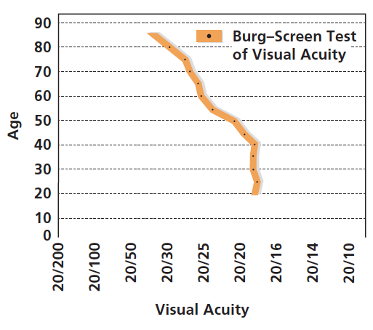
Figure 15-1 The Decline of Visual Acuity
Beginning around the age of 40, the ability to discern fine detail begins to drop.
Notes:
Starting at age 40, visual acuity - the ability to discern fine spatial detail in both close and distant objects - begins to decline.
The eye’s lenses change shape and elasticity.
The lenses become less transparent, which reduces the amount of light entering.
A nearly universal change in eyesight during middle adulthood is the loss of near vision, called Presbyopia.
Declines also occur in depth perception, distance perception, the ability to view the world in three dimensions, and night vision.
Sometimes changes in vision are brought on by a disease called Glaucoma, a condition where pressure in the fluid of the eye increases, either because the fluid cannot drain properly or because too much fluid is produced.
About 1 percent to 2 percent of those over 40 are affected.
African Americans are particularly susceptible.
It can be treated if caught early enough.
If left untreated it can cause blindness.

Slide 10
Hearing Loss in Middle Adulthood
Presbycusis
  About 12 percent of people between 45 and 65 suffer from presbycusis
  Men are more prone than women to hearing loss
  Sound localization is diminished
Notes:
The primary sort of loss is for sounds of high frequency, a problem called presbycusis.
About 12 percent of people between 45 and 65 suffer from presbycusis.
Men are more prone to hearing loss than women.
Because the two ears are not always equally affected by hearing loss, sound localization, the ability to detect the origin of a sound, is diminished.
Some hearing loss results from environmental factors, such as loud noises.
The rest are caused by aging, which brings a loss of hair cells in the inner ear.
Also, the eardrum becomes less elastic with age.

Slide 11
Reaction Time: Not-So-Slowing Down
Decreases slightly in middle adulthood
Improves or compensated for by being more careful and practicing the skill
Lifestyle choices such as exercise can slow this loss
Notes:
Decreases slightly in middle adulthood.
This is due to a gradual loss of muscle in the body and nervous system processing due to aging.
People can compensate by being more careful and practicing the skill.
Exercise can slow this loss.

Slide 12
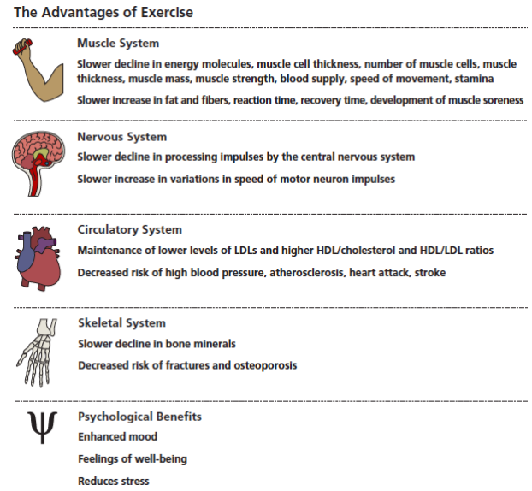
Figure 15-2 Use It or Lose It
Many benefits accrue from maintaining a high level of physical activity throughout life.
Notes:
Involvement in active exercise program retards effects of aging, producing several important outcomes.
Figure 15-2 The Benefits of Exercise
Many benefits accrue from maintaining a
high level of physical activity throughout life.
(Source: DiGiovanna, 1994.)

Slide 13
Sex in Middle Adulthood
Sexuality remains an important part of life for most middle-aged people
Frequency of sexual intercourse decreases with age
  Adults have more freedom
  Women no longer need to practice birth control
Notes:
Although frequency of sexual intercourse decreases with age, sexual activities remain vital part of most middle-aged adults’ lives.
With children grown and away from home, middle-aged adults have more freedom.
With menopause, women no longer need to practice birth control.
Men typically need more time to get erection.
Volume of fluid in ejaculation and production of testosterone declines.
In women, walls of vagina become less elastic and thinner and the vagina shrinks, potentially making intercourse painful.

Slide 14
Sexual Intercourse
Both men and women can face some challenges to their sexuality during middle adulthood
Men typically need more time to get an erection
  Volume of fluid in ejaculation declines
  Production of testosterone also declines
In women, walls of the vagina become less elastic and thinner
  Vagina shrinks, potentially making intercourse painful

Slide 15
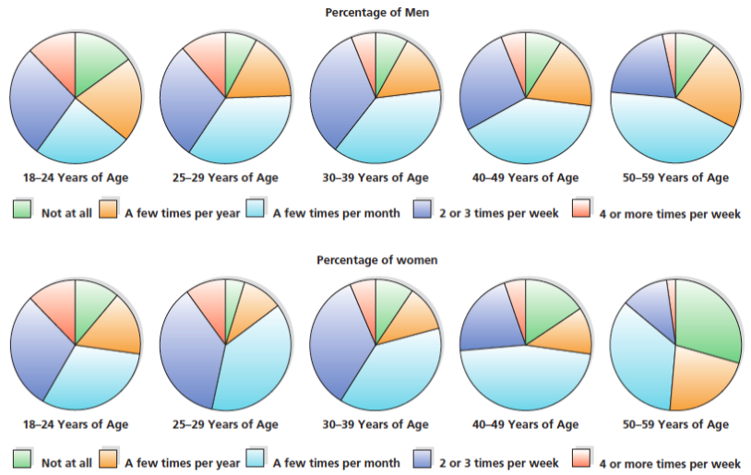
Figure 15-3 Frequency of Sexual Intercourse
As people age, the frequency of sexual intercourse declines.

Slide 16
The Female Climacteric
Starting about age 45, transition from being able to bear children to being unable to do so
Lasting about 15 to 20 years
Menopause
Notes:
Starting about age 45, the transition from being able to bear children to being unable to do so.
Lasting about 15 to 20 years.
Most notable sign is Menopause, the cessation of menstruation.
Process may begin as early as age 40 or as late as age 60.
Production of estrogen and progesterone drop.
Symptoms such as "hot flashes," headaches, feeling dizzy, heart palpitations, and aching joints are common during menopause.
Half of women report no symptoms at all.
Perimenopause is period beginning around 10 years prior to menopause when hormone production begins to change.
After year without a menstrual period, menopause is said to have occurred.

Slide 17
Menopause
Hormone Therapy (H T)
Women’s expectations about menopause relate to their experience of menopause
  Variations by race and culture

Slide 18
Hormone Therapy
Estrogen and progesterone used to alleviate menopausal symptoms:
Pro
  Changes ratio of “good” cholesterol to “bad” cholesterol
  Decreases thinning of bones
  Associated with reduced risk of stroke and
  colon cancer
Con
  Increases risk of breast cancer and blood clots
  Higher risk for pulmonary embolism and heart disease
Notes:
In Hormone Therapy (HT), estrogen and progesterone are administered to alleviate the worst of symptoms experienced by menopausal women.
Not simple all-or-nothing proposition; some women are simply better candidates for HT than others. Decision may be age related.

Slide 19
Results of Hormone Therapy (1 of 2)
Results of the Women’s Health Initiative study led to a profound rethinking of the benefits of H T
  Questions if H T could protect postmenopausal women against chronic disease

Slide 20
Results of Hormone Therapy (2 of 2)
Many women stopped taking hormone replacement drugs
  40 percent of postmenopausal women in the U.S. were using hormone therapy in 2002
  20 percent a decade later
Most recent thinking among medical experts is that it’s not a simple all-or-nothing proposition
  Some women are simply better candidates for H T than others

Slide 21
The Psychological Consequences of Menopause
Early research
  Menopause was linked directly to depression, anxiety, crying spells, lack of concentration, and irritability
Current research
  Normal part of aging that does not, by itself, produce psychological symptoms
Effects influenced by personal and cultural expectations of menopause
Notes:
Women who expect to have difficulties during menopause are more likely to attribute every physical symptom and emotional swing to it.
Women with more positive attitudes may be less apt to attribute physical sensations to menopausal physiological changes.
Attribution of physical symptoms may affect perception of rigors of menopause—and ultimately actual experience of period.
Women in non-Western cultures often have vastly different menopausal experiences from those in Western cultures.

Slide 22
The Male Climacteric
Male changes during middle age
  Period of physical and psychological change relating to male reproductive system that occurs during late middle age
  Enlargement of the prostate gland
  Problems with urination, including difficulty starting to urinate and frequent need to urinate during night
Men still produce sperm and can father children through middle age
Notes:
Men experience some changes during middle age.
Period of physical and psychological change relating to male reproductive system that occurs during late middle age.
Most common is enlargement of prostate gland.
By age 40, 10 percent of men have enlarged prostates.
Symptoms are problems with urination, including difficulty starting to urinate and frequent need to urinate during the night.
Men still produce sperm and can father children through middle age.

Slide 23
Health
15.5 Describe changes in health that occur in middle adulthood.
15.6 Describe the risk factors related to coronary heart disease.
15.7 Summarize what causes cancer and what tools are available to diagnose and treat it.

Slide 24
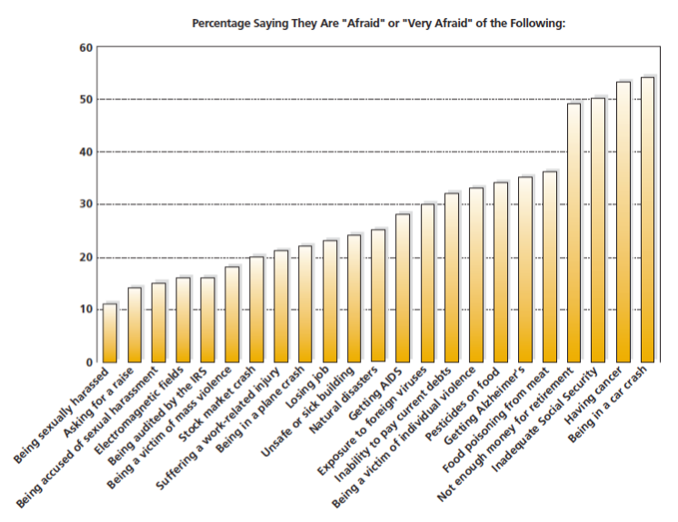
Figure 15-4 Worries of Adulthood
As people enter middle adulthood, health and safety concerns become increasingly important, followed by financial worries.

Slide 25
Chronic Diseases in Middle Adulthood
Arthritis typically begins after age 40
Diabetes is most likely to occur in people between the ages of 50 and 60
Hypertension (high blood pressure) is one of the most frequent chronic disorders found in middle age
Notes:
Arthritis typically begins after the age of 40, and diabetes is most likely to occur in people between the ages of 50 and 60, particularly if they are overweight
Hypertension (high blood pressure) is one of the most frequent chronic disorders found in middle age
Sometimes called the “silent killer” because it is symptomless, hypertension, if left untreated, greatly increases the risk of strokes and heart disease
For such reasons, a variety of preventive and diagnostic medical tests are routinely recommended for adults during middle adulthood

Slide 26
Table 15-1 Adult Preventive Health-Care Screening Recommendations (1 of 4)
Screening | Description | Ages 40 to 49 | Ages 50 to 59 | Age 60+
BLOOD PRESSURE | Used to detect hypertension, which can lead to heart attack, stroke, or kidney disease. | Every 2 years. | Every 2 years | Every 2 years; Every year if family history of hypertension.
CHOLESTEROL-TOTAL/H D L | Used to detect high cholesterol levels, which increase risk of heart disease. | All adults should receive total cholesterol screening, H D L cholesterol, L D L cholesterol, and triglycerides AT LEASTONCE; Cardiac risk factors and lipoprotein results will determine frequency of follow-up by your health-care provider. | All adults should receive total cholesterol screening, H D L cholesterol, L D L cholesterol, and triglycerides AT LEASTONCE; Cardiac risk factors and lipoprotein results will determine frequency of follow-up by your health-care provider. | All adults should receive total cholesterol screening, H D L cholesterol, L D L cholesterol, and triglycerides AT LEASTONCE; Cardiac risk factors and lipoprotein results will determine frequency of follow-up by your health-care provider.
EYE EXAMINATION | Used to determine If glasses required and check for eye disease. | Every 2 to 4 years; Diabetics-Every year. | Every 2 to 4 years; Diabetics- Every year. | Every 2 to 4 years; At age 65 and BLOOD PRESSURE over, every 1-2 years; Diabetics-Every year.

Slide 27
Table 15-1 Adult Preventive Health-Care Screening Recommendations (2 of 4)
Screening | Description | Ages 40 to 49 | Ages 50 to 59 | Age 60+
FLEXIBLE SIGMOIDOSCOPY OR DOUBLE CONTRAST BARIUM ENEMA OR COLONOSCOPY | A procedure using a scope or x-ray to detect cancer of the colon and rectum. | Blank | Baseline at age 50; Every 3 to 5 years after initial test. | Every 3 to 5 years. Age to stop depends on health; Follow up normal colonoscopy in 8 to 10 yrs.
FECAL OCCULT BLOOD SCREENING | Detects unseen blood in stool, which is early warning sign for colon cancer. | Blank | Every year. | Every year.
RECTAL EXAM (DIGITAL) | Examination of prostate or ovaries to detect cancer. | Blank | Every year. | Every year.
URINALYSIS SCREENING | Examination to detect presence of excess protein in urine. | Every 5 years. | Every 5 years. | Every 3 to 5 years.

Slide 28
Table 15-1 Adult Preventive Health-Care Screening Recommendations (3 of 4)
Screening | Description | Ages 40 to 49 | Ages 50 to 59 | Age 60+
IMMUNIZATIONS (SHOTS): TETANUS | Protection against infection after injury. | Every 10 years. | Every 10 years. | Every 10 years.
INFLUENZA (FLU) | Protection against the influenza virus. | Any person with chronic medical conditions, such as heart, lung, kidney disease, diabetes. | Annually, age 50 and over. | Annually, age 65 and over.
PNEUMOCOCCAL | Protection against pneumonia. | Blank | Blank | At age 65; Then every 6 years.
ADDITIONAL GUIDELINES FOR WOMEN | Blank | Blank | Blank | Blank
BREAST SELF-EXAM/BREAST EXAM BY PROVIDER | Examination to detect changes in breast that may indicate cancer. | Every month/Every year. | Every month/ Every year. | Every month/Every year.
MAMMOGRAM | Low-dose x-ray used to locate tumors for early detection of breast cancer. | Every year. | Every year. | Every year.

Slide 29
Table 15-1 Adult Preventive Health-Care Screening Recommendations (4 of 4)
Screening | Description | Ages 40 to 49 | Ages 50 to 59 | Age 60+
PAP SMEAR | Test that takes small sample of cells to detect cervical cancer or precancer cells. | After 3 normal tests in a row, screen every 2 to 3 years unless at special risk. | After 3 normal tests in a row, screen every 2 to 3 years unless at special risk. | Women 70 and older with 3 normal tests in a row and no abnormal tests in the 10 years prior to age 70 may cease having Pap test.
PELVIC EXAM | Examination to detect pelvic abnormality. | Every year (if ovaries remain after hysterectomy). | Every year (if ovaries remain after hysterectomy). | Every year (if ovaries remain after hysterectomy).
ADDITIONAL GUIDELINES FOR MEN | Blank | Blank | Blank | Blank
PROSTATE SPECIFIC ANTIGEN | Blood test used to detect cancer of the prostate gland. | Positive family history cancer-every year; (African Americans- every year). | Every year upon doctor’s advice. | Until age 75, every year upon doctor’s advice.
TESTICULAR SELF-EXAM | Examination to detect changes in testicles that may indicate cancer. | Every month. | Every month. | Every month.

Slide 30
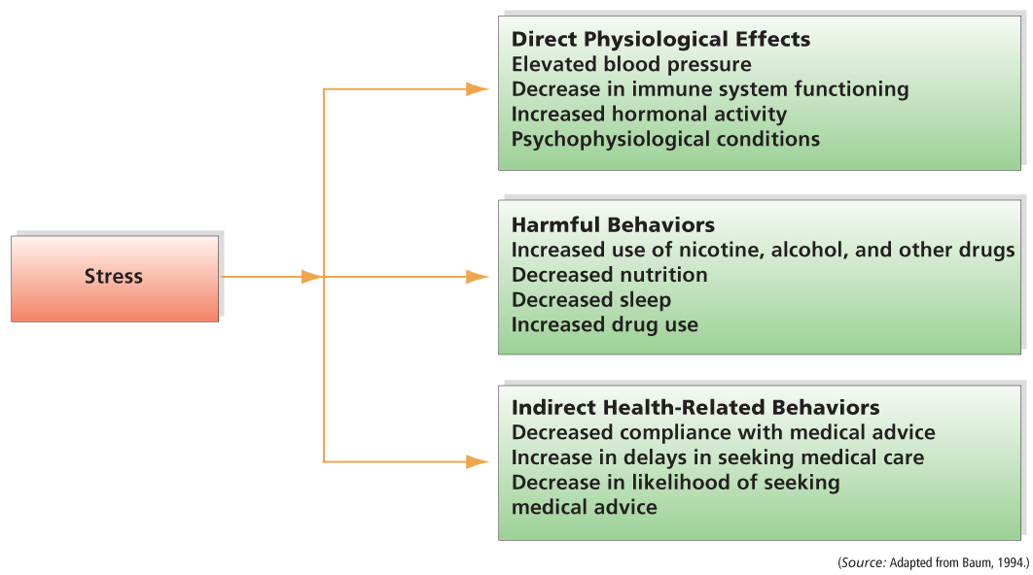
Figure 15-6 The Consequences of Stress
Stress produces three major consequences: direct physiological effects, harmful behaviors, and indirect health-related behaviors.
Notes:
Stress continues to have a significant impact on health during middle adulthood, as it did in young adulthood, although the nature of what is stressful may have changed.
Psychoneuroimmunologists, who study the relationship between the brain, immune system, and psychological factors, stress produces three main consequences.

Slide 31
Stress in Middle Adulthood
Stress continues to have a significant impact on health in middle age
According to psychoneuroimmunologists, who study the relationship between the brain, the immune system, and psychological factors, stress produces three main consequences
Direct effects
Harmful behaviors
Indirect health-related behaviors
Leads to unhealthy behaviors
Notes:
Stress continues to have a significant impact on health in middle age.
According to psychoneuroimmunologists, who study the relationship between the brain, the immune system, and psychological factors, stress produces three main consequences.
Direct physiological outcomes – e.g., increased blood pressure and hormonal activity.
Leads to unhealthy behaviors such as smoking, cutting back on sleep, drinking, or taking other drugs.
People under a lot of stress are more likely to give into these unhealthy behaviors.

Slide 32
Heart and Circulatory Disease in Middle Age
Heart and circulatory disease in middle age are responsible for more loss of work and disability days due to hospitalization than any other cause
Notes:
Each year heart and circulatory diseases kill around 200,000 people under the age of 65.

Slide 33
Linking Health and Personality
More men die in middle age of diseases of the heart and circulatory system than any other cause
  Both genetic and experiential characteristics are involved
  Heart disease runs in families
  Men are more likely to suffer than women, and risks increase with age
  Women are less vulnerable, but are not immune
Notes:
More men die in middle age of diseases of the heart and circulatory system than any other cause.
Both genetic and experiential characteristics are involved.
Heart disease runs in families.
Men are more likely to suffer than women, and risks increase with age.
There are several environmental and behavioral factors.
Cigarette smoking
High fat and cholesterol in diet
Lack of physical exercise
Evidence suggests that some psychological factors are also related to heart disease.

Slide 34
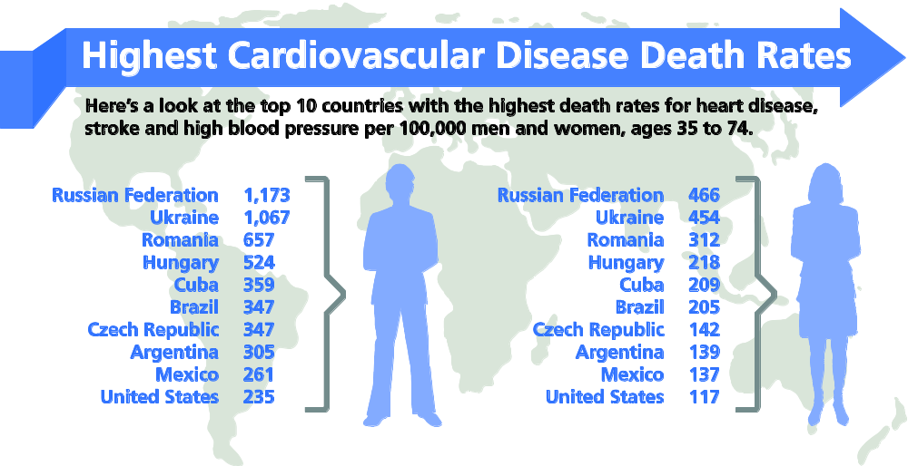
Figure 15-7 Death from Heart Disease Worldwide
The risk of dying from cardiovascular disease differs significantly depending on the country in which one lives. What cultural or environmental factors might help to explain this fact?
Notes:
Ask: What do you think contributes to these differences? What evidence from previous chapters can you use to support your answer?
The answer is that both genetic and experiential characteristics are involved. Some people seem genetically predisposed to develop heart disease. If a person’s parents suffered from it, the likelihood is greater that she or he will too. Similarly, sex and age are risk factors: Men are more likely to suffer from heart disease than women, and the risk rises as people age.
Environment and lifestyle choices are also important. Cigarette smoking, a diet high in fats and cholesterol, and a relative lack of physical exercise all increase the likelihood of heart disease. Such factors may explain country-to-country variations in the incidence of heart disease. For example, the death rate attributable to heart disease in Japan is relatively low and may be due to differences in diet: The typical diet in Japan is much lower in fat than the typical diet in the United States.

Slide 35
Type-A Behavior Pattern
Type-A behavior:
  Competitiveness, impatience, and a tendency toward frustration and hostility
  Evidence is correlational, so cannot conclude that Type A behavior causes heart disease
Notes:
Characterized by:
Competitiveness, impatience, and a tendency toward frustration and hostility, are more susceptible to heart disease.
Engagement in polyphasic activities - multiple activities carried out simultaneously.
They are easily angered and become verbally and nonverbally hostile if prevented from reaching their goals.
Heart rate and blood pressure rise, epinephrine and norepinephrine increase.
Wear and tear on heart produces disease.
Evidence is only correlational so we cannot say Type A behavior causes heart disease.
Most experts now say it is the negative emotion and hostility that are the major links to heart disease.
Most research has been done on men; we need to research women to see if Type A women are equally susceptible.

Slide 36
Type-B Behavior Pattern
Type-B behavior:
  Non-competitiveness, patience, and a lack of aggression
  Evidence that Type B people have less than
  half the risk of coronary disease than Type A people have

Slide 37
Type-D Behavior Pattern
D for “distressed”
Insecurity, anxiety, and negative outlook related to risk for heart attack

Slide 38
The Threat of Cancer
Cancer is associated with genetic and environmental risks
  Poor nutrition, smoking, alcohol use, exposure to sunlight, exposure to radiation, and particular occupational hazards
  Early treatment is related to higher survival rate
Notes:
Many forms of cancer respond quite well to medical treatment, and 40 percent of people diagnosed with the disease are still alive 5 years later; but second leading cause of death in U.S.
Therapy: radiation, chemotherapy, surgery.
Detection: breast examination, mammogram, testicle exam

Slide 39
Cancer Treatment
Takes a variety of forms
  Radiation therapy involves the use of radiation to destroy a tumor
  Chemotherapy involves the controlled ingestion of toxic substances meant to poison the tumor
Surgery may be used to remove the tumor
Early diagnosis is crucial

Slide 40
Breast Cancer
Mammography, a weak X-ray, is used to detect breast cancer
Death rate lower for those who had a “fighting spirit”
A positive psychological outlook may boost the body’s immune system
Notes:
Mammography, a weak X-ray, is used to detect breast cancer.
Women over 50 should routinely have one.
- Younger women have denser breasts and the problem of false positives increases.
Mammograms are expensive.
Increasing evidence suggests that cancer is also related to psychological factors.
Mammography, a weak X-ray, is used to detect breast cancer.
Death rate of women with breast cancer was much lower for those who had a "fighting spirit" or those who denied they had the disease.
People with close family ties are less likely to develop cancer.
Cancer patients who are habitually optimistic report less physical and psychological distress.
Participating in group therapy reduces anxiety and pain and increases survival rates.
A positive psychological outlook may be related to a tendency to adhere to a strict treatment regimen.
A positive psychological outlook.

Slide 41
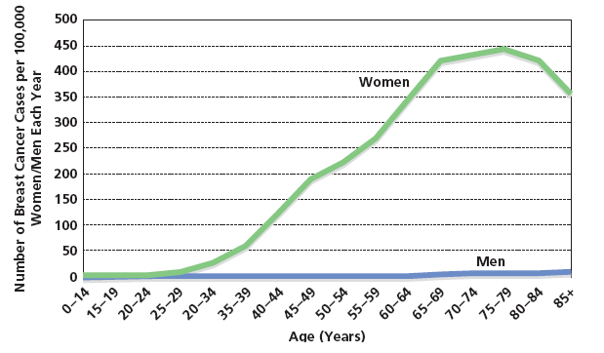
Figure 15-8 Age and the Risk of Breast Cancer
Starting around the age of 30, the risk of breast cancer becomes increasingly likely, as these annual incidence figures show.
Notes:
Determining age to begin routine screening mammograms is complicated by two considerations.
First, there is the problem of false positives or false negatives.
A second problem with routine mammograms is their expense, which runs around $125 on average.
Current consensus, at least among medical care providers, is that age 40 is the most reasonable age to begin routine annual screenings using mammograms.

Slide 42
Cognitive Development
15.8 Describe what happens to a person’s intelligence in middle adulthood.
15.9 Explain the role of expertise in middle adulthood.
15.10 Describe how aging affects memory and how memory can be improved.

Slide 43
Does Intelligence Decline in Adulthood?
Cross-sectional studies
Older subjects scored less well than younger subjects on traditional I Q tests
  Intelligence peaks at 18, stays steady until mid-20s, and declines until the end of life
Longitudinal studies
Different developmental patterns in intelligence
  Stable and even increasing I Q scores until mid-30s and some to mid-50s, then declined
Notes:
Older research
Cross sectional studies suggest decline with age in IQ scores may underestimate intelligence in older subjects due to cohort effects.
Current research
Longitudinal studies reveal fairly stable and even increasing intelligence test scores until mid-30s, and in some cases up to their 50s. At that point, though, scores began to decline.

Slide 44
Forms of Intelligence
Fluid intelligence is the ability to deal with new problems and situations
Crystallized intelligence is the store of information, skills, and strategies that people have acquired through education and prior experiences
Notes:
Fluid Intelligence is the ability to deal with new problems and situations.
Fluid intelligence is inductive reasoning, spatial orientation, perceptual speed, and verbal memory.
Fluid intelligence does decline with age.
Crystallized Intelligence is the store of information, skills, and strategies that people have acquired through education and prior experiences, and through their previous use of fluid intelligence.
Crystallized intelligence includes numerical and verbal abilities, such as solving a crossword puzzle or a mathematical problem.
Crystallized intelligence holds steady or increases with age.
Even though scores on IQ tests decline with age, middle-aged people show no decline in general cognitive competence.
Traditional tests may not tap into practical intelligence.

Slide 45
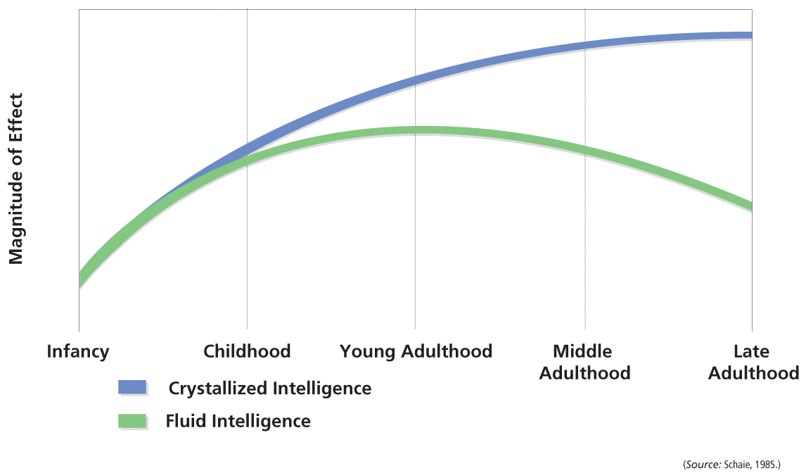
Figure 15-9 Changes in Crystalized and Fluid Intelligence
Although crystallized intelligence increases with age, fluid intelligence begins to decline in middle age. What are the implications for general competence in middle adulthood?
Notes:
Figure 15-9 Changes in Crystallized and Fluid Intelligence
Although crystallized intelligence increases with age, fluid intelligence begins to decline in middle age. What are the implications for general competence in middle adulthood? (Source: Schaie, 1985.)

Slide 46
Intellectual Decline?
When researchers looked at the two kinds of intelligence separately, a new answer appears to the question of whether intelligence declines with age
Yes and no
  Yes, because in general, fluid intelligence does decline with age
  No, because crystallized intelligence holds steady and in some cases actually improves

Slide 47
Beyond Fluid and Crystallized
  Certain abilities, such as inductive reasoning, spatial orientation, perceptual speed, and verbal memory, begin to decline very gradually at around age 25 and continue to decline through old age
  Numeric ability tends to increase until the mid-forties, is lower at age 60, and then stays steady throughout the rest of life
  Verbal ability rises until about the start of middle adulthood, around age 40, and stays fairly steady throughout the rest of the life span

Slide 48
Continued Competence During Gradual Decline
Four reasons why this discrepancy exists:
Typical measures of cognitive skills tap a different type of cognition than what is required to be successful in particular occupations
Measures of practical intelligence rather than traditional IQ tests to assess intelligence may yield little discrepancy
People can be quite successful professionally and still be on the decline in certain kinds of cognitive abilities
Older people may be successful because they have developed specific kinds of expertise and particular competencies

Slide 49
The Development of Expertise
Expertise is the acquisition of skill or knowledge in a particular area, and develops as people devote attention and practice to a task
  Expert: rely on experience and intuition, process information automatically, use different neural pathways to solve problems, use better strategies and better problem-solving
  Novice: strictly follow formal rules and procedures
Notes:
Expertise, the acquisition of skill or knowledge in a particular area, develops as people devote attention and practice.
While beginners use formal procedures and rules, experts rely on experience and intuition, and often bend the rules.
Because experts have so much experience, their behavior is often automatic, performed without much thought.

Slide 50
Memory: You Must Remember This
Research on memory changes in adulthood reveals
  Most people show only minimal losses
  Many exhibit no memory loss in middle adulthood
Three components of memory
  Sensory memory
  Short-term memory holds information for 15 to 25 seconds
  Long-term memory
Notes:
According to research on memory changes in adulthood, most people show only minimal losses, and many exhibit no memory loss in middle adulthood.
Memory is viewed in terms of three sequential components.
Sensory memory is an initial, momentary storage of information that lasts only an instant.
No decline in middle age.
Short-term memory holds information for 15 to 25 seconds.
No decline in middle age.
Long-term memory holds information that is rehearsed for a relatively permanent time.
Some decline in middle age.
Storage is less efficient.
A reduction in efficiency of memory retrieval.

Slide 51
Schemas in Middle Adulthood
Schemas
Help people represent the way the world is organized
Aid in categorization and interpretation of new information
Convey cultural information
Notes:
Schemas, organized bodies of information stored in memory.
People hold schemas for particular individuals (such as the particular behavior patterns of one’s mother, wife, or child) as well as for categories of people (mail carriers, lawyers, or professors) and behaviors or events (dining in a restaurant or visiting the dentist). People’s schemas serve to organize their behavior into coherent wholes and help them to interpret social events.

Slide 52

Copyright

