Slide 1

Development Across the Life Span
Eighth Edition
Chapter 16
Social and Personality Development in Middle Adulthood
Copyright © 2017,2014, 2010 Pearson Education, Inc. All Rights Reserved

Slide 2
Learning Objectives (1 of 3)
16.1 Describe ways in which personality develops during middle adulthood.
16.2 Summarize Erikson’s view of development during middle adulthood and how others have expanded on his ideas.
16.3 Discuss the nature of continuity in personality development during middle adulthood.
16.4 Describe typical patterns of marriage and divorce in middle adulthood.

Slide 3
Learning Objectives (2 of 3)
16.5 Differentiate the changing family situations middle-aged adults face.
16.6 Describe how people in middle adulthood react to becoming grandparents.
16.7 List the causes and characteristics of family violence in the United States.
16.8 Summarize characteristics of work and career in middle adulthood.

Slide 4
Learning Objectives (3 of 3)
16.9 Describe the effect losing one’s job has on a person in middle adulthood.
16.10 Explain how and why people change careers in middle adulthood.
16.11 Describe how people experience leisure time in middle adulthood.

Slide 5
Personality Development
16.1 Describe ways in which personality develops during middle adulthood.
16.2 Summarize Erikson’s view of development during middle adulthood and how others have expanded on his ideas.
16.3 Discuss the nature of continuity in personality development during middle adulthood.

Slide 6
Perspectives on Adult Personality Development
Normative-Crisis
Views personality development in terms of fairly universal stages, tied to a sequence of age-related crises
Life Events
Suggests that timing of particular events in adult’s life, rather than age per se, determine course of personality development
Changes in society call into question normative-crisis models that are closely tied to age

Slide 7
Adult Personality: Erik Erikson
Generativity-versus-stagnation stage
Generativity = looking beyond oneself to continuation of one’s life through others
Stagnation = focusing on the triviality of life
Critics argue that normative-crisis models are outdated; model came from a time when gender roles were more rigid

Slide 8
Adult Personality: George Valliant
Keeping meaning versus rigidity
  Occurs between the ages of 45 and 55
Adults seek to extract meaning from their lives by accepting strengths and weaknesses of others
  Those who are rigid become increasingly isolated from others

Slide 9
Adult Personality: Roger Gould
Adults pass through series of seven age-related stages
People in late 30s and early 40s begin to feel sense of urgency in attaining life’s goals
Descriptions not supported by research

Slide 10
Gould’s Approach (1 of 2)
16 to 18 Plan to leave home and terminate parental control
18 to 22 Leave the family and begin to reorient toward peers
22 to 28 Become independent and commit to career
(and often spouse and children)
29 to 34 Question oneself and experience confusion; may become dissatisfied with marriage and career

Slide 11
Gould’s Approach (2 of 2)
35 to 43 Feel an urgent need to achieve life goals, becoming increasingly aware of the passage and
    limits of time; often realign life goals
43 to 53 Settle down at last, with acceptance of one’s life
53 to 60 Grow more tolerant, accepting the past; become less negative and generally more mellow

Slide 12
Seasons of Life: Daniel Levinson
Most people are susceptible to fairly profound midlife crisis
Stage of uncertainty and indecision brought about by realization that life is finite
  Gender differences
  Despite widespread acceptance, evidence for midlife crisis does not exist

Slide 13
The Midlife Crisis
For the majority of people, transition to midlife is smooth and rewarding
Many middle-aged people find their careers have blossomed
They feel younger than they actually are

Slide 14
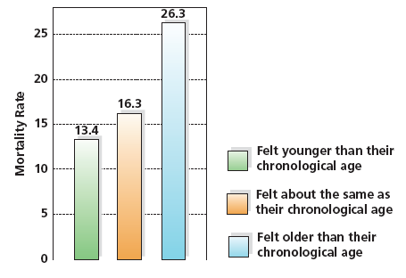
Figure 16-1 Feeling Younger and Age of Death
People who said they felt younger than their chronological age were more likely to live longer than those who felt older than their chronological death.

Slide 15
Stability Versus Change in Personality
Does personality change or remain stable over course of development?
Erikson and Levinson: substantial change
Costa and McCrae: stability in Big 5 traits across development

Slide 16
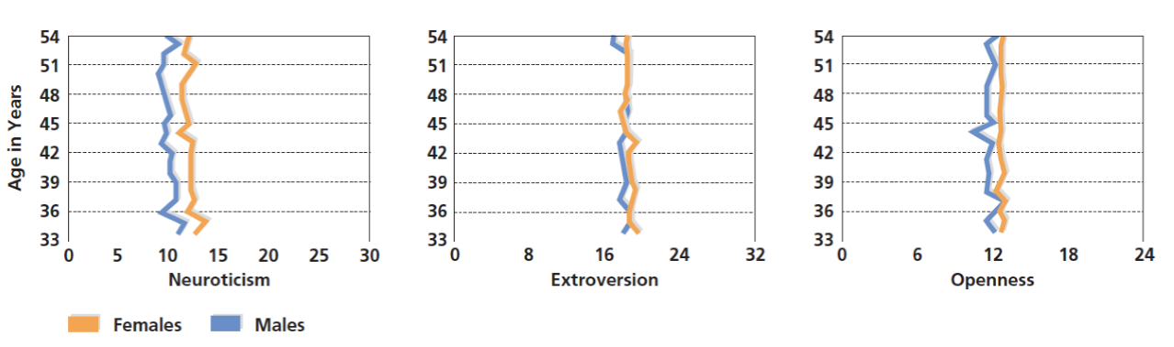
Figure 16-2 The Stability of Personality
According to Paul Costa and Robert McCrae, basic personality traits such as neuroticism, extroversion, and openness are stable and consistent throughout adulthood.

Slide 17
Stability and Change in the “Big Five” Personality Traits
Big Five traits are relatively stable past age 30 with some variations in specific traits
Neuroticism, extroversion, and openness to experience decline somewhat from early adulthood through middle adulthood
Agreeableness and conscientiousness increase
to a degree
Findings are consistent across cultures

Slide 18
Relationships: Family in Middle Age
16.4 Describe typical patterns of marriage and divorce in middle adulthood.
16.5 Differentiate the changing family situations middle-aged adults face.
16.6 Describe how people in middle adulthood react to becoming grandparents.
16.7 List the causes and characteristics of family violence in the United States.

Slide 19
Middle-Age Marriages
Most frequent pattern of marital satisfaction is U-shaped
Marital satisfaction begins to decline after marriage and falls to its lowest point following the birth of children
Marital satisfaction begins to grow after children leave adolescence and reaches its highest point when kids leave home

Slide 20
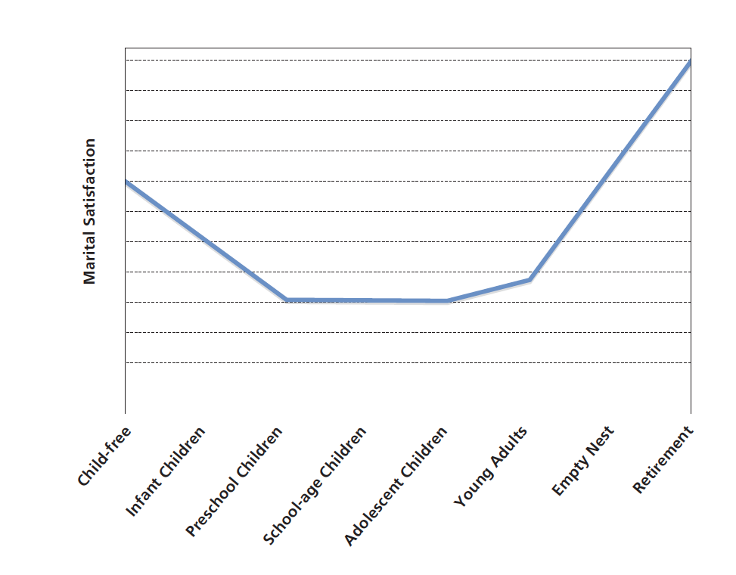
Figure 16-3 The Phases of Marital Satisfaction
For many couples, marital satisfaction falls and rises in a U-Shaped configuration. It begins to decline after the birth of children but increases when the youngest child leaves home and eventually returns to a level of satisfaction similar to that at the start of marriage. Why do you think this pattern of satisfaction occurs?

Slide 21
Mechanisms for Togetherness
Many couples state that their spouse is their
“best friend”
They also view marriage as a long-term commitment
They believe their spouse has grown more interesting over the years
Most feel their sex lives (although frequency goes down) are satisfying

Slide 22
Struggling Marriages
About 1 woman in 8 will get divorced after 40
People become more individualistic, spending less time together
Many feel concerned with their own personal happiness and leave an unhappy marriage
Divorce is more socially acceptable
Feelings of romantic, passionate love subside over time

Slide 23
Divorce
Although the overall divorce rate has declined in the last two decades, divorce among couples during midlife is rising
Divorce rate for people 50 and over has doubled in the last 20 years and is expected to increase

Slide 24
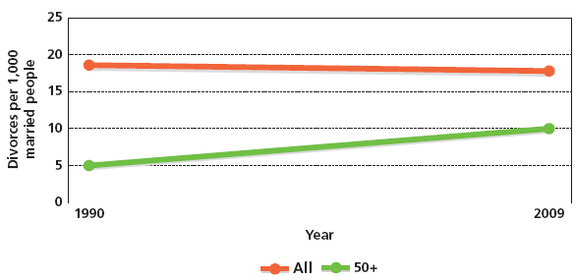
Figure 16-4 Rising Divorces in Middle Adulthood
Both the divorce rate and the number of people that experience divorce in those 50 years and above have risen significantly, and the increases are projected to continue in the future.

Slide 25
Marriage Gradient
The marriage gradient pushes men to marry younger women
Older women are victims of harsh societal standards regarding physical attractiveness
A major reason many remarry is that being divorced carries a stigma

Slide 26
Second Time Around
Older couples are more mature and realistic
Roles are more flexible
Couple looks at marriage less romantically and is more cautious
Divorce rate is higher for second marriages
More stress, especially with blended families
After divorce has been experienced once, it is easier to walk away a second time

Slide 27
Family Evolutions: From Full House to Empty Nest
Empty Nest Syndrome
When parents experience feelings of unhappiness, worry, loneliness, and depression resulting from their children’s departure from home
More myth than reality
Parents can work harder
More time alone
House stays cleaner
Phone does not ring as often

Slide 28
Boomerang Children
Young adults who come back to live in homes of their middle-aged parents
Men are more likely to do so than women
Parents tend to give sons more freedom than daughters
Unable to find a job
Difficulty making ends meet

Slide 29
The Sandwich Generation
Fulfilling needs of both their children and their aging parents
Couples are marrying and having children later
Parents are living longer

Slide 30
Caring for Aging Parents
Care of aging parents can be psychologically tricky
  Significant degree of role reversal
Range of care varies
  Financial
  Managing household
  Providing direct care
Influenced by cultural norms and expectations

Slide 31
Becoming a Grandparent
Marked gender differences in the ways people enjoy grandparenthood
Grandmothers are more interested in grandchildren and experience greater satisfaction than grandfathers
African American grandparents are more apt to be involved

Slide 32
Family Violence: The Hidden Epidemic
Prevalence
Between 21 and 34 percent of women will be slapped, kicked, beaten, choked, or threatened or attacked with a weapon at least once by an intimate partner
Close to 15 percent of all marriages in the United States are characterized by continuing, severe violence
Estimates suggest that 1 in 3 women across the globe experience some form of violent victimization during their lives

Slide 33
Factors That Put a Family at Risk for Abuse
Low socioeconomic status
Growing up in a violent home
Families with more children have more violence
Single-parent families with lots of stress

Slide 34
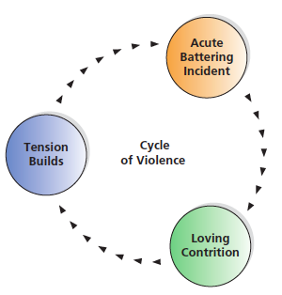
The Stages of Violence

Slide 35
The Cycle of Violence Hypothesis
Abuse and neglect of children leads them to be predisposed to abusiveness as adults
About one-third of people who were abused or neglected as children abuse their own children
Two-thirds of abusers were not abused as children

Slide 36
Spousal Abuse and Society
Cultural Roots of Violence
Others cultures have traditions in which violence is regarded as acceptable
Some experts suggest traditional power structure under which women and men function is root cause of abuse

Slide 37
Work and Leisure
16.8 Summarize characteristics of work and career in middle adulthood.
16.9 Describe the effect losing one’s job has on a person in middle adulthood.
16.10 Explain how and why people change careers in middle adulthood.
16.11 Describe how people experience leisure time in middle adulthood.

Slide 38
Work and Careers: Jobs at Midlife
Productivity
Job satisfaction
Worker characteristics and attitudes

Slide 39
Burnout
Dissatisfaction, disillusionment, frustration, and weariness from jobs
Occurs most often in jobs that involve helping others and strikes those who are most idealistic and driven

Slide 40
Unemployment
Causes economic and psychological consequences
Feeling anxious, depressed, and irritable
Self-confidence and concentration may plummet
Sometimes depression and/or suicide

Slide 41
Switching - and Starting - Careers at Midlife
Some people change or seek jobs voluntarily in middle adulthood
Previous job gave little satisfaction
Mastery of the previous job’s challenges achieved
No longer enjoy what they do
Need employment after raising children, divorce, or death of spouse

Slide 42
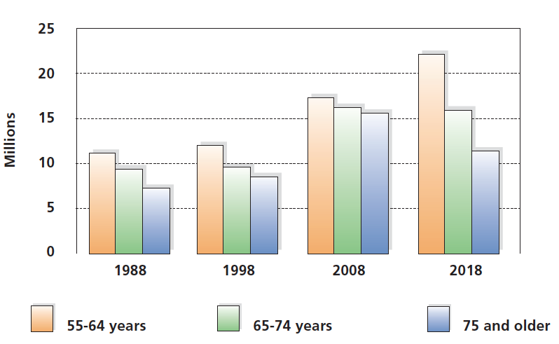
Figure 16-9 Women at Work
The percentage of women aged 55 to 64 who are in the labor force has steadily increased since 1980 and is slated to continue to grow over the current decade.

Slide 43
Leisure Time: Life Beyond Work
  70 waking hours per week of potential leisure time
  How to fill it?
  Watch T V, of course…
  Also socialize, take up a new hobby, become civic-minded, enjoy sports
  Maybe decide leisure is so leisurely that retirement looks good

Slide 44

Copyright

