Slide 1

Development Across the Life Span
Eighth Edition
Chapter 17
Physical and Cognitive Development in Late Adulthood
Copyright © 2017, 2014, 2010 Pearson Education, Inc. All Rights Reserved

Slide 2
Learning Objectives (1 of 3)
17.1 Describe what it is like to grow old in the United States today.
17.2 Summarize the physical changes that occur in old age.
17.3 Explain the extent to which people slow down as they age and the consequences of this slowing.
17.4 Describe how the senses are affected by aging.

Slide 3
Learning Objectives (2 of 3)
17.5 Describe the general state of health of older people and to what disorders they are susceptible.
17.6 Summarize how wellness can be maintained in old age.
17.7 Describe how sexuality is affected by aging.
17.8 Identify the factors involved with life span and the causes of death

Slide 4
Learning Objectives (3 of 3)
17.9 Discuss the possible extension of the life span through scientific advances and its implications.
17.10 Describe how well older adults function cognitively.
17.11 Discuss in what ways memory does and does not decline in late adulthood.
17.12 Describe how learning and education continue in late adulthood.

Slide 5
Physical Development in Late Adulthood
17.1 Describe what it is like to grow old in the United States today.
17.2 Summarize the physical changes that occur in old age.
17.3 Explain the extent to which people slow down as they age and the consequences of this slowing.
17.4 Describe how the senses are affected by aging.

Slide 6
Aging: Myth and Reality
Late adulthood holds a unique distinction among the periods of human life: It is actually increasing
in length
Greater proportion of people living in late adulthood
Elderly population now divided by functional aging
  Young old (65 to 74 years)
  Old old (75 to 84 years)
  Oldest old (85 years and older)
  Gerontologists: Specialists who study aging

Slide 7
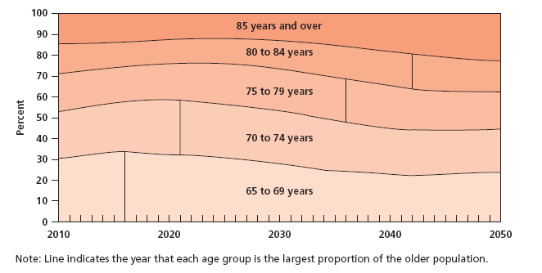
Figure 17-1 The Flourishing Elderly
The percentage of people over the age of 65 is projected to rise to almost 25 percent of the population by the year 2050. Can you name two factors that contribute to this increase?
Notes:
Note: Line indicates the year that each age group is the largest proportion of the older population.
The percentage of people over the age of 65 is projected to rise to almost 25 percent of the population by the year 2050. Can you name two factors that contribute to this increase? (Source: Adapted from U.S. Bureau of the Census, 2008.)

Slide 8
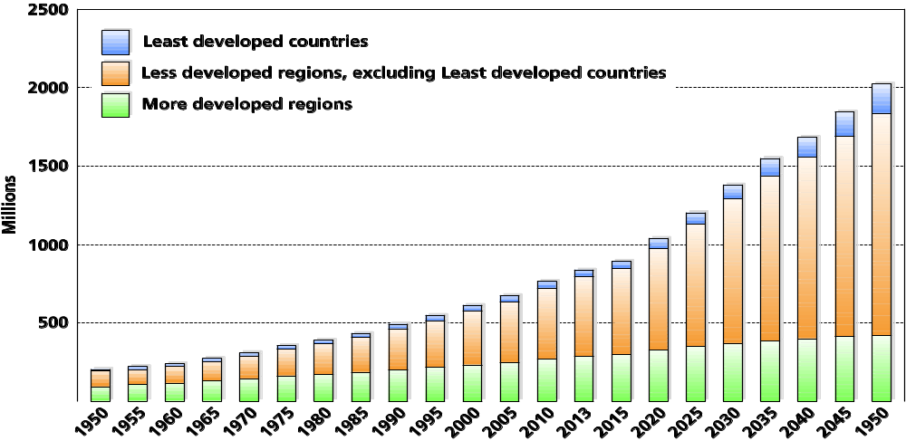
Figure 17-2 The Elderly Population Worldwide
Longer life is transforming population profiles worldwide, with the proportion of those over the age of 60 predicted to increase substantially by the year 2050.
Notes:
Because people are living longer, late adulthood is increasing in length.
The fastest growing segment of the population is the oldest old—people who are 85 or older. In the last two decades, the size of this group has nearly doubled. The population explosion among older people is not limited to the United States. In fact, the rate of increase is much higher in developing countries.
Sheer numbers of elderly are increasing substantially in countries around the globe.
By 2050, number of adults worldwide over the age 60 will exceed the number of people under age of 15 for first time in history.

Slide 9
Ageism
Prejudice and discrimination directed at older people is manifested in several ways
Negative attitudes about older people, especially about competence and attractiveness
Job discrimination
Notes:
Results of many attitude studies have found that older adults are viewed more negatively than younger ones on a variety of traits, particularly those having to do with general competence and attractiveness.
Identical behavior carried out by an older and a younger person often is interpreted quite differently.
This negative view of older people is connected to the reverence of youth and youthful appearance that characterizes many Western societies.

Slide 10
Discrimination
Identical behavior by an older person and a younger person is interpreted differently
Older adults with memory lapses are viewed as chronically forgetful with some mental disorder
Young adults with similar behavior are judged to have temporary forgetfulness
Most negative views are based on misinformation

Slide 11
The Myths of Aging (1 of 5)
The majority of old people (age 65 and older) have defective memory, are disoriented, or demented. T or F?
The five senses (sight, hearing, taste, touch, and smell) all tend to weaken in old age. T or F?
The majority of old people have no interest in, nor capacity for, sexual relations. T or F?
Lung capacity tends to decline in old age. T or F?
Notes:
Old age used to be equated with loss
Loss of brain cells
Loss of intellectual capabilities
Loss of energy
Loss of sex drive

Slide 12
The Myths of Aging (2 of 5)
The majority of old people are sick most of the time. T or F?
Physical strength tends to decline in old age. T or F?
At least one-tenth of the aged are living in long-stay institutions (such as nursing homes, mental hospitals, and homes for the aged). T or F?
Aged drivers have fewer accidents per driver than those under age 65. T or F?
Notes:
Old age used to be equated with loss
Loss of brain cells
Loss of intellectual capabilities
Loss of energy
Loss of sex drive

Slide 13
The Myths of Aging (3 of 5)
Older workers usually cannot work as effectively as younger workers. T or F?
Over three-fourths of the aged are healthy enough to carry out their normal activities. T or F?
The majority of old people are unable to adapt to change. T or F?
Old people usually take longer to learn something new. T or F?
Notes:
Old age used to be equated with loss
Loss of brain cells
Loss of intellectual capabilities
Loss of energy
Loss of sex drive

Slide 14
The Myths of Aging (4 of 5)
It is almost impossible for the average old person to learn something new. T or F?
Older people tend to react more slowly than do younger people. T or F?
In general, old people tend to be pretty much alike. T or F?
The majority of old people say they are seldom bored. T or F?
The majority of old people are socially isolated. T or F?
Notes:
Old age used to be equated with loss
Loss of brain cells
Loss of intellectual capabilities
Loss of energy
Loss of sex drive

Slide 15
The Myths of Aging (5 of 5)
Older workers have fewer accidents than do younger workers. T or F?
Scoring
All odd-numbered statements are false; all even-numbered statements are true. Most college students miss about six, and high school students miss about nine. Even college instructors miss an average of about three.
Notes:
Old age used to be equated with loss
Loss of brain cells
Loss of intellectual capabilities
Loss of energy
Loss of sex drive

Slide 16
Physical Transitions in Older People
Primary Aging
  Universal and irreversible changes
Secondary Aging
  Changes due to illness, health habits, or individual differences
  Not due to age itself
  Not inevitable
Notes:
Primary Aging is aging that involves universal and irreversible changes that, due to genetic programming, occur as people get older.
Secondary Aging is changes in physical and cognitive functioning that are due to illness, health habits, and other individual differences, but which are not due to increased age itself and are not inevitable.

Slide 17
Outward Signs of Aging
Gray and white hair
Hair thinning
Wrinkles
Diminishing height
Notes:
One of the most obvious outward signs of aging is the hair.
Gray or white
Thinner
The face and other parts of the body become wrinkled as the skin loses elasticity and collagen, the protein that forms the basic fibers of body tissue.
People may shrink as much as 4 inches.
Cartilage in backbone becomes thinner

Slide 18
Osteoporosis
Bones become brittle, fragile, and thin, often brought about by a lack of estrogen in the diet
25 percent of women over 60 have osteoporosis
Largely preventable with sufficient intake of calcium and protein, and exercise
Notes:
Women are most susceptible if they have Osteoporosis, a condition in which the bones become brittle, fragile, and thin, often brought about by a lack of calcium in the diet.
25 percent of women over 60 have osteoporosis.
Osteoporosis is the primary cause of broken bones.
Osteoporosis is largely preventable with sufficient calcium and exercise.

Slide 19
Double Standard
Women, especially in Western cultures, suffer from a double standard for appearance
Women who show signs of aging are judged more harshly than are men
Women are more likely to dye their hair
Women are more likely to have plastic surgery

Slide 20
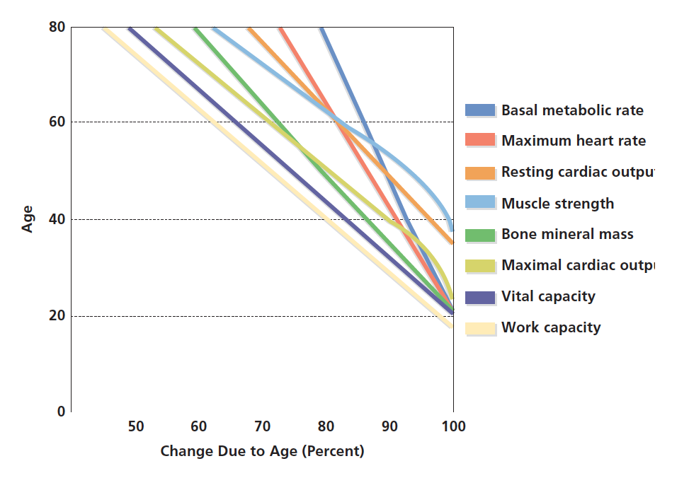
Figure 17-3 Changing Physical Capacities
As people age, significant changes occur in the functioning of various systems of the body.
Notes:
As people age, significant changes occur in the functioning of various systems of the body. (Source: Based on Whitbourne, 2001.)

Slide 21
Internal Aging
Brain becomes smaller and lighter with age
  Reduction of blood flow to the brain
  Space between the skull and the brain doubles from age 20 to age 70
  Number of neurons declines

Slide 22
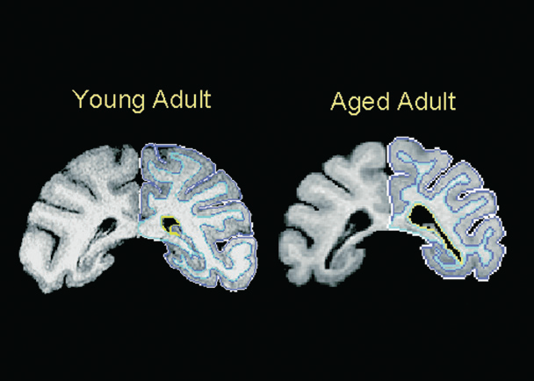
Figure 17-4 Brain Cell Decline
These MRI images show loss of white, but not gray, matter in the brain of a 32-year-old rhesus monkey (right). The young adult is 5 years old
Notes:
Significant changes also occur in the internal functioning of the organ systems.
The brain becomes smaller and lighter with age.
There is a reduction of blood flow to the brain.
The space between the skull and the brain doubles from age 20 to age 70.
The number of neurons, or brain cells, declines in some parts of the brain, though not as much as was once thought.

Slide 23
Lower Capacity of Bodily Systems
A 75-year-old’s heart pumps less than three-quarters of the blood it pumped during early adulthood
Efficiency of the respiratory system declines
with age
Digestive system produces less digestive juice and is less efficient in pushing food through the system

Slide 24
Slowing Reaction Time
Peripheral Slowing Hypothesis
Suggests that overall processing speed declines in peripheral nervous system
Generalized Slowing Hypothesis
Older people have more accidents
Decision process is slowed down

Slide 25
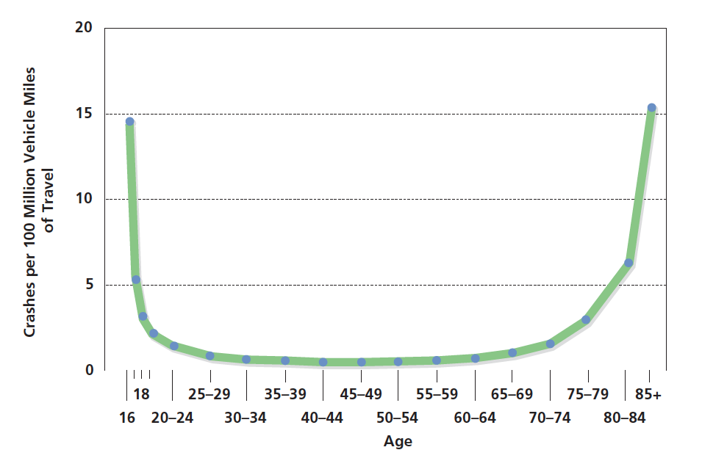
Figure 17-5 Vehicle Fatalities Across the Life Span
Drivers over age 70 have a fatal accident record comparable to that of teenagers when crashes are calculated per mile of driving. Why is this the case?
Notes:
Drivers over age 70 have a fatal accident record comparable to that of teenagers when crashes are calculated per mile of driving. Why is this the case?
(Source: National Highway Traffic Safety Administration, 1994.)

Slide 26
The Senses
Old age brings a distinct decline in the sense organs
Vision
  Lens becomes less transparent and the pupils shrink
  Optic nerve becomes less efficient
  Distant objects become less acute
Notes:
Vision
Lens becomes less transparent and the pupils shrink.
The optic nerve becomes less efficient.
Distant objects become less acute.
More light is needed to see and it takes longer to adjust to a change from light to darkness and vice versa.
Driving at night becomes difficult.
Reading becomes more of a strain and eye strain occurs more easily.

Slide 27
Vision
Cataracts
Cloudy or opaque areas of the lens of eye that interfere with passing light, frequently develop
Cataracts can be surgically removed
Intraocular lens implants, eyeglasses, or contact lenses can be used to restore eyesight
Notes:
Cataracts can be surgically removed.
Intraocular lens implants can replace old lens.
Glaucoma
It must be detected early enough.
The most common cause of blindness in people over the age of 60 is age-related macular degeneration (AMD), which affects the macula, a yellowish area of the eye located near the retina at which visual perception is most acute.

Slide 28
Glaucoma
Pressure in the fluid of the eye
Glaucoma can be corrected with drugs or surgery
Age-related macular degeneration (A M D)
  Affects the macula

Slide 29
Hearing
30 percent of adults between 65 and 74 have some hearing loss
50 percent of adults over 75 have hearing loss
High frequencies are the hardest to hear
Overall, more than 10 million elderly people in the United States have hearing impairments of one kind or another

Slide 30
Hearing Aids
Hearing aids would be helpful for 75 percent of people who need them
Only 20 percent of people wear them
Are imperfect and amplify all sounds, so it is difficult to discern conversations
There is a stigma attached to wearing a hearing aid
Because they cannot hear, some people withdraw from society because they feel left out and lonely

Slide 31
Taste and Smell
Both senses become less discriminating in old age
Due to decline in taste buds on tongue
Olfactory bulbs in the brain shrink and reduce the ability to smell
  People eat less and receive poor nutrition
  Older people may over-salt their food and develop hypertension, or high blood pressure

Slide 32
Health and Wellness in Late Adulthood
17.5 Describe the general state of health of older people and to what disorders they are susceptible.
17.6 Summarize how wellness can be maintained in old age.
17.7 Describe how sexuality is affected by aging.
17.8 Identify the factors involved with life span and the causes of death
17.9 Discuss the possible extension of the life span through scientific advances and its implications.

Slide 33
Health Problems in Older People
People of all ages suffer from cancer, heart disease, and other diseases and illnesses
Incidence of these diseases increases with age
Rebound is often slower

Slide 34
Common Physical Disorders
  Leading causes of death are heart disease, cancer, and stroke
  Higher incidence of infectious disease
  Arthritis
  Hypertension
Notes:
The leading causes of death in elderly people are heart disease, cancer, and stroke. Close to three-quarters of people in late adulthood die from these problems. Because aging is associated with a weakening of the body’s immune system, older adults are also more susceptible to infectious diseases (Feinberg, 2000). In addition to their risk of fatal diseases and conditions, most older people have at least one chronic, long-term condition (AARP, 1990). For instance, arthritis, an inflammation of one or more joints, afflicts roughly half of older people. Arthritis can cause painful swelling in various parts of the body, and it can be disabling. Sufferers can find themselves unable to carry out the simplest of everyday activities, such as unscrewing the cap of a jar of food or turning a key in a lock. Although aspirin and other drugs can relieve some of the swelling and reduce the pain, the condition cannot be cured.
Around one-third of older people have hypertension, or high blood pressure. Many people who have high blood pressure are unaware of their condition because it does not have any symptoms, which makes it more dangerous. Over time, higher tension within the circulatory system can result in deterioration of the blood vessels and heart, and can raise the risk of cerebrovascular disease, or stroke, if it is not treated.

Slide 35
Psychological and Mental Disorders
  Major depression
  Drug-induced psychological disorders
  Dementia
Notes:
Some 15 to 25 percent of those over age 65 are thought to show some symptoms of psychological disorder, although this represents a lower prevalence rate than in younger adults.
The behavioral symptoms related to these disorders are sometimes different in those over 65 than those displayed by younger adults.
Major depression is characterized by feelings of intense sadness, pessimism, and hopelessness.
Some studies suggest that the rate of depression actually may be lower during late adulthood. One reason for this contradictory finding is that there may be two kinds of depression in older adulthood: depression that continues from earlier stages of life and depression that occurs as a result of aging.
The most common mental disorder of elderly people is dementia, a broad category of serious memory loss accompanied by declines in other mental functioning, which encompasses a number of diseases. Although dementia has many causes, the symptoms are similar: declining memory, lessened intellectual abilities, and impaired judgment. The chances of experiencing dementia increase with age. Less than 2 percent of people between 60 and 65 years are diagnosed with dementia, but the percentages double for every 5-year period past 65.
Almost one-third of people over the age of 85 suffer from some sort of dementia. There are some ethnic differences, too, with African Americans and Hispanics showing higher levels of dementia than Caucasians.

Slide 36
Alzheimer’s disease
Progressive brain disorder
Produces loss of memory and confusion
Leads to the deaths of 100,000 people in the United States each year

Slide 37
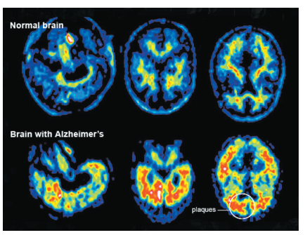
Figure 17-7 A Different Brain?
Brain scans show differences between the brains of those with Alzheimer’s disease and those who do not suffer from it.
Notes:
Leads to deaths of 100,000 people in U.S. each year
Nineteen percent of people 75 to 84 have Alzheimer’s disease
Nearly half of people over age of 85 are affected by the disease. In fact, unless a cure is found, some 14 million people will be victims of Alzheimer’s by 2050—more than three times more than the current number.

Slide 38
Characteristics of Alzheimer’s Disease (1 of 2)
Symptoms develop gradually
Start with forgetfulness
Affect recent memories first and then older memories fade
Causes confusion, inability to speak intelligibly, or recognition of closest family members
Notes:
At first, recent memories are affected, and then older memories fade. Eventually, people with the disease are totally confused, unable to speak intelligibly or to recognize even their closest family and friends. In the final stages of the disease, they lose voluntary control of their muscles and are bedridden. Because victims of the disorder are initially aware that their memories are failing and often understand quite well the future course of the disease, they may suffer from anxiety, fear, and depression—emotions not difficult to understand, given the grim prognosis.

Slide 39
Characteristics of Alzheimer’s Disease (2 of 2)
Loss of voluntary control of muscles occurs
Inherited disorder
Nongenetic factors such as high blood pressure or diet may increase susceptibility
Notes:
At first, recent memories are affected, and then older memories fade. Eventually, people with the disease are totally confused, unable to speak intelligibly or to recognize even their closest family and friends. In the final stages of the disease, they lose voluntary control of their muscles and are bedridden. Because victims of the disorder are initially aware that their memories are failing and often understand quite well the future course of the disease, they may suffer from anxiety, fear, and depression—emotions not difficult to understand, given the grim prognosis.

Slide 40
The Biology of Alzheimer’s Disease
Production of the protein beta amyloid precursor protein goes awry
Produces large clumps of cells that trigger inflammation and deterioration of nerve cells
Brain shrinks
Neuron death leads to shortage of various neurotransmitters
Notes:
Production of the protein beta amyloid precursor protein—a protein that normally helps the production and growth of neurons—goes awry.
This produces large clumps of cells that trigger inflammation and deterioration of nerve cell.
Brain shrinks, and several areas of hippocampus and frontal and temporal lobes show deterioration.
Certain neurons die, which leads to shortage of various neurotransmitters, such as acetylcholine.

Slide 41
Treatment of Alzheimer’s Disease
No cure
Treatment deals only with the symptoms
Drugs effective for only half of Alzheimer’s patients
Many spend the remainder of their lives in nursing homes
Notes:
While understanding of the causes of Alzheimer’s is incomplete, several drug treatments for Alzheimer’s appear promising, although none is effective in the long term. The most promising drugs are related to the loss of the neurotransmitter acetylcholine (Ach) that occurs in some forms of Alzheimer’s disease. Donepezil (Aricept), galantamine (Razadyne), rivastigmine (Exelon), and tacrine (Cognex) are among the most common drugs prescribed, and they alleviate some of the symptoms of the disease. Still, they are effective in only half of Alzheimer’s patients, and only temporarily.
As victims lose the ability to feed and clothe themselves, or even to control bladder and bowel functions, they must be cared for 24 hours a day. Because such care is typically impossible for even the most dedicated families, most Alzheimer’s victims end their lives in nursing homes. Patients with Alzheimer’s make up some two-thirds of those in nursing homes.

Slide 42
The Relationship Between Aging and Illness
Certain diseases, such as cancer and heart disease, have a clear genetic component
Economic well-being also plays role
Psychological factors play an important role in determining people’s susceptibility to illness, and ultimately, the likelihood of death
Notes:
Whether an older person is ill or well depends less on age than on a variety of factors, including genetic predisposition, past and present environmental factors, and psychological factors.
In 2002, for example, older individuals averaged $3,600 in out-of-pocket health care expenditures, an increase of 45 percent in ten years. Furthermore, older people spend almost 13 percent of their total expenditures on health care, more than two times more than younger individuals.

Slide 43
Promoting Good Health
People can do specific things to enhance their physical and psychological well-being - as well as their longevity - during old age
Eat a proper diet
Exercise
Avoid threats to health, such as smoking

Slide 44
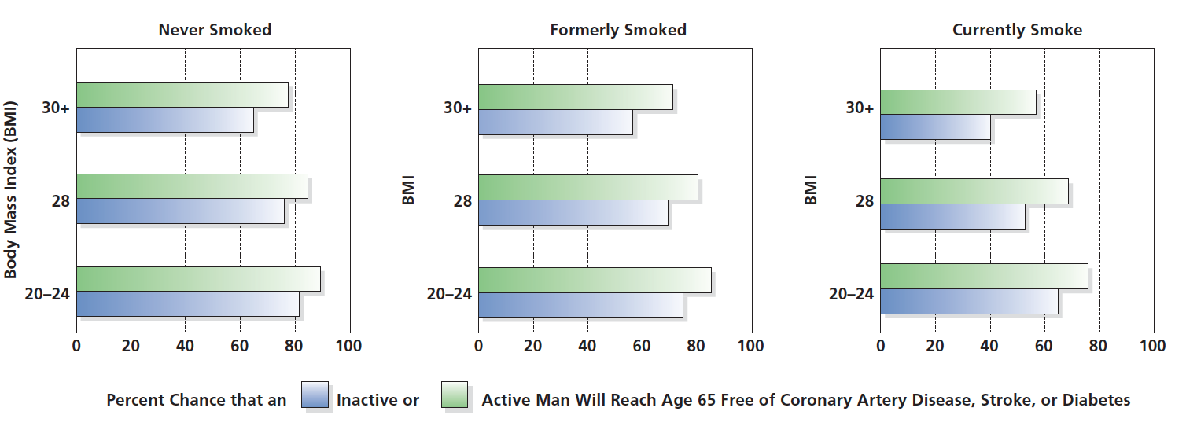
Figure 17-8 Benefits of Exercise and a Healthy Diet
A study of more than 7,000 men, aged 40 to 59, found that not smoking, keeping weight down, and exercising regularly can greatly reduce the risk of coronary heart disease, stroke, and diabetes. Although the study included only men, a healthy lifestyle can benefit women too. (To find your body mass index [B M I], multiply your weight in pounds by 705. Divide the result by your height in inches, then divide by your height again.)

Slide 45
Malnutrition and Hunger
Sometimes older people experience difficulties that prevent them from following even simple health guidelines
Varying estimates suggest that between 15 and 50 percent of elderly people do not have adequate nutrition, and several million experience hunger every day
  Poverty
  Physical inability to shop or cook
  Lack of motivation to eat properly
  Decline in taste and smell sensitivity

Slide 46
Sexuality in Old Age
Related to physical and mental health and previous sexual activity
Evidence suggests that people are sexually active well into their 80s and 90s
Previous sexual activity increases the desire for sex
Having sex regularly is associated with lower
risk of death
Notes:
Sex in Old Age: Use It or Lose It
Evidence suggests that people are sexually active well into their 80s and 90s.
Good physical and mental health are necessary.
Previous sexual activity increases the desire for sex - "Use it or lose it.”
Studies show that 43 percent of men and 33 percent of women over age 70 masturbate.
Two-thirds of men and women over age 70 had sex with their spouses on average about once a week.
It takes men longer to get an erection and women’s vaginas become thin and inelastic, and they produce less lubrication.

Slide 47
Sexuality in Late Adulthood
Physical changes
Decline in testosterone
Erection timing and refractory period
Vaginal changes
Sexual activity
Masturbation
Intercourse
Susceptibility to S T Ds

Slide 48
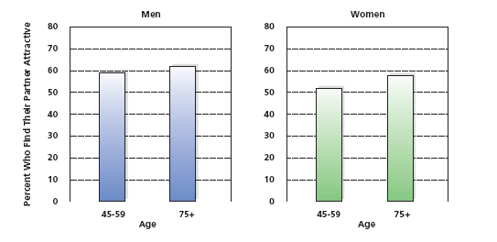
Figure 17-9 Attractiveness over Time
More than 50 percent of Americans over age 45 find their partners attractive, and as time goes on, more attractive
Notes:
Percentage of people who view their sexual partners as physically attractive actually increases with age.

Slide 49
Why is Death Inevitable?
Genetic programming theories of aging
Wear-and-tear theories of aging
Each explanation is supported by research
Each approach explains certain aspects of aging
Why the body begins to deteriorate and die remains something of a mystery
Notes:
Approaches to Aging
Genetic Preprogramming Theories Of Aging suggest that our body’s DNA genetic code contains a built-in time limit for the reproduction of human cells.
One theory is that genetic material has a "death gene" that is programmed to direct the body to deteriorate and die.
Another theory is that genetic instructions for running the body can be read only a certain number of times before they become illegible.
WEAR-AND-TEAR THEORIES OF AGING argue that the mechanical functions of the body simply wear out with age.
Some theories say that the body’s constant manufacture of energy to fuel its activities creates by-products, which eventually reach such high levels that they impair the body’s normal functioning.
Free radicals, electrically charged atoms, are produced in the cells and may cause negative effects on other cells.
This is a more optimistic theory, which suggests that longevity can be extended by eliminating the toxins produced by the body.
LIFE EXPECTANCY, the average age of death for members of a population, has been steadily increasing.
In 1776, the average life expectancy was 35.
In 1900, the average life expectancy was 47.
For a person born in 1980 life expectancy is 74.
By 2050, the average life expectancy is predicted to be 80.
Health conditions are better.
Many diseases are wiped out or better controlled through medicine.
People’s working conditions are better.
We are working on improving environmental conditions.
The maximum human lifespan is believed to hover around 120.
To extend the maximum lifespan would probably take genetic alterations.

Slide 50
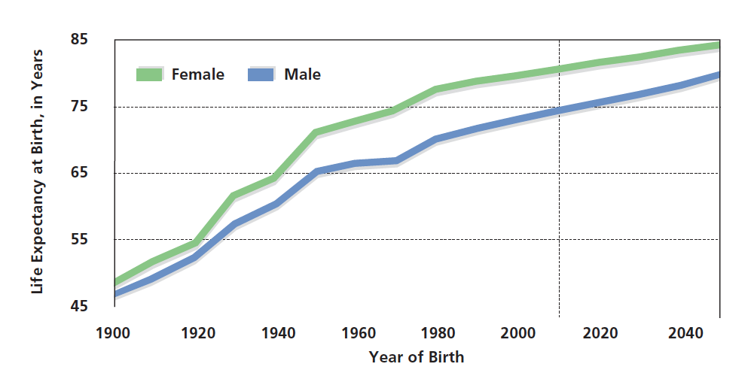
Figure 17-10 Living to Age 100
If increases in life expectancy continue, it may be a common occurrence for people to live to be 100 by the end of this century. What implications does this have for society?

Slide 51
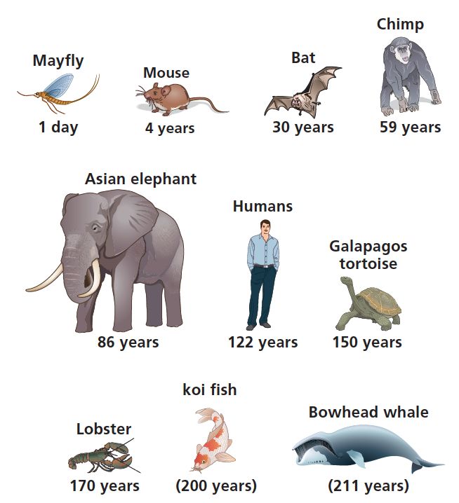
Figure 17-11 Animal Life Spans
Maximum recorded life spans for animals found in the wild.

Slide 52
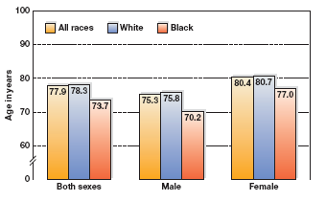
Figure 17-12 Life Expectancy of African Americans and Whites
Both male and female African Americans have a shorter life expectancy than male and female Caucasians. Are the reasons for this genetic, cultural, or both?
Notes:
Both male and female African Americans have a shorter life expectancy than male and female Caucasians.
Are the reasons for this genetic, cultural, or both?
(Source: Xu, Kochanek & Murphy, 2010.)

Slide 53
Finding the Fountain of Youth
Telomere therapy
Drug therapy
Unlocking a “longevity gene”
Reducing free radicals through antioxidant drugs
Restricting calories
Bionic solution: replacing worn-out organs
Notes:
Telomere therapy: tip of chromosomes grow shorter with each cell division. When telomere goes away, cell division stops.
Reducing free radicals: Free radicals are unstable molecules as result of cell functioning that may drift and cause cell damage; some believe reduced by antioxidants.
Restricting calories: fewer free radicals
Bionic solution: transplants

Slide 54
Cognitive Development in Late Adulthood
17.10 Describe how well older adults function cognitively.
17.11 Discuss in what ways memory does and does not decline in late adulthood.
17.12 Describe how learning and education continue in late adulthood.

Slide 55
Intelligence in Older People
Older Research Studies and Findings
Notion that older people become less cognitively adept initially arose from misinterpretations of research evidence
Problems
Cohort effects
Reaction-time components
Retesting effects
Subject attrition
Notes:
Initially drew a simple comparison between younger and older people’s performance on the same IQ test, using traditional cross-sectional experimental methods.

Slide 56
Recent Findings about Intelligence in Older People
Sequential studies
Some abilities gradually decline; others stay relatively steady
No uniform pattern of age-related changes across all intellectual abilities
Acquired strategies remains steady and may improve
Notes:
Some abilities gradually decline throughout adulthood, starting at around age 25, while others stay relatively steady.
There is no uniform pattern in adulthood of age-related changes across all intellectual abilities.
Fluid intelligence declines with age, while crystallized intelligence remains steady and in some cases actually improves.
Strategies that people have acquired remains steady and in some cases actually improves.

Slide 57
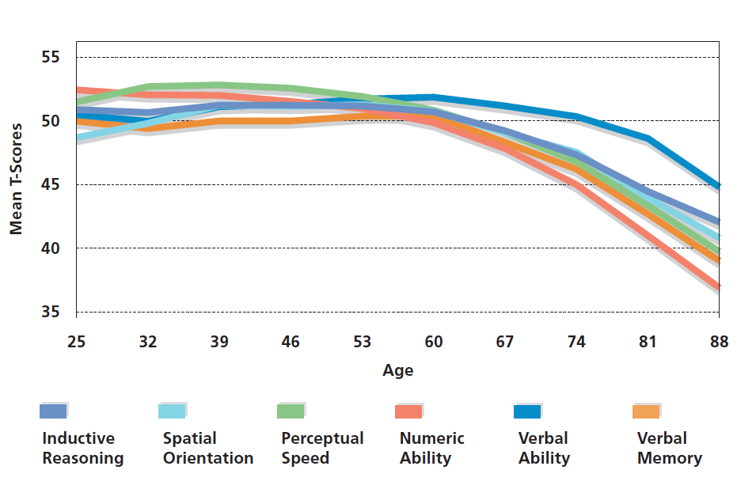
Figure 17-13 Changes in Intellectual Functioning
Although some intellectual abilities decline across adulthood, others stay relatively steady.
Notes:
Although some intellectual abilities decline across adulthood, others stay relatively steady. (Source: Schaie, 1994, p. 307.)

Slide 58
Environmental Factors
  Certain environmental and cultural factors are related to greater or lesser degrees of intellectual decline
  Lesser declines are associated with many factors such as
    absence of chronic disease
    higher socioeconomic status
    involvement in an intellectually stimulating environment
    a flexible personality style
    marriage to a bright spouse
Notes:
Schaie and Willis taught people whose reasoning and spatial skills had declined a variety of skills. More than half showed significant improvement.
Such Plasticity, or modifiability of behavior, suggests that there is nothing fixed about the changes that may occur in intellectual abilities during late adulthood ("Use it or lose it").
Lesser declines are associated with:
Good health
High SES
Involvement in an intellectually stimulating environment
Flexible personality
Being married to a bright spouse
Maintenance of good perceptual processing speed
Feeling self-satisfied with one’s accomplishments in middle and early old age

Slide 59
Maintaining Mental Ability
Exercising the aging brain
Continued stimulation keeps cognitive abilities sharp
Cognitive training showed long-term effects
Engaging in some form of mental workout - consistently and continually increasing the level of difficulty - is key to success

Slide 60
Two Views of Plasticity (1 of 2)
A developing structure or behavior is susceptible to experience
There is nothing fixed about the changes that occur in intellectual abilities during late adulthood

Slide 61
Two Views of Plasticity (2 of 2)
Rate of true, underlying cognitive decline in late adulthood is unaffected by mental exercise
Cognitive reserve allows continued performance at relatively high mental levels, even with underlying declines

Slide 62
Memory: Remembrance of Things Past and Present
Episodic memory
Semantic memory
Short-term memory
Notes:
Memory losses occur primarily to episodic memory, which relates to specific life experiences.
Semantic memories (general knowledge and facts) and implicit memories (memories about which people are not consciously aware) are largely unaffected by age.
Short-term memory declines gradually until age 70, when it becomes more pronounced.
Information presented quickly and verbally is forgotten sooner.
New information is more difficult to recall perhaps because it is not processed as efficiently.

Slide 63
Decline and Stability
Age-related memory declines are limited primarily to episodic memories
Semantic memories and implicit memories are largely unaffected by age
Notes:
Even when memory declines that can be directly traced to aging do occur, they are limited primarily to episodic memories, which relate to specific life experiences such as recalling the year you first visited New York City. In contrast, other types of memory, such as semantic memories (general knowledge and facts, such as the fact that 2 + 2 = 4 or the name of the capital of North Dakota) and implicit memories (memories about which people are not consciously aware, such as how to ride a bike), are largely unaffected by age.
Memory capacities do change during old age. For instance, short-term memory slips gradually during adulthood until age 70, when the decline becomes more pronounced. The largest drop is for information that is presented quickly and verbally, such as when someone staffing a computer helpline rattles off a series of complicated steps for fixing a problem with a computer. In addition, information about things that are completely unfamiliar is more difficult to recall.

Slide 64
Recalling the Days of Our Lives
Autobiographical memory
Pollyanna principle
Recall of material that “fits” current self-view
Particular periods of life are remembered more easily than others
Notes:
People’s AUTOBIOGRAPHICAL MEMORY, memories of information about one’s own life, frequently follows the Pollyanna principle, in which pleasant memories are more likely to be recalled than unpleasant memories.
People recall material that "fits" their current self-view.
Particular periods of life are remembered more easily than others.
70-year-olds recall their 20s and 30s best.
50-year-olds recall their teenage years and their 20s best.

Slide 65
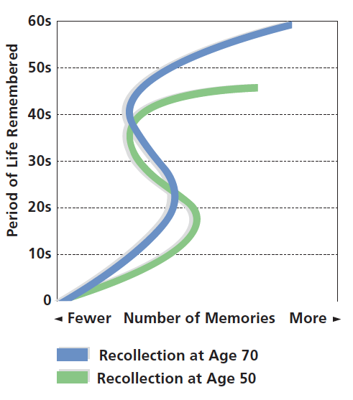
Figure 17-14 Remembrances of Things Past
Recall of autobiographical memories varies with age, with 70-year-olds recalling details from their 20s and 30s best, and 50-year-olds recalling memories from their teenage years and 20s. People of both ages also recall more recent memories best of all

Slide 66
Explaining Memory Changes in Old Age
Explanations for apparent changes in memory among older people tend to focus on three main categories
Environmental factors
Information processing deficits
Biological factors

Slide 67
Information-Processing Deficits
Inability to inhibit irrelevant information and thoughts declines
Speed of processing declines
Attention declines
Less efficient retrieval methods

Slide 68
Biological Factors
Brain and body deterioration
Especially frontal lobes
Continuation of education in old age
Can improve cognitive skills

Slide 69
Never Too Late
Popularity of programs such as Road Scholar is part of a growing trend among older people
Retired people have time to pursue further education
Many public colleges encourage senior citizens to enroll in classes by providing them with free tuition
Older adults often have no trouble maintaining their standing in rigorous college classes
Professors and other students generally find the presence of older people to be an educational benefit

Slide 70
Technology Use and Age
People 65 and older are less likely to use technology than younger individuals
Less interested and motivated
Cognitive barrier related to decline in fluid intelligence

Slide 71
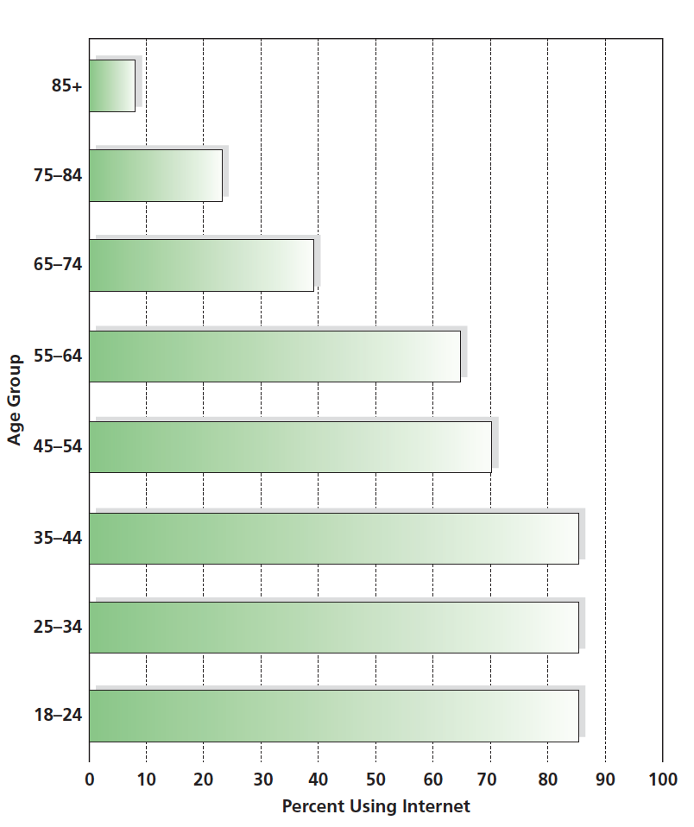
Figure 17-15 Technology Use and Age
Older individuals in the United States are far less likely to use the Internet than those who are younger.

Slide 72

Copyright

