Slide 1

Development Across the Life Span
Eighth Edition
Chapter 18
Social and Personality Development in Late Adulthood
Copyright © 2017,2014, 2011 Pearson Education, Inc. All Rights Reserved

Slide 2
Learning Objectives (1 of 3)
18.1 Describe ways in which personality develops during late adulthood.
18.2 Explain how age relates to the distribution of resources, power, and privilege.
18.3 Define wisdom and describe how it is correlated with age.
18.4 Differentiate the theories of aging.

Slide 3
Learning Objectives (2 of 3)
18.5 Describe the circumstances in which older people live and the difficulties they face.
18.6 Discuss how financially secure older people are in the United States today.
18.7 Summarize the positives and negatives of retiring as well as typical stages retired people pass through.
18.8 Describe how marriages fare in late adulthood.

Slide 4
Learning Objectives (3 of 3)
18.9 Describe the typical reactions to the death of a spouse during late adulthood.
18.10 Discuss the nature of relationships in late adulthood.
18.11 Explain how aging affects family relationships.
18.12 Discuss what causes elder abuse and how it can be prevented.

Slide 5
Personality Development and Successful Aging
18.1 Describe ways in which personality develops during late adulthood.
18.2 Explain how age relates to the distribution of resources, power, and privilege.
18.3 Define wisdom and describe how it is correlated with age.
18.4 Differentiate the theories of aging.

Slide 6
Continuity and Change in Personality
Fundamental continuity to personality
Profound social environmental changes throughout adulthood may produce fluctuations and changes in personality
Some discontinuities in development

Slide 7
Erik Erikson
Ego-integrity-versus-despair
Process of looking back over one’s life, evaluating it, and coming to terms with it
Integrity
Comes when people feel they have realized and fulfilled the possibilities that have come their way
Despair
Occurs when people feel dissatisfied with their life, and experience gloom, unhappiness, depression, anger, or feel that they have failed

Slide 8
Robert Peck
Personality development in elderly people is occupied by three major developmental tasks or challenges
Redefinition of self versus preoccupation with work role
Body transcendence versus body preoccupation
Ego transcendence versus ego preoccupation

Slide 9
Daniel Levinson
People enter late adulthood by passing through a transition stage
View themselves as being “old”
Recognize stereotypes and loss of power and respect
Serve as resources to younger individuals
Discover new freedom to do things for the sake of enjoyment and pleasure

Slide 10
Bernice Neugarten
Four different personality types of people in their 70s
Disintegrated and disorganized
Passive-dependent personalities
Defended personalities
Integrated personalities

Slide 11
Life Review and Reminiscence
A common theme of personality development
Triggered by increasingly obvious prospect of one’s death
Provides better understanding of past
Resolves lingering problems and conflicts
Leads to sense of sharing, mutuality, and a feeling of interconnectedness with others

Slide 12
Age Stratification Approaches to Late Adulthood
Economic resources, power, and privilege are distributed unequally at different stages of life course
Power and prestige for elderly have eroded in industrialized societies
Rapidly changing technology causes older adults to be seen as lacking important skills
Older adults are regarded as not particularly productive members of society and in some cases, simply irrelevant

Slide 13
Does Age Bring Wisdom?
Wisdom reflects accumulation of knowledge, experience, and contemplation
Wisdom is not the same as intelligence
Older adults appear to be able to draw on a more sophisticated theory of mind

Slide 14
Successful Aging: What is the Secret?
Disengagement theory
  Gradual retreat
Activity theory
  Continued involvement
Continuity theory
  Compromise position

Slide 15
Disengagement Theory
Late adulthood involves a gradual withdrawal from the world on physical, psychological, and social levels
Withdrawal is a mutual process and not necessarily negative

Slide 16
Activity Theory
Happiness and satisfaction from high level of involvement
Adaptation to inevitable changes
Continuing or replacing previous activities

Slide 17
Continuity Theory
People need to maintain their desired level of involvement in society to maximize their sense of well-being and self-esteem
Regardless of activity level, most older adults experience positive emotions as frequently as younger individuals
Good physical and mental health is important in determining an overall sense of well-being

Slide 18
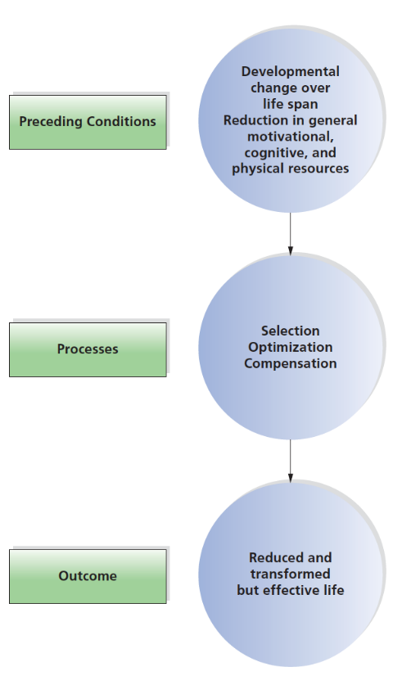
Figure 18-1 Selective Optimization with Compensation
According to the model proposed by Paul Baltes and Margret Baltes, successful aging occurs when an older adult focuses on his or her most important areas of functioning and compensates for losses in other areas. Is this unique to old age?

Slide 19
The Daily Life of Late Adulthood
18.5 Describe the circumstances in which older people live and the difficulties they face.
18.6 Discuss how financially secure older people are in the United States today.
18.7 Summarize the positives and negatives of retiring as well as typical stages retired people pass through.

Slide 20
Places and Spaces
Living at Home
Specialized Living Environments
  Continuing-care community
    Assisted living
  Nursing institutions
    Adult day-care facilities
    Skilled-nursing facilities

Slide 21
Living in Nursing Homes
Greater the extent of nursing home care, the greater adjustment required of residents
Loss of independence brought about by institutional life may lead to difficulties
Elderly people are as susceptible to society’s stereotypes about nursing homes

Slide 22
Institutionalism and Learned Helplessness
Institutionalism
Psychological state in which people in nursing homes develop apathy, indifference, and a lack of caring about themselves
Learned helplessness
A belief that one has no control over one’s environment

Slide 23
The Economics of Late Adulthood
People who were well-off in young adulthood remain so in late adulthood
Those who were poor remain poor in late adulthood

Slide 24
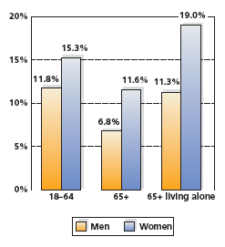
Figure 18-2 Poverty and the Elderly
While 10 percent of those 65 years of age and older live in poverty, women are almost twice as likely as men to be living in poverty.

Slide 25
Other Differences Related to Poverty
Racial and marital variables
8 percent of whites in late adulthood live below the poverty level
19 percent of Hispanics and 24 percent of African Americans live in poverty
Divorced black women aged 65 to 74 had a poverty rate of 47 percent

Slide 26
Financial Vulnerability in Older Adulthood
Reliance on a fixed income for support
Social Security benefits
Pensions, and savings, rarely keep up with inflation
Rising cost of health care

Slide 27
Work and Retirement
Retirement is a major decision
Social Security
Part-time employment
Mandatory retirement

Slide 28
Retirement (1 of 2)
Discrimination
Encourage older workers to leave their jobs in order to replace them with younger employees whose salaries will be considerably lower
Believe older workers are not up to demands of the job or are less willing to adapt to a changing workplace

Slide 29
Retirement (2 of 2)
Retirement decision based on variety of factors
  Burnout
  Health concerns
  Employer incentives
  Desire to travel, study, or spend more time with family

Slide 30
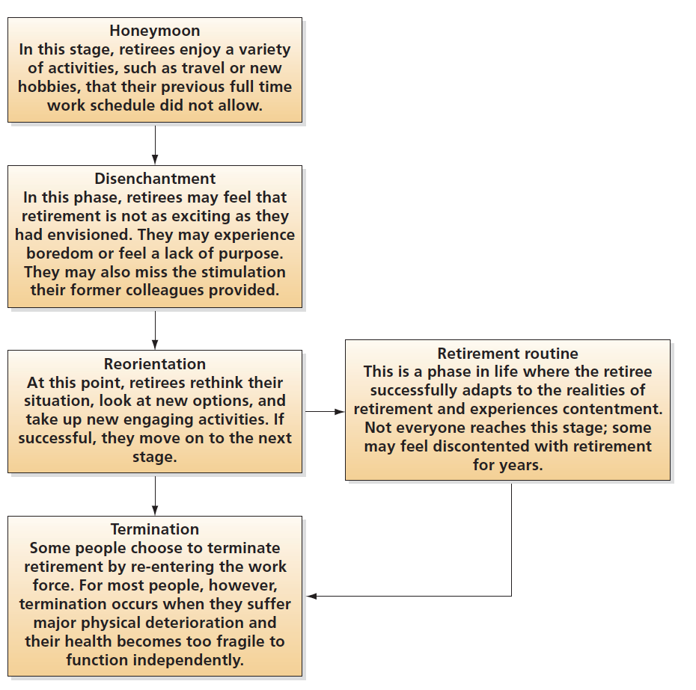
Figure 18-3 Stages of Retirement

Slide 31
Relationships: Old and New
18.8 Describe how marriages fare in late adulthood.
18.9 Describe the typical reactions to the death of a spouse during late adulthood.
18.10 Discuss the nature of relationships in late adulthood.
18.11 Explain how aging affects family relationships.
18.12 Discuss what causes elder abuse and how it can be prevented.

Slide 32
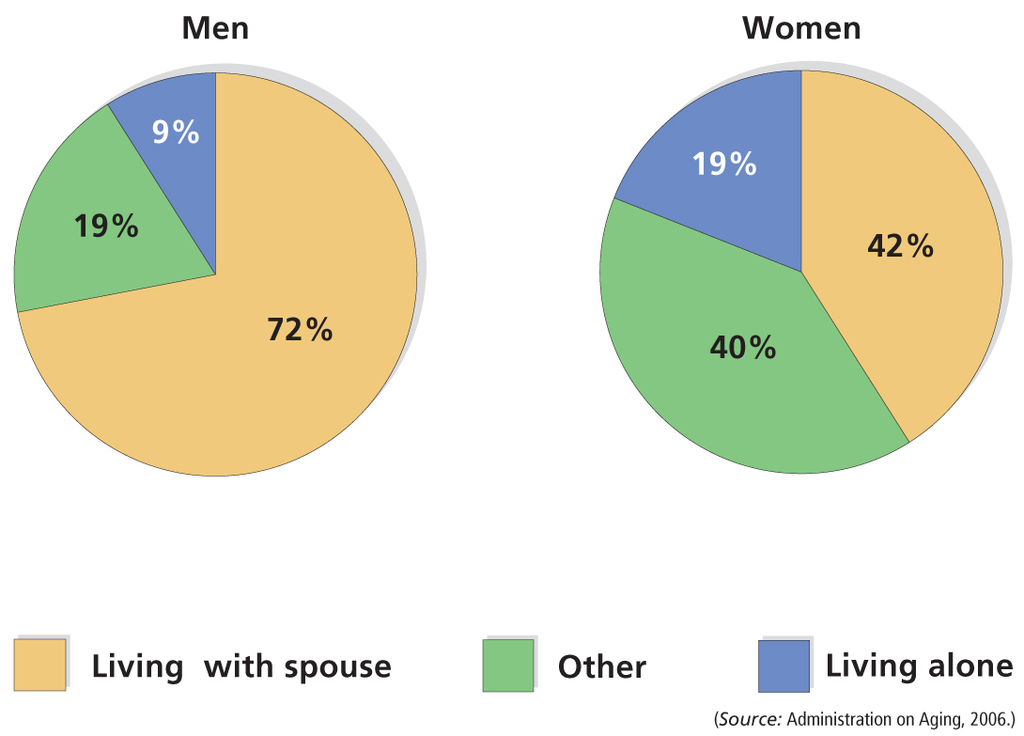
Figure 18-4 Living Patterns of Older Americans
What, if anything, do these patterns suggest about the relative health and adjustment of older men and women?

Slide 33
Stress and Its Consequences
Stress of retirement or old age may change relationships
2 percent of divorces in the U.S. involve women
over 60
Divorce is harder on women than on men

Slide 34
Refashioned Relationships
For many couples, retirement means that relationships need to be renegotiated
More time together
More sharing in household chores
Role reversals
Health changes

Slide 35
Caring for an Aging Spouse
Women more likely to provide care
Men die earlier
Traditional gender role of “caregiver”

Slide 36
The Death of a Spouse
Few events are more painful than the death of a spouse
No longer part of a couple
Must deal with profound grief
No one to share life with and social life often changes
Economic changes often occur

Slide 37
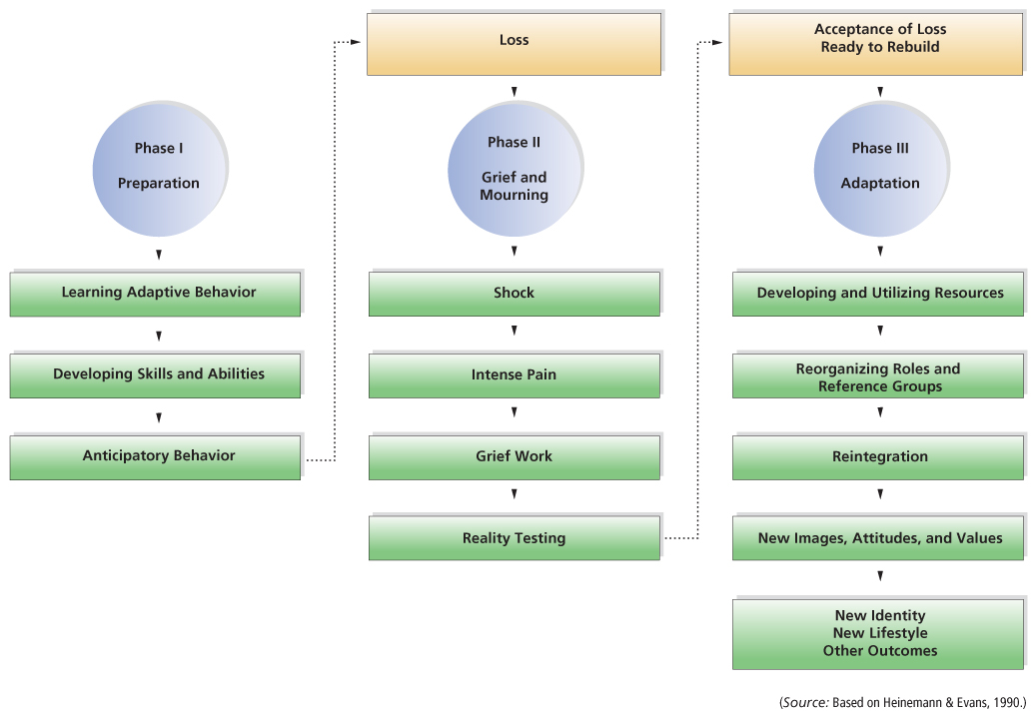
Figure 18-5 Adjustment to Widowhood
Do you think the process of adjustment is identical for men and women?

Slide 38
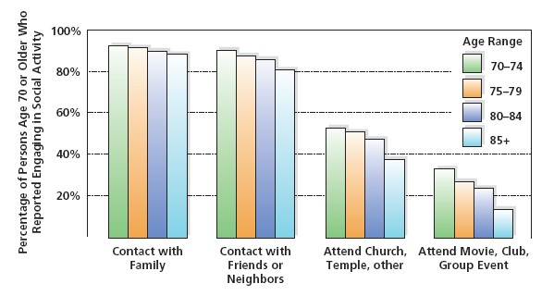
Figure 18-6 Social Activity in Late Adulthood
Friends and family play an important role in the social activities of the elderly.

Slide 39
Social Support (1 of 2)
Social support is assistance and comfort supplied by a network of caring, interested people
Important for successful aging
Material and psychological support

Slide 40
Social Support (2 of 2)
Benefits for Recipient
  Sympathetic ear and sounding board for one’s concerns
  Unmatched degree of understanding and a pool of helpful suggestions from like other
  Material support
Benefits for Provider
  Experience feelings of usefulness and heightened self-esteem

Slide 41
Family Relationships
Important connections
Siblings, children, grandchildren, and great-grandchildren provide an important source of comfort to adults during the last years of their lives
  Siblings are important because of shared life experiences
  Children often most important

Slide 42
Developmental Stake
Parents see their children as perpetuating their beliefs, values, and standards
Most parents and children remain close
  75 percent of children live within a 30-minute drive to their parents
  Daughters tend to be in more frequent contact than sons
  Mothers tend to be the recipient of communication more than fathers
  Children may turn to their elderly parents for advice, information, and monetary help

Slide 43
Table 18-1 Views of Parents and Children Regarding Behavior of Adult Children toward Parents (1 of 2)
Rank | Children’s Ranking | Parent’s Ranking
1 | Help understand resources | Discuss matters of importance
2 | Give emotional support | Help understand resources
3 | Discuss matters of importance | Give emotional support
4 | Make room in home in emergency | Give parents advice
5 | Sacrifice personal freedom | Be together on special occasions
6 | Care when sick | Sacrifice personal freedom
7 | Be together on special occasions | Make room in home in emergency
8 | Provide financial help | Feel responsible for parent

Slide 44
Table 18-1 Views of Parents and Children Regarding Behavior of Adult Children toward Parents (2 of 2)
Rank | Children’s Ranking | Parent’s Ranking
9 | Give parents advice | Care when sick
10 | Adjust family schedule to help | Adjust family schedule to help
11 | Feel responsible for parent | Visit once a week
12 | Adjust work schedule to help | Adjust work schedule to help
13 | Believe that parent should live with child | Provide financial help
14 | Visit once a week | Visit once a week
15 | Live close to parent | Believe that parent should live with child
16 | Write once a week | Live close to parent

Slide 45
Grandchildren
Not all grandparents are equally involved with their grandchildren
Gender differences in behaviors and reactions of grandparents and grandchildren
Cultural differences in grandparenting

Slide 46
Great-grandchildren
Play less of a role in the lives of both white and African American grandchildren
Close relationships tend to occur only when the great-grandparents and great-grandchildren live relatively near one another

Slide 47
Elder Abuse: Relationships Gone Wrong
Physical or psychological mistreatment or neglect of elderly individuals
May affect as much as 11 percent of elderly
Is most frequently committed by a family member
Often the result of a combination of economic, psychological, and social pressures on caregivers
Best approach for dealing with abuse is prevention

Slide 48

Copyright

