Slide 1

Final Examination Review

Slide 2

Your Choice
You may choose to take either the final paper or final exam.

Slide 3
Final Paper
Non-traditional synthesis of the information we have covered in this course. This paper should be between 8-10 pages long. With this paper I am asking you to explore what your ideal healthcare system would like and support why you feel this is the way we should administer healthcare in this country. You should explore topics like whether in your system patients would have a right to privacy, would your system include HIPAA or something else entirely different. Does your system include EMTALA? How does your system combat fraud, waste and abuse? What about informed consent. What system would you use when patients were harmed by healthcare providers? How is your system regulated? While you do not have to tackle every aspect of healthcare we have covered this semester, you need to provide a framework for how your ideal healthcare system would function. Your paper should prove that you have an understanding of what is needed for a functioning healthcare system in this country.
Key Areas to Address
Regulatory
Privacy
EMTALA
Payor-Who pays and how?
Malpractice, i.e. who pays when a patient is harmed?
End of Life Decision Making-Who gets to decide.
Final Paper: 300 points Plus Extra Credit – Due March 12th

Slide 4
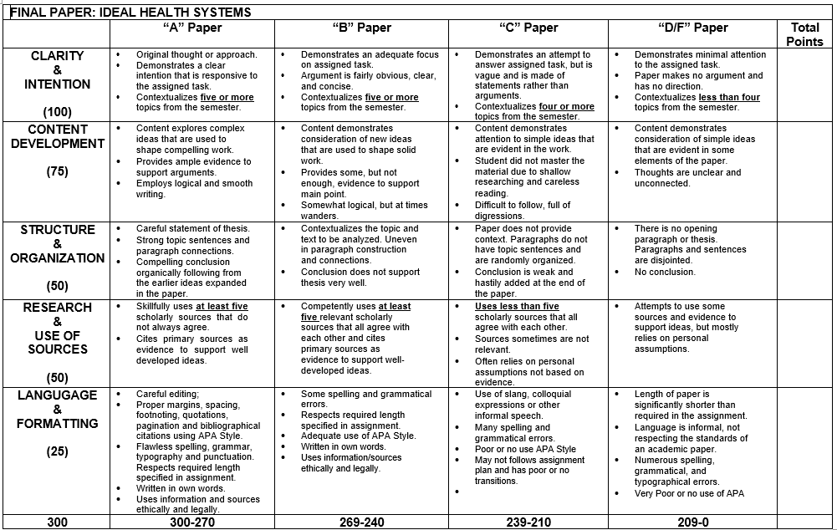
Final Paper Rubric

Slide 5
Final Paper Continued…
Comments: Remember I am looking for upper level thought when conceptualizing the topics we have discussed this semester. Ask yourself what does my ideal health system look like and how do I get there. What needs to be in place to achieve an ideal state and why. Your “why” statements should be persuasive. To get a top grade on this paper you are essentially writing 5 or more mini papers. Top grades will be awarded to those students who weave the 5 topics together to show why together those issues help form an ideal healthcare system. For example if you decide an ideal system needs to include some type of patient privacy rules, some type of anti-dumping statute, some type of informed consent, some type of regulatory oversight and structure and some type of malpractice system. You would review each of those issues separately, but extra points will be awarded for those students who show that together those issues form an ideal system.
EXTRA CREDIT: For an additional 5 points extra credit, you can submit a paragraph or two on what you liked about this class and what could have been better. I am looking for honest feedback, to improve the class moving forward.

Slide 6
Key Areas to Address
Regulatory
Privacy
EMTALA
Payor-Who pays and how?
Malpractice, i.e. who pays when a patient is harmed?
End of Life Decision Making-Who gets to decide.

Slide 7
Final Exam Preparation
Final exam period begins on Monday, March 8th at 8am and must be completed by Friday, March 12th at 11:55 p.m. CST
There will be a cumulative final in this class. Grading is anonymous.
You will be able to start and stop the final…. Open book is permissible.
The questions will be comprised of the following:
25 Multiple Choice questions, worth 2 points each. (Total Point Value: 50)
4 Short Answer questions, worth 25 points each. (Total Point Value: 100)
2 Long Essay questions, worth 75 points each. (Total Point Value: 150)
TOTAL POINTS: 300 Plus Extra Credit
Extra Credit: 5 points – What did you like about the class and what would you change?
If you access the final exam, you have to complete it. You cannot switch and do the final paper once the exam is accessed.
Use section headers.
This review is not cumulative and should serve only as a supplemental study resource.

Slide 8
Areas to Review
EMTALA
Informed Consent
HIPAA
Medicare
End of life
Medicaid (General)
Fraud, Waste, and Abuse
Anti kickback
Stark
Community benefit
Malpractice
Physician and hospital agreements
Healthcare transactions
Risk management
Medical errors

Slide 9

Regulatory Schemes
Fraud and Abuse:
False Claims Act
STARK (Physician Self-Referral Law)
Anti-Kickback
Civil Monetary Penalties Law
Privacy and Security:
HIPAA, HITECH, and the OMNIBUS Rule
Regulatory:
Deficit Reduction Act (2005, Medicaid Integrity Program)
Affordable Care Act (ACA) of 2010

Slide 10
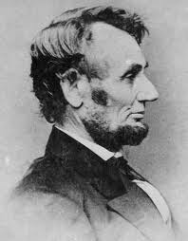
False Claims Act - 31 U.S.C. §§ 3729-3731
Enacted in 1863 to combat fraud by government contractors.
Known as “informer’s Act” or “Lincoln Laws”
Used extensively to combat fraud in government health care programs.
Amended in 1986 to include non-retaliation (whistleblower) protections.
More than $13 billion has been recovered since 1986

Slide 11
False Claims Act – Three Elements
Intent to Defraud Government
Submission of a False Claim
False Information was a Material Fact in the Government’s Decision to Grant Reimbursement

Slide 12

Liability and the FCA
The False Claims Act establishes liability for any individual or entity that KNOWINGLY presents false or fraudulent claims to the US government for payment
Covers claims presented to any health care program funded in whole or in part by federal funds
“Knowing” includes actual knowledge, deliberate ignorance and reckless disregard for the truth or falsity of the information
Applies to individuals and corporate entities

Slide 13

What is Knowing Under the FCA?
Has actual knowledge.
Acts in deliberate ignorance of the truth or falsity of the information.
Acts in reckless disregard of the truth or falsity of the information.
Proof of specific intent to defraud is not required.

Slide 14
Anti-Kickback & STARK
Remuneration
Referrals
Purpose:
To prevent payments and/or incentives to physicians designed to induce referrals that impact clinical judgment.
Basic Rules:
Never offer anything of value to induce referrals for the delivery of healthcare or the furnishing of designated health services for payment by a federal healthcare program (MEDICARE, MEDICAID, TRICARE, VA, CHIP, or FEHB)
Never compensate a physician without a signed, written agreement, or for more than FMV.

Slide 15
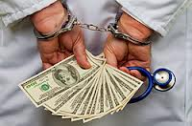
Anti-Kickback Statute
(42 USC § 1320a-7b(b)) – Criminal Statute
Prohibits offering, paying, soliciting or receiving remuneration (anything of value) to induce or reward referrals or generate Federal Government healthcare business.
Penalties
Fines up to $25,000 per violation
Up to 5 years in prison, per violation
Exclusion from Federal Government programs
Example of Kickbacks Include:
Offering or Acceptance of Professional Courtesy
Cash for referrals
Discounted or free rent for medical offices
Excessive compensation (v) Fair Market Value

Slide 16
Anti-Kickback – Three Elements
Knowingly & Willfully
PPACA of 2010
Intent to Violate “Some” Law
Induce the Referral of Services Reimbursed by a Federal Health Program
Direct or Indirect Payments or Remuneration

Slide 17
Anti-Kickback Safe Harbors
Investments in large publicly held healthcare companies and joint ventures | Space rental | Equipment rental | Personal services and management contracts
Sales of retiring physicians' practices to other physicians | Referral services | Warranties | Discounts
Increased coverage, reduced cost-sharing amounts, or reduced premium amounts offered by health plans | Group purchasing organization | Waiver of beneficiary coinsurance and deductible amounts | Employee Compensation
Price reductions offered to health plans | Practitioner recruitment | Obstetrical malpractice insurance subsidies | Investments in group practices
Cooperative hospital service organizations | Ambulatory surgical centers | Referral arrangements for specialty services. | Price reductions offered to eligible managed care organizations
Price reductions offered by contractors with substantial financial risk to managed care organizations | Ambulance replenishing | Health centers | Electronic prescribing items and services and Electronic health records items and services

Slide 18

Physician Self-Referral Law (STARK Law)
The Physician Self-Referral Law (42 U.S.C. Section 1395nn)
Prohibits a physician from making a referral for certain designated health services (DHS) to an entity in which the physician (or an immediate member of his or her family) has an ownership or investment interest or a compensation arrangement exists, unless an exception applies.

Slide 19

Key Language of STARK Law
[I]f a physician (or an immediate family member of such a physician) has a financial relationship with an entity…., then the physician may not make a referral to the entity for the furnishing of designated health services for which payment otherwise may be made [under Medicare or Medicaid]
[T]he entity may not present a claim….or bill any individual, third party payor, or other entity for designated health services furnished pursuant to a referral prohibited under this law.

Slide 20

What is a “Financial” Relationship?
A prohibited “financial” relationship may take TWO forms:
Direct or Indirect Ownership of an Entity – This includes equity stocks, interests in a Limited Liability Company (LLC), holding debt in the entity, and making loans to the entity.
Direct or Indirect Compensation – This includes compensation from the entity for employment, leases between healthcare facilities and physicians / physician practice groups, medical director agreements, and independent contracts with physicians.

Slide 21
STARK Exceptions
Publicly traded securities | Mutual funds | Specific providers | Rental of office space | Rental of equipment
Bona fide employment relationships | Personal service arrangements | Physician recruitment | Physician recruitment | Remuneration unrelated to DHS
Certain group practice arrangements with hospitals | Payments by a physician | Fair market value compensation | Implants (in ambulatory surgery centers) | Risk-sharing arrangements
Compliance training | Indirect compensation arrangements | Charitable donations by physicians | Referral services | Obstetrical malpractice insurance subsidies
Professional courtesy | Retention payments in underserved areas | Communitywide health information systems | Electronic prescribing items and services | Electronic health records items and services
Physician services | In-office ancillary services | Prepaid health plan services | Academic medical center services
Dialysis-related drugs (end-stage renal disease) | Preventive screening tests and immunizations | Post-cataract surgery eyeglasses and contact lenses | Intra-family rural referrals

Slide 22

How to Analyze STARK Issues
Is there a referral from a physician for a designated health service?
If yes….
Does the physician (or an immediate family member) have a direct or indirect financial relationship with the entity providing the DHS service?
If yes…
Does the financial relationship fit into an exception?
If NO….
There’s a Stark Violation

Slide 23

Emergency Medical Treatment and Labor Act (EMTALA)
In 1986, Congress enacted the Emergency Medical Treatment & Labor Act (EMTALA) to ensure public access to emergency services regardless of ability to pay.
Emergency Medical Treatment must be available to all persons regardless of diagnosis, financial status, race, color, national origin, handicap.
Section 1867 of the Social Security Act imposes obligations on Medicare-participating hospitals to provide medical screening examinations (MSE) or treatment for emergency medical conditions (EMC) regardless of an individual's ability to pay.

Slide 24


EMTALA Oversight and Enforcement
CMS is responsible for promulgating and interpreting guidelines. Hospitals must report an inappropriate transfer. Failure to report could result in Medicare exclusion.
OIG administers sanctions for EMTALA violations. Hospitals face CMPs of $25,000 if under 100 beds and up to $50,000 for larger hospitals. Physicians may receive CMP of up to $50,000 for refusal of on-call request/negligence.

Slide 25

EMTALA – Two Basic Duties
1. Duty to Screen
Medical Screening Examination (MSE)
  A physical exam whereby a physician or other licensed practitioner is able to reach, within reasonable degree of clinical certainty, that an emergency medical condition does or does not exist.
Duty to Stabilize
*Remember, duties are present as soon as
patient arrives at the hospital, even if arrives
mistakenly.

Slide 26

How Far Does EMTALA Reach?
EMTALA extends to 250 yards around the main hospital campus buildings (250 yards is the distance of two and a half football fields in length!).
For example, if a person collapses on the sidewalk outside of the ED, EMTALA is triggered.

Slide 27

EMTALA No Right of Refusal
Hospitals cannot be influenced by a person’s ability to pay, and the medical screening cannot be delayed to determine if the person has insurance coverage.
Hospitals with specialty units or regional referral centers identified by CMS cannot refuse to accept appropriately transferred patient who requires care within their specialty.

Slide 28
When EMTALA Doesn’t Apply
EMTALA does not apply to visitors or hospital employees who experience an emergency medical condition
EMTALA does not apply to anyone who has begun to receive services during routine outpatient visit and develops emergency medical condition
EMTALA is no longer applicable once the patient has been admitted (even if overnight for observation)

Slide 29

What is HIPAA?
HIPAA is a Federal Law applicable to Covered Entities, Business Associates (BAs), and sub-contractors, acting on behalf of BAs
HIPAA is the Health Insurance Portability and Accountability Act of 1996
HIPAA was a response, by Congress, to govern the healthcare industry, and secure the privacy of protected health information (PHI)

Slide 30


HIPAA Privacy Rule v. HIPAA Security Rule
HIPAA Privacy Rule - Established national standards for the protection of certain health information (PHI).
HIPAA Security Rule - Established security standards (Administrative, Physical and Technical) for the protection of electronic protected health information (e-PHI).

Slide 31
HITECH Required Safeguards
Administrative (45 CFR 164.308)
Physical (45 CFR 164.310)
Technical (45 CFR 164.312)
Develop, Implement, and Maintain Security Measures
Policies / Procedures (Compliance Program / Contingency Plan)
Educate and Train Employees
Implement Facility Controls (Internal / External)
Workstation Use / Security
Device / Media Controls
Access / Audit Controls
Integrity (Mechanisms to Authenticate e-PHI)
Person / Entity Authentication
Transmission Security (Encryption / Decryption)
Conduct Periodic Risk Assessments

Slide 32
Who is a Covered Entity?
Health Care Providers
Doctors
Clinics
Dentists
Chiropractors
Nursing Homes
Pharmacies
Health Plans
HMOs
Government Health Programs (Medicare, Medicaid, Tricare, and VA/CHAMPVA)
Health Insurance
Health Care Clearing Houses
A company that processes nonstandard health information, received from another entity, into a standardized electronic format (Billing, Value-Added Networks)

Slide 33
Minimum Necessary Requirement
Standard:
The minimum necessary standard requires covered entities to evaluate their practices and enhance safeguards as needed to limit unnecessary or inappropriate access to and disclosure of protected health information.
Exceptions:
Treatment
Authorization for Specific Purpose
Disclosures Required By Law
Disclosing Information with the Patient

Slide 34
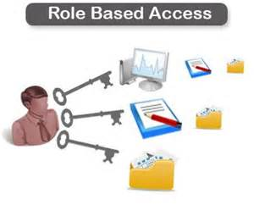
Role Based Access
Defines the flow of Protected Health Information
Role Based Access ensures that employees and healthcare workers use or disclose only the minimum amount of PHI to perform his/her job.

Slide 35

HIPAA-Compliant Authorizations
Authorizations must meet HIPAA Privacy Rule requirements:
Identification of the specific information to be used or disclosed
Expiration date or the expiration of the event
Signature of the patient and date
Expressed language allowing the individual to revoke authorization, in writing

Slide 36

Omnibus Rule
    Omnibus - Adjective: Containing or including “many” items
    http://www.merriam-webster.com/dictionary/omnibus
    Privacy Rule
    Security Rule
    Breach Notification Rule
    Enforcement Rule
So how “many” Items are we talking about?
“. . . the most sweeping changes to the HIPAA Privacy and Security Rules since they were first implemented.”
Leon Rodriguez, Director, HHS Office for Civil Rights

Slide 37

OMNIBUS RULE
Business Associates (BA)
Expanded Definition of BA under OMNIBUS RULE
BAs now include:
Health Information Organizations (HIOs)
E-Prescribing Gateways
Patient Safety Organizations
Vendors of PHI
Data Storage Vendors
Attorneys (WOW……………………)
Direct liability of BAs for HIPAA violations
New requirements for Business Associate Agreements (BAAs)

Slide 38

OMNIBUS RULE ….. Business Associates
Old Rule 45 CFR Section 160.103
A person, other than a workforce member, who performs a function or activity on behalf of a CE involving the use or disclosure of PHI, or who provides services to or for the CE involving the disclosure of PHI.
New Rule 45 CFR Section 160.103
A person, other than a workforce member, who creates, receives, maintains, or transmits PHI on behalf of a CE (including patient safety activities), or who provides services to or for the CE involving the disclosure of PHI

Slide 39

OMNIBUS RULE
Breach Notification Rule
Omnibus Rule changed the definition of “breach” by removing the “risk of harm” safe harbor.
New Standard – Is there a “significant risk” that PHI “has been compromised” based on the four-factor risk assessment?
A breach affecting more the 500 individuals must be reported to the media, and DHHS, no later than 60 days after discovery.
i
…………… CHANGES …………….
Presumption of a Breach Standard
Four Factor Risk Assessment

Slide 40

OMNIBUS RULE
Enforcement Changes
State Attorney General can pursue HIPAA violations, not just HHS Office of Inspector General. (Expansive Enforcement!)
Individual victims of HIPAA violations may participate in the recovery of penalty funds.
Increased Penalties for:
Level of mens rea (knowledge)
Reasonable Cause
Willful Neglect

Slide 41

Informed Consent
Informed consent is based upon a clear appreciation and understanding of the facts, implications, and consequences.
The person involved should have the legal capacity to give consent; the ability to exercise free power of choice, without force, fraud, deceit, or duress, and should have sufficient knowledge and comprehension of the subject matter involved, sufficient to make an enlightened decision.

Slide 42
Antitrust Laws
Antitrust laws are designed to prohibit unfair business practices and to promote competition in the marketplace.
Under antitrust laws, there are a number of practices that are considered illegal. These include price fixing, creating an illegal monopoly, geographic market allocation and bid rigging.
Companies found guilty of violating antitrust laws can face stiff fines and company officials could face jail time for their part in breaking antitrust regulations.

Slide 43
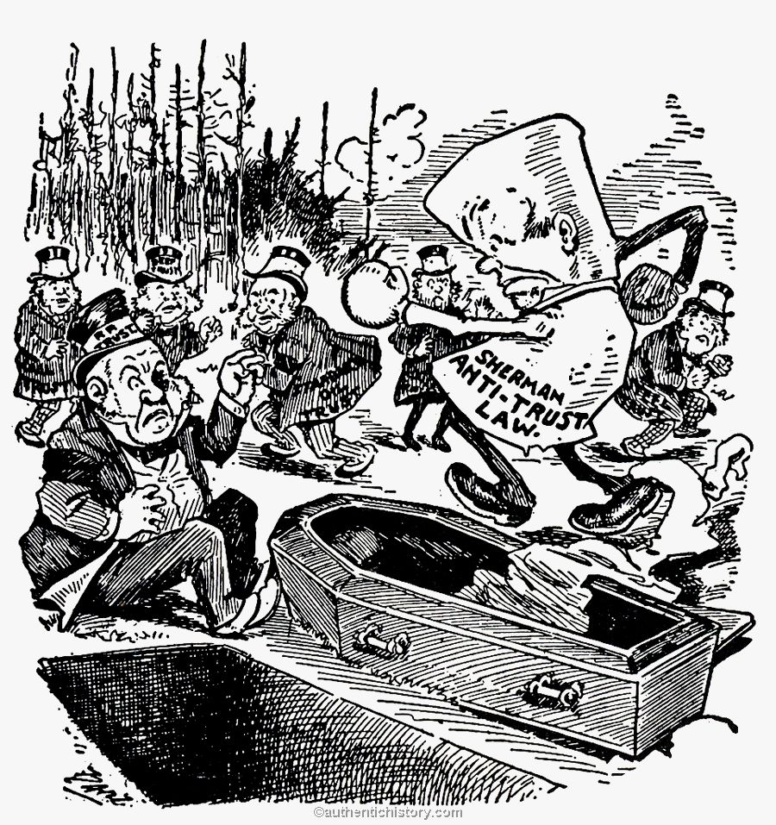
Antitrust Laws
Federal antitrust laws
  Sherman Act
  Clayton Act
  Federal Trade Comm’n Act
  Robinson-Patman Act
  Hart–Scott–Rodino Antitrust Improvements Act
State antitrust laws
  IC 48-101 et seq.

Slide 44
Sherman Antitrust Act
The Sherman Antitrust Act prohibits all contracts, combinations and conspiracies that unreasonably restrict interstate and foreign trade.
This includes price fixing, bid rigging and customer allocation.
Under the Sherman Act, it is a crime to monopolize any part of interstate commerce.
Provisions in the Sherman Act are primarily enforced by the Antitrust Division of the Justice Department

Slide 45
Express Language: Sherman Act § 1
“Every contract, combination in the form of trust or otherwise, or conspiracy, in restraint of trade … is declared to be illegal.
Every person who shall make any contract or engage in any combination or conspiracy hereby declared to be illegal shall be deemed guilty of a felony, and, on conviction thereof, shall be punished by fine not exceeding $100,000,000 if a corporation, or, if any other person, $1,000,000, or by imprisonment not exceeding 10 years, or by both said punishments, in the discretion of the court.”
(15 USC § 1)

Slide 46
Express Language: Sherman Act § 2
“Every person who shall “monopolize”, or attempt to monopolize, or combine or conspire with any other person or persons, to monopolize any part of the trade or commerce among the several States, or with foreign nations, shall be deemed guilty of a felony, and, on conviction thereof, shall be punished by fine not exceeding $100,000,000 if a corporation, or, if any other person, $1,000,000, or by imprisonment not exceeding 10 years, or by both said punishments, in the discretion of the court.”
(15 USC § 2)

Slide 47

Clayton Act
The Clayton Act prohibits mergers or acquisitions that are likely to restrict competition resulting in increased prices for consumers.
The Clayton Act is enforced by both the Antitrust Division and the Federal Trade Commission.

Slide 48
Express Language: Clayton Act § 7
“No person … shall acquire the whole or any part of the assets of another person engaged also in commerce or in any activity affecting commerce, where … the effect of such acquisition may be substantially to lessen competition, or to tend to create a monopoly.”
(15 USC § 18)

Slide 49

Sarbanes-Oxley Act
The Sarbanes-Oxley Act (SOA) came into force in July 2002
SOA introduced major changes to the regulation of corporate governance and financial practice.
SOA is named after Senator Paul Sarbanes and Representative Michael Oxley
SOA is arranged into eleven (11) titles which mandate the Securities and Exchange Commission (SEC) to implement rulings consistent with the law, establish corporate responsibilities, set non-negotiable deadlines for compliance, and impose criminal penalties for violations
From a compliance perspective, the most important sections within the eleven titles are usually considered to be 302, 401, 404, 409, 802, 806 and 807

Slide 50

Sarbanes-Oxley Act Section 302
Disclosure Controls
Section 302 of the SOA requires that an issuers annual and quarterly financial reports are certified by the organization’s principal officers for:
Correctness
Completeness
Effectiveness of Internal Controls

Slide 51
Sarbanes-Oxley Act Section 302
Statutory financial reports shall include certifications that:
Signing officers have reviewed the report
The reports do not contain any material untrue statements or material omission or be considered misleading
The financial statements and related information fairly present the financial condition and the results in all material respects
The signing officers are responsible for internal controls and have evaluated these internal controls within the previous ninety days (90) and have reported on their findings
A list of all deficiencies in the internal controls and information regarding fraud that involves employees involved with internal activities
Any significant changes in internal controls or related factors that could have a negative impact on the internal controls

Slide 52

Sarbanes-Oxley Act Section 401
Disclosure in Public Reports
Mandates Accuracy of Financial Reports: Financial statements, are required to be prepared in accordance with (or reconciled to) generally accepted accounting principles (“GAAP”)
Financial statements are required to be accurate and presented in a manner that does not contain incorrect statements or admit to state “material” information
Financial statements shall include all “material” off-balance sheet liabilities, obligations or transactions

Slide 53

Sarbanes-Oxley Act Section 806
Whistleblower Protection for Employees of Publically Traded Companies
“No company with a class of securities registered under section 12 of the Securities Exchange Act of 1934 (15 U.S.C. 78l), or that is required to file reports under section 15(d) of the Securities Exchange Act of 1934 (15 U.S.C. 78o(d)), or any officer, employee, contractor, subcontractor, or agent of such company, may discharge, demote, suspend, threaten, harass, or in any other manner discriminate against an employee in the terms and conditions of employment because of any lawful act done by the employee”

Slide 54
Exclusions
The authority of OIG to preside over excluded individuals and entities is derived from the Social Security Act
Congress first mandated the exclusion of physicians and other practitioners convicted of program-related crimes from participation in Medicare and Medicaid in 1977 through the Medicare-Medicaid Anti-Fraud and Abuse Amendments, Public Law 95-142
The Civil Monetary Penalties Law (CMPL), 42 U.S.C. § 1320a-7, enacted in 1981, modified penalties for excluded individuals and entities
CMPL authorizes OIG to impose penalties, assessments and program exclusions against any person that submits false or fraudulent claims for Medicare or Medicaid payment

Slide 55
Exclusions
Basis for Civil Penalties & Assessments
The OIG may impose a penalty against any person who “knowingly: presented or caused to be presented, as claim for the following:
Any item or service which the person “knew” or should have known was false or fraudulent or furnished by an excluded individual employed by or otherwise under contract with that person; AND
The item or service was furnished during a period of time in which the person was excluded

Slide 56
Exclusions
Mandatory Exclusion
The OIG is required by law to exclude from participation in all federal healthcare programs individuals and entities for the following reasons:
Conviction of program-related crimes / 5 year exclusion
Conviction relating to patient abuse or neglect / 5 year exclusion
Felony conviction relating to healthcare / 5 year exclusion
Felony conviction relating to controlled substance / 5 year exclusion
Conviction of two (2) mandatory exclusion offenses / Minimum10 years exclusion
Conviction on three (3) or more occasions of mandatory exclusion offenses. Permanent exclusion.

Slide 57
Exclusions
Permissive
The OIG can, at their discretion, can exclude individuals and entities for a number of reasons, including:
Misdemeanor conviction relating to healthcare fraud / 3 years.
Conviction relating to fraud in non-healthcare programs / 3 years.
Conviction relating to obstruction of an investigation / 3 years.
Misdemeanor conviction relating to controlled substance / 3 years.
License revocation or suspension / period of exclusion is imposed by state licensing authority.
Claims for excessive charges, unnecessary services or services which fail to meet professionally recognized standards of healthcare / 1 year.

Slide 58

Investigation and Prosecution of Medicare & Medicaid Fraud
Medicaid is medical coverage for indigent; especially pregnant women and children.
Enforcement of Medicaid and Medicare Fraud is a coordinated effort of three federal agencies:
Medicare is federally-funded, not state-funded.
The Office of the Inspector General;
Department of Justice; and
Federal Bureau of Investigation.

Slide 59
Office of Inspector General
Investigations into Medicare and Medicaid Fraud begin with the Office of the Inspector General
OIG investigators have the power to execute search warrants and serve subpoenas in connection with their investigation

Slide 60
End of Life Decisions
Patients have the right to end treatment, even if it will bring death sooner.
Patients may begin treatment and change their minds, even if it will bring death sooner.
If a patient has an advanced directive and names an individual as their duly appointed agent to make medical decisions, that agent may make decisions on the behalf of the patient if they become incapacitated and unable to make medical decisions.
In most states, including Texas, if a patient does not have an advanced directive, the spouse becomes the agent to make medical decisions if the patient is incapacitated and unable to make medical decisions.
Euthanasia is the administration of a lethal agent by another person to a patient for the purpose of relieving intolerable and incurable suffering.

Slide 61
Medical Malpractice
Physicians ALWAYS have the duty to disclose the truth to patients.
Should ALWAYS fully inform patients of benefits and risks.
To prove medical malpractice, the plaintiff MUST establish that:
  The negligent person had a duty to the injured individual
  The negligent person's actions or lack of action was not something a prudent practitioner would have done
  Actual harm (injury) occurred
Possible examples of medical malpractice:
  A doctor neither monitors nor diagnoses cerebral bleeding in a patient with a head injury, resulting in the patient's death.
  A doctor does not examine a person with an eye injury, resulting in vision loss.
  An incorrect diagnosis of cancer on a biopsy (pathology) inspection, leading to unnecessary surgery.
Probably not medical malpractice:
  A nurse develops a fever and cold after caring for sick patients without wearing a mask.

Slide 62
Nursing Malpractice
Possible example:
  The nurse administers penicillin to a patient with a documented history of allergy to the drug. The patient experiences an allergic reaction and has cerebral damage resulting from anoxia.
The Prudent Person Rule asks, "What would other reasonable people have done in the same situation?
Sentinel Event is a patient safety event that results in the death, permanent harm, or severe temporary harm. Sentinel events are debilitating to patients and health care providers involved in the event. The Joint Commission works closely with its organizations to address sentinel events and to prevent these types of events from occurring in the first place.

Slide 63
Other notes:
Informed consent is granted by a person after the patient has received knowledge and understanding of potential risks and benefits.
Credentialing includes verifying experience, professional training, licensing and education.

Slide 64
Final Exam TIPS
Outline your responses prior to inputting.
Read the question thoroughly BEFORE answering
Make the BEST selection possible
Do NOT second guess yourself
Do NOT read more into the question than what is being asked
Pace yourself
Review prior to submission.
Have CONFIDENCE in yourself & Remember, you have done well all semester long….This exam is NO exception ☺

