Slide 1

HCA 383
Finance on Excel

Slide 2
Types of Financial Statements
  Balance Sheet
  Profit & Loss – Income Statement
  Statement of Cash Flow
Notes:
GAAP Standards: Generally Accepted Accounting Principles – a common set of accounting principles, standards, and procedures used to compile the financial statements. All companies are audited against these standards if an audit occurs. These standards are maintained by the federal government.

Slide 3
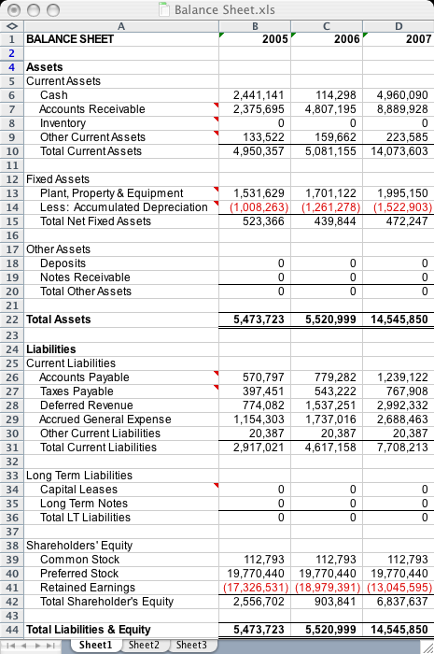
Balance Sheet Example
Notes:
Balance Sheet: this financial statement is a snapshot of the financial viability of an organization at any given time.
Statement of the assets, liabilities, and capital of a business/organization at any particular time, detailing the balance of income and expenditures over the preceding period.

Slide 4
IncomeStatement Example
Table 25-3. ABC Hospital: Income Statement for the Year Ended December 31, 2009 (in Thousands of Dollars)
 |  | 2009 | 2008
Revenues
 | Netpatient service revenue | 93000 | 94000
 | Facilities rental revenue | 5000 | 5000
 | Other revenue | 3300 | 25000
 | Total revenue | 101300 | 101500
Expenses
 | Salaries and benefits | 44000 | 42300
 | Supplies | 14500 | 15600
 | Insurance | 4500 | 3900
 | Leases | 3100 | 4600
 | Depreciation | 11000 | 12500
 | Interest | 38000 | 1700
 | Other expenses | 5900 | 7200
 | Total expenses | 86800 | 87800
 |  |  | 13700
Total Income |  | 14500 | 13700
Notes:
Profit and Loss: This statement shows the year to year statement of profitability
Summarizes the revenues, cost, and expenses incurred during a specific period of time, usually a fiscal quarter or a fiscal year

Slide 5
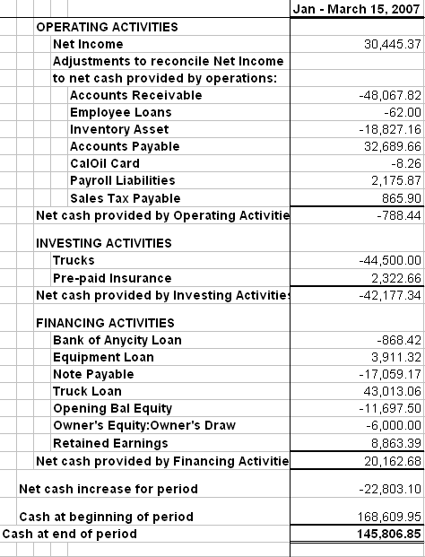
Statement of Cash Flows Example
Notes:
Cash Flow: This statement shows how much cash is on hand, where the cash came from, and where the cash is going
Reports the cash generated and used during a specific time interval. The report is organized into operating activities, investing activities, and financing activities.

Slide 6
Key Performance Indicators
Profitability – Asset Management
  Revenues – Expenses = Net Profit/Loss
  ROA = Net income/total assets
  ROE = Net income/total Equity
Cash / Investments – Measures of Liquidity
  DCOH = [cash + marketable securities]/[expenses-depreciation-provision for bad debt]/365
Debt to Equity – Debt Management
  Total Debt to Equity = total debt/total equity
Notes:
Profitability: looks at the bottom line of the organization
Revenues – Expenses = Net Profit/Loss
Return on Assets = net income/total assets
Return on Equity = net income/total equity
Cash/Investments: measures liquidity of an organization, such as Days Cash on Hand
Long-term debt to equity: measures how leveraged an organization is. If they have too much leverage then they have too much debt in relation to the companies equity and they likely have a negative fund balance.

Slide 7
Key Performance Indicators (2)
Operational Management
  Average Length of Stay
    ALOS = Inpatient days/total discharges
  Occupancy Rate
    OR=Inpatient days/[number of staffed beds x 365]
Notes:
Average Length of Stay = Inpatient days/total discharges
Industry Average 4.1 days
Occupancy Rate = Inpatient days/[number of staffed beds x 365]
Industry Average 44.9%

Slide 8
Ratio and Trend Analysis

Slide 9
Budgets – Forecasting the Future
Capital Budget
Working Capital (Operating Budget)
Flexible v. Fixed Budgets
Notes:
Capital budget: funding the future of property, plant, and equipment. This is equal to a providers Christmas wish list. To calculate the capital budget, it uses depreciation and cost amortization to justify the costs over a five year period. This budget is used in planning for capital expenditures, such as new building ventures.
Working Capital (operating budget): this budget includes personnel, utilities, and normal operating liabilities. This budget contains the organization’s most controllable costs.
Flexible vs. Fixed Budgets: flexible budgets are adjustable to the environment and they predict the average, but can be adjusted according to other factors. A flexible budget change that is explainable, an explainable variance, is a good variance to have. An explainable variance is a justifiable variance in the budget de to environmental factors. Flexible and Fixed budgets both look at historical, current, and future prediction data..
End of the day the main objective of a budget is to keep costs as low as possible.
The industry is moving towards a Volume based to a value based approach. It is not about how many patients come in any more. It is about how efficiently patients are treated.
This causes a struggle to keep numbers up. Fixed cost is based on volume. In order to keep fixed costs manageable, volume has to be raised.

Slide 10
Variable Vs. Fixed Cost
Variable Cost per Test |  |  | Fixed Costs per Year
Lab Supplies $10 |  |  | Labor | $100,000
 |  |  | Other fixed costs | $50,000
 |  |  |  | $150,000
‘Volume | Fixed Costs | Total Variable Costs | ‘Total Costs | ‘Average (Total) Cost Per Tests
0 | $150,000 | $0 | $150,000 | _
1 | $150,000 | $10 | $150,010 | $150,010.00
50 | $150,000 | $500 | $150,500 | $3,010.00
100 | $150,000 | $1,000 | $151,000 | $1,510.00
500 | $150,000 | $5,000 | $155,000 | $310.00
1,000 | $150,000 | $10,000 | $160,000 | $160.00
5,000 | $150,000 | $50,000 | $200,000 | $40.00
10,000 | $150,000 | $100,000 | $250,000 | $25.00
50,000 | $150,000 | $500,000 | $650,000 | $13.00
75,000 | $150,000 | $750,000 | $900,000 | $12.00
Notes:
Fixed Costs per Year: Labor, other fixed costs (employees on salary, property, plant and equipment (PPE)
Fixed Cost: Fixed remain unchanged as the volume varies.
Total variable costs : Volume * lab supplies (10)
Total variable costs =50 * 10= $500
Total Costs: Fixed Costs + Total Variable Costs
Average cost Per Test: Total Costs/ Volume e.g. $150,500/50= $3010 : This is an example of economics of scale (EOS)

Slide 11

Time Value of Money
Value of money is more in the future than in the present
Used in daily consumer, business and banking decision making
  driven by the idea that lenders and investors earn interest paid by borrowers in an effort to maximize the time value of their money
Used to calculate loan/mortgage/annuity payments

Slide 12
Interest
Compensation to a party for time money lent to another party
The longer it takes to repay, the higher the interest rate charged
Interest: compensates a party for time she spends apart from her money
  Simple Interest
  Compound Interest
  Fixed Interest Rate
  Variable Interest Rate

Slide 13

Materials Management
Inventory Management
  Systematic approach to sourcing, procuring, storing, allocating, and managing supplies and equipment in a healthcare facility
Product Value Analysis
  Process to ensure that the highest quality supplies and services are delivered at the most efficient cost and effective manner
  Safety and outcomes are considered first, then total cost is factored in
Par Level
  When to order restock

