Slide 1
Healthcare in Finland
Author
Institutional Affiliation
Instructor
Course code
Date of submission

Slide 2
Overview of Finland
Finland also known as the Republic of Finland is a Nordic country located in northern Europe.
The country shares its borders with Sweden to the west, Russia to the east, Norway to the north (nationsonline.org, 2021).
Finland is the home to about 5.5 million people and is ranked the 25th most populated country in Europe.
The major languages used by the inhabitants include the Swedish and the Finnish language which are both used as official languages in the country.

Slide 3
Finland is a parliamentary republic consisting of 19 regions and 310 municipalities.
The country’s climatic conditions significantly vary and is relative to latitude.
The southern parts of the country experience a humid continental climate. While the northern parts of the country experience the Boreal climate.
The total land area of the country is 338, 455 square kilometres and is the eighth-largest country in Europe by size. Helsinki is the largest urban area in the country and is also the capital of Finland.

Slide 4
About 1.5 million people reside here producing a third of the country’s total GDP.
In spite of the country’s relatively small size and population, Finland has continued to be a pacesetter in many fields since acquiring its independence.
Finland is observably a top performer in various metrics of national performance.
Globally, the country has continued to receive considerably positive ratings for its admirable efforts in education, economic completeness, quality of life and social development.

Slide 5
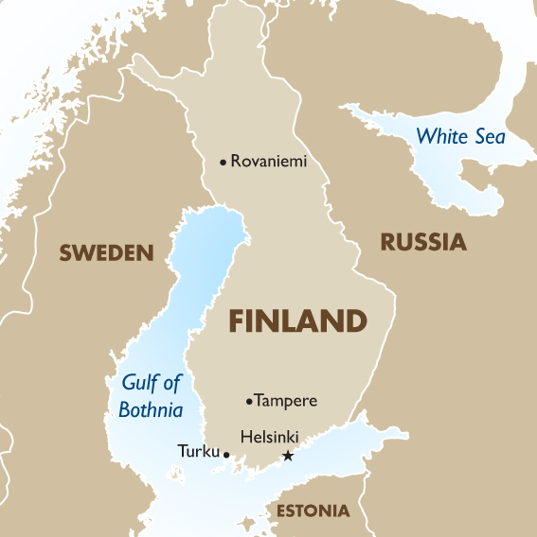
An image showing the position of Finland in Europe

Slide 6
Government of Finland
Currently, Finland is a parliamentary democracy constituted through elections and is based on competition among political parties.
Finland has a constitution that highlights the country’s political system stating that political power is vested in the people who are represented by elected representatives in parliament (Parliament in Finland, 2021).
In this view, the legislative power is exercised by the parliament. Even though the country has a president, the president has limited roles since most of the country’s governance is managed by the council of state.

Slide 7
The council of state is comprised of the Prime minister and a number of ministers who act as the highest level of government in Finland.
Besides the political and legislative powers, judicial powers In Finland lies with the court system regarded as the sole interpreters of the law.
Because Finland has no single constitutional court, the constitutionality of the Finnish laws largely depends on directions on individual court cases (Government, 2021).
The country’s current constitution was adopted in 2000 and elaborates on the fundamental rights of the citizens.

Slide 8
Amendments to this constitution require the support of 2/3 of the members of parliament and changes can only be made if they are considered urgent.
Elections in the country are held on two separate occasions; one to elect the president and the other to elect the members of parliament.
Although, by law, MPs are not restricted as to how many terms they can in parliament, the president is only allowed to serve a maximum of two terms.

Slide 9
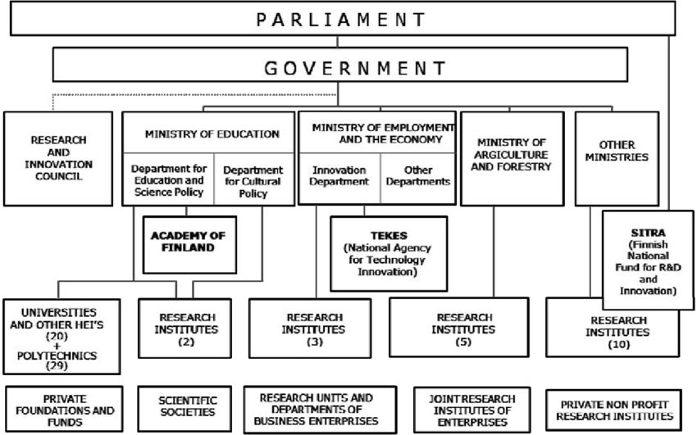
An image showing the structure of GOV’T in Finland

Slide 10
Demographics in Finland
The country’s total population is approximately 5.5 million people. This is according to the information obtained from the World Bank statistics.
Finland has an average population density of 19 persons per square kilometre and is regarded as one of the most sparsely populated countries in Europe.
The country has an uneven population distribution with a majority of the population living in urban areas.
About 1.5 million people reside in Helsinki, the country’s capital.

Slide 11
The ethnic composition of the country is relatively homogenous with the dominant ethnicity being the Finnish.
However, there are also other minority ethnic tribes in the country that include the Finland-swedes, Sami and Roma people (Worldometer, 2020)
Due to immigration, the country has recently seen an influx of major ethnic groups such as Russians, Somalis, Estonians and Kurds.
Approximately 5.2 % of the general population are foreigners. The official languages used in the country are Finnish and Swedish.

Slide 12
Since Finland was previously a part of Sweden, Swedish is the native language used by a majority of the population.
The largest religious group in the country is the Lutheran church with a congregation of over 69% of the country’s population.
The Freedom of religion act in Finland guarantees the individual freedom of everyone to practice a religion of their choice (European Commission, 2020).
The Freedom of religion act in Finland guarantees the individual freedom of everyone to practice a religion of their choice.

Slide 13
Despite the Lutheran church having a majority of the congregants, other religious denominations are also present in the country.
However, close to 28% of the population do not have any religious affiliation (Statistics Finland, 2019).
Pupils and students in the basic education sector have the right to instruction in religion usually approached from a cultural perspective and not from a denomination viewpoint.

Slide 14
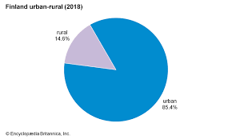
An image showing settlement areas in Finland

Slide 15
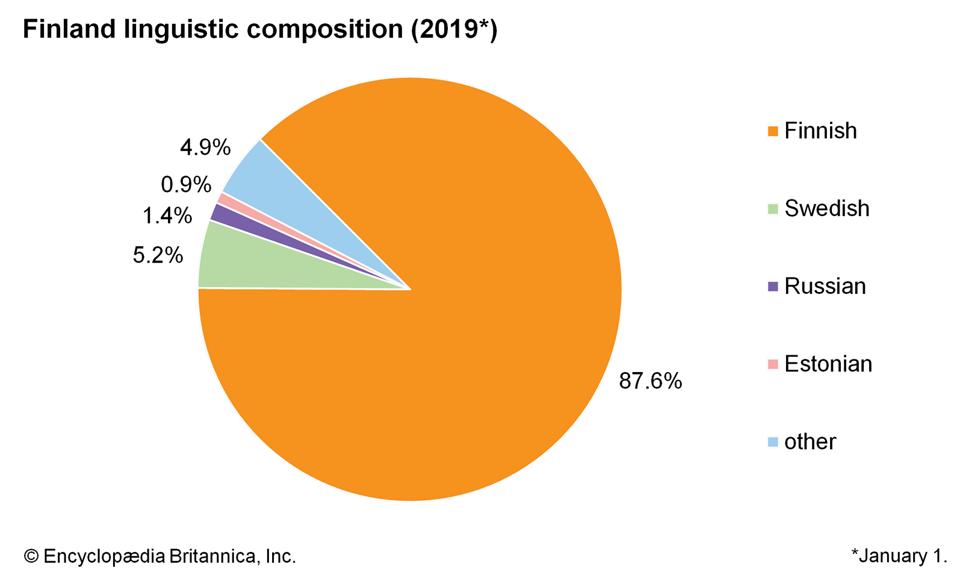
An image showing Linguistic composition in Finland

Slide 16
Population of Finland
With a population of 5.5 million people, Finland’s population is expected to decline in the coming years.
The proportion of the working population is reducing and a shortage in labour is expected to occur before 2031.
The fertility rate in Finland is 1.5, a figure that is below the recommended 2.1 fertility rate globally. Although the country has a higher life expectancy for both sexes that is currently at 82.5 years, the general population is expected to reduce significantly.

Slide 17
Statistics from the healthcare sector reveals a low death rate in Finland. Infant mortality currently stands at 1.4 for every 1000 live births. Admittedly, this is a lower figure.

Slide 18
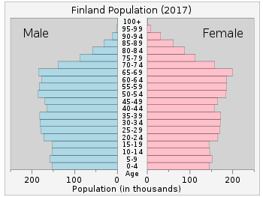
An image showing Finland population as of 2017

Slide 19
Organization of the healthcare system in Finland
The public healthcare system in Finland is observably open to all the residents in Finland regardless of their financial capabilities (Teperi et al. 2017).
The municipal health centres are responsible for the provision of primary healthcare services to the residents.
However, specialized medical care is offered by district hospitals. Nationals from the European Union on a temporary stay in Finland may receive medical services from these institutions, however, they must provide a European health insurance card to be able to access the healthcare services.

Slide 20
The primary healthcare services offered in the public healthcare institutions include; physician consultation, health counselling, screening and vaccinations, dental health services, emergency treatment, school and student healthcare and homecare services (Stuart Allt Web Design, 2021).
It is essential to note that besides the public healthcare institutions in Finland, private healthcare is also available for those who may prefer.

Slide 21
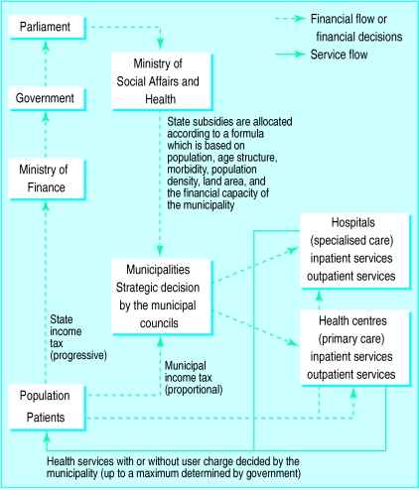
An image showing the organization of the Healthcare sector

Slide 22
Funding the healthcare sector
Healthcare in Finland is not free, however, the charges levied on these services are observably reasonable.
The municipalities are in charge of providing healthcare to the people, and it is majorly funded through taxes (Health management, 2021).
Patient fees only act as complementary to the municipal funding of the healthcare finding.
It is important to note that the fees charged by the municipalities are highlighted in the Act and Degree on social and healthcare Client Fees.

Slide 23
Out-of- pockets by patients is capped at 20.6 euros a year after which the patients are not to pay any additional funds to the hospitals.
Individuals visiting healthcare centres in Finland are required to carry with them their Kela cards to confirm their eligibility for social security and national health insurance in the country.
With these cards, medicines at a pharmacy may be sold to them at a discounted price.
Nationals from the European Union are entitled to healthcare services in Finland upon the provisions of a European Health insurance card.
However, those without the card are required to obtain travel insurance before visiting Finland.

Slide 24
The healthcare system in Finland is a three-level decentralized system that is funded by the public finds obtained through taxation.
Even though every decision in the healthcare sector is largely influenced by the ministry of Social Affairs and Health, the local municipalities provide essential healthcare services to the residents of Finland.
The healthcare system focuses particularly on health promotion and prevention of diseases consequently resulting in efficient healthcare outcomes.

Slide 25
National Health Insurance
All the Finnish residents are entitled to the national insurance scheme that is run through the Social Insurance Institution with offices across the country (Teperi et al. 2017).
The national insurance offers reimbursement for outpatient drugs, care sought from private healthcare providers, transport costs to healthcare centres, maternity allowances and rehabilitation services.

Slide 26
History of the healthcare system
The healthcare system in Finland has undergone drastic transformations for the betterment of the care provided to the people.
Since the 19th century, the number of hospitals has rapidly increased in Finland to effectively take care of the healthcare needs of the Finnish population.
Around 1929, the major causes of mortality in Finland were coronary heart diseases for men and breast cancer for women which resulted in the formation of a special committee that was tasked to establish and evaluate the status of healthcare in the country.

Slide 27
The decision from the special committee suggested the establishment of the local district hospitals by the municipalities.
Arguably, the suggestions from this committee also led to the establishment of a publicly funded healthcare system which is now utilized in the country today.
One of the most recent developments in the Finnish healthcare system is the switching of municipalities from a primary healthcare system to a family doctor system.
Currently, a single-family doctor is responsible for about 2000 patients.

Slide 28
Tellingly, the major aim of this new development is to have patients’ needs addressed by the physicians within three working days.
The new system has proven to be very successful.

Slide 29
The role of government in Healthcare
The government in Finland is responsible for the general strategies and decisions in the healthcare sector.
Through parliament, the government proposes bills to be discussed on matters of healthcare (Stuart Allt Web Design, 2021).
Similarly, the Ministry of Social Affairs and Health gives directions on the policies of social protection and healthcare.

Slide 30
Indicators of health in Finland
The major aim of the Finnish healthcare system is to culture and nurture a healthy population by improving the quality of life.
Observably, the child mortality rate in Finland is at its lowest and is considered one of the lowest globally.
In Finland, the infant mortality rate is below 4%. Additionally, in response to effective care, cardiovascular diseases have significantly reduced among Finnish men since prevention receives particular emphasis in primary healthcare

Slide 31
Each year, approximately 99% of children below 2 years are vaccinated against whooping cough and measles (Keskimaki et al. 2019).
This highlights the success in the screening and vaccination programs that the healthcare system has put in place.
However, the low fertility rates and the aging population in the country presents new challenges to the country’s healthcare system.

Slide 32
Quality of healthcare in Finland
The service provided by the healthcare system is observable of high quality, safe and appropriately organized as per the needs of the Finnish population (Keskimaki et al. 2019).
The healthcare system in Finland does not only offer good quality treatment to the residents but also focuses on patient safety, equality and professionalism.

Slide 33
Weaknesses of the system
In Finland, due to the decentralized healthcare system, the development of a single healthcare information system has been largely uncoordinated especially at the national level.
The use of various interoperable information systems by the municipalities has observably inhibited efficient information exchange between the care providers and the patients, particularly at the specialized care centres.
Due to the national health insurance coverage and the developments in the healthcare sector, the healthcare system in the country is not popular among the local Finnish people but is also internationally acclaimed.

Slide 34
The system is popular among people because it offers them an extensive set of services with low costs than in most comparable countries.

Slide 35
References
Teperi, J., Porter, M. E., Vuorenkoski, L., & Baron, J. F. (2017). The Finnish health care system: a value-based perspective. Sitra Reports 82, 2009.
Stuart Allt Web Design, F. (2021). Public Healthcare in Finland: Medical care, Fees, Pharmacies. Retrieved 20 February 2021, from https://www.expat-finland.com/living_in_finland/public_healthcare.html#fees
Keskimäki, I., Tynkkynen, L. K., Reissell, E., Koivusalo, M., Syrjä, V., Vuorenkoski, L., ... & World Health Organization. (2019). Finland: health system review.
Overview of the Healthcare System in Finland. (2021). Retrieved 20 February 2021, from https://healthmanagement.org/c/imaging/issuearticle/overview-of-the-healthcare-system-in-finland

Slide 36
Parliamentarism in Finland – this isFINLAND. (2021). Retrieved 21 February 2021, from https://finland.fi/life-society/parliamentarism-in-finland/
Government - Finland - issues, system, power, policy. (2021). Retrieved 21 February 2021, from https://www.nationsencyclopedia.com/Europe/Finland-GOVERNMENT.html
nationsonline.org, k. (2021). Finland - Country Profile - Nations Online Project. Retrieved 21 February 2021, from https://www.nationsonline.org/oneworld/finland.htm

