Slide 1
FOB destination and shipping point

Slide 2
Free On Board shipping point
Free on board(FOB) shipping point indicates that the responsibility and title of the products or services change immediately the buyer purchases the products.
In this case, the buyer is usually responsible for the delivery of his/ her own products and therefore the company / seller will not be responsible for any problem encountered during delivery.
Lehman et al, 2013

Slide 3
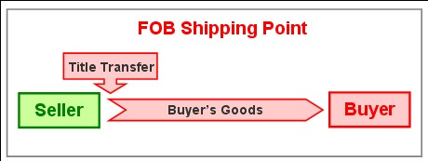
FOB shipping point illustration

Slide 4
Free On Board destination
Free on board destination can be described as the point or place where products are delivered after they have been purchased or ordered by a client.
After the products have been delivered to the buyers point of destination. The ownership of the products/ good immediately changes from the sellers name to the buyer’s. which means that the buyer have taken the full ownership of the products.
Sumup, 2011

Slide 5
Differences
In FOB destination, the sellers tend to charge extra delivery fee and the delivery of good is usually guaranteed. In case anything happens to the goods before delivery, the company takes full responsibility and therefore this makes sure that the goods arrive safely.
On the other hand, when a buyer choses to use the FOB shipping point, this means that the ownership and responsibility of the goods delivery change immediately the buyer receives them and therefore the company will not cover for any problems encountered before reaching its destination.
Allied, 2020

Slide 6
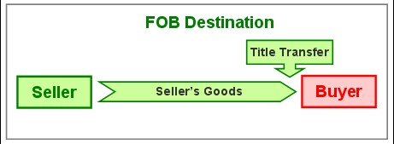
FOB Destination illustration

Slide 7
The 1/5 and n30 term
When recording sales and discounts, the Net 30 may tend to favor the buyer who choses to pay for the destination delivery mode since their products are still under the sellers management. This term mostly apply to bulk order customers that require home delivery.
On the other hand, the 1/5 term may favor those who choose to work with the shipping point since their delivery time is short compared to companies since their products may take time before being acquired by the buyer.
              Lehman et al, 2013

Slide 8
References
Allied, V. (2020). FOB shipping point vs FOB destination | Vara Allied blog. Chinese Product & Manufacturer Sourcing - Vara Allied. https://www.varaallied.com.au/blog/fob-shipping-point-vs-fob-destination-what-s-the-difference
Gilbertson, C. B., & Lehman, M. W. (2013). Century 21 accounting: Multicolumn journal. Google Books. https://books.google.co.ke/books?id=sZAKAAAAQBAJ&pg=PA499&dq=fob+destination+meaning&hl=en&sa=X&ved=2ahUKEwjq3dTj7tbyAhVMDmMBHYBjDMUQ6AEwAnoECAMQAg
Sumup. (2011). FOB destination - What is FOB destination? | SumUp invoices. SumUp - a better way to get paid. https://sumup.co.uk/invoices/dictionary/fob-destination/

