Slide 1
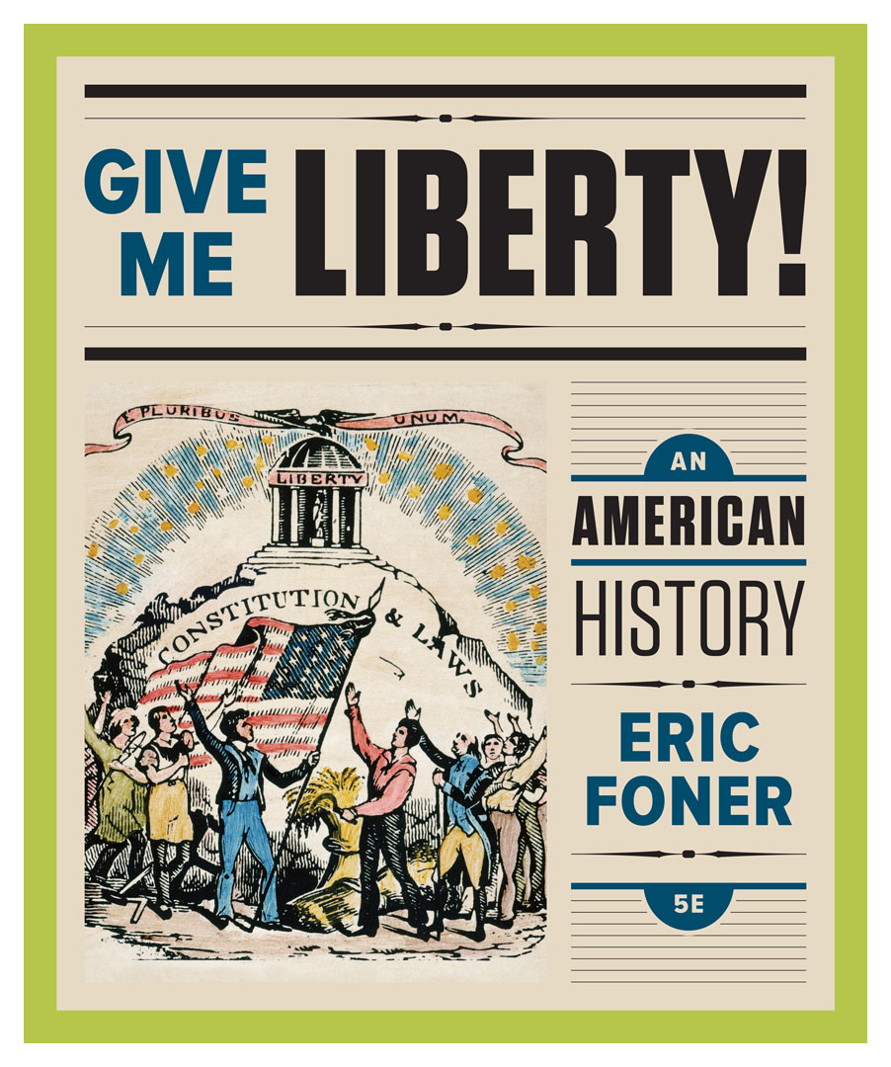
Lecture Slides
Give Me Liberty!
AN AMERICAN HISTORY
FIFTH EDITION
By Eric Foner

Slide 2
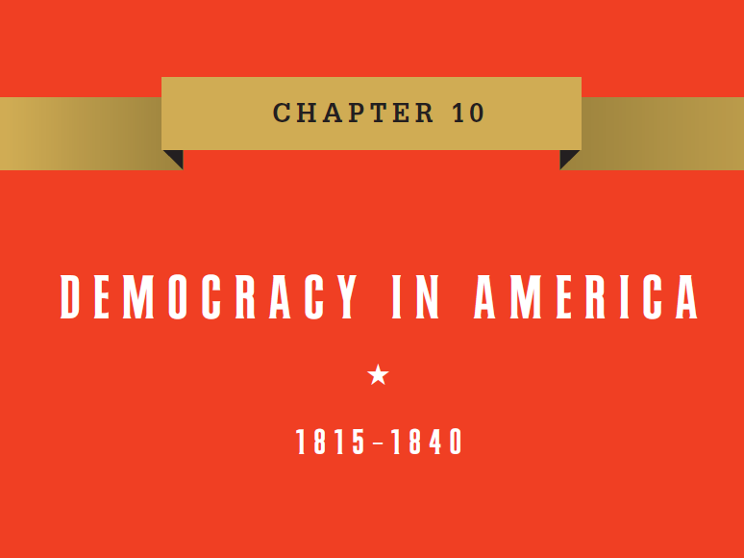
Chapter 10: Democracy in America, 1815 to 1840
Notes:
Chapter 10
Democracy in America, 1815–1840
The inauguration of Andrew Jackson on March 4, 1829, made it clear that something had changed in American politics. Previously, the swearing-in was a small, dignified event, but Jackson’s inauguration attracted 20,000 people who poured into the White House after the ceremony, ruining furniture and breaking china in “the reign of King Mob,” according to Supreme Court Justice Joseph Story. Jackson aroused powerful feelings, pro and con, as supporters viewed his election to be genuine democracy’s advent with the coming to power of the “common man,” while critics considered him a tyrant. Opponents called him King Andrew I, and named their political organization the Whig Party, after opponents of royal power in eighteenth-century England. The 1830s and 1840s came to be called the Age of Jackson, or the period of Jacksonian Democracy, and though one individual cannot fully capture an entire era’s complexity, Jackson’s career did embody its developments, namely the market revolution, westward movement, slavery’s expansion, and democracy’s growth. Unlike previous presidents, Jackson was a symbol of the self-made man, having rose to prominence from a humble background, reflecting the era’s democratic opportunities. Born in 1767 on the South Carolina frontier, and orphaned during the Revolution, he early on displayed the courage and impetuousness that would make him famous. During his youth, he served as a courier for patriotic forces in the War for Independence, and was captured, imprisoned, and nearly killed when a British officer struck him with a sword after he refused to polish the officer’s boots. As a young man, he moved to Tennessee, where he studied law, became politically involved locally, and won election to the House of Representatives, the Senate, and served as a judge on the state’s supreme court. His military campaigns against the British and Indians helped consolidate American control in the Deep South, making possible the rise of the Cotton Kingdom. Though he acquired a large plantation in Tennessee, he symbolized one of the foremost features of national life, the triumph of political democracy. Americans prided themselves on being the world’s oldest democracy, though New Zealand may have the better claim having granted women and the indigenous population constitutional voting rights in 1893. Even in the nineteenth century, when democracy meant male suffrage, some Latin American nations extended the right to vote to free blacks and the descendants of the indigenous population well before the United States. Europe lagged far behind where universal male suffrage was not achieved until the 1880s in Britain, and only sporadically in France. More to the point, perhaps, democracy became a central part of the definition of American nationality and the American idea of freedom.

Slide 3
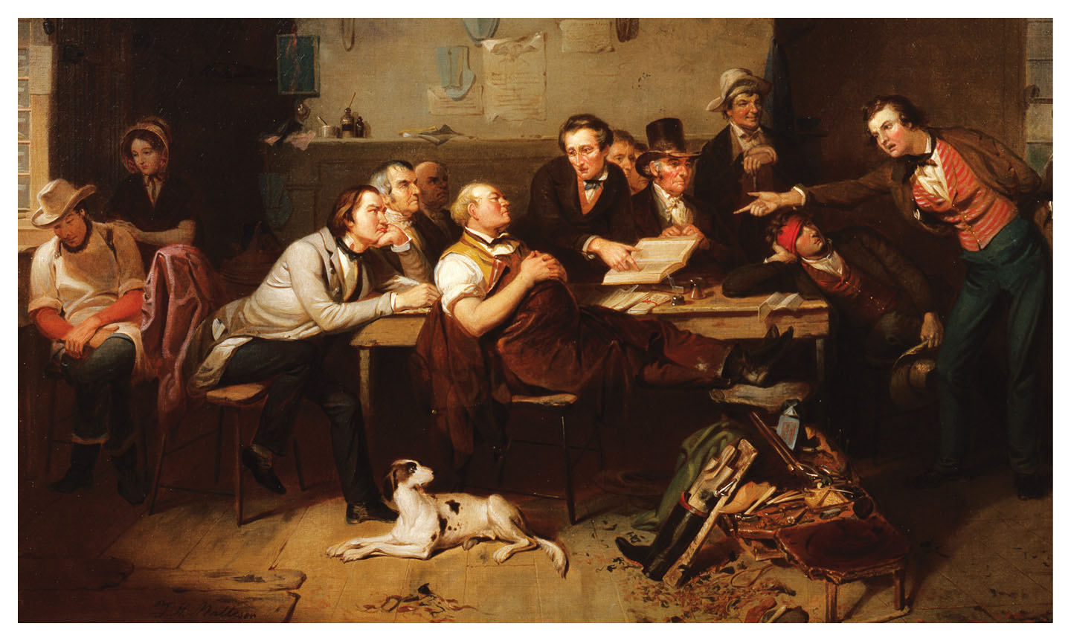
Justice’s Court in the Back Woods
Justice’s Court in the Back Woods, by Tompkins Harrison Matteson, 1852 Give Me Liberty!: An American History, 5th Edition
Copyright © 2017 W.W. Norton & Company
Notes:
Justice’s Court in the Back Woods, an 1852 painting by Tompkins Harrison Matteson, depicts the expansion of the public sphere to include ordinary Americans. A court is in session in a local tavern. The justice of the peace, who presides, is a shoemaker who has set aside his tools but still wears his leather work apron. A lawyer appeals to the jury, composed of average (male) citizens. The case has to do with an assault. The plaintiff, his head bandaged, leans on the table at the right, while a woman consoles the defendant on the far left.

Slide 4
Lecture Preview
The Triumph of Democracy
Nationalism and Its Discontents
Nation, Section, and Party
The Age of Jackson
The Bank War and After
Notes:
The subtopics for this lecture are listed on the screen above.

Slide 5
Focus Question: The Triumph of Democracy
  Focus Question:
  What were the social bases for the flourishing democracy of the early
  mid-nineteenth century?
Notes:
The purpose of the focus questions is to help students find larger themes and structures to bring the historical evidence, events, and examples together for a connected thematic purpose.
As we go through each portion of this lecture, you may want to keep in mind how the information relates to this larger thematic question. Here are some suggestions: write the focus question in the left or right margin on your notes and as we go through, either mark areas of your notes for you to come back to later and think about the connection, OR as you review your notes later (to fill in anything else you remember from the lecture or your thoughts during the lecture or additional information from the readings), write small phrases from the lecture and readings that connect that information to each focus question AND/OR are examples that work together to answer the focus question.

Slide 6
Expanding Democracy
Property and Democracy
The Dorr War
Notes:
One basis of political democracy in this period was the challenge to property qualifications for voting. It began in the American Revolution but culminated in the early nineteenth century. After the Revolution, no new state required property ownership to vote, and in older states, constitutional conventions in the 1820s and 1830s abolished property qualifications, partly because the growing number of wage earners who did not own much property demanded the vote. In the South, however, where large slaveowners dominated politics and distrusted mass democracy, property requirements were eliminated only gradually and disappeared quite late, by 1860. The personal independence required of the citizen was henceforth located not in owning property but in owning one’s self, a reflection of this period’s individualism.
The single exception to this democratizing trend was Rhode Island, which required voters to own considerable real estate or pay a certain amount of rent. The state was a center of factory production, and many wage earners could not vote. In 1841, reformers met at a People’s Convention and drafted a new state constitution that gave the vote to all adult men and stripped it from blacks. When the convention extralegally ratified the constitution and inaugurated Thomas Dorr, a lawyer, as governor, president John Tyler dispatched federal troops to the state, and the movement collapsed. The Dorr War demonstrated the passions aroused by exclusion of any white men from voting, and the legislature soon eliminated the property qualification for native-born men, both black and white (it was retained for immigrants until 1888).

Slide 7
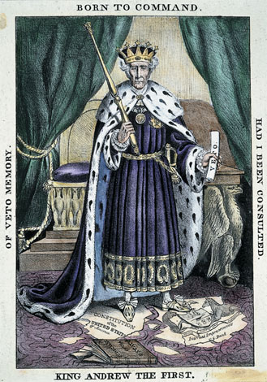
“King Andrew the First”
An anti-Jackson cartoon from 1832 depicting the President as an aspiring monarch Give Me Liberty!: An American History, 5th Edition
Copyright © 2017 W.W. Norton & Company
Notes:
An anti-Jackson cartoon from 1832 portrays Andrew Jackson as an aspiring monarch, wielding the veto power while trampling on the Constitution.

Slide 8
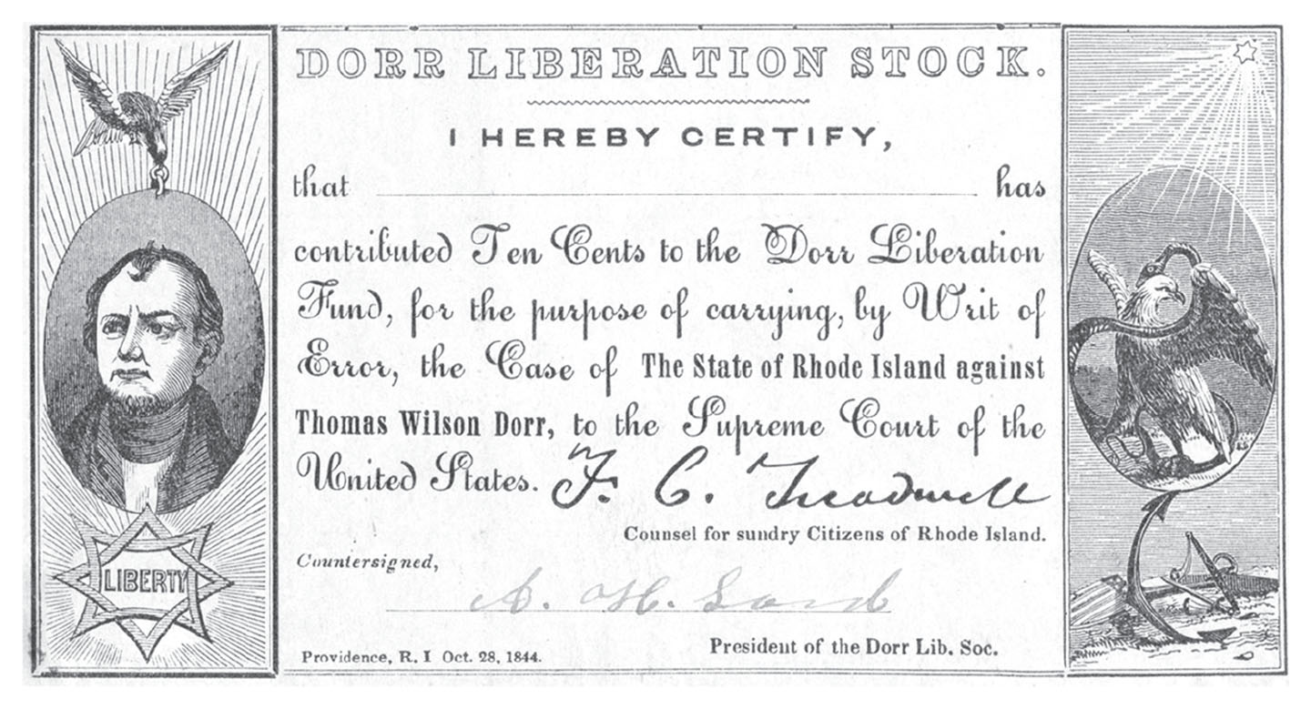
Dorr Liberation Stock
Dorr Liberation Stock, a certificate indicating that a person has helped Give Me Liberty!: An American History, 5th Edition
finance Thomas Dorr’s appeal to the U.S. Supreme Court Copyright © 2017 W.W. Norton & Company
Notes:
Dorr Liberation Stock, a certificate indicating that a person has helped to finance Thomas Dorr’s appeal to the U.S. Supreme Court of his conviction for treason against the state of Rhode Island because of his role in the Dorr War. The Court ruled against him, and Dorr served two years in prison.

Slide 9
Alexis de Tocqueville
Tocqueville on Democracy
Notes:
By 1840, more than 90 percent of adult white men could vote. By then, America had a vibrant democratic system that engaged massive numbers of citizens. Lacking traditional bases of nationality such as ethnic or religious unity, democratic political institutions imparted a sense of identity to Americans. Alexis de Tocqueville, a French writer who visited the United States in the early 1830s, wrote of this political culture in his classic book Democracy in America. As an aristocrat, Tocqueville disliked democracy, but his key insight was that democracy was more than just voting or political institutions. Democracy, to Tocqueville, was a culture that encouraged individual initiative, belief in equality, and a public sphere with numerous voluntary organizations that wanted to improve society. Democracy was new. The idea that sovereignty resided in the mass of ordinary citizens was a departure in Western thought, which traditionally had viewed democracy as the road to anarchy. But in the United States, pressure from those originally excluded from political participation created a democracy for white men that triumphed in the Age of Jackson. In America, the right to vote and participation in politics offered a sense of national identity. While democracy reinforced the sense of equality among those who belonged to the political nation, it deepened the divide separating them from those who did not.

Slide 10
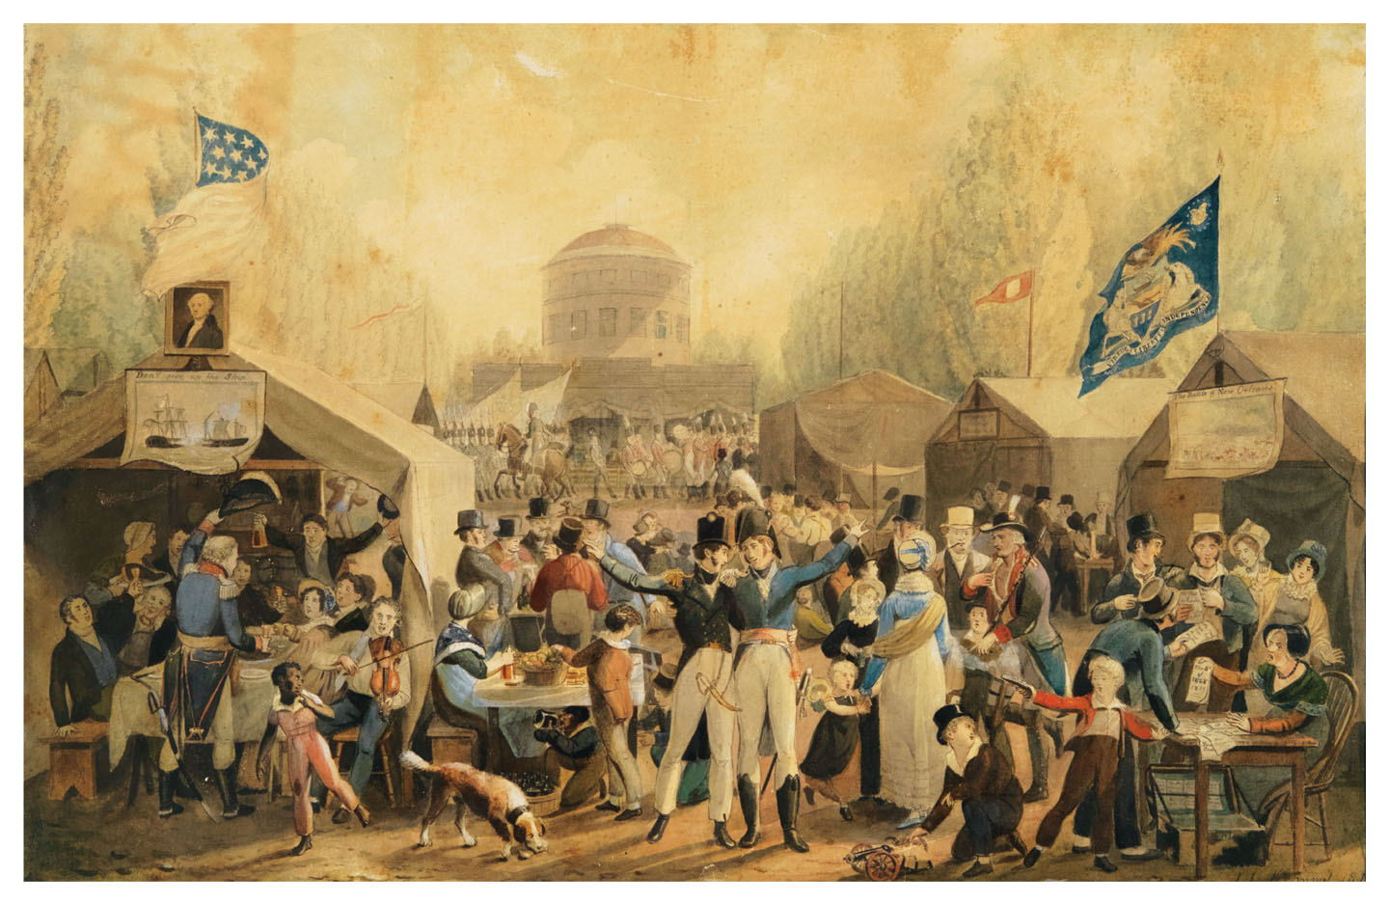
Independence Day Celebration in Centre Square
Independence Day Celebration in Centre Square, by John Lewis Krimmel, 1819 Give Me Liberty!: An American History, 5th Edition
Copyright © 2017 W.W. Norton & Company
Notes:
Independence Day Celebration in Centre Square, an 1819 painting by John Lewis Krimmel, a German-American artist, depicts a gathering to celebrate the Fourth of July in Philadelphia. On the left, beneath a portrait of George Washington, is a depiction of a naval battle from the War of 1812; on the right, beneath the state flag of Pennsylvania, is an image of the Battle of New Orleans. The celebration, an example of rising American nationalism, includes men and women, soldiers, merchants, and ordinary citizens, but is entirely white except for a young black boy in the lower left.

Slide 11
“The World of Print”
The Information Revolution
Notes:
The market revolution and political democracy expanded the public sphere and the world of print. This “information revolution” was facilitated in part by the invention of the steam-powered printing press, which printed much more matter at far less cost. A new style of sensational journalism catered to a mass readership, which was soon created in newspapers with a total circulation higher than that of all Europe. Low postal rates and the growth of political parties also sparked the expansion of print and allowed newspapers to reach audiences far beyond their own locality. Labor organizations, reformers, and even Native American tribes printed their own alternative newspapers for the first time in American history, and the growth of print offered a new generation of women writers a venue for expression.

Slide 12
Triumph Curbed
The Limits of Democracy
Notes:
As democratization expanded the number of people who participated in politics, it was necessary to define the boundaries of the political nation in terms of freedom and who could enjoy it. Antebellum American political life was both expansive and exclusive. Democracy absorbed native-born white men and white immigrants, but established barriers to the participation of women and non-white men. As democracy triumphed, the grounds for political exclusion shifted from economic dependency to supposed natural incapacity. Gender and racial differences were seen as part of a single, natural hierarchy of innate endowments. A natural boundary was not at all exclusive, many argued, and women and non-whites were deemed lacking in qualities necessary for democracy and self-government. While freedom for white men involved a process of personal transformation, of developing their potential to the fullest extent, democracy’s limits rested on the idea that the character and abilities of non-whites and women were fixed by nature. And the world of politics was partly defined against the feminine sphere of the home. Freedom in the public sphere in no way required freedom in the private sphere.

Slide 13
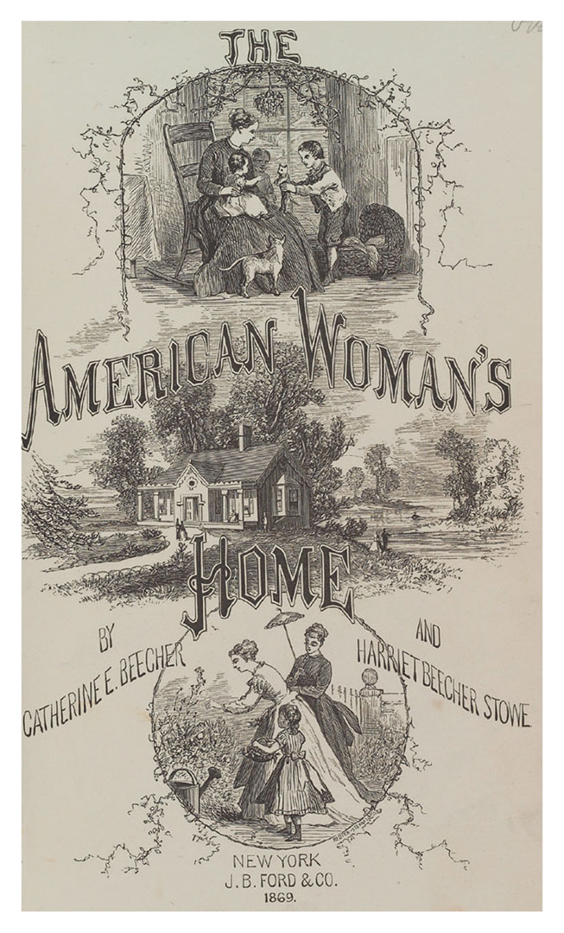
The American Woman’s Home
The American Woman’s Home, a guide to domestic life by the sisters Give Me Liberty!: An American History, 5th Edition
Catharine Beecher and Harriet Beecher Stowe Copyright © 2017 W.W. Norton & Company
Notes:
Even though works like this were meant to instruct middle-class women on how to meet their domestic responsibilities, their popularity allowed talented women to take on a new public role as writers.

Slide 14
Democracy and Whiteness
A Racial Democracy
Race and Class
Notes:
In a nation obsessed with equality, democracy was more and more associated with whiteness. While white Americans of all social classes dressed similarly and mixed in public, blacks were increasingly excluded from public life. Racist depictions of blacks in the culture became widespread. An ideology of racial superiority and inferiority, with an allegedly scientific basis, took root where it had never before existed. After 1800, every state except Maine admitted to the Union limited voting rights to white males.
By 1860, blacks could vote on the same basis as whites in only five New England states, which had only 4 percent of the nation’s free black population. Whites of the revolutionary era had considered blacks as potential members of the body politic, but in the nineteenth century, membership in the political nation was increasingly demarcated by race. No blacks had full equality before the law, and they were barred from schools, militias, and other public institutions. In effect, race replaced class as the boundary between American men with political freedom and those without, a process that incorporated many white immigrants into American democracy.

Slide 15
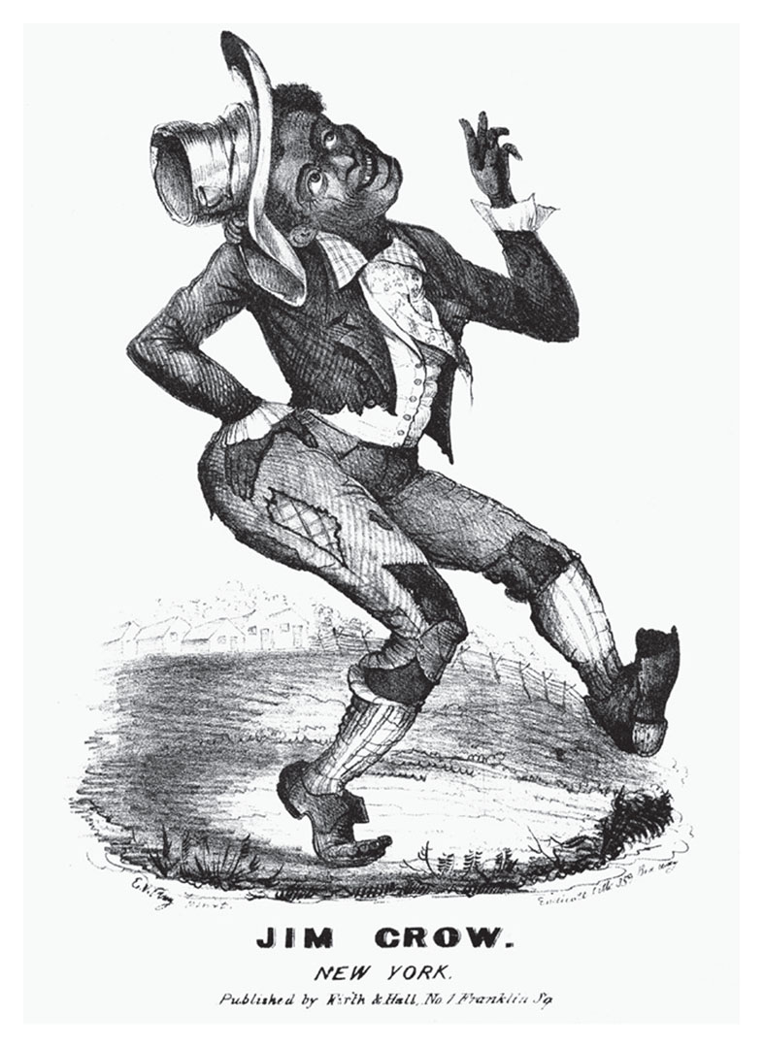
Jim Crow
Jim Crow, sheet music depicting one of the most popular characters in minstrel shows Give Me Liberty!: An American History, 5th Edition
Copyright © 2017 W.W. Norton & Company
Notes:
Note to Compositor: insert image from page 352, top left-hand corner of the page.
Jim Crow, a piece of sheet music from 1829
Minstrel shows were a form of nineteenth-century entertainment in which white actors impersonated blacks. One of the most popular characters was Jim Crow, the happy, childlike plantation slave created by the performer Thomas D. Rice. Years later, “Jim Crow” would come to mean the laws and customs of southern segregation.

Slide 16
Focus Question: Nationalism and Its Discontents
  Focus Question:
  What efforts were made in this period to strengthen the economic integration of the nation, and what major crises hindered these efforts?
Notes:
The purpose of the focus questions is to help students find larger themes and structures to bring the historical evidence, events, and examples together for a connected thematic purpose.
As we go through each portion of this lecture, you may want to keep in mind how the information relates to this larger thematic question. Here are some suggestions: write the focus question in the left or right margin on your notes and as we go through, either mark areas of your notes for you to come back to later and think about the connection, OR as you review your notes later (to fill in anything else you remember from the lecture or your thoughts during the lecture or additional information from the readings), write small phrases from the lecture and readings that connect that information to each focus question AND/OR are examples that work together to answer the focus question.

Slide 17
Nationalism and the Second Bank of the United States
The American System
Banks and Money
Notes:
The War of 1812 showed how far the United States was from being an integrated nation. The Bank of the United States had expired, transportation was poor, and manufacturing had been required to counter the British embargo. Even though they wanted the United States to remain Jefferson’s agrarian republic, Republicans, led by Henry Clay and John C. Calhoun, believed manufacturers needed protection if the United States was to become independent from Britain. In 1815, President James Madison proposed a plan for government-promoted economic development that became known as the “American System.” This system would rest on a new national bank, a tariff on imports to protect and foster manufacturing, and federal financing of road and canal construction, called “internal improvements.” Although the tariff and national bank became law in 1816, Madison vetoed an internal improvements bill. He was afraid that if the national government were given powers not expressed in the Constitution it would interfere with individual liberty and slavery in southern states.
The Second Bank of the United States (BUS), a private, profit-making corporation that served as the government’s financial agent, soon became resented by many Americans. The BUS was also tasked with regulating the volume of paper money printed by private banks to prevent fluctuations and inflation. Today, only the federal government issues paper money, the total of which is determined by the Federal Reserve Bank rather than the amount of gold held at the repository at Fort Knox. During the nineteenth century however, paper money consisted of notes promising to pay the bearer a specified amount of specie on demand, and its value was determined by the issuing institutions reputation for stability; values often fluctuated wildly as banks printed more currency than they held in corresponding specie. Banks relied on public confidence, and the Bank of the United States was supposed to prevent overissuance because it held federal funds in large amounts of currency from various banks. The prospect of the government demanding specie for that currency was intended to guard against banks acting improperly, for if a bank could not provide the specie when asked, it would have to suspend operations.

Slide 18
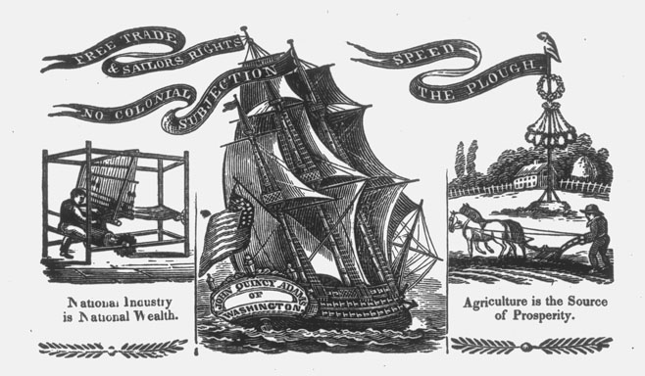
The Campaign of 1824
A broadside from the campaign of 1824 promoting the American System of Give Me Liberty!: An American History, 5th Edition
government-sponsored economic development. Copyright © 2017 W.W. Norton & Company
Notes:
An image from a broadside from the campaign of 1824, promoting the American System of government-sponsored economic development. The illustrations represent industry, commerce, and agriculture. The ship at the center is named the John Quincy Adams. Its flag, “No Colonial Subjection,” suggests that without a balanced economy, the United States will remain economically dependent on Great Britain.

Slide 19
1819
The Panic of 1819
The Politics of the Panic
Notes:
Rather than regulate the currency and loans issued by local banks, the Bank of the United States contributed to widespread speculation, mostly in land, after the War of 1812. When high European demand for American farm goods decreased back to normal levels in 1819, this speculative bubble burst. Falling land prices ruined farmers and businessmen who could no longer pay their loans, banks failed, and unemployment spread in eastern cities.
The short-lived Panic of 1819 disrupted the political harmony established after the war’s end. Some states controversially provided relief to debtors, much to the chagrin of creditors. Most important, the panic reinforced many Americans’ long-standing distrust of banks, and it undermined the reputation of the BUS, which was blamed for the panic. When states retaliated against the BUS by taxing its local branches, the Supreme Court under John Marshall ruled in McCulloch v. Maryland (1819) that the BUS was a legitimate exercise of congressional authority under the Constitution. This directly contradicted the “strict constructionist” view that Congress could use only those powers expressly in the Constitution.

Slide 20
The Slavery Debate
The Missouri Controversy
The Slavery Question
Notes:
In 1816, James Monroe became president, inaugurating a period of one-party Republican rule, an “Era of Good Feelings,” in which almost no Federalists won federal or state offices. In 1820, Monroe was reelected almost unanimously. With no party opposition, however, politics was organized around competing sectional interests. Slavery was a sectional issue that threatened to disrupt national unity. In 1819, when Missouri applied for statehood, a New York Republican proposed that Congress force the new state constitution to ban the further importation of slaves and to free slave children upon their reaching age twenty-five. The Republican Party split along sectional lines on the Missouri question. Most northern Republicans supported the restrictions, while southern Republicans opposed them. In 1820, a compromise was reached that allowed Missouri to adopt a constitution without the antislavery restrictions, and allowed Maine, which prohibited slavery, to become a free state, in order to maintain sectional balance between free and slave states in the Congress. In addition, slavery would be prohibited in all remaining territory of the Louisiana Purchase north of latitude 36°30´.
Thomas Jefferson, who had drafted the clause of the Northwest Ordinance of 1787 that prohibited slavery north of the Ohio River, strenuously opposed efforts to keep the institution out of Missouri because he viewed the controversy as a Federalist effort to divide the Republican Party. While he was correct that politics rather than morals motivated most northern congressmen, it was mostly Republicans rather than the few remaining Federalists that voted against slavery in Missouri. By 1820, New York had surpassed Virginia in population, and the state’s Republicans advocated emancipation in Missouri; twenty-eight years of Virginia presidents interrupted only by John Adams of Massachusetts persuaded many northerners of undue southern influence in Washington, with more slave states meaning more southern congressmen and electoral votes. The Missouri controversy raised the fatal issue of slavery’s western expansion for the first time, and revealed widespread sectionalism. John Quincy Adams predicted that “dissolution of the Union” over the issue of slavery would lead to civil war and the elimination of the institution of slavery overall. But for the time being the slavery debate faded from national attention once more.

Slide 21
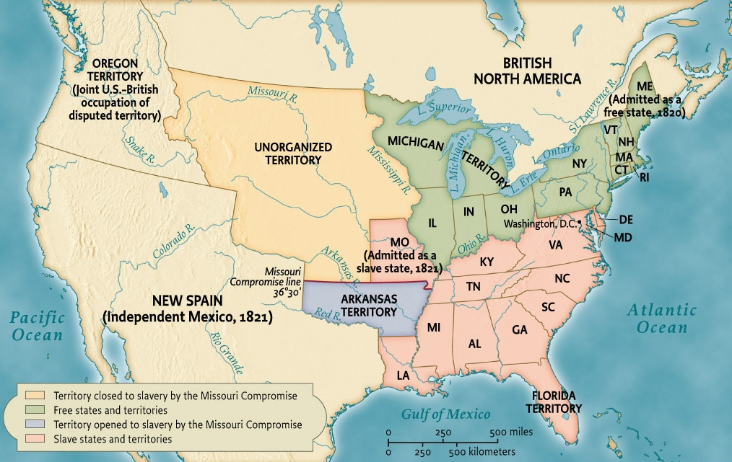
The Missouri Compromise, 1820
Map 10.1 The Missouri Compromise, 1820 Give Me Liberty!: An American History, 5th Edition
Copyright © 2017 W.W. Norton & Company
Notes:
The Missouri Compromise temporarily settled the question of the expansion of slavery by dividing the Louisiana Purchase into free and slave areas.

Slide 22
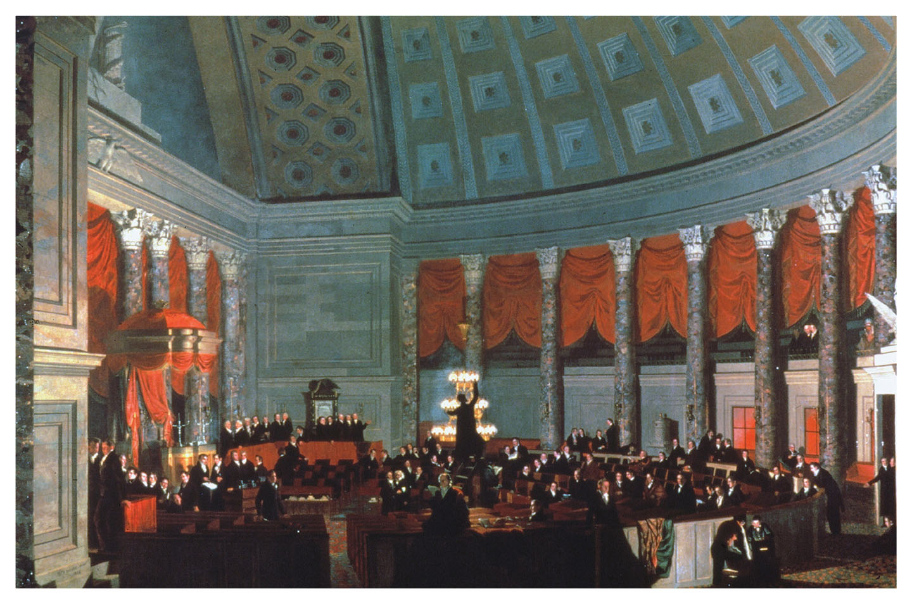
The House of Representatives, 1822
The House of Representatives, by Samuel F. B. Morse, 1822 Give Me Liberty!: An American History, 5th Edition
Copyright © 2017 W.W. Norton & Company
Notes:
The House of Representatives in 1822, in a painting by Samuel F. B. Morse (who also invented the telegraph)
By this time, most adult white men could vote for members of the House, a far wider franchise than was known in Europe at the time.

Slide 23
Focus Question: Nation, Section, and Party
  Focus Question:
  What were the major areas of conflict between nationalism and sectionalism?
Notes:
The purpose of the focus questions is to help students find larger themes and structures to bring the historical evidence, events, and examples together for a connected thematic purpose.
As we go through each portion of this lecture, you may want to keep in mind how the information relates to this larger thematic question. Here are some suggestions: write the focus question in the left or right margin on your notes and as we go through, either mark areas of your notes for you to come back to later and think about the connection, OR as you review your notes later (to fill in anything else you remember from the lecture or your thoughts during the lecture or additional information from the readings), write small phrases from the lecture and readings that connect that information to each focus question AND/OR are examples that work together to answer the focus question.

Slide 24
Revolutions in the Western Hemisphere
The United States and the Latin American Wars of Independence
The Monroe Doctrine
Notes:
Between 1810 and 1822, Spain’s Latin American colonies rebelled and established independent nations, including Mexico, Venezuela, Ecuador, and Peru. By 1825, Spain’s empire in the Western Hemisphere contained only Cuba and Puerto Rico. Americans sympathized with these republican revolutions, and the United States was the first to recognize these new governments. Important parallels existed between the Spanish-American revolutions and the United States War for Independence, primarily that they were precipitated by imperial attempts to raise more revenue out of colonies. The Spanish government had been trying to strengthen its hold over the empire since the late-eighteenth century. Napoleon invaded Spain in 1808, and in 1812, a constitution was adopted that granted more localized control to colonies; when the king was restored in 1814, he revoked the constitution and attempted to reassert imperial control. As in the British colonies, local elites demanded status and equality. Declarations of independence in Spanish colonies resembled the United States’ declaration, such as Venezuela’s 1811 document that employed language strikingly similar to Jefferson’s. Unlike the British colonies, however, the Spanish empire was too vast and disconnected for common nationhood, and it dissolved into seventeen independent countries. While communication and printing in the Spanish territories was scarce, imported literature spread the era’s revolutionary ideas. In some ways, the Latin American constitutions that emerged were more democratic than the United States Constitution. Most attempted to create a single national “people” out of diverse populations, and therefore extended the right to vote to blacks and American Indians. While black soldiers fought on both sides of revolutionary conflicts, which set gradual abolition of slavery in motion, the Latin American wars tended to last longer, and were often followed by periods of destructive civil war. The result was greater difficulty achieving economic development than in the United States.
John Quincy Adams, Monroe’s secretary of state, feared that Spain might try to regain its former colonies, and in 1823 he drafted a speech for the president that became known as the Monroe Doctrine. This doctrine stated that the United States would oppose any future efforts by European powers to colonize the Americas, would abstain from involvement in Europe’s wars, and would prevent European nations from interfering in the new Latin American nations. This doctrine assumed that the Old and New World were separate political and diplomatic systems, and claimed for the United States the role of the dominant power in the Western Hemisphere. Adams also meant to secure the commerce of the region for U.S., as opposed to British, interests.

Slide 25
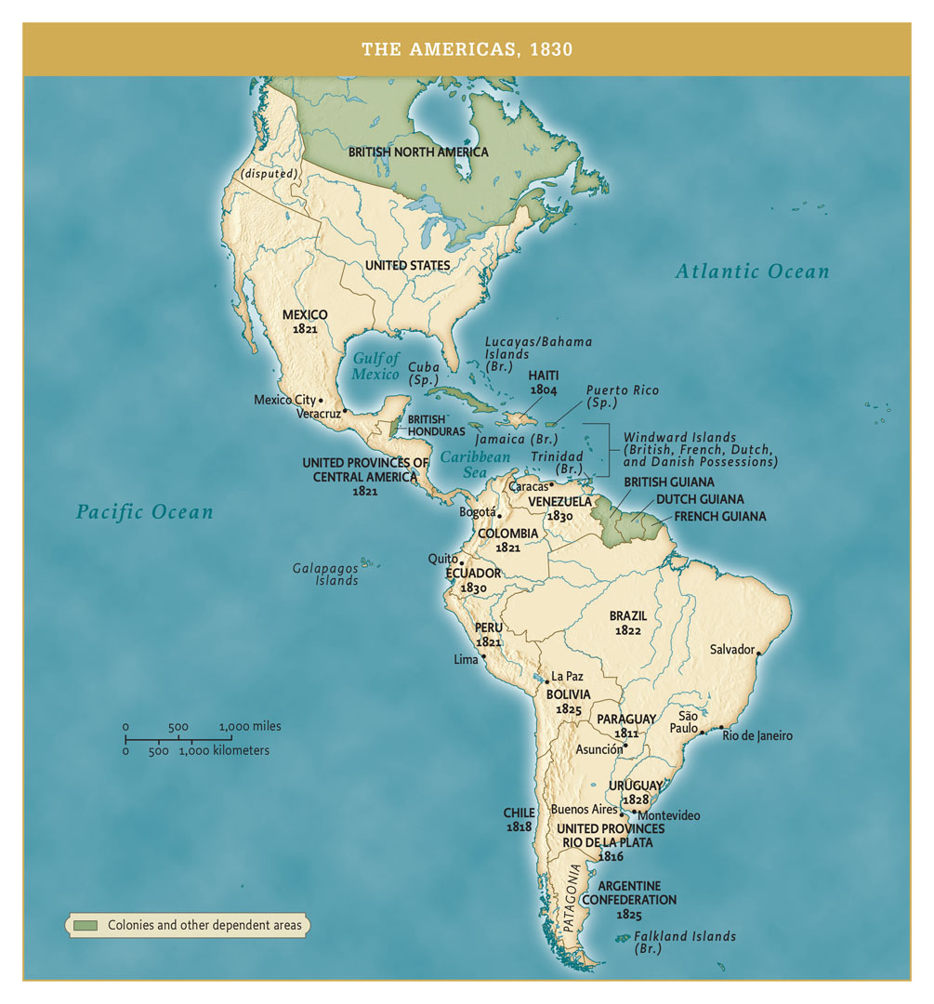
The Americas, 1830
The Americas, 1830 Give Me Liberty!: An American History, 5th Edition
Copyright © 2017 W.W. Norton & Company
Notes:
This map depicts the Western Hemisphere after most of Spain’s colonies achieved their independence.

Slide 26
1824
The Election of 1824
Notes:
In the 1824 presidential election, the only candidate with nationwide support was Andrew Jackson, known for his military victories. The other candidates—John Quincy Adams of Massachusetts, William Crawford of Georgia, and Henry Clay of Kentucky—found support mostly in their regions. Though Jackson received the largest tally of the popular vote and carried all regions except for New England, none of the candidates received a majority of electoral college votes. Running last and eliminated, Henry Clay used his influence to lead the House of Representatives into electing John Quincy Adams, who Clay believed would promote the American System. Clay was soon appointed secretary of state. This appointment led to charges that a “corrupt bargain” between Clay and Adams had secured the presidency for Adams, and laid the basis for the emergence of a Democratic Party behind Andrew Jackson’s candidacy in the 1828 election. The alliance around Adams and Clay came to form the opposition Whig Party in the 1830s.

Slide 27
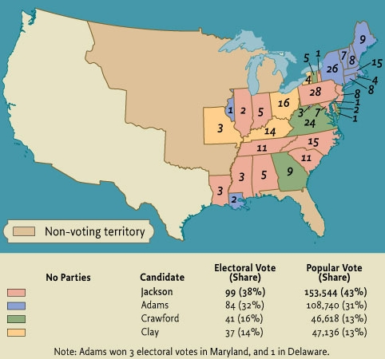
The Presidential Election of 1824
Map 10.3 The Presidential Election of 1824 Give Me Liberty!: An American History, 5th Edition
Copyright © 2017 W.W. Norton & Company

Slide 28
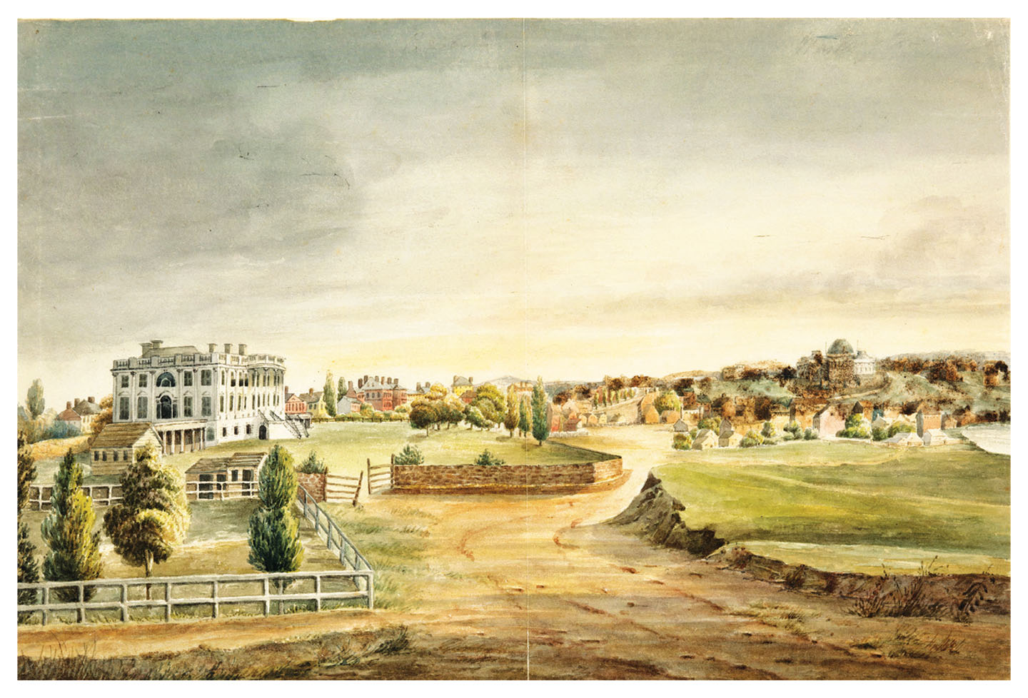
The White House, 1826
The White House, by Anthony St. John Baker, 1826 Give Me Liberty!: An American History, 5th Edition
Copyright © 2017 W.W. Norton & Company
Notes:
The White House in 1826, during the presidency of John Quincy Adams, as painted by a British diplomat, Anthony St. John Baker. The stone wall, erected by Thomas Jefferson, was removed after the Civil War.

Slide 29
Nationalism
The Nationalism of John Quincy Adams
“Liberty Is Power”
Notes:
John Quincy Adams, the son of John Adams, the second president, came from a privileged background and had experience as a diplomat and senator in the U.S. Congress. Despite his uncharismatic nature, John Quincy Adams was strongly nationalist. He supported the American System of government-sponsored economic development. As the author of the Monroe Doctrine, Adams wanted to increase American commerce and power in the Western Hemisphere, and hoped that the United States would eventually incorporate Canada, Cuba, and part of Mexico.
Adams had a much larger view of federal power than many at the time. He thought the federal government should direct and sponsor internal improvements such as road and canals; pass laws to promote agriculture, manufacturing, and the arts and establish a national university and naval academy. At a time when many Americans believed government power threatened freedom, Adams argued that “liberty is power.” His ideas horrified believers in strict construction, who wanted a limited role for the federal government, and Congress approved few of his programs; some of his ideas such as a national university and the adoption of the metric system of measurements have yet to be implemented.

Slide 30
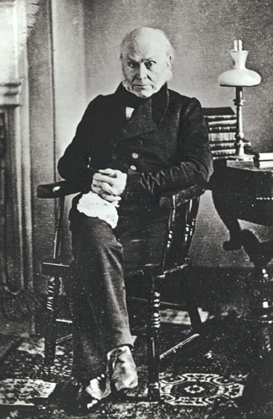
John Quincy Adams
John Quincy Adams, 1843 Give Me Liberty!: An American History, 5th Edition
Copyright © 2017 W.W. Norton & Company
Notes:
John Quincy Adams in an 1843 daguerreotype

Slide 31
1828
Martin Van Buren and the Democratic Party
The Election of 1828
Notes:
Adams rallied an opposition around Andrew Jackson dedicated to individual liberty, states’ rights, and limited government. Jackson’s campaign, organized by Martin Van Buren, a New York senator, started immediately after Adams took office. While Adams typified an old politics in which elites ruled, Van Buren, the son of a tavern keeper, represented a new era in American politics, in which ordinary men could become party managers and professionals and wield great power. Van Buren believed political parties and party competition were legitimate and good for the republic, by checking the power of administrations and offering voters choices. He also believed parties would suppress sectionalism by bringing together supporters and candidates from all across the country. Van Buren was alarmed by the sectionalism inspired by the slavery question in the Missouri debates, and he hoped to resurrect the Jeffersonian alliance between southern planters and northern farmers and urban workers.
By 1828, Van Buren had established the political apparatus of the Democratic Party, with local and state units overseen by a national committee, and newspapers devoted to the party. Adams disdained political organization, refused to dismiss federal officeholders who campaigned for Jackson and did little to promote his own reelection. Outside of a commitment to limited government, Jackson’s campaign made few promises, but instead relied on his popularity and party machinery. Jackson’s supporters disdained Adams’s intellectual attainments and accused him of having mistresses while serving as a diplomat in Europe, while simultaneously praising Jackson’s frontier manliness. Jackson’s opponents condemned his having executed army deserters, and questioned the morality of his wife Rachel for marrying him before her divorce was final; Jackson blamed the scandal for her death shortly after the election. By 1828, voters rather than legislatures chose electors in all states except for South Carolina, which helped to encourage campaigning and high voter turnout. Jackson won an astounding victory, carrying the entire South and West, as well as Pennsylvania. The election was the first to demonstrate how universal white male suffrage had transformed America politics, and for better or worse, the United States entered the Age of Jackson.

Slide 32
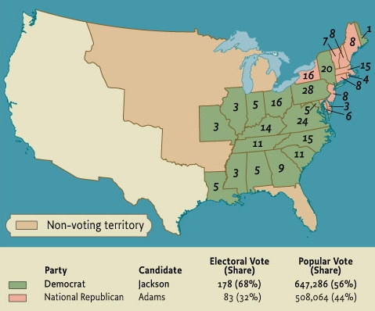
The Presidential Election of 1828
Map 10.4 The Presidential Election of 1828 Give Me Liberty!: An American History, 5th Edition
Copyright © 2017 W.W. Norton & Company

Slide 33
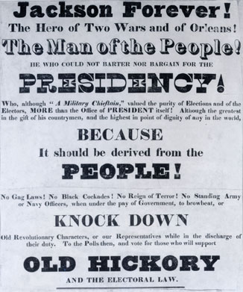
Jackson in 1828
An 1828 campaign broadside illustrating Jackson’s supporters Give Me Liberty!: An American History, 5th Edition
promoting him as a military hero Copyright © 2017 W.W. Norton & Company
Notes:
A broadside from the 1828 campaign illustrates how Andrew Jackson’s supporters promoted him as a military hero and “man of the people.”

Slide 34
Focus Question: The Age of Jackson
  Focus Question:
  In what ways did Andrew Jackson embody the contradictions of democratic nationalism?
Notes:
The purpose of the focus questions is to help students find larger themes and structures to bring the historical evidence, events, and examples together for a connected thematic purpose.
As we go through each portion of this lecture, you may want to keep in mind how the information relates to this larger thematic question. Here are some suggestions: write the focus question in the left or right margin on your notes and as we go through, either mark areas of your notes for you to come back to later and think about the connection, OR as you review your notes later (to fill in anything else you remember from the lecture or your thoughts during the lecture or additional information from the readings), write small phrases from the lecture and readings that connect that information to each focus question AND/OR are examples that work together to answer the focus question.

Slide 35
Jackson Presidency
The Party System
Notes:
Andrew Jackson was a man of contradictions. He was not well educated but he was eloquent; he championed the common man but excluded Indians and African-Americans from democracy; he rose from modest origins to become a rich man and slaveowner in Tennessee; he disliked banks, paper money, and some of the results of the market revolution; he was a strong nationalist who believed that states, not the federal government, should govern; and he opposed federal intervention in the economy or interference in private life.
By Jackson’s presidency, politics was a mass activity, constantly engaging millions of Americans and penetrating all spheres of life. It was a mass spectacle, with enormous meetings, party newspapers, parades, and celebrated politician orator. Large national conventions replaced congressional caucuses in nominating candidates. Political parties and urban political machines dispensed patronage in the form of jobs, assistance, and other benefits. Jackson himself introduced the “spoils system,” in which a new administration replaced previously appointed officials with its own party’s appointees. Furthermore, newspaper publications dedicated to communicating party platforms and stances played an increasingly prominent role in shaping public opinion; newspaper editors helped to write Jackson’s speeches and communicate between the White House and local officials.

Slide 36
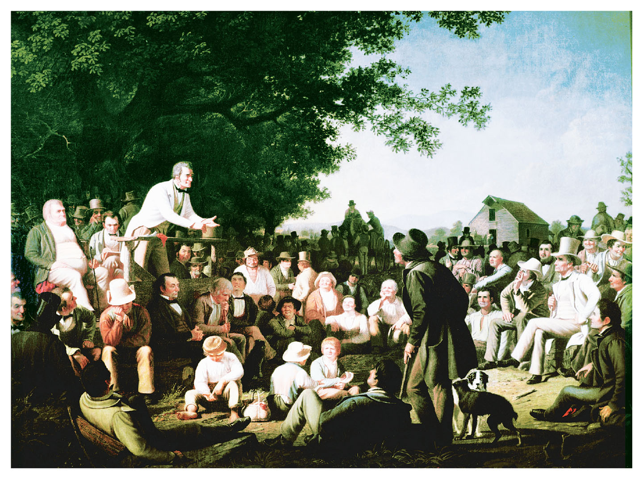
Stump Speaking
Stump Speaking, painting by George Caleb Bingham, 1850s Give Me Liberty!: An American History, 5th Edition
Copyright © 2017 W.W. Norton & Company
Notes:
In this painting from the 1850s, George Caleb Bingham depicts a candidate in a county election addressing a group of voters, an illustration of grassroots democracy in action. One of the listeners appears about to question or challenge the speaker. A founder of the Whig Party in Missouri, Bingham himself ran for office several times and was elected to the state legislature in 1848.

Slide 37
The Parties
Democrats and Whigs
Notes:
Politics in the age of Jackson concerned issues associated with the market revolution and tensions between national and sectional loyalties. Political debate centered on banks, tariffs, currency, internal improvements, and the balance of power between national and local authority. The market revolution shaped many party positions. Democrats tended to be alarmed by the growing gap between social classes, and warned that “nonproducers,” such as bankers, merchants, and speculators, were using connections with government to enhance their wealth to the disadvantage of “producers,” such as farmers, artisans, and laborers. They wanted government to avoid interfering with the economy and giving special favors to economic interests. Without government interference in the market, ordinary Americans would compete fairly in a self-regulating market, and the most meritorious would succeed. Democrats tended to be upcoming businessmen, farmers, and urban workers. Whigs supported the American System, believing that the protective tariff, internal improvements, and a national bank could develop the economy and spread prosperity for all classes. They were strongest in the Northeast, the most modernized region. Many bankers and businessmen supported their program, as did farmers near rivers, canals, and other waterways. While many slaveholders supported the Democrats, who believed states’ rights protected slavery, the largest southern planters voted Whig.

Slide 38
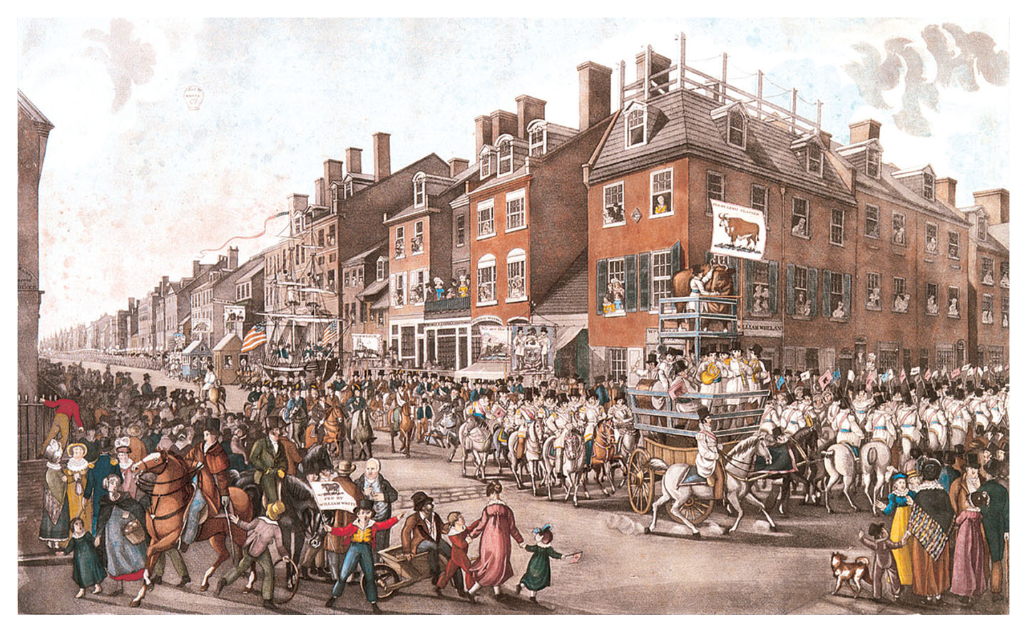
Procession of Victuallers
Procession of Victuallers, commemorating a parade of butchers Give Me Liberty!: An American History, 5th Edition
through the streets of Philadelphia in 1821 Copyright © 2017 W.W. Norton & Company
Notes:
Note to Compositor: insert image from page 368, bottom of the page.
Procession of Victuallers is a lithograph commemorating a parade of butchers through the streets of Philadelphia in 1821. Their banner, “We Feed the Hungry,” illustrates the belief among members of the “producing classes” that their work led to practical benefits for society, unlike the activities of “nonproducers” like bankers.

Slide 39
Public and Private
Public and Private Freedom
Politics and Morality
Notes:
Party battles of the Jacksonian era reflected conflict between “public” and “private” definitions of American freedom and their relationship to government power. To Democrats, liberty was a private entitlement best protected by local governments and threatened by a powerful national state. With Jackson, the national government’s power decreased. Weak federal power ensured private freedom and states’ rights, so Democrats under Jackson reduced spending, lowered the tariff, killed the national bank, and refused federal aid for internal improvements. States thus replaced the federal government as main economic actors, planning road and canal systems and chartering banks and other corporations.
Democrats also thought individual morality was a private concern, and they opposed attempts to impose a uniform moral vision on society, such as temperance laws restricting or banning the production and sale of liquor, or Sabbath laws banning business on Sundays. This was one reason that Irish and German immigrants tended to vote Democratic. Democrats supported policies that enhanced the “free agency” of individuals, leaving them free to make their own decisions and pursue their own interests. Whigs believed that liberty and power reinforced each other. They thought an energetic federal government enhanced freedom, and liberty required a prosperous and moral America. Government would create the conditions for economic development, producing prosperity for all classes and regions. Like the Federalists, wealthy Whigs saw society as a hierarchy of social classes, but unlike the Federalists, they believed class status was not fixed; individuals could rise in society through hard work. Whigs also believed the government should intervene in individuals’ lives to ensure that they acted as free moral agents, and thus supported schools, temperance laws, and Sabbath laws.

Slide 40
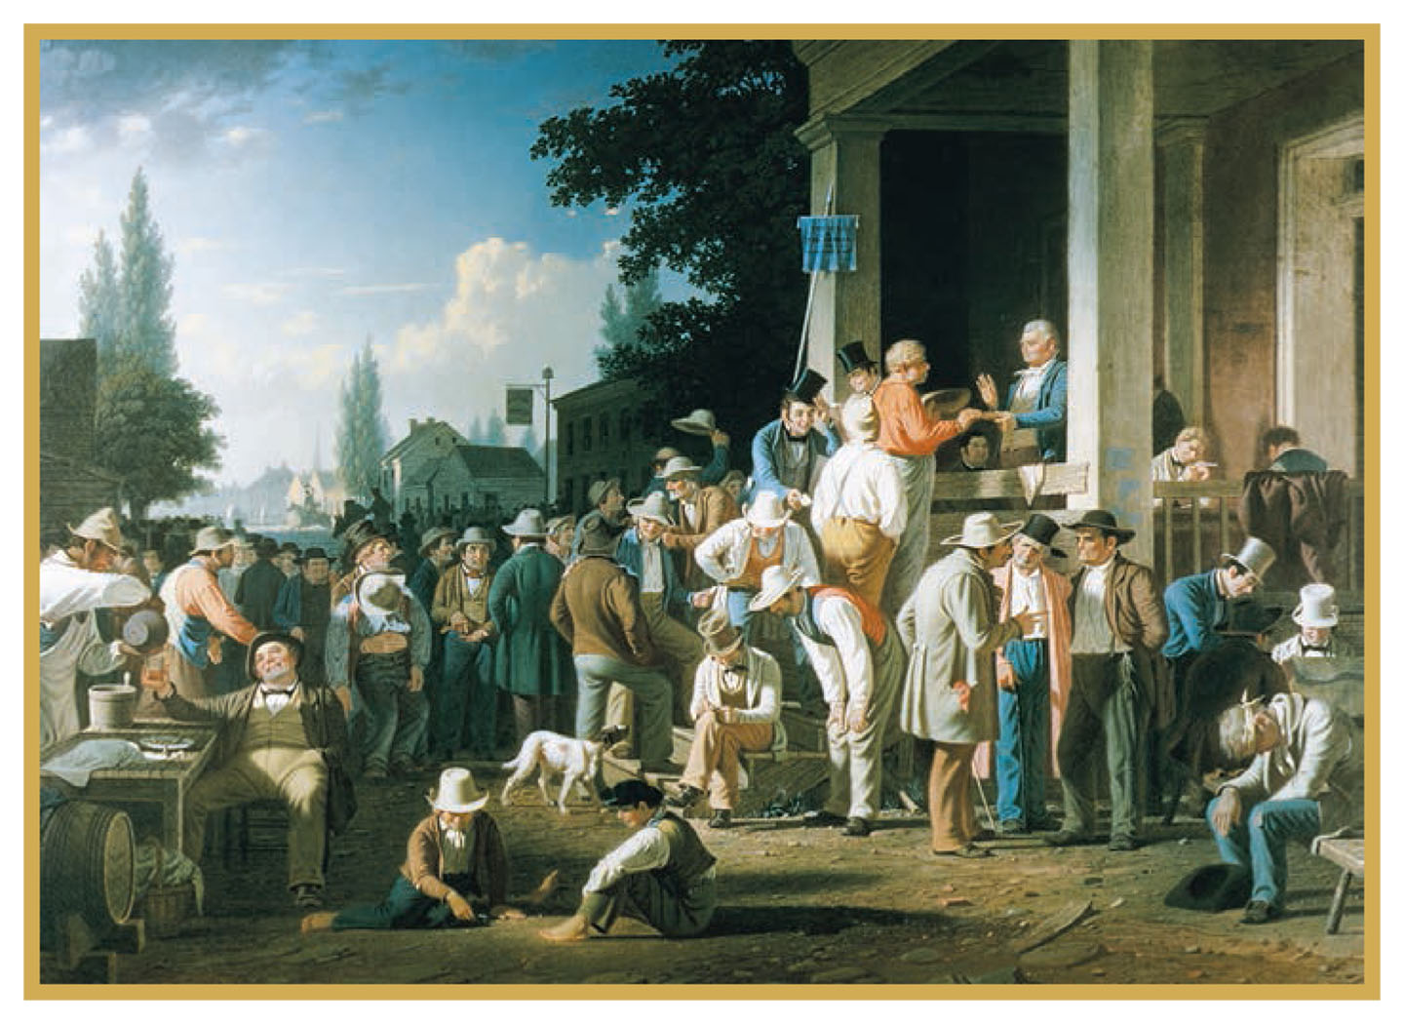
County Election
County Election, by George Caleb Bingham, 1852 Give Me Liberty!: An American History, 5th Edition
Copyright © 2017 W.W. Norton & Company
Notes:
County Election is another painting by George Caleb Bingham depicting American democracy in action. In this 1852 work, a voter takes an oath while party workers dispense liquor, seek to persuade voters, and keep track of who has cast ballots. The banner on the pole reads, “The Will of the People the Supreme Law.” The slogan is meant to be ironic. Bingham includes a number of Democratic politicians he accused of cheating him in a recent election.

Slide 41
The States’ Rights Debate
South Carolina and Nullification
Calhoun’s Political Theory
Notes:
Dedicated to states’ rights, Jackson’s first term saw his efforts to uphold federal supremacy over states. The 1828 tariff, which raised taxes on imported goods, aroused opposition in the South, particularly in South Carolina, where it was called the “tariff of abominations.” Believing that the tariff punished southern consumers in order to benefit northern industry, South Carolina’s legislature threatened to nullify it, that is, to declare it null and void in South Carolina. South Carolina had a higher percentage of slaves than any other state and was ruled by an oligarchic elite of large plantation owners alarmed by the Missouri controversy and by growing federal power.
Jackson’s vice president, John C. Calhoun of South Carolina, developed a theory of nullification. In it he argued that states had created the national government, and each state retained the right to prevent the enforcement of Congress’s laws within its border that seemed to exceed powers written in the Constitution. Opponents such as Daniel Webster argued that the people, not the states, had created the Constitution and the federal government, and that nullification was illegal, unconstitutional, and treasonous.

Slide 42
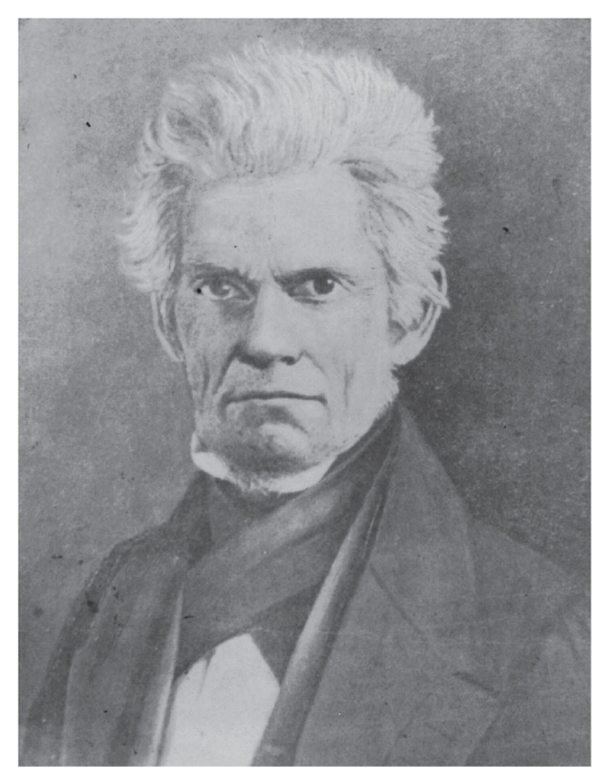
John C. Calhoun
Give Me Liberty!: An American History, 5th Edition
Copyright © 2017 W.W. Norton & Company
Notes:
John C. Calhoun evolved from a nationalist into the most prominent spokesman for state sovereignty and the right of nullification.

Slide 43
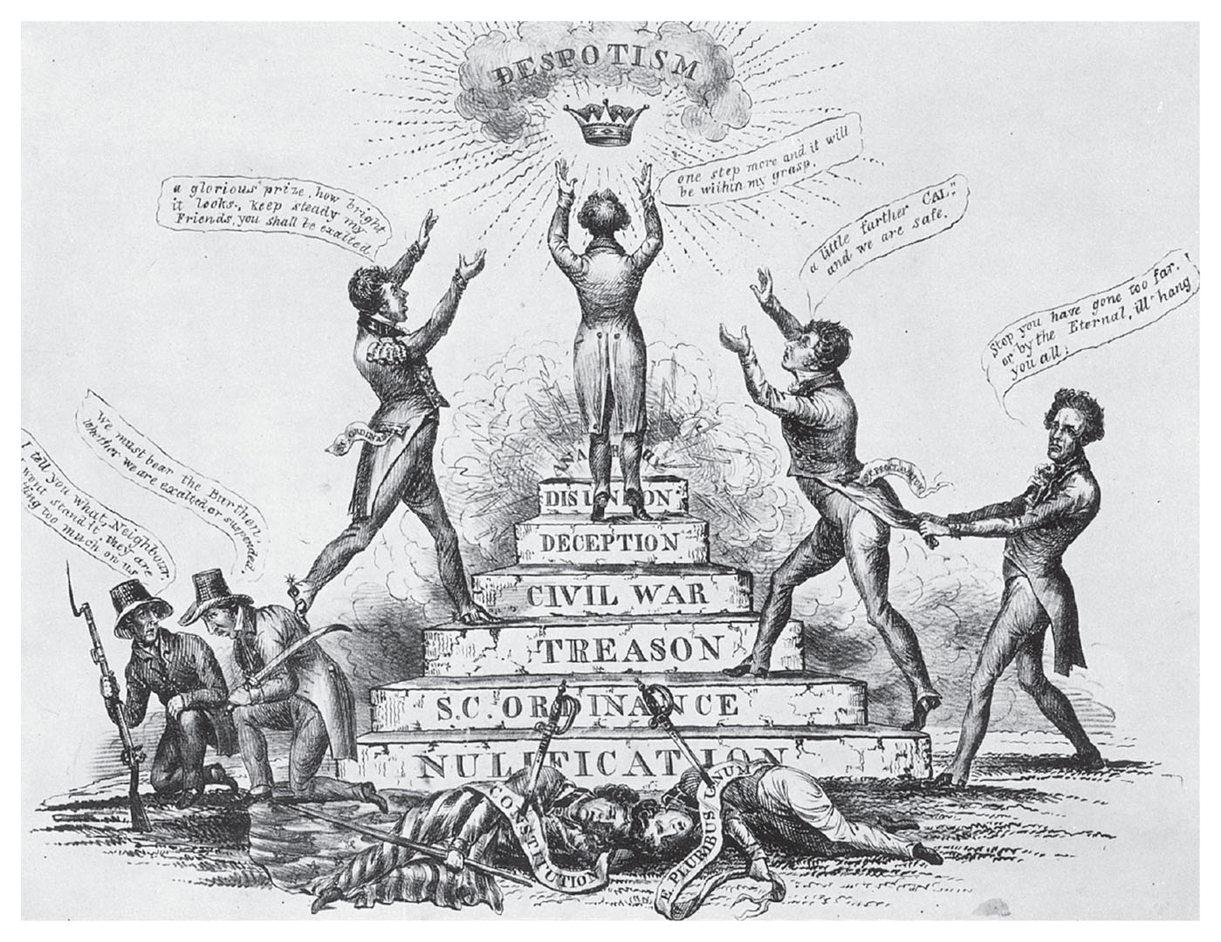
Nullification
A cartoon from 1833 depicting the nullification controversy Give Me Liberty!: An American History, 5th Edition
Copyright © 2017 W.W. Norton & Company
Notes:
A cartoon published in 1833, at the height of the nullification controversy, shows John C. Calhoun climbing steps, including those marked “nullification,” “treason,” and “civil war,” toward the goal of “despotism.” He is flanked by James H. Hammond and Robert Y. Hayne, two of South Carolina’s political leaders. On the right, President Andrew Jackson threatens to hang them.

Slide 44
Sectionalism Intensified
The Nullification Crisis
Notes:
While no other southern state threatened nullification, Calhoun’s theory offered the South a political philosophy to use when sectionalism intensified. Calhoun argued that the theory did not threaten disunion but preserved it, allowing unique and diverse states to preserve their interests while remaining part of the federal union. To President Jackson, however, nullification was disunion. In 1832, when a new tariff was enacted, South Carolina declared it would be null and void the next year. In response, Jackson persuaded Congress to pass the Force Act authorizing him to use the military to collect the tariff in South Carolina. To avoid war, Henry Clay, along with Calhoun, created a compromise tariff in 1833 that reduced duties. South Carolina rescinded the nullification law, and Calhoun abandoned his Democratic Party and Jackson for Clay and Webster, and the Whigs, where they were united only by their hatred for Jackson.

Slide 45
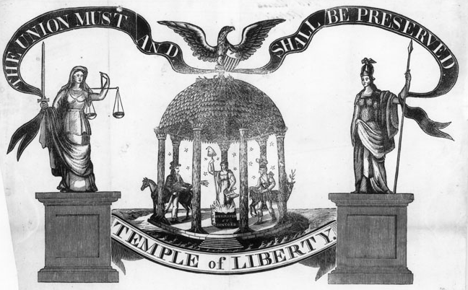
“A Temple of Liberty”
An 1834 print portrays the United States as a Temple of Liberty. Give Me Liberty!: An American History, 5th Edition
Copyright © 2017 W.W. Norton & Company
Notes:
An 1834 print portrays the United States as a Temple of Liberty. At the center, a figure of liberty rises from the flames, holding the Bill of Rights and a staff with a liberty cap. Justice and Minerva (Roman goddess of war and wisdom) flank the temple, above which flies a banner, “The Union Must and Shall Be Preserved.”

Slide 46
Jackson and American Indians
Indian Removal
The Supreme Court and the Indians
Notes:
Jackson’s nationalism and commitment to national sovereignty also showed in his Indian policy. The last Indian resistance in the Old Northwest ended in American victory in the Black Hawk War in 1832. In the South, cotton’s spread introduced land-hungry white settlers into areas where “civilized” tribes such as the Cherokee, Choctaw, and Creek had long practiced white ways, including slavery. But in 1830 Jackson secured passage of the Indian Removal Act, which allowed for the removal of tens of thousands of Indians from the Southwest. The law repudiated Jeffersonian notions that Indians could be assimilated and eventually incorporated into white America.
The Cherokee in Georgia, threatened with expulsion by that state’s government, had their own constitution, schools, and English newspaper. They appealed to the Supreme Court to protect their land rights, which had been guaranteed in treaties with the federal government. In 1832, the Court decided that Indians did not in fact own their land, but rather were nomads who only had a “right of occupancy.” Another Supreme Court decision defined Indians as “wards” of the federal government who did not have full rights as citizens, and were not independent nations sovereign from state governments. A subsequent decision seemed to reverse this judgment, giving Indian nations a separate political identity to be dealt with by the federal government, not the states. But Jackson refused to enforce this last decision, and he let Georgia expel the Cherokee, with help from the federal government, which sent troops to forcibly remove them and other tribes in the 1830s. The Indians were forced to move to territories in the West with inferior land; thousands died on the way. In Florida, the Seminoles resisted removal for seven years by fighting a costly guerrilla war against American troops, but they too succumbed. By the 1840s, Indians had all but disappeared as a visible presence in the eastern states of America.

Slide 47
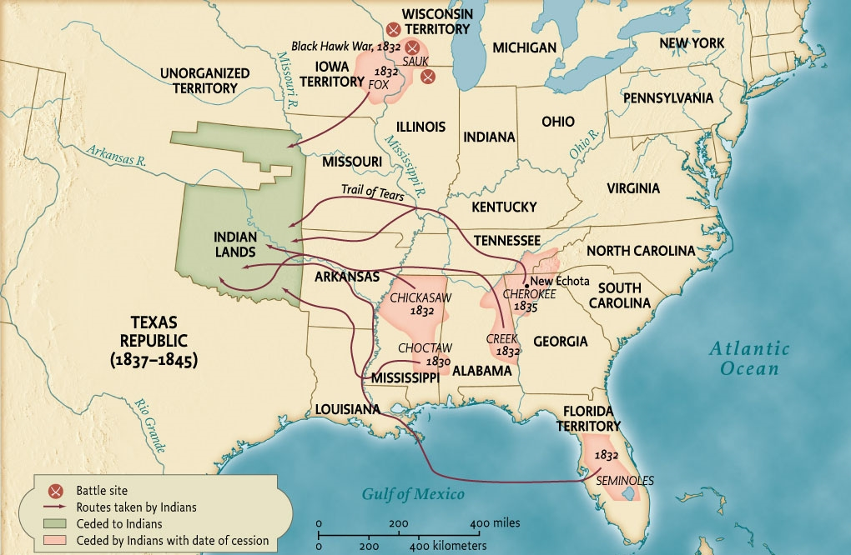
Indian Removals, 1830-1840
Map 10.5 Indian Removals, 1830–1840 Give Me Liberty!: An American History, 5th Edition
Copyright © 2017 W.W. Norton & Company
Notes:
The removal of the so-called Five Civilized Tribes from the Southeast all but ended the Indian presence east of the Mississippi River.

Slide 48
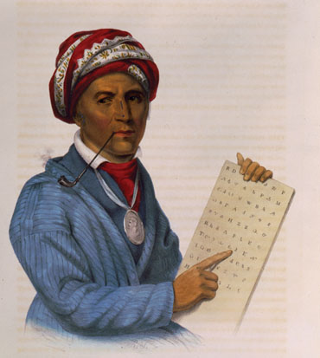
Sequoia
A lithograph from 1836 depicts Sequoia with the alphabet of the Give Me Liberty!: An American History, 5th Edition
Cherokee language that he developed. Copyright © 2017 W.W. Norton & Company
Notes:
A lithograph from 1836 depicts Sequoia with the alphabet of the Cherokee language that he developed. Because of their written language and constitution, the Cherokee were considered by many white Americans to be a “civilized tribe.”

Slide 49
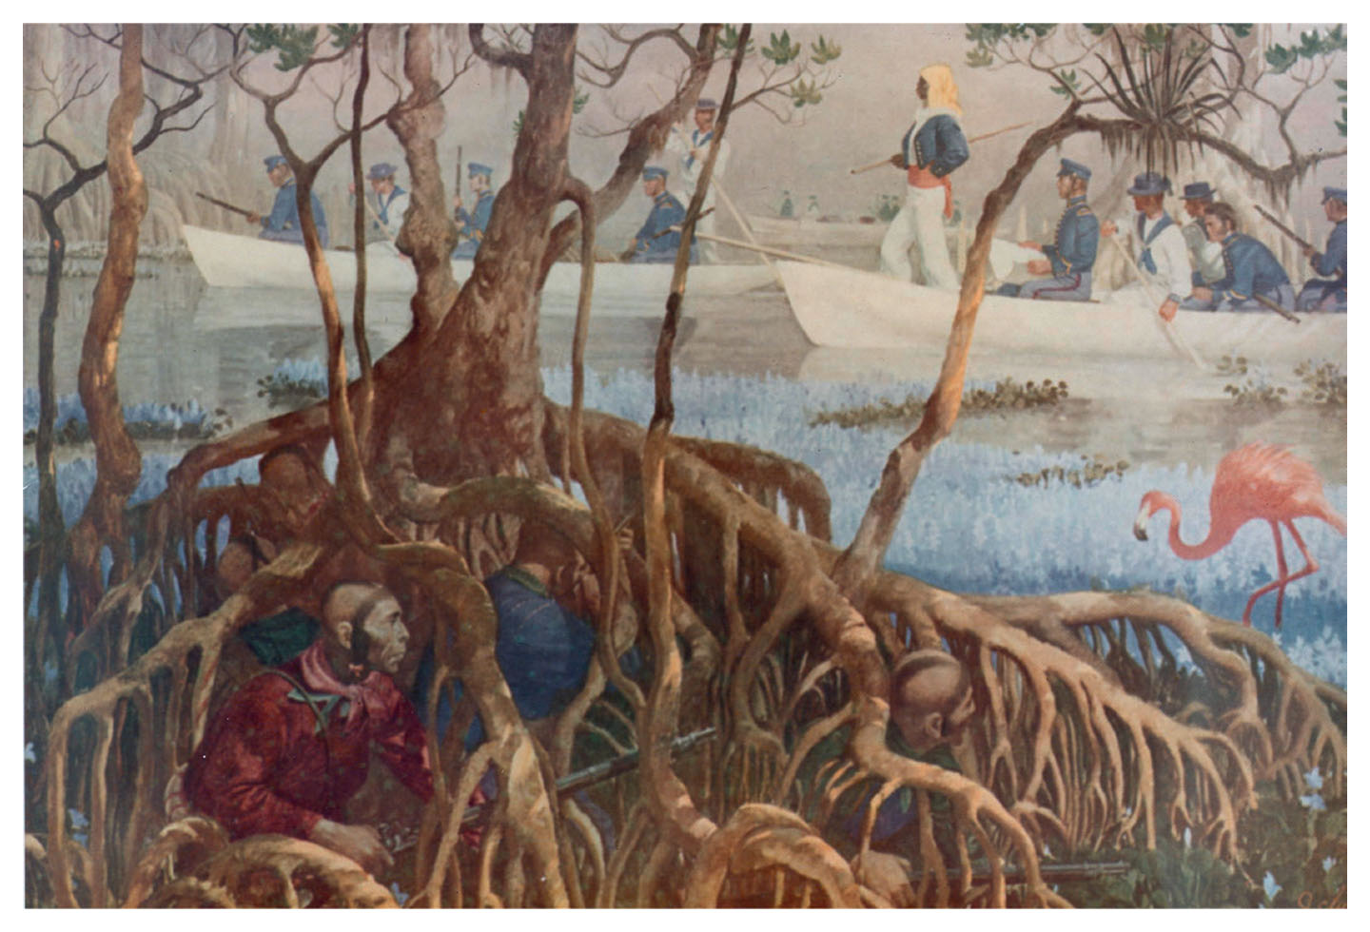
Hiding in a Mangrove Swamp
Hiding in a Mangrove Swamp, showing Seminole Indians avoiding American sailors Give Me Liberty!: An American History, 5th Edition
Copyright © 2017 W.W. Norton & Company
Notes:
Hiding in a Mangrove Swamp, a painting showing Seminole Indians in the Florida Everglades avoiding American sailors during the Second Seminole War

Slide 50
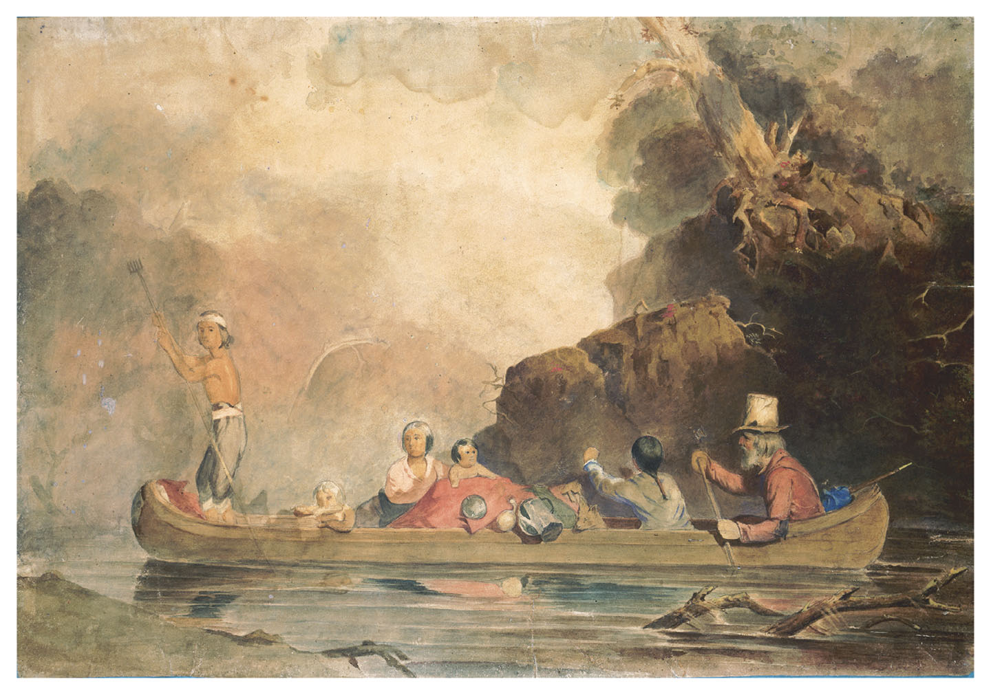
The Trapper and His Family
The Trapper and His Family, by Charles Deas, 1845 Give Me Liberty!: An American History, 5th Edition
Copyright © 2017 W.W. Norton & Company
Notes:
The Trapper and His Family (1845), by the artist Charles Deas, depicts a white pioneer who married an Indian woman.

Slide 51
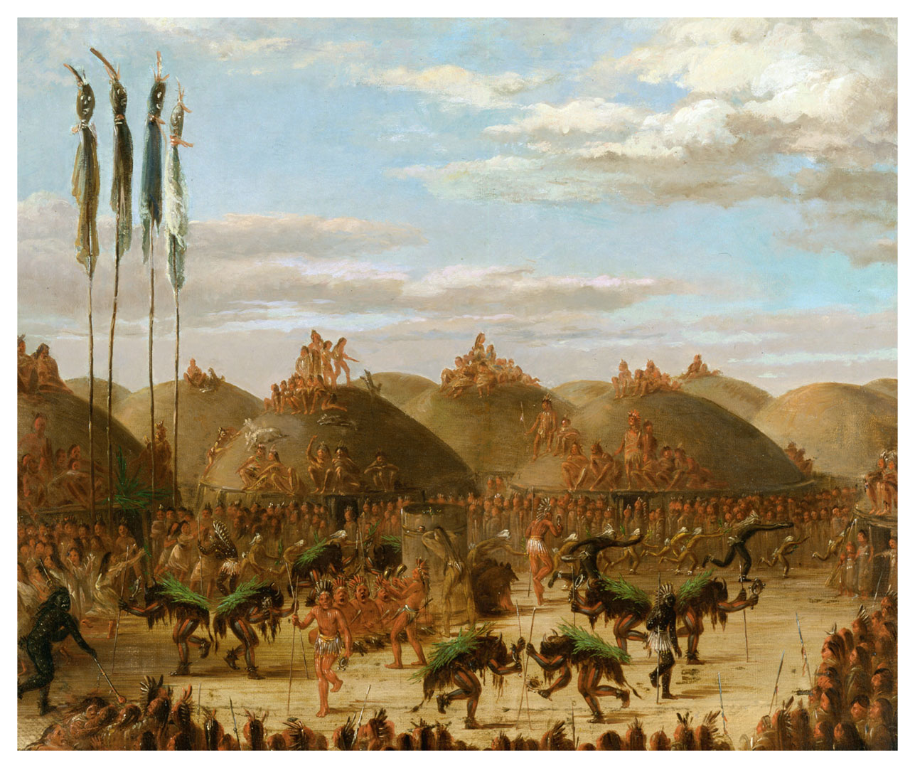
Bull Dance
Bull Dance, by George Catlin, 1832 Give Me Liberty!: An American History, 5th Edition
Copyright © 2017 W.W. Norton & Company
Notes:
Bull Dance, an 1832 painting of a ceremony of the Mandan tribe by George Catlin, who created dozens of works depicting Indians in the trans-Mississippi West. Each participant in the dance wears an entire buffalo skin, complete with head, horns, hooves, and tail. At the time, millions of buffalo inhabited the West, providing food and hides for Native Americans. Catlin saw himself as recording a vanishing way of life.

Slide 52
Focus Question: The Bank War and After
  Focus Question:
  How did the Bank War influence the economy and party competition?
Notes:
The purpose of the focus questions is to help students find larger themes and structures to bring the historical evidence, events, and examples together for a connected thematic purpose.
As we go through each portion of this lecture, you may want to keep in mind how the information relates to this larger thematic question. Here are some suggestions: write the focus question in the left or right margin on your notes and as we go through, either mark areas of your notes for you to come back to later and think about the connection, OR as you review your notes later (to fill in anything else you remember from the lecture or your thoughts during the lecture or additional information from the readings), write small phrases from the lecture and readings that connect that information to each focus question AND/OR are examples that work together to answer the focus question.

Slide 53
Jackson and the Bank of the United States
Biddle’s Bank
Notes:
The most significant political fight of the Jacksonian era was Jackson’s campaign against the Bank of the United States, which to many represented the hopes and anxieties caused by the market revolution. While banking’s growth had spurred economic development, many distrusted bankers as “nonproducers” who gave nothing to the nation’s real wealth, and profited from the labor of others. Banks also tended to overissue paper money, whose deterioration in value reduced the real income of wage earners. Jackson and others now thought that “hard money”—gold and silver—was the only honest currency. The aristocratic Nicholas Biddle directed the BUS, and he celebrated the bank’s power to control America’s financial system. This alarmed Democrats. In 1832, Biddle’s allies persuaded Congress to extend the BUS’s charter for another twenty years, even though it was set to expire in 1836. Jackson saw this as blackmail, since he believed the BUS would use its resources to defeat him in the 1832 election if he vetoed the bill. He did veto it, and his veto message resonated with popular values. He stated that Congress could not create an institution with such power and economic privilege unaccountable to voters. Exclusive privileges like the BUS charter widened the gap between the wealthy and the humble farmers, mechanics, and laborers, whom Jackson claimed to defend. The Bank War allowed Jackson to enhance the power of the presidency. He was the first president to use the veto as a major weapon and directly address voters over the heads of Congress. Jackson’s reelection in 1832 over Henry Clay, the Whig candidate, assured the demise of the BUS.

Slide 54
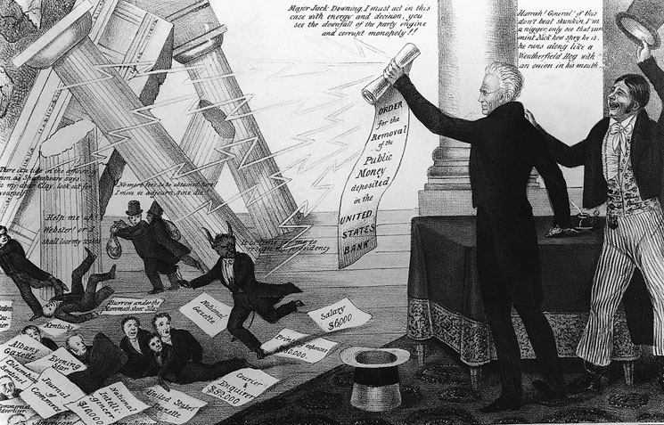
The Downfall of Mother Bank
The Downfall of Mother Bank, Democratic celebration of the destruction Give Me Liberty!: An American History, 5th Edition
of the Second Bank of the United States Copyright © 2017 W.W. Norton & Company
Notes:
The Downfall of Mother Bank, a Democratic cartoon celebrating the destruction of the Second Bank of the United States
President Andrew Jackson topples the building by brandishing his order removing federal funds from the Bank. Led by Nicholas Biddle, with the head of a demon, the Bank’s corrupt supporters flee, among them Henry Clay, Daniel Webster, and newspaper editors allegedly paid by the institution.

Slide 55
1837
The Pet Banks and the Economy
The Panic of 1837
Notes:
But what would replace the Bank of the United States? Jackson’s veto was supported by two groups: state bankers who wanted to free themselves from Biddle’s regulations and issue more paper currency (called “soft money”), and “hard money” advocates who opposed all banks, whether chartered by states or the federal government, and thought gold and silver was the only reliable currency. Jackson, wanting to dissolve the BUS before 1836, removed federal funds from the BUS and deposited them in local, state banks. Political and personal connections often determined the choice of which “pet banks” got federal funds. Without government deposits, the BUS lost its ability to regulate the state banks’ activities. State banks issued more and more paper money to finance economic development; the value of bank notes in circulation skyrocketed from $10 million in 1833 to $149 million in 1837. Prices rose, real wages declined, and speculators prospered.
The speculative bubble inevitably burst. The federal government sold 20 million acres of land in 1836, ten times the 1830 amount, and almost all of it paid for in paper money, which had questionable value. In July 1836, Jackson issued the Specie Circular, mandating that land payments to the federal government be made in hard currency. Simultaneously, British banks demanded that their creditors pay them in hard currency, and a recession in Britain caused a drop in the demand for American cotton. Together, these events caused an economic crisis, the Panic of 1837, which was followed by a depression that lasted until 1843. Businesses failed, workers lost their jobs, and farmers and others lost their lands. States that had taken up economic development projects defaulted on their debts.

Slide 56
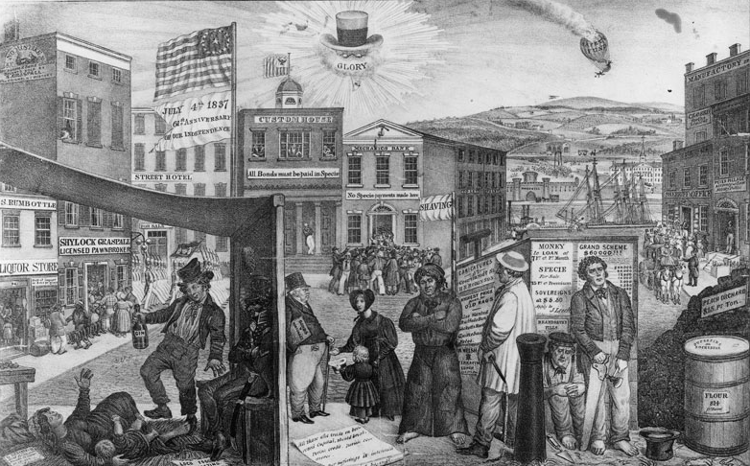
The Times
The Times, an 1837 engraving that blames Andrew Jackson’s Give Me Liberty!: An American History, 5th Edition
policies for the economic depression Copyright © 2017 W.W. Norton & Company
Notes:
The Times, an 1837 engraving that blames Andrew Jackson’s policies for the economic depression
The Custom House is idle, while next door a bank is mobbed by worried depositors. Beneath Jackson’s hat, spectacles, and clay pipe (with the ironic word “glory”), images of hardship abound.

Slide 57
Jackson’s Lieutenant
Van Buren in Office
Notes:
In 1836, Martin Van Buren, the new president and Jackson’s lieutenant, represented the hard money, anti-bank wing of the Democratic Party. In 1837, Van Buren announced that he hoped to remove federal funds from pet banks and keep them in the Treasury Department, directly under federal control. Only in 1840 did Congress approve this policy, known as the Independent Treasury, which completely separated the national government from banking. It was repealed in 1841 but restored in 1846. Making federal funds unavailable for banks to use for investment would have dampened economic growth had not the discovery of gold in California in 1848 poured new money into the economy.

Slide 58
1840
The Election of 1840
His Accidency
Notes:
Van Buren was not as popular as Jackson, and by 1840, the Whigs had mastered the political techniques Democrats had used to mobilize voters. That year, the Whigs nominated for president William Henry Harrison, a military hero from the War of 1812. He had no platform, but was portrayed as a common man who grew up in a “log cabin” and drank cider. His running mate was John Tyler, a states’ rights Democrat from Virginia who had joined the Whigs after the nullification crisis. The Whigs sold their candidate much better than the Democrats did Van Buren, and with a record voter turnout of 80 percent of eligible voters, Harrison won a sweeping victory.
But Harrison soon contracted pneumonia and died, making John Tyler an accidental president. When the Whig majority in Congress attempted to enact the American System into law, Tyler returned to his Democratic principles and vetoed every measure, including a new national bank and higher tariff. His cabinet resigned and the Whigs repudiated him. In the new age of Jacksonian democracy, presidents could not rule without parties, and Tyler accomplished little in his four years in office. But a storm was gathering that would test the stability of American democracy and the statesmanship of its political leaders.

Slide 59
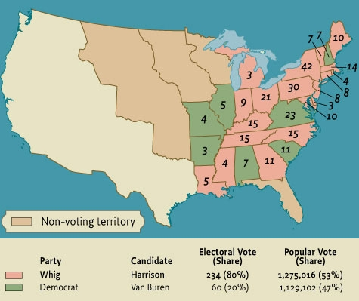
The Presidential Election of 1840
Map 10.6 The Presidential Election of 1840 Give Me Liberty!: An American History, 5th Edition
Copyright © 2017 W.W. Norton & Company

Slide 60
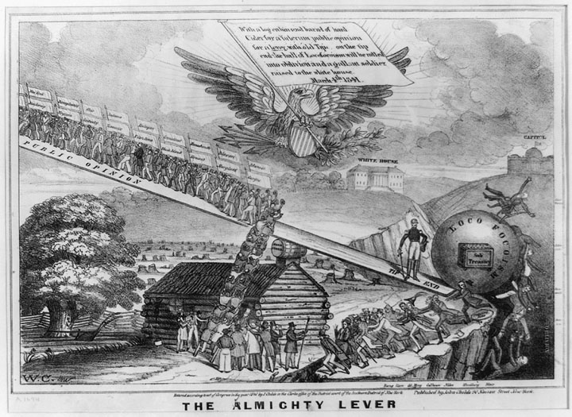
“The Almighty Lever”
An 1840 campaign cartoon depicts public opinion as the “almighty lever” Give Me Liberty!: An American History, 5th Edition
of politics in a democracy. Copyright © 2017 W.W. Norton & Company
Notes:
A political cartoon from the 1840 presidential campaign shows public opinion as the “almighty lever” of politics in a democracy. Under the gaze of the American eagle, “Loco-Foco” Democrats slide into an abyss, while the people are poised to lift William Henry Harrison, the Whig candidate, to victory.

Slide 61
Review: Part One
The Triumph of Democracy
  Focus Question: What were the social bases for the flourishing democracy of the early mid-nineteenth century?
Nationalism and Its Discontents
  Focus Question: What efforts were made in this period to strengthen the economic integration of the nation, and what major crises hindered these efforts?
Nation, Section, and Party
  Focus Question: What were the major areas of conflict between nationalism and sectionalism?

Slide 62
Review: Part Two
The Age of Jackson
  Focus Question: In what ways did Andrew Jackson embody the contradictions of democratic nationalism?
The Bank War and After
  Focus Question: How did the Bank War influence the economy and party competition?

Slide 63
MEDIA LINKS
—— Chapter 10 ——
Title | Media links
Eric Foner on anticolonial rebellions between 1810 and 1822 | Anticolonial Rebellions between 1810 and 1822
Eric Foner on the Jacksonian period | The Jacksonian Period
Eric Foner on Democrats vs. Whigs | Democrats vs. Whigs
Eric Foner on Jackson’s presidential powers | Jackson's Presidential Powers

Slide 64
Next Lecture PREVIEW:
—— Chapter 11 ——
The Peculiar Institution
The Old South
Life under Slavery
Slave Culture
Resistance to Slavery

Slide 65
This concludes the Norton Lecture Slide Set for Chapter 10
Give Me Liberty!
AN AMERICAN HISTORY
FIFTH EDITION by
Eric Foner
Norton Lecture Slides
Independent and Employee-Owned

