Slide 1
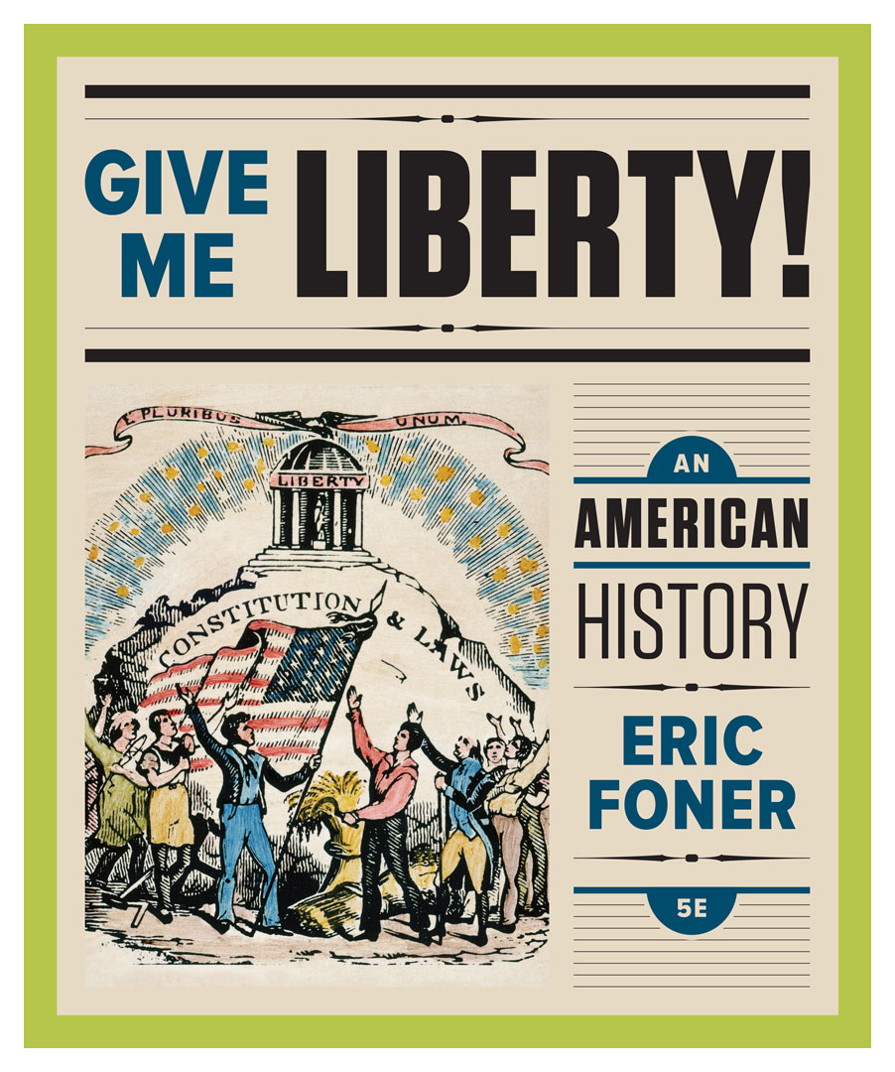
Lecture Slides
Give Me Liberty!
AN AMERICAN HISTORY
FIFTH EDITION
By Eric Foner

Slide 2
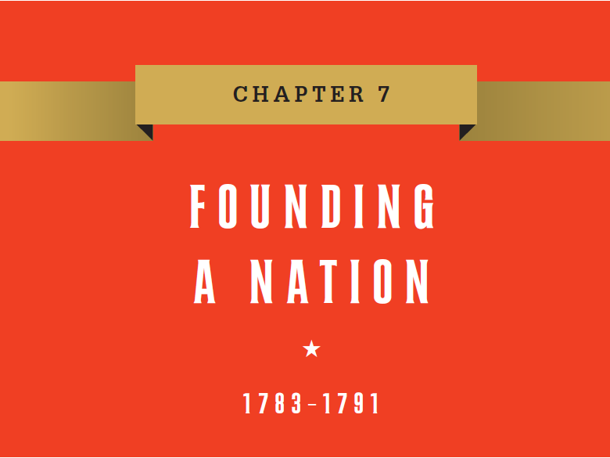
Chapter 7 Founding A Nation, 1783 to 1791
Notes:
During June and July of 1788, civic leaders all over the Atlantic coast organized celebrations of the ratification of the U.S. Constitution. Benjamin Rush commented that for a day, social class “forgot its claims,” as thousands rich and poor, businessman and apprentice, joined in common ceremony. New York’s Grand Federal Procession was led by farmers followed by members of a wide array of the city’s crafts, lawyers, merchants, and clergymen, testifying to the strong popular support for the Constitution in the nation’s cities. The prominent role of skilled artisans reflected how the Revolution secured their place in the public sphere, and elaborate banners and floats expressed hopes inspired by the new government. Throughout the revolutionary era, Americans spoke of their nation as a “rising empire,” destined to populate and control the continent, while emphasizing its difference from European governments of force. Jefferson stated that it would be “an empire of liberty,” bound together by the principles of the Declaration of Independence. Already, the United States exceeded the size of Great Britain, Spain, and France combined, and as a new nation, it possessed many advantages, including physical isolation from the constant wars of the Old World, a youthful population promising growth, broad property distribution, and high literacy rates among white citizens. But while Americans dreamed of economic prosperity and continental empire, prospects were not entirely promising; control over the nation’s territory was far from secure with nearly all of the 3.9 million inhabitants recorded in the first census (1790) concentrated on the Atlantic coast, and large areas west of the Appalachian Mountains remaining in Indian hands. Furthermore, the British retained posts in American territory near the Great Lakes, and there were fears that Spain would close the port of New Orleans to American commerce. Away from navigable waterways, communication and transportation was primitive; the country was overwhelmingly rural (fewer than one in thirty lived in a place with 8,000 inhabitants or more), and the population consisted of numerous ethnic and religious groups, as well as some 700,000 slaves, making unity difficult. No republican government had ever been established over such a large area or diverse population, and local loyalties outweighed national patriotism, meaning it would take time for a consciousness of a common nationality to sink deep roots. Today, with the United States as the most powerful country on earth, it is difficult to recall that in 1783 the future seemed precarious for the fragile nation making its way in a world of hostile great powers. Profound questions needed answers: what course of development should the United States follow? How could competing claims of local self-government, sectional interests, and national authority be balanced? Who should be considered full-fledged members of the American people, entitled to the blessings of liberty? These issues became the focus of heated debate as the first generation of Americans sought to consolidate their new republic.

Slide 3
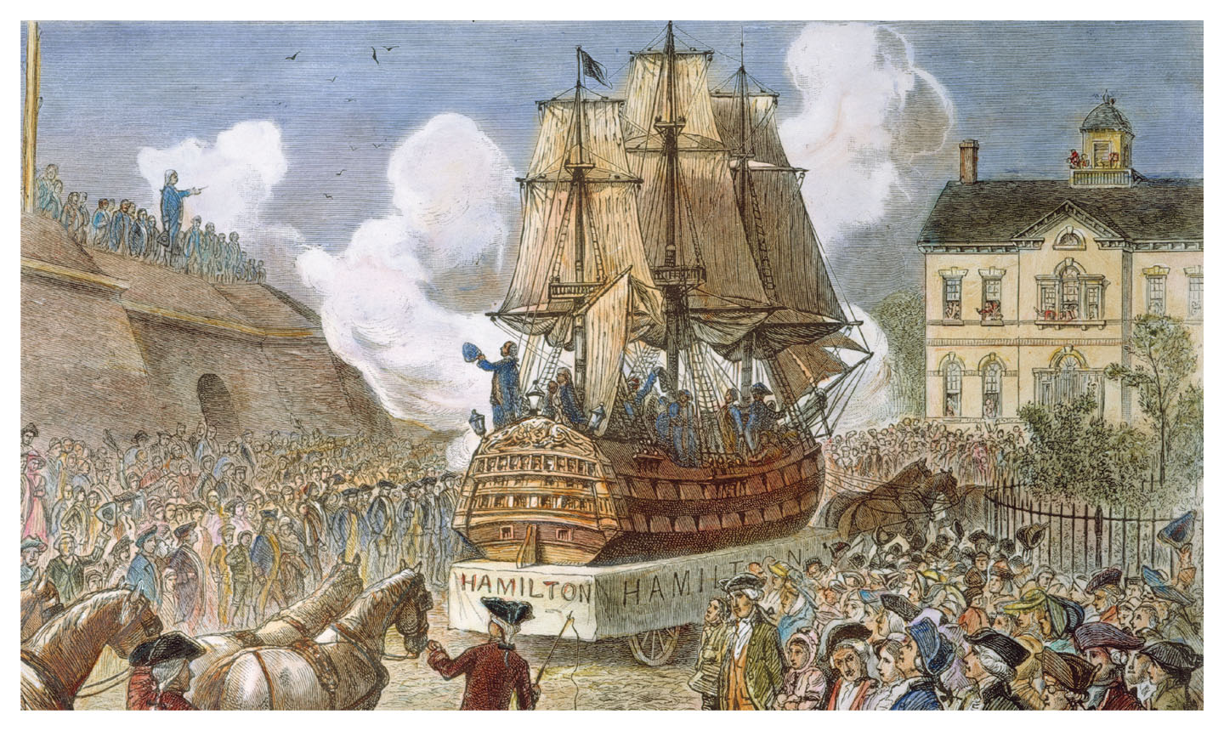
The Federal Ship Hamilton
The Federal Ship Hamilton, depicting the centerpiece of the Give Me Liberty!: An American History, 5th Edition
Grand Federal Procession in New York City, 1788 Copyright © 2017 W.W. Norton & Company
Notes:
The Federal Ship Hamilton, an engraving depicting the centerpiece of the Grand Federal Procession in New York City in 1788 that celebrated the ratification of the Constitution. The ship carried over thirty seamen and fired several thirteen-gun salutes during the parade, one for each state. Alexander Hamilton was one of the era’s key nationalists and an author of The Federalist, which made the argument for ratification.

Slide 4
Lecture Preview
America under the Confederation
A New Constitution
The Ratification Debate and the Origin of
the Bill of Rights
“We the People”
Notes:
The subtopics for this lecture are listed on the screen above.

Slide 5
Focus Question: America under the Confederation
  Focus Question:
  What were the achievements and problems of the Confederation government?
Notes:
The purpose of the focus questions is to help students find larger themes and structures to bring the historical evidence, events, and examples together for a connected thematic purpose.
As we go through each portion of this lecture, you may want to keep in mind how the information relates to this larger thematic question. Here are some suggestions: write the focus question in the left or right margin on your notes and as we go through, either mark areas of your notes for you to come back to later and think about the connection, OR as you review your notes later (to fill in anything else you remember from the lecture or your thoughts during the lecture or additional information from the readings), write small phrases from the lecture and readings that connect that information to each focus question AND/OR are examples that work together to answer the focus question.

Slide 6
Confederation Government
The Articles of Confederation
Notes:
In the revolutionary era, Americans described their nation as a “rising empire” that would eventually control all of North America. America’s empire would not be ruled by force, as were the empires of Europe. As Thomas Jefferson wrote, America would be an “empire of liberty” cemented by a commitment to the principles of the Declaration of Independence. The United States was already larger than Great Britain, Spain, and France combined, and it benefited from its isolation from war-torn Europe, its young population, and a broad distribution of property and literacy among whites. Yet, America did not control its vast western territories, which was populated by Indians and bordered by the British and Spanish, who posed a military and commercial threat. The nation was also rural and its population divided among varying ethnic and religious groups. No republic had ever been established in such a large area, with such a diverse people. The success and unity of the nation was far from assured.
The nation’s first written constitution was the Articles of Confederation, drafted by Congress in 1777 and approved by the states in 1781. The Articles were an attempt to balance the national coordination needed to win the war against fears that centralized power threatened liberty. With the Articles, the thirteen states retained their own sovereignty. The national government was a one-house Congress, in which each state had only one vote. No president existed to enforce laws, and no judiciary existed to interpret the laws. Major decisions required the approval of nine states, rather than a simple majority. The national government only had powers related to war—the powers to declare war and conduct foreign relations. Congress could issue money but not impose taxes or regulate commerce, and its revenue came from the voluntary contributions of state governments. Amendments to the Articles never received enough votes to pass. Although the Articles made a strong central government impossible, they did enable the states to surrender their disputed claims to western lands and give them to the federal government—a major achievement.

Slide 7
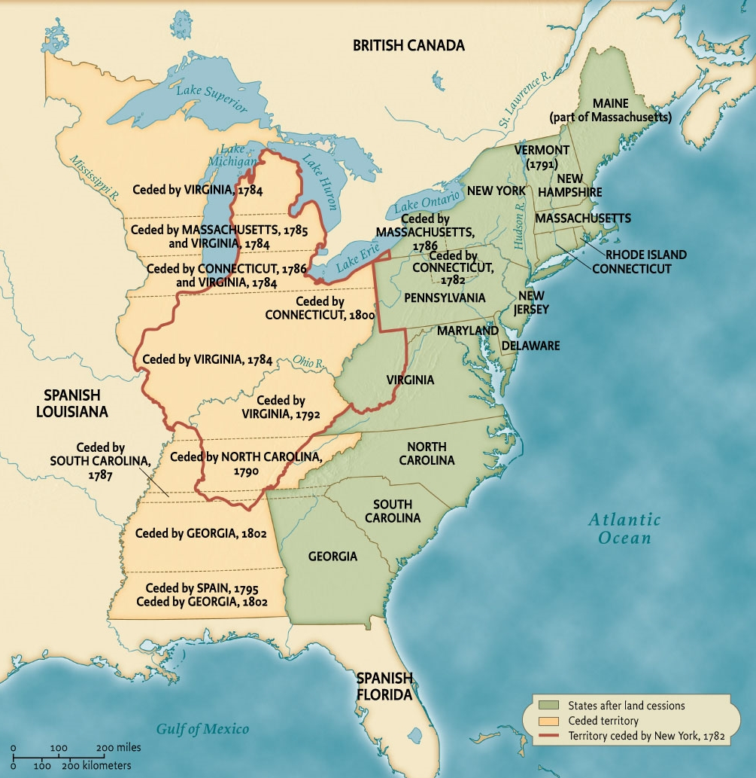
Western Lands, 1782 to 1802
Map 7.1 Western Lands, 1782–1802, depicting western land ceded by the states Give Me Liberty!: An American History, 5th Edition
Copyright © 2017 W.W. Norton & Company
Notes:
The creation of a nationally controlled public domain from western land ceded by the states was one of the main achievements of the federal government under the Articles of Confederation.

Slide 8
The West
Congress and the West
Settlers and the West
Notes:
The national government established rules for settling the enormous new national domain in the West. While Americans considered it empty, it was inhabited by 100,000 Indians. When Congress declared independence from Britain, it argued that Indians had forfeited their rights to the land when they sided with the British, despite the fact that only certain tribes had done so. The government secured from the Indians much of the land north of the Ohio River, but left small parts of lands in the South to be held permanently by the Cherokee, Choctaw, and Chickasaw tribes. Though many national leaders believed that the nation’s prosperity depended on farmers’ gaining western lands, others saw government land sales as a source of revenue, and some worried that it would cause perennial conflict with the Indians. Private land companies hoped to buy up the land and sell it to settlers at a huge profit.
The war’s end caused a huge number of Americans to migrate westward into upstate New York and what became Kentucky and Tennessee. They believed their right to take western lands was essential to American freedom. They ignored Indian land titles, demanded that the government sell or give away the land, and often settled land to which they had no legal title. Many national leaders worried that these settlers were unruly and disorderly and would incite war with Indians, and they sought to regulate western settlement.

Slide 9
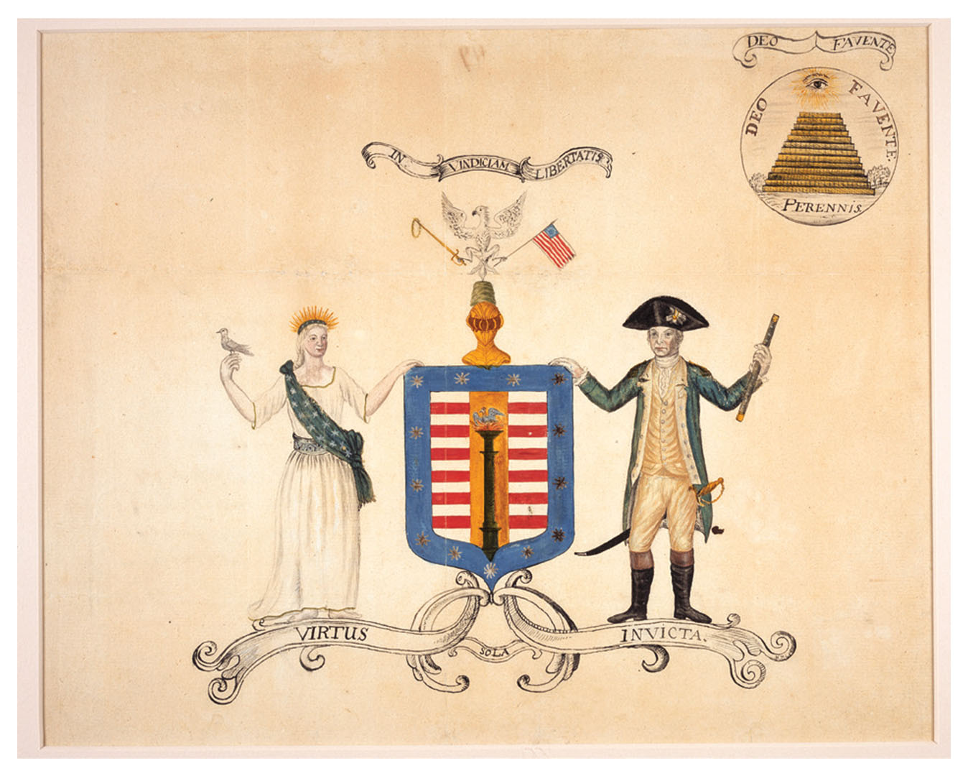
Designing the Great Seal of the United States
A design for the Great Seal of the United States, 1782 Give Me Liberty!: An American History, 5th Edition
Copyright © 2017 W.W. Norton & Company
Notes:
A design for the Great Seal of the United States produced by a committee of Congress in 1782 includes symbols of liberty, war, and peace, a shield with thirteen stars, and an eagle, all below a Latin phrase meaning “In Defense of Liberty.” On the reverse (illustrated at upper right) is an unfinished pyramid with thirteen steps and the Eye of Providence.

Slide 10
Regulating Sale and Settlement
The Land Ordinances
Notes:
In the 1780s, Congress regulated the way western land was sold and settled. The Ordinance of 1784, written by Thomas Jefferson, established the steps by which these areas would be governed. This measure divided the region into districts first governed by Congress and eventually admitted to the Union as states. Congress rejected by a single vote a clause in the bill that would have prohibited slavery in the entire West. A 1785 ordinance regulated land sales in the region north of the Ohio River, which became known as the Old Northwest. This land was to be surveyed by the government and sold in sections for $1 per acre. This system was meant to control and concentrate settlement and raise revenue for Congress, but settlers violated the rules by moving into areas where surveys had not been done.
Initially, the minimum purchase required by the government was too large for individual farmers to pay. Much of the land was sold to large land companies and speculators, who then divided the land and sold it to settlers at a huge profit. This caused many Americans in coming decades to demand that the government provide free or cheap land.
The Northwest Ordinance of 1787 called for the eventual establishment of three to five states north of the Ohio River and east of the Mississippi River. This ensured Jefferson’s “empire of liberty.” The United States would not rule its territories as a colonial power but would allow these lands to become equal parts of the political system as self-governing states. Territorial expansion and self-government would grow together.
This ordinance also recognized that Indians had a claim to lands in this area and promised not to take their land without consent. Yet, national land policy assumed that Indians would disappear as a result of purchase, treaties, or voluntary removal. The ordinance also prohibited slavery in the Old Northwest.

Slide 11
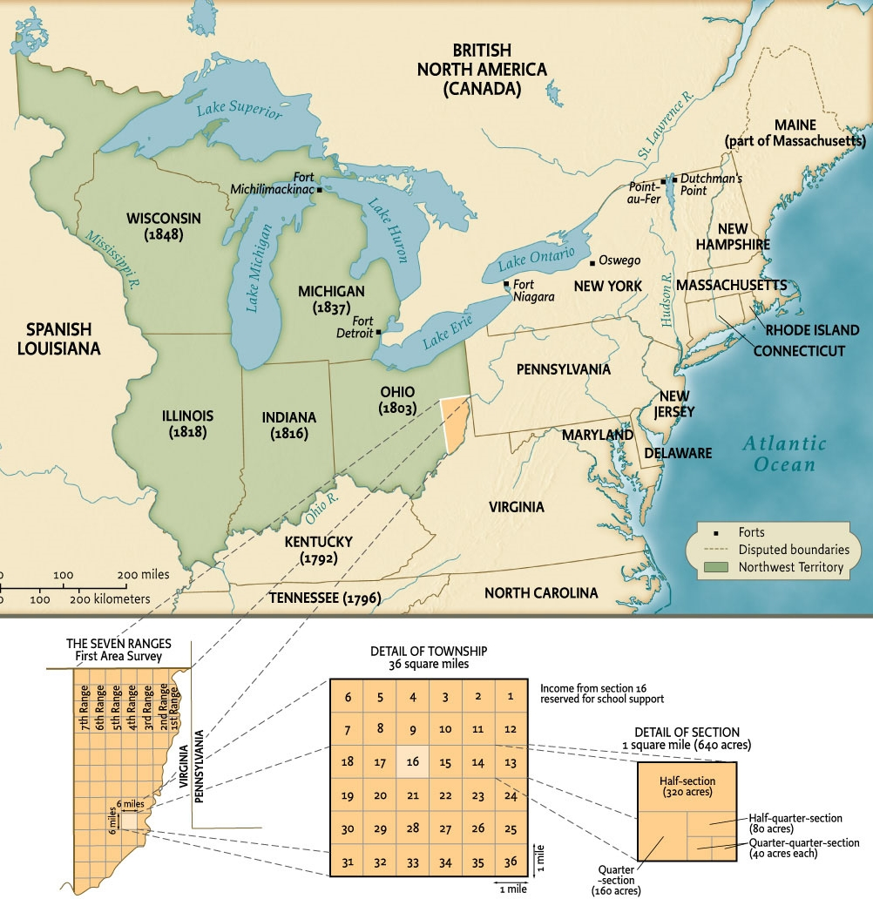
Western Ordinances, 1784 to 1787
Map 7.2 Western Ordinances, 1785–1787 Give Me Liberty!: An American History, 5th Edition
Copyright © 2017 W.W. Norton & Company
Notes:
A series of ordinances in the 1780s provided for both the surveying and sale of lands in the public domain north of the Ohio River and the eventual admission of states carved from the area as equal members of the Union.

Slide 12
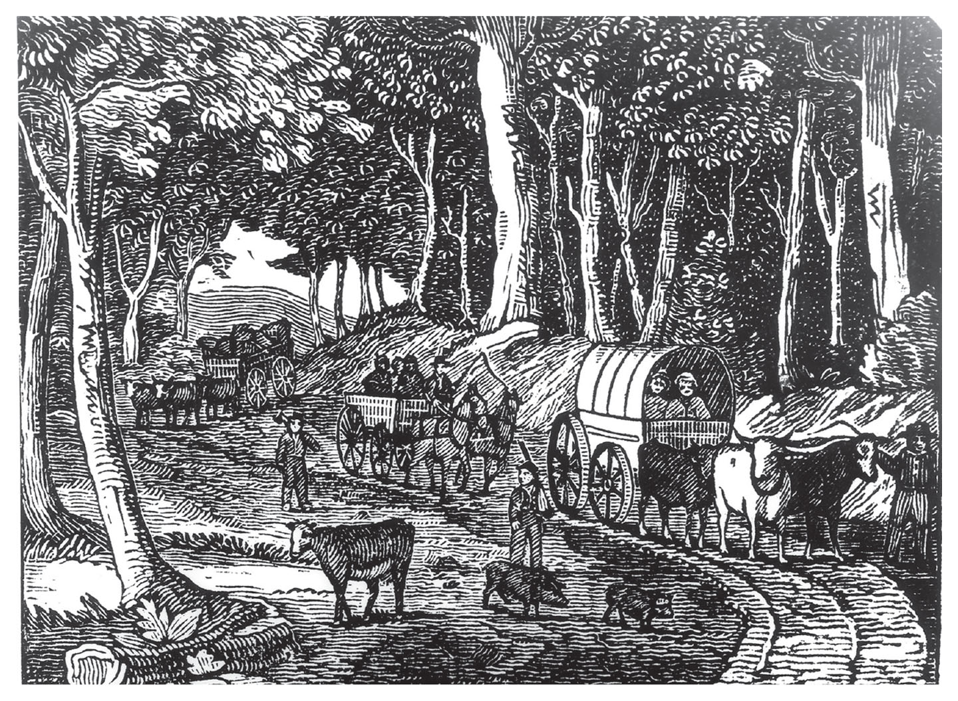
Farm Families Moving West
An engraving in The Farmers’ and Mechanics’ Almanac depicts farmers moving west. Give Me Liberty!: An American History, 5th Edition
Copyright © 2017 W.W. Norton & Company
Notes:
An engraving from The Farmers’ and Mechanics’ Almanac shows farm families moving west along a primitive road.

Slide 13
Problems with the Articles of Confederation
The Confederation’s Weaknesses
Shays’s Rebellion
Notes:
Many prominent Americans believed that the Articles of Confederation were irredeemably flawed. First in their minds was the nation’s economic crisis in the 1780s. To finance the Revolutionary War, Congress had borrowed large sums of money by selling interest-bearing bonds and paying soldiers and suppliers in notes to be redeemed at a later date. But without revenue, Congress was unable to pay the interest and the debts themselves. The British had barred American ships from trading with the West Indies, and European goods flooded the market, ruining the businesses of many artisans, driving down wages, and removing money from the country. States adopted their own relief measures, printing more money and postponing debt collection. Creditors saw these laws as infringements of their property rights.
In late 1786 and early 1787, debt-ridden farmers closed courts in western Massachusetts to prevent seizure of their lands for failure to pay taxes. The revolt came to be known as Shays’s Rebellion, after one of their leaders, Daniel Shays, a veteran of the Revolutionary War. The rebels, in demanding relief and the printing of paper money, thought they were continuing the Revolution’s traditions. An army organized by the Massachusetts government quelled the rebellion with little violence. The revolt convinced some influential Americans that a stronger national government was needed to encourage economic growth, protect property, and secure law and order.

Slide 14
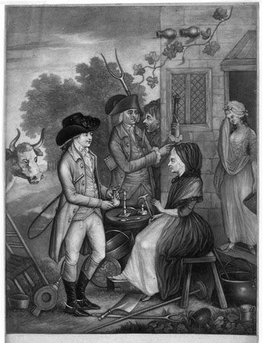
A Bankruptcy Scene
A Bankruptcy Scene, depicting creditors repossessing an indebted family’s belongings. Give Me Liberty!: An American History, 5th Edition
Copyright © 2017 W.W. Norton & Company
Notes:
Creditors repossess the belongings of a family unable to pay its debts, while a woman weeps in the background. Popular fears of bankruptcy led several states during the 1780s to pass laws postponing the collection of debts.

Slide 15
Nationalism
Nationalists of the 1780s
Notes:
One man afraid of democratic excess was James Madison, a Virginian and disciple of Thomas Jefferson who led the movement to strengthen national government. He was joined by Alexander Hamilton of New York, the most vocal advocate of a robust national government, who wanted to make the nation into a world military and commercial power. These nationalists found allies among others to whom the Revolution had given a consciousness of the nation, such as army officers, members of Congress, and diplomats. Influential economic interests such as bondholders, who wanted Congress to be able to generate revenue (in order to pay them back), and urban artisans, who wanted tariff protection, joined with those afraid that states were violating property rights to demand a stronger national government.
In September 1786, delegates from six states met at Annapolis, Maryland, to explore new ways to regulate interstate and foreign commerce. They proposed another gathering in Philadelphia to amend the Articles of Confederation, and Shays’s Rebellion stimulated support for this plan.

Slide 16
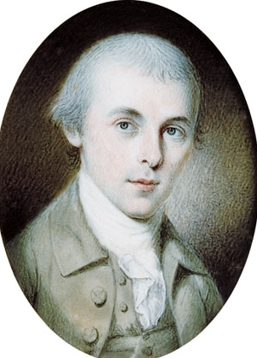
James Madison
James Madison, “father of the Constitution,” by Charles Wilson Peale, 1783 Give Me Liberty!: An American History, 5th Edition
Copyright © 2017 W.W. Norton & Company
Notes:
James Madison, “father of the Constitution,” in a miniature portrait painted by Charles Wilson Peale in 1783
Madison was only thirty-six years old when the Constitutional Convention met.

Slide 17
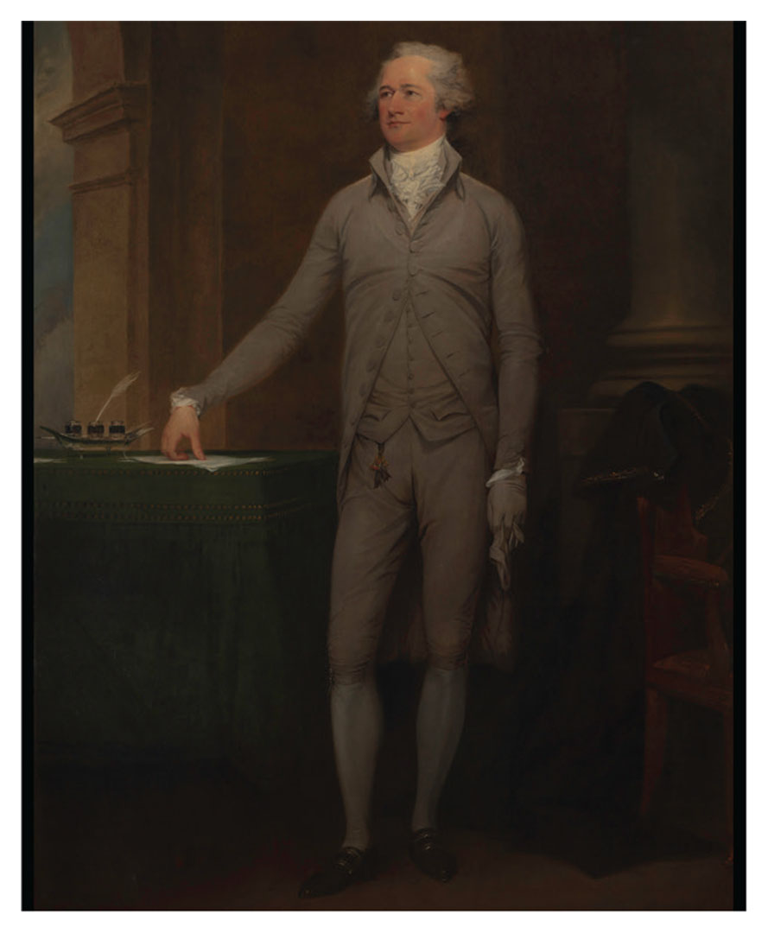
Alexander Hamilton
Alexander Hamilton, another youthful leader of the nationalists of the 1780s, Give Me Liberty!: An American History, 5th Edition
by John Trumbell, 1792 Copyright © 2017 W.W. Norton & Company
Notes:
Alexander Hamilton, another youthful leader of the nationalists of the 1780s, was born in the West Indies in 1755. This life-size portrait was commissioned by five New York merchants and painted by John Trumbull in 1792, when Hamilton was secretary of the Treasury.

Slide 18
Focus Question: A New Constitution
  Focus Question:
  What major disagreements and compromises molded the final content of the Constitution?
Notes:
The purpose of the focus questions is to help students find larger themes and structures to bring the historical evidence, events, and examples together for a connected thematic purpose.
As we go through each portion of this lecture, you may want to keep in mind how the information relates to this larger thematic question. Here are some suggestions: write the focus question in the left or right margin on your notes and as we go through, either mark areas of your notes for you to come back to later and think about the connection, OR as you review your notes later (to fill in anything else you remember from the lecture or your thoughts during the lecture or additional information from the readings), write small phrases from the lecture and readings that connect that information to each focus question AND/OR are examples that work together to answer the focus question.

Slide 19
Constitutional Convention
The Structure of Government
Notes:
Many of the fifty-five men who met at the Constitutional Convention were very prominent individuals, including George Washington, John Adams, and Benjamin Franklin. Men of education and great wealth, they were, in their social status, highly unrepresentative of most Americans. They shared a commitment to a stronger national government and believed that democracy had gone too far. They deliberated in private to ensure free and honest debate, and records of the proceedings were not published until 1840, when all the delegates were deceased.
All the delegates agreed there must be a legislature, an executive, and a judiciary in a new national government. The new Constitution would allow Congress to raise money through direct taxes, without relying on the state governments for revenue. The federal government would represent the people too. Even delegates who thought democracy had gone too far rejected Hamilton’s proposal for a king and House of Lords.
Debate centered on how to balance federal and state governments and the interests of small and large states. Madison’s Virginia Plan proposed the creation of a two-house legislature with a state’s population determining its representation in each house. Smaller states who feared domination by the more populous states countered with the New Jersey Plan, calling for a single-house Congress in which each state cast one vote. A compromise formed a two-house Congress, with a Senate in which each state had two members, and a House of Representatives, where members were apportioned according to a state’s population. Senators would be chosen by state legislatures every six years, insulating them from shifts in public opinion. Representatives were elected every two years directly by the people.

Slide 20
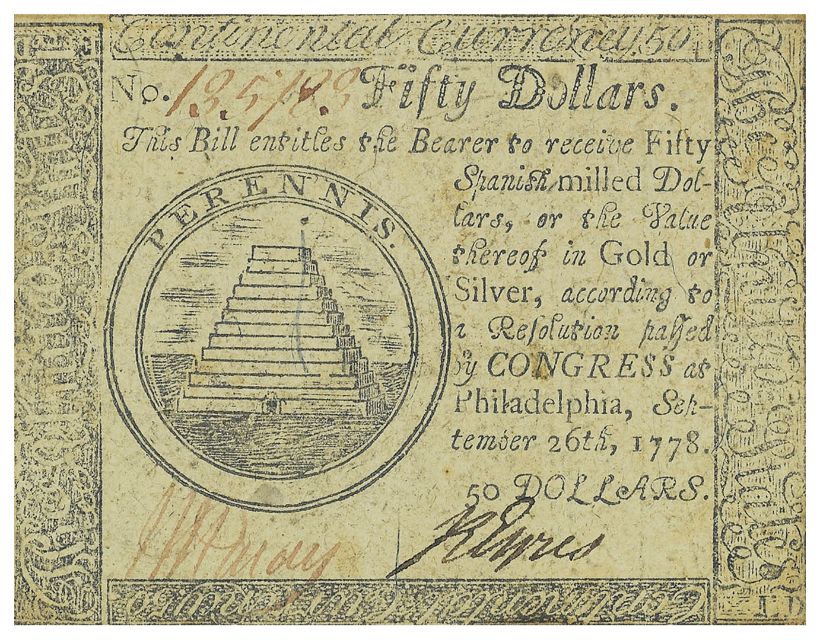
Revolutionary Currency
A fifty-dollar note issued by the Continental Congress during the War of Independence Give Me Liberty!: An American History, 5th Edition
Copyright © 2017 W.W. Norton & Company
Notes:
A fifty-dollar note issued by the Continental Congress during the War of Independence
Congress’s inability to raise funds to repay such paper money in gold or silver was a major reason why nationalists desired a stronger federal government.

Slide 21
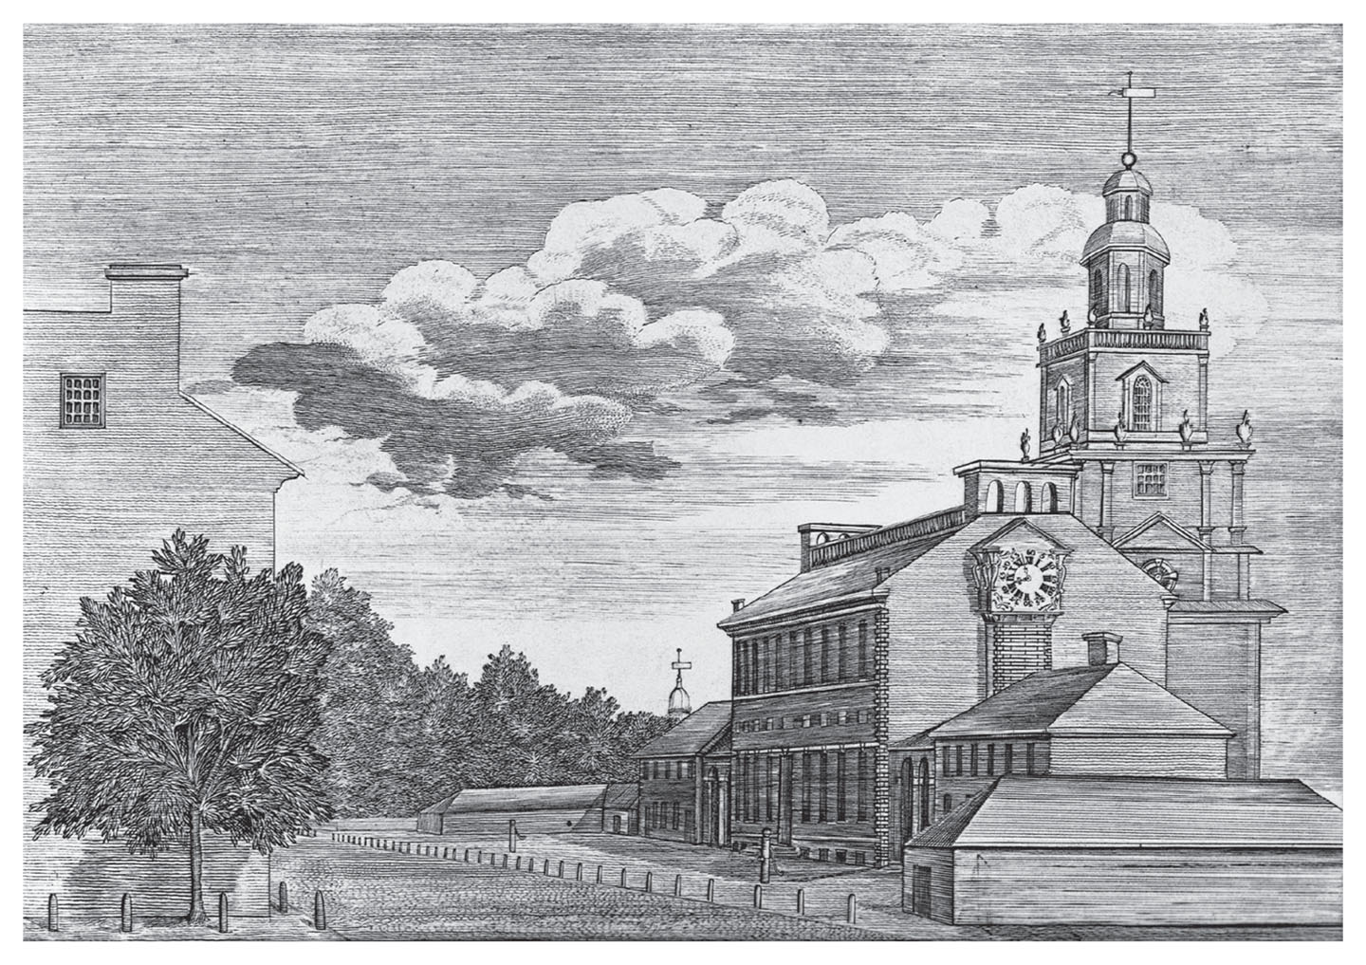
Independence Hall
The Philadelphia State House, now called Independence Hall Give Me Liberty!: An American History, 5th Edition
Copyright © 2017 W.W. Norton & Company
Notes:
The Philadelphia State House (now called Independence Hall) is where the Declaration of Independence was signed in 1776 and the Constitutional Convention took place in 1787.

Slide 22
The New Constitution’s Limits
The Limits of Democracy
Notes:
The direct election of members of the House of Representatives was an expansion of democracy. But the government structure created by the Constitution represented a limitation on democracy overall. Delegates hoped to isolate the nation’s government from popular sentiments that had alarmed elites in the 1780s. They wanted to ensure that the right kind of men were elected to office.
While the people would remain sovereign, they would choose those who governed them from among the elite. They assumed the Senate would be composed of each state’s most prominent citizens, and made the House of Representatives quite small, assuming that only very prominent men could win elections in large districts. Neither the president nor federal judges would be elected directly. The president was to be chosen by the electoral college or the House, and electors were not voted upon directly, either. The electoral college was an indirect means to elect the president, because the delegates did not trust ordinary voters to choose the president and vice president directly.

Slide 23
Framing
The Division and Separation of Powers
Notes:
The Constitution is actually quite brief and barely outlines the structure of the national government. It embodies two basic political principles: federalism, sometimes called “the division of powers,” and the system of “checks and balances” among the three branches of the national government, also called the “separation of powers.”
Federalism is the relationship between the national government and the states. The Constitution, compared to the Articles, strengthened national authority. It gave the president power to enforce the law and command the military. It gave Congress powers to impose taxes, borrow money, regulate commerce, declare war, deal with Indians and foreign nations, and promote the “general welfare.” States were barred from printing their own money or relieving debtors, as they had done under the Articles. But the daily responsibilities of government, such as law enforcement and education, were left to the states.
The “separation of powers” is the way the Constitution is designed to prevent any single branch of the national government from dominating the other two branches. Congress enacts laws, but the president can veto them, and a two-thirds majority is needed to pass a law over his veto. Federal judges are nominated by the president and approved by Congress, but they have lifelong terms to ensure their independence. The president can be impeached by the House and removed from office by the Senate.

Slide 24
Slavery
The Debate over Slavery
Slavery in the Constitution
Notes:
Slavery also sparked debate at the Constitutional Convention. Though the words “slavery” and “slave” do not appear in the Constitution, the Constitution affected slavery as an institution. It prohibited Congress from banning the Atlantic slave trade for twenty years, required states to return fugitive slaves to their owners, and stipulated that three-fifths of the slave population would be counted in determining each state’s representation in the House of Representatives and the electoral college. Many of these measures were proposed by delegates from South Carolina, who were fiercely proslavery.
These compromises about slavery made it more central to American politics and life than ever before. The Constitution allowed the importation of slaves to continue until 1808, when Congress prohibited it. But by then, 170,000 more slaves had been brought to the United States, more than one-quarter of all slaves carried to the country since 1700. The fugitive slave clause gave slavery “extraterritoriality”: slavery as a legal condition remained the status of an individual slave, even if that individual entered a “free” state where slavery had been abolished. The Constitution did not give the national government any authority to interfere with slavery in the states. And the three-fifths clause gave the white South far more power in national affairs than its free population warranted, allowing it to dominate the House of Representatives and ensure that every president but four elected between 1788 and 1848 was a southern slaveholder.

Slide 25
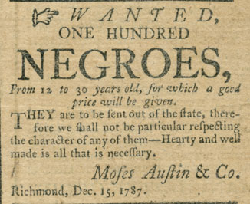
Slave Advertisement
Advertisement for slaves for sale that appeared in a Richmond Give Me Liberty!: An American History, 5th Edition
newspaper months after the Constitution was signed Copyright © 2017 W.W. Norton & Company
Notes:
This advertisement for the sale of 100 slaves from Virginia to states farther south appeared in a Richmond newspaper only a few months after the signing of the Constitution. Slavery was a major subject of debate at the Constitutional Convention.

Slide 26
The Constitution Finalized
The Final Document
Notes:
Once the delegates approved the document, it was sent to the states to be ratified. The Constitution established a new framework for American development. It enabled a national market to develop by giving Congress power over tariffs, interstate commerce, the coinage of money, patents, bankruptcy rules, and prohibiting interference with property rights.

Slide 27
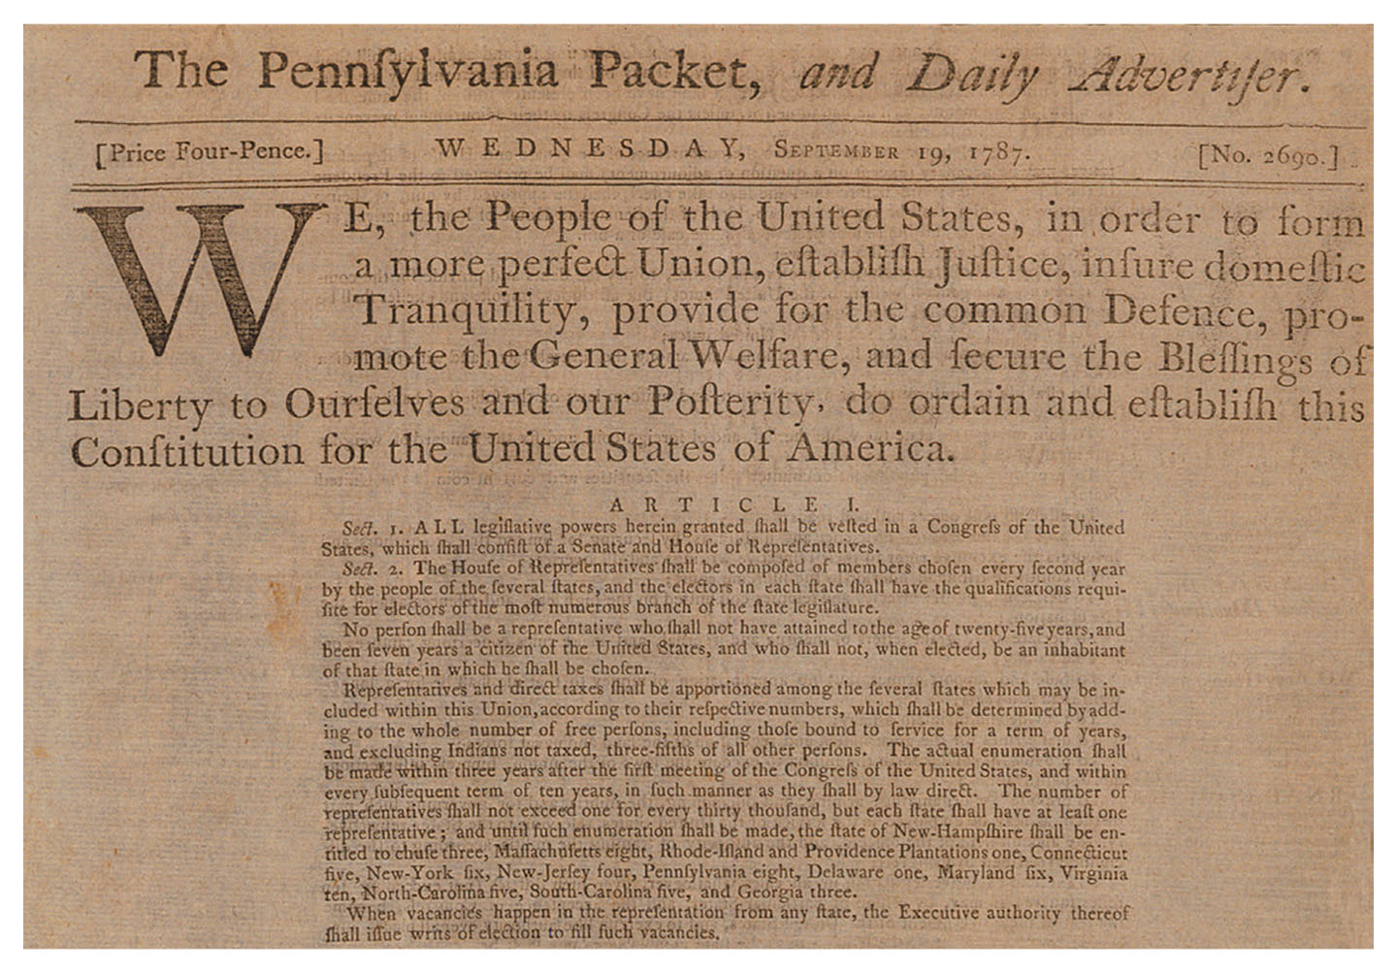
Preamble to the Constitution
The preamble to the Constitution appearing in a newspaper in Pa. Give Me Liberty!: An American History, 5th Edition
Copyright © 2017 W.W. Norton & Company
Notes:
The preamble to the Constitution, as printed in a Pennsylvania newspaper two days after the Constitutional Convention adjourned

Slide 28
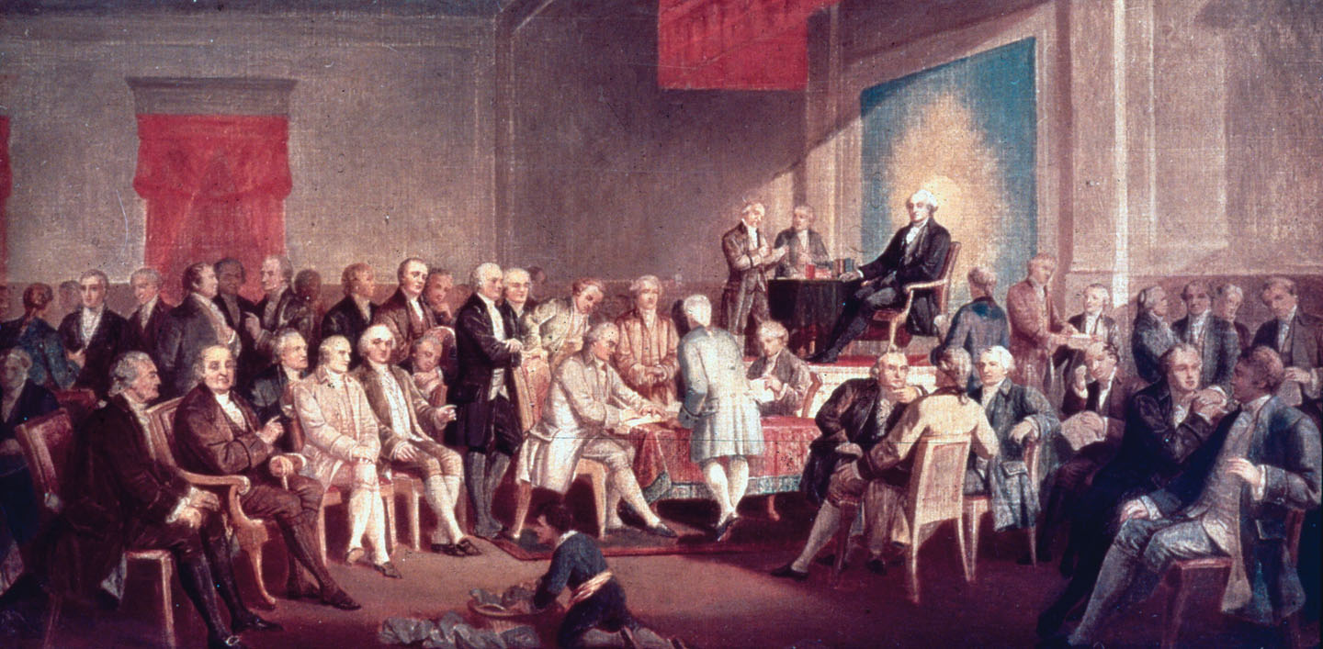
The Signing of the Constitution
The Signing of the Constitution, by Thomas Prichard Rossiter Give Me Liberty!: An American History, 5th Edition
Copyright © 2017 W.W. Norton & Company
Notes:
The Signing of the Constitution, by mid-nineteenth-century American artist Thomas Prichard Rossiter, depicts the conclusion of the Constitutional Convention of 1787. Among the founding fathers depicted are James Wilson, signing the document at the table in the center, and George Washington, presiding from the dais with an image of the sun behind him.

Slide 29
Focus Question: The Ratification Debate and the
Origin of the Bill of Rights
  Focus Question:
  How did Anti-Federalist concerns raised during the ratification process lead to the creation of the Bill of Rights?
Notes:
The purpose of the focus questions is to help students find larger themes and structures to bring the historical evidence, events, and examples together for a connected thematic purpose.
As we go through each portion of this lecture, you may want to keep in mind how the information relates to this larger thematic question. Here are some suggestions: write the focus question in the left or right margin on your notes and as we go through, either mark areas of your notes for you to come back to later and think about the connection, OR as you review your notes later (to fill in anything else you remember from the lecture or your thoughts during the lecture or additional information from the readings), write small phrases from the lecture and readings that connect that information to each focus question AND/OR are examples that work together to answer the focus question.

Slide 30
The Ratification Debate and Literature
The Federalist
“Extend the Sphere”
Notes:
Even though the Constitution provided that it would go into effect when nine states had approved it—not all thirteen states, as the Articles of Confederation required—ratification was not certain. Each state held an election for delegates to a special statewide ratifying convention, and these elections generated intense activity. Alexander Hamilton, James Madison, and John Jay authored a series of eighty-five essays that appeared as The Federalist in 1788. These three argued that the Constitution did not endanger Americans’ liberties, it protected them.
Madison, especially in essays nos. 10 and 51, developed a new vision of the relationship between government and society in the United States. Madison identified the basic dilemma of the new republic: government must be based on the will of the people, but the people were susceptible to dangerous opinions, especially those that might threaten property rights. He worried that a growing number of poor in the future might use their political power to secure “a more equal distribution of wealth.”
The solution, for Madison, was to be found in the republic’s size and diversity. Previous republics had always been small in size, but the size of America, he argued, would stabilize, not weaken, its government. In a nation so large, so many distinct interests would develop that no single interest would ever be able to take over the government and dominate the others. Every majority would be a coalition of minorities, securing the rights of individuals. Madison reassured Americans that they had only to “extend the sphere” to ensure the republic’s perpetuation under the Constitution. Madison thus strengthened the idea that westward expansion was essential to American freedom; made the structure of government and its size, not its virtue, the basis of republicanism; and advanced the “liberal” notion that men are motivated by self-interest and that social good emerges from conflict between private interests.

Slide 31
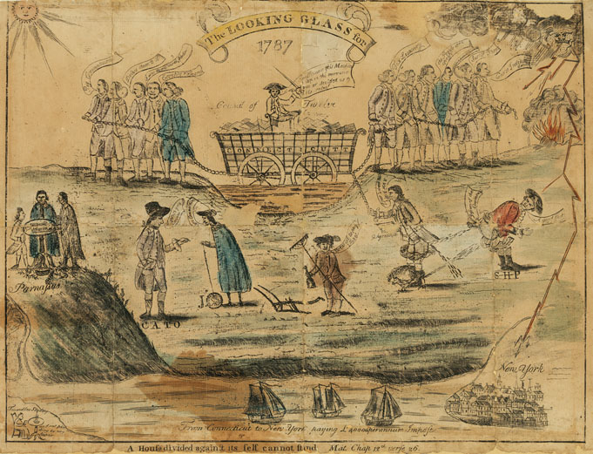
The Issues of Debate
This satirical engraving by Amos Doolittle depicts some of the issues Give Me Liberty!: An American History, 5th Edition
in the debate over the ratification of the Constitution. Copyright © 2017 W.W. Norton & Company
Notes:
This satirical engraving by Amos Doolittle (who created the image of the Battle of Concord in Chapter 5) depicts some of the issues in the debate over the ratification of the Constitution. The wagon in the center is carrying Connecticut and sinking into the mud under the weight of debts and paper money as “Federals” and “Antifederals” try to pull it out. Federals call for the state to “comply with Congress” (that is, to pay money requisitioned by the national government); the Antifederals reply, “tax luxury” and “Success to Shays,” a reference to Shays’s Rebellion. Underneath the three merchant ships is a phrase criticizing the tariffs that states were imposing on imports from one another (which the Constitution prohibited).

Slide 32
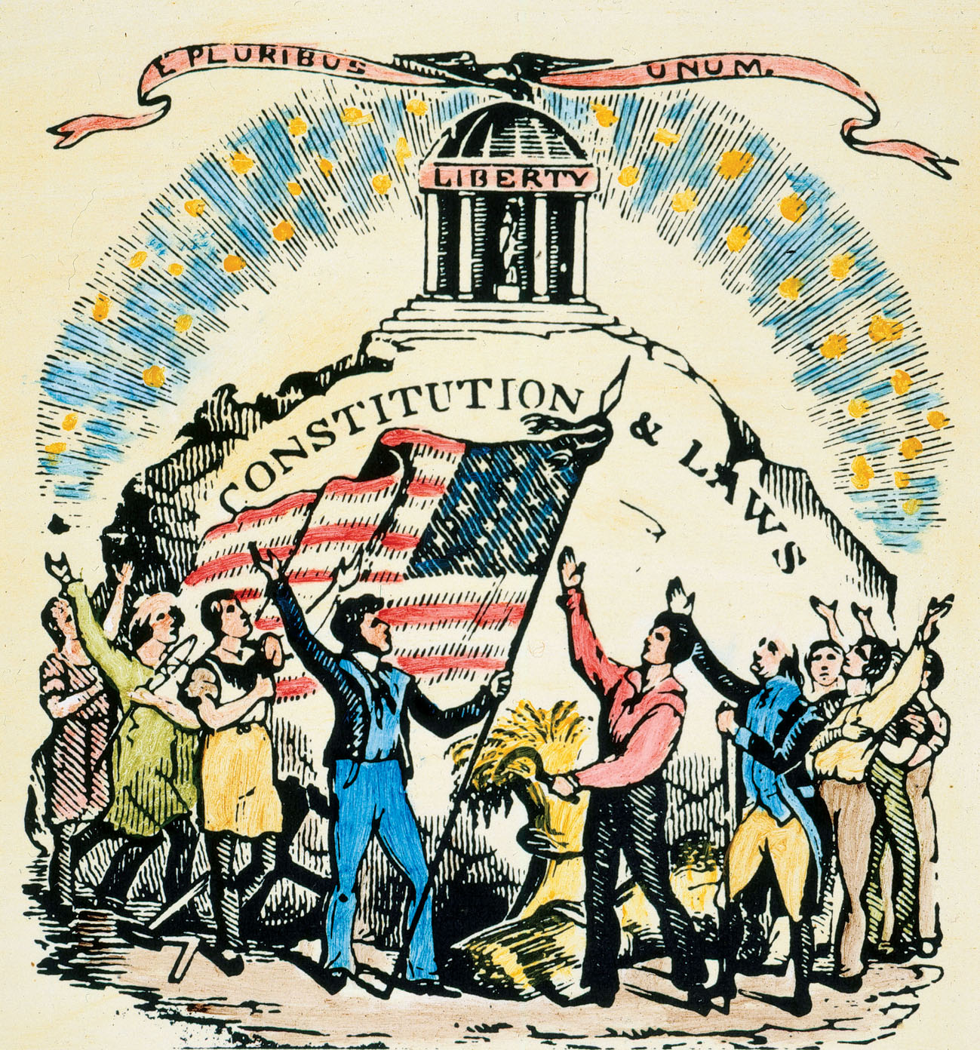
“The Temple of Liberty”
The signing of the Constitution beneath a temple of liberty. Give Me Liberty!: An American History, 5th Edition
Copyright © 2017 W.W. Norton & Company
Notes:
In this late-eighteenth-century engraving, Americans celebrate the signing of the Constitution beneath a temple of liberty.

Slide 33
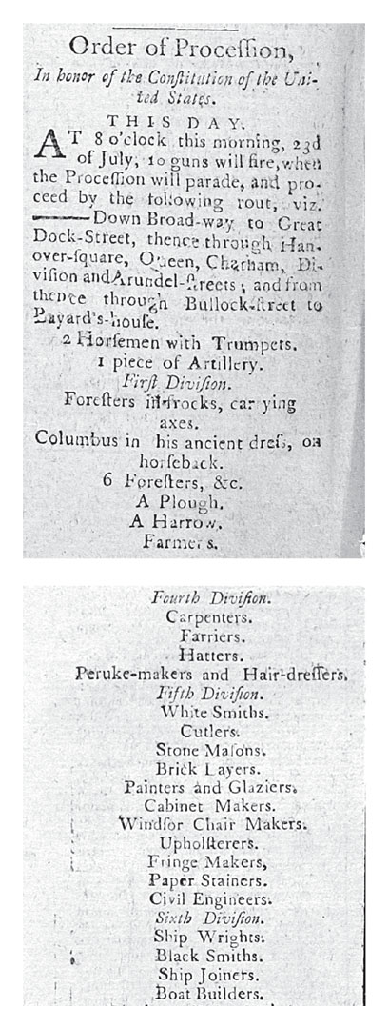
Order of the Grand
Federal Procession
Procession list document illustrating the variety of crafts in the pre-industrial city. Give Me Liberty!: An American History, 5th Edition
Copyright © 2017 W.W. Norton & Company
Notes:
In New York City’s Grand Federal Procession of 1788, celebrating the ratification of the Constitution, members of each trade and occupation marched together. This document illustrates the variety of crafts in the pre-industrial city.

Slide 34
Opposition
The Anti-Federalists
Notes:
Those opposing ratification, called Anti-Federalists, believed that the Constitution favored power more than liberty. They were poorly organized, and included many of the farmers who sought economic relief in the 1780s. The Anti-Federalists predicted that the new government would be controlled by merchants, creditors, and others hostile to the interests of ordinary Americans. They believed that only a small republic could succeed, not an expansive republic, as Madison argued. Liberty was the watchword of the Anti-Federalists, and they charged that the Constitution did not protect individual rights such as trial by jury or freedom of speech and the press, as the state constitutions did.
Pro-Constitution politics prevailed in cities and rural areas integrated into the commercial marketplace. Its strongest supporters were men of great wealth. But the promise of prosperity also appealed to urban artisans, laborers, and sailors, who thought a stronger central government would revive a lagging economy. Anti-Federalism found most of its support in rural and frontier areas populated by struggling farmers.
Ultimately, the pro-Constitutionalists’ energy, organization, and command of the press prevailed. Madison won support for the Constitution by promising that the first Congress would enact a Bill of Rights. Although many people in Massachusetts, New York, and Virginia opposed the document, only Rhode Island and North Carolina voted against ratification.

Slide 35
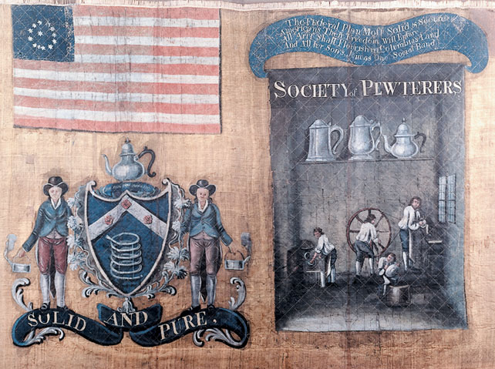
Banner of the Society of Pewterers
Banner of the Society of Pewterers, carried by an artisan group Give Me Liberty!: An American History, 5th Edition
in the Grand Federal Procession Copyright © 2017 W.W. Norton & Company
Notes:
A banner carried by one of the many artisan groups that took part in New York City’s Grand Federal Procession of 1788 celebrating the ratification of the Constitution. The banner depicts artisans at work in their shop and some of their products. The words “Solid and Pure,” and the inscription at the upper right, link the quality of their pewter to their opinion of the new frame of government and hopes for the future. The inscription reads:
“The Federal Plan Most Solid and Secure
Americans Their Freedom Will Endure All
Arts Shall Flourish in Columbia’s Land And
All Her Sons Join as One Social Band”

Slide 36
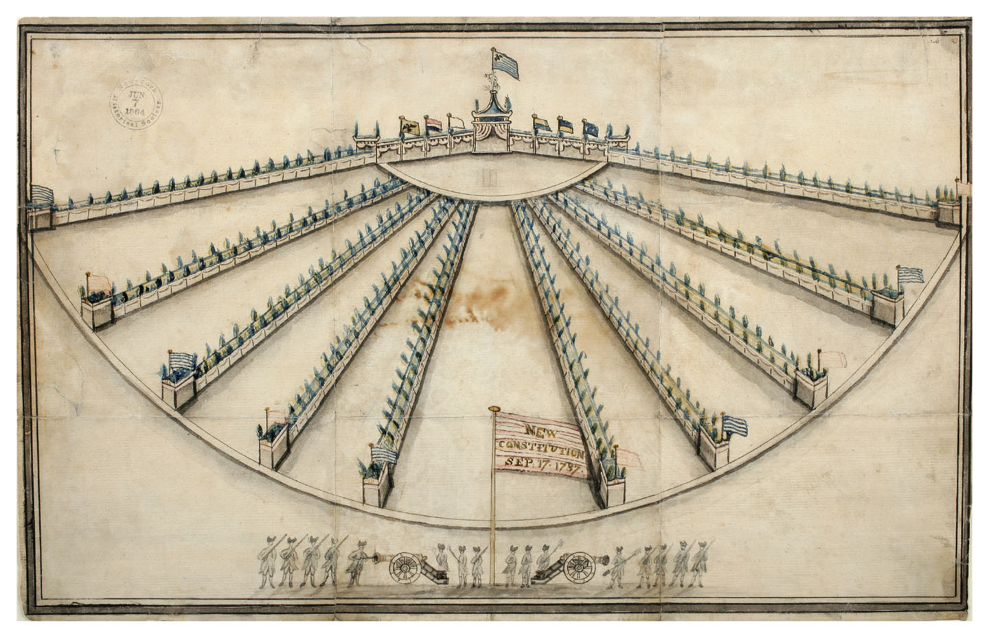
Grand Federal Procession Banquet
Celebratory banquet after the Grand Federal Procession Give Me Liberty!: An American History, 5th Edition
Copyright © 2017 W.W. Norton & Company
Notes:
After the Grand Federal Procession, hundreds of marchers enjoyed a celebratory banquet. The ten tables represented the states that had ratified by July 1788 when the procession took place.

Slide 37
Compromise for Ratification
The Bill of Rights
Notes:
The individual rights that are today protected by the Constitution and celebrated by Americans were not actually in the original document ratified in 1788. Madison had promised that Congress would pass a Bill of Rights in order to gain support for ratification, but he believed that such a bill was redundant and would not prevent majorities from violating constitutional rights in the future. But each new state constitution had a bill of rights.
Madison presented a series of amendments that became the basis for the Bill of Rights ratified by the states in 1791. They included the First Amendment, prohibiting Congress from legislating about religion and protecting freedom of the press and assembly; the Second, upholding the right to bear arms and organize militias; and other amendments affirming the right to trial by jury and prohibiting abuses such as arrests without warrants and forcing a person accused of a crime to testify against himself. The Ninth declared that rights not specifically mentioned in the Constitution were “retained by the people,” opening the door to establish new rights not articulated in the text. The Tenth Amendment affirmed that powers not delegated to the national government or prohibited to the states were reserved to the states, protecting states against encroaching federal power.
The Bill of Rights showed how the Revolution had changed America. Most remarkably, the Constitution recognized religious freedom. The Constitution, unlike the Declaration of Independence, is entirely secular. It does not refer to God, and it bars religious tests for federal officeholders. The First Amendment prohibits Congress from legislating on religious matters, a departure from colonial and British precedent.

Slide 38
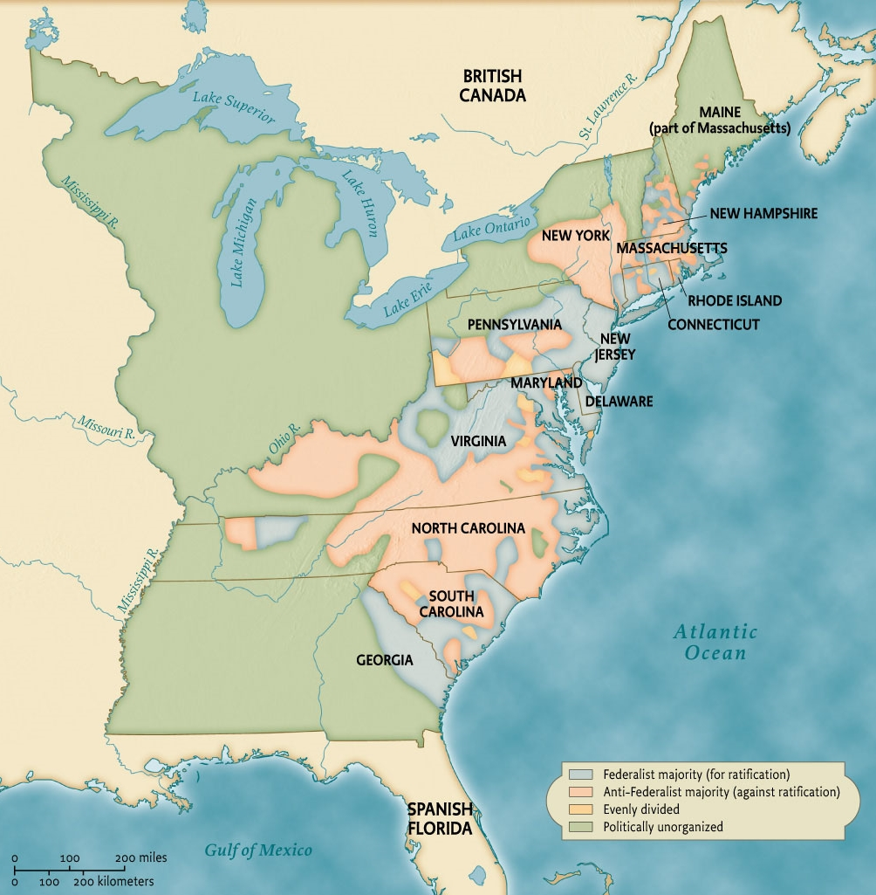
Ratification of the Constitution
Map 7.3 Ratification of the Constitution Give Me Liberty!: An American History, 5th Edition
Copyright © 2017 W.W. Norton & Company
Notes:
Federalists, those who supported the new Constitution, tended to be concentrated in cities and nearby rural areas, while backcountry farmers were more likely to oppose the new frame of government.

Slide 39
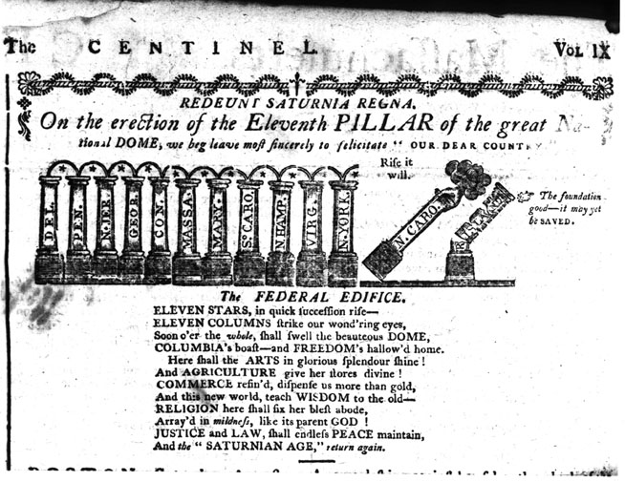
New York Ratifies
An engraving and a poem, published in 1788 after New York ratified Give Me Liberty!: An American History, 5th Edition
Copyright © 2017 W.W. Norton & Company
Notes:
This is an engraving and a poem, published in 1788 in an American newspaper, after New York became the eleventh state to ratify the new Constitution. North Carolina would ratify in 1789 and Rhode Island in 1790.

Slide 40
Focus Question: “We the People"
  Focus Question:
  How did the definition of citizenship in the new republic exclude Native Americans and African-Americans?
Notes:
The purpose of the focus questions is to help students find larger themes and structures to bring the historical evidence, events, and examples together for a connected thematic purpose.
As we go through each portion of this lecture, you may want to keep in mind how the information relates to this larger thematic question. Here are some suggestions: write the focus question in the left or right margin on your notes and as we go through, either mark areas of your notes for you to come back to later and think about the connection, OR as you review your notes later (to fill in anything else you remember from the lecture or your thoughts during the lecture or additional information from the readings), write small phrases from the lecture and readings that connect that information to each focus question AND/OR are examples that work together to answer the focus question.

Slide 41
Identity
National Identity
Notes:
Colonial Americans had been divided by ethnicity, religion, class, and status, and united only by their allegiance to Great Britain. The Revolution created a new collective body, the American people, whose members were to enjoy freedom as members of a new political community. Since government in the United States rested on the will of the people, establishing the identity of the people was important.
The Constitution began with “We the People,” but “People” did not include all those living within the United States. The Constitution identified three groups in the United States: Indians, who were treated as members of independent tribes, and not part of the American nation; “other persons,” or slaves; and “the people,” the only group entitled to freedom in America.
America at first seemed to offer a civic identity to all who dedicated themselves to America’s political principles. But only certain groups of people were deemed citizens in the new nation.

Slide 42
Defining “We the People"
Indians in the New Nation
Notes:
The way the early republic related to Indians and African-Americans shows the contradictory principles shaping the American national identity. American leaders agreed that western Indian lands should go to white Americans but disagreed about which option was best for dealing with the Indian population: removal, disappearance, or assimilation into white “civilization.”
Many Americans thought Indians unfit for citizenship. Indian tribes were not represented in the new government. The treaty system gave them the unique status of independent, sovereign nations, but treaties, often signed by only a few, unrepresentative members of a tribe, were essentially a means of transferring Indian land to the state or federal governments.
Military conflict in the Old Northwest continued until 1794, when a U.S. victory led to the Treaty of Greenville the next year, which gave most of Ohio and Indiana to the U.S. government and established a system whereby tribes received annual grants of money, at the cost of government interference in tribal affairs.
Not all Americans believed that Indians were innately inferior to white Americans. Some, like Thomas Jefferson, believed they lived at a less advanced stage of civilization. In the 1790s, the federal government distributed agricultural tools and livestock to Indians to encourage them to adopt American ways of life.

Slide 43
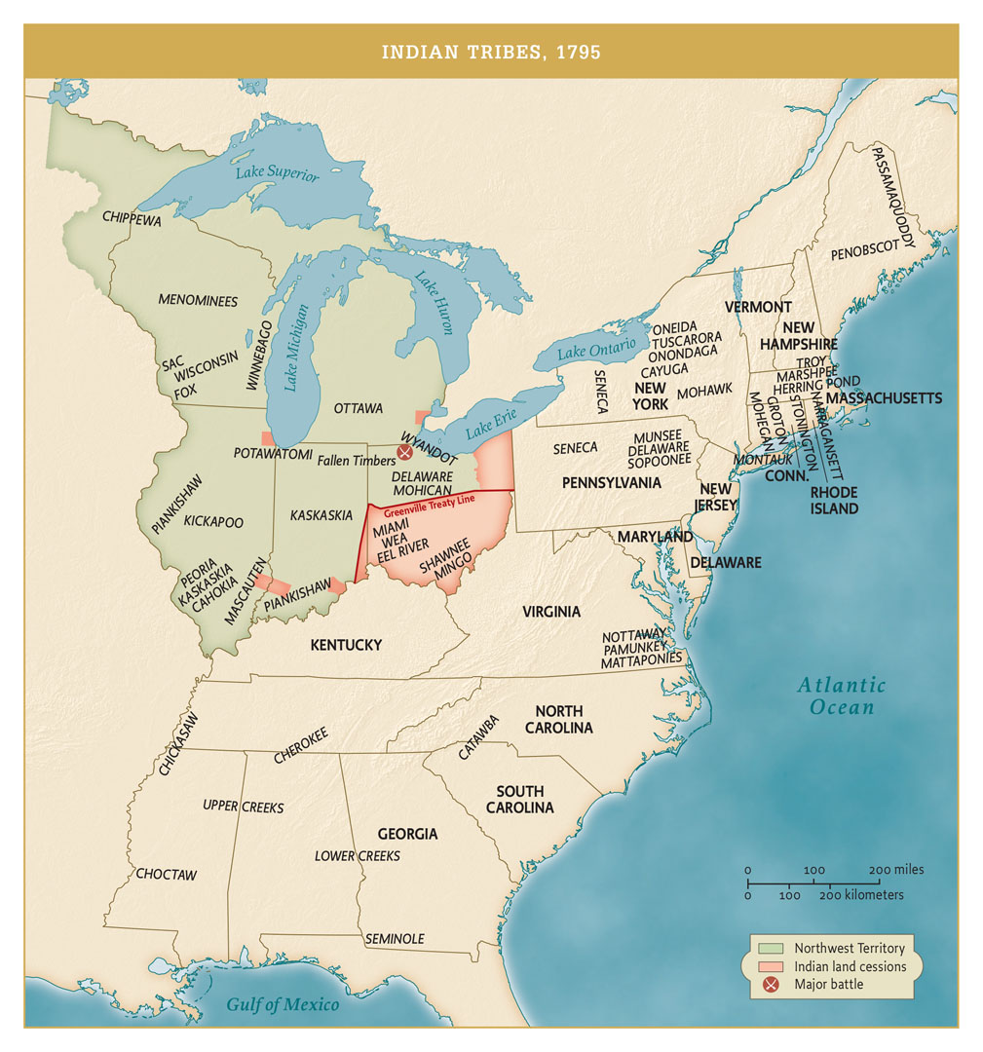
Indian Tribes, 1795
Indian Tribes, 1795 Give Me Liberty!: An American History, 5th Edition
Copyright © 2017 W.W. Norton & Company
Notes:
By 1795, the Indian population had declined significantly from the early colonial era, but the area west of the Appalachian Mountains was still known as “Indian country.”

Slide 44
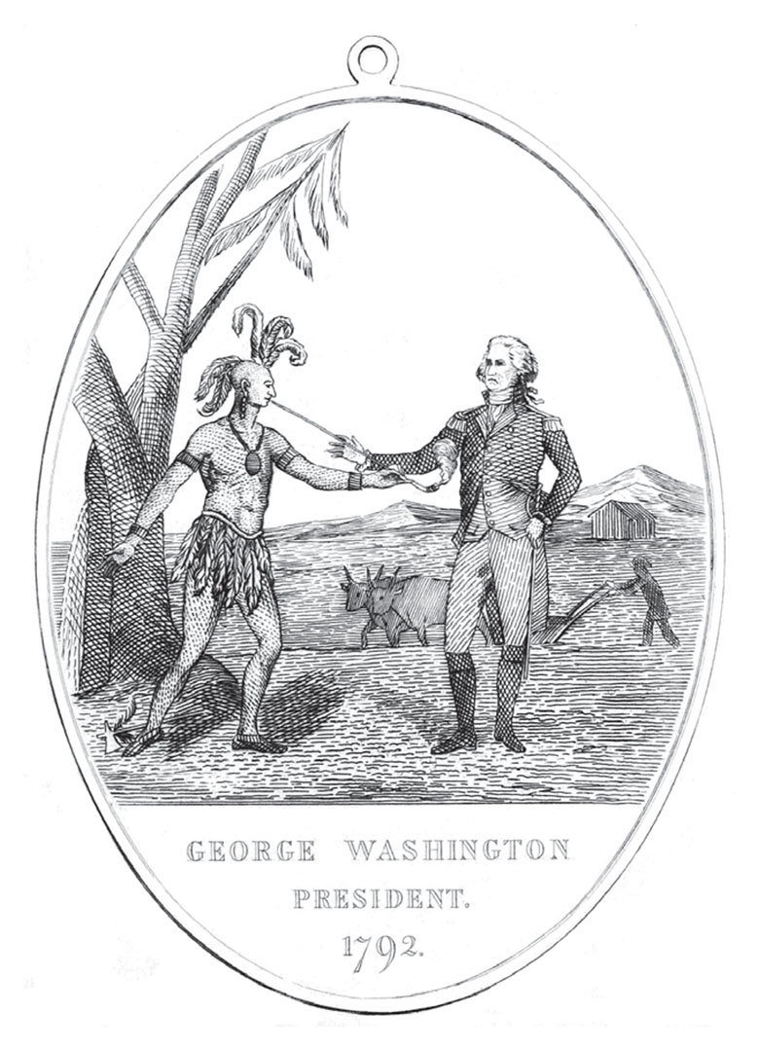
Medal Issued to Red Jacket
A medal issued to Red Jacket, a Seneca chief, depicting Give Me Liberty!: An American History, 5th Edition
George Washington offering an Indian a peace pipe Copyright © 2017 W.W. Norton & Company
Notes:
A medal issued to Red Jacket, a Seneca chief, during his visit to Philadelphia (then the national capital) in 1792, depicts George Washington offering an Indian a peace pipe. The agricultural scene in the background was intended to suggest that Indians should take up farming.

Slide 45
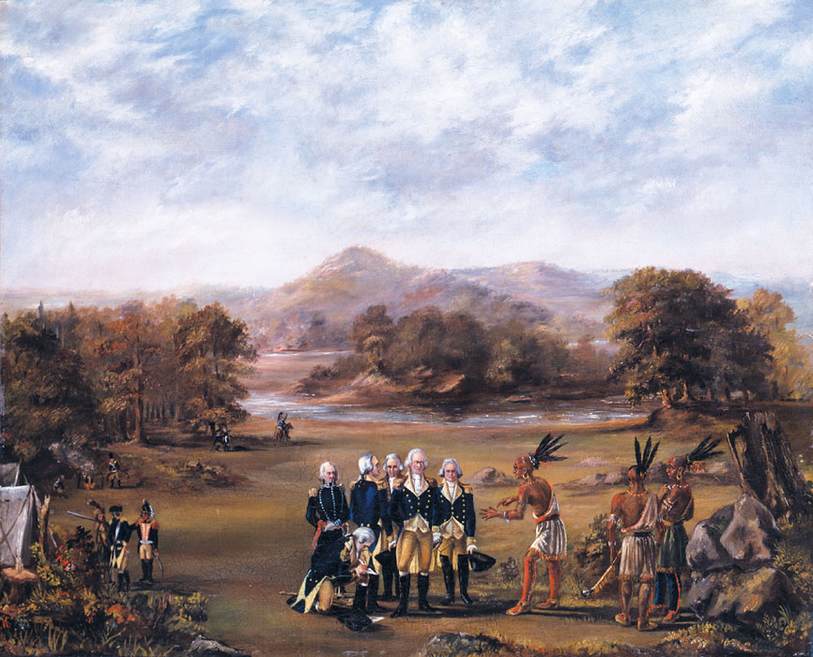
The Treaty of Greenville, 1795
The signing of the Treaty of Greenville of 1795 Give Me Liberty!: An American History, 5th Edition
Copyright © 2017 W.W. Norton & Company
Notes:
The signing of the Treaty of Greenville of 1795, painted by an unknown member of General Anthony Wayne’s staff. In the treaty, a group of tribes ceded most of the area of the current states of Ohio and Indiana, along with the site that became the city of Chicago, to the United States.

Slide 46
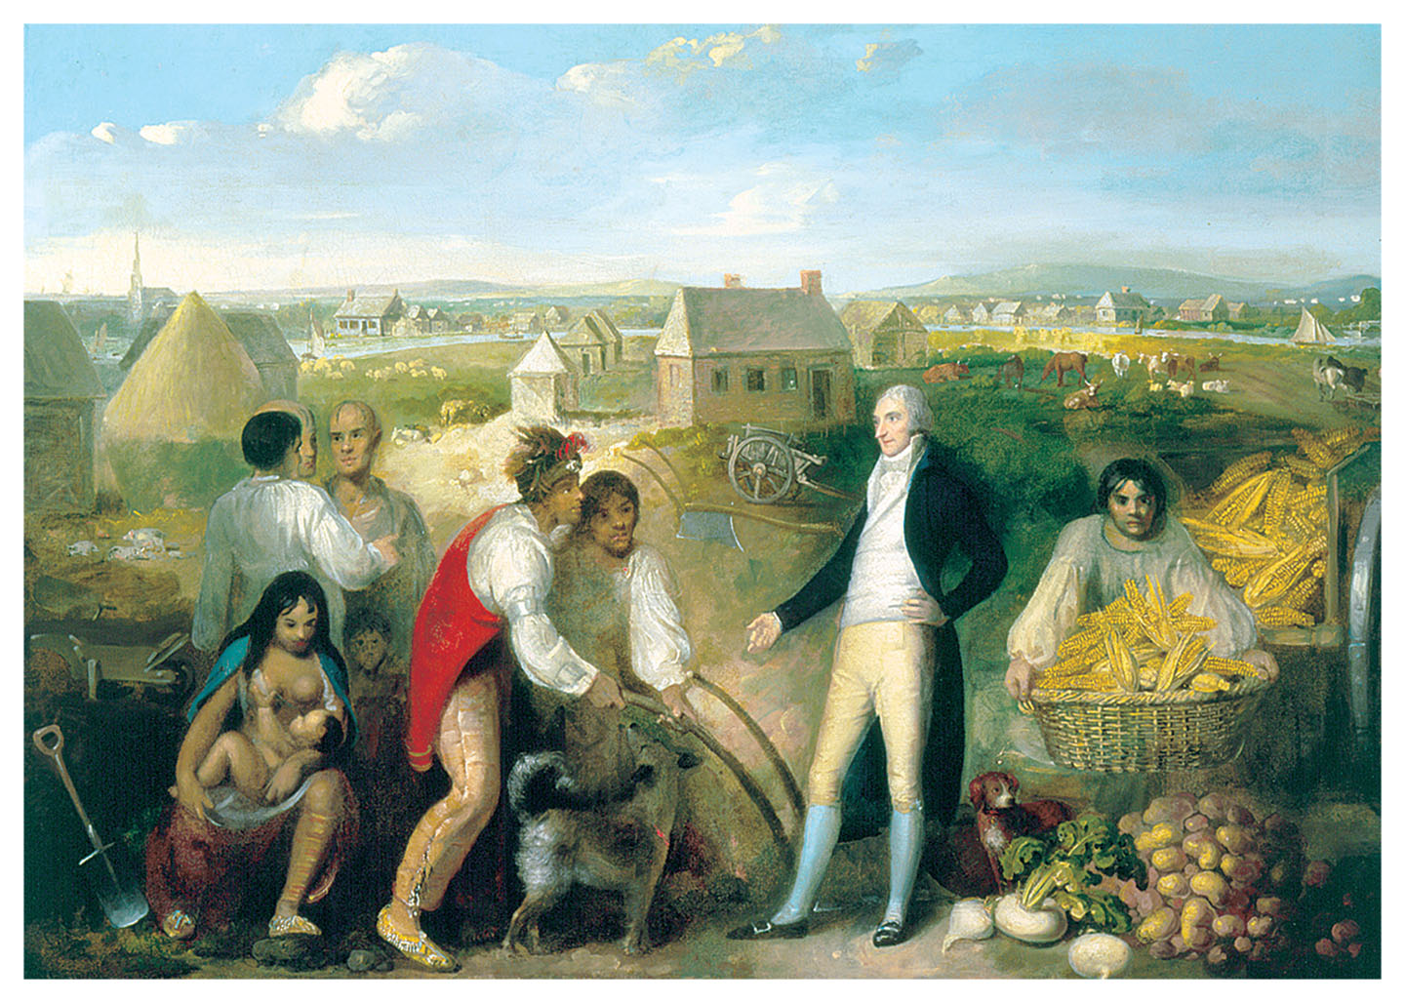
Benjamin Hawkins Trading with the Creek Indians, Part 1
Benjamin Hawkins Trading with the Creek Indians, by an unknown artist painted in 1805 Give Me Liberty!: An American History, 5th Edition
Copyright © 2017 W.W. Norton & Company
Notes:
Painted around 1805 by an unidentified artist, this work depicts Hawkins explaining the advantages of settled agriculture as part of a plan to promote “civilization” among Native Americans. Having served in the Continental army during the War of Independence and as a senator from North Carolina, Hawkins was appointed in 1795 Superintendent of Indian Affairs for the southeastern United States. He supplied the Creeks, Cherokees, and Choctaws with agricultural training and farm implements and married a Creek woman.

Slide 47
African-Americans in the New Nation
Blacks and the Republic
Notes:
The status of free blacks in the early republic was ambiguous. The Constitution did not initially define who are citizens of the United States, so individual states defined the boundaries of freedom. In some states, North and South, free blacks had some rights, including the right to vote. But the vast majority of blacks were enslaved, and slaves were not considered members of the nation or fully eligible for citizenship if free.
Early immigration policy shows that Americans excluded blacks from their conception of who was an American. The Naturalization Act, passed by Congress in 1790, first defined American nationality by allowing only “free white persons” to emigrate and become citizens. Although some believe that this law initiated an “open immigration” policy, the word “white” in the law excluded the majority of mankind from coming to America and becoming citizens.

Slide 48
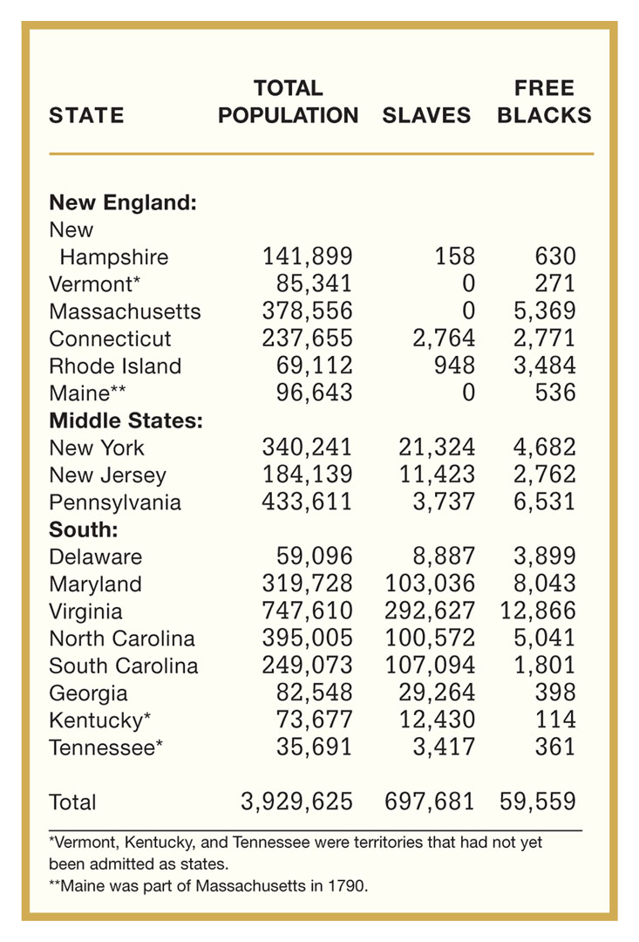
Total Population and Black Population of the United States, 1790
Table 7.1 Total Population and Black Population of the United States, 1790 Give Me Liberty!: An American History, 5th Edition
Copyright © 2017 W.W. Norton & Company

Slide 49
Jefferson’s Outlook on Race and Slavery
Jefferson, Slavery, and Race
Notes:
John Locke had argued that liberty flowed from a man having the power of reason, and it did not seem a contradiction at this time to deny liberty to irrational beings. Increasingly, white Americans saw blacks as lacking the qualities that enabled freedom—self-control, reason, and allegiance to the larger community.
Thomas Jefferson, in his Notes on the State of Virginia, published in 1785, claimed that blacks, because of their nature and experience of slavery, were disloyal to America, and he speculated that blacks were inherently inferior to whites. While he believed that Indians might have the capacity to become as civilized as whites, he did not believe blacks naturally had this capacity. While hoping for the end of slavery and opposing the slave trade, he also supported colonization, or the idea that blacks, once freed from slavery, could never fully be part of America, and should be colonized in Africa or other parts of the Western Hemisphere. In his ambivalent approach to race and slavery, Jefferson reflected the thinking of his generation.

Slide 50
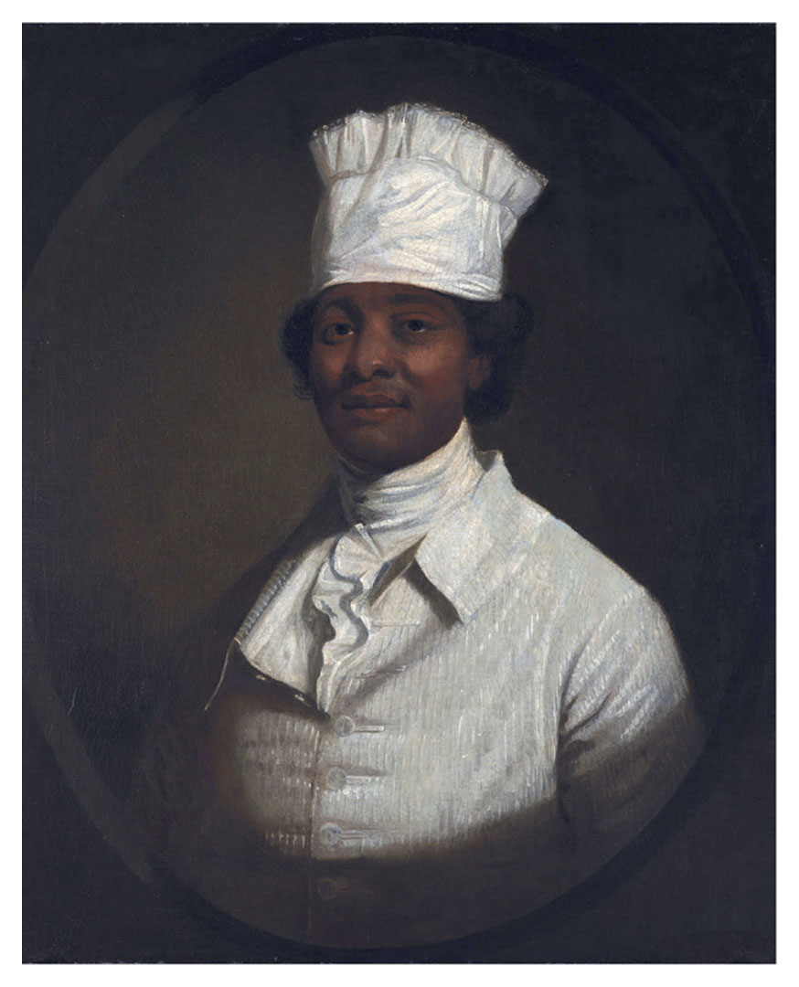
Benjamin Hawkins Trading with the Creek Indians, Part 2
Portrait thought to depict Hercules, Washington’s slave Give Me Liberty!: An American History, 5th Edition
and chief cook at Mount Vernon, Virginia Copyright © 2017 W.W. Norton & Company
Notes:
This painting by artist Gilbert Stuart, best known for his portraits of George Washington, is thought to depict Hercules, Washington’s slave and the chief cook at his estate at Mount Vernon, Virginia. As president, Washington brought Hercules to Philadelphia, then the nation’s capital, in violation of Pennsylvania’s 1780 emancipation law, which freed any slave who resided in the state for six months. In 1797, as Washington and his family were preparing to return home at the end of his term in office, Hercules escaped. Washington died two years later; his will freed his slaves, including Hercules.

Slide 51
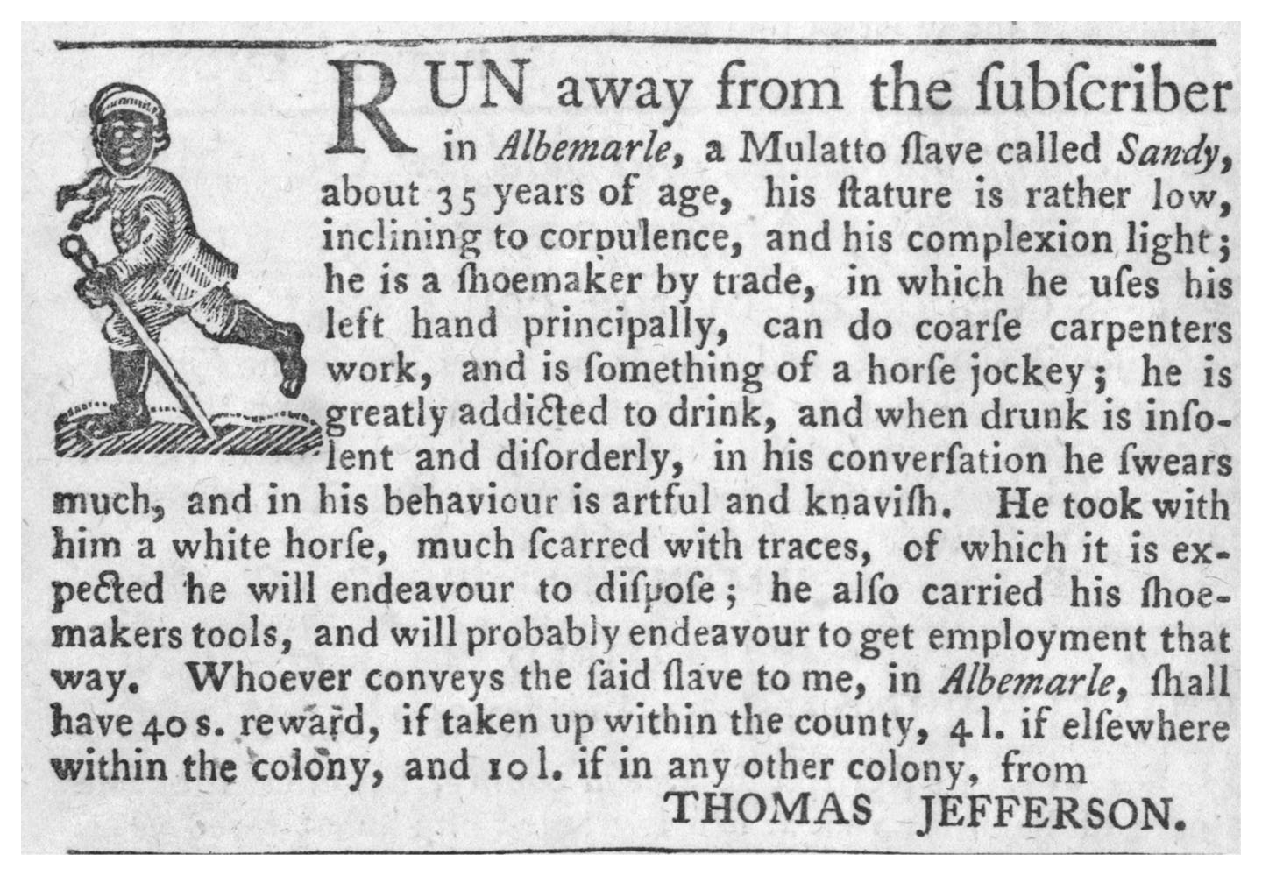
Jefferson Places an Advertisement for a Runaway Slave
Ad for runaway slave Sandy, placed by Thomas Jefferson in a Virginia newspaper, 1769 Give Me Liberty!: An American History, 5th Edition
Copyright © 2017 W.W. Norton & Company
Notes:
Thomas Jefferson, future author of the Declaration of Independence and in private a sharp critic of slavery, placed this advertisement in a Virginia newspaper in 1769, seeking the return of a runaway slave. Sandy was in fact recaptured, and Jefferson sold him in 1773.

Slide 52
Freedom
Principles of Freedom
Notes:
While the decline of apprenticeship and indentured servitude expanded freedom for whites, the Revolution widened the divide between free Americans and enslaved Americans. Race now became a convenient justification for slavery in a nation dedicated to liberty. “We the people” increasingly meant only white Americans.

Slide 53
Review
America under the Confederation
  Focus Question: What were the achievements and problems of the Confederation government?
A New Constitution
  Focus Question: What major disagreements and compromises molded the final content of the Constitution?
The Ratification Debate and the Origin of
the Bill of Rights
  Focus Question: How did Anti-Federalist concerns raised during the ratification process lead to the creation of the Bill of Rights?
“We the People”
  Focus Question: How did the definition of citizenship in the new republic exclude Native Americans and African-Americans?

Slide 54
Media Links
——Chapter 7——
Title | Media links
Eric Foner on the Constitution, pt. 1 | The Constitution, pt. 1
Eric Foner on the Constitution’s impact on slavery | The Constitution's Impact on Slavery
Eric Foner on the Bill of Rights, pt. 2 | The Bill of Rights, pt. 2
Eric Foner on the racial division between slaves and free men | The Racial Division between Slaves and Free Men
Eric Foner on the market revolution, pt. 1 | The Market Revolution, pt. 1

Slide 55
Next Lecture PREVIEW:
—— Chapter 8 ——
Securing the Republic, 1791 to 1815
Politics in an Age of Passion
The Adams Presidency
Jefferson in Power
The “Second War of Independence”

Slide 56
This concludes the Norton Lecture Slide Set for Chapter 7
Give Me Liberty!
AN AMERICAN HISTORY
FIFTH EDITION by
Eric Foner
Norton Lecture Slides
Independent and Employee-Owned

