Slide 1
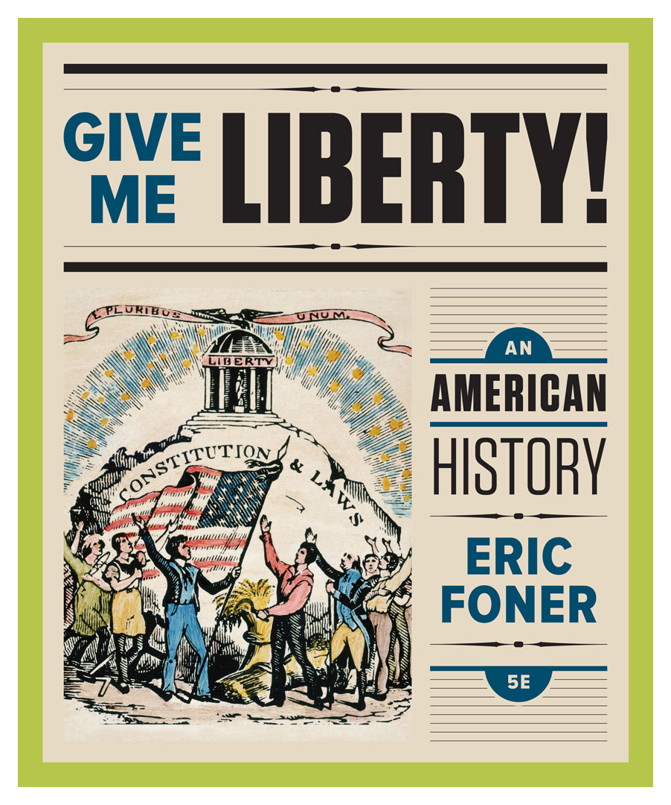
Lecture Slides
Give Me Liberty!
AN AMERICAN HISTORY
FIFTH EDITION
By Eric Foner

Slide 2
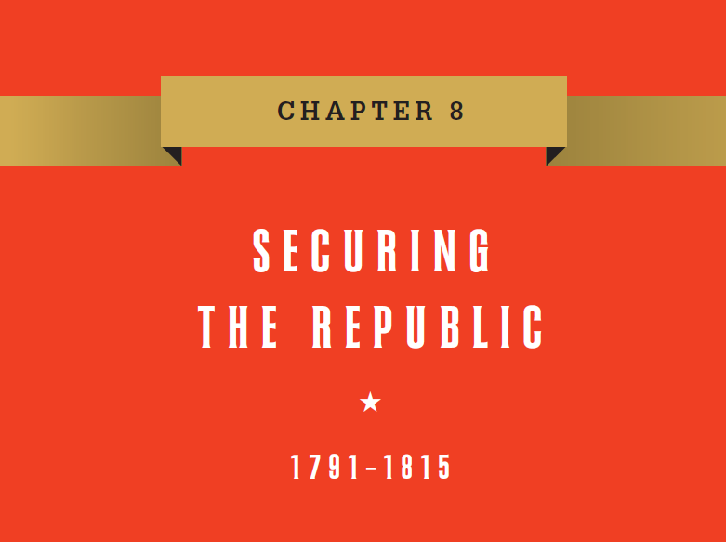
Chapter 8 Securing The Republic, 1791 to 1815
Notes:
On April 30, 1789, in New York City, the nation’s temporary capital, George Washington became the first president under the new Constitution. Elected unanimously, Washington took the oath of office on the balcony of Federal Hall dressed in a plain suit rather than European finery before a large crowd that reacted with “loud and repeated shouts” of approval. He then retreated inside to deliver his inaugural address before members of Congress and other dignitaries. Washington’s speech expressed the revolutionary generation’s conviction that it had embarked on an experiment of enormous historical importance, whose outcome was by no means certain. “The preservation of the sacred fire of liberty and the destiny of the republican model of government,” Washington proclaimed, depended on the success of the American experiment in self-government. Most Americans seemed to agree that freedom was the special genius of American institutions, and a House of Representatives resolution congratulated Washington for his election by “the freest people on the face of the earth.” When it came time to issue money, Congress instructed that liberty, rather than the head of state, adorn the currency. Americans leaders believed that success for the new government required political harmony, and they were especially anxious to avoid the emergence of organized political parties, considered divisive and disloyal, which had appeared already in several states. The Constitution makes no mention of political parties, assuming candidates ran as individuals (otherwise, the second-place finisher would not have become vice president). Nonetheless, national parties, originating in Congress, arose and spread to the general populace. Instead of harmony, the 1790s became an “age of passion,” in which each party questioned the other’s loyalty and lambasted opponents in the extreme. Political rhetoric became inflamed because the stakes seemed so high―nothing less than the legacy of the Revolution, the new nation’s future, and the survival of American freedom.

Slide 3
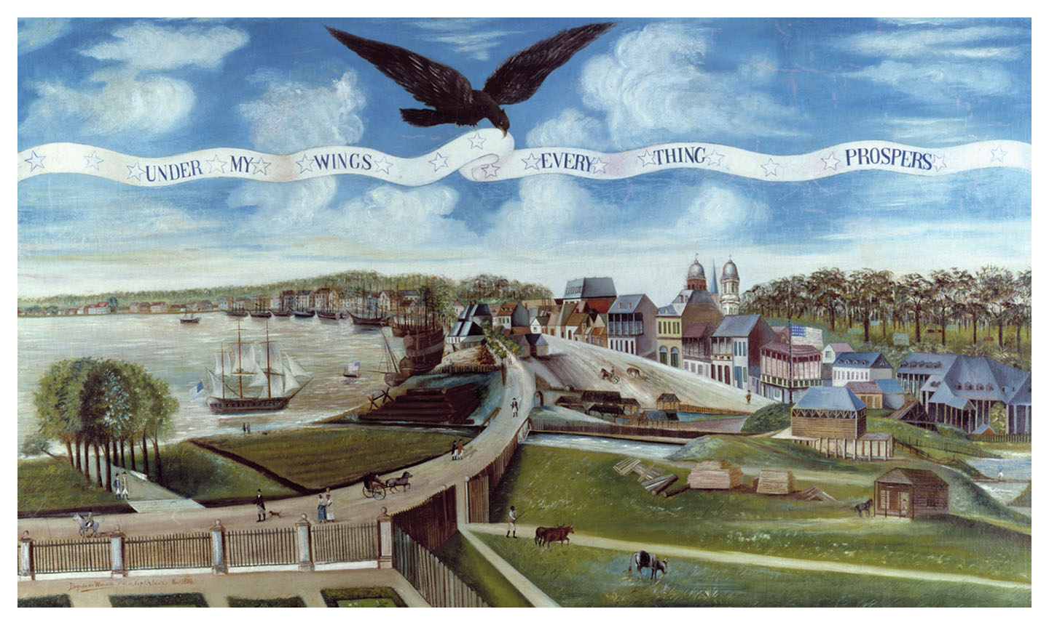
New Orleans, 1803
New Orleans in 1803, at the time of the Louisiana Purchase Give Me Liberty!: An American History, 5th Edition
Copyright © 2017 W.W. Norton & Company
Notes:
The painting shows a view of the city from a nearby plantation. The town houses of merchants and plantation owners line the broad promenade along the waterfront. At the lower center, a slave goes about his work. An eagle holds aloft a banner that suggests the heady optimism of the young republic: Under My Wings Every Thing Prospers.

Slide 4
Lecture Preview
Politics in an Age of Passion
The Adams Presidency
Jefferson in Power
The “Second War of Independence”
Notes:
The subtopics for this lecture are listed on the screen above.

Slide 5
Focus Question: Politics in an Age of Passion
  Focus Question:
  What issues made the politics of the 1790s so divisive?
Notes:
The purpose of the focus questions is to help students find larger themes and structures to bring the historical evidence, events, and examples together for a connected thematic purpose.
As we go through each portion of this lecture, you may want to keep in mind how the information relates to this larger thematic question. Here are some suggestions: write the focus question in the left or right margin on your notes and as we go through, either mark areas of your notes for you to come back to later and think about the connection, OR as you review your notes later (to fill in anything else you remember from the lecture or your thoughts during the lecture or additional information from the readings), write small phrases from the lecture and readings that connect that information to each focus question AND/OR are examples that work together to answer the focus question.

Slide 6
Financial Planning
Hamilton’s Program
Notes:
President Washington embodied national unity and the virtue of republican self-sacrifice, having retired from public life after the war. His vice president, John Adams, was an important political leader of the Revolution. Washington’s cabinet included Thomas Jefferson as secretary of state and Alexander Hamilton as head of the Treasury Department. He formed a Supreme Court, with John Jay as its chief justice.
But a financial plan proposed by Hamilton frayed national unity. Taking Great Britain as his model, Hamilton wanted to stabilize the nation’s finances, garner the support of powerful financiers, and foster economic development. He hoped to make the United States a world military and commercial power. To establish the government’s creditworthiness, Hamilton proposed that it pay off at full face value all national and state debts from the Revolution. He wanted to create a new national debt, issued as interest-bearing bonds to government creditors, that would tie wealthy investors to the national government. He wanted to establish a Bank of the United States, modeled on the Bank of England, that would act as the nation’s financial agent—a private corporation that would hold government funds, make loans to the government, and make profits for stockholders. To raise revenue, he proposed a tax on whiskey. And in a Report on Manufactures, Hamilton called for a tariff and government subsidies to develop factories that would produce domestically goods that at that time were imported from abroad.

Slide 7
Opposition
The Emergence of Opposition
The Jefferson-Hamilton Bargain
Notes:
Though American financiers, manufacturers, and merchants supported Hamilton’s vision of the nation as a powerful commercial republic, many had a different vision. His plans for close ties with Britain alarmed James Madison and Thomas Jefferson, who looked not to Europe but to westward expansion as ensuring a prosperous, republican future. They disliked urban growth and manufacturing, and did not want economic policy that catered to bankers and business leaders. They hoped America would be a republic of independent farmers who sold their goods to the world through free trade. Jefferson and Madison feared that a powerful central government, if allied with a growing class of commercial capitalists, would endanger American freedom.
Initial opposition to Hamilton’s program came from the South, which lacked investors and owners of government bonds, where support for manufacturing and a diversified economy was weak, and whose states had paid off much of their war debt. Hamilton argued that the Constitution’s clause giving Congress the power to enact laws for the “general welfare” authorized his plans, but opponents, known as “strict constructionists,” argued that the federal government could use only the powers that were stated explicitly in the Constitution—which, they charged, did not authorize a national bank. A compromise secured Hamilton’s fiscal program, minus subsidies for factories, in exchange for locating the nation’s capital between Virginia and Maryland. This became Washington, the District of Columbia.

Slide 8
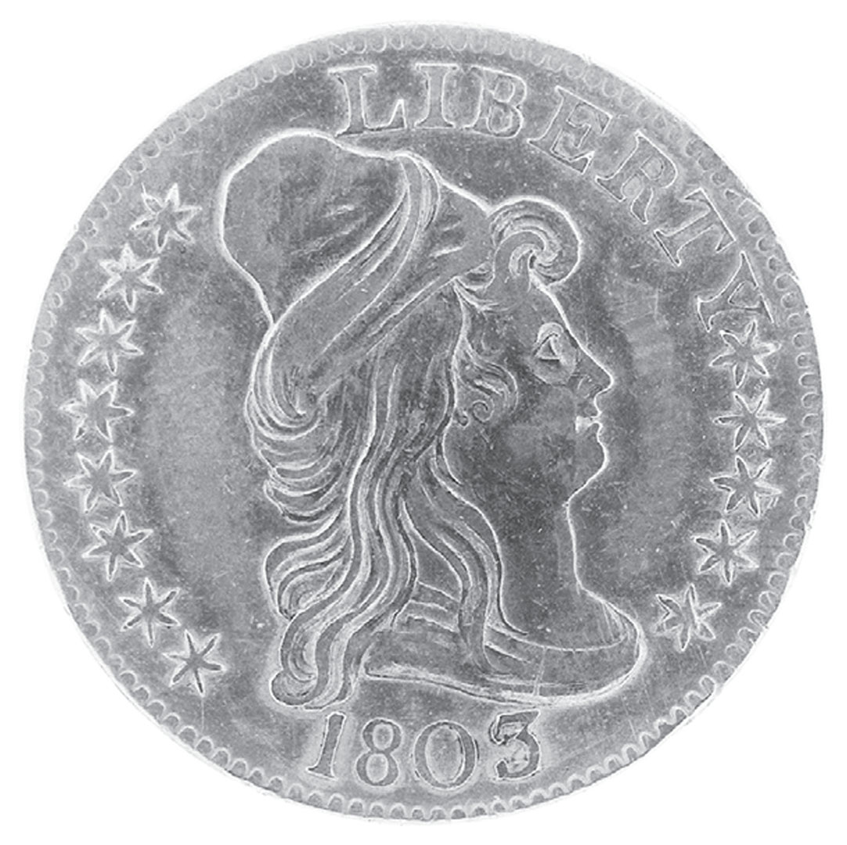
Early American Coin
An early American coin bearing an image of liberty and the word itself Give Me Liberty!: An American History, 5th Edition
Copyright © 2017 W.W. Norton & Company
Notes:
An early American coin, bearing an image of liberty and the word itself, as directed by Congress in a 1792 law
The first U.S. coin to feature a real person rather than an idealized image of liberty was the Lincoln penny, issued in 1909 for the centennial of his birth.

Slide 9
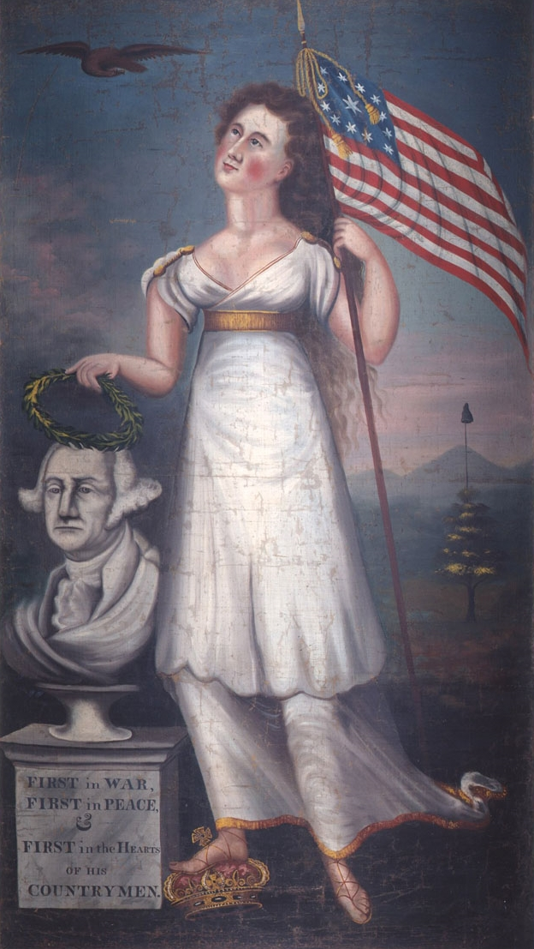
Liberty and Washington
Liberty and Washington, painted by an unknown artist around 1800, Give Me Liberty!: An American History, 5th Edition
depicts a female figure of liberty placing a wreath on a bust of the first president. Copyright © 2017 W.W. Norton & Company
Notes:
Liberty and Washington, painted by an unknown artist around 1800, depicts a female figure of liberty placing a wreath on a bust of the first president. She carries an American flag and stands on a royal crown, which has been thrown to the ground. In the background is a liberty cap. Washington had died in 1799 and was now immortalized as a symbol of freedom, independence, and national pride.

Slide 10
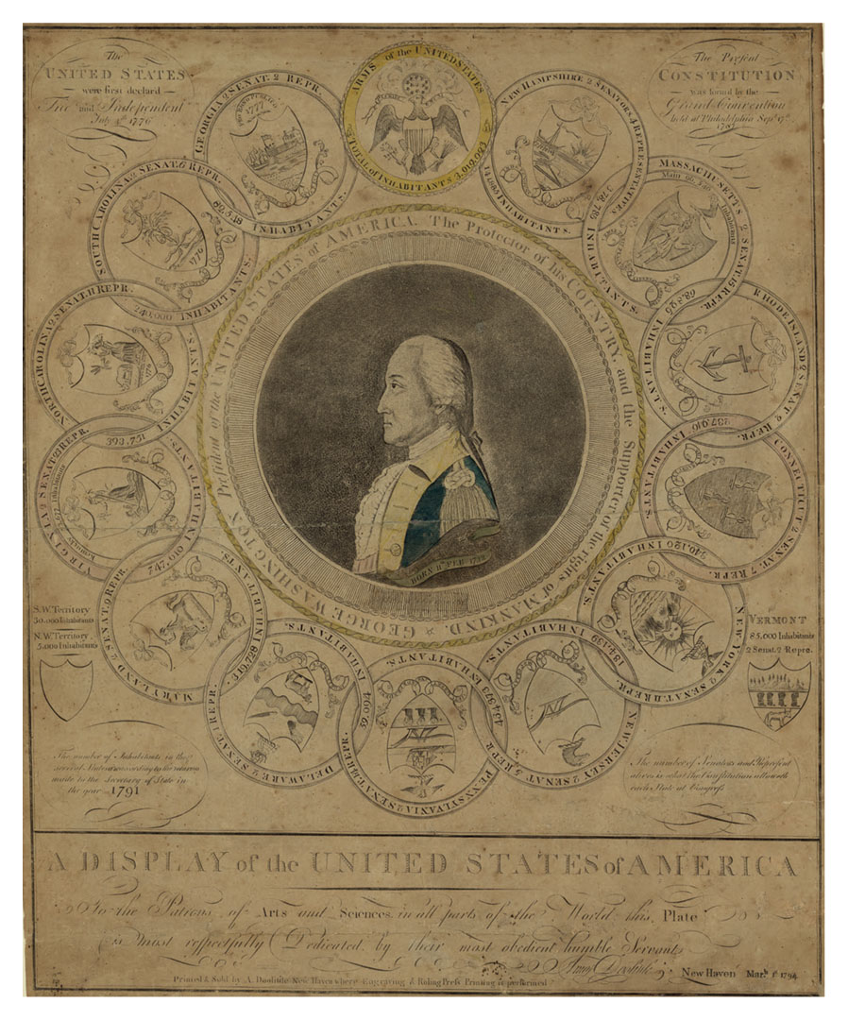
A Display of the United States of America
A Display of the United States of America, by Amos Doolittle, 1794 Give Me Liberty!: An American History, 5th Edition
Copyright © 2017 W.W. Norton & Company
Notes:
The prominent Connecticut artist Amos Doolittle created this engraving, A Display of the United States of America, in 1794, during George Washington’s second term as president. Washington is at the center with the motto “The protector of his country and the supporter of the rights of mankind.” He is surrounded by the seals of the original thirteen states, plus the seal of Vermont in the lower right corner. The seals contain various images of commerce and liberty.

Slide 11
Revolution in France
The Impact of the French Revolution
Notes:
The French Revolution of 1789 deepened political divisions in America. At first, almost all Americans celebrated the revolution, as it seemed inspired by their own revolution and republic. But the turn in France in 1793 to a more radical revolution, marked by the execution of King Louis XVI and aristocrats, and war between France and Great Britain, polarized Americans. Jefferson and his followers thought the French Revolution, despite its extremism, was a victory for self-government everywhere. To Washington and Hamilton and their followers, the revolution invited anarchy, and they believed America should befriend Britain. But since the American Revolution, the United States had been a permanent ally of France. In 1793, Washington declared that the United States would be neutral in the war between France and Britain. But he also moved to expel a French envoy, Edmond Genet, for trying to recruit American ships to attack British vessels. At the same time, Britain seized American ships and sailors. John Jay negotiated a controversial treaty in 1794 that effectively canceled the American-French alliance and recognized British commercial and naval supremacy.

Slide 12
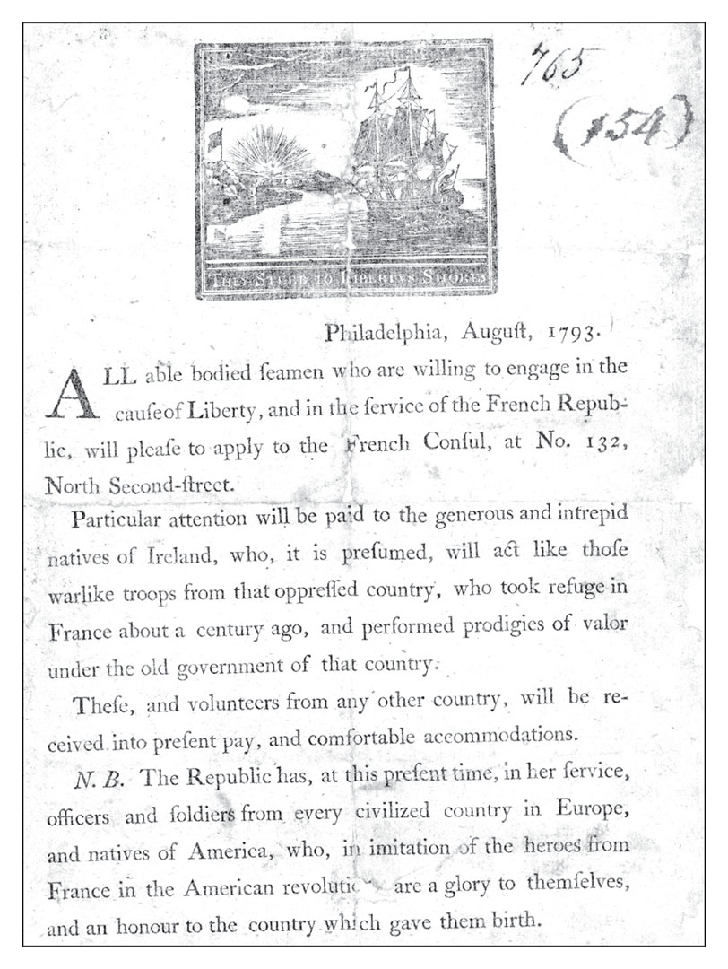
Recruitment for the French Revolution
A recruiting poster seeking “able bodied seamen” willing to Give Me Liberty!: An American History, 5th Edition
volunteer to fight for revolutionary France Copyright © 2017 W.W. Norton & Company
Notes:
This is a recruiting poster, seeking “able bodied seamen” willing to volunteer to fight for revolutionary France and “the cause of Liberty,” issued in Philadelphia by Edmond Genet, a French envoy. Genet thought Irish immigrants in the United States would be especially willing to serve France in its war with Great Britain.

Slide 13
Rebellion and Political Parties
Political Parties
The Whiskey Rebellion
Notes:
By the mid-1790s, two parties appeared in Congress, calling themselves Federalists and Republicans. Both parties claimed the language of American liberty, and each accused the other of conspiring to destroy that liberty. The Federalists supported the Washington administration, favored Hamilton’s economic program, and wanted ties with Britain. Well-to-do merchants, farmers, lawyers, and established political leaders, especially in the North, tended to support the Federalists. They were generally elitist, and saw society as a fixed hierarchy in which political office should go to wealthy men, who expected deference from lesser men. They feared that the spirit of liberty generated by the Revolution was degenerating into anarchy.
The Federalists may have been the only major party in American history forthrightly to proclaim democracy and freedom dangerous in the hands of ordinary citizens. The “Whiskey Rebellion” of 1794 broke out when backcountry Pennsylvania farmers tried to block collection of the new tax on distilled spirits. Invoking the symbols of 1776, they based their actions on the symbols of liberty, reinforcing the Federalist insistence that such ideas were dangerous in the hands of the citizenry. Washington dispatched 13,000 militiamen to quell the resistance, and accompanied them himself, the only time a president has actually commanded an army in the field. His response was designed to restore order for “the impression” on Europeans who did not believe American self-government could survive.

Slide 14
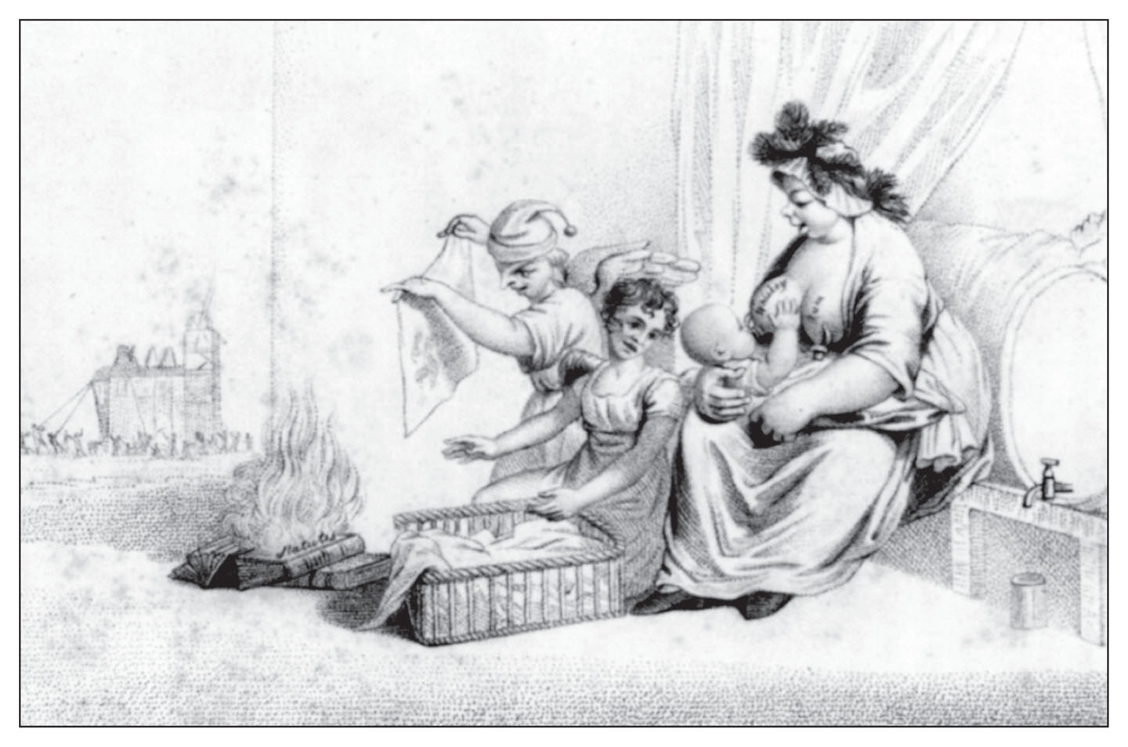
Infant Liberty Nursed by Mother Mob
Infant Liberty Nursed by Mother Mob, a Federalist cartoon printed in 1807 Give Me Liberty!: An American History, 5th Edition
Copyright © 2017 W.W. Norton & Company
Notes:
Infant Liberty Nursed by Mother Mob, a Federalist cartoon from 1807, illustrates the party’s fear that the spirit of liberty was degenerating into anarchy. In the background, a mob assaults a building, while in the foreground a pile of books burns.

Slide 15
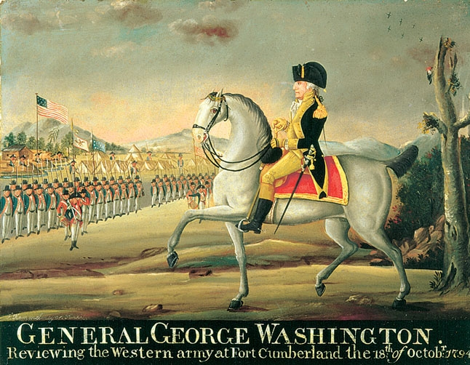
President George Washington
President George Washington as commander-in-chief of the army to put Give Me Liberty!: An American History, 5th Edition
down the Whiskey Rebellion, by Frederick Kemmelmeyer, 1794 Copyright © 2017 W.W. Norton & Company
Notes:
A 1794 painting by the Baltimore artist and sign painter Frederick Kemmelmeyer depicting President George Washington as commander-in-chief of the army dispatched to put down the Whiskey Rebellion.

Slide 16
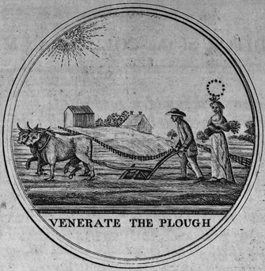
Venerate the Plough
Venerate the Plough, a medal of the Philadelphia Society Give Me Liberty!: An American History, 5th Edition
for the Promotion of Agriculture, 1786 Copyright © 2017 W.W. Norton & Company
Notes:
Americans like Jefferson and Madison believed that farmers were the most virtuous citizens and therefore agriculture must remain the foundation of American life.

Slide 17
Embracing Popular Politics
The Republican Party
Notes:
The Republicans, led by Madison and Jefferson, seemed to embrace popular politics. They supported France and had more faith in democratic self-government. Southern planters, ordinary farmers around the country, and urban artisans who sympathized with the French Revolution supported this party. They were far more critical of social and economic inequality, and more congenial to broad democratic participation by ordinary Americans, than the Federalists. Each party believed that only itself was legitimate and representative of all the nation’s interests, with Federalists denouncing Republicans as French agents, anarchists, and traitors, and Republicans denouncing Federalists as monarchists. For both sides, the other party was deemed an illegitimate “faction” and an enemy of American liberty and the Revolution’s principles.

Slide 18
The Growth of the Public Sphere
An Expanding Public Sphere
The Democratic-Republican Societies
Notes:
The partisanship of the 1790s expanded the public sphere and the democratic content of American freedom. It increased the number of citizens who attended political events and read newspapers. Ordinary men never before active in politics wrote pamphlets and organized political meetings.
These men included members of the Democratic-Republican societies, inspired by the Jacobin clubs of Paris. They openly supported the French Revolution and praised American and French liberty. Federalists viewed them as illegitimately usurping the representative authority of the government; Washington dismissed them as “self-created societies.” They justified their existence by claiming that the people had a right to debate political questions and organize to influence government policy. They believed that political liberty involved more than just voting, and included popular organizing and pressure tactics. Although the societies soon disappeared, they were absorbed by the emerging Republican Party, which also found support among radical British immigrants who defended the French Revolution, such as Thomas Paine.

Slide 19
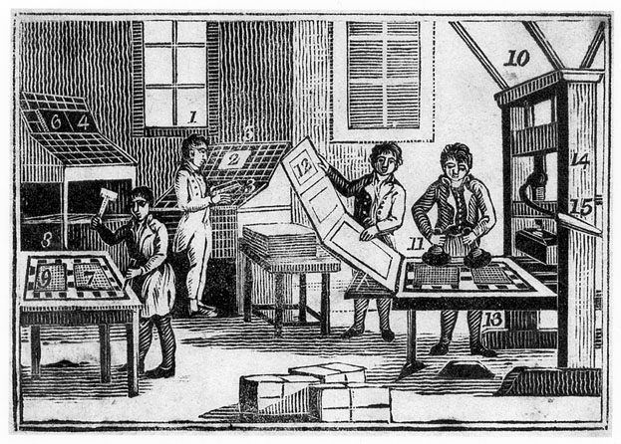
Early Republic Print Shop
A print shop in the early republic, where newspapers played a major public role Give Me Liberty!: An American History, 5th Edition
Copyright © 2017 W.W. Norton & Company
Notes:
The increasing number of newspapers played a major role in the expansion of the public sphere.

Slide 20
Women and the New Nation
The Rights of Women
Women and the Republic
Notes:
The democratic spirit of the 1790s also invigorated discussion of women’s rights. In England in 1792, Mary Wollstonecraft published A Vindication of the Rights of Women, in which she argued that rights should be extended to women. While not challenging traditional gender roles, she argued that women should have greater access to education and a role and representation in government. The expanding public sphere of the 1790s offered opportunities for American women to participate in politics, and a small but growing number of women published political and literary writings in American newspapers. One of these, Judith Sargent Murray, insisted that women should have equal access to education. If women seemed intellectually inferior to men, she argued, it was because they were denied an opportunity to learn.
Women were still not part of the body politic. Although women were counted in determining representation in Congress, and nothing in the Constitution explicitly limited rights to men, the document and almost all Americans assumed that politics was an exclusively male sphere. The men who wrote the Constitution did not envision the active and continuing involvement of ordinary citizens in affairs of state. But political parties sought to mobilize voters for highly contested elections, while “self-created societies,” stirrings of women’s political consciousness, and even armed rebellions broadened and deepened the democratization of public life set in motion by the American Revolution.

Slide 21
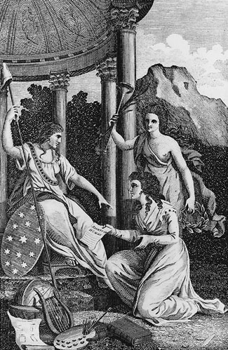
“Genius of the Ladies Magazine”
An engraving from The Lady’s Magazine and Repository of Give Me Liberty!: An American History, 5th Edition
Entertaining Knowledge, Philadelphia, 1792 Copyright © 2017 W.W. Norton & Company
Notes:
A woman identified as the “Genius of the Ladies Magazine” kneels before Liberty, presenting a petition for the “Rights of Women.” In the foreground are symbols of the arts, science, and literature―knowledge that should be available to women as well as men.

Slide 22
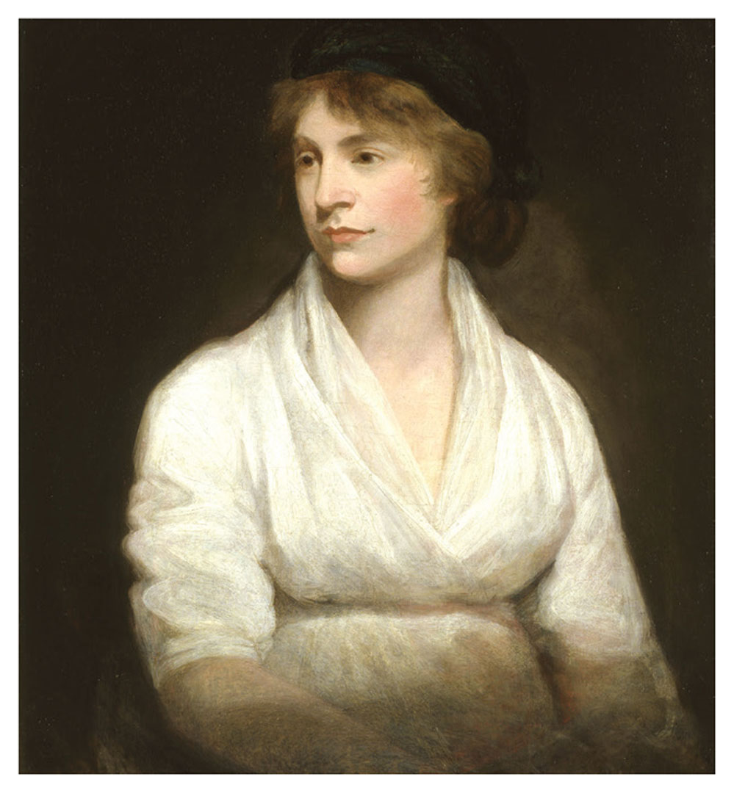
Mary Wollstonecraft
Give Me Liberty!: An American History, 5th Edition
Copyright © 2017 W.W. Norton & Company
Notes:
Mary Wollstonecraft, author of the pioneering work A Vindication of the Rights of Woman, in a 1797 portrait

Slide 23
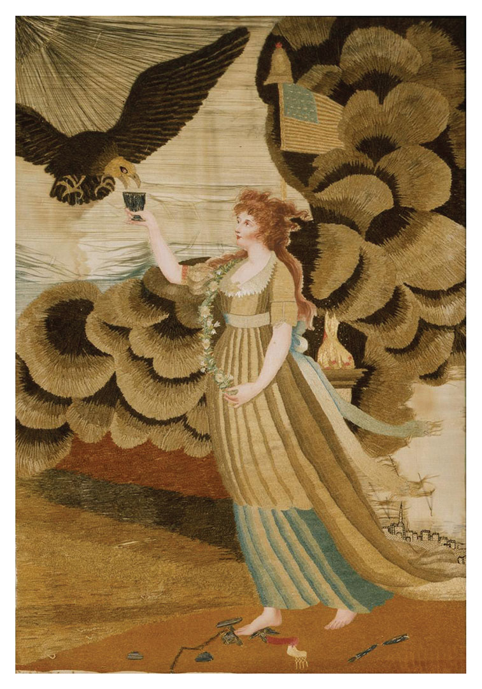
Liberty in the Form of the Goddess of Youth
Embroidery based on Liberty in the Form of the Goddess of Youth, Give Me Liberty!: An American History, 5th Edition
by Mary Green, Worcester, Massachusetts, 1804 Copyright © 2017 W.W. Norton & Company
Notes:
This is an 1804 embroidery by sixteen-year-old Mary Green of Worcester, Massachusetts, based on Liberty in the Form of the Goddess of Youth, a widely reprinted engraving linking liberty and nationhood. Atop the American flag sits a liberty cap. At the goddess’s feet lie symbols of Old World monarchy, including the key to the Bastille (the Paris prison stormed by a crowd at the outset of the French Revolution) and a broken royal scepter.

Slide 24
Focus Question: The Adams Presidency
  Focus Question:
  How did competing views of freedom and global events promote the political divisions of the 1790s?
Notes:
The purpose of the focus questions is to help students find larger themes and structures to bring the historical evidence, events, and examples together for a connected thematic purpose.
As we go through each portion of this lecture, you may want to keep in mind how the information relates to this larger thematic question. Here are some suggestions: write the focus question in the left or right margin on your notes and as we go through, either mark areas of your notes for you to come back to later and think about the connection, OR as you review your notes later (to fill in anything else you remember from the lecture or your thoughts during the lecture or additional information from the readings), write small phrases from the lecture and readings that connect that information to each focus question AND/OR are examples that work together to answer the focus question.

Slide 25
Election of John Adams
The Election of 1796
Notes:
George Washington was reelected unanimously in 1792, but in 1796 he decided to retire from public life, and he set a precedent that the presidency should not be a lifelong office. In his Farewell Address, Washington warned against parties and partisanship, and urged Americans to avoid Europe’s power politics by refusing to embrace “permanent alliances” with other nations.
The election of 1796 was the first contested presidential election. John Adams with Thomas Pinckney of South Carolina ran for the Federalists, and Thomas Jefferson, with Aaron Burr of New York, ran for the Republicans. Although Adams won the presidency with the most electoral votes, Jefferson received more votes than Pinckney, so he became Adams’s vice president. Adams was brilliant but was disliked by nearly everyone, even his supporters, and his administration faced constant crisis. Although the United States was neutral in the war between France and Britain, it defended its right to trade non-military goods with both nations. In 1797, before negotiating the renewal of France’s treaty with the United States, French officials demanded bribes. Outraged, Adams publicized the affair, thereafter known as the XYZ affair, and soon U.S. and French ships were engaged in a “quasi-war” at sea. America had effectively become an ally of Great Britain in the European war. In 1800, Adams negotiated a peace with France. Less cautious in domestic affairs, Adams used the federal army to quell more resistance to taxes in backcountry Pennsylvania, this time in the form of “Fries’s Rebellion.” John Fries was arrested for treason after leading a crowd to release arrested men from prison, and the army terrorized his supporters, tore down liberty poles, and whipped Republican newspaper editors. While Adams pardoned Fries in 1800, the region never voted Federalist again.

Slide 26
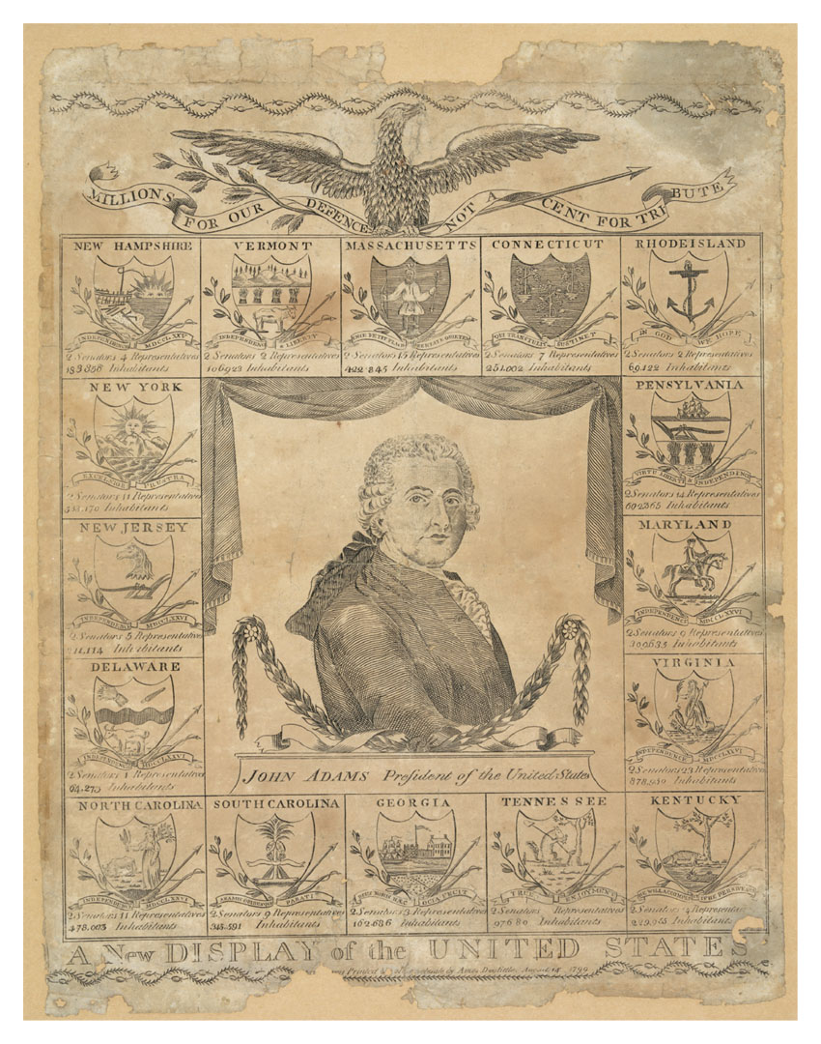
A New Display of the United States
A New Display of the United States, engraving by Amos Doolittle, 1803 Give Me Liberty!: An American History, 5th Edition
Copyright © 2017 W.W. Norton & Company
Notes:
A New Display of the United States, an 1803 engraving by Amos Doolittle, depicts President John Adams surrounded by shields of sixteen states (the original thirteen plus Kentucky, Tennessee, and Vermont), with the population and number of senators and representatives of each. At the top, an eagle holds an arrow, an olive branch, and a banner reading “Millions for Our Defence Not a Cent for Tribute,” a motto that originated during the XYZ affair of 1798 when French officials demanded bribes before entering into negotiations to avoid war with the United States.

Slide 27
Persecution of Dissent
The “Reign of Witches”
The Virginia and Kentucky Resolutions
Notes:
The most controversial act of the Adams administration was the Alien and Sedition Acts, passed by a Federalist-dominated Congress in 1798. The acts made it harder for immigrants to become naturalized citizens and allowed the deportation of immigrants deemed “dangerous” by federal authorities, moves meant to silence immigrant radicals who supported the Republicans and the French. They also authorized the prosecution of any assembly or publication critical of the government. This was meant to allow federal authorities to suppress Republican newspapers attacking the Adams administration and its policies. Jefferson, referring to the Salem witch trials, believed these acts inaugurated a “reign of witches.” More than a dozen individuals were charged with sedition, many of whom were convicted, including Matthew Lyons, a Republican member of Congress.
Instead of squelching the opposition, the Alien and Sedition Acts only provoked its growth by calling into question the boundaries of free speech and sparking a heated debate based on the First Amendment. Madison and Jefferson drafted resolutions to be passed by the Virginia and Kentucky legislatures. Both criticized the acts as violations of the First Amendment. The original draft of Jefferson’s resolution asserted that states could unilaterally stop the enforcement of such laws within their borders—but the Kentucky legislature deleted this passage before passing its resolution. While many Americans were repelled by the idea that states could refuse to follow federal laws, more Americans believed that the Alien and Sedition Acts violated protections for free speech enshrined in the Constitution. No other state adopted the resolutions, and many Americans, including Republicans feared the consequences of state action that might endanger the Union. The crisis did however, reinforce the idea of “freedom of discussion” as an indispensable attribute of American liberty and democratic government.

Slide 28
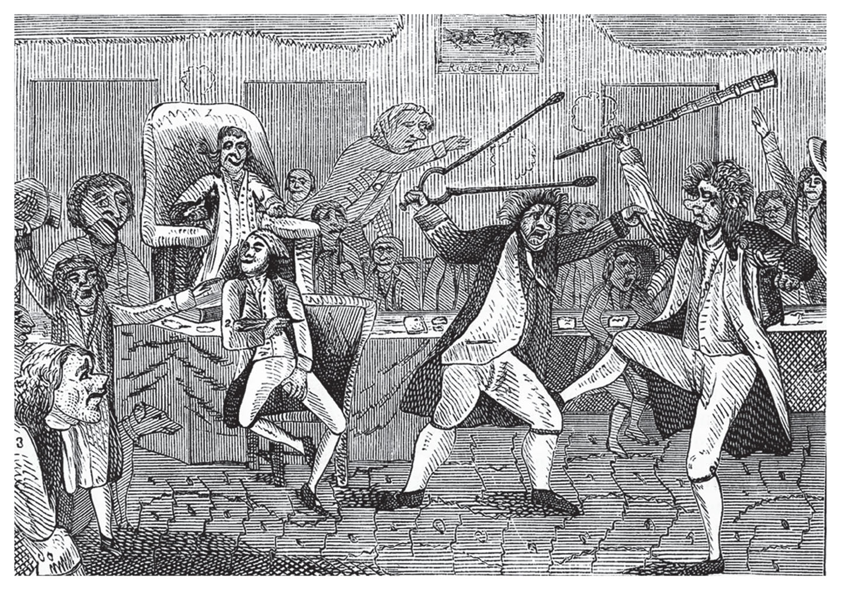
Congressional Pugilists
Cartoon Congressional Pugilists, printed in 1798 Give Me Liberty!: An American History, 5th Edition
Copyright © 2017 W.W. Norton & Company
Notes:
Congressional Pugilists, a 1798 cartoon depicting a fight on the floor of Congress between Connecticut Federalist Roger Griswold and Matthew Lyon, a Republican from Vermont
Lyon would soon be jailed under the Sedition Act for criticizing the Adams administration in his newspaper.

Slide 29
Politics at 1800
The “Revolution of 1800”
Notes:
By 1800, Republicans had developed effective campaigning techniques to mobilize voters for their candidate and cause. Federalists, who viewed politics as an activity of only the elite, found it difficult to match their opponents’ mobilization. Jefferson won the election of 1800 over incumbent John Adams, but even before he was inaugurated, a constitutional crisis had to be worked out. Each party arranged to have an elector throw away one of his two votes for president, so that its presidential candidate would come out a vote ahead of the vice presidential; when the designated Republican elector failed to do so, Jefferson and his running mate, Aaron Burr, tied. The election was thrown into the Federalist controlled House of Representatives where neither candidate received a majority vote until Alexander Hamilton tipped the balance. Though Hamilton was an outspoken opponent of Jefferson, he believed Jefferson was enough of a statesman to recognize that the Federalist financial system could not be entirely dismantled. On the other hand, he believed Burr to be a power-hungry, potential tyrant. The crisis led Congress to pass the Twelfth Amendment to the Constitution requiring electors to cast separate votes for president and vice president; additionally, the incident sparked a chain of events leading to a duel between Burr and Hamilton four years later that would result in Hamilton’s death. Burr was later tried for treason after allegedly engaging in a plot to form a new nation in the West from lands detached from the United States and the Spanish Empire; after his acquittal, he went into exile in Europe, eventually returning to live out the rest of his life practicing law in New York. The events of the 1790s demonstrated that a majority of Americans believed they had a right to play an active role in politics, express their opinions freely, and contest government policy; though Federalists remained overwhelmingly elitist, they never contested the election results, and established the precedent of peaceful transfer of power from one party to another after elections.

Slide 30
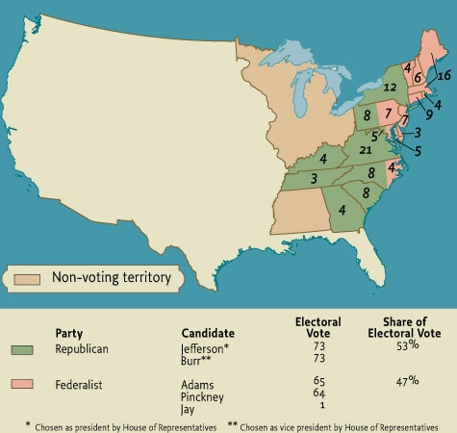
The Presidential Election of 1800
Map 8.1 The Presidential Election of 1800 Give Me Liberty!: An American History, 5th Edition
Copyright © 2017 W.W. Norton & Company

Slide 31
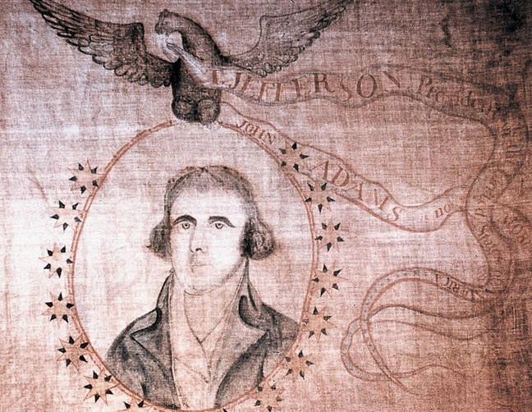
“John Adams Is No More”
An 1800 campaign banner, with a portrait of Thomas Jefferson Give Me Liberty!: An American History, 5th Edition
and the words “John Adams is no more” Copyright © 2017 W.W. Norton & Company
Notes:
An 1800 campaign banner, with a portrait of Thomas Jefferson and the words “John Adams is no more”

Slide 32
Slavery’s Impact on Developing Politics
Slavery and Politics
Notes:
Slavery lurked in the background of debates in the 1790s. Jefferson was elected only because he received all of the South’s electoral college votes. Jeffersonian liberty rested on the fact that three-fifths of the slaves were counted in apportionment. If it had been otherwise, Adams would have been reelected in 1800. The first Congress received petitions for the abolition of slavery, including one signed by Benjamin Franklin. Madison and other political leaders, even though they found slavery distasteful, believed that it was too divisive to be made an issue in national politics, and they ignored the petitions. In 1793, to implement the Constitution’s fugitive slave clause, Congress enacted a law providing for local officials to facilitate the return of escaped slaves.

Slide 33
Revolution Abroad and Rebellion at Home
The Haitian Revolution
Gabriel’s Rebellion
Notes:
The Haitian Revolution demonstrated how slavery shaped and warped American freedom. Jeffersonians who celebrated the French Revolution as an advance for liberty were horrified by the slave revolt in 1791 in Saint Domingue (modern-day Haiti), France’s most treasured colonial possession, an island of sugar plantations in the Caribbean. The slaves defeated British and French forces sent to suppress the rebellion, and they declared an independent nation in 1804. The revolt affirmed the universal appeal of freedom in this age of revolutions and fostered hopes of freedom among America’s slaves. Whites were generally terrified by the specter of armed slave insurrection, and they interpreted the turmoil in Haiti as a sign that blacks could not govern themselves. Ironically, the Adams administration encouraged the independence of black Haiti, hoping American merchants could replace the French in the sugar trade, while Jefferson’s administration sought to isolate and destroy the hemisphere’s second independent republic.
In addition to Jefferson’s “revolution,” 1800 witnessed an attempted real one during which slaves rebelled in a bid for freedom. Richmond blacksmith Gabriel Prosser, and his brothers Solomon and Martin planned a march on the city intending to cut it off from the surrounding plantations. During the rebellion, some white inhabitants were killed, and others, including Governor James Monroe, were held as hostages until the demand for abolition was met. Gabriel hoped that poor whites would join the movement, and he ordered that Methodists, Quakers, and “French people” be spared, considering them to be potential sympathizers. When a storm washed out the roads to Richmond, the rebellion was discovered, its leaders arrested, and twenty-six slaves, including Gabriel were hanged, while dozens of others were removed from the state. Blacks made up half of Richmond’s population in 1800, 20 percent of which were free; the rebellion was rooted in a black community that had emerged in this population during the 1780s and 1790s. Gabriel recruited supporters at black Baptist churches, funerals, barbecues, and other gatherings; many of the slaves in Richmond were literate and hired themselves out to work for wages that would go to owners, elements of autonomy that account for slave artisans’ role in the rebellion. Gabriel’s Rebellion was a product of the age, and participants spoke the language of liberty forged during the American Revolution. Adopting many of the symbols and figures of revolutionary era liberty, the rebellion demonstrated that slaves longed for liberty and freedom as much as anyone. In the wake of the rebellion, Congress moved in the opposite direction of freedom, tightening control over the black population, restricting individual slaveholders’ rights to free their slaves, and slamming shut the door to manumission opened by the American Revolution.

Slide 34
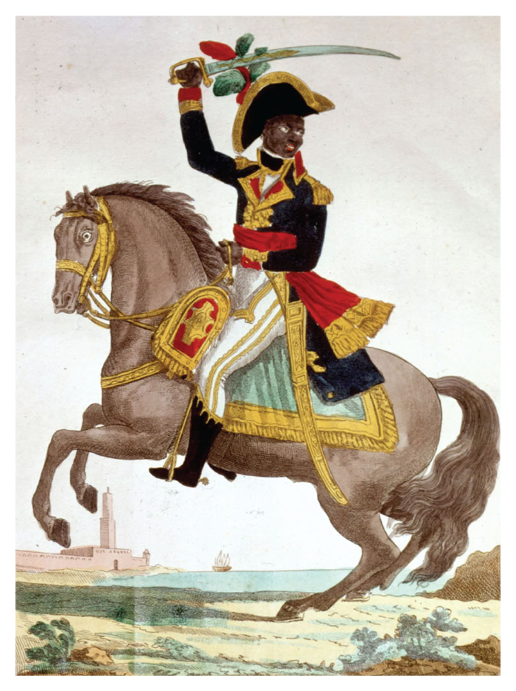
Toussaint L’Ouverture
Toussaint L’Ouverture, leader of the slave revolution Give Me Liberty!: An American History, 5th Edition
in Saint Domingue (Haiti), painted in 1800 Copyright © 2017 W.W. Norton & Company
Notes:
Toussaint L’Ouverture, leader of the slave revolution in Saint Domingue (modern-day Haiti), painted in 1800 as part of a series of portraits of French military leaders. It depicts him as a courageous general.

Slide 35
Focus Question: Jefferson in Power
  Focus Question:
  What were the achievements and failures of Jefferson’s presidency?
Notes:
The purpose of the focus questions is to help students find larger themes and structures to bring the historical evidence, events, and examples together for a connected thematic purpose.
As we go through each portion of this lecture, you may want to keep in mind how the information relates to this larger thematic question. Here are some suggestions: write the focus question in the left or right margin on your notes and as we go through, either mark areas of your notes for you to come back to later and think about the connection, OR as you review your notes later (to fill in anything else you remember from the lecture or your thoughts during the lecture or additional information from the readings), write small phrases from the lecture and readings that connect that information to each focus question AND/OR are examples that work together to answer the focus question.

Slide 36
Jefferson Presidency
Judicial Review
Notes:
At Jefferson’s inauguration in March 1801, he tried to conciliate his Federalist opponents by claiming that both parties shared the same principles even if they disagreed in their opinions. Jefferson vowed to reduce government, free trade, ensure freedom of religion and the press, and avoid “entangling alliances” with other nations. He sought to dismantle much of the Federalist edifice and prevent the kind of centralized state Federalists promoted. He pardoned those jailed under the Sedition Act, reduced the army and navy and the number of government employees, abolished all taxes except for the tariff, and paid off part of the nation’s debt.
As Hamilton had predicted, it proved impossible for Jefferson to uproot national authority entirely. Jefferson distrusted the unelected judiciary, but it was headed by John Marshall, an Adams appointee, who was a strong believer in national supremacy. In 1803, the Marshall Court decided the case of Marbury v. Madison. Just before leaving office, Adams appointed multiple justices of the peace in the District of Columbia, but Madison refused to commission them for their offices; four of the appointees, one of them William Marbury, sued for their positions. Marshall declared the section of the Judiciary Act of 1789 permitting courts to order executive officials to deliver commissions unconstitutional and void because it exceeded the constitutional power of Congress. According to Marshall, even though Marbury was entitled to his commission, the Supreme Court could not force its delivery by the current administration. While Jefferson got his way with the decision, he saw it as a high-cost victory because Marshall had established the precedent of “judicial review,” meaning the Supreme Court had assumed the right to determine the constitutionality of Congress’ actions. Seven years later, the case Fletcher v. Peck extended Supreme Court judicial review to state laws. When a corrupt land bargain was rescinded by a subsequent legislature, Marshall declared that a contract could be broken by a state regardless of the circumstances of the initial legislature’s actions.

Slide 37
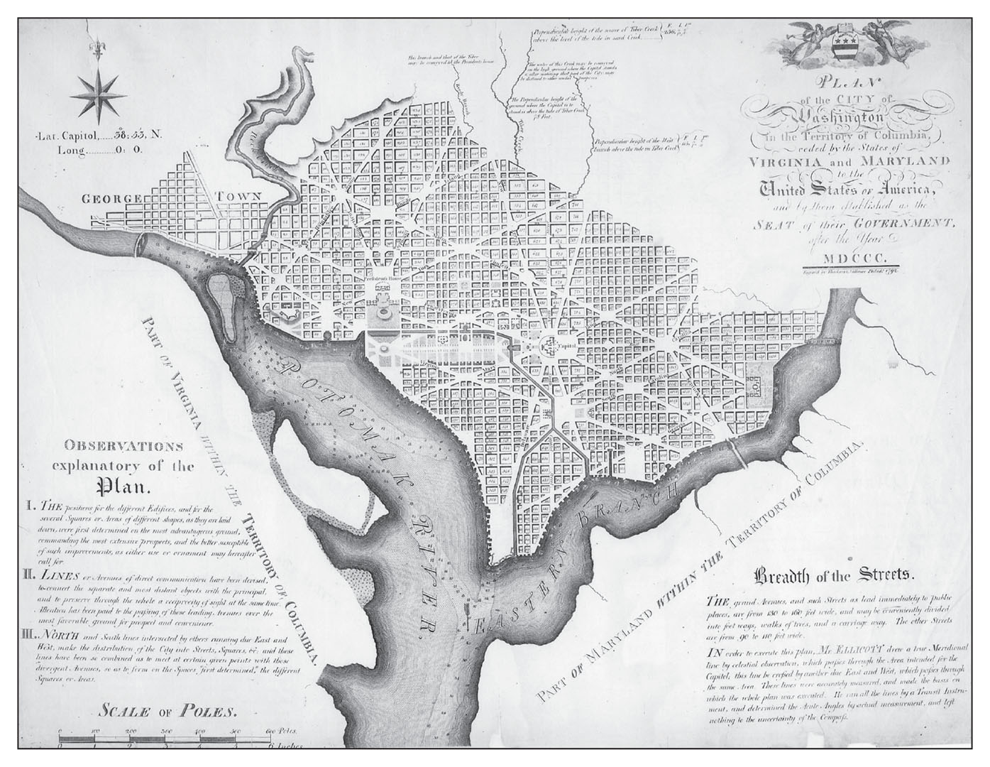
Washington, D.C.
Plan for Washington, D.C., by Pierre Charles L’Enfant, 1791 Give Me Liberty!: An American History, 5th Edition
Copyright © 2017 W.W. Norton & Company
Notes:
Pierre Charles L’Enfant’s 1791 plan for Washington, D.C., includes broad avenues that crisscross the city that are named for the thirteen states, and a long mall stretching from the Potomac River to the Capitol building, slightly to the right of center.

Slide 38
Louisiana
The Louisiana Purchase
Notes:
Jefferson saw the Louisiana Purchase as his greatest achievement, and yet his view was highly ironic given its origins and character. Acquired by France in 1800, the vast Louisiana territory, stretching from the Mississippi to the Rocky Mountains, was purchased by Jefferson for the very small sum of $15 million. But it was sold only because the Haitian Revolution, which Jefferson detested, had defeated an overtaxed French military and Napoleon needed funds for campaigns in Europe. Americans were happy to secure the port of New Orleans, thus ensuring a previously precarious right to freely trade on the Mississippi. Though Jefferson doubled the nation’s size and ended France’s presence in North America, the Federalists opposed the purchase as wasteful. Jefferson believed Louisiana ensured the survival of the agrarian republic of small and independent, virtuous farmers. A strict constructionist, he also acknowledged that the Constitution nowhere gave the president the right to take this kind of action without approval from Congress. Nonetheless, he felt the benefits justified his transgression.

Slide 39
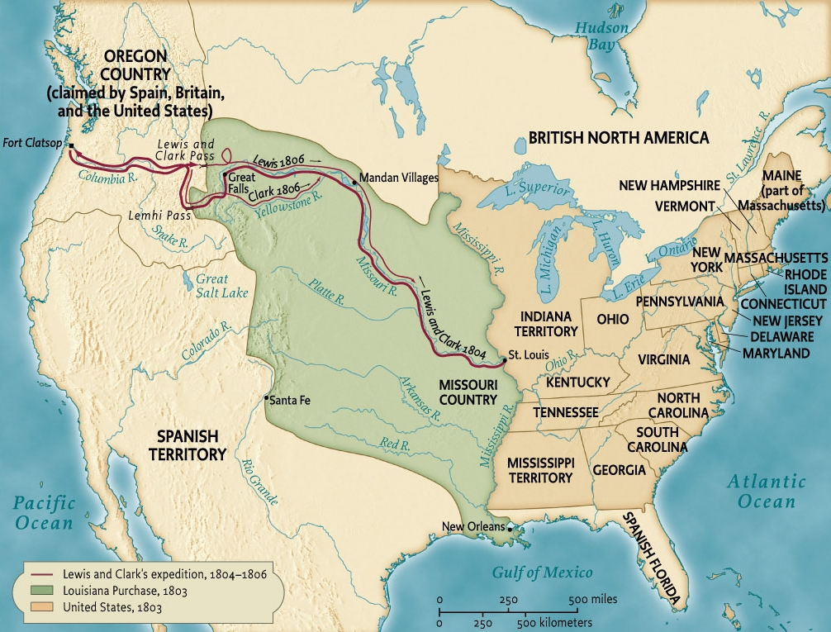
The United States Doubled
Map 8.2 The Louisiana Purchase Give Me Liberty!: An American History, 5th Edition
Copyright © 2017 W.W. Norton & Company
Notes:
The Louisiana Purchase of 1803 doubled the land area of the United States.

Slide 40
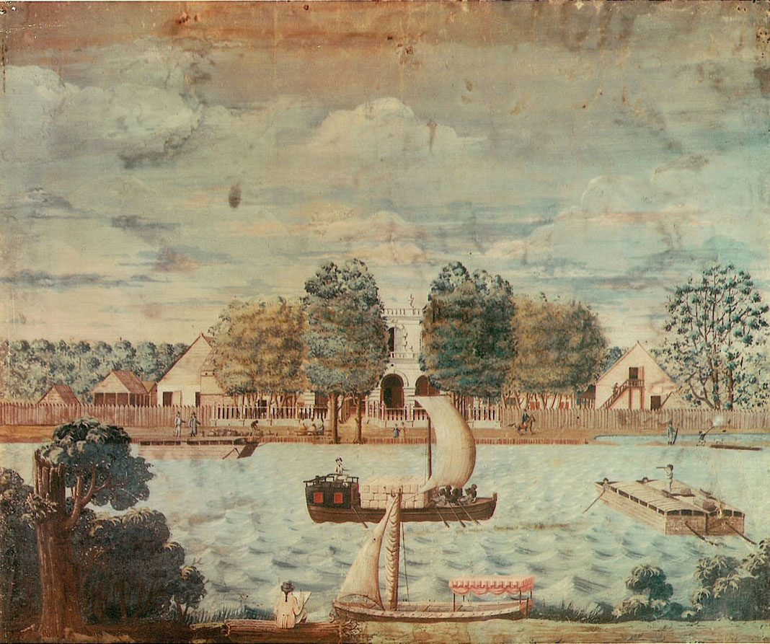
White Hall Plantation
White Hall Plantation, Louisiana, ca. 1800 Give Me Liberty!: An American History, 5th Edition
Copyright © 2017 W.W. Norton & Company
Notes:
White Hall Plantation, painted around 1800, depicts a Louisiana plantation and the dynamism of the region’s economy on the eve of its acquisition by the United States. Black oarsmen man a boat carrying bales of cotton for sale in New Orleans.

Slide 41
Venturing into New Territory
Lewis and Clark
Incorporating Louisiana
Notes:
Soon after purchasing Louisiana, Jefferson dispatched two fellow Virginians, Meriwether Lewis and William Clark, to explore it. They were to conduct scientific and commercial surveys in order to find ways to exploit the region’s resources, develop trade with Indians, and find a commercial route to the Pacific Ocean that could foster trade with Asia. In two years, and guided for a large segment of the journey by Sacajawea, a 15-year old Shoshone Indian woman, Lewis and Clark traveled all the way to the Pacific (reaching it in the area of today’s Oregon) and back. Though they did not find a commercial route to Asia, their success reinforced the belief that America’s territory would one day extend to the Pacific Ocean.
In 1803, New Orleans was the only part of the Louisiana Purchase with a significant non-Indian population; over half of 8,000 residents were slaves and free blacks. Incorporating the diverse population into the United States was no easy task. French and Spanish law accorded free blacks nearly all the rights of white citizens, slaves were entitled to certain legal protections, and freedom through purchase or voluntary emancipation was much easier than in the United States. The treaty that transferred Louisiana to the United States promised that all free inhabitants would enjoy the rights of citizens. While Louisiana retained the Spanish and French civil codes outlining the principle of “community property” within a marriage (women’s co-ownership), free blacks’ rights steadily declined. The local legislature adopted one of the most sweeping slave codes in the South forbidding any consideration of freedom and severely limited avenues for manumission. For slaves in Louisiana, the “tyranny” of Spain was far freer than the “liberty” of the United States.

Slide 42
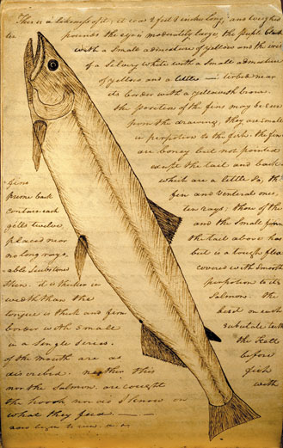
Gathering Information About the West
A salmon depicted in William Clark’s journal of the Lewis and Clark expedition Give Me Liberty!: An American History, 5th Edition
Copyright © 2017 W.W. Norton & Company
Notes:
A page from William Clark’s journal of the Lewis and Clark expedition, depicting a salmon
Among their tasks was to record information about the West’s plants, animal life, and geography.

Slide 43
The United States and the Barbary States
The Barbary Wars
Notes:
The Louisiana Purchase showed that, despite being far removed from Europe, the United States was deeply affected by events across the Atlantic. Because the United States depended on many goods, especially manufactured goods, from Europe, the wars there directly influenced Americans’ livelihoods. Jefferson hoped to avoid becoming entangled in Europe’s wars, but ultimately he could not ignore these struggles. Jefferson, who wanted a diminished central state, used the military to fight the nation’s first war, a war to protect commerce in the Mediterranean. In North Africa, the Barbary states had long preyed on European and U.S. shipping, although they refrained from attacking ships if a nation paid a hefty tribute. When Jefferson refused demands that the United States increase its tribute, the pasha of Tripoli, in modern-day Libya, declared war on the United States, a conflict that lasted until 1804. Despite the conflict’s resolution, Tripoli continued to harass American shipping until after a show of force during the War of 1812. The Barbary Wars were the new nation’s first encounter with the Islamic world; in the 1790s, in an attempt to establish peaceful relations, the federal government declared that the United States was “not, in any sense, founded on the Christian religion.” Nonetheless, the conflicts began a pattern in which Americans viewed Muslims as an exotic people whose ways of life did not adhere to Western standards; for many Americans, Islam rested beside monarchy and aristocracy as Old World despotism.

Slide 44
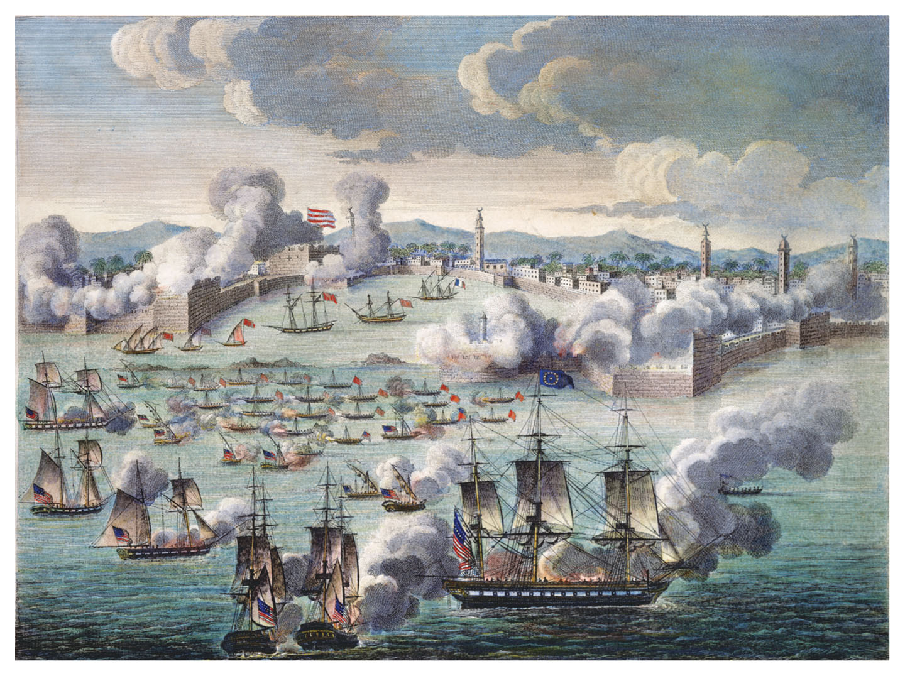
The Attack Made on Tripoli
The Attack Made on Tripoli, part of the Barbary Wars, 1805 Give Me Liberty!: An American History, 5th Edition
Copyright © 2017 W.W. Norton & Company
Notes:
The Attack Made on Tripoli, a print from 1805, celebrates the bombardment of Tripoli (in present-day Libya) by the U.S. Navy as part of the Barbary Wars, the first American encounter with the Islamic world.

Slide 45
Brewing War
The Embargo
Madison and Pressure for War
Notes:
When war between France and Britain resumed in 1803, each nation imposed a blockade to deny the other’s trade with the United States, which was officially neutral. The British also engaged in the impressment of American sailors, essentially kidnapping them for service in the Royal Navy. Jefferson, believing America’s economy required free trade, persuaded Congress to enact the Embargo Act, which prohibited all American vessels from sailing to foreign ports, to force an end to the blockades. The Embargo stopped almost all American exports, and devastated the nation’s ports, but did not persuade France or Great Britain to end their blockades. In 1809, Jefferson signed the Non-Intercourse Act, which banned trade only with Britain and France, and promised a resumption of trade with either nation if it ended its ban on American shipping.
In 1808, Jefferson’s successor James Madison easily won election as president. With the Embargo a failure and deeply unpopular, in 1810 Madison forged a new policy in which trade was resumed with both powers, but it provided that if either France or Britain stopped interfering with American shipping, the United States could reimpose an embargo on the other nation, unless that nation too ceased its intervention against U.S. ships. France ended its blockade, and the British increased their attacks on American ships and sailors. In 1812, Madison resumed the embargo against Britain. Young congressmen from the West, known as “war hawks,” such as Henry Clay of Kentucky and John Calhoun of South Carolina, called for war, in part because it would be an opportunity to conquer Florida and Canada. Others wanted a war to defend the principles of free trade and end Europe’s power over America.

Slide 46
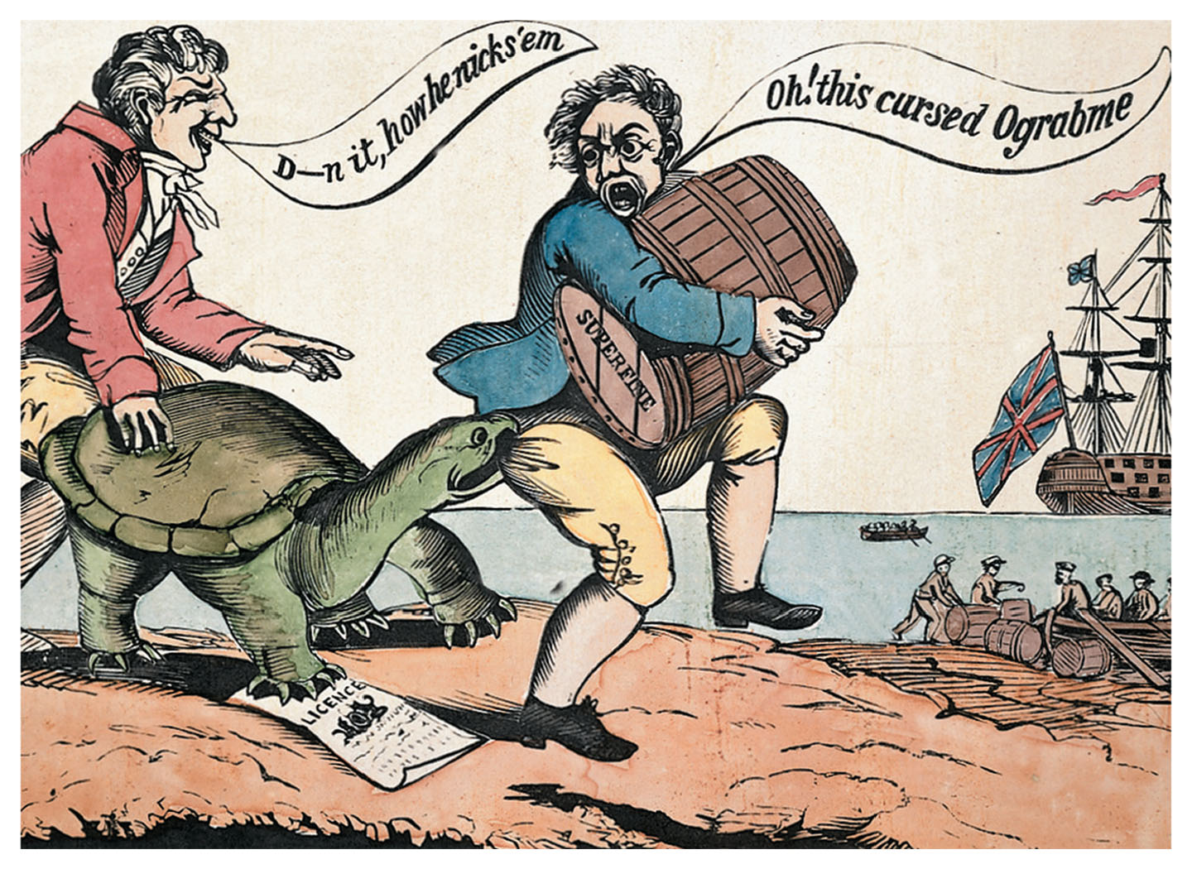
O-Grab-Me, or, the American Snapping-Turtle
O-Grab-Me, or, the American Snapping-Turtle, a cartoon criticizing Jefferson’s Embargo Give Me Liberty!: An American History, 5th Edition
Copyright © 2017 W.W. Norton & Company
Notes:
O-Grab-Me, or, the American Snapping-Turtle, a cartoon criticizing Jefferson’s Embargo (spelled backward as o-grab-me), which banned all American shipping to foreign ports

Slide 47
Focus Question: The “Second War of Independence"
  Focus Question:
  What were the causes and significant results of the War of 1812?
Notes:
The purpose of the focus questions is to help students find larger themes and structures to bring the historical evidence, events, and examples together for a connected thematic purpose.
As we go through each portion of this lecture, you may want to keep in mind how the information relates to this larger thematic question. Here are some suggestions: write the focus question in the left or right margin on your notes and as we go through, either mark areas of your notes for you to come back to later and think about the connection, OR as you review your notes later (to fill in anything else you remember from the lecture or your thoughts during the lecture or additional information from the readings), write small phrases from the lecture and readings that connect that information to each focus question AND/OR are examples that work together to answer the focus question.

Slide 48
Indians in the Early Nineteenth Century
The Indian Response
Tecumseh’s Vision
Notes:
The crisis between the United States and Britain took place against a backdrop of deteriorating Indian relations in the West, a circumstance that further propelled the country toward war. Jefferson had long favored removal west of Indians who refused to assimilate, and the Louisiana Purchase made that policy more feasible, so Jefferson enthusiastically pursued the purchase of Indian lands between the Appalachian Mountains and the Mississippi River. While he encouraged traders to lend money to Indians in the hopes of forcing them to sell their land to pay off debts, the government also continued to encourage settled agriculture among Indian communities. Furthermore, African American slavery was encouraged among Indian peoples as an element of “advancing civilization.”
By 1800, nearly 400,000 settlers lived west of the Appalachian Mountains, far more than the remaining Indians, whose seemingly irreversible decline led some to question their continued opposition to assimilation. Among the Creek and Cherokee, leaders of mixed Indian–white ancestry such as Major Ridge and John Ross encouraged acceptance of the federal “civilizing” policy; trading and slaveholding was common among these communities, and their views infuriated “nativists” who wished to root out European influences and prevent further white settlement on Indian lands. The period from 1800–1812 was an “age of prophecy” among Indians, and revitalization movements sprang up among the Creeks, Cherokees, Shawnees, Iroquois, and various other communities. The leader Handsome Lake of the Seneca believed that Indians could regain autonomy without directly challenging whites or repudiating their ways, and he urged his people to take up farming and schooling, while also avoiding vices such as fighting, gambling, drinking, and sexual promiscuity.
A more militant position was taken by two Shawnee brothers, Tecumseh and Tenskwatawa. They refused to sign treaties with whites and advocated resistance to the federal government, and Tenskwatawa, a prophet, argued that whites were the source of all evil and that Indians should completely separate from everything European. In 1810, Tecumseh organized attacks on frontier settlements, but the following year, in Tecumseh’s absence, William Henry Harrison’s forces destroyed the militants’ village at the Battle of Tippecanoe.

Slide 49
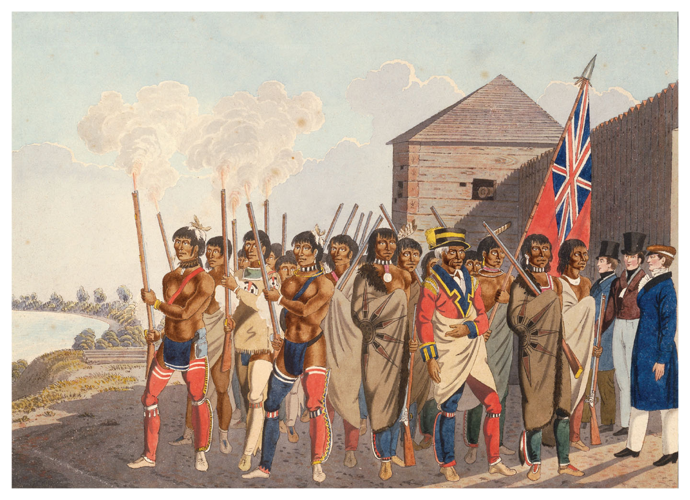
War Party at Fort Douglas
War Party at Fort Douglas, by Peter Rindisbacher, 1823 Give Me Liberty!: An American History, 5th Edition
Copyright © 2017 W.W. Norton & Company
Notes:
This watercolor by the Swiss-born Canadian artist Peter Rindisbacher depicts an incident during the War of 1812 when Indian allies of Great Britain fired rifles into the air to greet their commander, Captain Andrew Bulger, pictured on the far right.

Slide 50
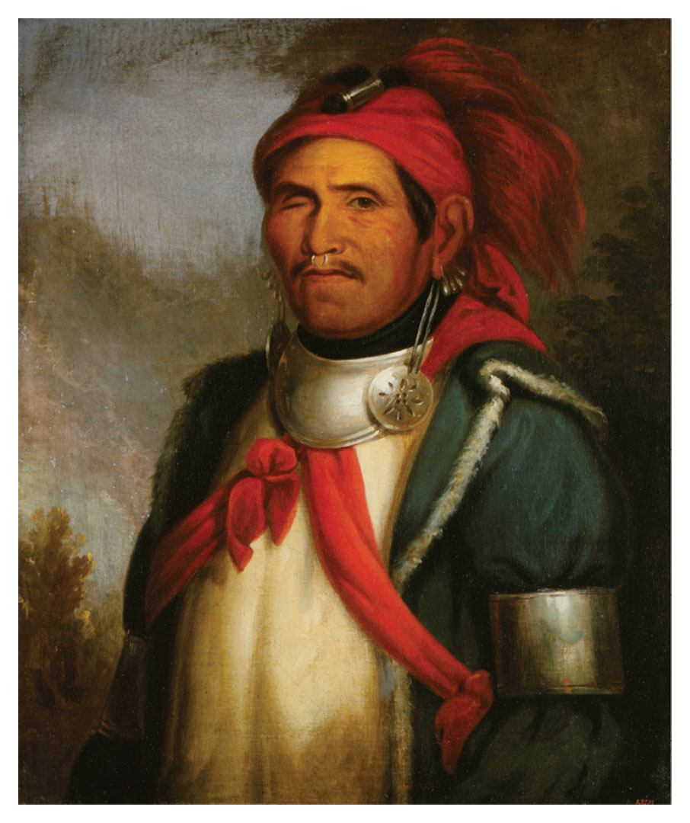
Tenskwatawa (the Prophet)
Tenskwatawa (the Prophet), by Charles Bird King Give Me Liberty!: An American History, 5th Edition
Copyright © 2017 W.W. Norton & Company
Notes:
Tenskwatawa (the Prophet), in a portrait by the American artist Charles Bird King, who painted numerous Indian leaders

Slide 51
War with Britain Once More
The War of 1812
Notes:
When Madison asked Congress to declare war on Britain in 1812, the vote reflected a divided nation. Federalists and Republicans representing northern states, where mercantile and financial interests were concentrated, voted against the war. Southern and western representatives voted overwhelmingly for it. Deeply divided, the United States lacked a large navy or army, lacked a central bank (since the Bank of the United States’ charter expired in 1811), and northern merchants and bankers refused to loan money to the government. Britain, even though focused on the war in Europe, initially repelled American invasions in Canada and imposed an effective blockade on the nation’s shipping.
In 1814, the British invaded and captured Washington, D.C., burned the White House, and forced the government to flee. The United States had a few victories, including the defense of Baltimore at Fort McHenry, an event that inspired the song that became the national anthem, the “Star-Spangled Banner.” The United States decisively vanquished Indian forces in the West and South, killing Tecumseh and many other militants. Most notably, forces led by Andrew Jackson forced Indians to cede much of the southeastern lands that became Alabama and Mississippi, and then famously repulsed British forces at the Battle of New Orleans in January 1815. This battle was fought before news reached America that American and British negotiators had signed the Treaty of Ghent, which had ended the war the previous month. The treaty changed nothing, giving the United States no territory or rights regarding U.S. ships or impressment. The treaty produced an unusual episode in American diplomacy concerning the fate of thousands of slaves who, like during the War of Independence, fled to British lines to find freedom. Though the treaty specified the return of those slaves after the war, Britain refused, and after lengthy, inconclusive negotiations, both Britain and the United States agreed to international arbitration by one of the world’s leading despots, Czar Nicholas I of Russia. Nicholas ruled in favor of the United States, and Britain paid compensation, while most of the freed slaves settled in Nova Scotia, Canada.

Slide 52
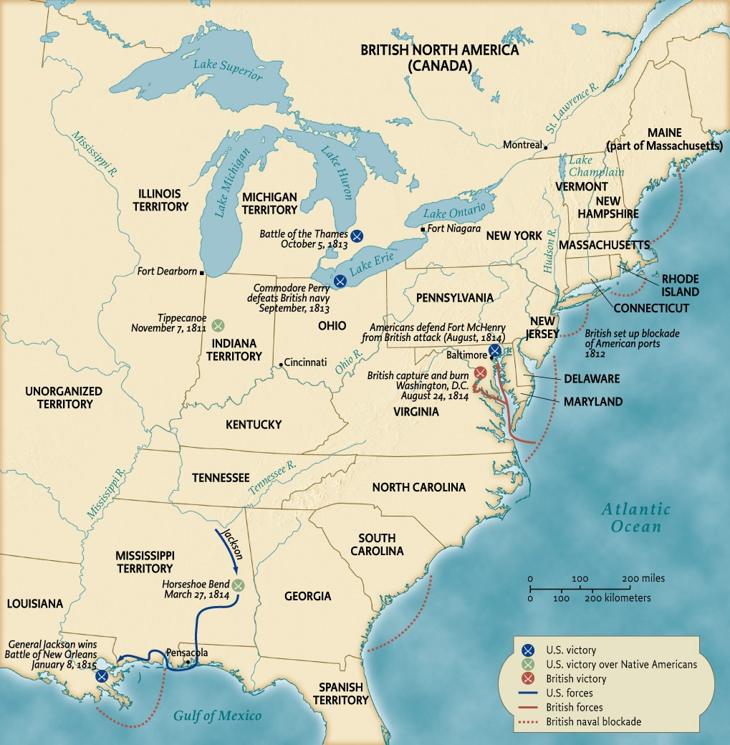
The War of 1812
Map 8.3 The War of 1812 Give Me Liberty!: An American History, 5th Edition
Copyright © 2017 W.W. Norton & Company
Notes:
Although the British burned the nation’s capital, the War of 1812 essentially was a military draw.

Slide 53
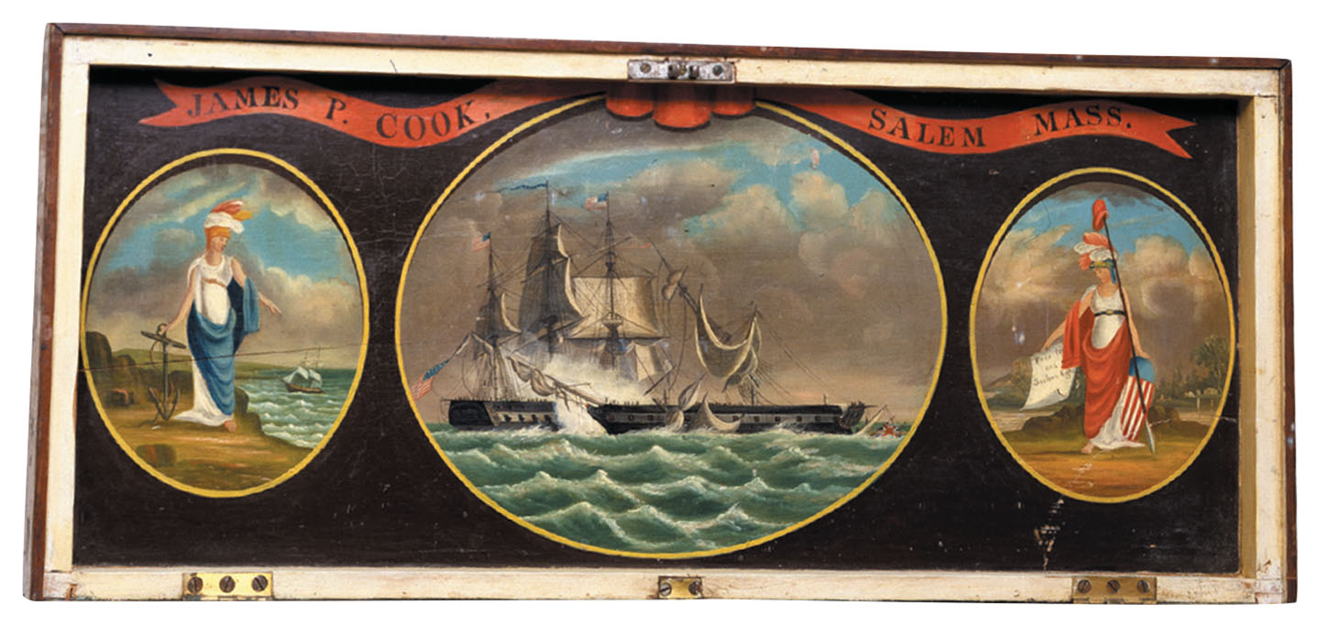
Scenes of the War of 1812
The lid of a chest decorated with scenes from the War of 1812 Give Me Liberty!: An American History, 5th Edition
Copyright © 2017 W.W. Norton & Company
Notes:
Images of Hope, on the left, and Liberty flank a picture of the naval battle in which the USS Constitution defeated a British warship. Liberty holds a paper that reads, “Free Trade and Sailors Rights,” two of the issues that drew the United States into the war.

Slide 54
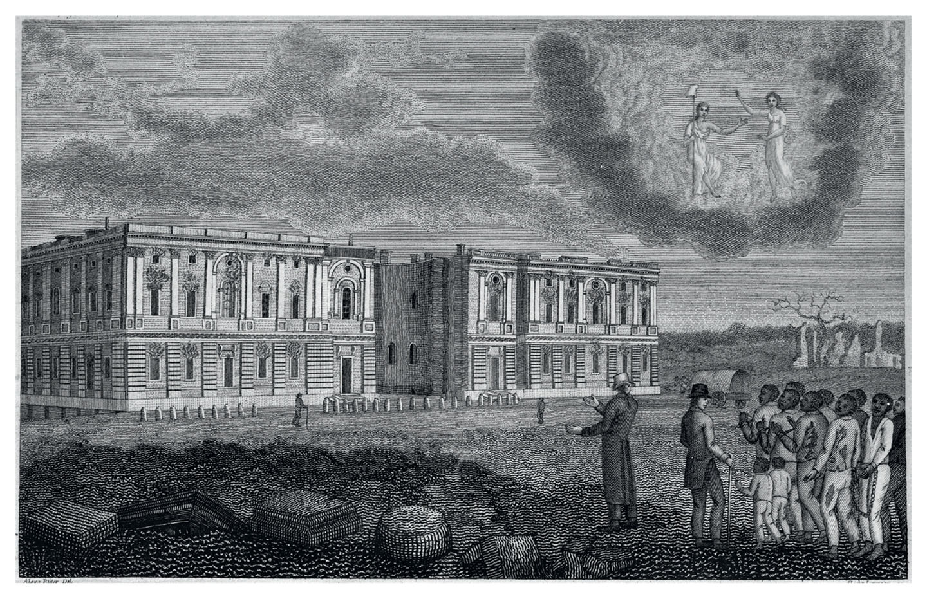
The Burning of Washington, D.C.
Engraving depicting the burning of Washington, D.C., from an 1817 book, by Jesse Torrey Give Me Liberty!: An American History, 5th Edition
Copyright © 2017 W.W. Norton & Company
Notes:
An engraving depicting the burning of Washington, D.C., by the British during the War of 1812, from an 1817 book by the antislavery Philadelphia physician Jesse Torrey
Torrey suggests that the event is divine punishment for the practice of slave trading in the nation’s capital. The image includes children among the group of chained slaves at the right to emphasize the breakup of slave families. At the top is a heavenly image of liberty.

Slide 55
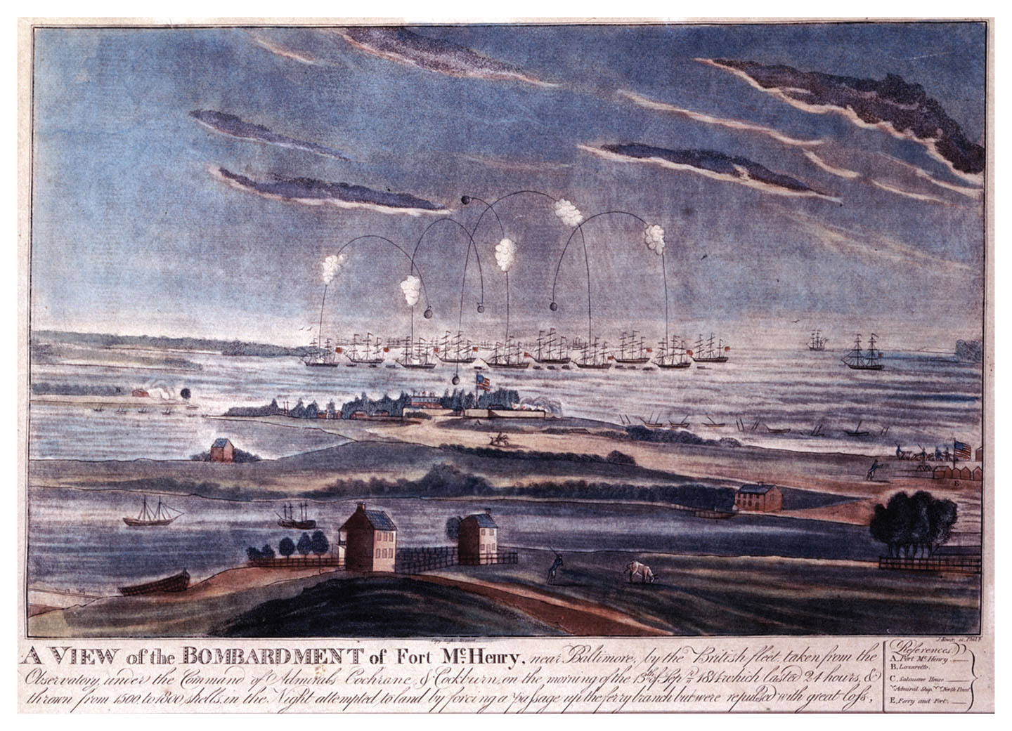
The Bombardment of Fort McHenry
The bombardment of Fort McHenry, Baltimore, September 1814 Give Me Liberty!: An American History, 5th Edition
Copyright © 2017 W.W. Norton & Company
Notes:
The bombardment of Fort McHenry in Baltimore harbor in September 1814 was of minor military importance, but it is remembered as the inspiration for Francis Scott Key’s poem, “The Star-Spangled Banner.”

Slide 56
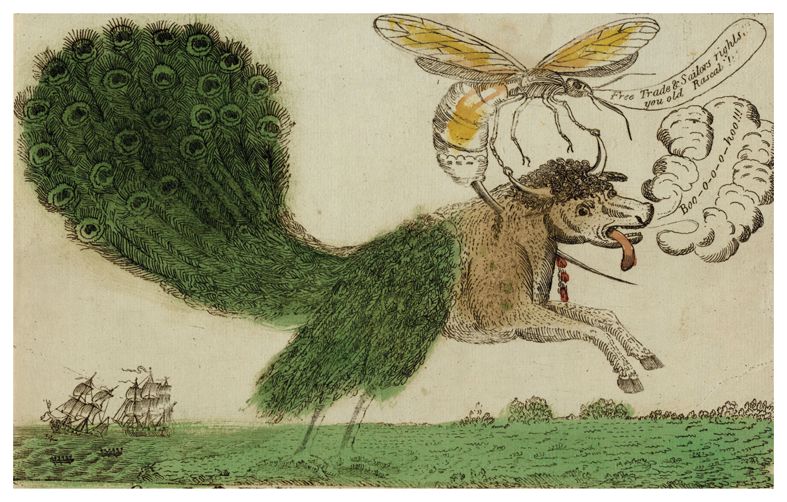
The Hornet and Peacock, or, John Bull in Distress
The Hornet and Peacock, or, John Bull in Distress, by Amos B. Doolittle, 1813 Give Me Liberty!: An American History, 5th Edition
Copyright © 2017 W.W. Norton & Company
Notes:
The Hornet and Peacock, or, John Bull in Distress, a watercolor by Amos B. Doolittle from 1813, celebrates a victory by the American warship Hornet over the British vessel Peacock during the War of 1812. Britain is represented as a half-bull, half-peacock creature being stung in the neck by a hornet.

Slide 57
Effects and Meaning of the War of 1812
The War’s Aftermath
The War of 1812 and the Canadian Borderland
Notes:
At the time, some Americans called the War of 1812 the Second War of Independence. The war affirmed the ability of the republic to defend itself and wage war without sacrificing its republican institutions. It made Andrew Jackson a national hero, and it sealed the doom of Indians who occupied lands east of the Mississippi River, thus finally securing this vast area for whites, many of whom in the South would bring slaves and slavery with them. The war strengthened Americans’ nationalism and their sense of isolation and separation from Europe.
The War of 1812 profoundly affected the border between the United States and Canada as a dividing line where much of the fighting took place. A large trade had developed between Vermont and Quebec where much of the smuggling during Jefferson’s Embargo had taken place; during the war, many Canadians became suspicious of American traders as spies, and American attacks added to anti-Americanism. Many had family and interests on both sides of the border, and exchange continued after the war, but more Americans directed their gaze westward. The War reaffirmed both American and Canadian national identities, and both viewed the conflict as a struggle for freedom from the other. On the other side of the Atlantic, Britain’s defeat of Napoleon inaugurated a long period of peace in Europe. Diplomatic affairs faded from its previously prominent role in American public life leading to an increased sense of separation from Europe, while Canada also experienced an increased sense of nationalism, partly based on separateness from the United States. Americans were puzzled why Canadians did not welcome American forces as bringers of liberty, and each side developed enduring stereotypes of the other; Americans viewed Canadians as monarchical, European, and lacking in understanding of liberty, while Canadians viewed Americans as unusually prone to violence.

Slide 58
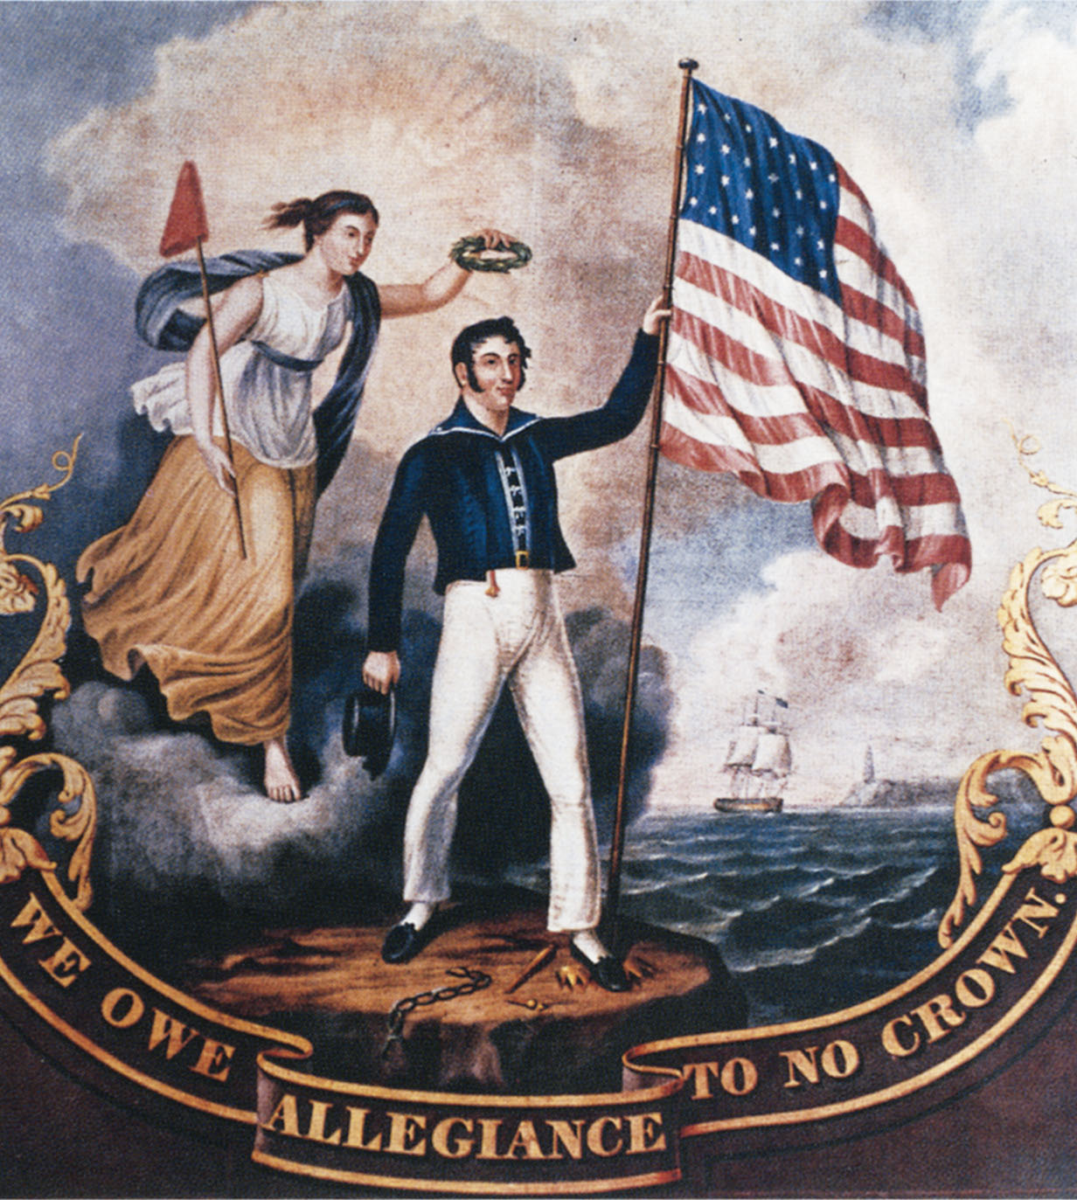
“We Owe Allegiance to No Crown”
Painting by John Archibald Woodside, from the time of the War of 1812 Give Me Liberty!: An American History, 5th Edition
Copyright © 2017 W.W. Norton & Company
Notes:
This colorful painting by the artist John Archibald Woodside from around the time of the War of 1812 contains numerous symbols of freedom, among them the goddess of liberty with her liberty cap, a broken chain at the sailor’s feet, the fallen crown (under his left foot), a broken royal scepter, and the sailor himself, since English interference with American shipping was one of the war’s causes.

Slide 59
Federalist Disintegration
The End of the Federalist Party
Notes:
The war sealed the demise of the Federalist Party, which had been briefly revitalized by widespread opposition to the war in the North. Madison only narrowly won reelection as president in 1812. But an ill-timed convention of New England Federalists at Hartford, Connecticut, in December 1814 badly injured the party. Convention delegates criticized the domination of the presidency by Virginians, lamented the diminishing influence of the Northeast as new southern and western states joined the union, and called for an end to the three-fifths clause. They demanded two-thirds votes in Congress for declaring war, admitting new states, and laws restricting trade. Contrary to later myth, the Hartford Convention did not call for secession or disunion, but it affirmed the right of a state to “interpose” its authority if the federal government violated the Constitution. Ultimately, Jackson’s electrifying victory at New Orleans made the Federalists seem unpatriotic.
Within a few years the Federalist Party disappeared. The urban and commercial interests the party represented were small in an expanding agrarian nation, and their elitism and distrust of democracy was increasingly out of touch with an increasingly democratic culture. But the Federalists had raised an issue that would not go away in the future—the domination of the national government by the slaveholding South—and the kind of commercial development they championed would soon inaugurate a social and economic transformation of the nation.

Slide 60
Review
Politics in an Age of Passion
  Focus Question: What issues made the politics of the 1790s so divisive?
The Adams Presidency
  Focus Question: How did competing views of freedom and global events promote the political divisions of the 1790s?
Jefferson in Power
  Focus Question: What were the achievements and failures of Jefferson’s Presidency?
The “Second War of Independence"
  Focus Question: What were the causes and significant results of the War of 1812?

Slide 61
MEDIA LINKS
—— Chapter 8 ——
Title | Media links
Eric Foner on the Haitian Revolution | The Haitian Revolution
Eric Foner on democratizing public life in the 1790s | Democratizing Public Life in the 1790s
Eric Foner on the Revolution’s impact on American freedom, pt. 3 | The Revolution's Impact on American Freedom, pt. 3
Eric Foner on America’s policy toward Indians in the nineteenth century | America's Policy Toward Indians in the Nineteenth Century
Eric Foner on the “empire of liberty” | The "Empire of Liberty"
Eric Foner on nineteenth-century slaves | Nineteenth-century Slaves

Slide 62
Next Lecture PREVIEW:
—— Chapter 9 ——
The Market Revolution, 1800 to 1840
A New Economy
Market Society
The Free Individual
The Limits of Prosperity

Slide 63
This concludes the Norton Lecture Slide Set for Chapter 8
Give Me Liberty!
AN AMERICAN HISTORY
FIFTH EDITION by
Eric Foner
Norton Lecture Slides
Independent and Employee-Owned

