Slide 1
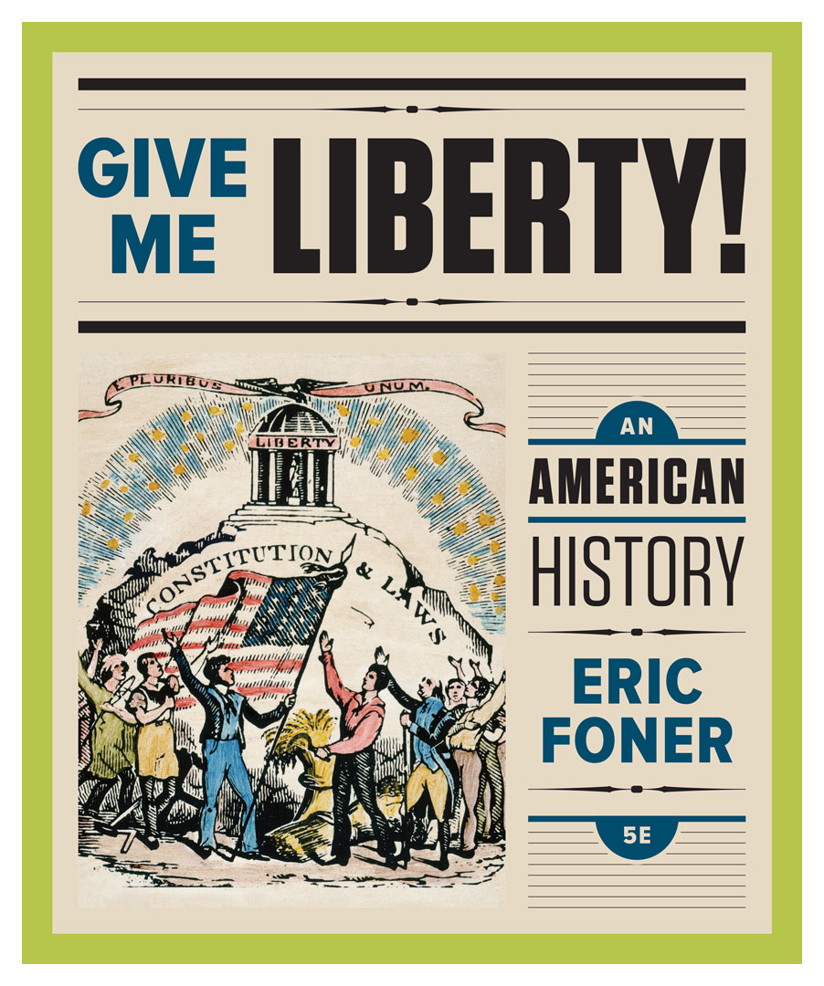
Lecture Slides
Give Me Liberty!
AN AMERICAN HISTORY
FIFTH EDITION
By Eric Foner

Slide 2

Chapter 9 The Market Revolution 1800 to 1840
Notes:
Nearly fifty years after he had fought with Washington in the War of Independence, the Marquis de Lafayette visited the United States in 1824 on a thirteen-month tour that became a Jubilee of Liberty. Since his last journey to the country in 1784, the nation’s population had tripled, it’s territory doubled, and political institutions thrived. Lafayette’s tour demonstrated how profoundly the nation had changed. Thirteen states had grown to twenty-four, and he was able to visit every one, a journey that would have been practically impossible forty years earlier. Lafayette’s trip up the Mississippi and Ohio Rivers was made possible by the recently invented steamboat, which was bringing economic development to the trans-Appalachian West; he also crossed upstate New York via the Erie Canal, the longest of its kind in the world, which linked the Great Lakes region to the Atlantic via the Hudson River. Americans of the first half of the nineteenth century described liberty as the nation’s defining quality and unique genius of its institutions. Images of liberty, familiar in the eighteenth century, became even more common in popular culture. Andrew Jackson declared that no population ever “enjoyed so much freedom and happiness as the people of these United States,” and Alexis de Tocqueville wrote of a “holy cult of freedom” he encountered during his early 1830s visit to the United States. But American ideas of freedom were changing, and three processes begun in the Revolution quickened after the War of 1812. The spread of market relations, westward movement of the population, and the rise of a vigorous political democracy, all affected American societal development, and reshaped the idea of freedom, becoming more closely identified with economic opportunity, physical mobility, and political participation. But American freedom also continued to be shaped by slavery, which was moving westward with the young republic on the same steamboats and canals enabling farm families to market their goods. That transportation system facilitated the growth of the slave-based cotton plantations of the South as slavery drew a strict racial boundary around American democracy, making voting, officeholding, and participation in the public sphere privileges for whites alone. In several southern cities, “persons of color” were warned to stay away from the ceremonies honoring Lafayette. Half a century after the winning of independence, the coexistence of liberty and slavery, and their simultaneous expansion, remained the central contradiction of American life.

Slide 3
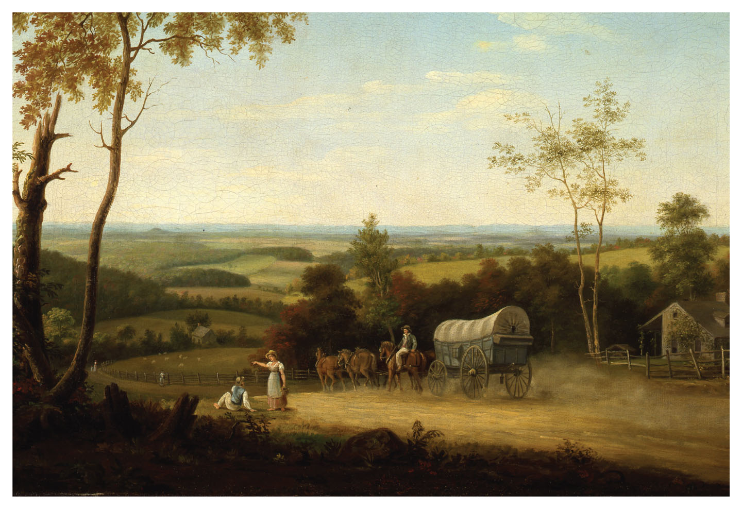
Conestoga Wagon on the Pennsylvania Turnpike
Conestoga Wagon on the Pennsylvania Turnpike, by Thomas Birch, 1816 Give Me Liberty!: An American History, 5th Edition
Copyright © 2017 W.W. Norton & Company
Notes:
Conestoga Wagon on the Pennsylvania Turnpike, by the English-born American artist Thomas Birch, depicts a rural scene in 1816. Named for a Pennsylvania town, the Conestoga Wagon was large enough to carry a family and up to six tons of goods. It was used by many of the families who moved west in the aftermath of the War of 1812.

Slide 4
Lecture Preview
A New Economy
Market Society
The Free Individual
The Limits of Prosperity
Notes:
The subtopics for this lecture are listed on the screen above.

Slide 5
Focus Question: A New Economy
  Focus Question:
  What were the main elements of the market revolution?
Notes:
The purpose of the focus questions is to help students find larger themes and structures to bring the historical evidence, events, and examples together for a connected thematic purpose.
As we go through each portion of this lecture, you may want to keep in mind how the information relates to this larger thematic question. Here are some suggestions: write the focus question in the left or right margin on your notes and as we go through, either mark areas of your notes for you to come back to later and think about the connection, OR as you review your notes later (to fill in anything else you remember from the lecture or your thoughts during the lecture or additional information from the readings), write small phrases from the lecture and readings that connect that information to each focus question AND/OR are examples that work together to answer the focus question.

Slide 6
The Economy and Transportation
Roads and Steamboats
The Erie Canal
Notes:
In the first half of the nineteenth century, economic changes called by historians “the market revolution” transformed the United States. Innovations in transportation and communication sparked these changes. In the colonial era, technology had barely advanced—ships did not become faster, no canals were built, manufacturing was done by hand, and roads were little more than paths. The market revolution though, accelerated changes already underway in the colonial era; slave labor had long driven cash-crop plantations, and consumer goods were a major part of the economy and political bargaining. In 1800, most farm families were not tied to the marketplace, used little cash, and produced much of what they needed at home. It was nearly impossible for farmers far from cities or waterways to get their produce to market.
The first advance in overland transportation was the construction of toll roads, called turnpikes, by private companies and state and local governments; these were largely ineffective because, even on better roads, horse-drawn wagons were still an inefficient mode of transport. It was improved water transportation that more effectively sped up and lowered the costs of commerce. In 1807, on the Hudson River in New York, the first steamboat, built by Robert Fulton, went into operation. Steamboats made possible upstream navigation and rapid transport across the Great Lakes, and eventually the Atlantic Ocean.
In 1825, the Erie Canal in upstate New York was completed. The canal facilitated the settlement of upstate New York and the Old Northwest, and helped foster trade between farmers in the West and manufacturers in the East; the connection to the Old Northwest made New York City the dominant port. The federal government of the era was generally unwilling to fund internal improvements, and the responsibility fell to the states. The Erie Canal inspired a craze of canal building by state and local governments, many of which went bankrupt during the depression after the Panic of 1837.

Slide 7
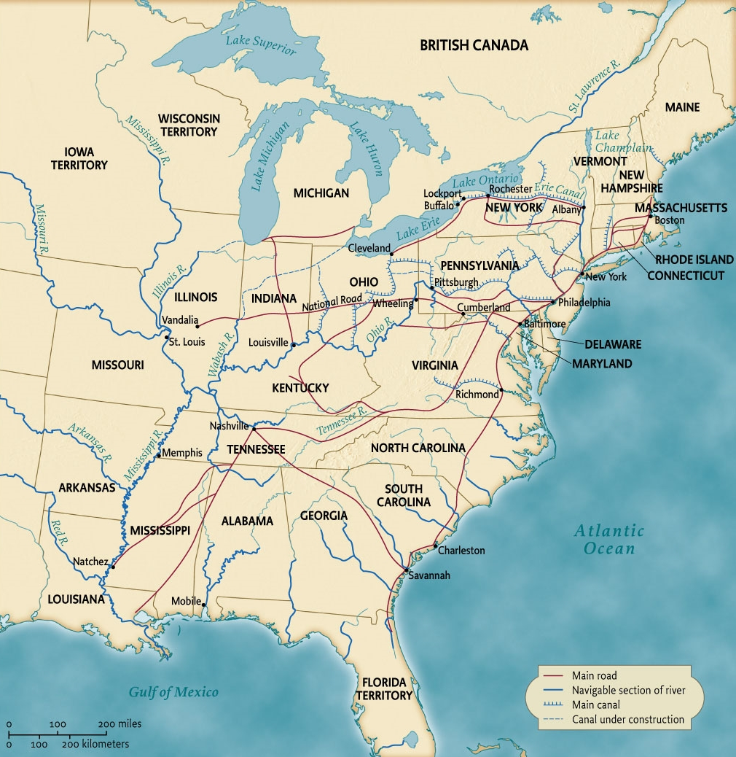
The Market Revolution: Roads and Canals, 1840
Map 9.1 The Market Revolution: Roads and Canals, 1840 Give Me Liberty!: An American History, 5th Edition
Copyright © 2017 W.W. Norton & Company
Notes:
The improvement of existing roads and building of new roads and canals sharply reduced transportation times and costs and stimulated the growth of the market economy.

Slide 8
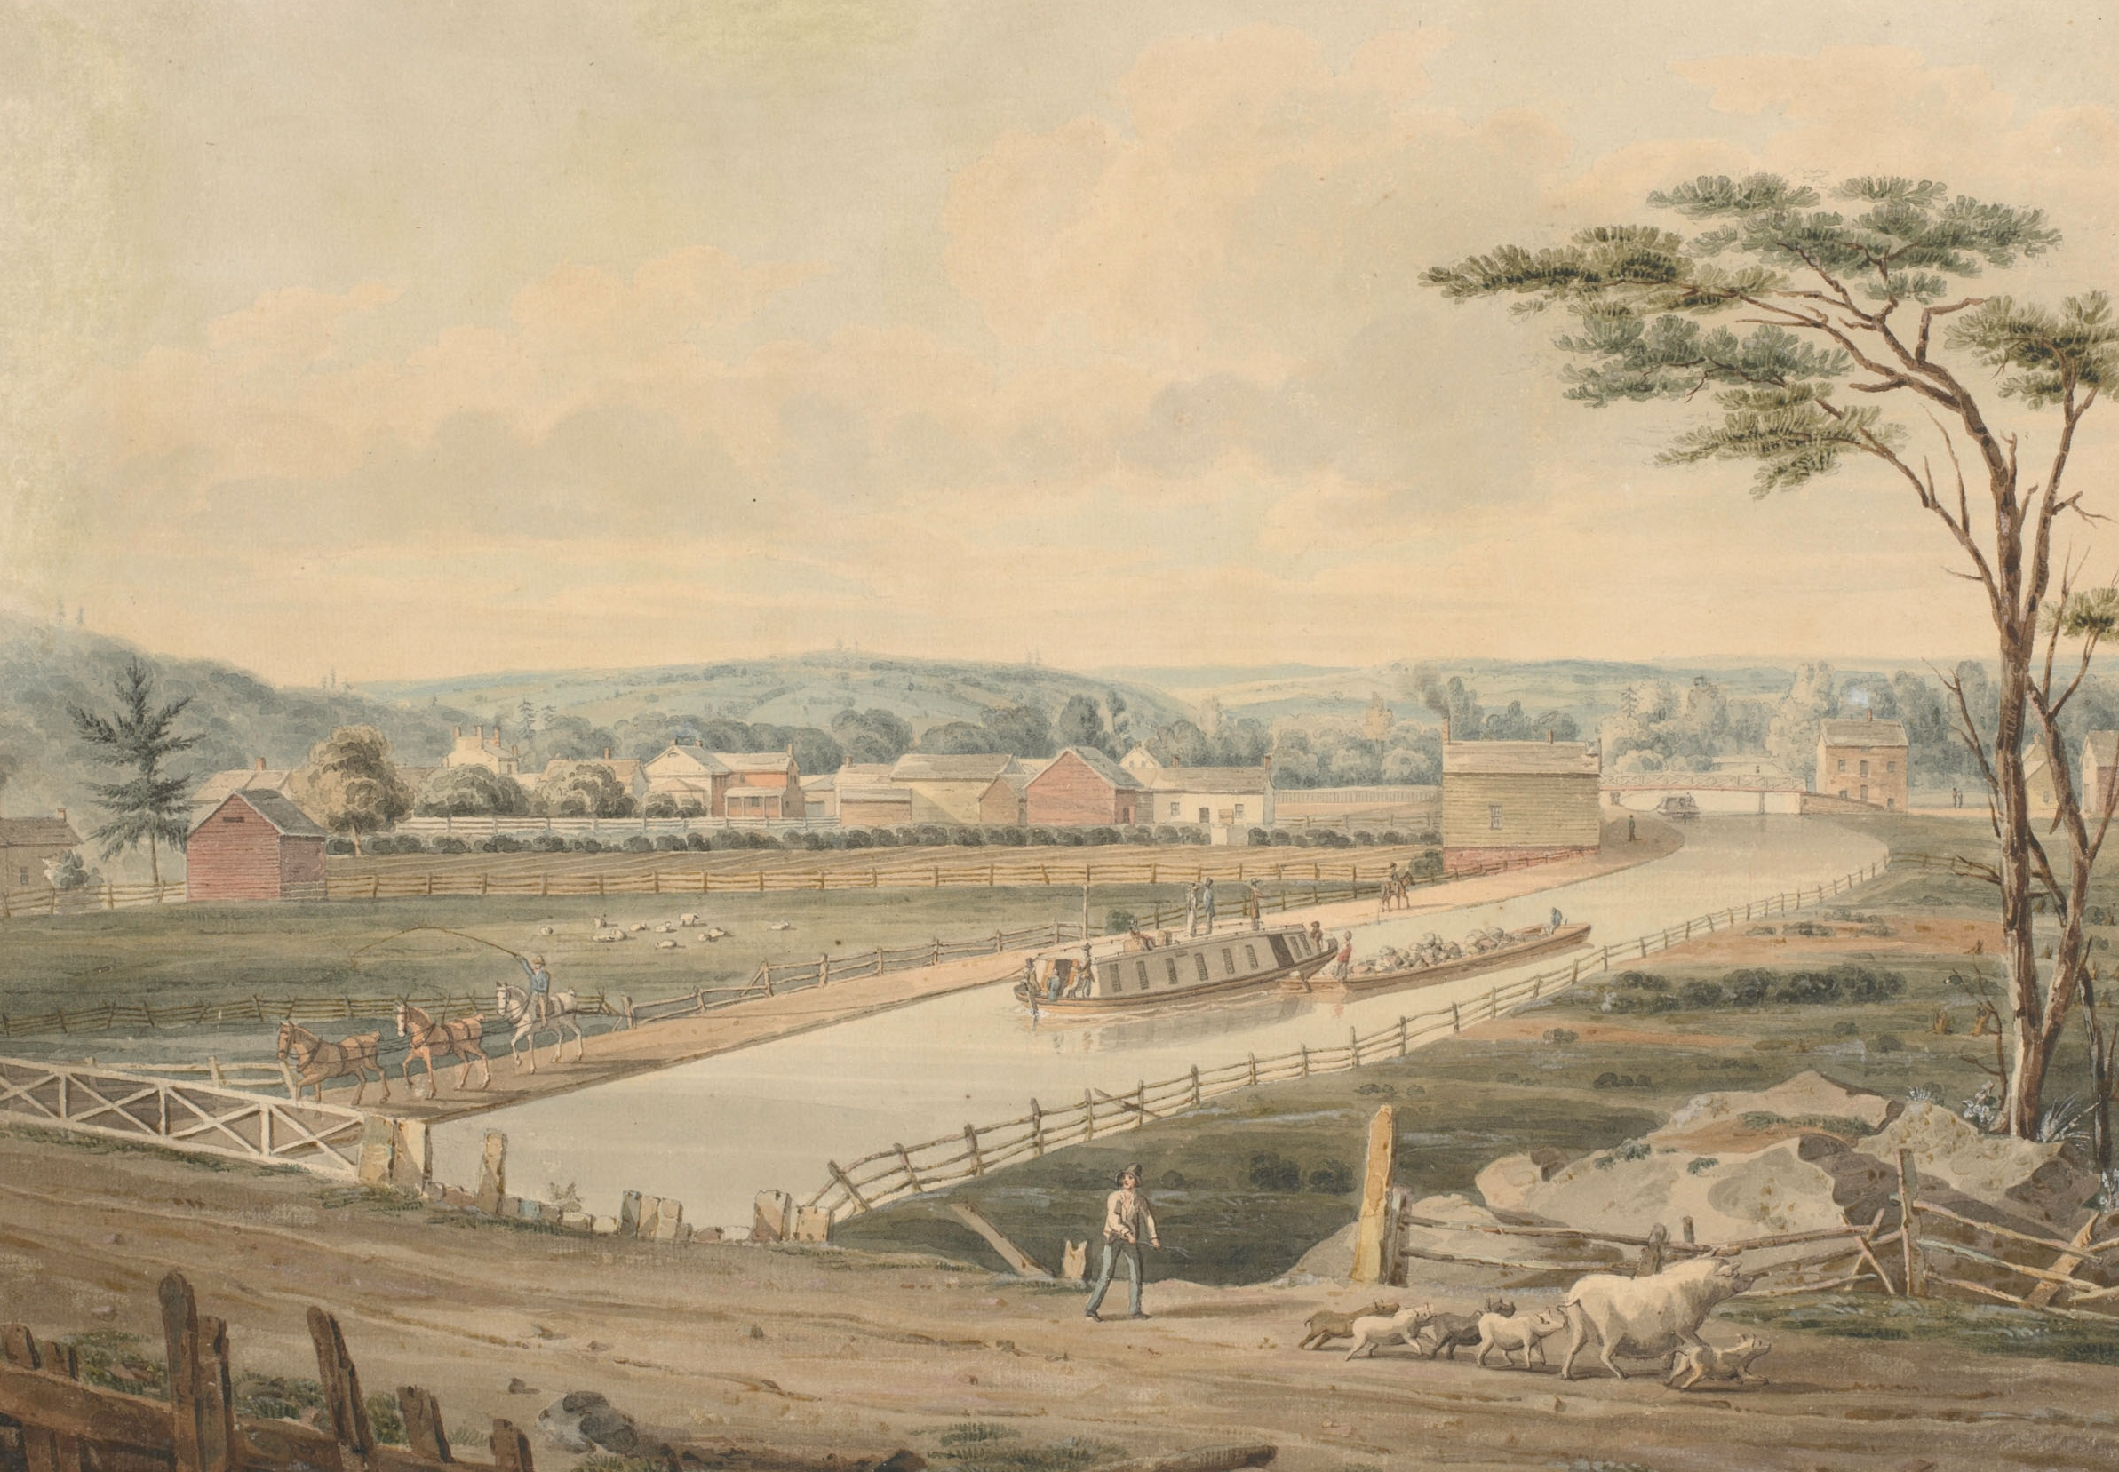
The Erie Canal
A watercolor depicting the Erie Canal, by John William Hill, 1829 Give Me Liberty!: An American History, 5th Edition
Copyright © 2017 W.W. Norton & Company
Notes:
A watercolor from 1829 by John William Hill depicts the Erie Canal five years after it opened. Boats carrying passengers and goods traverse the waterway, along whose banks farms and villages have sprung up.

Slide 9
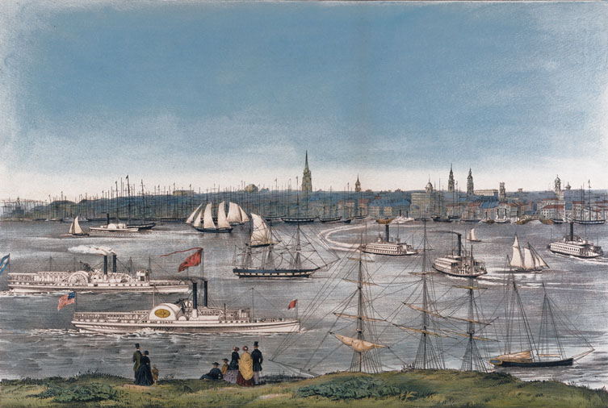
Steam and Sail in New York Harbor
A view of the harbor at New York City, by Nathaniel Currier, 1849 Give Me Liberty!: An American History, 5th Edition
Copyright © 2017 W.W. Norton & Company
Notes:
A view of New York City, in 1849, by the noted lithographer Nathaniel Currier
Steamships and sailing vessels of various sizes crowd the harbor of the nation’s largest city and busiest port.

Slide 10
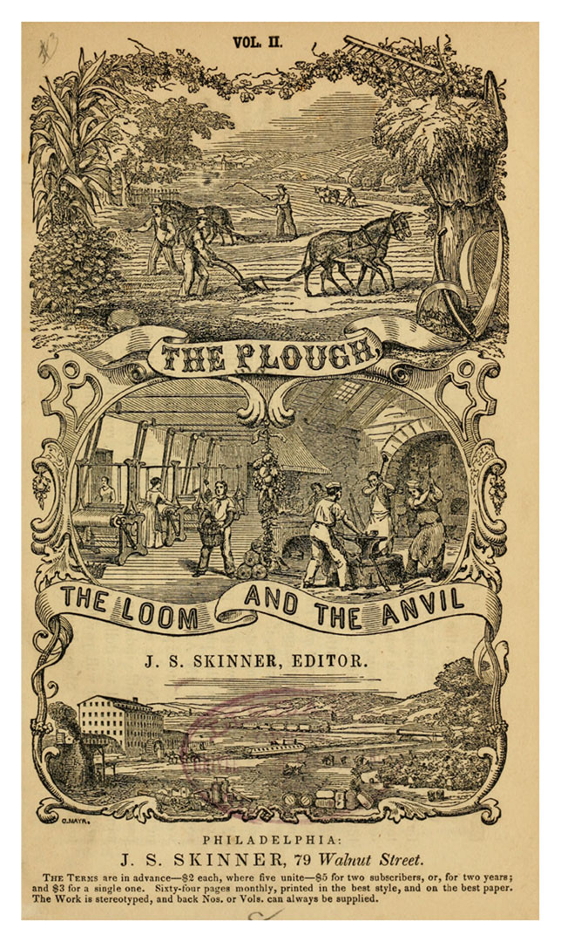
Integrated and Diverse Market Economy
Cover of a periodical depicts the integrated and diverse market economy Give Me Liberty!: An American History, 5th Edition
Copyright © 2017 W.W. Norton & Company
Notes:
The cover of a periodical published in Philadelphia depicts the integrated, diversified economy promoted by the market revolution. The top two images depict farmers, factory workers, and craftsmen; at the bottom, a canal boat and a railroad illustrate how goods are transported.

Slide 11
Transportation and Communication
Railroads and the Telegraph
Notes:
While canals connected only existing waterways, railroads opened vast new areas of the interior, while stimulating coal mining, for fuel, and iron manufacturing, for locomotives and rail. Work on the first railroad, the Baltimore and Ohio, began in 1828. By 1860, the nation’s rail network was 30,000 miles long, more than the total in the rest of the world combined. At the same time, the invention of the telegraph in the 1830s by Samuel F. B. Morse allowed for instantaneous communication. First used commercially in 1844, the telegraph served businesses and newspapers by helping to speed the flow of information and bringing uniformity to prices, and would eventually serve as communication for individuals.

Slide 12
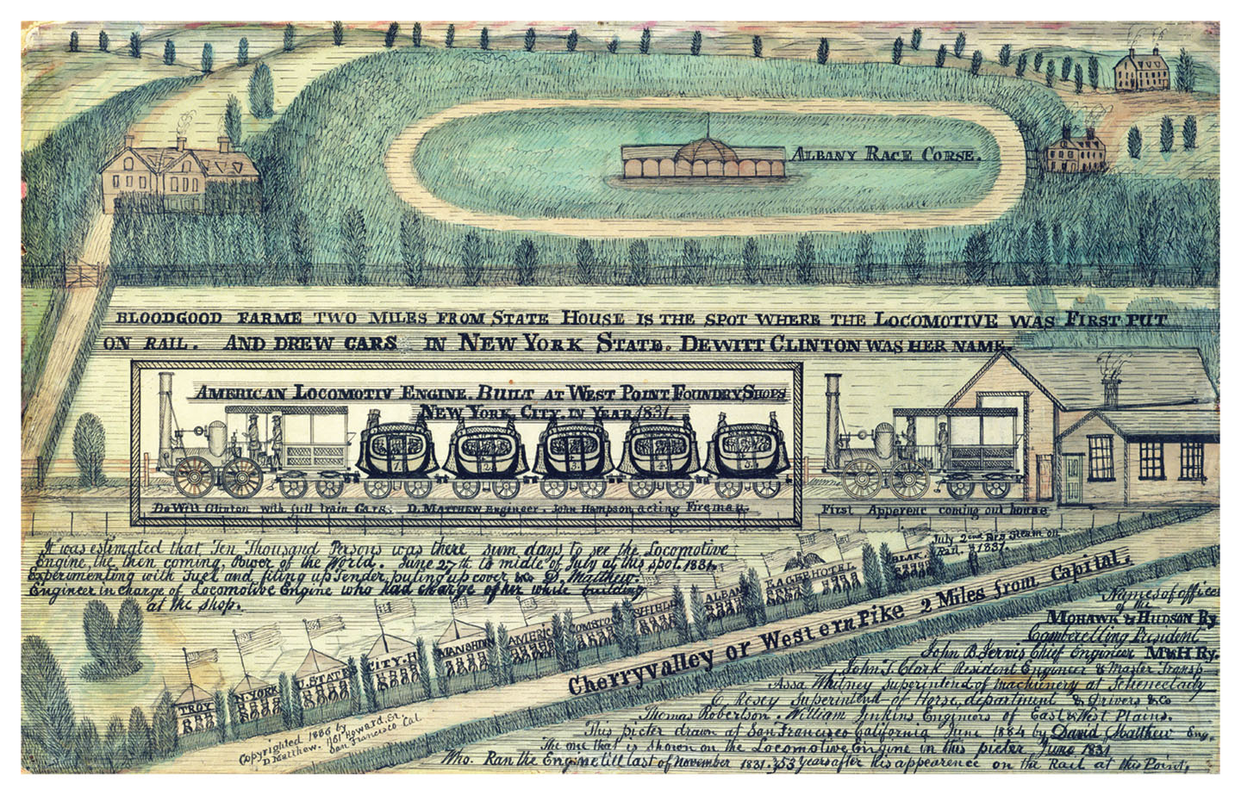
Locomotive DeWitt Clinton
Locomotive DeWitt Clinton, 1884, recalling the early days of rail and canal travel Give Me Liberty!: An American History, 5th Edition
Copyright © 2017 W.W. Norton & Company
Notes:
An 1884 watercolor, Locomotive DeWitt Clinton, recalls the early days of rail travel, and also depicts modes of transportation on canal and river. The train is driven by a steam-powered locomotive and the cars strongly resemble horse-drawn stagecoaches.

Slide 13
Borderlands West
The Rise of the West
An Internal Borderland
Notes:
Transportation and communication improvements fostered the growth of the West as a new region. Between 1790 and 1840, around 4.5 million people crossed the Appalachian Mountains—much of it after the War of 1812, when land-hungry easterners moved west. Between 1815 and 1821, Indiana, Illinois, Missouri, Alabama, Mississippi, and Maine became states. Three different streams of settlers moved West: small farmers and planters with slaves in the South, who created the Cotton Kingdom of Alabama, Mississippi, Louisiana, and Arkansas; farm families from the Upper South who moved to southern Ohio, Indiana, and Illinois; and New Englanders who moved across New York to northern Ohio, Indiana, Illinois, Michigan, and Wisconsin. National boundaries did not prevent American settlement. In Florida, and later in Texas and Oregon, American settlers claimed land ruled by foreign countries (Spain, Mexico, and Britain) or Indian tribes. They were confident that American sovereignty would follow. American settlers and military incursions, some led by Andrew Jackson, led to the acquisition of Spanish Florida by 1819 in the Adams-Onís Treaty. By 1840, 7 million Americans—about two-fifths of the total population—lived west of the Appalachian Mountains. Furthermore, the careers of the era’s leading public figures reflected the westward movement, with Andrew Jackson, Henry Clay, and others having been born in Atlantic coast states, but making their mark in politics after moving west.
Before the War of 1812, the Old Northwest was a prime example of a borderland with American Indian, French, English, and American cultures meeting along unstable boundaries. The American victory over the British and Indians established United States dominance, but a new borderland developed. The Northwest Ordinance of 1787 prohibited slavery in the Old Northwest, making the Ohio River the boundary between free and slave societies, but for many years it was easier for people and goods to travel between slave-state Kentucky and southern Ohio, Indiana, and Illinois than it was for movement between the area and the northern parts of these states. The southern portions of these states came to have more in common with Kentucky and Tennessee than the northern counties of their own territory. New Englanders settled in the northern parts of the states, while southerners who shipped their goods southward rather than northward or eastward settled in the southern portions of the states. The concentration of southerners made Illinois and Indiana key political battlegrounds during the emerging slavery controversy.

Slide 14
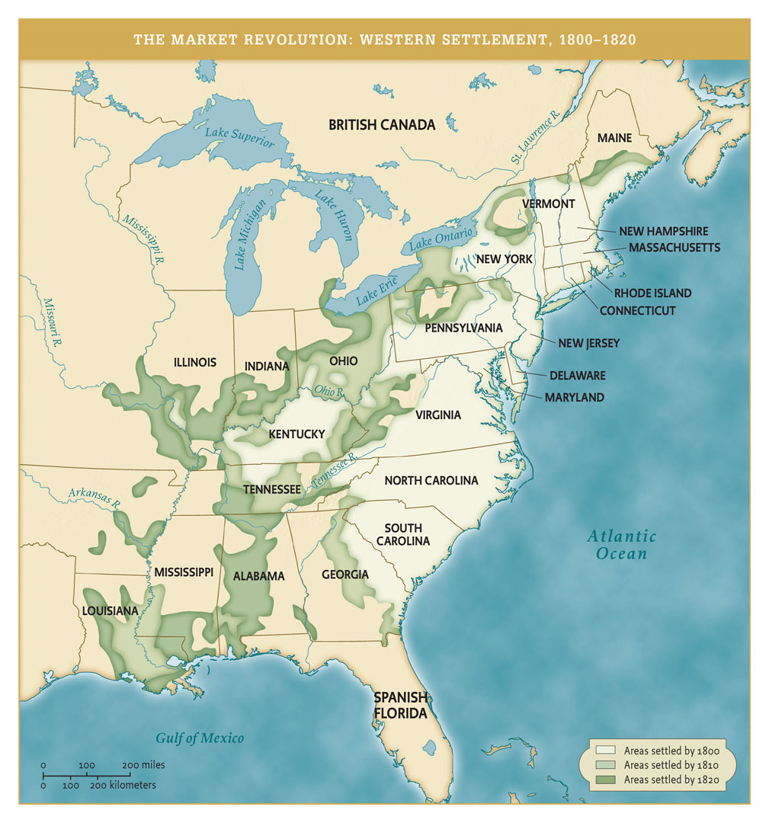
The Market Revolution: Western Settlement, 1800 to 1820
The Market Revolution: Western Settlement, 1800–1820 Give Me Liberty!: An American History, 5th Edition
Copyright © 2017 W.W. Norton & Company
Notes:
In the first two decades of the nineteenth century, the westward movement of the population brought settlement to and across the Mississippi River. Before canals―and later, railroads―opened previously landlocked areas to commercial farming, settlement was concentrated near rivers.

Slide 15
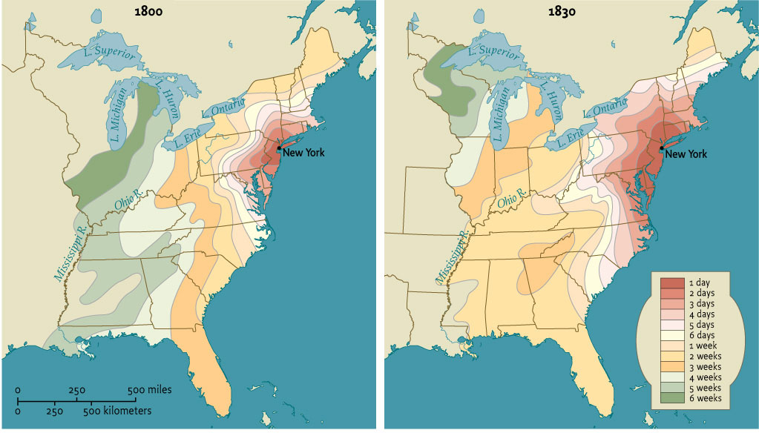
Travel Times from New York City in 1800 and 1830
Map 9.3 Travel times from New York City in 1800 and 1830 Give Me Liberty!: An American History, 5th Edition
Copyright © 2017 W.W. Norton & Company
Notes:
These maps illustrate how the transportation revolution of the early nineteenth century made possible much more rapid travel within the United States.

Slide 16
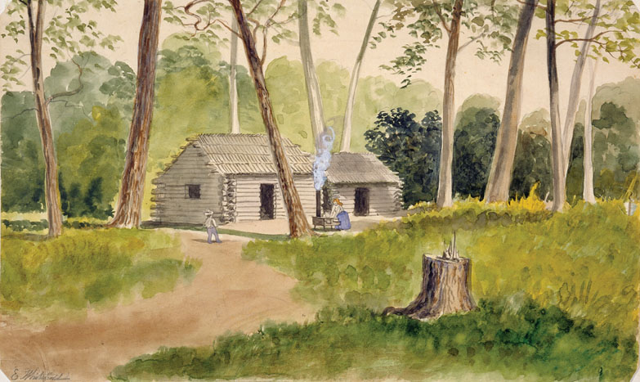
Cabin in the Minnesota Woods
A watercolor by the artist Edwin Whitefield depicts a squatter’s Give Me Liberty!: An American History, 5th Edition
cabin in the Minnesota woods. Copyright © 2017 W.W. Norton & Company
Notes:
A watercolor by the artist Edwin Whitefield depicts a squatter’s cabin in the Minnesota woods.

Slide 17
Cotton
The Cotton Kingdom
The Unfree Westward Movement
Notes:
The market revolution and westward expansion occurred simultaneously in the North and South, heightening section divisions. In some ways, the most dynamic feature of the American economy in the first thirty years of the nineteenth century was the rise of the Cotton Kingdom. The early industrial revolution began in England, and spread to the North, where it centered on textile factories that demanded huge amounts of cotton, a crop for which the Deep South was particularly suited. In 1793, Eli Whitney invented the cotton gin for separating seeds from the fibers, a particularly laborious process that slowed the marketing of cotton; now the crop could be produced and marketed on a much larger scale. Coupled with rising demand for cotton and newly opened land in the west, the cotton gin revolutionized American slavery. Expected to die out because tobacco exhausted the soil, slavery instead expanded with cotton plantations spreading into the South Carolina upcountry. South Carolina reopened the African slave trade between 1803 and 1808 before Congress banned it in 1808 (the earliest date allowed by the Constitution), after which a massive internal trade developed. After the War of 1812, the United States consolidated control over the Deep South and acquired Florida forcing Indians to cede lands for white settlement, and thus, the expansion of cotton production and slavery.
Historians estimate that around one million slaves were shifted from older slave states to the newly opened Deep South between 1800 and 1860. While some were transferred to new plantations acquired by their owners, most were sold at auction into a well-organized business that gathered slaves in Maryland, Virginia, and South Carolina to be shipped to markets in Mobile, Natchez, and New Orleans. Slave coffles, or the forced marching to the Deep South of chained groups of slaves, became a common occurrence. Westward expansion meant increased freedom for whites, and significantly decreased freedom for African-Americans, as families and communities were torn apart to fuel the internal slave trade. In 1793, the United States produced five million pounds of cotton, a number that would grow to 170 million by 1820; most of the growth was based on slave plantation production.

Slide 18
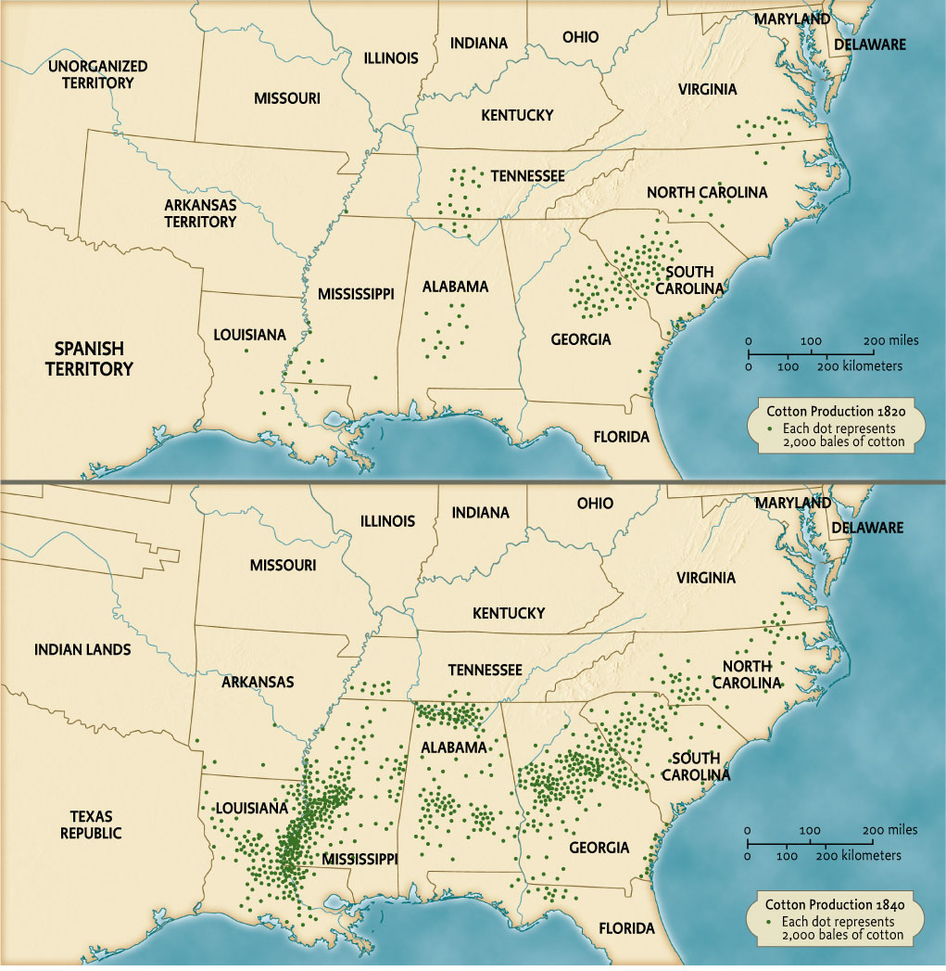
The Market Revolution: The Spread of Cotton Cultivation, 1820 to 1840
Map 9.4 The market revolution: the spread of cotton cultivation, 1820–1840 Give Me Liberty!: An American History, 5th Edition
Copyright © 2017 W.W. Norton & Company
Notes:
Maps of cotton production graphically illustrate the rise of the Cotton Kingdom stretching from South Carolina to Louisiana.

Slide 19
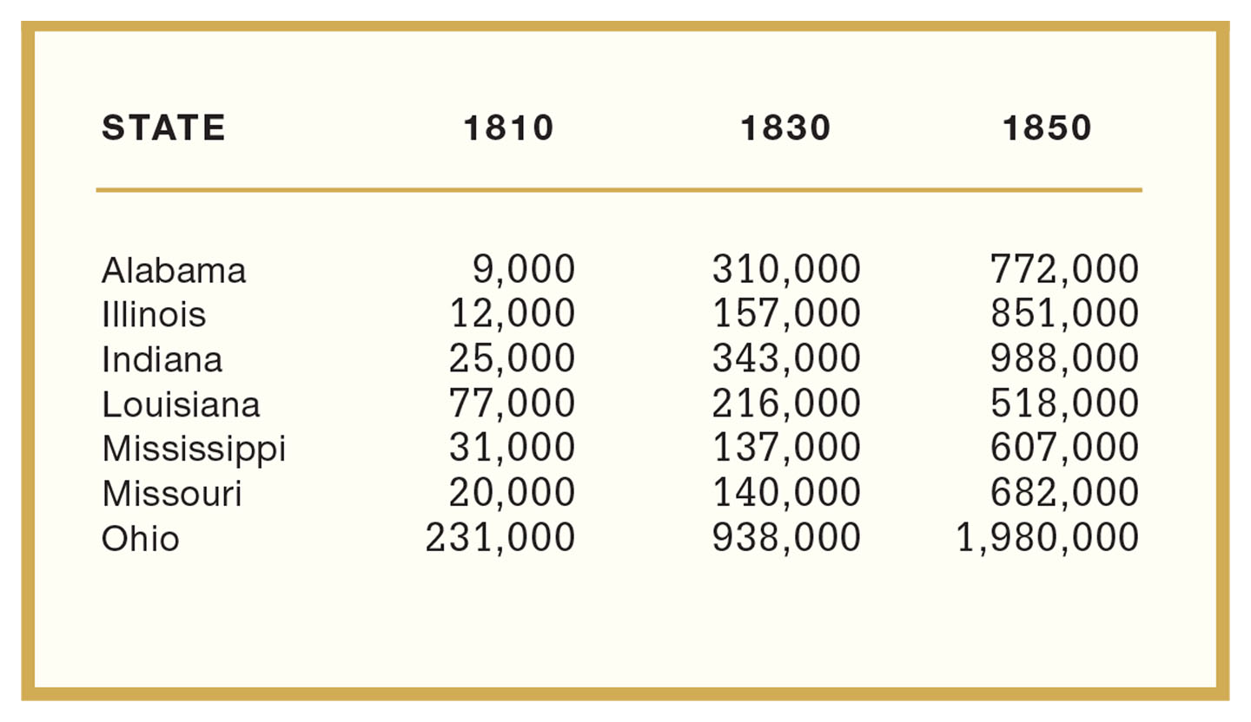
Population Growth of Selected Western States, 1800 to 1850 (Excluding Indians)
Table 9.1 Population Growth of Selected Western States, 1800–1850 (Excluding Indians) Give Me Liberty!: An American History, 5th Edition
Copyright © 2017 W.W. Norton & Company

Slide 20
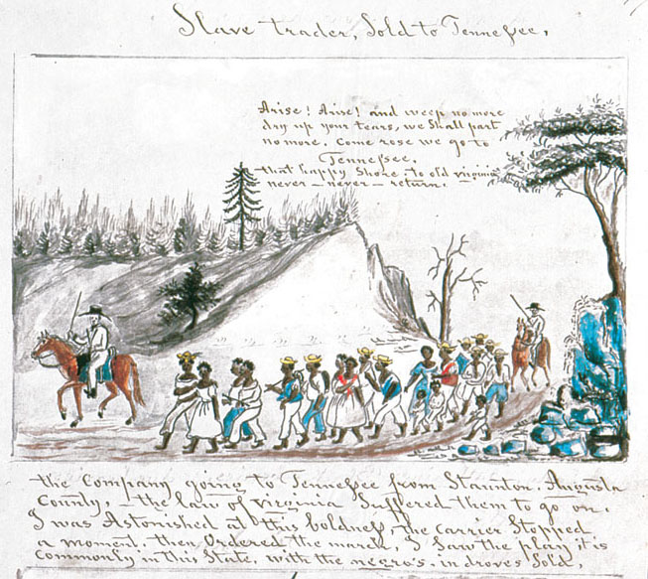
Slave Trader, Sold to Tennessee
Slave Trader, Sold to Tennessee, by Lewis Miller, mid-1850s Give Me Liberty!: An American History, 5th Edition
Copyright © 2017 W.W. Norton & Company
Notes:
Slave Trader, Sold to Tennessee, a watercolor sketch by the artist Lewis Miller from the mid-1850s. Miller depicts a group of slaves being marched from Virginia to Tennessee. Once Congress voted to prohibit the further importation of slaves into the country, slaveowners in newly opened areas of the country had to obtain slaves from other parts of the United States.

Slide 21
Focus Question: Market Society
  Focus Question:
  How did the market revolution spark social change?
Notes:
The purpose of the focus questions is to help students find larger themes and structures to bring the historical evidence, events, and examples together for a connected thematic purpose.
As we go through each portion of this lecture, you may want to keep in mind how the information relates to this larger thematic question. Here are some suggestions: write the focus question in the left or right margin on your notes and as we go through, either mark areas of your notes for you to come back to later and think about the connection, OR as you review your notes later (to fill in anything else you remember from the lecture or your thoughts during the lecture or additional information from the readings), write small phrases from the lecture and readings that connect that information to each focus question AND/OR are examples that work together to answer the focus question.

Slide 22
Farmers and Market Society
Commercial Farmers
Notes:
Even though cotton agriculture in some sense commercialized the South, it did not create a dynamic and diversified economy. Cotton plantation slavery simply spread the agrarian, slave-based social order of the eastern states westward. The Cotton Kingdom remained rural, and the South’s transportation and banking systems were underdeveloped arms of the plantation economy. Manufacturing and technological development lagged there, compared to the North.
The market revolution transformed the North into an integrated economy of commercial farms and manufacturing cities. The pioneer stage of moving westward reinforced farmer’s self-sufficiency because the tasks of settlement left little time for market-based agriculture; once the Old Northwest became more settled, however, farmers were drawn into the market economy linked to eastern centers of commerce and banking by increasingly developed transportation networks. Goods previously produced at home were now more often bought in stores, and more concentration was placed on producing crops and livestock for market rather than subsistence. The cities of the East became a market and source of credit for western farmers. Banks and insurance companies financed land acquisition, supplies, and in the 1840s/1850s, new types of mechanized equipment. The steel plow invented by John Deere in 1837 made it possible to rapidly cultivate large areas of western prairie land. Cyrus McCormick invented the reaper in 1831, which allowed for a large increase in the amount of wheat a farmer could harvest; thousands were in use by the Civil War, and from 1840 to 1860, the country’s wheat output tripled. Unlike cotton, the crop was primarily consumed in the United States, much of it sold to eastern farmers who transferred their efforts to dairy, fruit, and vegetable production for nearby urban centers.

Slide 23
Urban Expansion
The Growth of Cities
Notes:
Cities were part of the West from its beginning. Cities that stood at the intersection of interregional trade―such as Cincinnati, a center of pig slaughterhouses, and St. Louis―grew enormously and quickly. Chicago was the West’s greatest city. Thanks to the railroad and its location on the Great Lakes, Chicago by 1860 was the fourth-largest city in the nation, serving as a center where western farm products were collected and shipped east. Urban centers in the West and East experienced great changes wrought by the market revolution. The number of people in cities increased dramatically. Urban merchants, bankers, and master craftsmen exploited the expanding market among commercial farmers. Their efforts to increase production and reduce labor costs transformed work. Skilled artisans who once made an entire product at home, where they controlled their own work, were now gathered in large workshops, where entrepreneurs supervised them, subdivided their tasks, and paid them a wage to perform only one process in production. These workers faced relentless pressure from employers to make more goods faster, at lower wages, and under intense supervision.

Slide 24
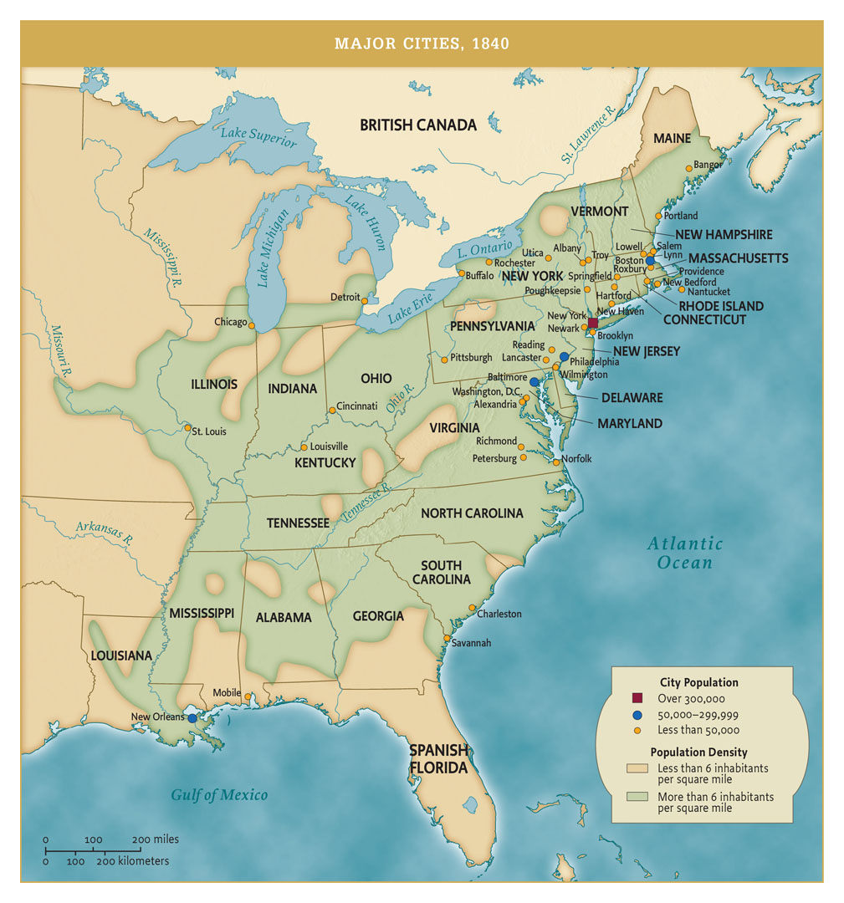
Major Cities, 1840
Major Cities, 1840 Give Me Liberty!: An American History, 5th Edition
Copyright © 2017 W.W. Norton & Company
Notes:
Although the United States was still predominantly agricultural, by 1840 major cities had arisen in the northern and northwestern states. The South lagged far behind in urban growth. Most cities were located on navigable waterways―either the Atlantic coast or inland rivers―or on rivers that provided water power for early factories.

Slide 25
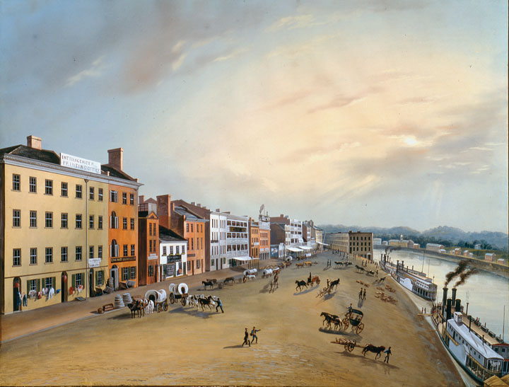
Cincinnati, 1835
Cincinnati, the self-styled Queen City of the West, 1835. Give Me Liberty!: An American History, 5th Edition
Copyright © 2017 W.W. Norton & Company
Notes:
A painting of Cincinnati, self-styled Queen City of the West, from 1835; steamboats line the Ohio River waterfront.

Slide 26
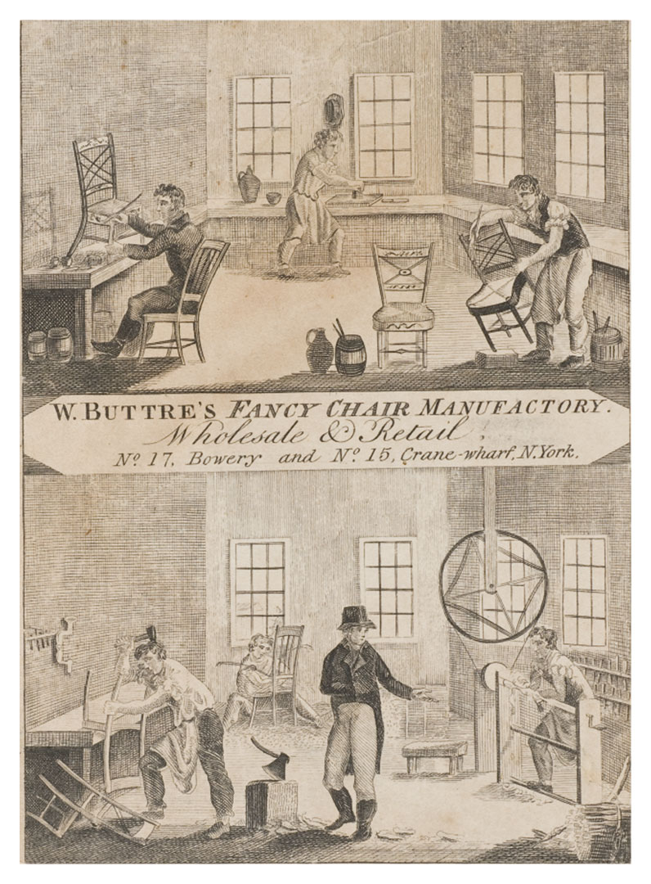
Workshop in New York City
Chair-manufacturing workshop in New York City Give Me Liberty!: An American History, 5th Edition
Copyright © 2017 W.W. Norton & Company
Notes:
A trade card depicts the interior of a chair-manufacturing workshop in New York City. The owner stands at the center, dressed quite differently from his employees. The men are using traditional hand tools; furniture manufacturing had not yet been mechanized.

Slide 27
Industrial Expansion
The Factory System
The Industrial Worker
Notes:
In some industries, particularly textiles, factories entirely replaced traditional craft production. Factories gathered large groups of workers under central supervision and replaced hand tools with power-driven machinery. The first factory in America was established in 1790 at Pawtucket, Rhode Island, by Samuel Slater, an English immigrant, who built from memory a spinning jenny in order to evade laws making it illegal to export plans for industrial machines. These early spinning factories produced yarn which, through the “outwork” system, was sent out to rural farm families, who wove it into cloth. The same outwork system characterized early shoe production, in which parts were sent out to families, who assembled them and gave them back to merchants, who sold the shoes. But shoemaking and textiles were eventually brought under one factory roof. The first large American factory that used power looms to weave cotton cloth was built in Waltham, Massachusetts, in 1814. Beginning in the 1820s, other manufacturers established factories in Lowell and other small towns, creating small industrial towns and cities across New England. The first factories, powered by waterfalls and river rapids, were matched by the 1840s by factories using steam power, which could be located anywhere. In 1850, factories made not just textiles and shoes but a wide variety of goods, including tools, firearms, clocks, and agricultural machinery. The “American system of manufactures” relied on the mass production of interchangeable parts that could be quickly assembled into standardized finished products. This was first practiced and perfected in clock production by Eli Terry of Connecticut, and small arms production by Eli Whitney. An impressive array of mechanical skills was dispersed across northern society with towns often having sawmills, paper mills, iron works, shoemakers, hat makers, tailors, and various other small enterprises. The early industrial revolution was largely confined to New England and a few cities outside it. The South, with its slaveholding class generally opposed to industrialization, lagged far behind in factory production and the development of an internal market. Outside New England, most work was still carried on in small, unmechanized workshops.
The market revolution changed Americans’ conception of time itself. Farming still relied on seasonal rhythms, but in cities, clocks became a part of daily life with work and leisure time clearly separated from one another. During the colonial era, bouts of intensive work were alternated with periods of leisure, but the market revolution brought work schedules based on production for specified hours per day. Worker’s pay became increasingly separated from the product itself and based on a daily or hourly wage. Railroads also operated on a set schedule making Americans more conscious of life on “clock time.” Few native-born men were attracted to factory employment because they viewed closely supervised work for a set time as a violation of the independence that defined their ideas of American freedom; employers turned to those who lacked other ways of earning a living.

Slide 28
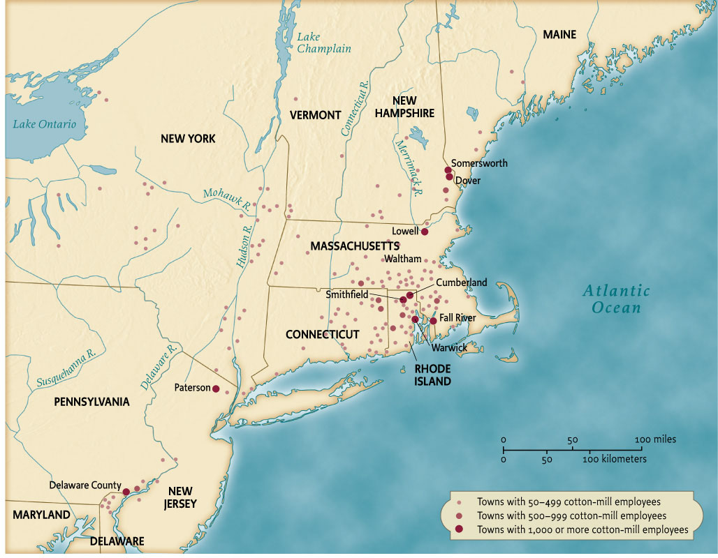
Cotton Mills, 1820s
Map 9.6 Cotton Mills, 1820s Give Me Liberty!: An American History, 5th Edition
Copyright © 2017 W.W. Norton & Company
Notes:
The early industrial revolution was concentrated in New England, where factories producing textiles from raw cotton sprang up along the region’s many rivers, taking advantage of water power to drive their machinery.

Slide 29
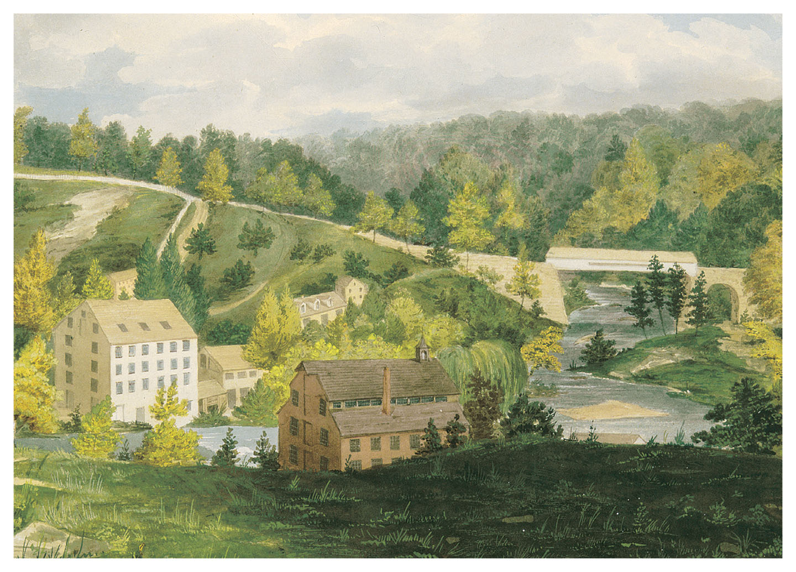
Mill on the Brandywine
Mill on the Brandywine, 1830 Give Me Liberty!: An American History, 5th Edition
Copyright © 2017 W.W. Norton & Company
Notes:
Mill on the Brandywine, an 1830 watercolor of a Pennsylvania paper mill
Because it relied on water power, much early manufacturing took place in the countryside.

Slide 30
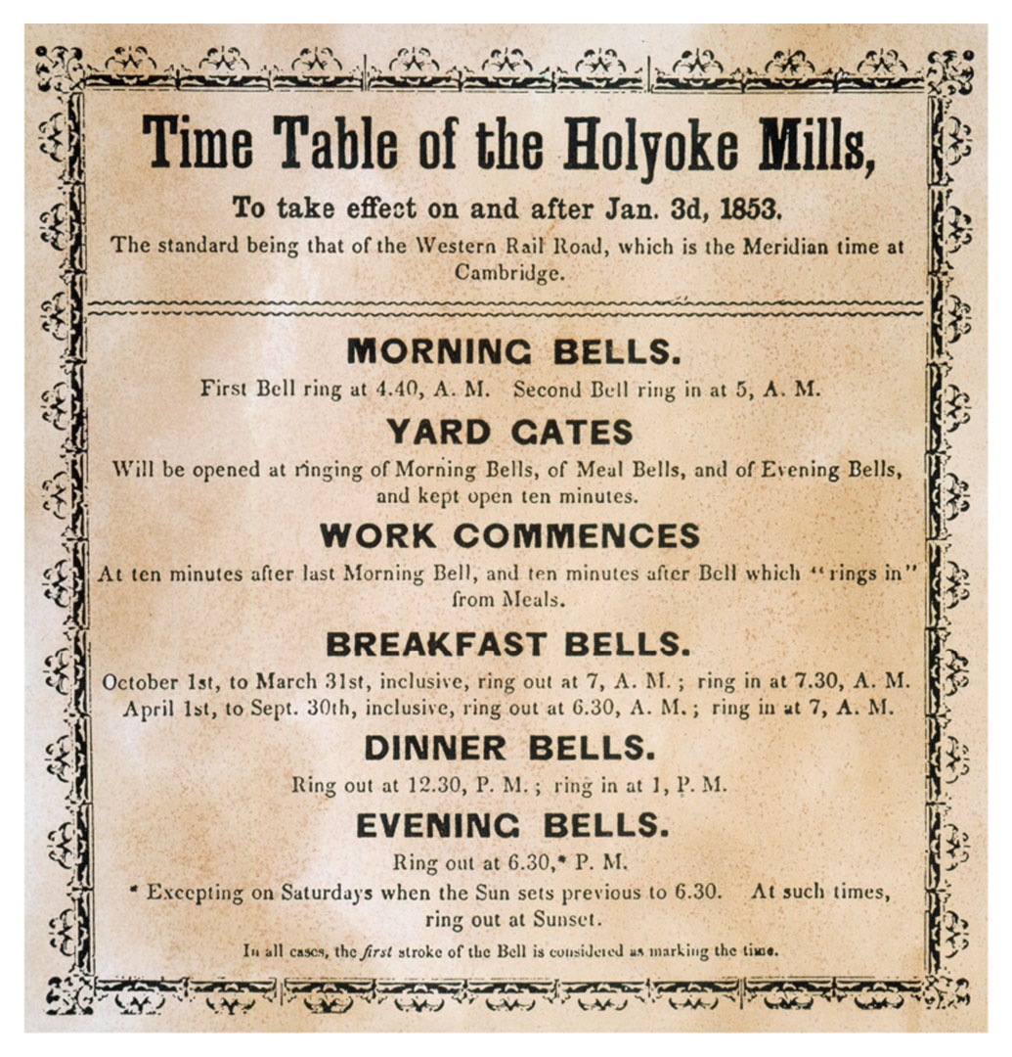
Textile Mills of Holyoke, Massachusetts
An 1853 broadside illustrates the timetable of the textile mills of Holyoke, Massachusetts. Give Me Liberty!: An American History, 5th Edition
Copyright © 2017 W.W. Norton & Company
Notes:
A broadside from 1853 illustrates the long hours of work (from 5 AM to 6:30 PM with brief breaks for meals) in the textile mills of Holyoke, Massachusetts. Factory labor was strictly regulated by the clock.

Slide 31
Women and Industry
The “Mill Girls”
Notes:
Most early New England factories first used female and child labor. In Lowell, the best-known center of early textile manufacturing, employers built an entire town with churches, lecture halls, and boarding halls, in order to convince farm families to allow their daughters to leave home for work. Though the constant supervision was highly restrictive, this was the first time that women were sent into the public world in large numbers, and most valued the opportunity to earn money at a time when few other jobs were open to women. The “mill girls” were a transient labor force, since most sought to marry after only a few years of factory work. By the 1840s and 1850s, immigrant labor eased the shortage of industrial workers when large-scale immigration from various regions of Europe began.

Slide 32
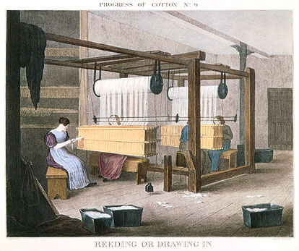
Women at Work
Women at work tending machines in the Lowell textile mills. Give Me Liberty!: An American History, 5th Edition
Copyright © 2017 W.W. Norton & Company
Notes:
Women at work tending machines in the Lowell textile mills.

Slide 33
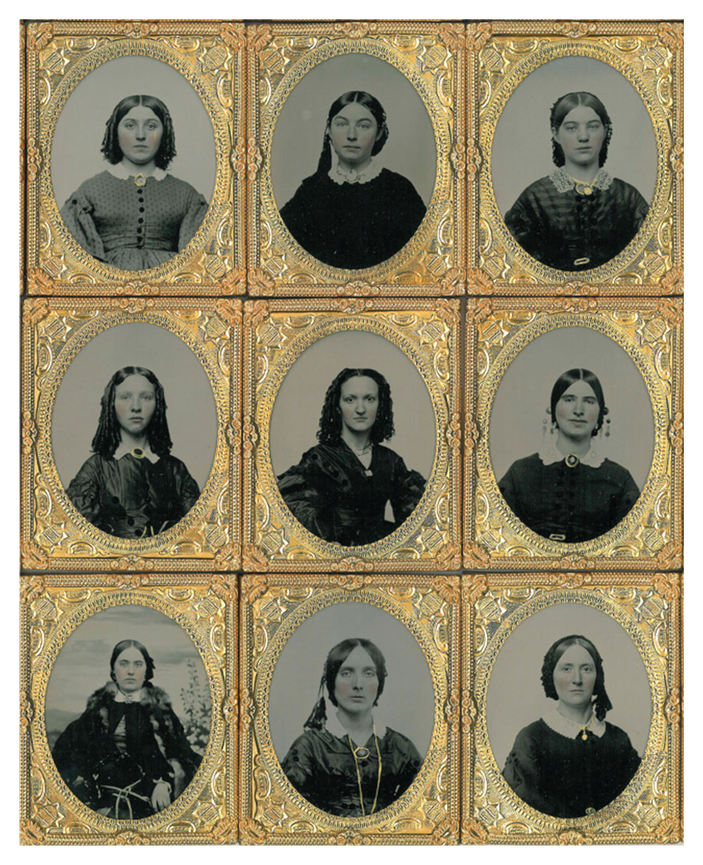
Amoskeag Textile Workers
Young women employed at the Amoskeag textile mills, 1854. Give Me Liberty!: An American History, 5th Edition
Copyright © 2017 W.W. Norton & Company
Notes:
Young women workers from the Amoskeag textile mills in Manchester, New Hampshire, photographed in 1854.

Slide 34
Immigration
The Growth of Immigration
Irish and German Newcomers
Notes:
Economic growth fueled a demand for labor, which was partly filled by immigrants. Immigration swelled between 1840 and 1860, when over 4 million people came to the United States, mostly from Ireland and Germany. Modernization of agriculture, the industrial revolution, and steamship and rail transportation spurred many of these migrants to America. Most went to the North, where jobs were plentiful and they would not face competition from slave labor. Very few immigrants went to southern states, except for peripheral cities such as New Orleans, St. Louis, or Baltimore, but immigrants in both northern cities and rural areas were quite visible. The introduction of the oceangoing steamship made Atlantic crossings much cheaper, thus accelerating emigration from Europe to the United States, Canada, and Australia; frequently, the first emigrant of a family to go was a male member, who would work and send back money for the remainder of the family to follow.
America offered political and religious freedom to Europeans living under repressive governments and rigid social hierarchies. But the largest number of immigrants fled catastrophe—the Irish men and women who escaped from the Great Famine of 1845–1851, when a potato blight starved 1 million Irish to death and caused another million to migrate, mostly to America. These migrants, having worked mostly in agricultural labor, moved into unskilled or low-skilled jobs—men into common labor, rail and canal construction, longshore and factory work, and women into domestic service. The Germans were the second-largest group of immigrants, and tended to include more skilled workers, such as artisans, craftsmen, and shopkeepers, and formed tight-knit immigrant communities in the East and West. Additionally, some 40,000 Scandinavians emigrated to the United States, mostly settling on farms in the Old Northwest. Industrial expansion and the failed Chartist movement of the 1840s inspired many English workers to emigrate as well.

Slide 35
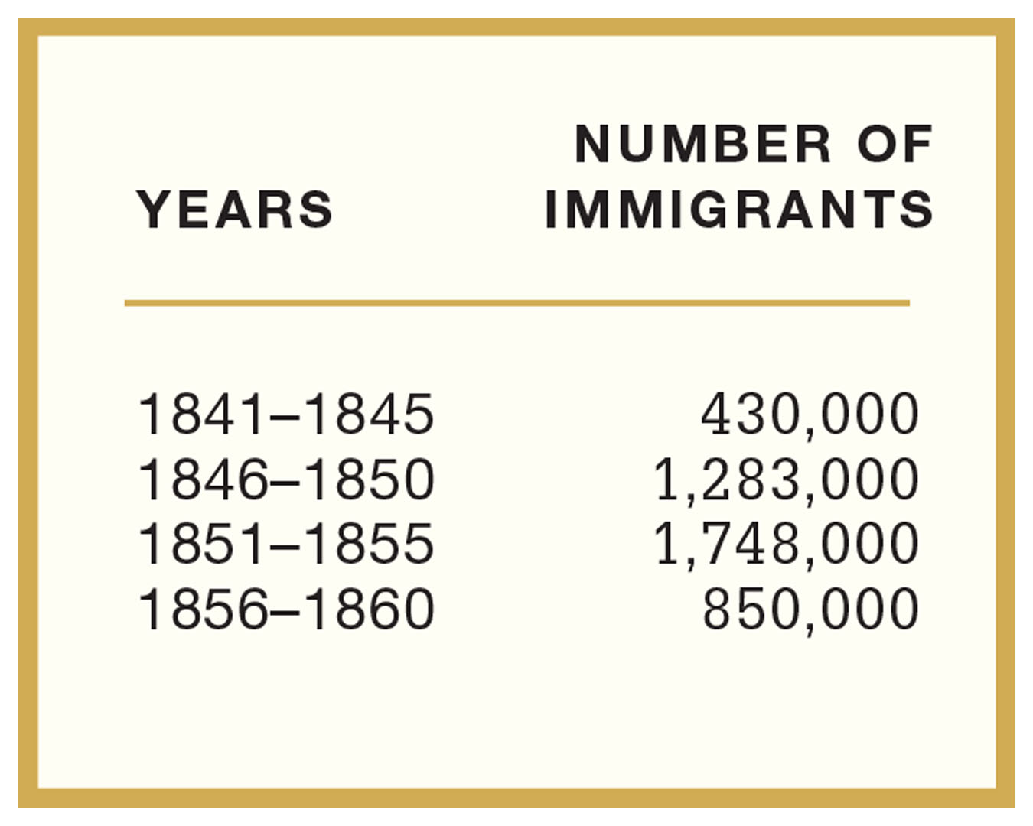
Total Number of Immigrants by Five-Year Period
Table 9.2 Total Number of Immigrants by Five-Year Period Give Me Liberty!: An American History, 5th Edition
Copyright © 2017 W.W. Norton & Company

Slide 36
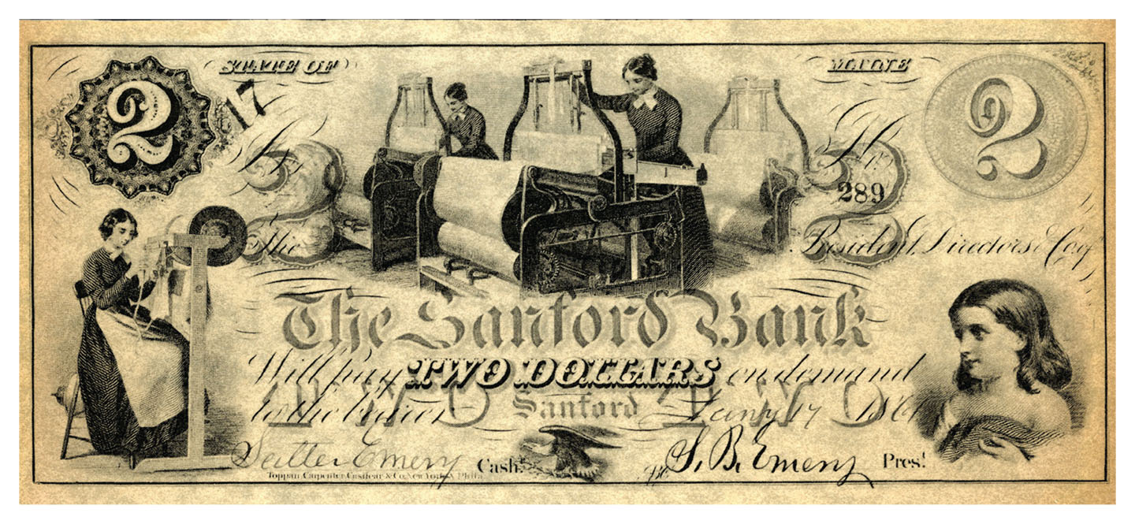
Locally Issued Currency
Currency issued by a bank in Sanford, Maine Give Me Liberty!: An American History, 5th Edition
Copyright © 2017 W.W. Norton & Company
Notes:
Currency issued by a bank in Sanford, Maine, is embellished with images of women textile workers, illustrating their centrality to the state’s economy. Before the Civil War, there was no national currency and banks issued their own paper money.

Slide 37
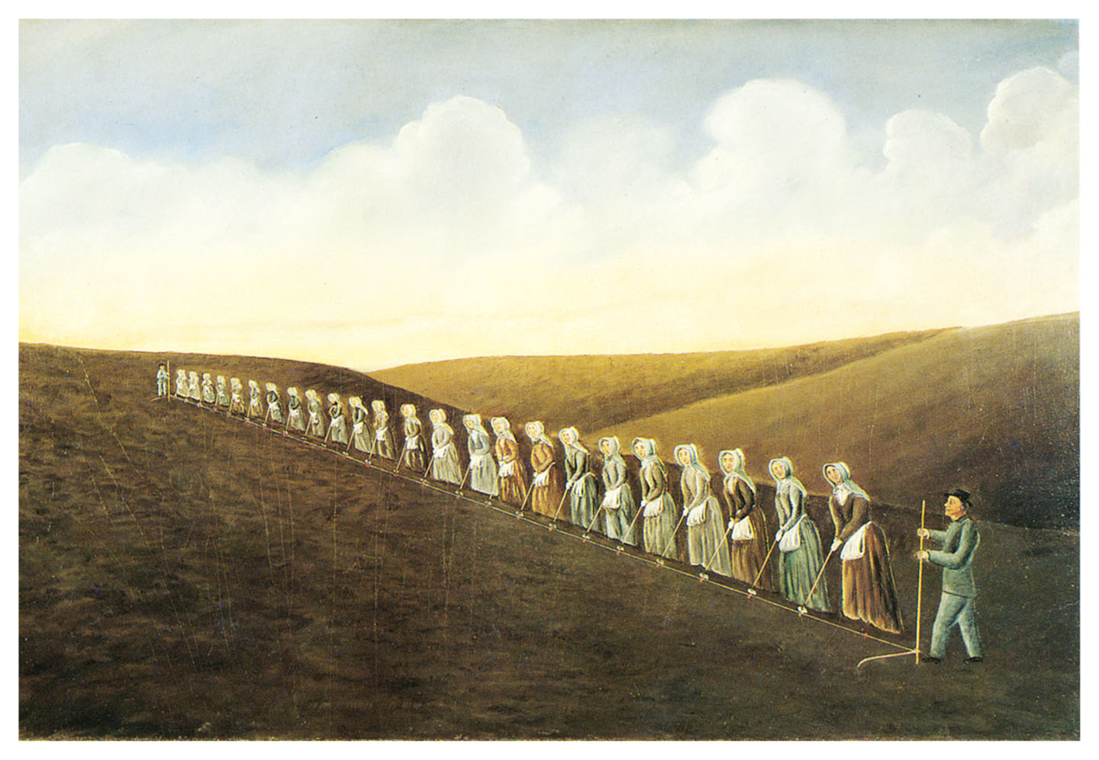
Bishop Hill, Illinois
Immigrant settlement of Bishop Hill, Illinois, by Olof Krans Give Me Liberty!: An American History, 5th Edition
Copyright © 2017 W.W. Norton & Company
Notes:
Although our image of the West emphasizes the lone pioneer, many migrants settled in tightly knit communities and worked cooperatively. This painting by Olof Krans, who came to the United States from Sweden with his family in 1850 at the age of twelve, shows a group of women preparing to plant corn at the immigrant settlement of Bishop Hill, Illinois.

Slide 38
Nativism
The Rise of Nativism
Notes:
While English immigrants were easily absorbed in American culture, the Irish faced bitter hostility. They were Roman Catholics in a mostly Protestant society with deep anti-Catholic traditions, and they increased the visibility and power of the Catholic Church. Irish immigrants in the 1840s and 1850s alarmed many native-born Americans; “nativists,” who feared the impact of immigration on American political and social life, blamed immigrants for crime, political corruption, heavy drinking, and job competition that undercut wages for native-born skilled workers. The Irish were rapidly integrated into the Democratic Party’s urban political machines, which dispensed jobs and poor relief to immigrants. Nativists applied similar stereotypes to the Irish that were directed against blacks, namely that the Irish in particular were a lazy, childlike, and irrational people unfamiliar with American ideas of liberty and subservient to the Catholic Church, thus threatening democratic institutions, social reform, and public education. Riots targeted immigrants and their institutions, and nativist politicians were elected in the 1840s and 1850s. Nativism did not become a national political movement until the 1850s, but a nativist mayor was elected in New York City in 1844.

Slide 39
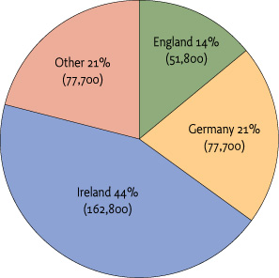
Sources of Immigration, 1850
Figure 9.1 Sources of Immigration, 1850 Give Me Liberty!: An American History, 5th Edition
Copyright © 2017 W.W. Norton & Company

Slide 40
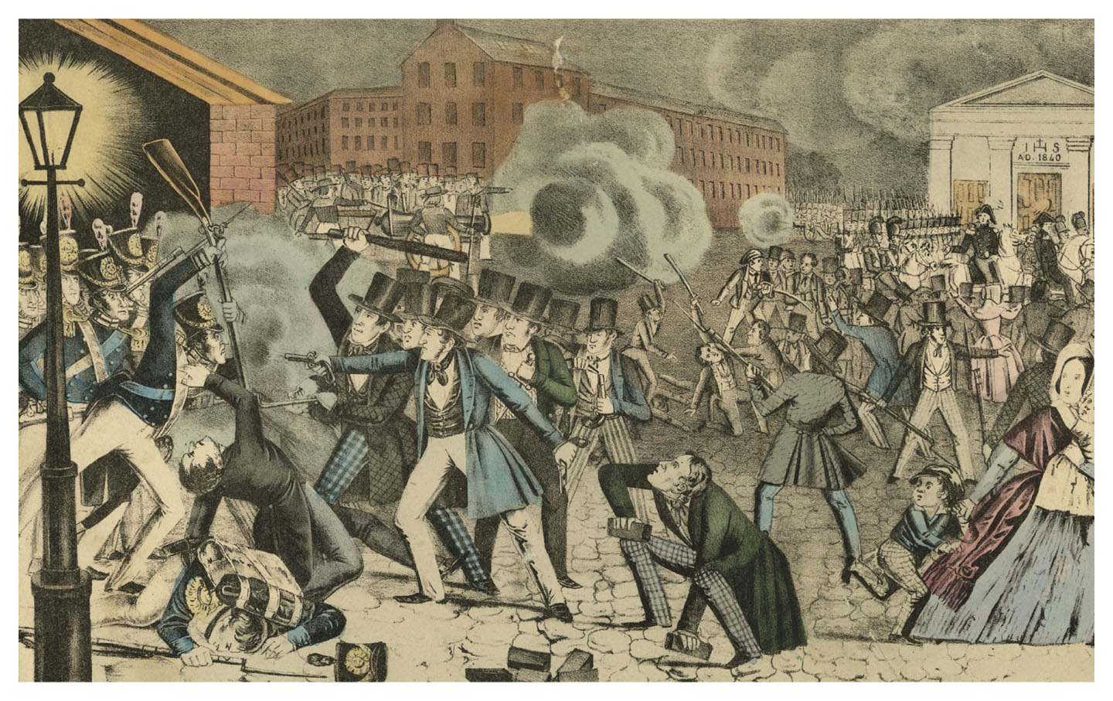
Riot in Philadelphia
Riot in Philadelphia, 1844, depicting street battles between nativists and Irish Catholics Give Me Liberty!: An American History, 5th Edition
Copyright © 2017 W.W. Norton & Company
Notes:
Riot in Philadelphia, an 1844 lithograph, depicts street battles between nativists and Irish Catholics that left fifteen persons dead. The violence originated in a dispute over the use of the Protestant King James Bible in the city’s public schools.

Slide 41
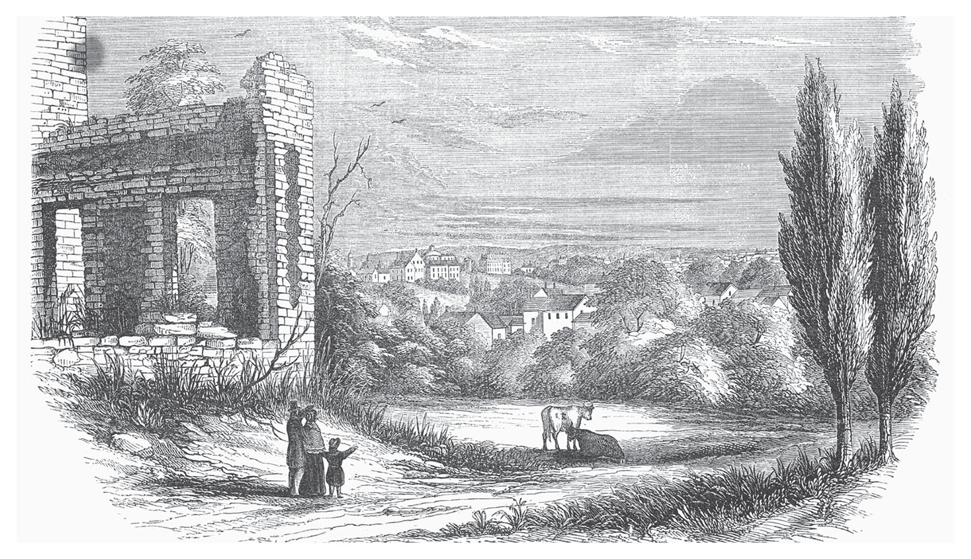
Ursuline Convent, 1834
The Ursuline Convent in Charlestown, Massachusetts, burned by a mob in 1834 Give Me Liberty!: An American History, 5th Edition
Copyright © 2017 W.W. Norton & Company
Notes:
An engraving depicts the ruins of the Ursuline Convent in Charlestown, Massachusetts, burned by a mob in 1834 after a sermon by the Reverend Lyman Beecher, who warned that Catholics were conspiring to dominate the American West.

Slide 42
Law and the Market
The Transformation of Law
Notes:
American law in this period increasingly supported the efforts of entrepreneurs to participate in the market revolution, while protecting them from local governments and liability that might interfere with their activities. The corporate form of business organization, in which a corporate firm receives a charter from the government and stockholders are not individually liable for company debts, became central to economic life in this period. Corporations found reinforcement in Supreme Court decisions that validated their legal status; Dartmouth College v. Woodward (1819) defined corporate charters issued by states as contracts, thus preventing future lawmakers from altering or rescinding them; Gibbons v. Ogden, five years later, determined that a monopoly granted by the New York legislature for steamboat navigation. Meanwhile, at the local level, courts found businesses blameless for property damage and held that employers had full authority in the workplace, even using old conspiracy laws to convict workers who joined unions or went on strike. Only in 1842, did the Massachusetts state court render a decision (Commonwealth v. Hunt) stating there was nothing inherently illegal in striking or unionizing.

Slide 43
Focus Question: The Free Individual
  Focus Question:
  How did the meanings of American freedom change in this period?
Notes:
The purpose of the focus questions is to help students find larger themes and structures to bring the historical evidence, events, and examples together for a connected thematic purpose.
As we go through each portion of this lecture, you may want to keep in mind how the information relates to this larger thematic question. Here are some suggestions: write the focus question in the left or right margin on your notes and as we go through, either mark areas of your notes for you to come back to later and think about the connection, OR as you review your notes later (to fill in anything else you remember from the lecture or your thoughts during the lecture or additional information from the readings), write small phrases from the lecture and readings that connect that information to each focus question AND/OR are examples that work together to answer the focus question.

Slide 44
The Free Individual and the West
The West and Freedom
Notes:
By the 1830s and 1840s, the market revolution and westward expansion had profoundly affected all Americans’ lives, reinforcing older ideas of freedom and creating new ones. American freedom had long been linked with available land in the West. In this period was coined the phrase “manifest destiny,” referring to the divine mission of the United States to occupy all of North America and extend freedom, despite any costs to peoples and nations already there. But an old idea connecting freedom and a divine mission to move west and settle land had its origins in colonial times.
In national myth and ideology, the West would long remain a sanctuary for the free American. To many, the settlement and exploitation of the West offered America a chance to avoid becoming like Europe, where society was marked by fixed social classes and large numbers of wage-earning poor. In the West, free or cheap land was abundant and factory labor less common. The West seemed to offer men facing wage labor and rising land prices in the East an opportunity to gain economic independence—the social condition of freedom.

Slide 45
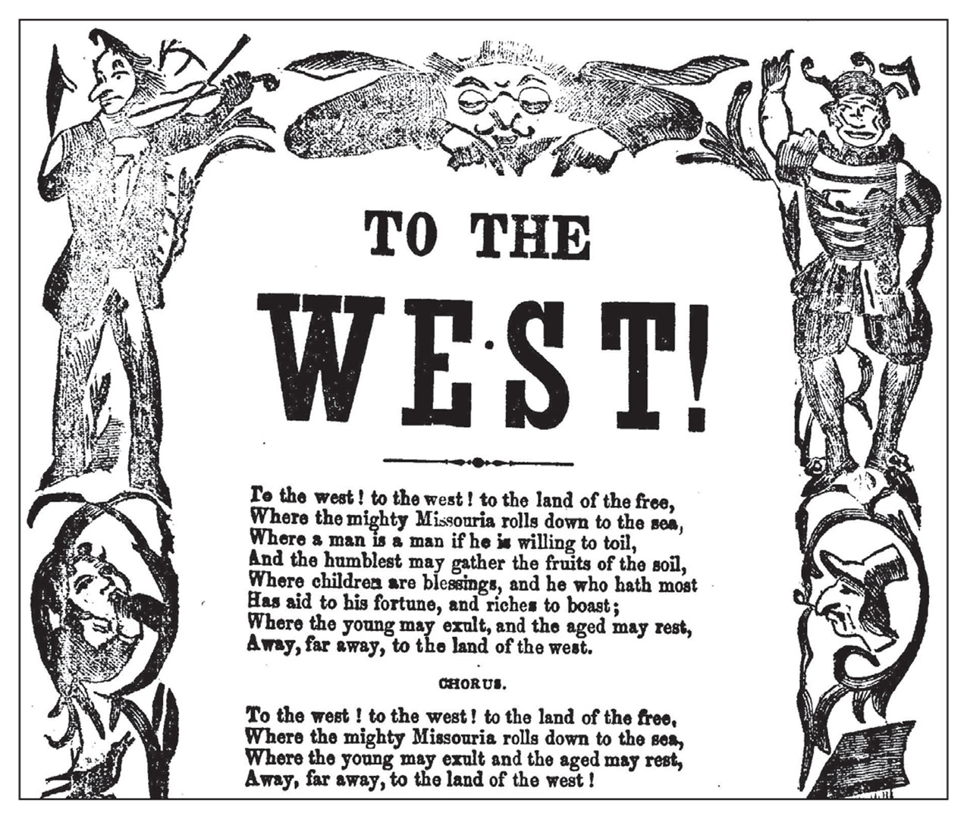
The West as “the Land of the Free”
An 1845 song offers a satire of the widely held image of the West as “the land of the free,” Give Me Liberty!: An American History, 5th Edition
where the “humblest” American can achieve economic success. Copyright © 2017 W.W. Norton & Company
Notes:
A song written in 1845 offers a satire of the widely held image of the West as “the land of the free,” a place where the “humblest” American can achieve economic success. The pictures surrounding the text offer a somewhat different image of westerners, and the verses go on to complain about illness and hardship. But the opening words reflect the ways in which Americans have always viewed the West.

Slide 46
Transcendentalism
The Transcendentalists
Individualism
Notes:
The energetic, competitive world of the market revolution led many Americans to identify freedom with the absence of restraints on self-directed individuals who sought economic advancement and personal development. Opportunities for personal growth presented a new definition of Jefferson’s pursuit of happiness that well fitted a new America in which westward expansion and market relations shattered old spatial and social boundaries. A group of New England intellectuals, called “transcendentalists,” reflected this national mood in their writings and activities. Together they insisted that individual judgment should take precedence over existing social traditions and institutions. Ralph Waldo Emerson defined freedom as an open-ended process of self-realization, in which individuals could remake themselves and their own lives. Henry David Thoreau called for individuals to rely on themselves.
The term “individualism” was first used in this era. Unlike in the colonial period, many Americans now believed that individuals should pursue their own self-interest, no matter what the cost to the public good, and that they should and could depend only on themselves. Americans more and more saw the realm of the private self as one in which other individuals and government should not interfere.

Slide 47
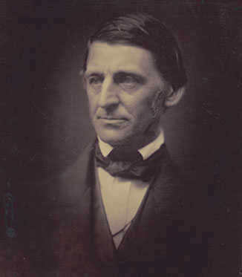
Ralph Waldo Emerson
Ralph Waldo Emerson in a daguerreotype, an early form of photography Give Me Liberty!: An American History, 5th Edition
Copyright © 2017 W.W. Norton & Company
Notes:
The daguerreotype, an early form of photography, required the sitter to remain perfectly still for twenty seconds or longer. The philosopher Ralph Waldo Emerson, depicted here, did not like the result. He complained in his journal that in his “zeal not to blur the image,” ever muscle had become “rigid” and his face was fixed in a frown as “in madness, or in death.”

Slide 48
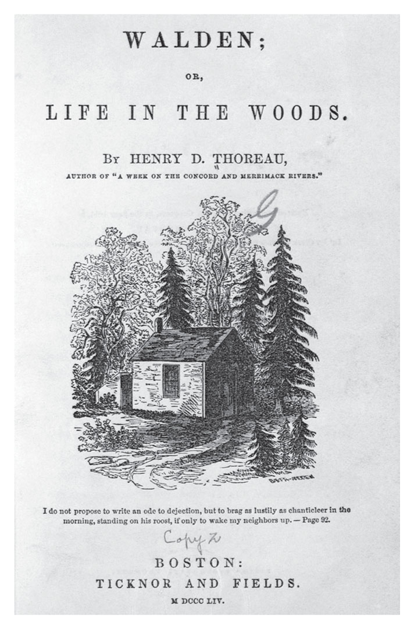
Walden; or, Life in the Woods
Henry David Thoreau’s Walden Give Me Liberty!: An American History, 5th Edition
Copyright © 2017 W.W. Norton & Company
Notes:
The sketch of Henry David Thoreau’s cabin on Walden Pond illustrates his belief that Americans could enjoy what he called “absolute freedom” by rejecting market society and retreating into the wilderness. Only in this way, he insisted, could they preserve both individual independence and the natural environment.

Slide 49
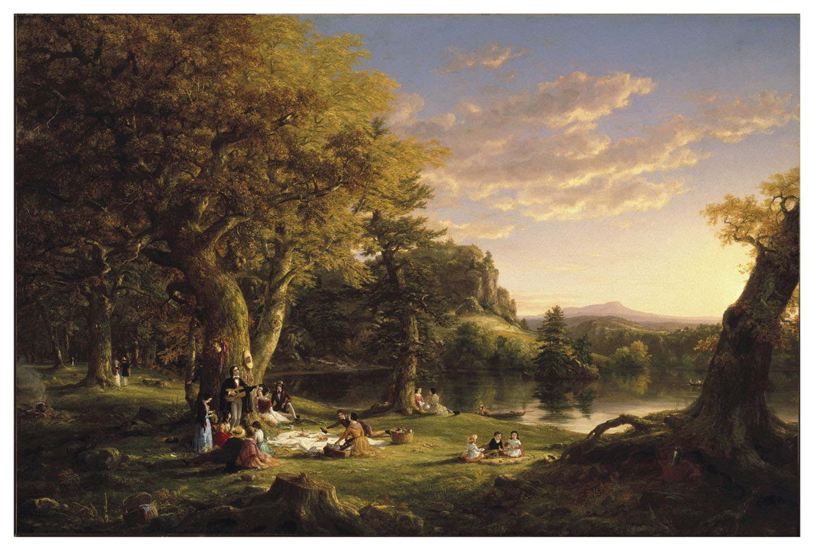
A Pic-Nic Party
A Pic-Nic Party, by Thomas Cole, 1846 Give Me Liberty!: An American History, 5th Edition
Copyright © 2017 W.W. Norton & Company
Notes:
Thomas Cole’s 1846 painting A Pic-Nic Party exemplifies the work of the Hudson River School, a group of artists fascinated by the glory of nature. Cole portrays nature and civilization coexisting in harmony, although the prominence of the stump in the foreground, the remains of a tree felled by an axe, suggests that man poses danger to the natural environment.

Slide 50
Religious Revival
The Second Great Awakening
The Awakening’s Impact
Notes:
The popular religious revivals that swept over the nation during the Second Great Awakening added a religious dimension to the celebration of self-improvement, self-reliance, and self-determination. These revivals were first organized by established religious leaders worried about low levels of church attendance and reached their height in the 1820s and 1830s, when the Reverend Charles Grandison Finney held revivals in New York. Like evangelists in the eighteenth century, Finney enthusiastically warned his audience of hell, and promised them salvation if they would end their sinful habits. Evangelical preachers rejected the idea that man was naturally sinful and preordained to heaven or hell, and argued instead that humans had free will to either live in sin or reach heaven by doing “good works.” The Second Great Awakening democratized American Christianity and made it a mass enterprise. Religious devotion and attendance boomed, and smaller evangelical sects such as the Methodists and Baptists grew rapidly. Deism, a form of religious belief hostile to organized churches, had been prominent among the generation of the founding fathers, but now waned, and Christianity became central to American culture. New religious prophets seemed to appear regularly in early-nineteenth-century America, and particularly at large camp meetings especially prominent on the frontier, they preached the doctrine of human free will over predestination. These gatherings saw rich and poor, male and female, and even occasionally black and white worshipping together, pledging to abandon worldly sins in favor of a godly life.
The evangelicals stressed the right of private judgment in spiritual affairs and the possibility of universal salvation through faith and good deeds. Evangelicals used the opportunities to travel and spread their message, which had been made available by the market revolution, and their mass religion and idea that ordinary Americans could forge their own spiritual destinies resonated with the spread of market values. While evangelicals criticized selfishness, greed, and indifference to the welfare of others, the revivals flourished in areas transformed by the market revolution. Evangelical ministers promoted a controlled individualism, marked by industry, sobriety, and self-discipline as the essence of freedom.

Slide 51
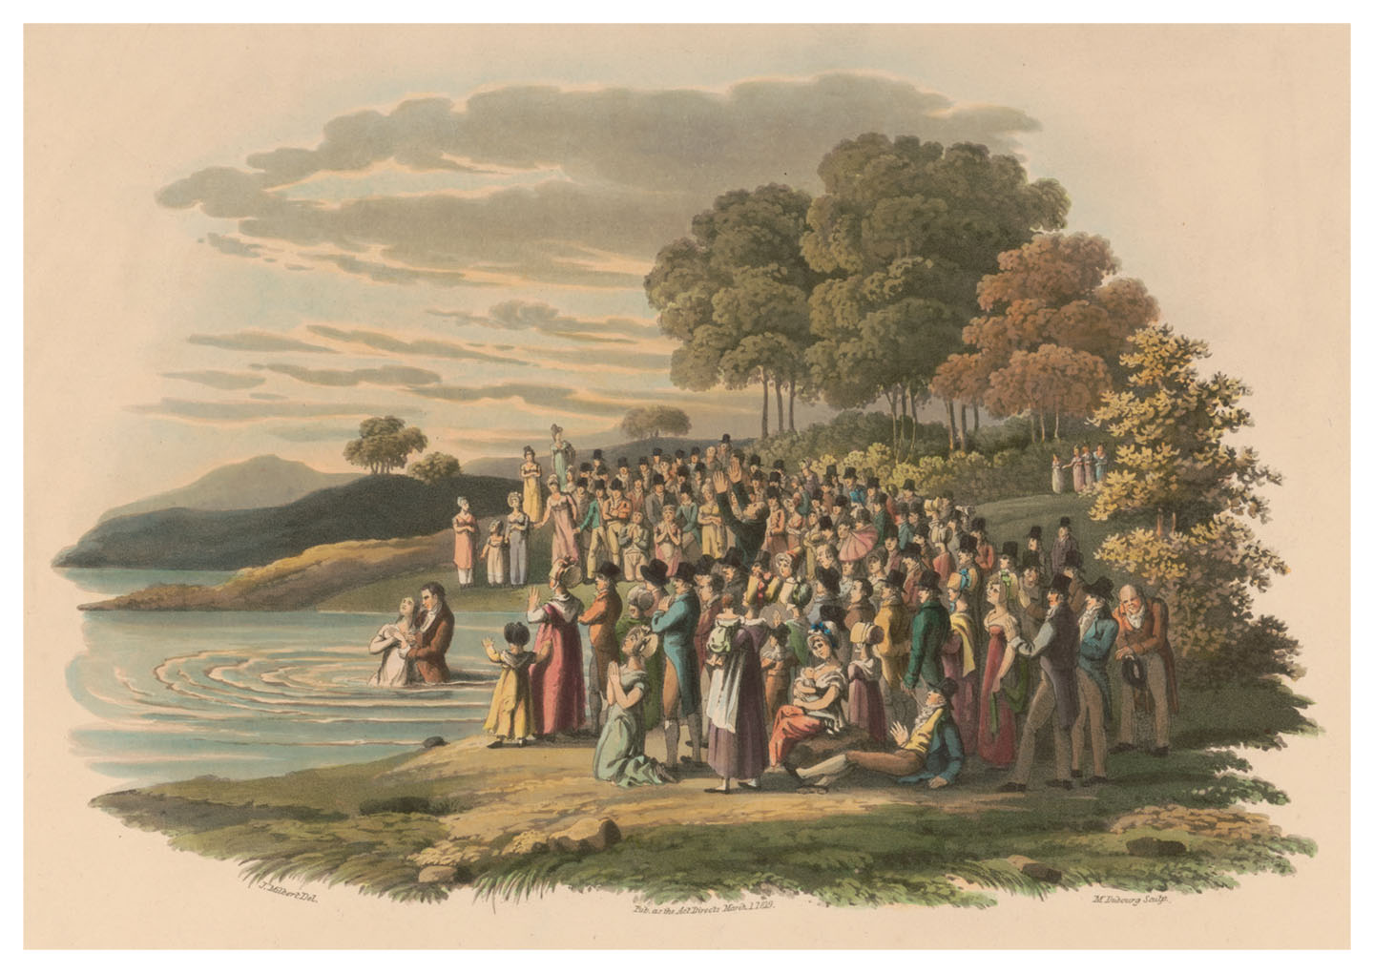
Nineteenth-century anabaptists
Engraving depicting an Anabaptist ceremony. Give Me Liberty!: An American History, 5th Edition
Copyright © 2017 W.W. Norton & Company
Notes:
This 1819 engraving depicts a ceremony of Anabaptists, one of the numerous religious groups that flourished in nineteenth-century America. Anabaptists reject infant baptism in favor of the baptism of adults who have professed religious belief.

Slide 52
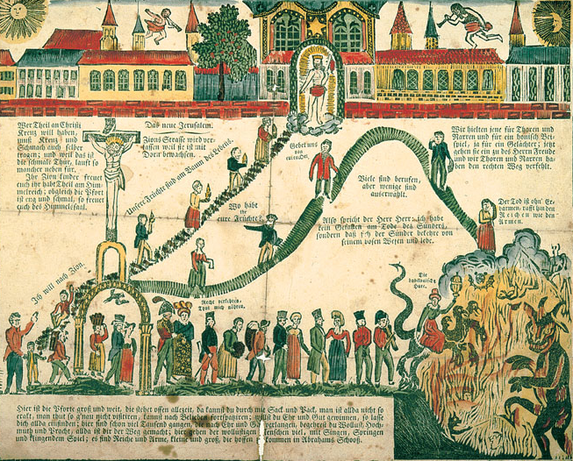
Das neue Jerusalem (the new Jerusalem)
Das neue Jerusalem (The New Jerusalem) illustrates the narrow gateway to heaven Give Me Liberty!: An American History, 5th Edition
and the fate awaiting sinners in hell. Copyright © 2017 W.W. Norton & Company
Notes:
Das neue Jerusalem (The New Jerusalem), an early-nineteenth-century watercolor, in German, illustrates the narrow gateway to heaven and the fate awaiting sinners in hell. These were common themes of preachers in the Second Great Awakening.

Slide 53
Mormonism
The Emergence of Mormonism
Notes:
The Second Great Awakening illustrated how the end of governmental support for established churches promoted religious pluralism and the emergence of new denominations. One of the most successful religions to emerge was the Church of Jesus Christ of Latter-Day Saints, or Mormons. Mormonism was founded in the 1820s by Joseph Smith, an upstate New York farmer who experienced religious visions as a youth. He claimed to have been led by an angel to a set of golden plates covered with writing that he translated and published as The Book of Mormon, after a fourth-century prophet. Depending on one’s point of view, The Book of Mormon is either a divinely inspired holy book or an impressive piece of American literature, that tells the story of three families who traveled from the ancient Middle East to the Americas, and evolved into American Indian tribes. Jesus Christ appears to be one of the family groups in the Western Hemisphere after his death and resurrection, which meant that the word of God had been transmitted not only to the people of the Biblical Middle East, but the Americas as well. The second coming of Christ would take place in the New World where Smith was God’s prophet. Mormonism emerged in upstate New York, a center of the Second Great Awakening, where it responded to the disruptions of the market revolution. The religion was self-consciously democratic, admitting anyone who accepted Smith’s message (though African-Americans were excluded from the priesthood until 1978), and Smith condemned the selfishness of the rich. Paper money seemed to have little intrinsic value at the time, with gold as the unchallenged standard of value, perhaps explaining why the text appeared on gold tablets. Over time, Smith’s visions led him to more controversial views, especially polygamy, or marrying more than one person, and he married no fewer than thirty women, which outraged non-Mormons. Driven from New York, Ohio, and Missouri by mobs, the Mormons settled in Illinois in 1839, where they intended to await the second coming of Christ; Smith was arrested five years later, charged with inciting a riot that destroyed an anti-Mormon newspaper, and while awaiting trial, he was murdered in jail. Brigham Young, Smith’s successor, led over 2,000 followers to the Great Salt Lake (in present-day Utah) in 1847, where they hoped to escape persecution. By 1852, there were 16,000 Mormons in Utah, and the experience of expulsion shaped their theology. The distinctive practice of posthumous baptism, in which modern members baptize ancestors long dead, seeks to unite families across generations, and had led to the establishment of a publicly available genealogical library of records from around the world. The Mormon experience revealed the limitations of nineteenth-century religious toleration in America, but also the opportunities offered by religious toleration; today, Mormons constitute the fourth-largest church in the United States, and The Book of Mormon has been translated into over 100 languages.

Slide 54
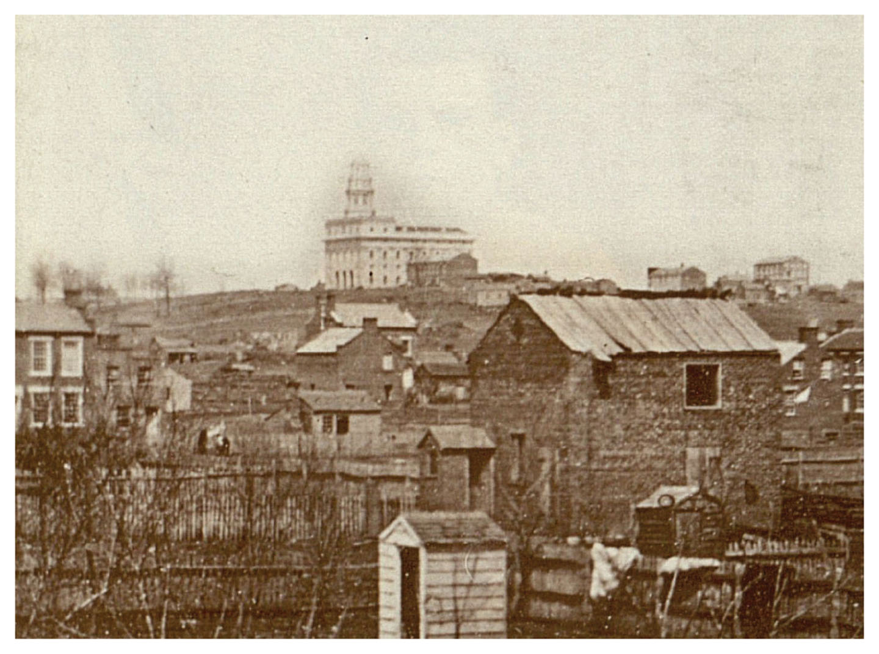
Mormon Temple in Nauvoo, Illinois
Mormon Temple in Nauvoo, Illinois, 1846 Give Me Liberty!: An American History, 5th Edition
Copyright © 2017 W.W. Norton & Company
Notes:
In this 1846 photograph, the massive Mormon temple in Nauvoo, Illinois, towers over the ramshackle wooden buildings of this town along the Mississippi River.

Slide 55
Focus Question: The Limits of Prosperity
  Focus Question:
  How did the market revolution affect the lives of workers, women, and African-Americans?
Notes:
The purpose of the focus questions is to help students find larger themes and structures to bring the historical evidence, events, and examples together for a connected thematic purpose.
As we go through each portion of this lecture, you may want to keep in mind how the information relates to this larger thematic question. Here are some suggestions: write the focus question in the left or right margin on your notes and as we go through, either mark areas of your notes for you to come back to later and think about the connection, OR as you review your notes later (to fill in anything else you remember from the lecture or your thoughts during the lecture or additional information from the readings), write small phrases from the lecture and readings that connect that information to each focus question AND/OR are examples that work together to answer the focus question.

Slide 56
Market Revolution and Prosperity
Liberty and Prosperity
Notes:
With the market revolution, the right to compete for economic advancement became essential to American freedom. Symbols of liberty were bound up with symbols of prosperity. John Jacob Astor, the son of a poor German immigrant, became the richest man in America by using money earned from shipping to invest in Manhattan real estate. His story, and the stories of men like him, seemed to embody opportunities open to the “self-made man.” This success was achieved not through hereditary privilege or government favoritism, as in Europe, but through hard work and intelligence. The market revolution and expanding commercial life enriched bankers, merchants, industrialists, and planters and produced a new middle class of clerks, accountants, and other professionals, such as teachers, doctors, and lawyers.

Slide 57
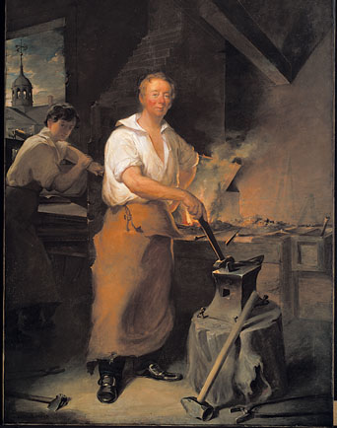
Pat Lyon at the Forge
Pat Lyon at the Forge, a painting of a prosperous blacksmith (1826–1827) Give Me Liberty!: An American History, 5th Edition
Copyright © 2017 W.W. Norton & Company
Notes:
Proud of his accomplishments as a self-made man who had achieved success through hard work and skill rather than inheritance, Lyon asked the artist to paint him in his shop wearing his work clothes.

Slide 58
“Not Everyone Benefited”
Race and Opportunity
Notes:
Not everyone benefited from the market revolution. Most African-Americans were slaves, but even free blacks were excluded from economic opportunities. Free blacks in northern states experienced discrimination in every sphere of life. They were segregated into the poorest and unhealthiest areas of cities like New York, Philadelphia, and Cincinnati, and were subjected to assaults in riots by white mobs. They were barred from schools and other public facilities, and created their own institutional life of schools and churches, such as the African Methodist Episcopal Church. Many blacks experienced downward economic mobility, unable to practice their craft skills because of discrimination by white employers and workers, and were relegated to the most unskilled and menial low-paid labor. Blacks also could not take advantage of the opening of the West, since federal law barred them from accessing public land, and some western states prohibited them from even entering their territory.

Slide 59
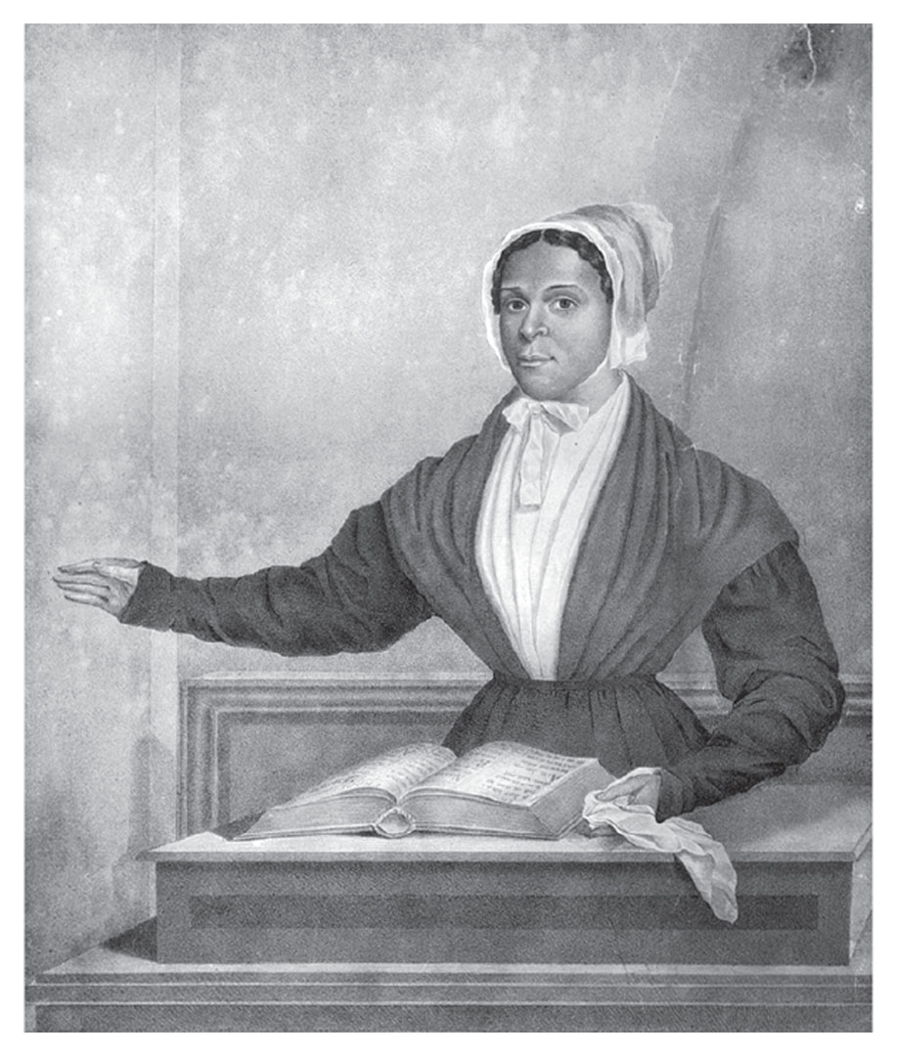
Juliann Jane Tillman
Juliann Jane Tillman, a preacher in the African Methodist Episcopal Church, 1844 Give Me Liberty!: An American History, 5th Edition
Copyright © 2017 W.W. Norton & Company
Notes:
Juliann Jane Tillman, a preacher in the African Methodist Episcopal Church, in an 1844 engraving
Many Protestant denominations allowed women to preach, although their presence also aroused much criticism.

Slide 60
Separate Spheres
The Cult of Domesticity
Notes:
Many opportunities created by the market revolution were also closed to women. As the household declined as a site of economic production, women’s traditional roles were undermined by mass-produced goods once made at home. Some women entered factories, while others embraced a new definition of femininity centered in women’s ability to create a private sphere in the home removed from the competitive tensions of the market economy. Here, a woman’s role was not to produce things but to sustain nonmarket values such as love, friendship, and mutual obligation, providing men with a shelter from the rigors of the market.
Earlier ideas of “republican motherhood” were replaced by this “cult of domesticity.” Virtue came to be defined as a personal quality associated with women, who were expected to be sexually innocent, beautiful, frail, and dependent on men. The cult of domesticity minimized even women’s indirect participation in public life, viewing women as nurturing, selfless, and ruled by emotions, while seeing men as rational, aggressive, and domineering. While men could move freely between the public and private spheres, women were to remain confined within the private family.

Slide 61
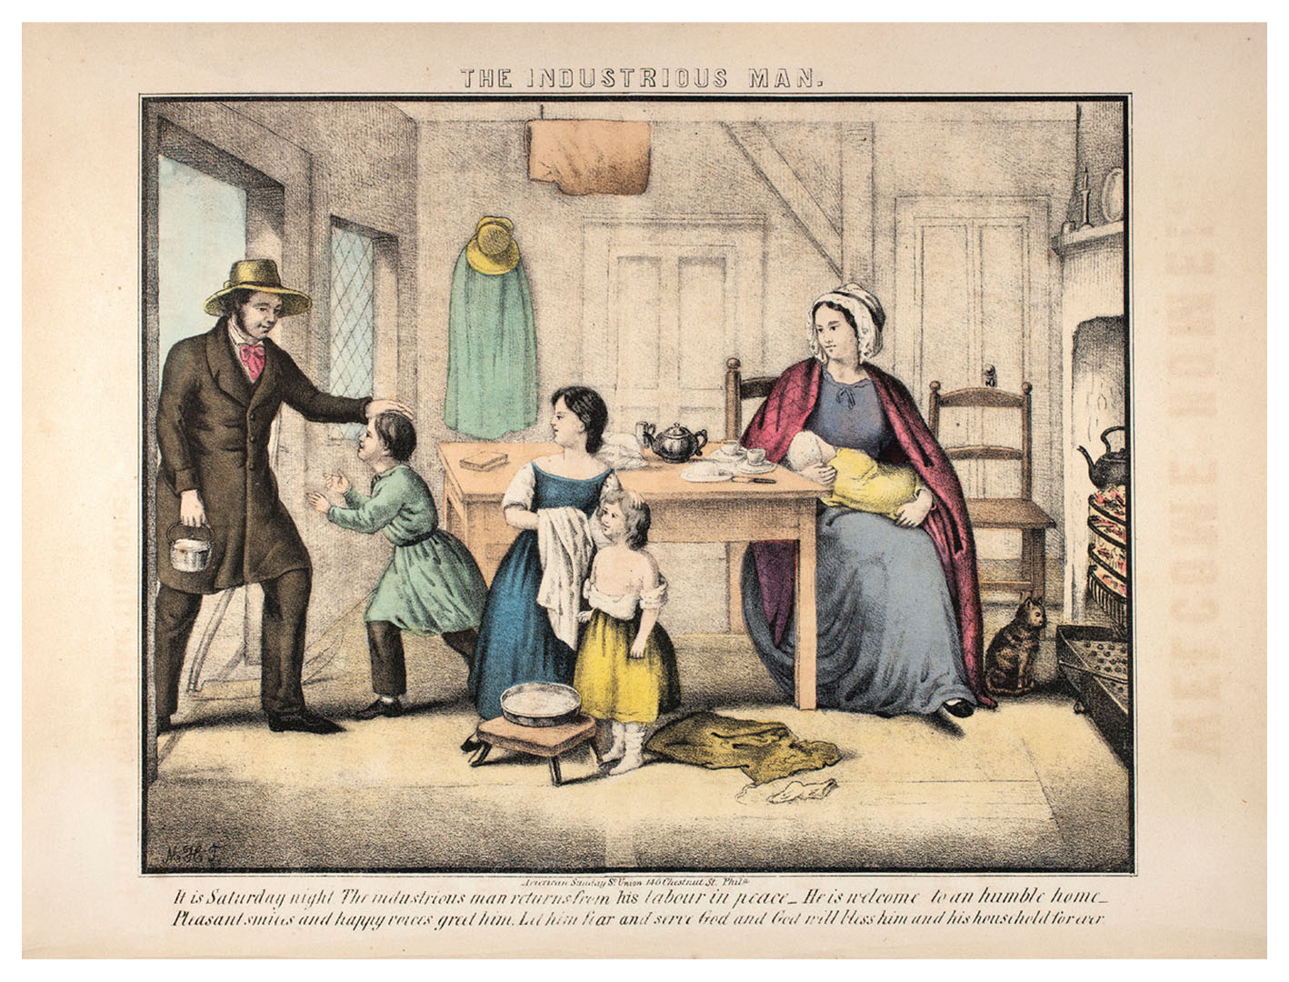
The Industrious Man
The Industrious Man, depicting perceptions of an ideal family scene Give Me Liberty!: An American History, 5th Edition
Copyright © 2017 W.W. Norton & Company
Notes:
The Industrious Man, a lithograph from a book produced for children by the American Sunday School Union in the 1840s, depicts an ideal family scene. The father, a laborer, returns home carrying his lunch pail to find his wife and children awaiting him in a comfortable although hardly extravagant home. The scene exemplifies the idea of separate spheres, according to which men worked outside the home and women’s role was to fulfill their family responsibilities.

Slide 62
Women as Wage Earners
Women and Work
Notes:
But the cult of domesticity did not capture the realities of life for the many women who worked for wages at least part of their lives. Women who worked outside the home could not compete freely for jobs, since only low-paying jobs were open to them, and married women could not sign their own contracts or, until after the Civil War, keep their wages, which went to their husbands. Many poor women worked as domestic servants, factory workers, and seamstresses. Respectability was earned in middle-class homes, which were segregated in neighborhoods distant from other classes, in part by keeping wives and children at home and hiring women to do household work. Even working-class men adopted these values and protested that capitalism was ripping women from the home and subjecting them to exploitation and abuse in the marketplace.

Slide 63
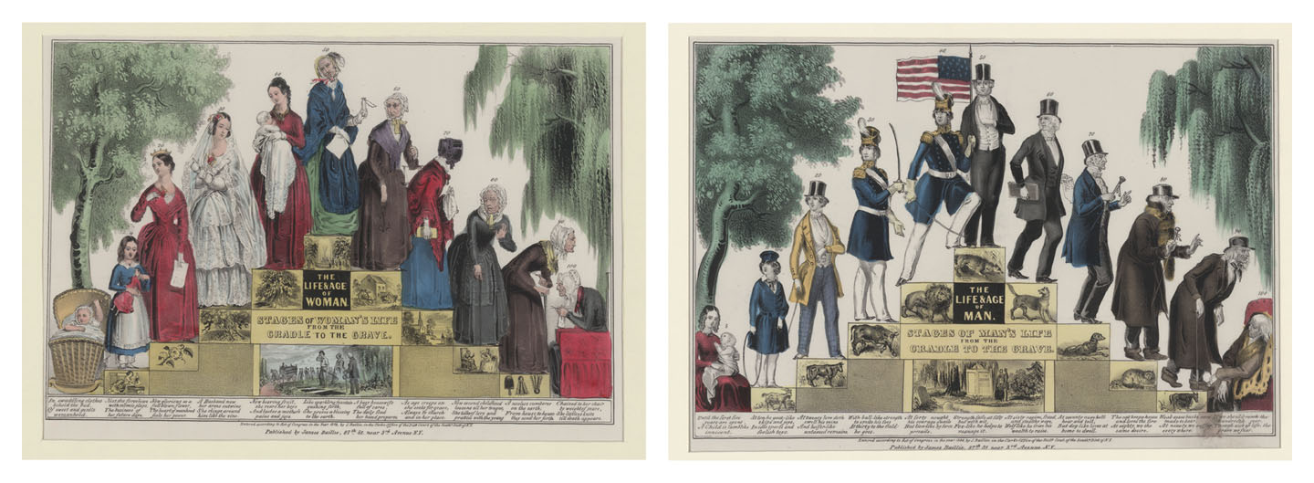
Life and Age of Woman
Life and Age of Man
Life and Age of Woman and Life and Age of Man depict the Give Me Liberty!: An American History, 5th Edition
stages of life of the two sexes, 1848. Copyright © 2017 W.W. Norton & Company
Notes:
Life and Age of Woman and Life and Age of Man, popular lithographs from 1848, depict the stages of life of the two sexes. The ideal man achieves military and then commercial success, while the woman’s life focuses on marriage and motherhood. The woman seems to show signs of aging more rapidly than the man.

Slide 64
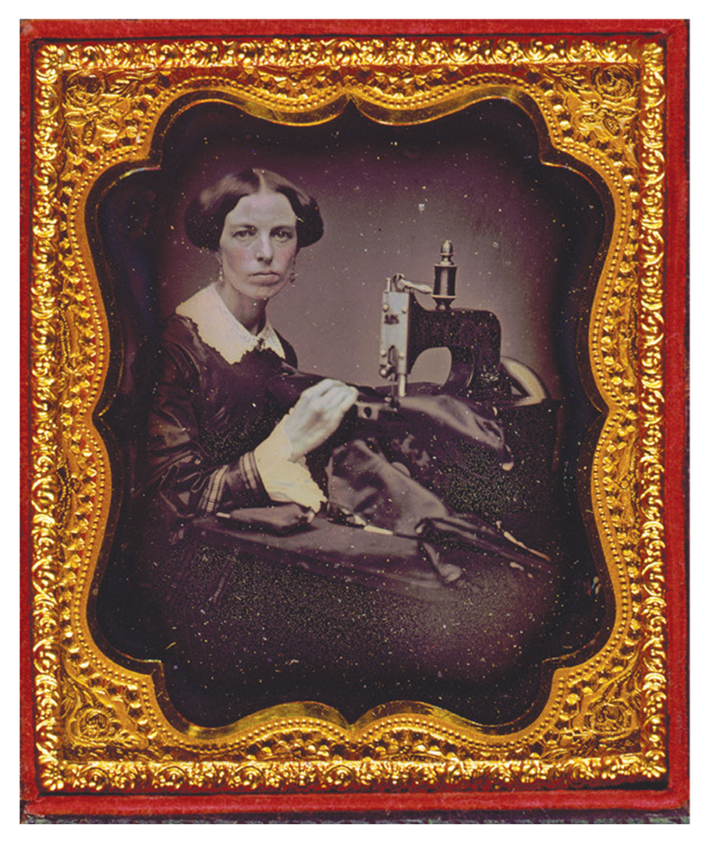
Woman Working with a Sewing Machine
A woman with a sewing machine, in an undated photograph Give Me Liberty!: An American History, 5th Edition
Copyright © 2017 W.W. Norton & Company
Notes:
A woman with a sewing machine, in an undated photograph. It is not clear if she is sewing for herself and family, or for income as a seamstress.

Slide 65
Early Labor Organization
The Early Labor Movement
The “Liberty of Living”
Notes:
Many Americans experienced the market revolution as a loss of freedom. The economy suffered a sharp recession in 1819, a depression starting in 1837, and several downturns in between, all of which caused high levels of unemployment and reductions in wages. While the economic transformations of the market revolution greatly expanded America’s output and trade and increased living standards, it also widened the gap in wealth and income between wealthy merchants and industrialists at one end and workers and the poor on the other, especially in the urban Northeast. Worried by the erosion of their traditional skills and the danger of being reduced to dependent wage earners, skilled craftsmen in the late 1820s created the world’s first Workingmen’s Parties. These were short-lived political organizations that sought to mobilize lower-class support for candidates who demanded free public education, an end to imprisonment for debt, and laws limiting work to ten hours per day. In the 1830s, unions were organized and strikes were common.
Workers’ language of protest drew on older ideas of freedom linked to economic autonomy, public-spirited virtue, and social equality. The conviction of twenty New York tailors in 1835 under the common law of conspiracy for organizing for better wages inspired a public procession marking the “burial of liberty.” These actions and ideas were not confined to men, as women also struck for higher wages, such as the walkoff at the Lowell mills in 1834. Some labor spokesmen described wage labor itself as slavery, since dependence on another person for one’s economic livelihood was believed to be incompatible with freedom. Rooted in the traditions of the small producer and the identification of freedom with economic autonomy, labor’s critique of the market economy challenged the idea that individual improvement offered an adequate response to social inequality. Here lay the origins of the idea, commonly espoused in the late-nineteenth and early-twentieth century, that economic security, or a standard of living beneath no one should fall, was essential to American freedom. Thus, the market revolution transformed and divided American society and its conceptions of freedom, and placed new emphasis on individualism among white men, while limiting opportunities for women and African-Americans. Inevitably, the debate over the market revolution and its consequences would be reflected in American politics.

Slide 66
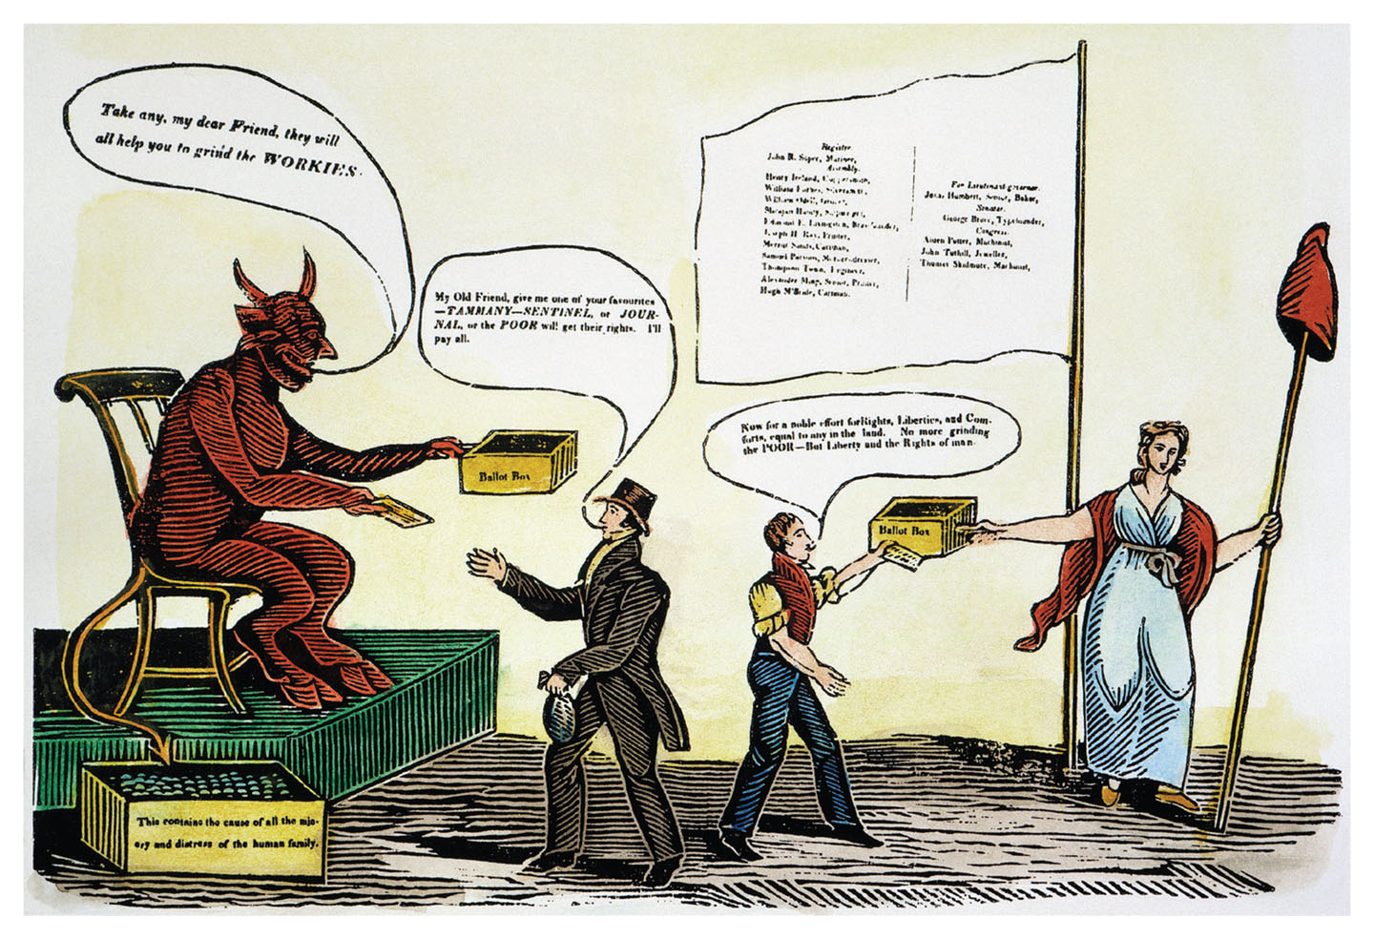
No More Grinding the Poor – But Liberty and the Rights of Man
No More Grinding the Poor – But Liberty and the Rights of Man, Give Me Liberty!: An American History, 5th Edition
a labor movement cartoon of the 1830s Copyright © 2017 W.W. Norton & Company
Notes:
The devil and a millionaire conspire to buy an election with money (in the box at the lower left), while an honest workingman hands his ballot to a female figure of liberty. The worker’s motto is “Liberty, Equity, Justice, and The Rights of Man.”

Slide 67
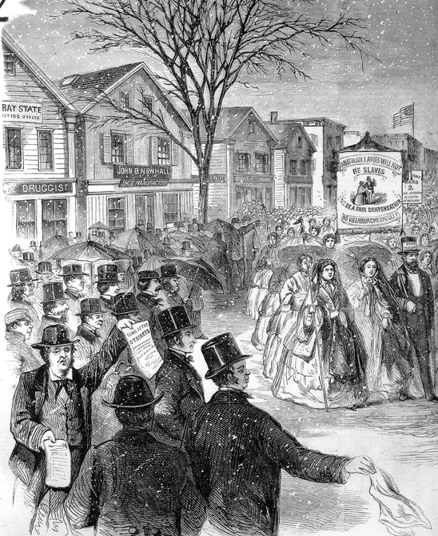
The Shoemakers’ Strike in Lynn
The Shoemakers’ Strike in Lynn—Procession in the Midst of a Snow-Storm, Give Me Liberty!: An American History, 5th Edition
of Eight Hundred Women Operatives Copyright © 2017 W.W. Norton & Company
Notes:
An engraving from Frank Leslie’s Illustrated Newspaper, March 17, 1860 shows the striking women workers carrying a banner comparing their condition to that of slaves.

Slide 68
Review
A New Economy
  Focus Question: What were the main elements of the market revolution?
Market Society
  Focus Question: How did the market revolution spark social change?
The Free Individual
  Focus Question: How did the meanings of American freedom change in this period?
The Limits of Prosperity
  Focus Question: How did the market revolution affect the lives of workers, women, and African-Americans?

Slide 69
Media Links
——Chapter Nine——
Title | Media links
Eric Foner on the market revolution, pt. 2 | The Market Revolution, pt. 2
Eric Foner on the Cotton Kingdom | The Cotton Kingdom
Eric Foner on westward expansion in the nineteenth century | Westward Expansion in the Nineteenth Century
Eric Foner on the abolitionist movement | The Abolitionist Movement
Eric Foner on Mormons as an American and global phenomenon | Mormons as an American and Global Phenomenon

Slide 70
Next Lecture PREVIEW:
—— Chapter 10 ——
Democracy in America, 1815–1840
The Triumph of Democracy
Nationalism and Its Discontents
Nation, Section, and Party
The Age of Jackson
The Bank War and After

Slide 71
This concludes the Norton Lecture Slide Set for Chapter 9
Give Me Liberty!
AN AMERICAN HISTORY
FIFTH EDITION by
Eric Foner
Norton Lecture Slides
Independent and Employee-Owned

