Slide 1
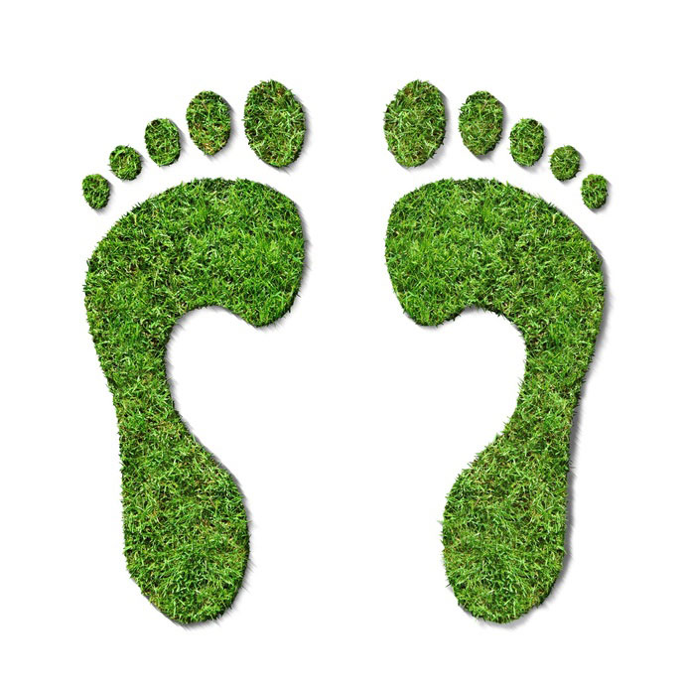
HOW MANY WORLDS I NEED?
Carbon Footprint
NAME:
CLASS:
INSITUTION:

Slide 2
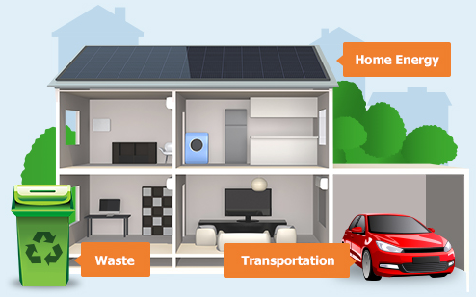
DEFINTION
Carbon footprint is a measure used to calculate quantity of carbon dioxide that is released in the atmosphere due to individual, organizational or communal activities.

Slide 3
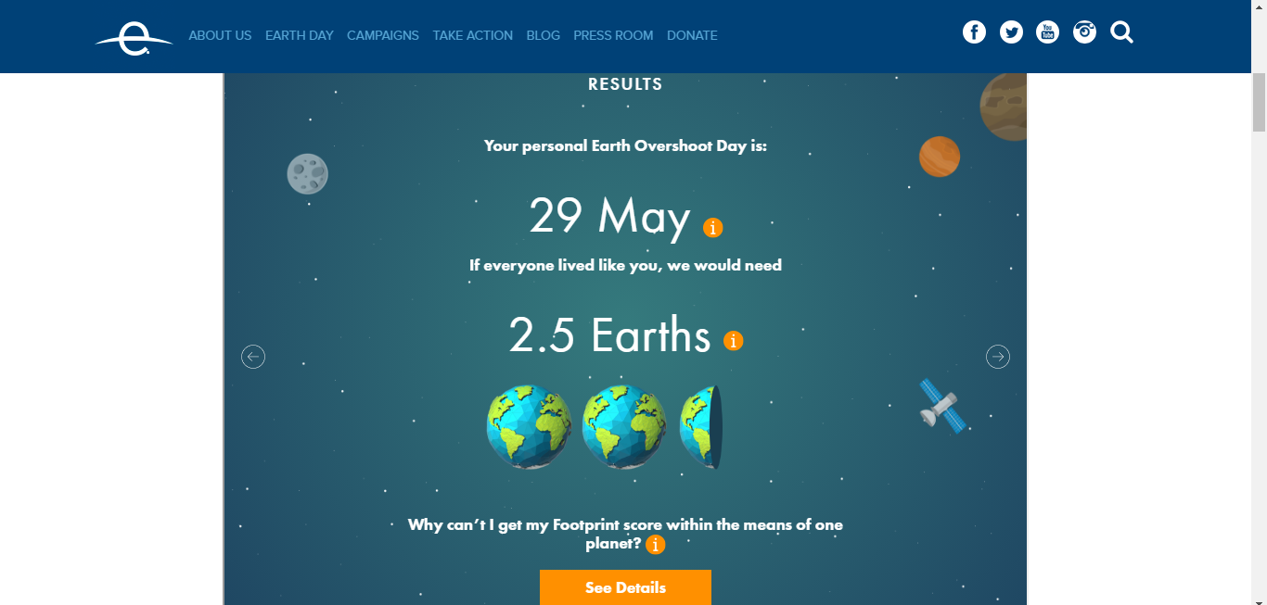

Slide 4

LIFESTYLE
In my current lifestyle
I occasionally eat animal products.
Only 30% of my food is unprocessed and local grown.
I make average efficiency in energy utility. (125 for renewable sources).
I travel about 267km a week in vehicles with inefficient fuel economy.

Slide 5
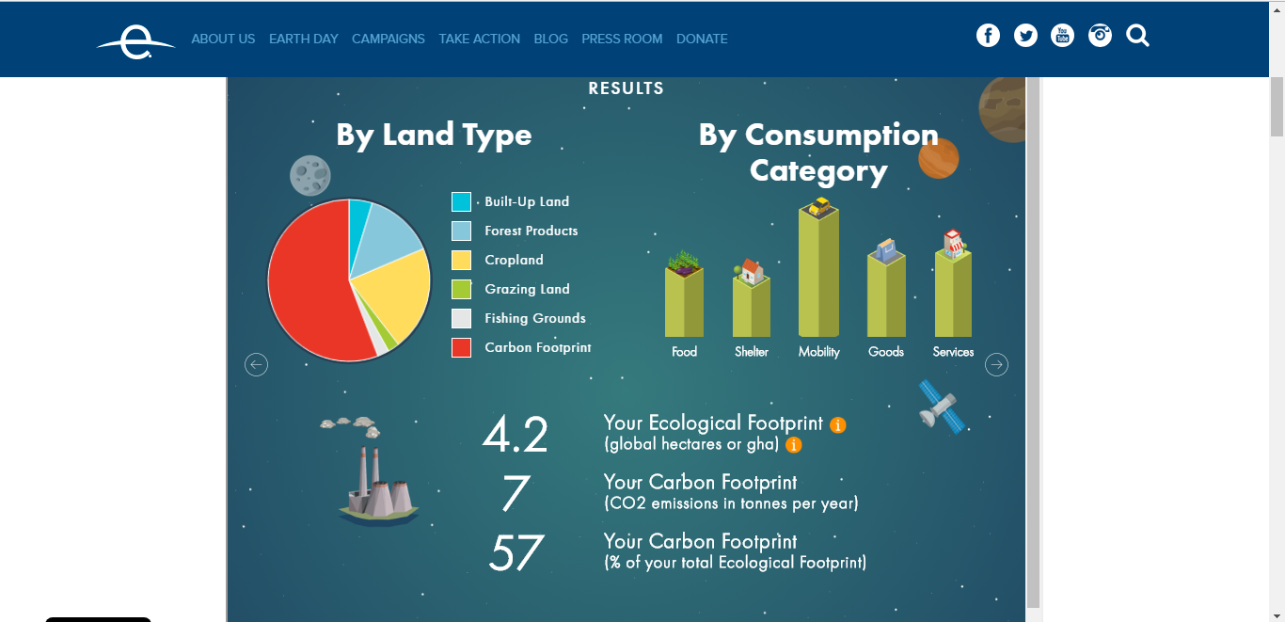

Slide 6

FOOTPRINT AREAS
According to my results I can reduce my carbon footprint in these three areas;
I do not utilize energy efficiently
I eat a lot of animal products and processed foods.
I make unnecessary fuel consumption on my travels.

Slide 7
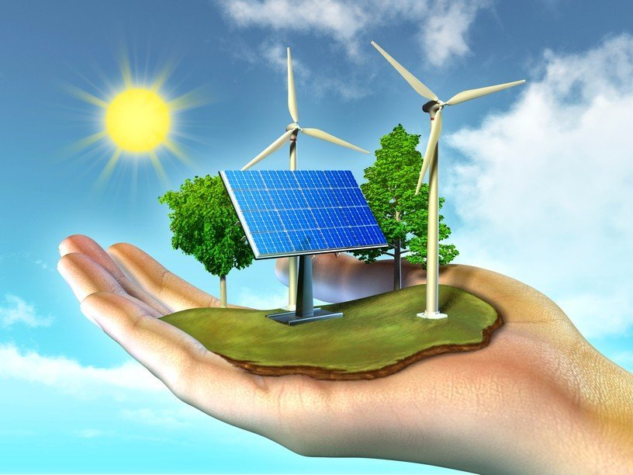
HOUSE
I will use more energy efficient appliances in my house and reduce energy wastage and consumption which is currently hardly efficient.
I will use passive heating and controlled temperature and ventilation using advance and energy efficient tools while cutting down my electricity consumption.

Slide 8
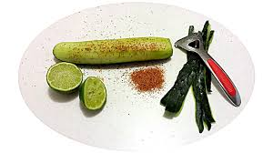
FOOD
I will eat less animal product which contribute about 50% of my diet.
I will also reduce my consumption of packaged food and eat more of local grown and unprocessed food which increase my foot print by 57%

Slide 9
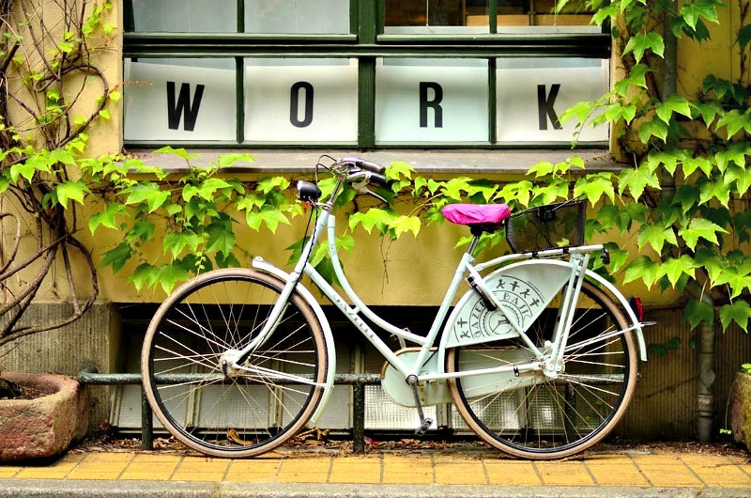
MOBILITY
I will use more public transport and alternative means of trasnsport instead of my private car that is nit fuel economy and energy inefficient. I will travel more with the train and buses in cases where I can.
I will also use more car pooling which I currently I only do occasionally once on a few weeks to more times in a week at about 60% of all my travels

Slide 10
CONCLUSION
To reduce my footprint;
I will use more energy efficient appliances in my household.
I will travel less in my car and use carpooling an public transport.
I will eat more unprocessed and locally grown food and less animal products.

