Slide 1
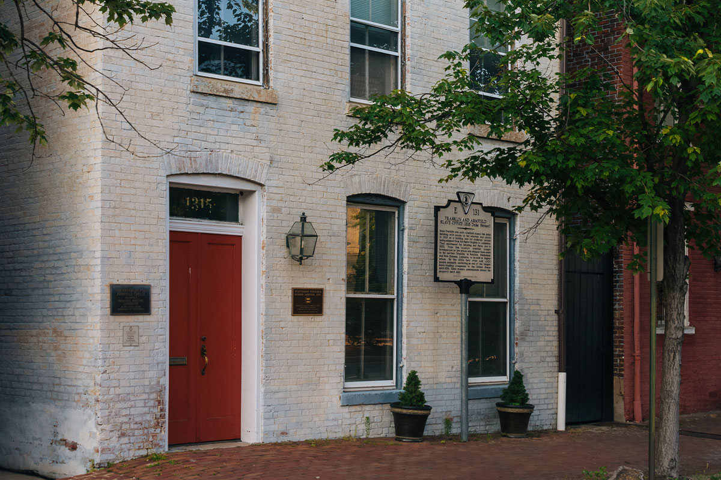
Freedom House Museum. Content
Physical Appearance
History
Topic Commemorated by site
Lessons
Importance of site
References

Slide 2
Located at Alexandria, 1315, Duke street
Resembles a federal row house
Red door on the left as the entrance
Windows on all Four sides of the building
Brick-finish walls both inside and outside
Wooden floors with a shiny finish

Slide 3
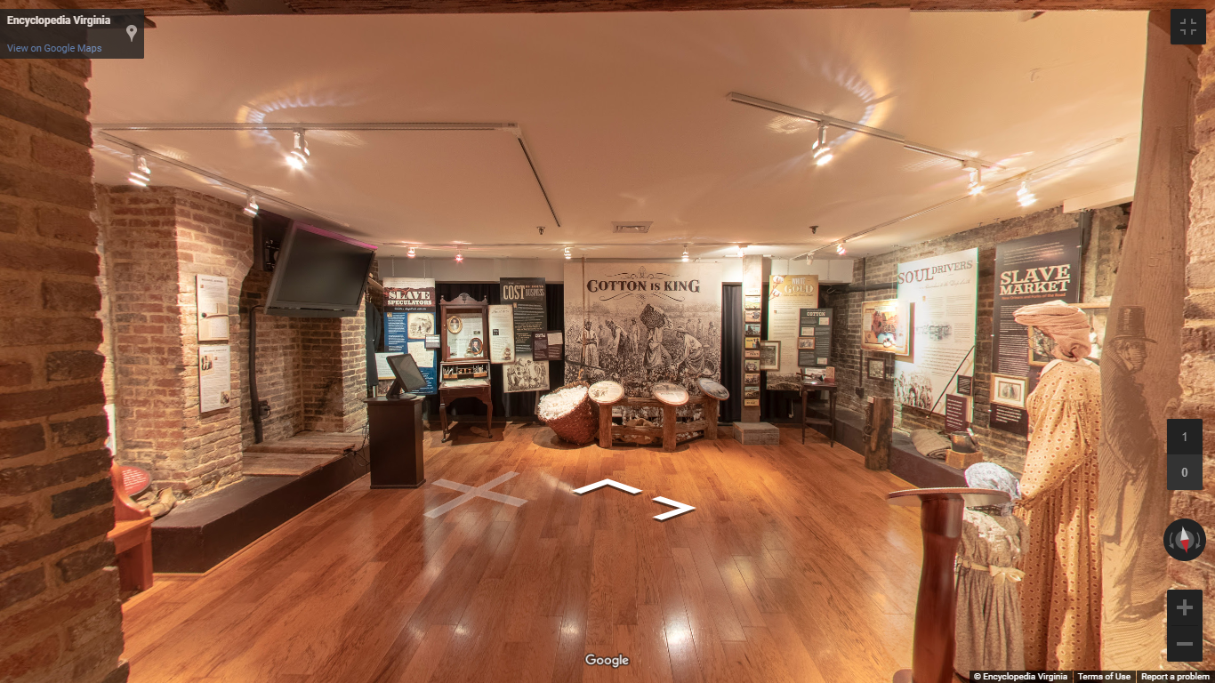
Largest slave-trade center in Alexandria
Up to 150 slaves kept on hold at a time
Solomon Northup held there (1814)
Originally built in 1812
Residence for General Robert Young
Developed by Northern Virginia Urban League

Slide 4
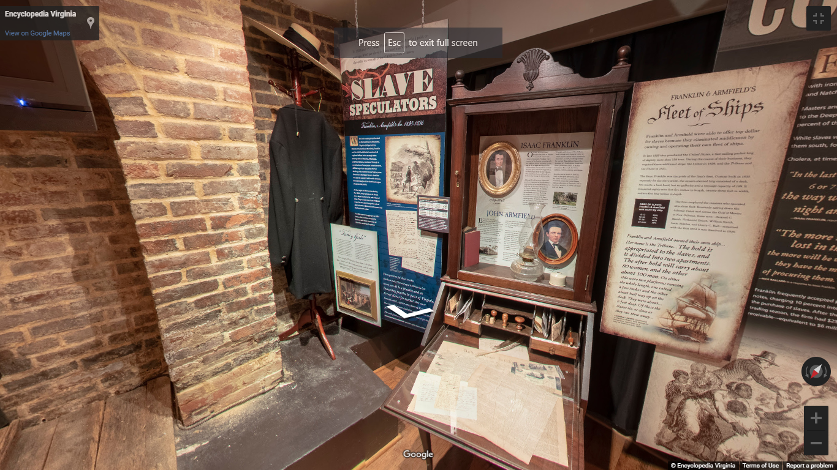
Slavery
History of slaves
Painful story of slave trade
Freedom
Bondage
Historical injustices

Slide 5
Slaves underwent traumatic experiences
History can be preserved
Information is timeless
Time sometimes doesn’t heal
Ancient African history
Importance of preserving history
Methods of preserving ancient artifacts

Slide 6
Reminder of historical facts
Preserving rich historical information
Storing and displaying local culture
Act as a public record of history
Artifact preservation

Slide 7
References
America, N. (2021). Freedom House Museum | Alexandria, USA Attractions. Retrieved 14 May 2021, from https://www.lonelyplanet.com/usa/virginia/alexandria/attractions/freedom-house-museum/a/poi-sig/1510181/1341611
Freedom House Museum. (2021). Retrieved 14 May 2021, from https://www.alexandriava.gov/FreedomHouse
Freedom House Museum, Alexandria – Encyclopedia Virginia. (2021). Retrieved 14 May 2021, from https://encyclopediavirginia.org/12850-3c4ae2e1d33eb14/

